Slide 1
Numpy, Pandas, & Dow Jones Industrial Index

Slide 2
Git Update
First time git clone https://github.com/philmui/algorithmic-bias-2019
All subsequent times (if you are not retaining any of your changes): git clean --fd git reset --hard git fetch --all

Slide 3
Groups
Form groups of 4 students
Help everyone to be able to ”git fetch --all” for their individual course repo
Help everyone in your group to run Lecture 02’s “tweetering.py” on all real-time tweets containing either:
“trump”
“clinton”

Slide 4
Agenda
Numpy
Pandas
Finance
Group Exercise
Assignment

Slide 5
Agenda
Numpy
Pandas
Finance
Group Exercise
Assignment

Slide 6
NumPy

Slide 7
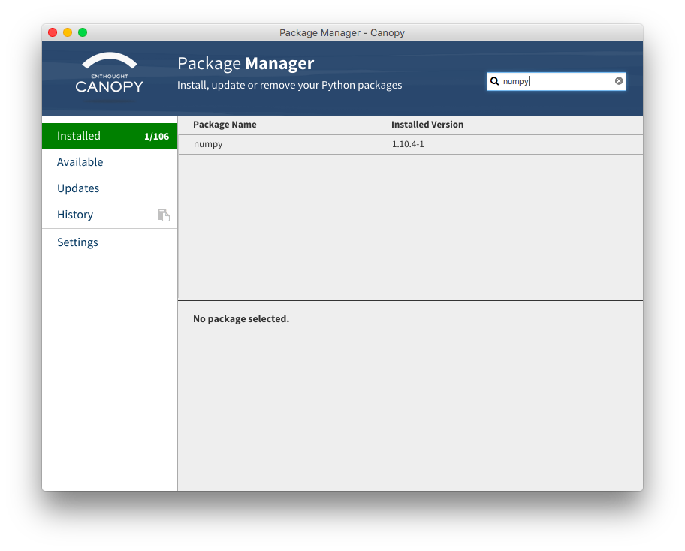

Slide 8
numpy module
Items are all the same type.
Contiguous data storage in memory of items.
Considerably faster than lists.
Class with data and methods (subroutines).
Notes:
Guess what nd stands for? N-dimensional
spell checker on numpy: bumpy, dumpy, & lumpy. Just need Grumpy and you have the 7 Dwarves.
8

Slide 9
numpy module
import numpy
dir()
dir(numpy)
help(numpy)
help(numpy.ndarray) # class
help(numpy.array) # built-in function
Notes:
Guess what nd stands for? N-dimensional module can be referred to as a package site-packages directory
spell checker on numpy: bumpy, dumpy, & lumpy. Just need Grumpy and you have the 7 Dwarves.
9

Slide 10
numpy module
import numpy
dir(numpy)
help(numpy.zeros) tuple
a = numpy.zeros( (3,5) )
# create 3 rows, 5 columns
[ [ 0., 0., 0., 0., 0. ],
[ 0., 0., 0., 0., 0. ],
[ 0., 0., 0., 0., 0. ] ]
# default type is float64
Notes:
Store in memory as C or Fortran ordering
Try to match your accessing order
10

Slide 11
numpy Array Access
Access order corresponding to printed order:
[row] [column] index starts with 0
a[0][2] = 5
[ [ 0., 0., 5., 0., 0. ],
[ 0., 0., 0., 0., 0. ],
[ 0., 0., 0., 0., 0. ] ]
Notes:
Store in memory as C or Fortran ordering
Try to match your accessing order
11

Slide 12
NumPy arrays versus Python lists
Python lists: Very general
a = [1,2]
b = [[1,2],[3,4]]
c = [[1,2, ’duh’],[3,[4]]]
NumPy arrays:
x = array([1,2])
y = array([[1,2],[3,4]])
All rows must have same length, etc.
All entries must have same data-type, e.g. all real or all complex

Slide 13
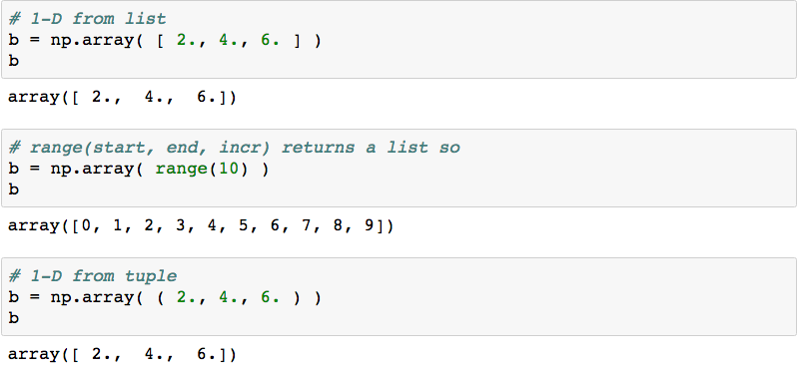
Create 1-D Array

Slide 14
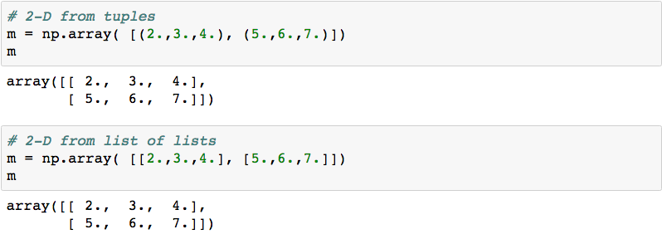
Create 2-D Matrix

Slide 15
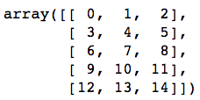
Group Exercise
Create a (5, 3) 2-d array / matrix with Numpy that looks like the following:
Challenge: do it in 1 line
Notes:
m = np.arange(15).reshape((5,3))

Slide 16
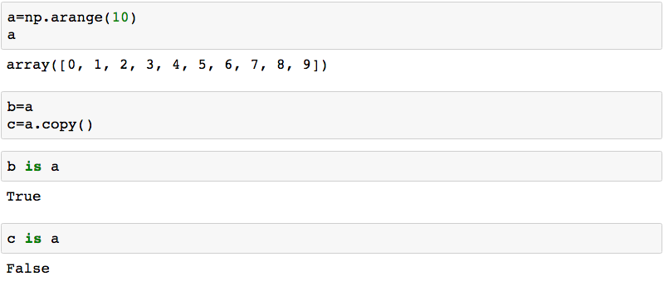
Pointer vs. Deep Copy

Slide 17
Pointer vs. Deep Copy
a = numpy.zeros( (3, 3) )
b = a # b is a pointer to a
c = a.copy() # c is a new array
b is a # True
c is a # False
Views
base

Slide 18
Array Arithmetic
a = numpy.array( range(10, 20) )
a + 5
a – 3
a * 5
a / 3.14
a.sum()
a > 15
(a > 15).sum()

Slide 19
Array Arithmetic by Index
a = numpy.array( range(10) )
b = numpy.array( range(0, 1000, 100) )
a + b # a[0] + b[0], a[1] + b[1] ...
a – b
a * b # not row, column matrix product
a / b
The 2 arrays must be the same shape.
Notes:
If a and b are not the same shape:
operands could not be broadcast together with shapes ...

Slide 20
Row, Column Matrix Product
c = numpy.dot(a, b)
Dot product of 2 arrays.
Matrix multiplication for 2D arrays.

Slide 21
Cross Product
zA = numpy.cross(xA, yA)
Note: we have been using numpy. functions

Slide 22
Array Shape
a = numpy.linspace(2, 32, 16)
a = a.reshape(4, 4) # ndarray . method
a.shape # ndarray attribute tuple (4, 4)
a = numpy.linspace(2,32,16).reshape(8,2)
Notes:
Python golf
len(a) or a.size

Slide 23
Array Diagonals
a = numpy.linspace(1, 64, 64)
a = a.reshape(8, 8)
numpy.triu(a) # upper triangle
numpy.tril(a) # lower triangle
numpy.diag(a) # main diagonal
numpy.diag(a, 1) # 1 above
numpy.diag(a, -1) # 1 below

Slide 24
Array Data Types
numpy.float64 is the default type
float32
int8, int16, int32, int64, uint8, uint16, uint32, uint64
complex64, complex128
bool - True or False
a.dtype shows type of data in array
>>> help(numpy.ndarray) # Parameters Attributes
Notes:
int8 is a byte
signed or unsigned ints
Correspond to C language implementation
24

Slide 25
Multi-Dimensional Indexing
a = numpy.array( range(12) )
a = a.reshape(2,6) # 2 rows, 6 columns
a[1][5] contains 11
a[1, 5] is equivalent, more efficient

Slide 26
Array Slicing
a = numpy.array(range(0, 100, 10))
Array([ 0, 10, 20, 30, 40, 50, 60, 70, 80, 90])
a[2:4] contains 20, 30
a[-4 : -1] contains 60, 70, 80
Slicing returns ndarray

Slide 27
Array Slicing
a = numpy.array(range(64)).reshape(8,8)
a[3, 4] contains 28
asub = a[3:5, 4:6]
Very useful for looking at data & debugging.
a[:,2] # all rows, column 2
a[3, 2:5] # row 3, columns 2 and 3 and 4
Notes:
Python was written by people who have done a lot of programming & debugging

Slide 28
Array Stuff
a.T
a.min()
a.max()
a.round()
a.var()
a.std()

Slide 29
Organize Arrays
Make a list of arrays named a, b, and c:
w = [ a, b, c]
len(w) # length of list is 3
w[1].max() # use array method

Slide 30
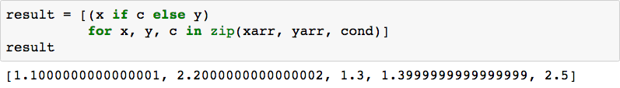
Conditional Logic with NumPy
Consider these arrays:
Use native “list comprehension” from Python:

Slide 31

Conditional Logic with NumPy
Consider these arrays:
Use NumPy conditional logic:

Slide 32
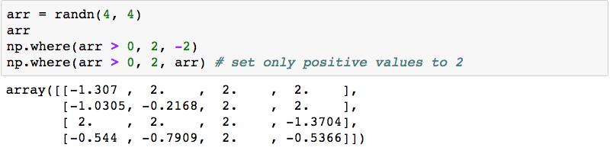
Why Conditional Logic with NumPy?
Consider these arrays:
Works with vectors / arrays / list by default
Fast

Slide 33
EXERCISE

Slide 34
Pandas

Slide 35
Agenda
Numpy
Pandas
Finance
Group Exercise
Assignment

Slide 36
Pandas

Slide 37
Series : pandas 1-D vectors
Index: array([0,1,2,3])
Series([4, 7, -5, 3])
Values: array([ 4, 7, -5, 3])
Name

Slide 38
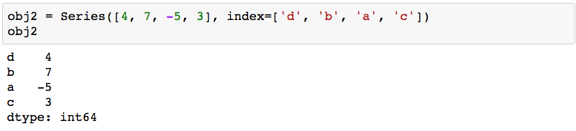
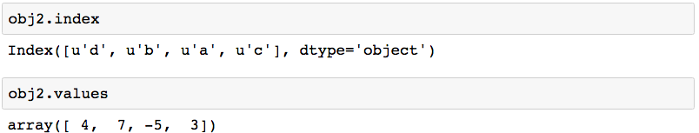
Series: Index, Values
2 main Series attribues: Index, Values

Slide 39
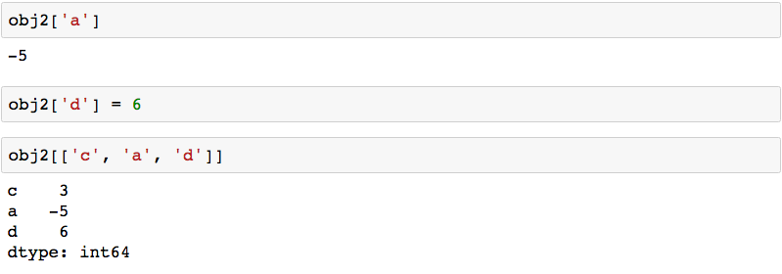
Series: element selection

Slide 40
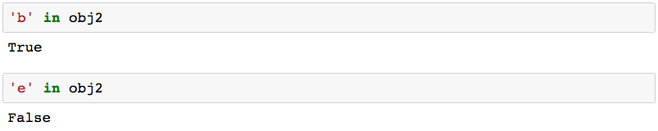
Series: membership

Slide 41
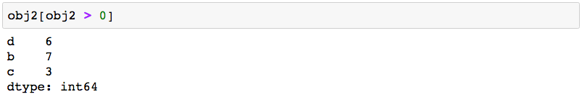
Series: element filtering

Slide 42
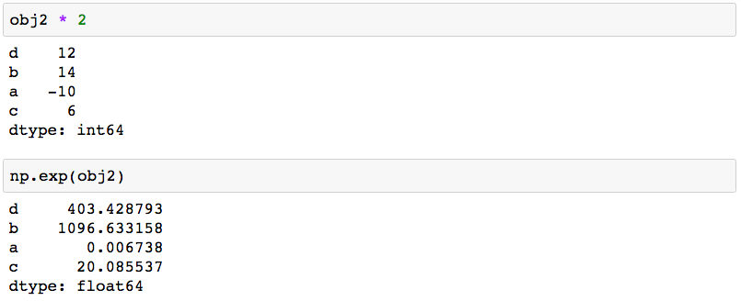
Series: scalar operations

Slide 43
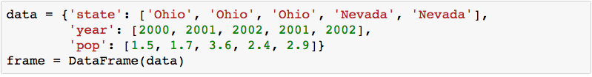
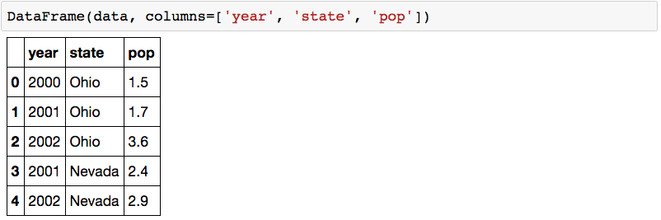
DataFrame: table in pandas

Slide 44
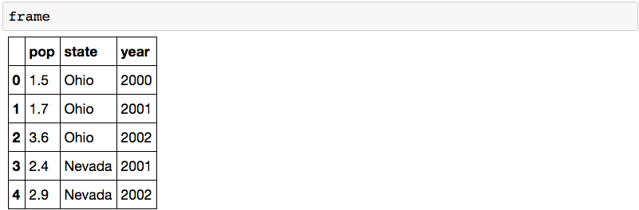
DataFrame: table in pandas

Slide 45
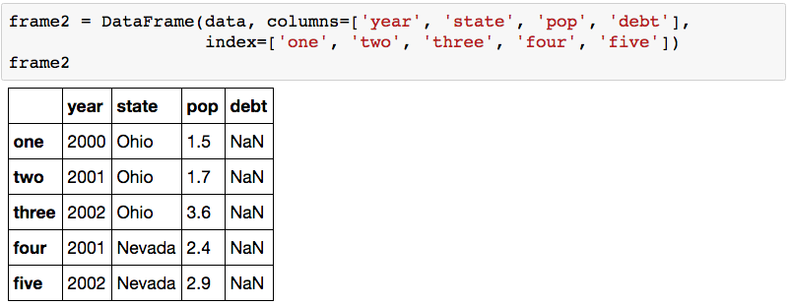
DataFrame: columns of lists with indices

Slide 46
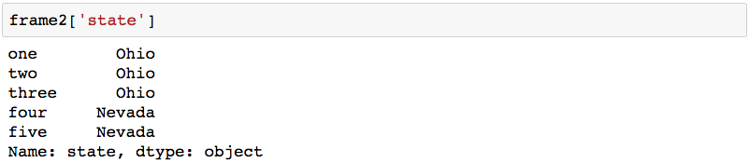
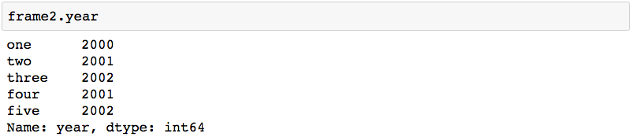
DataFrame: columns

Slide 47
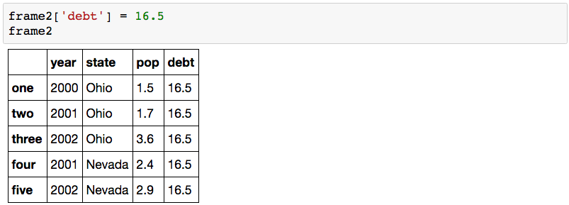
DataFrame: inserting data

Slide 48
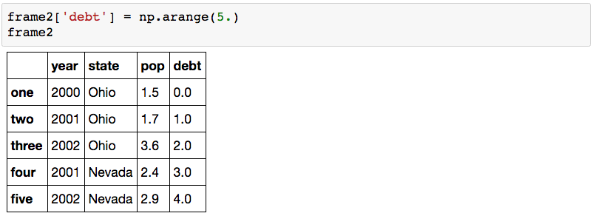
DataFrame: inserting data

Slide 49
Agenda
Numpy
Pandas
Finance
Group Exercise
Assignment

Slide 50
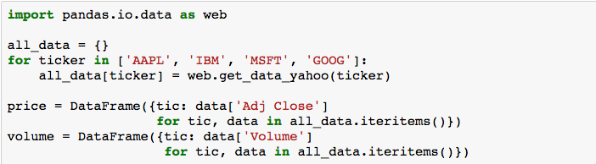
Getting Yahoo Finance Data

Slide 51
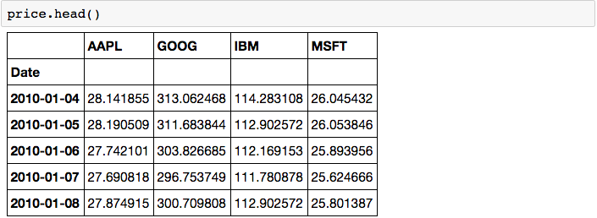
Stock data as DataFrame

Slide 52
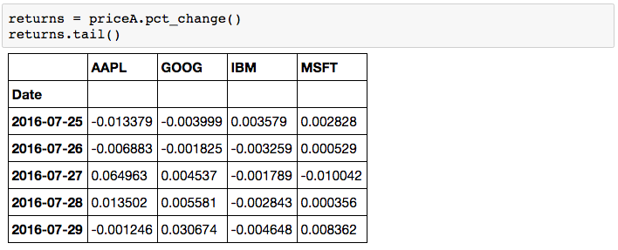
Stock data as DataFrame

Slide 53
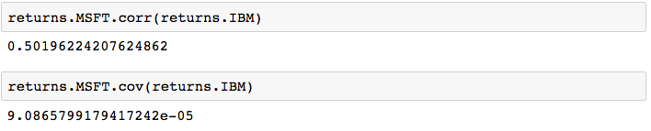
Correlation among stocks

Slide 54
Group Exercise: Dow Jones
Form groups of 4 students
Exercise 1: find list of all Dow Jones component stock tickers
Exercise 2: search & discuss how the Dow Jones component stock values are related to the Dow Jones Industrial Index value.

Slide 55
Assignment: Dow Jones

