Slide 1
Data Shaping & Visualization

Slide 2
Agenda
Project
Data Shaping
Merge & joins
Concat
Clean
Tableau
Matplotlib

Slide 3
Agenda
Project
Data Shaping
Merge & joins
Concat
Clean
Tableau
Matplotlib

Slide 4
Your project : guidelines
Goal: apply what you have learned so far to a realistic data science challenge + exercise your creativity + have fun!
This is meant to be a significant group effort to learn by practicing what you are learning to a real-world data science problem.
The writeup of your final project is in the form of a Jupyter notebook, associated data, and presentation board

Slide 5
Your project : topic selection
Goal: apply what you have learned in this class to a realistic data science challenge + exercise your creativity + have fun!
You can choose any ”significant” data set via downloadable sites, APIs, or use any of the datasets from the class.
You need to propose an interesting data insight investigation that you would like to explore, analyze the data, visualize the data, and finally write up your conclusion on what insights you have reached.

Slide 6
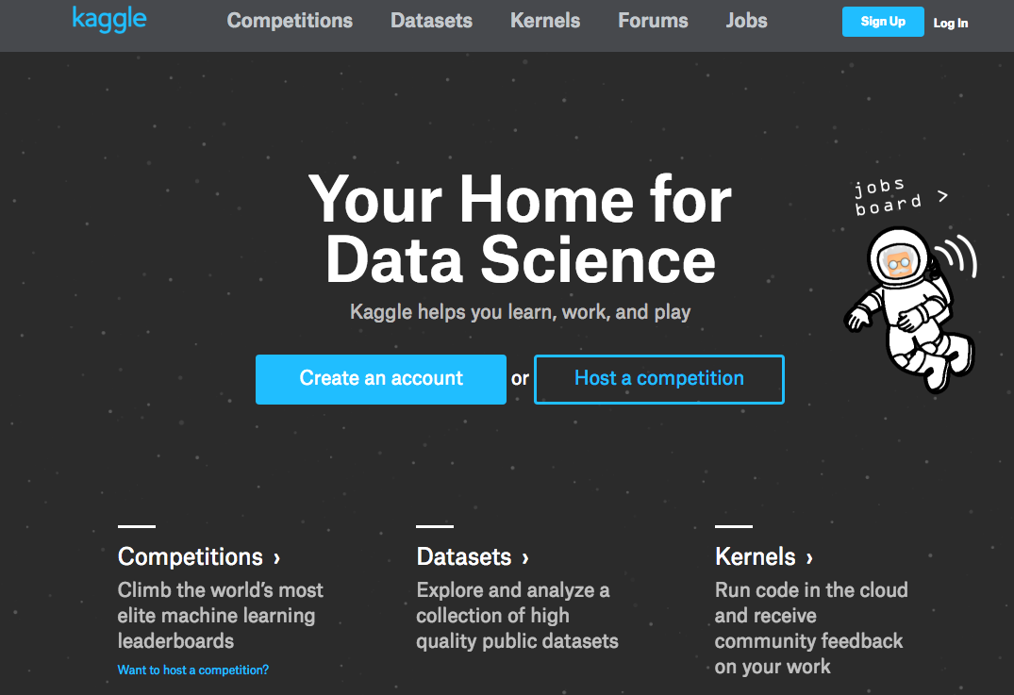
Project Ideas …

Slide 7
Agenda
Project
Data Shaping
Merge & joins
Concat
Clean
Tableau
Matplotlib

Slide 8
Joining Datasets
A
B

Slide 9
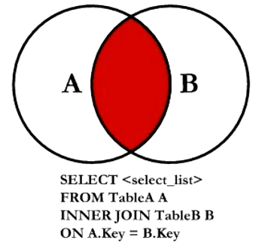
Joining Datasets : Inner Join

Slide 10
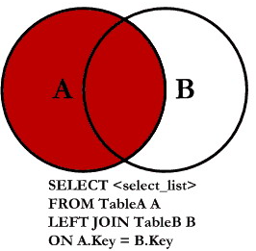
Joining Datasets : Left Outer Join

Slide 11
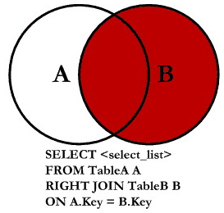
Joining Datasets : Right Outer Join

Slide 12
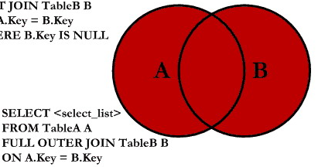
Joining Datasets : Full Outer Join
SELECT <select_list>
FROM TableA A
FULL OUTER JOIN TableB B
ON A.Key = B.Key

Slide 13
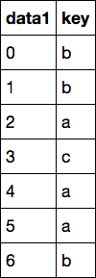
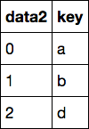
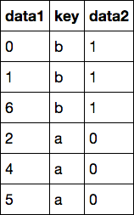
Merging (inner join)
merge
→

Slide 14
Merging (inner join)
inner join
→

Slide 15
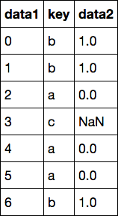
Merging (left outer join)
outer join
→

Slide 16
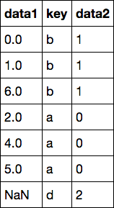
Merging (right outer join)
outer join
→

Slide 17
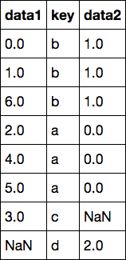
Merging (full outer join)
outer join
→

Slide 18
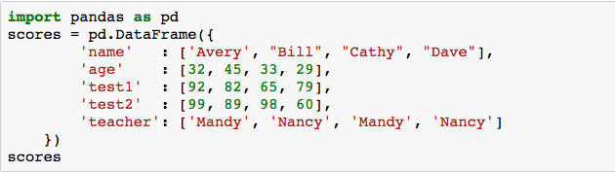
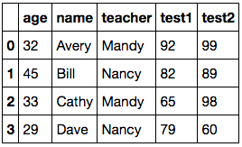
GroupBy : setup

Slide 19
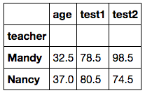
GroupBy : by teacher

Slide 20
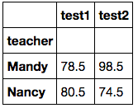
GroupBy : by teacher

Slide 21
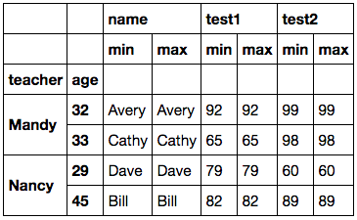
GroupBy : specific aggregations

Slide 22
Stacking & Unstacking
stack: this “rotates” or pivots from the columns in the data to the rows
unstack: this pivots from the rows into the columns

Slide 23
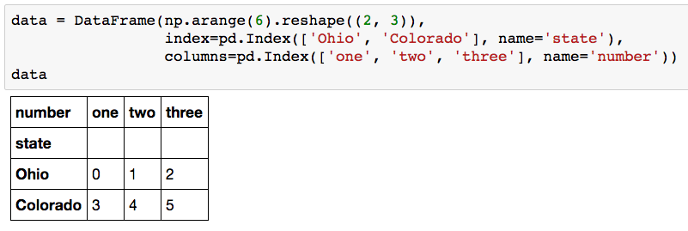
Stacking

Slide 24
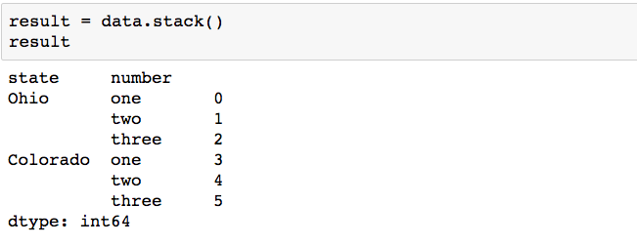
Stacking

Slide 25
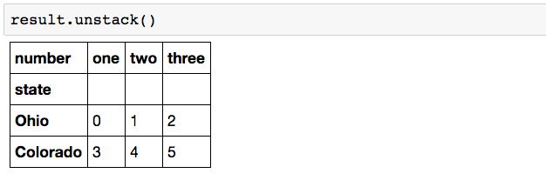
Stacking

Slide 26
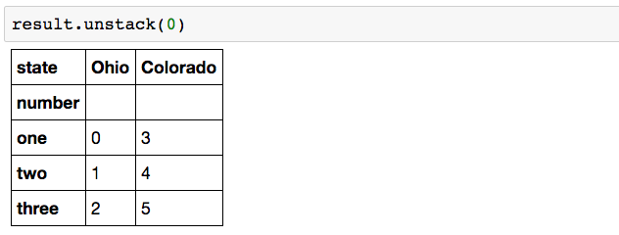
Stacking

Slide 27
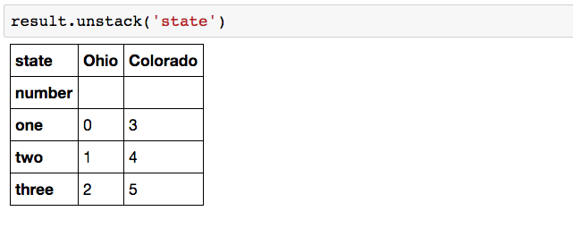
Stacking

Slide 28
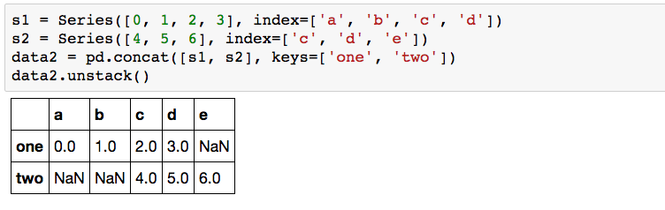
Stacking : may introduce Missing Values

Slide 29
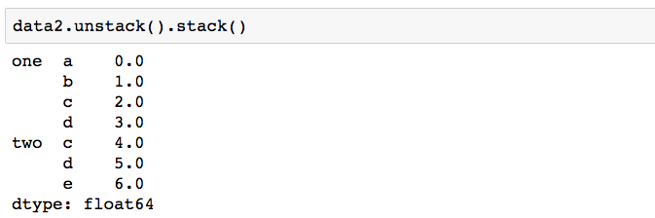
Stacking : may introduce Missing Values

Slide 30
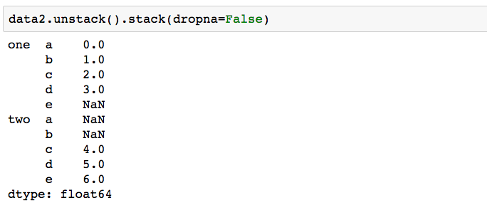
Stacking : may introduce Missing Values

Slide 31
Open notebook: “lecture05.data.shaping”

Slide 32
Agenda
Project
Data Shaping
Merge & joins
Concat
Clean
Tableau
Matplotlib

Slide 33
Tableau

Slide 34
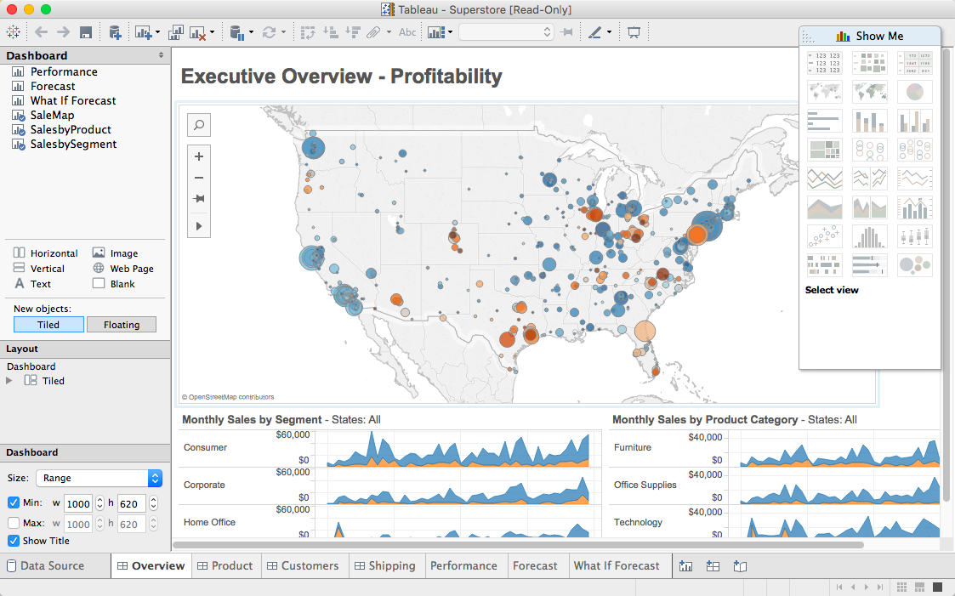

Slide 35
Student Tableau License
http://tableau.com/students

Slide 36

Data Ingestion
Joins: inner, left, right, full
Extract – Transform – Load (ETL)
Field Transformation
Live / Extract
Filtering
Large dataset & role of Tableau

Slide 37
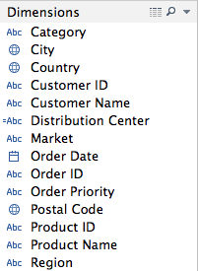
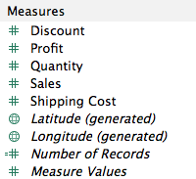
Dimensions & Measures
Dimensions : categorical
Measures : numerical

Slide 38
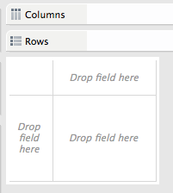
Rows & Columns

Slide 39
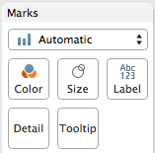
Marks

Slide 40
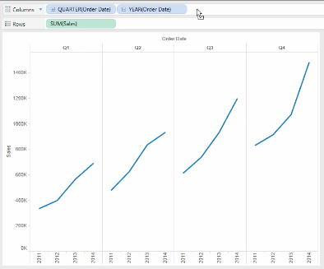
Multi-level Analysis

Slide 41
Group Exercise
Load the “global_superstore.xls” dataset into Tableau
Answer the following questions:
Which region has the highest sales?
For (1), which product segment for that region has the highest sales?
Regardless of region, which product segment in a given region has the highest sales?
Take 15 min in your group to decide on extracting an interesting insight from this dataset to present to the class.

Slide 42
Agenda
Project
Data Shaping
Merge & joins
Concat
Clean
Tableau
Matplotlib

Slide 43
Matplotlib

Slide 44
Matplotlib
Matplotlib is a python 2D plotting library which produces publication quality figures in a variety of hardcopy formats and interactive environments across platforms.
Matplotlib is the whole package; pylab is a module in matplotlib that gets installed alongside matplotlib; and matplotlib.pyplot is a module in matplotlib
Pyplot provides the state-machine interface to the underlying plotting library in matplotlib.

Slide 45
Subplot
Subplot divides the current figure into rectangular panes that are numbered row wise.
Each pane contains an axes object. Subsequent plots are output to the current pane.

Slide 46
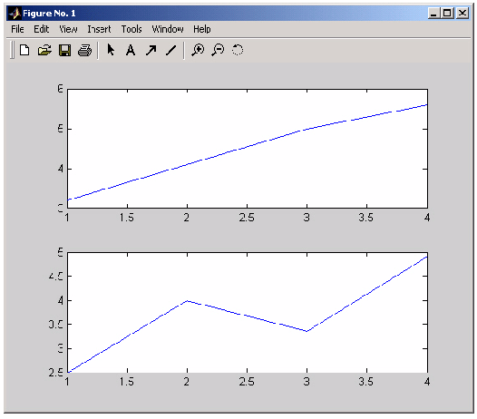
Subplot grid 2X1

Slide 47
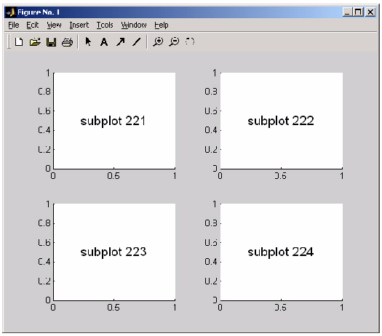
Subplot grid 2x2

Slide 48
Matplotlib Gallery
http://matplotlib.org/examples/index.html

