Slide 1
Data Ingestion

Slide 2
Agenda
Python Review
Virtual Envs & Requirements
Data Ingestion
Plain text
CSV
Excel
PDF
API
Assignment: for the CodeAcademy submission
Web Scraping (if we have time)

Slide 3
Python Review

Slide 4
Review
Integers
Floating Point
Dynamic Typing – no declarations
x = 5
y = 6.3
Names start with a letter, cAsE SeNsiTiVe.
Long names OK.

Slide 5
Review Character Strings
Dynamic typing – no declaration
No memory allocation
Immutable
s = “Good Afternoon”
len(s) # length of string

Slide 6
Review String Slicing
s = “Good Afternoon”
s[0] evaluates to “G”
s[5:10] selects “After” # string slicing
s[:10] selects “Good After”
s[5:] selects “Afternoon”
s[-4:] selects “noon” # last 4 characters
Notes:
String slicing is very useful when you start thinking about strings: beginning, end, first character, last character, etc.

Slide 7
String Methods
String is a Class with data & subroutines:
t = s.upper()
pos = s.find(“A”)
first = “George”
last = “Washington”
name = first + “ “ + last
# string concatenation
Notes:
Can also use single quotes to surround a string

Slide 8
Review Lists
Ordered sequence of items
Can be floats, ints, strings, Lists
a = [16, 25.3, “hello”, 45]
a[0] contains 16
a[-1] contains 45
a[0:2] is a list containing [16, 25.3]
Notes:
Very flexible but not high performance

Slide 9
Create a List
days = [ ]
days.append(“Monday”)
days.append(“Tuesday”)
years = range(2000, 2014)
years = xrange(2000, 2014)
Notes:
ranges from the number you want to the first number you don’t want
You can define your own irange function to include the last number
You can define your own frange function to return a list containing floating point numbers
9

Slide 10
List Methods
List is a Class with data & subroutines:
d.insert( )
d.remove( )
d.sort( )
Can concatenate lists with +

Slide 11
String split
s = “Princeton Plasma Physics Lab”
myList = s.split() # returns a list of strings
print myList
[ “Princeton”, “Plasma”, “Physics”, “Lab” ]
help(str.split) # delimiters, etc.
Notes:
Now that we have reviewed lists, we can add the string split method
First step in parsing
11

Slide 12
Tuple
Designated by ( ) parenthesis
A List that can not be changed. Immutable.
No append.
Good for returning multiple values from a subroutine function.
Can extract slices.

Slide 13
Review math module
import math
dir(math)
math.sqrt(x)
math.sin(x)
math.cos(x)
from math import *
dir()
sqrt(x)
from math import pi
dir()
print pi
Notes:
A python source code file of classes is a module.
import a module or some classes from a module
13

Slide 14
import a module
import math # knows where to find it
___________________________________
import sys
sys.path.append(“/u/efeibush/python”)
import cubic.py # import your own code
_____________________________________
if task == 3:
import math # imports can be anywhere
Notes:
Something new about imports
It’s not on the test.
14

Slide 15
Review Defining a Function
Block of code separate from main.
Define the function before calling it.
def myAdd(a, b): # define before calling
return a + b
p = 25 # main section of code
q = 30
r = myAdd(p, q)
Notes:
if p = “hello” and q = “goodbye” it will return “hellogoodbye”
15

Slide 16
Keyword Arguments
Provide default values for optional arguments.
def setLineAttributes(color=“black”, style=“solid”, thickness=1):
...
# Call function from main program
setLineAttributes(style=“dotted”)
setLineAttributes(“red”, thickness=2)
Notes:
For methods that have many arguments
Need this technique for graphing later today.

Slide 17
Looping with the range() function
for i in range(10): # i gets 0 - 9
range() is limited to integers
numpy provides a range of floats
Notes:
xrange() – generates number as needed instead of creating all numbers initially
First homework assignment is to write frange that returns a list of floats.
17

Slide 18
Summary
Integer, Float
String
List
Tuple
def function
Keywords: if elif else
while for in
import print
Indenting counts :
Notes:
An indent always starts after a colon.
Outdent does not have a specific character or symbol.

Slide 19
Run python as Interpreter
type()
dir()
help()

Slide 20
Virtual Envs & Packages

Slide 21
Virtual envs: isolation & portability
Operating System
venv
venv
venv
bokeh==0.12.1
configparser==3.3.0.post2
lxml==3.6.0
matplotlib==1.5.1
nbconvert==4.2.0
numpy==1.10.4
openpyxl==2.3.5
oauthlib==1.0.3
pandas==0.18.0
pandas-datareader==0.2.1
…
bokeh==0.12.1
configparser==3.3.0.post2
lxml==3.6.0
matplotlib==1.5.1
nbconvert==4.2.0
numpy==1.10.4
openpyxl==2.3.5
oauthlib==1.0.3
pandas==0.18.0
pandas-datareader==0.2.1
…
bokeh==0.12.1
configparser==3.3.0.post2
lxml==3.6.0
matplotlib==1.5.1
nbconvert==4.2.0
numpy==1.10.4
openpyxl==2.3.5
oauthlib==1.0.3
pandas==0.18.0
pandas-datareader==0.2.1
…

Slide 22
Packages we use: requirements.txt
bokeh==0.12.1
configparser==3.3.0.post2
lxml==3.6.0
matplotlib==1.5.1
nbconvert==4.2.0
numpy==1.10.4
openpyxl==2.3.5
oauthlib==1.0.3
pandas==0.18.0
pandas-datareader==0.2.1
…

Slide 23
Using ‘pip’
$ venv dsenv $ source dsenv/bin/activate $ pip install r requirements.txt

Slide 24
Starting Jupyter
$ source dsenv/bin/activate (venv) $ jupyter notebook

Slide 25
Data Ingestion

Slide 26
lecture02.ingestion.ipynb

Slide 27
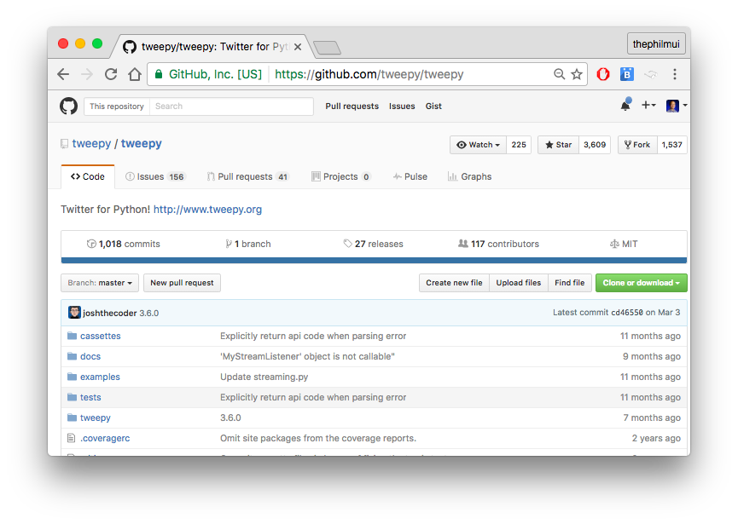

Slide 28
Submission for Completing CodeAcademy Assignment
This assignment will represent your completion of any Python online tutorial:
https://www.learnpython.org/
https://www.codecademy.com/learn/python
https://developers.google.com/edu/python/
Requirements for submission is on next page.

Slide 29
Submission Requirements:
Use the Twitter API to a good sample of tweets about “trump” and “clinton”. (Suggestion: at least 100 tweets each).
Count the most frequently associated words for both categories.
Print the top 10 most associated words which are not “stop words”.
Assign value 1 for "positive" sentiment, -1 for "negative" sentiment for each of the top 10 words.
What is the average sentiment value (as represented by the top 10 words) for tweets associated with "trump" and "clinton"?
Attach your code to your submission

Slide 30
Web Scraping

Slide 31
lecture02.web.scraping.ipynb

