Slide 1
Data Wrangling

Slide 2
Agenda
Pandas
Web Scraping
CSS
XPath
Hacker News
Merging Data
Pandas Input / Output

Slide 3
Pandas

Slide 4
Series : pandas 1-D vectors
Index: array([0,1,2,3])
Series([4, 7, -5, 3])
Values: array([ 4, 7, -5, 3])
Name

Slide 5
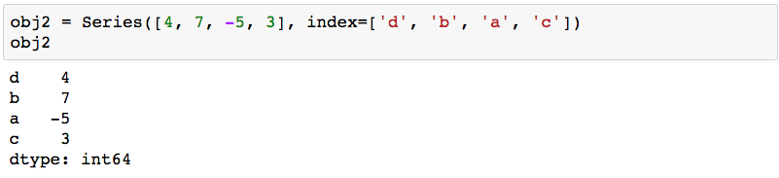
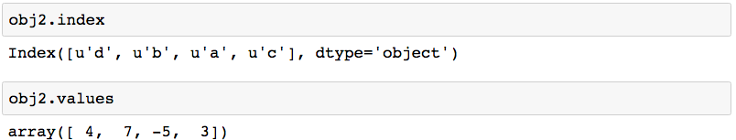
Series: Index, Values
2 main Series attribues: Index, Values

Slide 6
DataFrame: pandas > 1-D vectors
Index: array([0,1,2,3])
Series([4, 7, -5, 3])
Values: array([ 4, 7, -5, 3])
Name

Slide 7
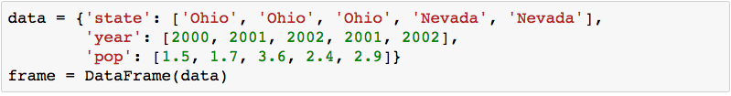
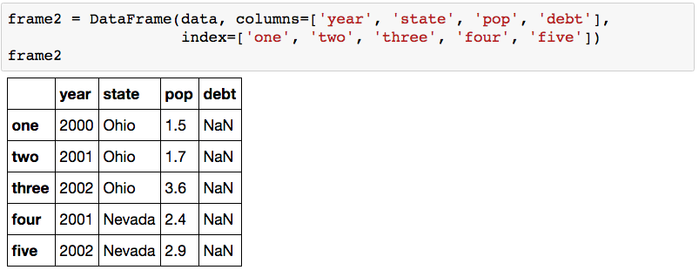
DataFrame: columns of lists with indices

Slide 8
Agenda
Pandas
Web Scraping
CSS
XPath
Hacker News
Merging Data
Pandas Input / Output

Slide 9
Web Scraping

Slide 10
lecture04.web.scraping.ipynb

Slide 11
CSS

Slide 12
What is CSS?
CSS stands for Cascading Style Sheets
Styles define how XHTML elements and markup should be displayed by the browser (or user agent)
Styles can be included in the <head> area of an XHTML document, or placed in external Style Sheet files.
Multiple style definitions are able to cascade into one…

Slide 13
Rules in CSS
A CSS Style Sheet is basically a collection of rules, describing how the browser should display XHTML elements.
Each rule contains 2 parts:
A Selector, stating which element in the XHTML a rule applies to;
One or more Declarations, which describe how these elements should be displayed.

Slide 14
CSS : Example
<html>
<head>
<title>Example page with embedded style</title>
<style type="text/css">
body { font-family : sans-serif;
color : blue;
background-color : yellow }
h1 { font-style : italic }
p { font-size : 14pt }
ol { font-size : 12pt;
color : red;
font-family : serif }
</style>
</head>
...
</html>

Slide 15
CSS Rules: Selectors and Declarations
Rule
Selector
h1 { font-family: Times, Georgia, serif; font-size: 24px; text-align: center; }
Declarations
Enclosed in curly brackets { }

Slide 16
CSS Rules: Declaration Parts
Only values with a space in the name need to be enclosed in quotes
h1 { font-family: “Trebuchet MS”, serif; font-size: 24px; text-align: center;
}
Note: values do not have to be enclosed in quotation marks, unless the value name includes a space (e.g multi-word name).

Slide 17
CSS Simple, or Element Selectors
The most basic form of CSS selector is an XHTML element name;
h1, h2, p, ol, ul, table, etc.
This is the simple or element selector. Example:
p { color: #003366; }
This will set every occurrence of content marked up the <p> paragraph tag to be a dark blue colour.

Slide 18
CSS Class Selectors
However, in XHTML markup, elements can have class attributes assigned to them. The value attached to a class attribute can be one (or more) names, separated by spaces. Example:
<h1 class=“special”> or
<h1 class=“special underlined”>
The actual definition of the value “special” is defined in a CSS class selector…

Slide 19
CSS Class Selectors
h1.special { color: #FF0000; }
This will now make all <h1> elements with the class “special” display text with a red colour. <h1> elements that don’t have the class attribute “special” will continue to display in the default <h1> colour.
A CSS class selector can also be defined more generally, without the element name (just the dot):
.special { color: #FF0000; }
This class can now be applied to any XHTML element that has the class attribute “special”.
Actually the full CSS syntax is *.special, where * is a selector that matches anything. However, CSS shorthand means we can drop the *.

Slide 20
CSS ID Selectors
XHTML elements can also have id selectors assigned to them. Example:
<p id=“summary”>blah, blah, blah.</p>
In the CSS, the id “summary” can be styled in a rule, thus:
#summary { font-style: italic; }
Whereas class selectors can be used across a number of elements in an XHTML document, ID selectors can only be assigned to one specific element in any given XHTML document.

Slide 21
CSS ID Selectors
In the CSS, id selectors are always defined with a # (hash) symbol first:
#summary { font-style: italic; }
Again, this is CSS shorthand for…
*#summary { font-style: italic; }
…meaning the id #summary can be applied to any XHTML element (but only one element can have that id name in the XHTML document).

Slide 22
Class Selectors vs ID Selectors
ID selectors:
As they must be unique to a page, ID selectors are useful for persistent structural elements, such as navigation zones, or key content areas, that occur once on a page, but that are consistent across a site.
For example, #mainNav may be the selector to style the the main navigation element, which will likely appear on every page of your site.
So, ID selectors are generally applied to conceptually similar elements across a site.

Slide 23
Class Selectors vs ID Selectors
Class selectors:
As they can be allied to any number of elements on a page, class selectors are useful for identifying (and targeting) types of content, or similar items.
For example, you have a news page with a date at the start of each story. If you use ID selectors, you’d have to give every occurrence of the date a separate ID name. Much easier to give every date one class name and style that one class.

Slide 24
CSS Pseudo-Classes
Pseudo-classes are CSS classes used to add effects to certain elements. They are used most often to style the anchor elements <a> of hyperlinks. Example:
a:link { color: blue; text-decoration: underlined; }
Can also be written without the a (anchor) element:
:link { color: blue; text-decoration: underlined; }

Slide 25
CSS Pseudo-Classes
There are four pseudo-class elements provided to make rollover and on-click effects possible:
a:link { color: blue; text-decoration: underlined; } link not yet visited
a:visited { color: green; text-decoration: underlined; } visited link
a:hover { color: red; text-decoration: none; } effect on the link when the mouse hovers over it
a:active { color: purple; text-decoration: none; } effect on the link when the mouse button is pressed down on it
Note that pseudo-classes for rollover effects must be written in this order in a CSS file for them to work correctly.

Slide 26
Combining Pseudo-Classes with Classes
Pseudo-classes can also be combined with regular CSS class selectors to create multiple link and rollover styles, depending on the parent class. Examples:
a.main:link { color: blue; } a.sidebar:link { color: grey; } a.footer:link { color: white; }

Slide 27
XPath

Slide 28
<?xml version="1.0"?>
<FitnessCenter>
<Member>
<Name>Jeff</Name>
<FavoriteColor>lightgrey</FavoriteColor>
</Member>
<Member>
<Name>David</Name>
<FavoriteColor>lightblue</FavoriteColor>
</Member>
<Member>
<Name>Roger</Name>
<FavoriteColor>lightyellow</FavoriteColor>
</Member>
</FitnessCenter>
This XML document can be
represented as a tree, as shown below
Document
/
PI
<?xml version=“1.0”?>
Element
FitnessCenter
Element
Member
Element
Member
Element
Member
Element
Name
Element
FavoriteColor
Element
Name
Element
FavoriteColor
Element
Name
Element
FavoriteColor
Text
Jeff
Text
lightgrey
Text
David
Text
lightblue
Text
Roger
Text
lightyellow

Slide 29
Terminology - node
Processing Instruction (PI) node
Document node
Element nodes
Document
/
PI
<?xml version=“1.0”?>
Element
FitnessCenter
Text nodes
Element
Member
Element
Member
Element
Member
Element
Name
Element
FavoriteColor
Element
Name
Element
FavoriteColor
Element
Name
Element
FavoriteColor
Text
Jeff
Text
lightgrey
Text
David
Text
lightblue
Text
Roger
Text
lightyellow

Slide 30
Document
/
PI
<?xml version=“1.0”?>
Element
FitnessCenter
With respect to this node, these are its children
Element
Member
Element
Member
Element
Member
Element
Name
Element
FavoriteColor
Element
Name
Element
FavoriteColor
Element
Name
Element
FavoriteColor
Text
Jeff
Text
lightgrey
Text
David
Text
lightblue
Text
Roger
Text
lightyellow

Slide 31
Document
/
PI
<?xml version=“1.0”?>
Element
FitnessCenter
These are its descendant nodes
Element
Member
Element
Member
Element
Member
Element
Name
Element
FavoriteColor
Element
Name
Element
FavoriteColor
Element
Name
Element
FavoriteColor
Text
Jeff
Text
lightgrey
Text
David
Text
lightblue
Text
Roger
Text
lightyellow

Slide 32
Document
/
PI
<?xml version=“1.0”?>
Element
FitnessCenter
This is the context node
Element
Member
Element
Member
Element
Member
Element
Name
Element
FavoriteColor
Element
Name
Element
FavoriteColor
Element
Name
Element
FavoriteColor
Text
Jeff
Text
lightgrey
Text
David
Text
lightblue
Text
Roger
Text
lightyellow

Slide 33
Document
/
PI
<?xml version=“1.0”?>
Element
FitnessCenter
Element
Member
That's
its parent
Element
Member
Element
Member
Element
Name
Element
FavoriteColor
Element
Name
Element
FavoriteColor
Element
Name
Element
FavoriteColor
Text
Jeff
Text
lightgrey
Text
David
Text
lightblue
Text
Roger
Text
lightyellow

Slide 34
Document
/
PI
<?xml version=“1.0”?>
Element
FitnessCenter
Element
Member
Those are its ancestors
Element
Member
Element
Member
Element
Name
Element
FavoriteColor
Element
Name
Element
FavoriteColor
Element
Name
Element
FavoriteColor
Text
Jeff
Text
lightgrey
Text
David
Text
lightblue
Text
Roger
Text
lightyellow

Slide 35
Document
/
PI
<?xml version=“1.0”?>
Element
FitnessCenter
Element
Member
It has 2 siblings
Element
Member
Element
Member
Element
Name
Element
FavoriteColor
Element
Name
Element
FavoriteColor
Element
Name
Element
FavoriteColor
Text
Jeff
Text
lightgrey
Text
David
Text
lightblue
Text
Roger
Text
lightyellow

Slide 36
Document
/
PI
<?xml version=“1.0”?>
Element
FitnessCenter
Element
Member
They are following-siblings
Element
Member
Element
Member
Element
Name
Element
FavoriteColor
Element
Name
Element
FavoriteColor
Element
Name
Element
FavoriteColor
Text
Jeff
Text
lightgrey
Text
David
Text
lightblue
Text
Roger
Text
lightyellow

Slide 37
Document
/
PI
<?xml version=“1.0”?>
Element
FitnessCenter
Element
Member
It has no preceding-siblings
Element
Member
Element
Member
Element
Name
Element
FavoriteColor
Element
Name
Element
FavoriteColor
Element
Name
Element
FavoriteColor
Text
Jeff
Text
lightgrey
Text
David
Text
lightblue
Text
Roger
Text
lightyellow

Slide 38
Capabilities of XPath
XPath provides a syntax for:
navigating around an XML document
selecting nodes and values
comparing node values
performing arithmetic on node values
XPath provides some functions (e.g., concat(), substring(), etc.) to facilitate the above.

Slide 39
Select all Para Elements
//Para
descendents

Slide 40
Select the first Para
//Para[1]

Slide 41
Select the last Para
//Para[last()]

Slide 42
Select the classification attribute of the first Para
//Para[1]/@classification

Slide 43
Is the Document element’s classification top-secret?
/Document/@classification = 'top-secret'

Slide 44
Is the Document element’s classification top-secret or secret?
(/Document/@classification = 'top-secret') or
(/Document/@classification='secret')

Slide 45
Logical Operators
A or B
A and B
not(A)

Slide 46
Select all Para’s with a secret classification
//Para[@classification = 'secret']

Slide 47
Check that no Para has a top-secret classification
not(//Para[@classification = 'top-secret'])

Slide 48
Select the Following Siblings
following-sibling::*

Slide 49
Select the First Following Sibling
following-sibling::*[1]

Slide 50
Select the Following Para Siblings
following-sibling::Para

Slide 51
Select all Following Siblings
following-sibling::*

Slide 52
Select all Preceding Siblings
preceding-sibling::*

Slide 53
Get parent element's classification
../@classification

Slide 54
Axis
following-sibling
preceding-sibling
child
parent
ancestor
descendent
self

Slide 55
Count the number of Para elements
count(//Para)

Slide 56
Count the number of Para elements with secret classification
count(//Para[@classification = 'secret'])

Slide 57
Does the first Para element contain the string “SCRIPT”?
contains(//Para[1], 'SCRIPT')

Slide 58
Select all nodes containing the string “SCRIPT”
//node()[contains(., 'SCRIPT')]
The node() function matches on these nodes:
- element
- text
- comment
- processing instructions (PIs)
Note that it does not match on these nodes:
- attribute
- document

Slide 59
Count the number of nodes containing the string “SCRIPT”
count(//node()[contains(., 'SCRIPT')])

Slide 60
Select the first 20 characters of the first Para
substring(//Para[1], 1, 20)

Slide 61
What's the length of the content of the first Para?
string-length(//Para[1])

Slide 62
Convert Document’s classification to lowercase
translate(/Document/@classification, 'ABCDEFGHIJKLMNOPQRSTUVWXYZ', 'abcdefghijklmnopqrstuvwxyz')

Slide 63
Boolean Operators
eq means equal
ne means not equal
lt means less than
gt means greater than
le means less than or equal to
ge means greater than or equal to

Slide 64
If Document's classification is top-secret then there can be no Para with a classification not equal to top-secret
if (/Document/@classification eq 'top-secret') then not(//Para[@classification ne 'top-secret']) else true()

Slide 65
Two built-in functions
true()
false()

Slide 66
Cast a value to a numeric type
number(Cost)

Slide 67
The sum() function
<?xml version="1.0"?> <numbers> <number>23</number> <number>5</number> <number>-41</number> <number>50</number> <number>12</number> </numbers>
sum(//number)
→ returns 49.0

Slide 68
lecture04.web.scraping.ipynb

Slide 69
Assignment: Hacker News
Hacker News: https://news.ycombinator.com/
Please upload your Jupyter notebook here that contains the implementation of this function:
# Print out the average points of the posters to frontpage of HackerNews
def getExperiencePointsNow(): # stuff here print "Average experience now: %.2f" % (avgScore) getExperiencePointsNow()
Explain how articles get ranked & pushed to frontpage of Hacker News (https://news.ycombinator.com/)

Slide 70
Agenda
Pandas
Web Scraping
CSS
XPath
Hacker News
Merging Data
Pandas Input / Output

Slide 71
European Union circa 2016

Slide 72
Extra-EU Trade Data for 2010, 2012, 2014
http://ec.europa.eu/eurostat/web/products-datasets/-/ext_lt_invcur

Slide 73
“Extra-EU trade”
“Extra-EU trade” statistics cover the trading of goods between Member States and a non-member countries.

Slide 74
SITC
SITC : Standard International Trade Classification
SITC0-4A

Slide 75
Extra-EU Trade Data for 2010, 2012, 2014
partner,currency,stk_flow,sitc06,geo\time 2014 2012 2010
EXT_EU,EUR,EXP,SITC0-4A,AT 61.9 65.6 67
EXT_EU,EUR,EXP,SITC0-4A,BE 53.8 85.8 92.4
EXT_EU,EUR,EXP,SITC0-4A,BG 57 46.2 54.1
EXT_EU,EUR,EXP,SITC0-4A,CY 79.1 60.7 61.4
EXT_EU,EUR,EXP,SITC0-4A,CZ 58.3 66.7 59.1
EXT_EU,EUR,EXP,SITC0-4A,DE 62.5 61.5 65.9
EXT_EU,EUR,EXP,SITC0-4A,DK 12.8 14 12.2
EXT_EU,EUR,EXP,SITC0-4A,EA 60.7 65.4 64.1
EXT_EU,EUR,EXP,SITC0-4A,EE 67.9 62.8 51.8
EXT_EU,EUR,EXP,SITC0-4A,EL 60.3 58.4 59
EXT_EU,EUR,EXP,SITC0-4A,ES 61.8 63.7 75.6
EXT_EU,EUR,EXP,SITC0-4A,EU 50.1 53.5 53.2
EXT_EU,EUR,EXP,SITC0-4A,FI 42.4 40.7 47.7
EXT_EU,EUR,EXP,SITC0-4A,FR 63.8 62.3 58.4
EXT_EU,EUR,EXP,SITC0-4A,HR 77.3 : :
EXT_EU,EUR,EXP,SITC0-4A,HU 45.4 45.5 67.8
...

Slide 76
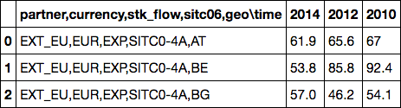
Read in by chunk of 100 rows
df = pd.DataFrame()
for chunk in pd.read_csv('data/ext_lt_invcur.tsv', sep='\t', chunksize=100):
df = pd.concat([df, chunk])

Slide 77
Transforming column 1 : step 1 (splitting)
df = pd.DataFrame()
for chunk in pd.read_csv('data/ext_lt_invcur.tsv', sep='\t', chunksize=100):
data_rows = [row for row in chunk.ix[:,0].str.split(',')]
data_cols = chunk.columns[0].split(',')
print(data_rows[:2], data_cols)
break;
([['EXT_EU', 'EUR', 'EXP', 'SITC0-4A', 'AT'], ['EXT_EU', 'EUR', 'EXP', 'SITC0-4A', 'BE']], ['partner', 'currency', 'stk_flow', 'sitc06', 'geo\\time'])

Slide 78
Transforming column 1 : step 2 (fixing colname)
df = pd.DataFrame()
for chunk in pd.read_csv('data/ext_lt_invcur.tsv', sep='\t', chunksize=100):
data_rows = [row for row in chunk.ix[:,0].str.split(',')]
data_cols = [col.split('\\')[0] for col in chunk.columns[0].split(',')]
print(data_rows[:2], data_cols)
break;
([['EXT_EU', 'EUR', 'EXP', 'SITC0-4A', 'AT'], ['EXT_EU', 'EUR', 'EXP', 'SITC0-4A', 'BE']], ['partner', 'currency', 'stk_flow', 'sitc06', 'geo'])

Slide 79
Transforming column 1 : step 3 (merge)
df = pd.DataFrame()
for chunk in pd.read_csv('data/ext_lt_invcur.tsv', sep='\t', chunksize=100):
data_rows = [row for row in chunk.ix[:,0].str.split(',')]
data_cols = [col.split('\\')[0] for col in chunk.columns[0].split(',')]
clean_df = pd.DataFrame(data_rows, columns=data_cols)
# now we can concat by "column" which means axis=1
new_df = pd.concat([clean_df, chunk], axis=1)
print(new_df)
break;
partner currency stk_flow sitc06 geo \
0 EXT_EU EUR EXP SITC0-4A AT
1 EXT_EU EUR EXP SITC0-4A BE
2 EXT_EU EUR EXP SITC0-4A BG
3 EXT_EU EUR EXP SITC0-4A CY
4 EXT_EU EUR EXP SITC0-4A CZ

Slide 80
Transforming column 1 : step 4 (clean)
df = pd.DataFrame()
for chunk in pd.read_csv('data/ext_lt_invcur.tsv', sep='\t', chunksize=100):
data_rows = [row for row in chunk.ix[:,0].str.split(',')]
data_cols = [col.split('\\')[0] for col in chunk.columns[0].split(',')]
clean_df = pd.DataFrame(data_rows, columns=data_cols)
# now we can concat by "column" which means axis=1
new_df = pd.concat([clean_df, chunk.drop(chunk.columns[0], axis=1)],
axis=1)
print(new_df)
break;
partner currency stk_flow sitc06 geo
0 EXT_EU EUR EXP SITC0-4A AT
1 EXT_EU EUR EXP SITC0-4A BE
2 EXT_EU EUR EXP SITC0-4A BG
3 EXT_EU EUR EXP SITC0-4A CY
4 EXT_EU EUR EXP SITC0-4A CZ

Slide 81
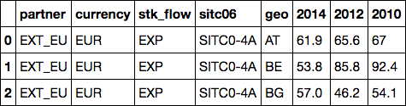
Transforming column 1 : step 5 (finalize)
df = pd.DataFrame()
for chunk in pd.read_csv('data/ext_lt_invcur.tsv', sep='\t', chunksize=100):
data_rows = [row for row in chunk.ix[:,0].str.split(',')]
data_cols = [col.split('\\')[0] for col in chunk.columns[0].split(',')]
clean_df = pd.DataFrame(data_rows, columns=data_cols)
# now we can concat by "column" which means axis=1
new_df = pd.concat([clean_df, chunk.drop(chunk.columns[0], axis=1)],
axis=1)
df = pd.concat([df, new_df])

Slide 82
Data Exploration
df.shape()
(1320, 8)

Slide 83
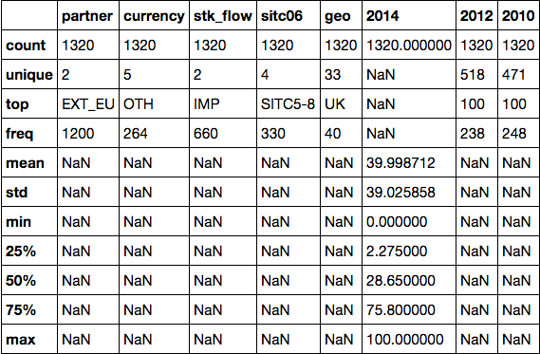
Data Exploration
df.describe(include=‘all’)

Slide 84
Group Exercise
Find the “mean” 2014 EU export % to Extra-EU states with:
sitc06==“SITC33” #petroleum products
currency==“EUR” # euro currency
Stk_flow==“EXP” # export only

Slide 85
Agenda
Pandas
Web Scraping
CSS
XPath
Hacker News
Merging Data
Pandas Input / Output

Slide 86
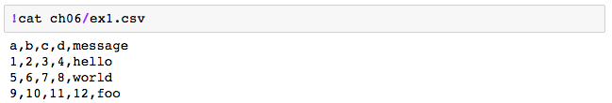
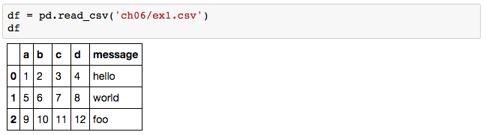
Reading CSV into DataFrame

Slide 87
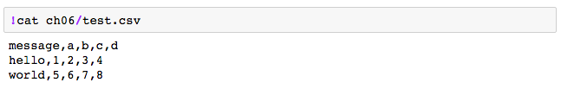
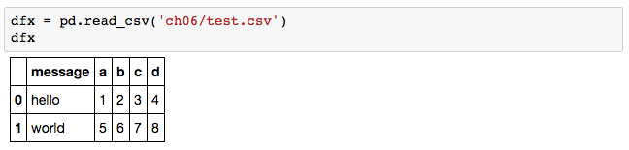
Reading CSV into DataFrame

Slide 88
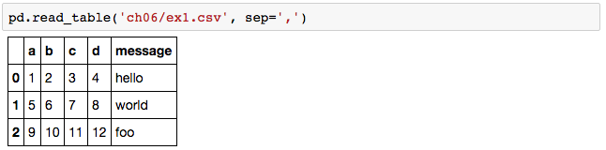
Reading CSV into DataFrame

Slide 89

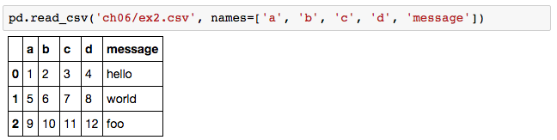
Reading CSV into DataFrame

Slide 90
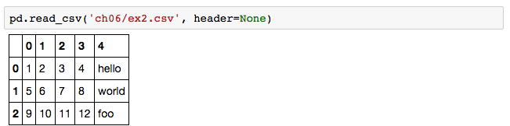
Reading CSV into DataFrame

Slide 91
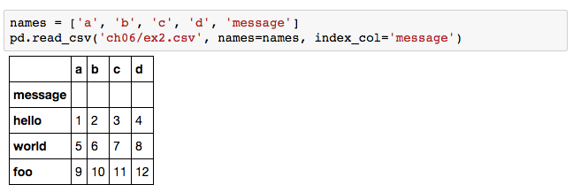
Reading CSV into DataFrame

Slide 92
Assignment: Hacker News
Hacker News: https://news.ycombinator.com/
Please upload your Jupyter notebook here that contains the implementation of this function:
# Print out the average points of the posters to frontpage of HackerNews
def getExperiencePointsNow(): # stuff here print "Average experience now: %.2f" % (avgScore) getExperiencePointsNow()
Explain how articles get ranked & pushed to frontpage of Hacker News (https://news.ycombinator.com/)
Return 2 lists: (1) top 10 articles by points, (2) top 10 articles by comments
For these 2 lists, find the Pearson correlation coefficient for these 2 lists
Ask a good question & answer it from the Hacker News front page

Slide 93
Reminder: Midterm Next Week
In-class (1 hour)
Take-home (1 dataset)

