Slide 1
visualizations

Slide 2
Midterm Take-Home Assignment
Your dataset is at: midterm/ext_lt_intratrd.tsv
This is an individual assignment – no sharing
Available now, submit to Camino by next Friday evening
5 questions (on next page)

Slide 3
Midterm Take-Home Questions:
Which EU country has the highest average intra-EU trade from 1999-2015 and what is this annual average?
Which year has the highest amount of intra-EU trade between 1999-2015 and what is the total amount?
Which EU country has the largest increase from 1999-2015 in terms of intra-EU trade? Macro-economically, what is your hypothesis behind this increase?
Which EU country has the largest decrease from 1999-2015 in terms of intra-EU trade? Macro-economically, what is your hypothesis behind this drop?
Analyze this dataset as a DataFrame and describe an insight that you are able to deduce.

Slide 4
4 visualizations

Slide 5
Choosing among visualization tools
Tableau : no-code, drag and drop Excel type analysis
Matplotlib : basic plotting -- bars, pies, lines, scatter plots, etc.
Seaborn : statistical visualization -- use it if you're creating heatmaps or somehow summarizing your data and still want to show the distribution of your data
Bokeh : interactive visualization -- if your data is so complex (or you haven't yet found the "message" in your data), then use Bokeh to create interactive visualizations that will allow your viewers to explore the data themselves

Slide 6
Agenda
Matplotlib
Seaborn
Bokeh
Tableau
Final Project

Slide 7
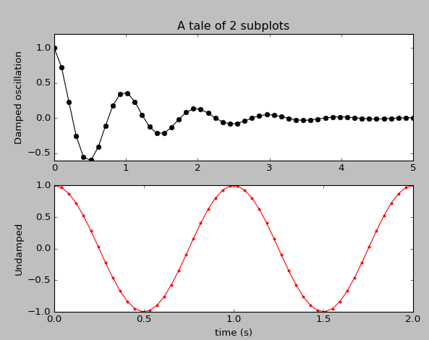
Anatomy of a matplotlib plot

Slide 8
Anatomy of a matplotlib plot
import numpy as np
import matplotlib.pyplot as plt
x1 = np.linspace(0.0, 5.0)
x2 = np.linspace(0.0, 2.0)
y1 = np.cos(2 * np.pi * x1) * np.exp(-x1)
y2 = np.cos(2 * np.pi * x2)
plt.subplot(2, 1, 1)
plt.plot(x1, y1, 'ko-')
plt.title('A tale of 2 subplots')
plt.ylabel('Damped oscillation')
plt.subplot(2, 1, 2)
plt.plot(x2, y2, 'r.-')
plt.xlabel('time (s)')
plt.ylabel('Undamped')
plt.show()

Slide 9
Import libraries
import numpy as np
import matplotlib.pyplot as plt
x1 = np.linspace(0.0, 5.0)
x2 = np.linspace(0.0, 2.0)
y1 = np.cos(2 * np.pi * x1) * np.exp(-x1)
y2 = np.cos(2 * np.pi * x2)
plt.subplot(2, 1, 1)
plt.plot(x1, y1, 'ko-')
plt.title('A tale of 2 subplots')
plt.ylabel('Damped oscillation')
plt.subplot(2, 1, 2)
plt.plot(x2, y2, 'r.-')
plt.xlabel('time (s)')
plt.ylabel('Undamped')
plt.show()

Slide 10
Anatomy of a matplotlib plot
import numpy as np
import matplotlib.pyplot as plt
x1 = np.linspace(0.0, 5.0)
x2 = np.linspace(0.0, 2.0)
y1 = np.cos(2 * np.pi * x1) * np.exp(-x1)
y2 = np.cos(2 * np.pi * x2)
plt.subplot(2, 1, 1)
plt.plot(x1, y1, 'ko-')
plt.title('A tale of 2 subplots')
plt.ylabel('Damped oscillation')
plt.subplot(2, 1, 2)
plt.plot(x2, y2, 'r.-')
plt.xlabel('time (s)')
plt.ylabel('Undamped')
plt.show()

Slide 11
Define 2 x-axis ranges in linear space
import numpy as np
import matplotlib.pyplot as plt
x1 = np.linspace(0.0, 5.0)
x2 = np.linspace(0.0, 2.0)
y1 = np.cos(2 * np.pi * x1) * np.exp(-x1)
y2 = np.cos(2 * np.pi * x2)
plt.subplot(2, 1, 1)
plt.plot(x1, y1, 'ko-')
plt.title('A tale of 2 subplots')
plt.ylabel('Damped oscillation')
plt.subplot(2, 1, 2)
plt.plot(x2, y2, 'r.-')
plt.xlabel('time (s)')
plt.ylabel('Undamped')
plt.show()

Slide 12
Create 2 sinusoidal functions
import numpy as np
import matplotlib.pyplot as plt
x1 = np.linspace(0.0, 5.0)
x2 = np.linspace(0.0, 2.0)
y1 = np.cos(2 * np.pi * x1) * np.exp(-x1)
y2 = np.cos(2 * np.pi * x2)
plt.subplot(2, 1, 1)
plt.plot(x1, y1, 'ko-')
plt.title('A tale of 2 subplots')
plt.ylabel('Damped oscillation')
plt.subplot(2, 1, 2)
plt.plot(x2, y2, 'r.-')
plt.xlabel('time (s)')
plt.ylabel('Undamped')
plt.show()

Slide 13
Plot subplot #1
import numpy as np
import matplotlib.pyplot as plt
x1 = np.linspace(0.0, 5.0)
x2 = np.linspace(0.0, 2.0)
y1 = np.cos(2 * np.pi * x1) * np.exp(-x1)
y2 = np.cos(2 * np.pi * x2)
plt.subplot(2, 1, 1)
plt.plot(x1, y1, 'ko-')
plt.title('A tale of 2 subplots')
plt.ylabel('Damped oscillation')
plt.subplot(2, 1, 2)
plt.plot(x2, y2, 'r.-')
plt.xlabel('time (s)')
plt.ylabel('Undamped')
plt.show()

Slide 14
Plot subplot #2
import numpy as np
import matplotlib.pyplot as plt
x1 = np.linspace(0.0, 5.0)
x2 = np.linspace(0.0, 2.0)
y1 = np.cos(2 * np.pi * x1) * np.exp(-x1)
y2 = np.cos(2 * np.pi * x2)
plt.subplot(2, 1, 1)
plt.plot(x1, y1, 'ko-')
plt.title('A tale of 2 subplots')
plt.ylabel('Damped oscillation')
plt.subplot(2, 1, 2)
plt.plot(x2, y2, 'r.-')
plt.xlabel('time (s)')
plt.ylabel('Undamped')
plt.show()

Slide 15
Finally: show it!
import numpy as np
import matplotlib.pyplot as plt
x1 = np.linspace(0.0, 5.0)
x2 = np.linspace(0.0, 2.0)
y1 = np.cos(2 * np.pi * x1) * np.exp(-x1)
y2 = np.cos(2 * np.pi * x2)
plt.subplot(2, 1, 1)
plt.plot(x1, y1, 'ko-')
plt.title('A tale of 2 subplots')
plt.ylabel('Damped oscillation')
plt.subplot(2, 1, 2)
plt.plot(x2, y2, 'r.-')
plt.xlabel('time (s)')
plt.ylabel('Undamped')
plt.show()

Slide 16
Anatomy of a matplotlib plot

Slide 17
Agenda
Matplotlib
Seaborn
Bokeh
Tableau
Final Project

Slide 18
Seaborn
Seaborn is a Python visualization library based on matplotlib.
It provides a high-level interface for drawing attractive statistical graphics.

Slide 19
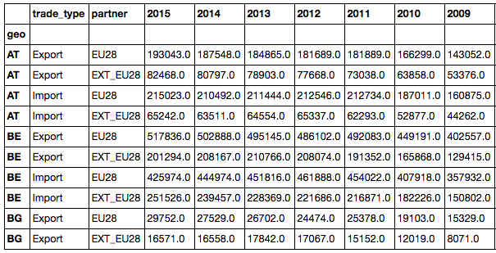
Seaborn : how attractive?

Slide 20
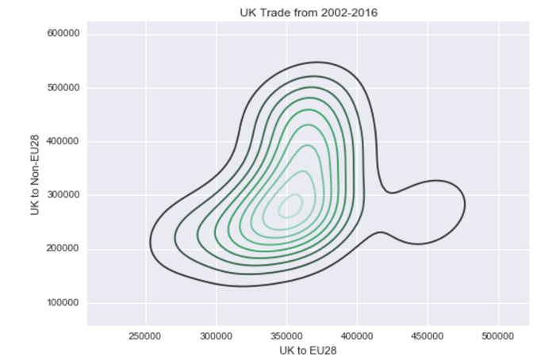
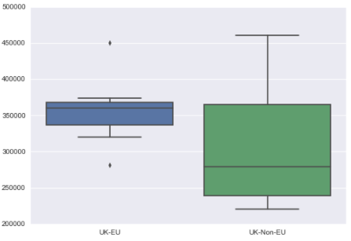
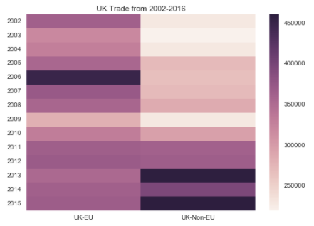
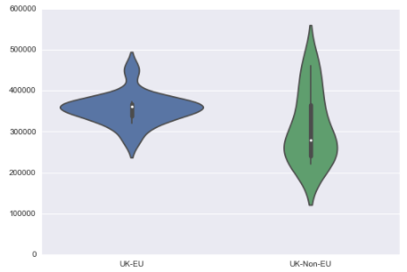
Seaborn : how attractive?

Slide 21
matplotlib_seaborn.ipynb

Slide 22
Agenda
Matplotlib
Seaborn
Bokeh
Tableau
Final Project

Slide 23
Bokeh: web interactive display
Creates interactive visualization for web presentation.
In the style of D3.js
High-performance interactivity over very large or streaming datasets
Quick creation of plots, dashboards, data apps

Slide 24
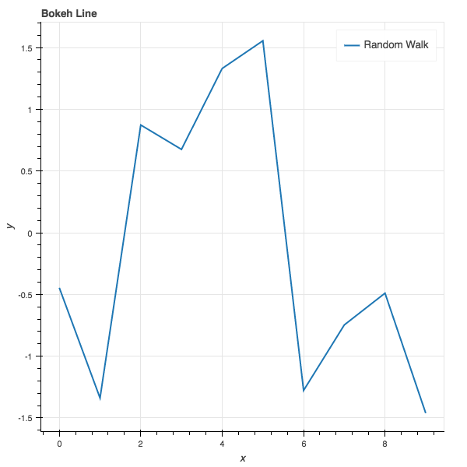
Anatomy of a Simple Bokeh App

Slide 25
Anatomy of a Simple Bokeh App
import numpy as np
from bokeh.plotting import figure, output_file, show
a = np.arange(10)
b = np.random.randn(10)
output_file("lines.html")
p = figure(title="Bokeh Line", x_axis_label='x', y_axis_label='y')
p.line(a, b, legend="Random Walk", line_width=2)
show(p)

Slide 26
Import the libraries
import numpy as np
from bokeh.plotting import figure, output_file, show
a = np.arange(10)
b = np.random.randn(10)
output_file("lines.html")
p = figure(title="Bokeh Line", x_axis_label='x', y_axis_label='y')
p.line(a, b, legend="Random Walk", line_width=2)
show(p)

Slide 27
Define the x and y ranges
import numpy as np
from bokeh.plotting import figure, output_file, show
a = np.arange(10)
b = np.random.randn(10)
output_file("lines.html")
p = figure(title="Bokeh Line", x_axis_label='x', y_axis_label='y')
p.line(a, b, legend="Random Walk", line_width=2)
show(p)

Slide 28
Define name of the HTML file
import numpy as np
from bokeh.plotting import figure, output_file, show
a = np.arange(10)
b = np.random.randn(10)
output_file("lines.html")
p = figure(title="Bokeh Line", x_axis_label='x', y_axis_label='y')
p.line(a, b, legend="Random Walk", line_width=2)
show(p)

Slide 29
Create the actual figure
import numpy as np
from bokeh.plotting import figure, output_file, show
a = np.arange(10)
b = np.random.randn(10)
output_file("lines.html")
p = figure(title="Bokeh Line", x_axis_label='x', y_axis_label='y')
p.line(a, b, legend="Random Walk", line_width=2)
show(p)

Slide 30
Finally, show it!
import numpy as np
from bokeh.plotting import figure, output_file, show
a = np.arange(10)
b = np.random.randn(10)
output_file("lines.html")
p = figure(title="Bokeh Line", x_axis_label='x', y_axis_label='y')
p.line(a, b, legend="Random Walk", line_width=2)
show(p)

Slide 31
Anatomy of a Simple Bokeh App

Slide 32
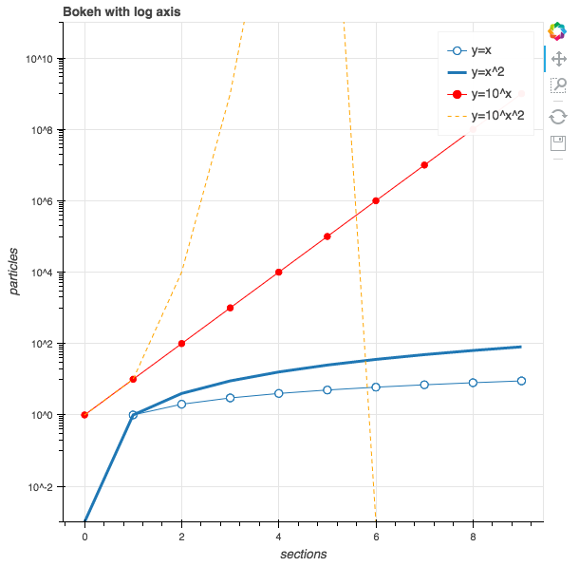
Anatomy of an Interactive Bokeh App

Slide 33
Anatomy of an Interactive Bokeh App
x = np.arange(10)
y0 = [i**2 for i in x]
y1 = [10**i for i in x]
y2 = [10**(i**2) for i in x]
output_file("loglines.html")
p = figure(tools="pan,box_zoom,reset,save", y_axis_type="log",
y_range=[0.001, 10**11], title="Bokeh with log axis",
x_axis_label='sections', y_axis_label='particles')
p.line(x, x, legend="y=x")
p.circle(x, x, legend="y=x", fill_color="white", size=8)
p.line(x, y0, legend="y=x^2", line_width=3)
p.line(x, y1, legend="y=10^x", line_color="red")
p.circle(x, y1, legend="y=10^x",
fill_color="red", line_color="red", size=6)
p.line(x, y2, legend="y=10^x^2",
line_color="orange", line_dash="4 4")
show(p)

Slide 34
Define x-range
x = np.arange(10)
y0 = [i**2 for i in x]
y1 = [10**i for i in x]
y2 = [10**(i**2) for i in x]
output_file("loglines.html")
p = figure(tools="pan,box_zoom,reset,save", y_axis_type="log",
y_range=[0.001, 10**11], title="Bokeh with log axis",
x_axis_label='sections', y_axis_label='particles')
p.line(x, x, legend="y=x")
p.circle(x, x, legend="y=x", fill_color="white", size=8)
p.line(x, y0, legend="y=x^2", line_width=3)
p.line(x, y1, legend="y=10^x", line_color="red")
p.circle(x, y1, legend="y=10^x",
fill_color="red", line_color="red", size=6)
p.line(x, y2, legend="y=10^x^2",
line_color="orange", line_dash="4 4")
show(p)

Slide 35
Define 3 separate functions in terms of x
x = np.arange(10)
y0 = [i**2 for i in x]
y1 = [10**i for i in x]
y2 = [10**(i**2) for i in x]
output_file("loglines.html")
p = figure(tools="pan,box_zoom,reset,save", y_axis_type="log",
y_range=[0.001, 10**11], title="Bokeh with log axis",
x_axis_label='sections', y_axis_label='particles')
p.line(x, x, legend="y=x")
p.circle(x, x, legend="y=x", fill_color="white", size=8)
p.line(x, y0, legend="y=x^2", line_width=3)
p.line(x, y1, legend="y=10^x", line_color="red")
p.circle(x, y1, legend="y=10^x",
fill_color="red", line_color="red", size=6)
p.line(x, y2, legend="y=10^x^2",
line_color="orange", line_dash="4 4")
show(p)

Slide 36
Specify name of output HTML file
x = np.arange(10)
y0 = [i**2 for i in x]
y1 = [10**i for i in x]
y2 = [10**(i**2) for i in x]
output_file("loglines.html")
p = figure(tools="pan,box_zoom,reset,save", y_axis_type="log",
y_range=[0.001, 10**11], title="Bokeh with log axis",
x_axis_label='sections', y_axis_label='particles')
p.line(x, x, legend="y=x")
p.circle(x, x, legend="y=x", fill_color="white", size=8)
p.line(x, y0, legend="y=x^2", line_width=3)
p.line(x, y1, legend="y=10^x", line_color="red")
p.circle(x, y1, legend="y=10^x",
fill_color="red", line_color="red", size=6)
p.line(x, y2, legend="y=10^x^2",
line_color="orange", line_dash="4 4")
show(p)

Slide 37
Specify the exact set of “tools” on graph
x = np.arange(10)
y0 = [i**2 for i in x]
y1 = [10**i for i in x]
y2 = [10**(i**2) for i in x]
output_file("loglines.html")
p = figure(tools="pan,box_zoom,reset,save", y_axis_type="log",
y_range=[0.001, 10**11], title="Bokeh with log axis",
x_axis_label='sections', y_axis_label='particles')
p.line(x, x, legend="y=x")
p.circle(x, x, legend="y=x", fill_color="white", size=8)
p.line(x, y0, legend="y=x^2", line_width=3)
p.line(x, y1, legend="y=10^x", line_color="red")
p.circle(x, y1, legend="y=10^x",
fill_color="red", line_color="red", size=6)
p.line(x, y2, legend="y=10^x^2",
line_color="orange", line_dash="4 4")
show(p)

Slide 38
Actually creating the 3 separate graphs
x = np.arange(10)
y0 = [i**2 for i in x]
y1 = [10**i for i in x]
y2 = [10**(i**2) for i in x]
output_file("loglines.html")
p = figure(tools="pan,box_zoom,reset,save", y_axis_type="log",
y_range=[0.001, 10**11], title="Bokeh with log axis",
x_axis_label='sections', y_axis_label='particles')
p.line(x, x, legend="y=x")
p.circle(x, x, legend="y=x", fill_color="white", size=8)
p.line(x, y0, legend="y=x^2", line_width=3)
p.line(x, y1, legend="y=10^x", line_color="red")
p.circle(x, y1, legend="y=10^x",
fill_color="red", line_color="red", size=6)
p.line(x, y2, legend="y=10^x^2",
line_color="orange", line_dash="4 4")
show(p)

Slide 39
Finally, show it!
x = np.arange(10)
y0 = [i**2 for i in x]
y1 = [10**i for i in x]
y2 = [10**(i**2) for i in x]
output_file("loglines.html")
p = figure(tools="pan,box_zoom,reset,save", y_axis_type="log",
y_range=[0.001, 10**11], title="Bokeh with log axis",
x_axis_label='sections', y_axis_label='particles')
p.line(x, x, legend="y=x")
p.circle(x, x, legend="y=x", fill_color="white", size=8)
p.line(x, y0, legend="y=x^2", line_width=3)
p.line(x, y1, legend="y=10^x", line_color="red")
p.circle(x, y1, legend="y=10^x",
fill_color="red", line_color="red", size=6)
p.line(x, y2, legend="y=10^x^2",
line_color="orange", line_dash="4 4")
show(p)

Slide 40
Anatomy of an Interactive Bokeh App

Slide 41
Agenda
Matplotlib
Bokeh
Tableau
Final Project

Slide 42
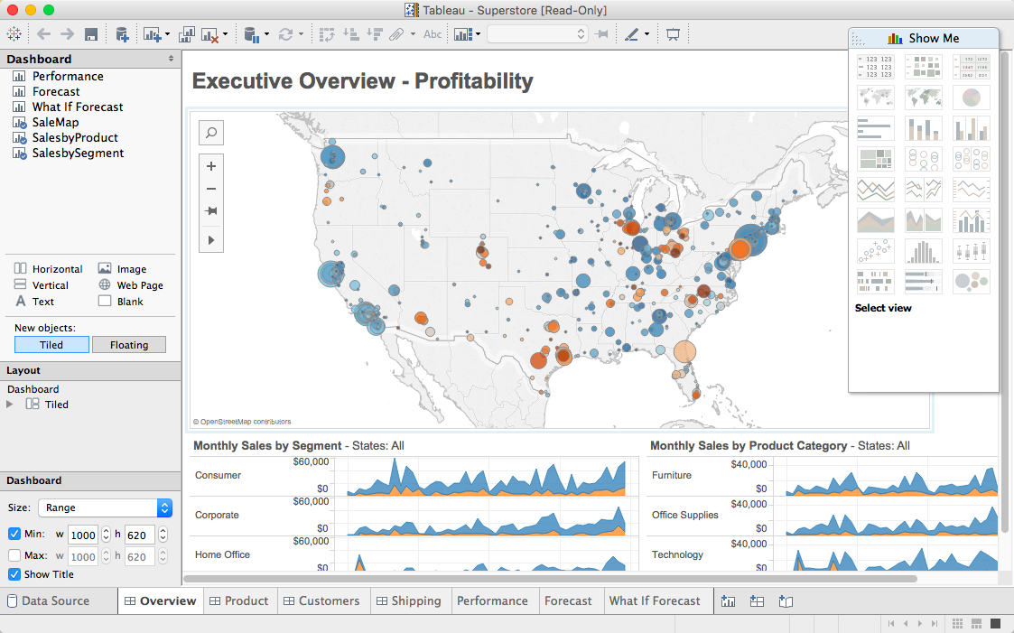

Slide 43

Data Ingestion
Joins: inner, left, right, full
Extract – Transform – Load (ETL)
Field Transformation
Live / Extract
Filtering
Large dataset & role of Tableau

Slide 44
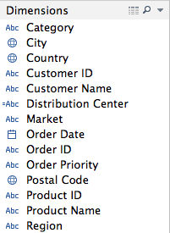
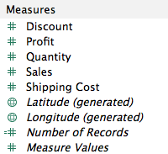
Dimensions & Measures
Dimensions : categorical
Measures : numerical

Slide 45
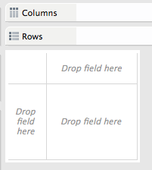
Rows & Columns

Slide 46
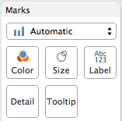
Marks

Slide 47
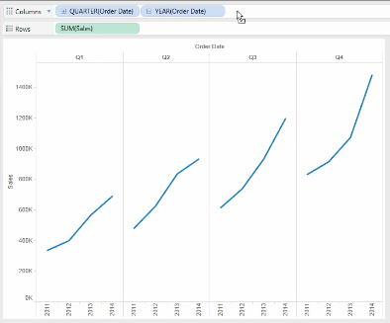
Multi-level Analysis

Slide 48
Group Exercise
Load the “office_supplies.xls” dataset into Tableau
Answer the following questions:

Slide 49
Agenda
Matplotlib
Bokeh
Tableau
Final Project

Slide 50
Your final project : guidelines
Goal: apply what you have learned in this class to a realistic data science challenge + exercise your creativity + have fun!
This is meant to be a significant individual effort to learn by practicing what you are learning to a real-world data science problem.
The writeup of your final project is in the form of a Jupyter notebook and associated data – to be uploaded to the final project assignment in Camino.
You are to submit your final notebook by September 3 @ 11:59pm.

Slide 51
Your final project : topic selection
Goal: apply what you have learned in this class to a realistic data science challenge + exercise your creativity + have fun!
You can choose any ”significant” data set via downloadable sites, APIs, or use any of the datasets from the class.
You need to propose an interesting data insight investigation that you would like to explore, analyze the data, visualize the data, and finally write up your conclusion on what insights you have reached.
Grading of your final project will be based on the following rubric.

Slide 52
Your final project : grading rubric
Area | Details | Grading %
Topic Selection | Did you create a reasonably interesting data insight hypothesis for your investigation? | 10%
Packaging | Did you create a Jupyter project packaging that looks professional and understandable? | 10%
Analysis Competence | Does your notebook show competence in using the data science tools we learned in class? | 40%
Insight | Does your project show useful or interesting insights from the data analysis you have done? | 40%

