Slide 1
Data Shaping & Visualization

Slide 2
Agenda
Midterm
Final Project
Data Shaping
Merge & joins
Concat
Clean
Tableau
Matplotlib

Slide 3
Midterm

Slide 4
Midterm – 2 parts
In-class (20 questions, 1 hour)
Take-home (1 dataset)
Will be in Camino by Sunday
Due date next Saturday

Slide 5
Agenda
Midterm
Final Project
Data Shaping
Merge & joins
Concat
Clean
Tableau
Matplotlib

Slide 6
Your final project : guidelines
Goal: apply what you have learned in this class to a realistic data science challenge + exercise your creativity + have fun!
This is meant to be a significant individual effort to learn by practicing what you are learning to a real-world data science problem.
The writeup of your final project is in the form of a Jupyter notebook and associated data – to be uploaded to the final project assignment in Camino.
You are to submit your final notebook by September 3 @ 11:59pm.

Slide 7
Your final project : topic selection
Goal: apply what you have learned in this class to a realistic data science challenge + exercise your creativity + have fun!
You can choose any ”significant” data set via downloadable sites, APIs, or use any of the datasets from the class.
You need to propose an interesting data insight investigation that you would like to explore, analyze the data, visualize the data, and finally write up your conclusion on what insights you have reached.
Grading of your final project will be based on the following rubric.

Slide 8
Your final project : grading rubric
Area | Details | Grading %
Topic Selection | Did you create a reasonably interesting data insight hypothesis for your investigation? | 10%
Packaging | Did you create a Jupyter project packaging that looks professional and understandable? | 10%
Analysis Competence | Does your notebook show competence in using the data science tools we learned in class? | 40%
Insight | Does your project show useful or interesting insights from the data analysis you have done? | 40%

Slide 9
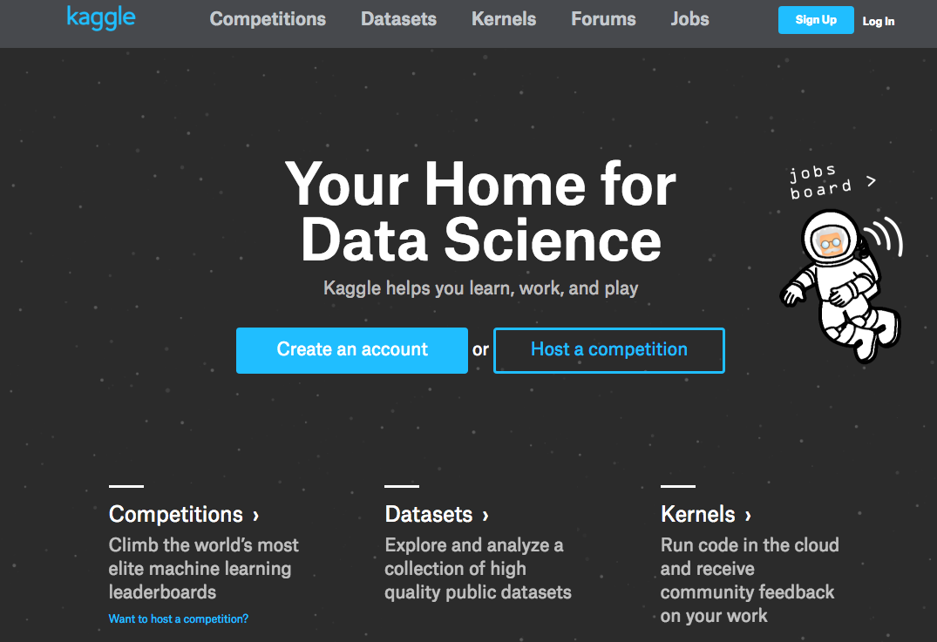
Final Project

Slide 10
Agenda
Midterm
Final Project
Data Shaping
Merge & joins
Concat
Clean
Tableau
Matplotlib

Slide 11
Joining Datasets
A
B

Slide 12
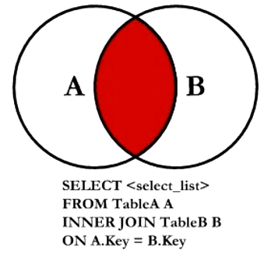
Joining Datasets : Inner Join

Slide 13
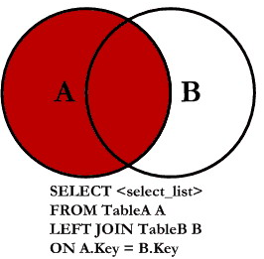
Joining Datasets : Left Outer Join

Slide 14
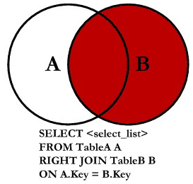
Joining Datasets : Right Outer Join

Slide 15
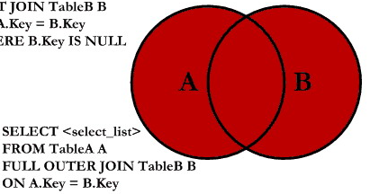
Joining Datasets : Full Outer Join
SELECT <select_list>
FROM TableA A
FULL OUTER JOIN TableB B
ON A.Key = B.Key

Slide 16
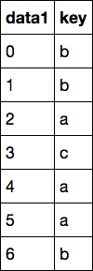
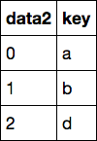
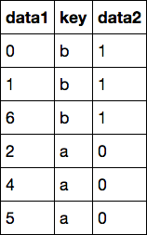
Merging (inner join)
merge
→

Slide 17
Merging (inner join)
inner join
→

Slide 18
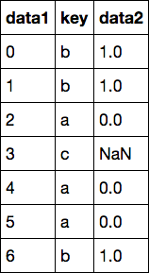
Merging (left outer join)
outer join
→

Slide 19
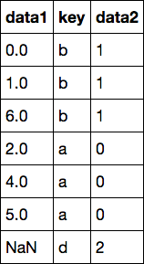
Merging (right outer join)
outer join
→

Slide 20
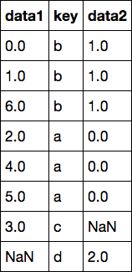
Merging (full outer join)
outer join
→

Slide 21
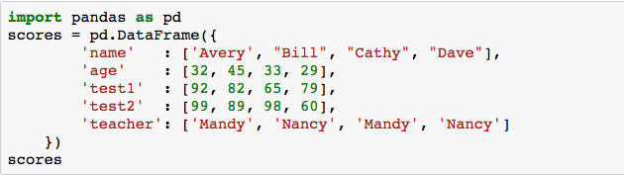
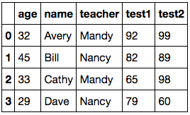
GroupBy : setup

Slide 22
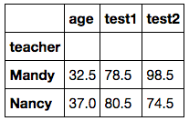
GroupBy : by teacher

Slide 23
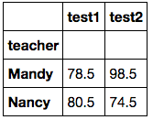
GroupBy : by teacher

Slide 24
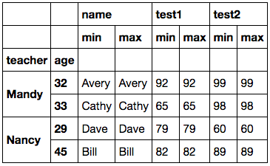
GroupBy : specific aggregations

Slide 25
Stacking & Unstacking
stack: this “rotates” or pivots from the columns in the data to the rows
unstack: this pivots from the rows into the columns

Slide 26
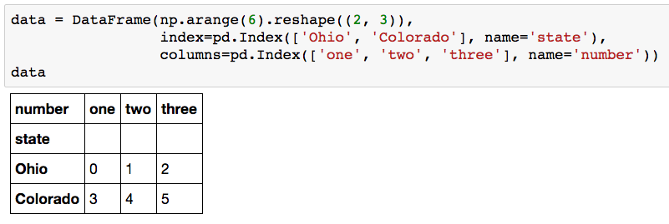
Stacking

Slide 27
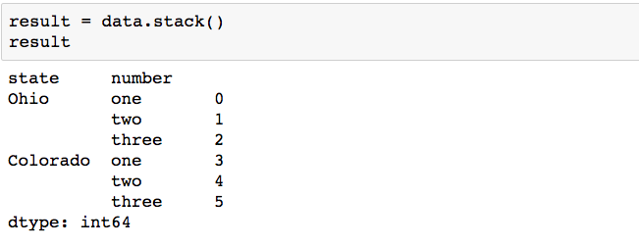
Stacking

Slide 28
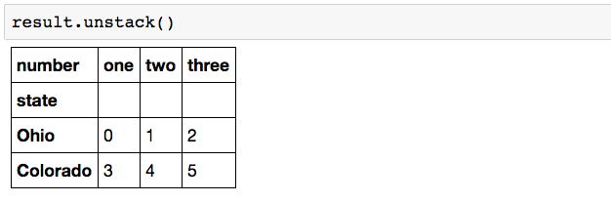
Stacking

Slide 29
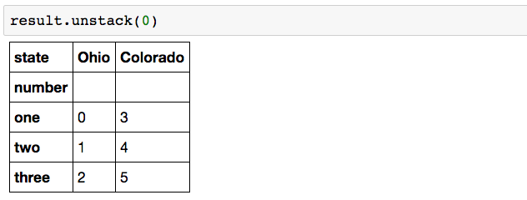
Stacking

Slide 30
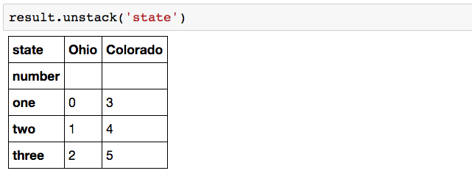
Stacking

Slide 31
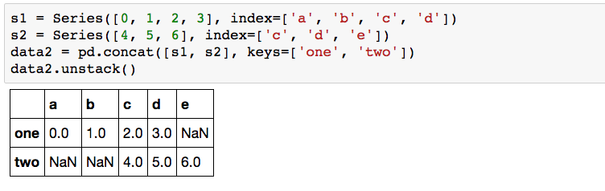
Stacking : may introduce Missing Values

Slide 32
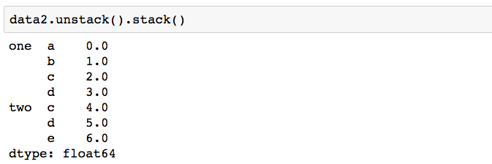
Stacking : may introduce Missing Values

Slide 33
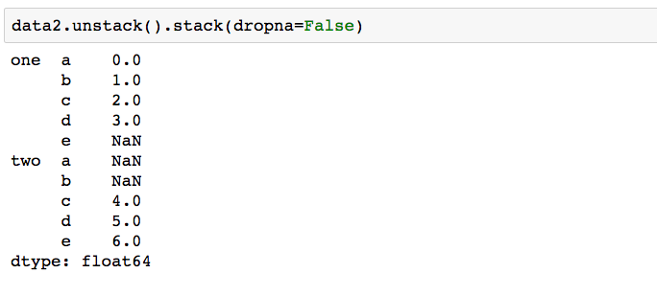
Stacking : may introduce Missing Values

Slide 34
Open notebook: “lecture05.data.shaping”

Slide 35
Agenda
Midterm
Final Project
Data Shaping
Merge & joins
Concat
Clean
Tableau
Matplotlib

Slide 36
Tableau

Slide 37
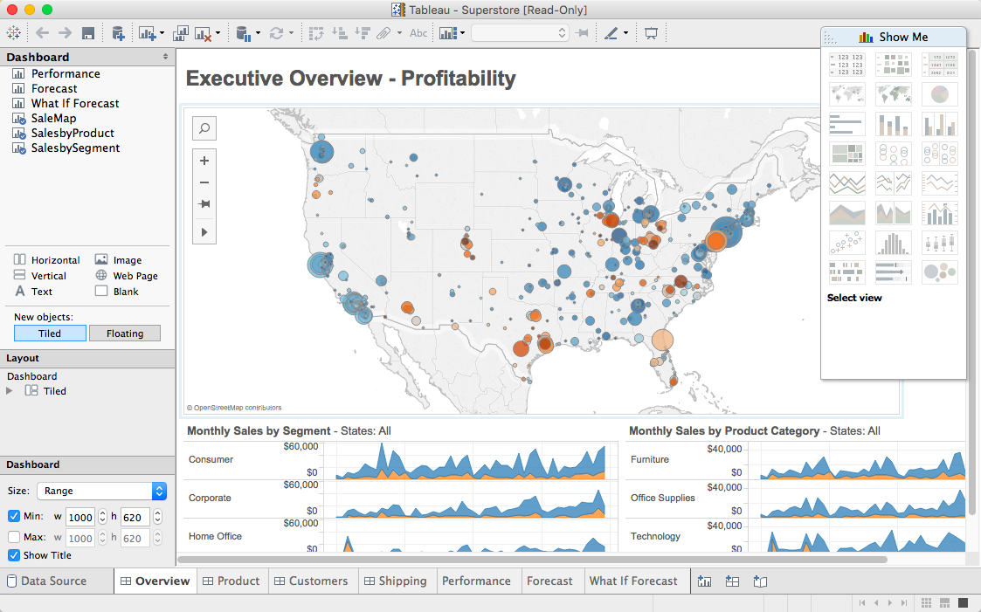

Slide 38
Student Tableau License
http://tableau.com/students

Slide 39

Data Ingestion
Joins: inner, left, right, full
Extract – Transform – Load (ETL)
Field Transformation
Live / Extract
Filtering
Large dataset & role of Tableau

Slide 40
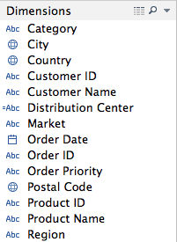
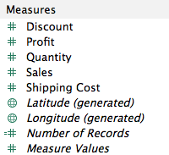
Dimensions & Measures
Dimensions : categorical
Measures : numerical

Slide 41
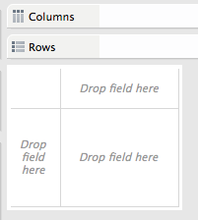
Rows & Columns

Slide 42
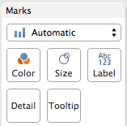
Marks

Slide 43
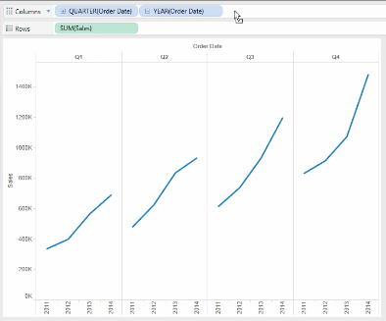
Multi-level Analysis

Slide 44
Group Exercise
Load the “global_superstore.xls” dataset into Tableau
Answer the following questions:
Which region has the highest sales?
For (1), which product segment for that region has the highest sales?
Regardless of region, which product segment in a given region has the highest sales?
Take 15 min in your group to decide on extracting an interesting insight from this dataset to present to the class.

Slide 45
Agenda
Midterm
Final Project
Data Shaping
Merge & joins
Concat
Clean
Tableau
Matplotlib

Slide 46
Matplotlib

Slide 47
Matplotlib
Matplotlib is a python 2D plotting library which produces publication quality figures in a variety of hardcopy formats and interactive environments across platforms.
Matplotlib is the whole package; pylab is a module in matplotlib that gets installed alongside matplotlib; and matplotlib.pyplot is a module in matplotlib
Pyplot provides the state-machine interface to the underlying plotting library in matplotlib.

Slide 48
Subplot
Subplot divides the current figure into rectangular panes that are numbered row wise.
Each pane contains an axes object. Subsequent plots are output to the current pane.

Slide 49
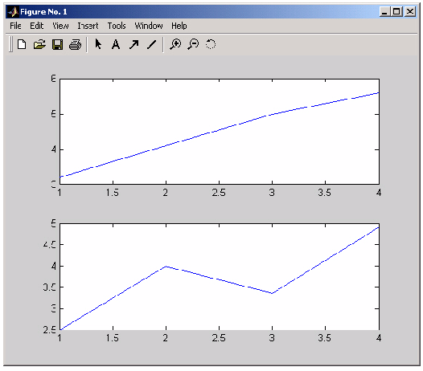
Subplot grid 2X1

Slide 50
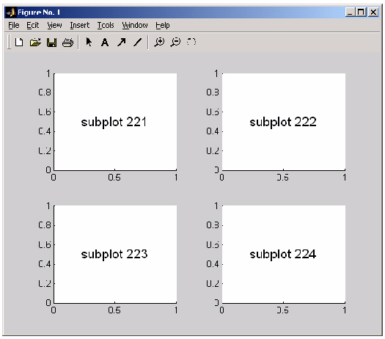
Subplot grid 2x2

Slide 51
Matplotlib Gallery
http://matplotlib.org/examples/index.html

