Slide 1
Machine Learning 2

Slide 2
Topics for Today
Binary Classification
Logistic Regression
Support Vector Machine (SVM)
Clustering
K-Means
Spectral Clustering

Slide 3
Topics for Today
Binary Classification
Logistic Regression
Support Vector Machine (SVM)
Clustering
K-Means
Spectral Clustering

Slide 4
Logistic Regression

Slide 5
An Introduction
Logistic regression is a method for analyzing relative probabilities between discrete outcomes (binary or categorical dependent variables)
Binary outcome: standard logistic regression
ie. Dead (1) or NonDead (0)
Categorical outcome: multinomial logistic regression
ie. Zombie (1) or Vampire (2) or Mummy (3) or Rasputin (4)

Slide 6
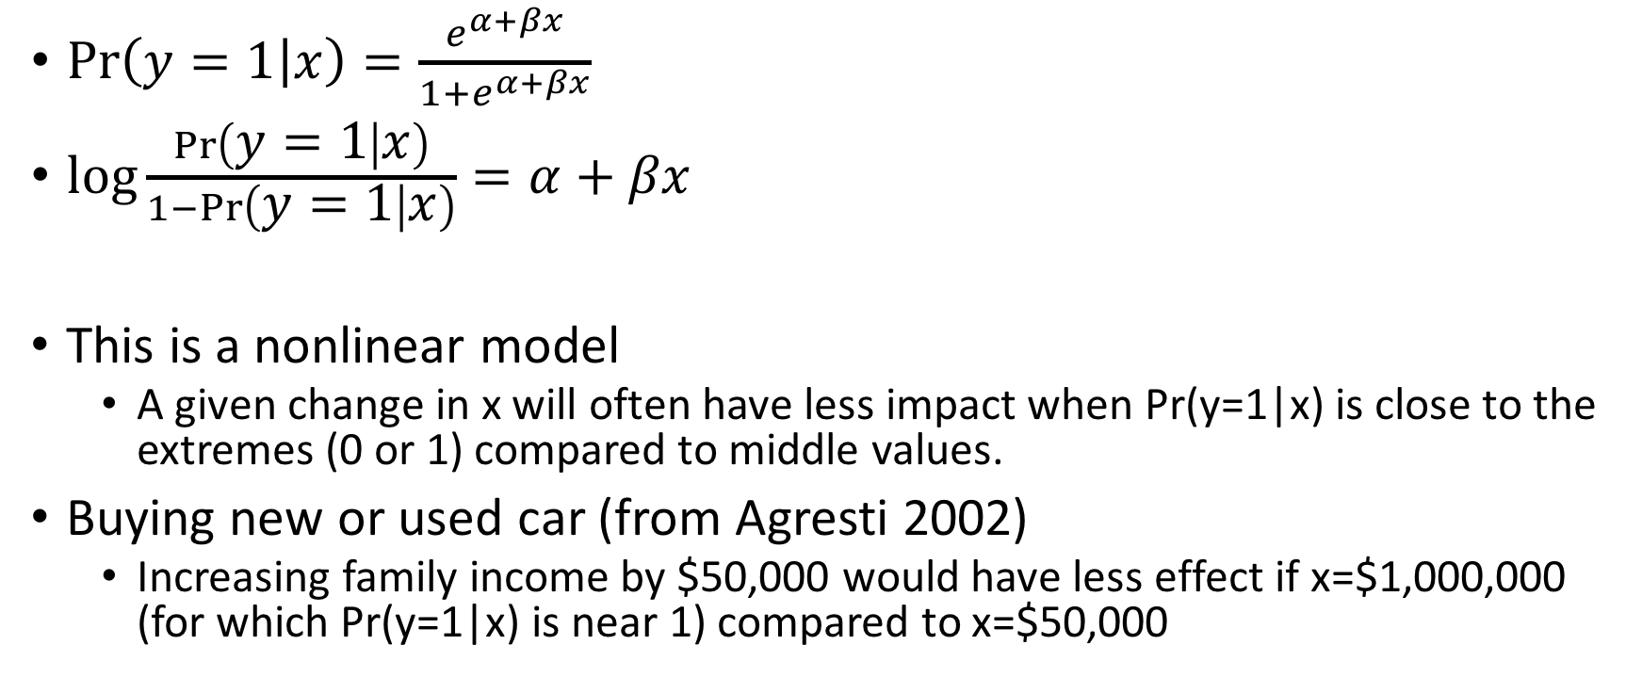
Logistic Regression Model
$\operatorname{Pr}\left(y=1 | x\right)=\frac{e^{α+βx}⁡}{1+e^{α+βx}⁡}$
$\log{\frac{\operatorname{Pr}\left(y=1 | x\right)}{1−\operatorname{Pr}\left(y=1 | x\right)}}=α+βx$
This is a nonlinear model
A given change in x will often have less impact when Pr(y=1|x) is close to the extremes (0 or 1) compared to middle values.
Buying new or used car (from Agresti 2002)
Increasing family income by $50,000 would have less effect if x=$1,000,000 (for which Pr(y=1|x) is near 1) compared to x=$50,000

Slide 7
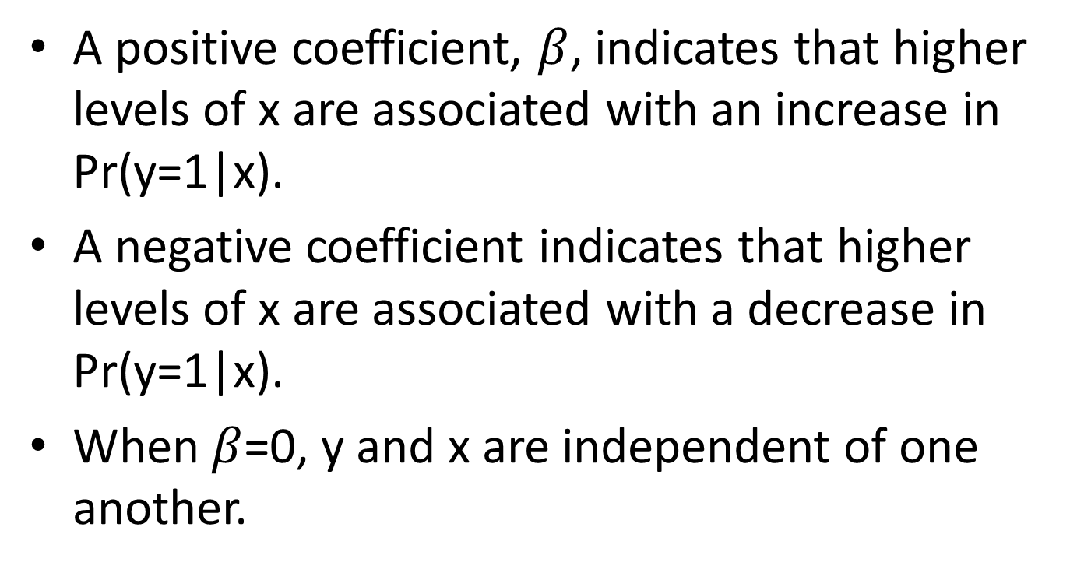
Interpreting Coefficients
A positive coefficient, $β$, indicates that higher levels of x are associated with an increase in Pr(y=1|x).
A negative coefficient indicates that higher levels of x are associated with a decrease in Pr(y=1|x).
When $β$=0, y and x are independent of one another.

Slide 8


How It All Works
The logistic equation is written as a function of z, where z is a measure of the total contribution of each variable x used to predict the outcome
Coefficients determined by maximum likelihood estimation (MLE), so larger sample sizes are needed than for OLS

Slide 9
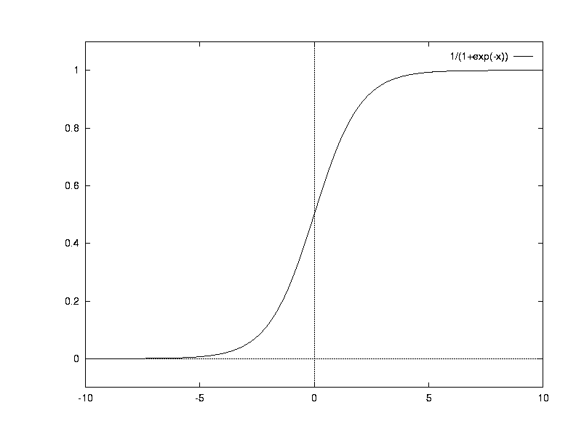
Graph of the Logistic Function

Slide 10
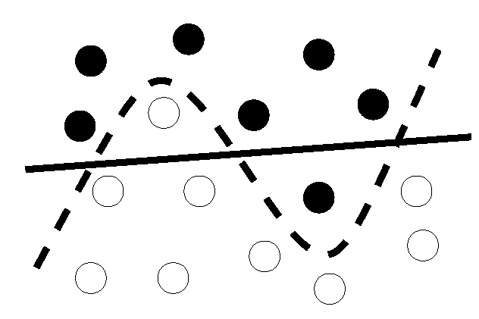
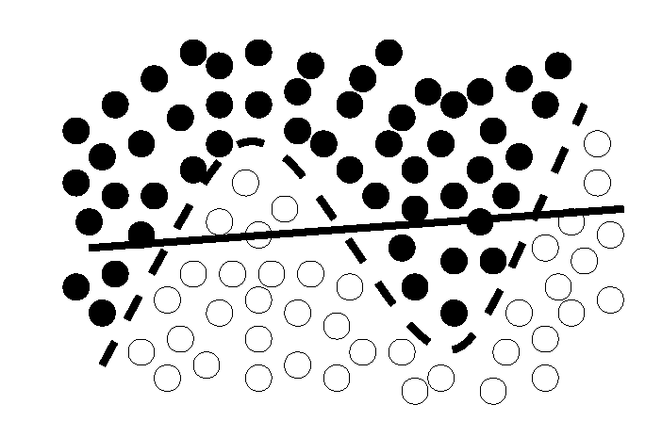
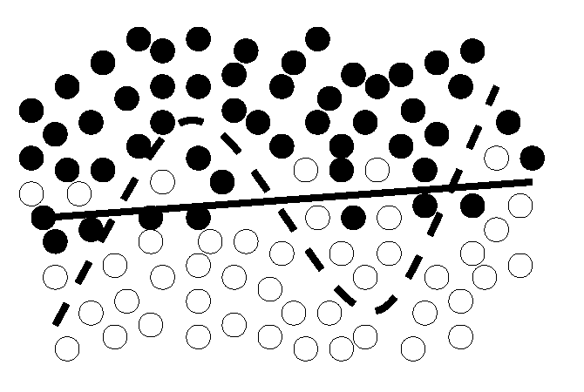
Balancing generalization and overfitting
which boundary?
go for simplicity or accuracy?
?
more training data makes the choice more obvious

Slide 11
logistic-regression.ipynb

Slide 12
Topics for Today
Binary Classification
Logistic Regression
Support Vector Machine (SVM)
Clustering
K-Means
Spectral Clustering

Slide 13
Support Vector Machine (SVM)
Maximal Margin Classification

Slide 14
Linear classifiers
Find linear function (hyperplane) to separate positive and negative examples
Which hyperplane is best?

Slide 15
Support vector machines (SVM)
Find hyperplane that maximizes the margin between the positive and negative examples
C. Burges, A Tutorial on Support Vector Machines for Pattern Recognition, Data Mining and Knowledge Discovery, 1998

Slide 16
Support vector machines (SVM)
Find hyperplane that maximizes the margin between the positive and negative examples
For support vectors,
Distance between point and hyperplane:
Therefore, the margin is 2 / ||w||
Support vectors
Margin
C. Burges, A Tutorial on Support Vector Machines for Pattern Recognition, Data Mining and Knowledge Discovery, 1998

Slide 17
svm.ipynb

Slide 18
Topics for Today
Binary Classification
Logistic Regression
Support Vector Machine (SVM)
Clustering
K-Means
Spectral Clustering

Slide 19
Clustering

Slide 20
Introducing Clustering
Clustering is an important data mining task.
Clustering makes it possible to “almost automatically” summarize large amounts of high-dimensional data.
Clustering (aka segmentation) is applied in many domains: retail, web, image analysis, bioinformatics, psychology, brain science, medical diagnosis etc.

Slide 21
Clustering : Key Idea
Given: (i) a data set D and (ii) similarity function s
Goal: break up D into groups such that items which are similar to each other end in the same group AND items which are dis-similar to each other end up in different groups.
Example: customers with similar buying patterns end up in the same cluster.
People with similar “biological signals” end in the same cluster.
Regions with similar “weather” patterns.

Slide 22
Clustering Example: Iris Data
Iris data set is a “very small” data set consisting of attributes of 3 flower types.
Flower types: Iris_setosa; Iris_versicolor; Iris-virginica
4 attributes: sepal-length; sepal-width; petal-length; petal-width
Thus each flower is “data vector” in a four-dimensional space. The “fifth” dimension is a label.
Example: [5.1,3.5,1.4,0.2,iris-setosa]
It is hard to visualize in four-dimensions!

Slide 23
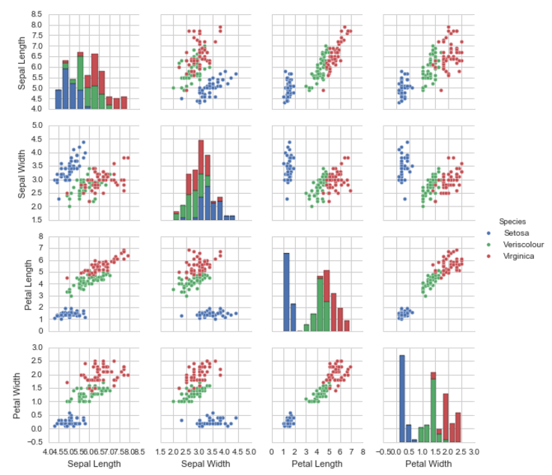
Which is the “best” pair of attributes to distinguish the three flower types ?

Slide 24
Attributes and Features
In almost all cases the labels are not given but we can acquire attributes and construct new features.
Notice the terminology: attributes, features, variables, dimensions – they are often used interchangeably.
I prefer to distinguish between attributes and features.
We acquire attributes and construct features. Thus there are finitely many attributes but infinitely many possible features.
For example, Iris data set had four attributes. Lets construct a new feature: sepal-length/sepal-width.

Slide 25
Similarity and Distance Functions
We have already seen the cosine similarity function.
sim(x,y) = (x.y)/||x||||y||
We can also define a “distance” function which in some sense is like an “opposite” of similarity.
Entities which are highly similar to each other have a small distance between them; while items which are less similar have a large distance between them.
Example: dist(x,y) = 1 – sim(x,y)
“identical” objects: sim(x,y) = 1 → dist(x,y) = 0
sim(x,y) = 0 → dist(x,y) = 1

Slide 26
Euclidean Distance
Take two data vectors d1 and d2
D1 = (x1,x2,…,xn)
D2 = (y1,y2,…yn)
Then Euclidean Distance between D1 and D2 is

Slide 27
Euclidean Distance: Examples
D1=(1,1,1); D2=(1,1,1)
dist(D1,D2) = 0
D1=(1,2,1); D2= (2,1,1)

Slide 28
Simple Clustering: One-dimensional/one-centroid
1
2
6
3
Three data points: 1,2 and 6
Want to summarize with one point
The average of (1,2,6) = 9/3 = 3
3 is called the centroid

Slide 29
K-means algorithm
Let C = initial k cluster centroids
Mark C as unstable
While <C is unstable>
Assign all data points to their nearest centroid in C.
Compute the centroids of the points assigned to each element of C.
Update C as the set of new centroids.
Mark C as stable or unstable by comparing with previous set of centroids.
End While
Where : n:num of points; k: num of clusters; d: dimension; I: num of iterations
Complexity is linear in n.

Slide 30
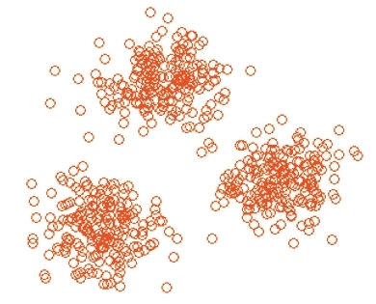
When does K-means work?
K-means works perfectly when clusters are “linearly separable”
Clusters are compact and well separated

Slide 31
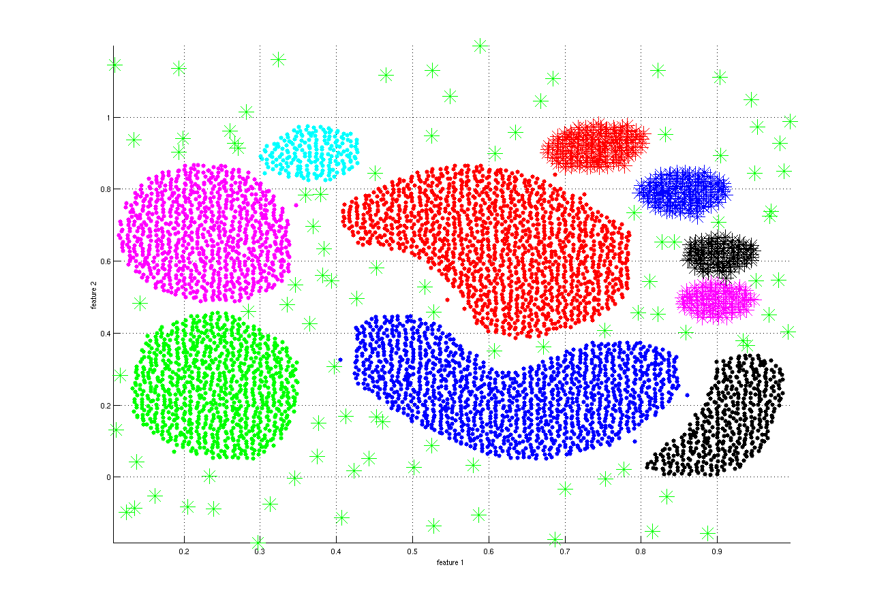
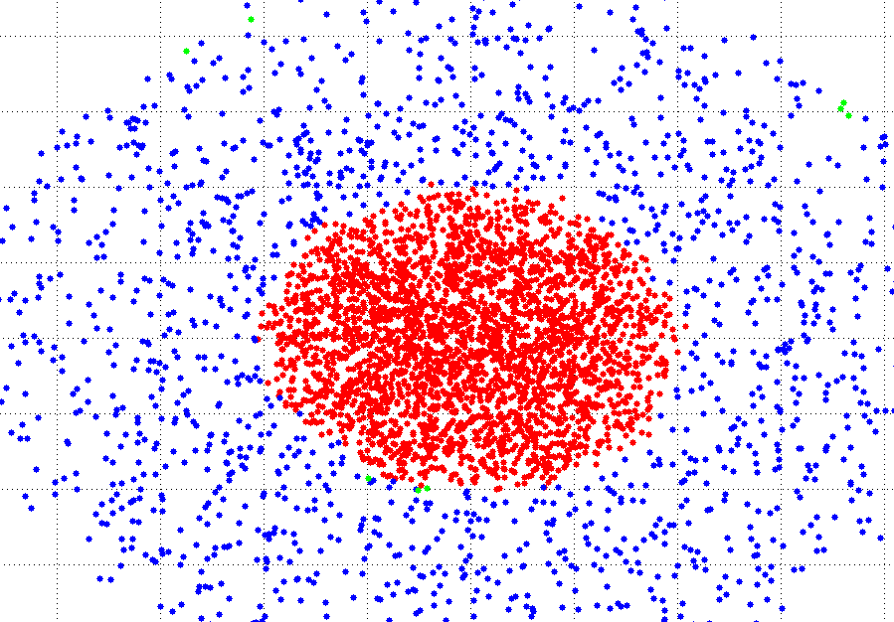
When does K-means not work?
When clusters are “not-linearly separable”
Data contains arbitrarily shaped clusters of different densities

Slide 32
More Advanced Clustering
Kernel K-means
K-means applied in Kernel space
Spectral clustering
Eigen subspace of the affinity matrix (Kernel matrix)

Slide 33
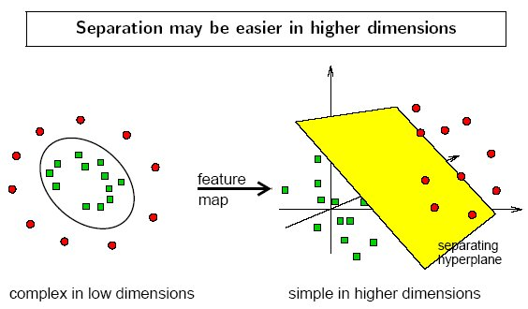
The Kernel Trick Revisited

Slide 34
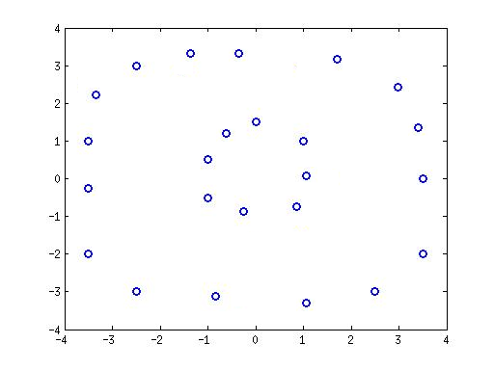
Example
Data with circular clusters
k-means

Slide 35
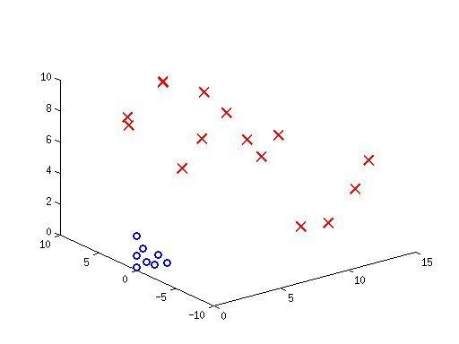
Example
Kernel k-means

Slide 36
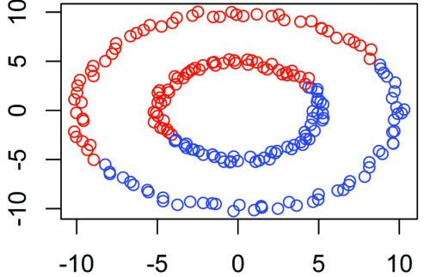
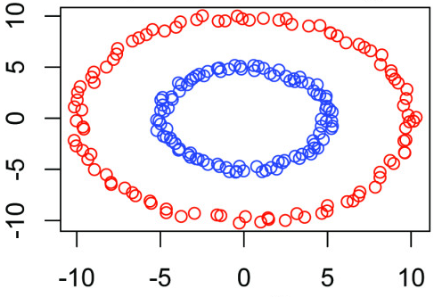
k-means Vs. Kernel k-means
k-means
Kernel k-means

Slide 37
kmeans.ipynb

Slide 38
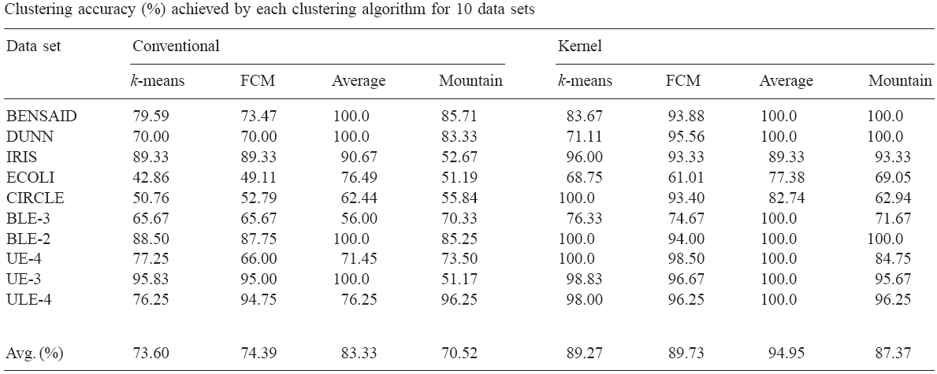
Performance of Kernel K-means
Evaluation of the performance of clustering algorithms in kernel-induced feature space, Pattern Recognition, 2005

Slide 39
Limitations of Kernel K-means
More complex than k-means
Need to compute and store n x n kernel matrix
What is the largest n that can be handled?
Intel Xeon E7-8837 Processor (Q2’11), Oct-core, 2.8GHz, 4TB max memory
< 1 million points with “single” precision numbers
May take several days to compute the kernel matrix alone
Use distributed and approximate versions of kernel k-means to handle large datasets
Notes:
Questions?

Slide 40
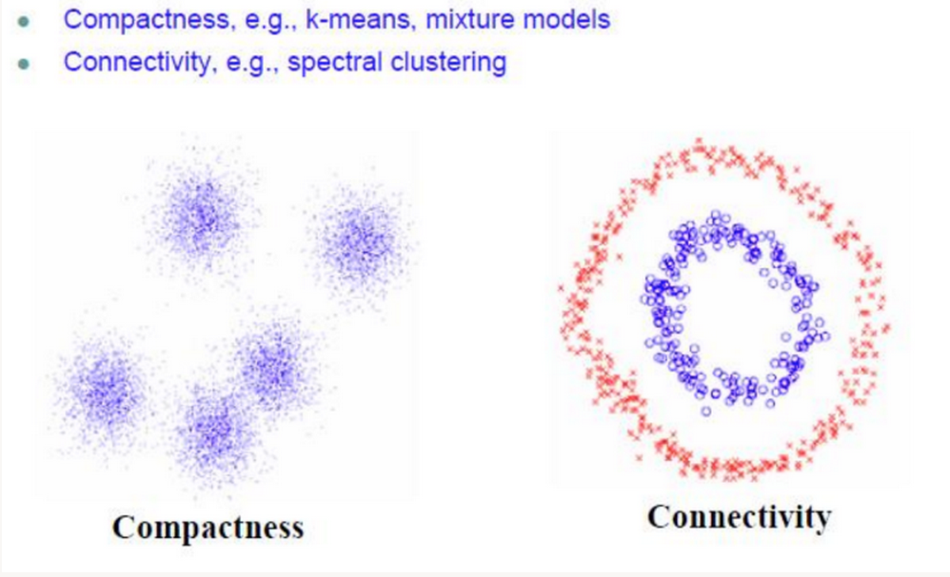
Motivation
http://charlesmartin14.wordpress.com/2012/10/09/spectral-clustering/

Slide 41
Spectral Clustering & K-means
Spectral Clustering
K-means Clustering
Ng et al., NIPS 2001

Slide 42
Spectral Clustering
data
Solve the eigenvalue problem:
Lv=λv
Create an Affinity Matrix A
Construct the Graph Laplacian, L, of A
Construct a projection matrix P using these k eigenvectors
Pick k eigenvectors that correspond to smallest k eigenvalues
Project the data:
P^{T}LP
Perform clustering (e.g., k-means) in the new space

Slide 43

Affinity (Similarity matrix)
Some examples
The ε-neighborhood graph: Connect all points whose pairwise distances are smaller than ε
K-nearest neighbor graph: connect vertex v_{m} to v_{n} if v_{m} is one of the k-nearest neighbors of v_{n.}
The fully connected graph: Connect all points with each other with positive (and symmetric) similarity score, e.g., Gaussian similarity function:
http://charlesmartin14.files.wordpress.com/2012/10/mat1.png

Slide 44
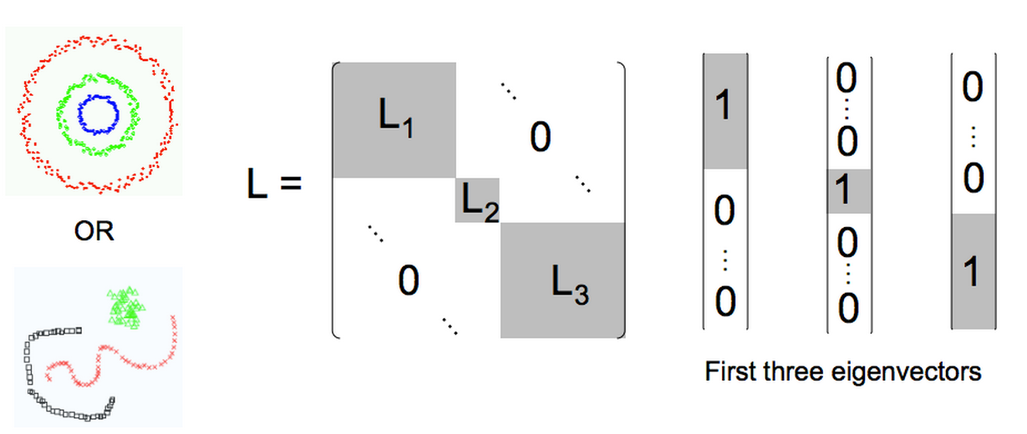
Laplacian Matrix
For good clustering, we expect to have block diagonal Laplacian matrix
http://charlesmartin14.wordpress.com/2012/10/09/spectral-clustering/

Slide 45
Laplacian Matrix
Given a graph G with n vertices, its n x n Laplacian matrix L is defined as:
L = D - A
L is the difference of the degree matrix D and the adjacency matrix A of the graph
Spectral graph theory studies the properties of graphs via the eigenvalues and eigenvectors of their associated graph matrices: adjacency matrix and the graph Laplacian and its variants
The most important application of the Laplacian is spectral clustering that corresponds to a computationally tractable solution to the graph partitioning problem

Slide 46
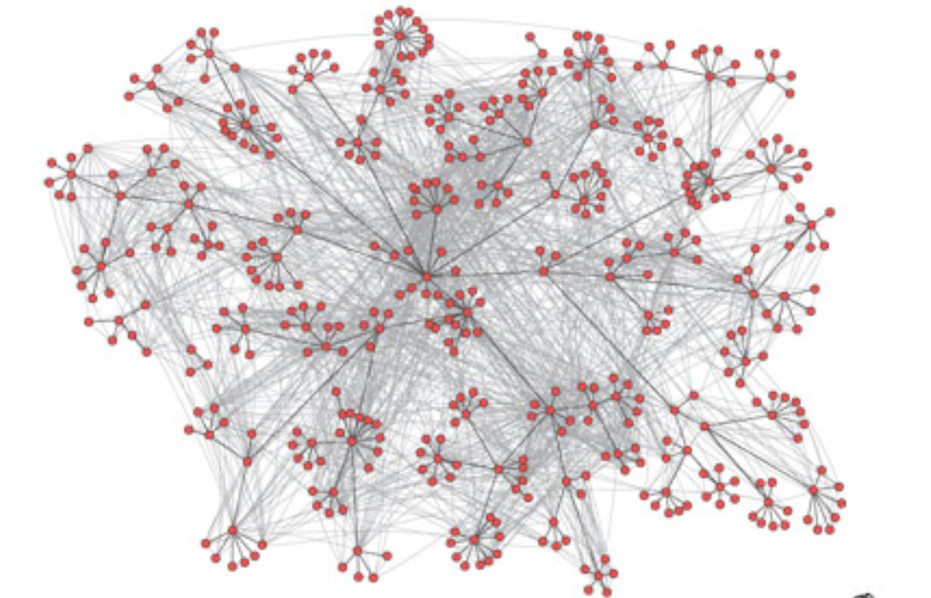
Application: social Networks
Corporate email communication (Adamic and Adar, 2005)
Hein & Luxburg

Slide 47
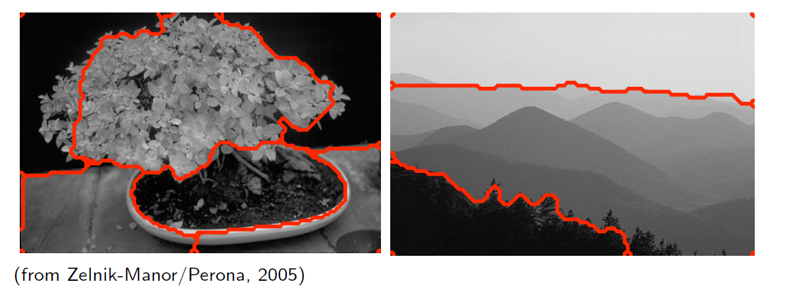
Application: Image Segmentation
Hein & Luxburg

