Slide 1
Machine Learning 1
Regression & Classification

Slide 2
Prelude
Due to popular demand, we are redirecting the last 2 lectures of this course from Big Data Analytics & Spark to Machine Learning.
Your final project is due on Dec 3rd, with optional presentation in class to show off what you have done for your project to the whole class. This is your chance to learn the real-skill of communicating insights to others.

Slide 3
Agenda
Missing Values
Introduction to Machine Learning
Scikit-Learn
Regression
Classification

Slide 4
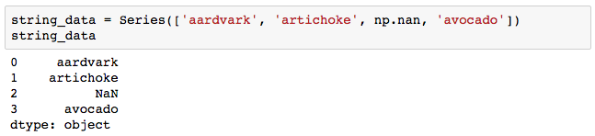
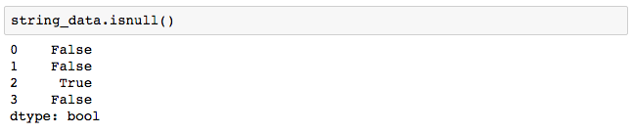
Missing Values: NaN

Slide 5
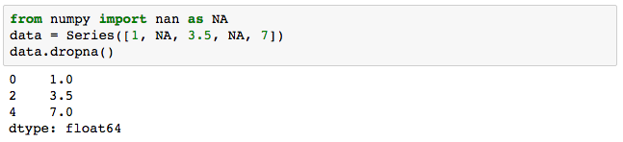
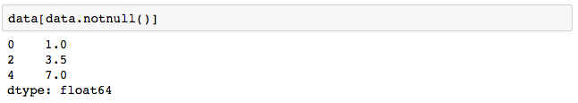
Strategy 1: filtering out missing values

Slide 6
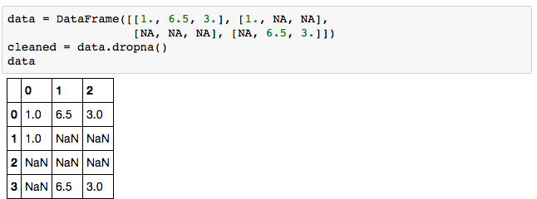
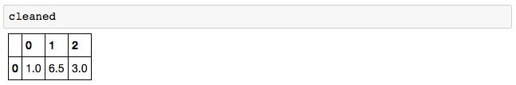
Strategy 1: filtering out missing values

Slide 7
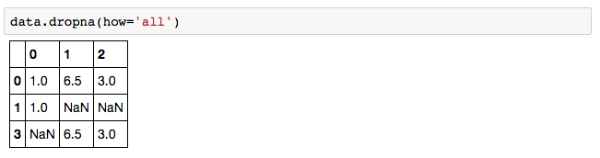
Strategy 2: filtering out some missing values

Slide 8
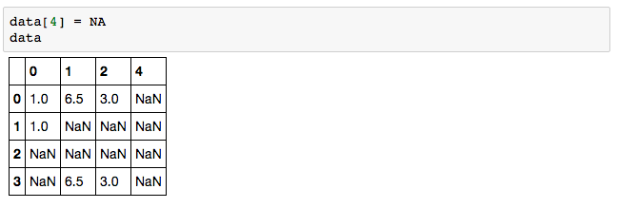
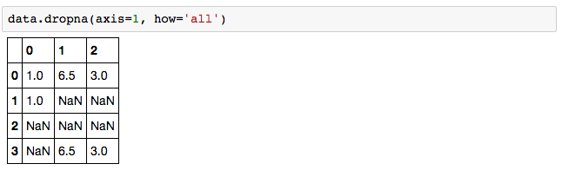
Strategy 2: filtering out some missing values

Slide 9
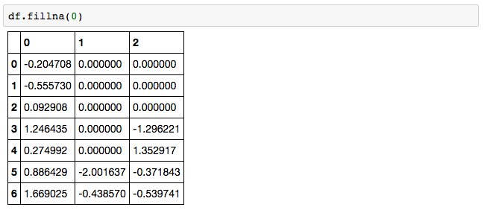
Strategy 3.1: filling in missing values

Slide 10
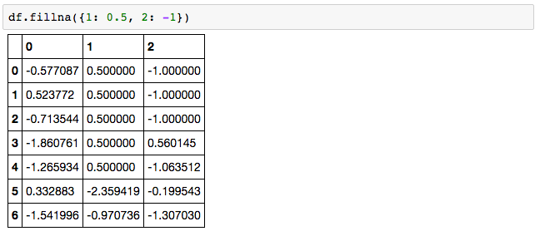
Strategy 3.2: filling in missing values

Slide 11
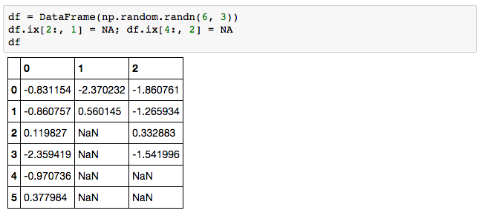
Strategy 3.3 forward filling missing values

Slide 12
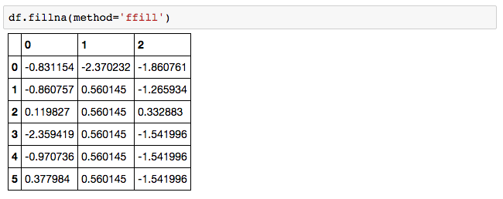
Strategy 3.3 forward filling missing values

Slide 13
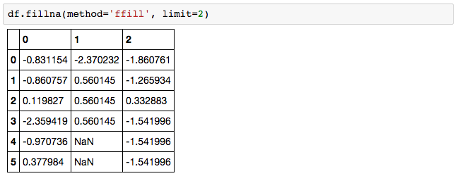
Strategy 3.3 forward filling missing values

Slide 14
Agenda
Missing Values
Introduction to Machine Learning
Scikit-Learn
Regression
Classification

Slide 15
Machine learning
T = tasks to be performed
E = experience (usually in the form of history datasets)
P = performance for an algorithm for T using E

Slide 16
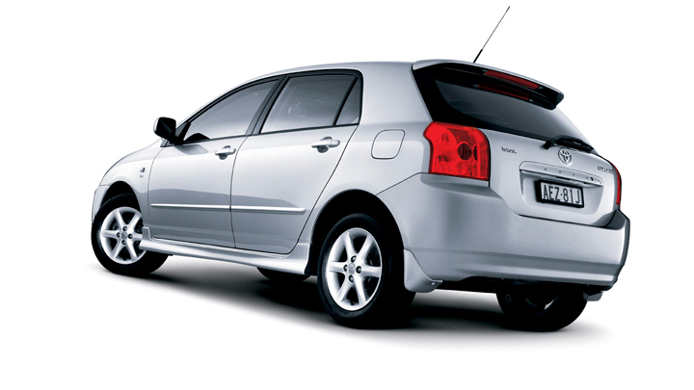
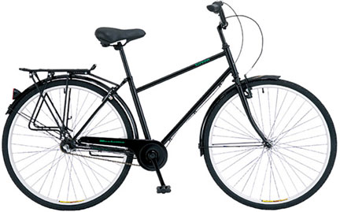

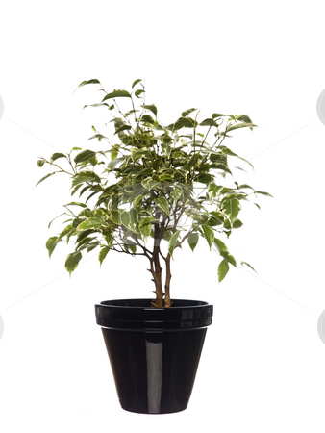

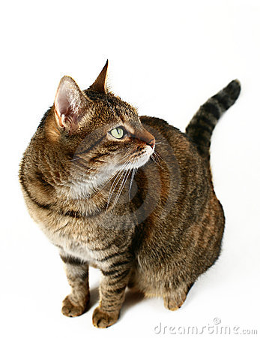

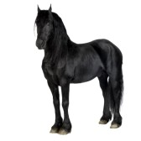
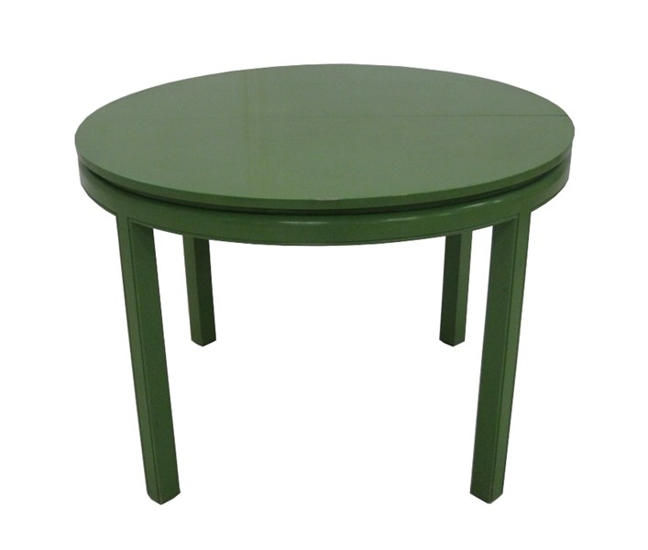

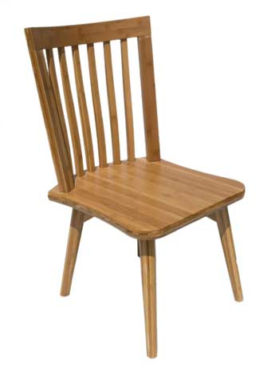
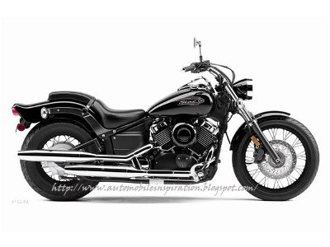
Typical Paradigms of Recognition
Feature Computation
Model

Slide 17
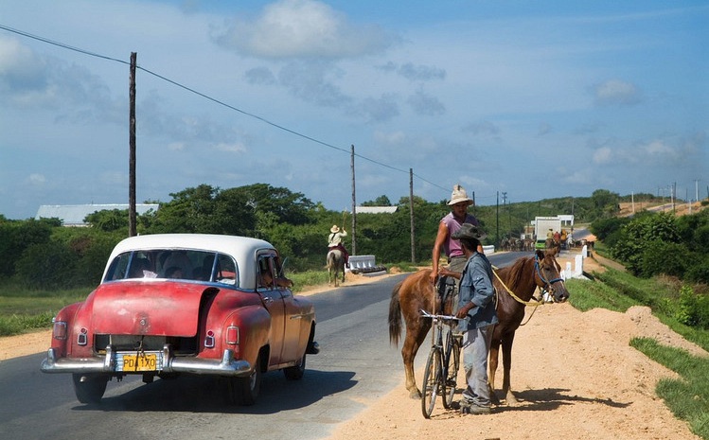
Visual Recognition
Identification
Classification
Is this your car?

Slide 18
Visual Recognition
Verification
Classification
Is this a car?

Slide 19
Visual Recognition
Classification:
Is there a car in this picture?
Classification

Slide 20
Visual Recognition
Detection:
Where is the car in this picture?
Classification
Structure Learning

Slide 21
Visual Recognition
Activity Recognition:
Classification
What is he doing?
What is he doing?

Slide 22
Visual Recognition
Pose Estimation:
Regression
Structure Learning

Slide 23
Visual Recognition
Object Categorization:
Structure Learning
Sky
Person
Tree
Horse
Car
Person
Bicycle
Road

Slide 24
Visual Recognition
Segmentation
Classification
Sky
Structure Learning
Tree
Car
Person

Slide 25
Types of ML approaches
Regression
Linear regression
Structured output regression
Classification
Generative vs. Discriminative
Supervised, unsupervised, semi-supervised, weakly supervised
Linear, nonlinear
Ensemble methods
Probabilistic
Structure Learning
Graphical Models
Margin based approaches

Slide 26
Agenda
Missing Values
Introduction to Machine Learning
Scikit-Learn
Regression
Classification

Slide 27
Scikit-learn : ML in Python
scikit-learn is a Python module integrating classic machine learning algorithms in the tightly-knit world of scientific Python packages (numpy, scipy, matplotlib)
Tools for:
Regression
Classification
Clustering
Dimensionality Reduction
Model Selection

Slide 28
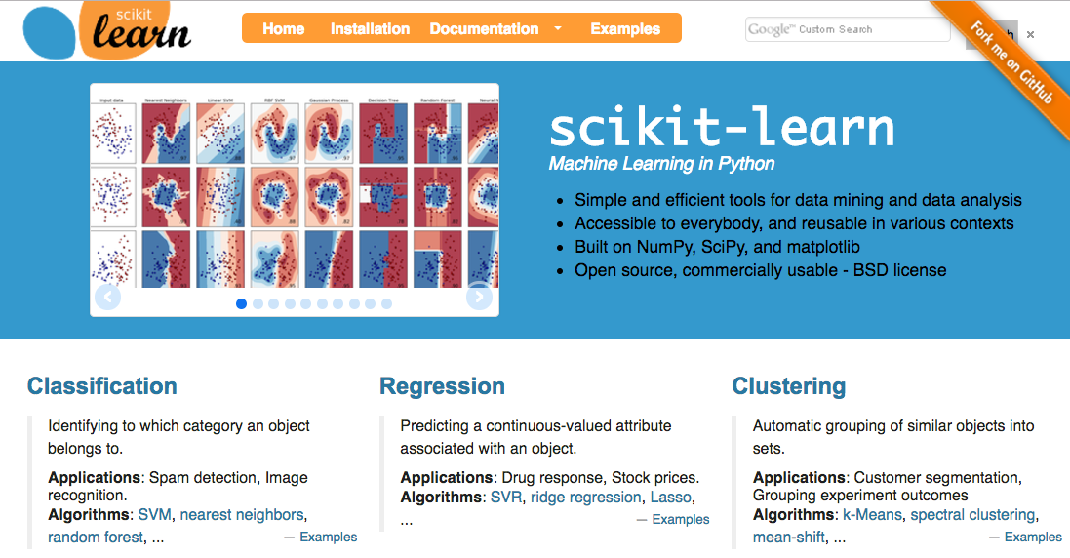
Scikit-learn : http://scikit-learn.org/

Slide 29
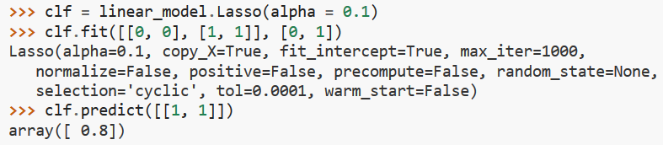
Fit and predict
All models (Classification and regression) implement at least two functions:
fit(x, y) - Fit the model to the given dataset
predict(x) - Predict the y values associated with the x values

Slide 30
Agenda
Missing Values
Introduction to Machine Learning
Scikit-Learn
Regression
Classification

Slide 31
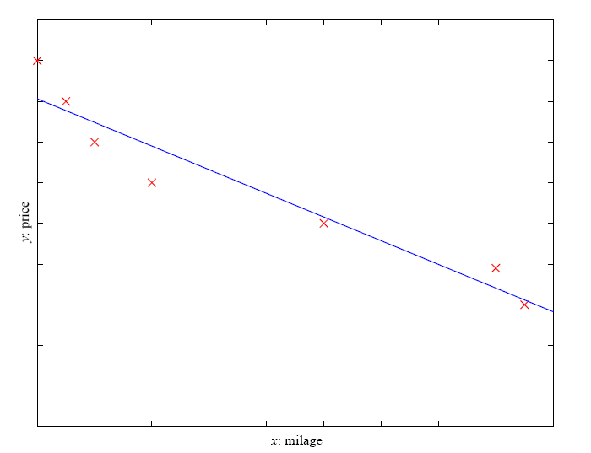
Regression: fitting ”lines”
Example: Price of a used car
x : car attributes
y : price
y = g (x | θ )
g ( ) model,
θ parameters
y = wx+w₀

Slide 32
Supervised Learning: Regression
Regression: tries to fit a mathematical function that describes the learning data set E to minimize some error function
Example: House price prediction
E = house prices (“targets”) with characteristics on # rooms, location, sq footage, etc.
T = predict the house sale price
P = how well the estimator can accurately predict the actual sale price

Slide 33
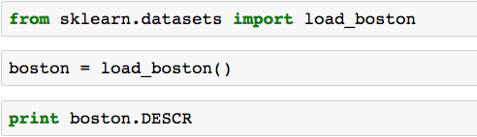
Linear Regression : House Price Prediction
UC Irvine House Dataset : Boston House Prices for 506 homes
http://archive.ics.uci.edu/ml/datasets/Housing

Slide 34
Boston Housing Dataset: 13 Attributes
CRIM per capita crime rate by town
ZN proportion of residential land zoned for lots over 25,000 sq.ft.
INDUS proportion of non-retail business acres per town
CHAS Charles River dummy variable (= 1 if tract bounds river; 0 otherwise)
NOX nitric oxides concentration (parts per 10 million)
RM average number of rooms per dwelling
AGE proportion of owner-occupied units built prior to 1940
DIS weighted distances to five Boston employment centres
RAD index of accessibility to radial highways
TAX full-value property-tax rate per $10,000
PTRATIO pupil-teacher ratio by town
Bk 1000(Bk - 0.63)^2 where Bk is the proportion of blacks by town
LSTAT % lower status of the population
MEDV Median value of owner-occupied homes in $1000's
“boston.target”

Slide 35

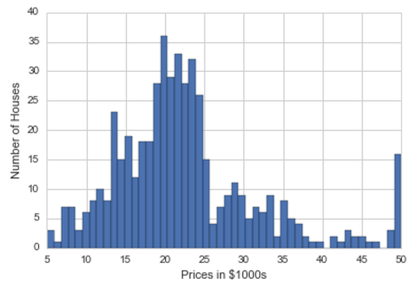
Visualizing Boston House Prices

Slide 36
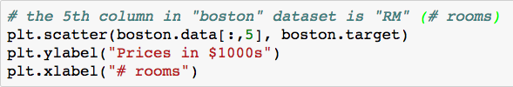
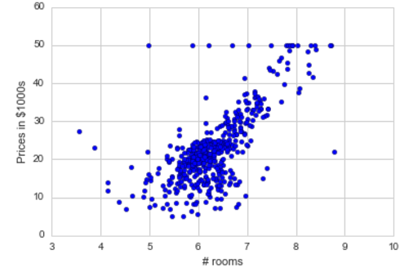
Visualizing Influence of # Rooms

Slide 37
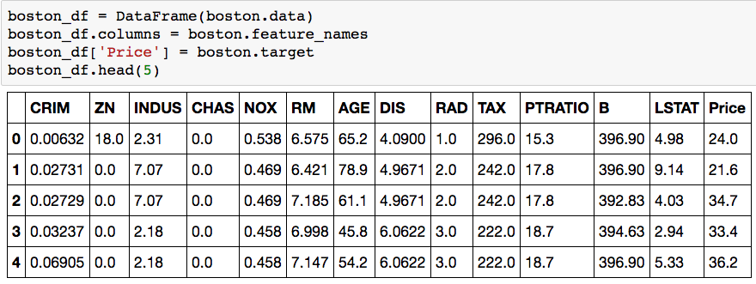
Visualizing Influence of # Rooms with fit
Start by creating a DataFrame that can be used by Seaborn

Slide 38
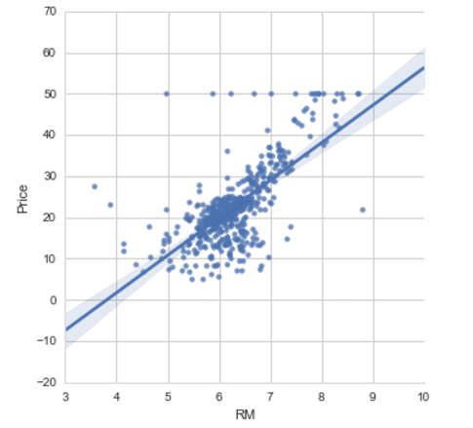
Visualizing Influence of # Rooms with fit

Slide 39
Ridge regression
Linear prediction: $\hat{y_{i}}=w⋅x_{i}$
Loss function:
$$L=\sum_{i}{{\frac{1}{2}\left({\hat{y}}_{i}−y_{i}\right)}^{2}} + \frac{1}{2}λ{\left|w\right|}^{2}$$
Both the fit quality and the penalty can be changed.
Fit quality
Penalty

Slide 40
Changing the penalty
$\left|w\right|=\sqrt{\sum_{i}{w_{i}^{2}}}$ is called the “$L_{2}$ norm”
${\left|w\right|}_{1} =\sum_{i}{\left|w_{i}\right|}$ is called the “$L_{1}$ norm”
In general ${\left|w\right|}_{p} =\sqrt[p]{\sum_{i}{{\left|w_{i}\right|}^{p}}}$ is called the “$L_{p}$ norm”

Slide 41
The LASSO
Loss function:
$$L=\sum_{i}{{\frac{1}{2}\left({\hat{y}}_{i}−y_{i}\right)}^{2}} + \frac{1}{2}λ{\left|w\right|}_{1}$$
Fit quality
Penalty

Slide 42
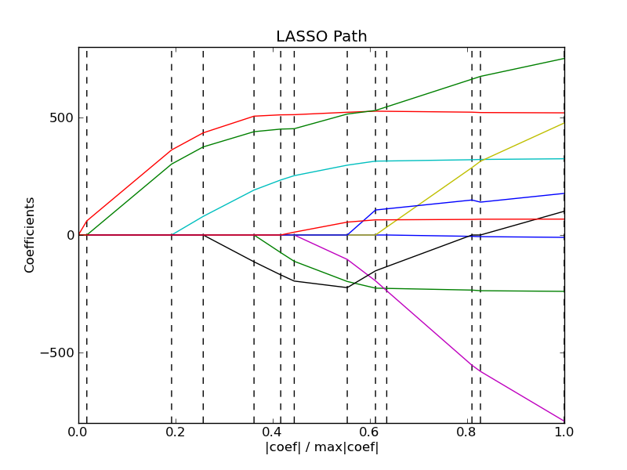
LASSO regularization path
Most weights are exactly zero
“sparse solution”, selects a small number of explanatory variables
This can help avoid overfitting when p>>N
Models are easier to interpret – but remember there is no proof of causation.
Path is piecewise-linear
http://scikit-learn.org/0.11/auto_examples/linear_model/plot_lasso_lars.html

Slide 43
Agenda
Missing Values
Introduction to Machine Learning
Scikit-Learn
Regression
Classification

Slide 44
Supervised Learning: Classification
Classification: assign discrete labels to input data
Example: Medical image diagnosis
E = CAT medical scans with labels (“targets”) on (1) tumor, or (2) no tumor
T = predict tumor or not tumor for new images
P = how well the estimator can accurately predict tumor or not

Slide 45
Supervised Learning: Use Cases
Prediction of future cases: Use the rule to predict the output for future inputs
Knowledge extraction: The rule is easy to understand
Compression: The rule is simpler than the data it explains
Outlier detection: Exceptions that are not covered by the rule, e.g., fraud

Slide 46
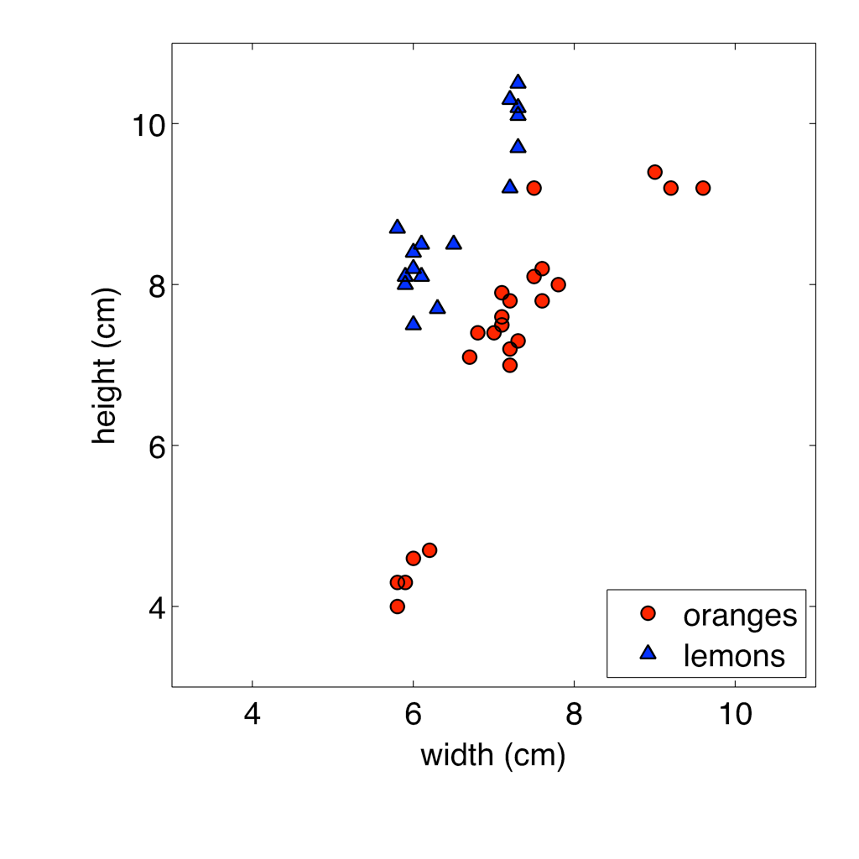
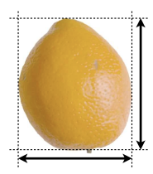
Classification: Oranges and Lemons

Slide 47
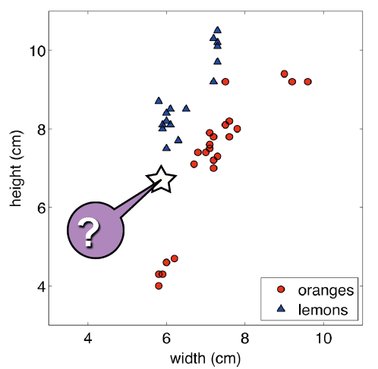
Classification: Oranges and Lemons

Slide 48
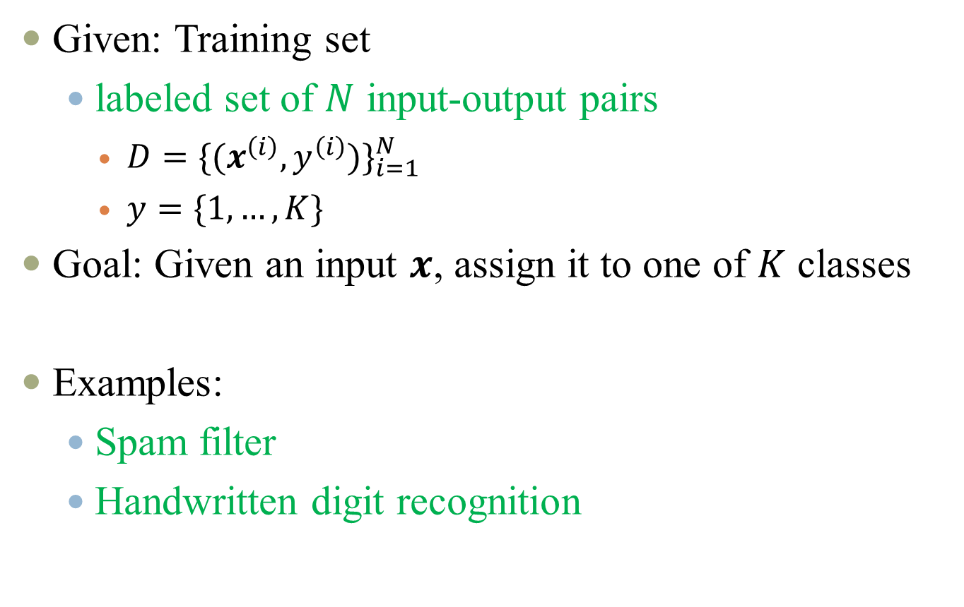
Classification problem
Given: Training set
labeled set of $N$ input-output pairs
$D={{\{(x}^{\left(i\right)},y^{\left(i\right)})\}}_{i=1}^{N}$
$y=\{1,…,K\}$
Goal: Given an input $x$, assign it to one of $K$ classes
Examples:
Spam filter
Handwritten digit recognition

Slide 49





Digit Recognition
Input: pixel grids
Output: a digit 0-9

Slide 50

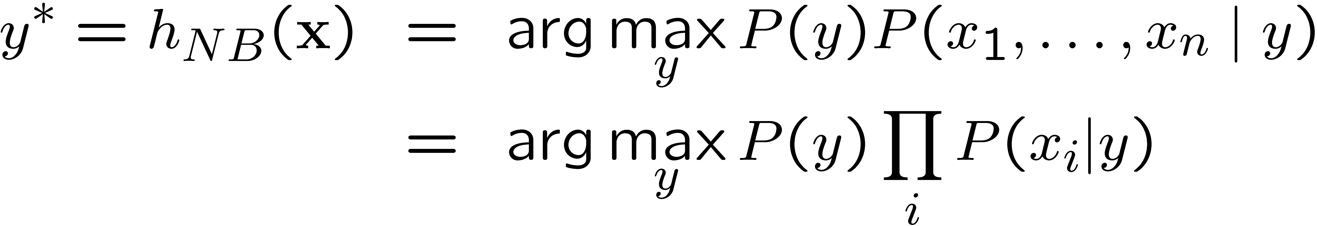
Naïve Bayes Classifier
Y
Given:
Prior P(Y)
n conditionally independent features X given the class Y
For each X_{i}, we have likelihood P(X_{i}|Y)
Decision rule:
X₁
X₂
X_{n}

Slide 51



Example Distribution
1 | 0.1
2 | 0.1
3 | 0.1
4 | 0.1
5 | 0.1
6 | 0.1
7 | 0.1
8 | 0.1
9 | 0.1
0 | 0.1
1 | 0.01
2 | 0.05
3 | 0.05
4 | 0.30
5 | 0.80
6 | 0.90
7 | 0.05
8 | 0.60
9 | 0.50
0 | 0.80
1 | 0.05
2 | 0.01
3 | 0.90
4 | 0.80
5 | 0.90
6 | 0.90
7 | 0.25
8 | 0.85
9 | 0.60
0 | 0.80

Slide 52
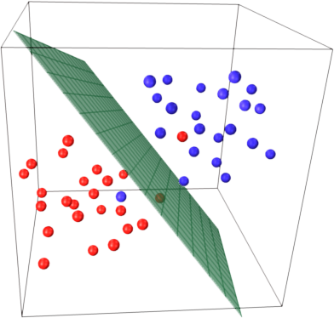
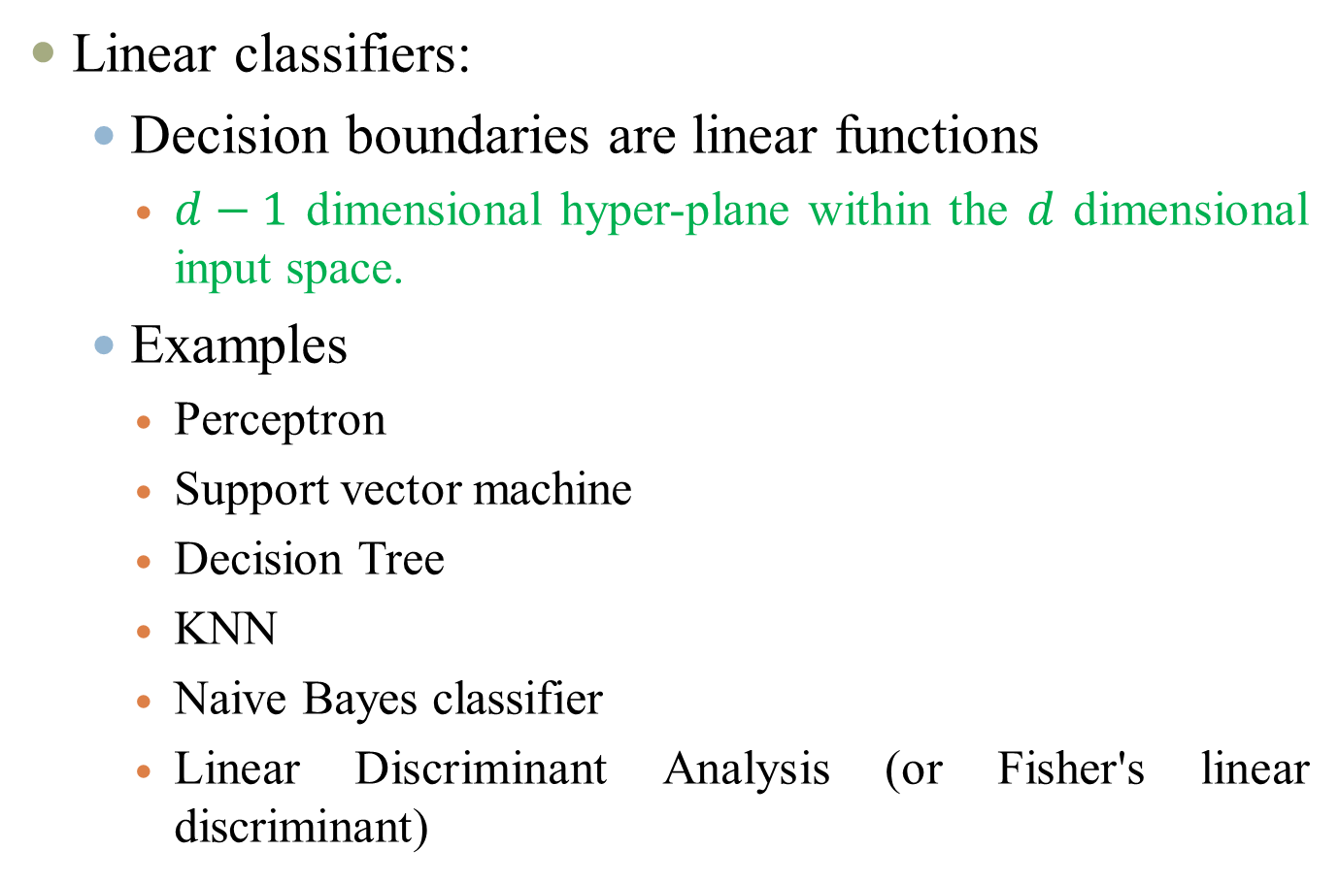
Linear classifiers
Linear classifiers:
Decision boundaries are linear functions
$d−1$ dimensional hyper-plane within the $d$ dimensional input space.
Examples
Perceptron
Support vector machine
Decision Tree
KNN
Naive Bayes classifier
Linear Discriminant Analysis (or Fisher's linear discriminant)

Slide 53
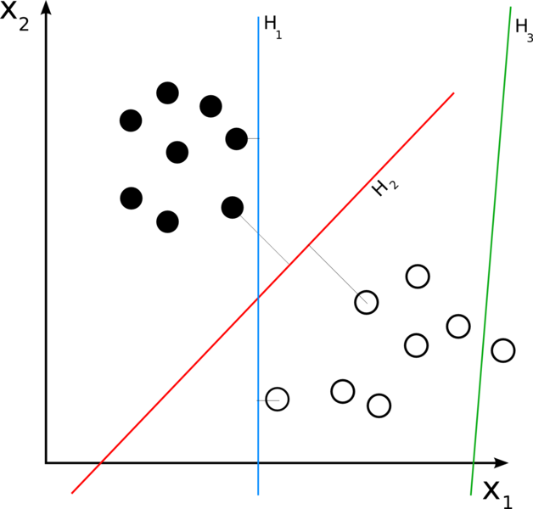
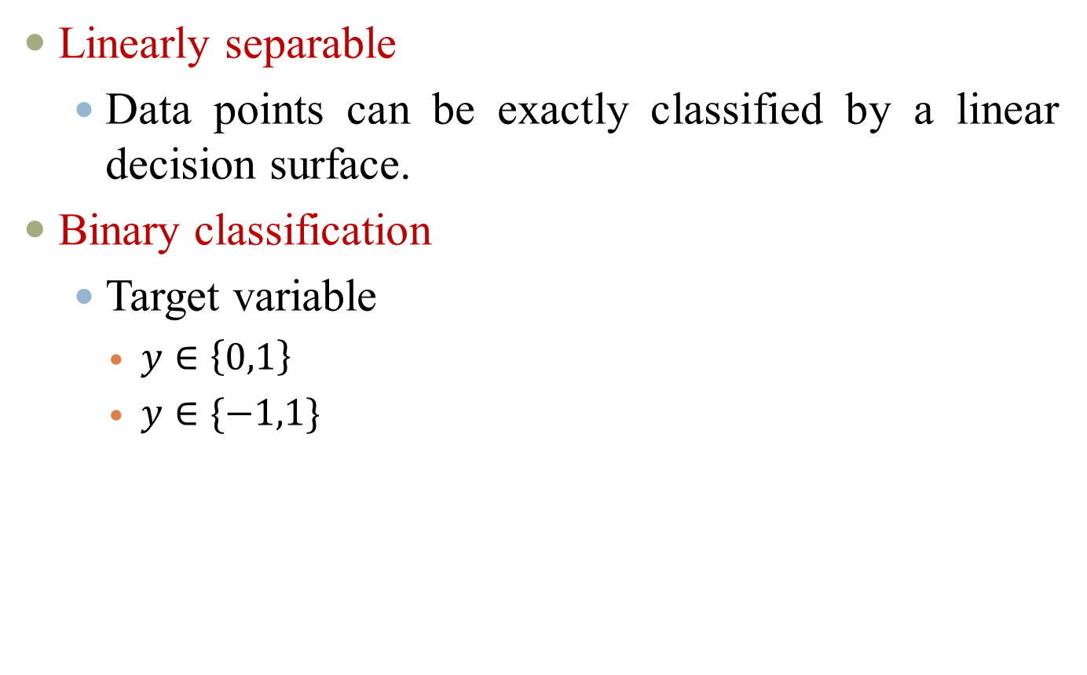
Linear classifiers
Linearly separable
Data points can be exactly classified by a linear decision surface.
Binary classification
Target variable
$y∈\left\{0,1\right\}$
$y∈\{−1,1\}$

Slide 54
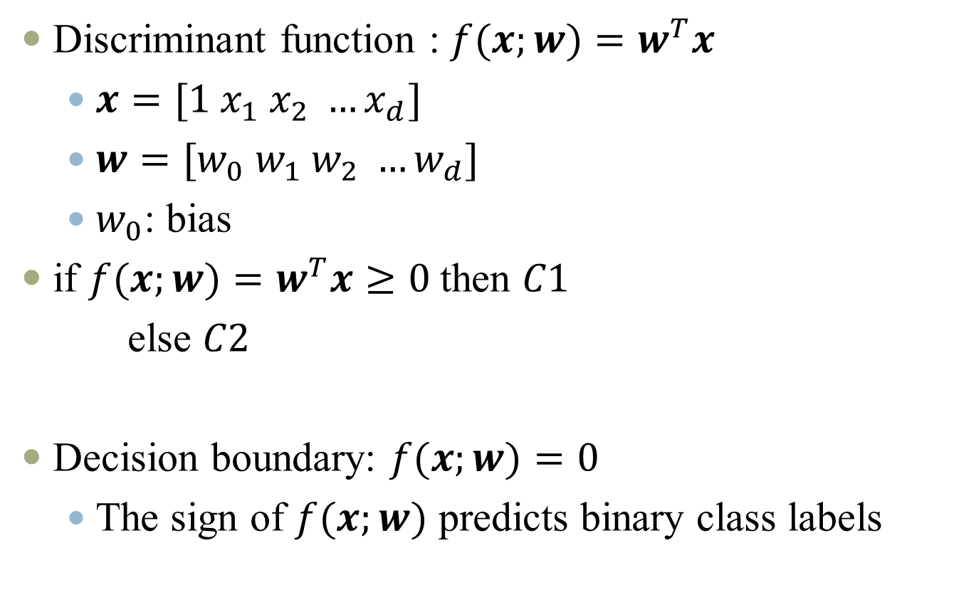
Decision boundary
Discriminant function : $f(x;w)=w^{T}x$
$x=[1 x_{1} x_{2} …x_{d}]$
$w=[w_{0} w_{1} w_{2} …w_{d}]$
$w_{0}$: bias
if $f(x;w)=w^{T}x≥0$then $C1$
else $C2$
Decision boundary: $f(x;w)=0$
The sign of $f(x;w)$ predicts binary class labels

Slide 55
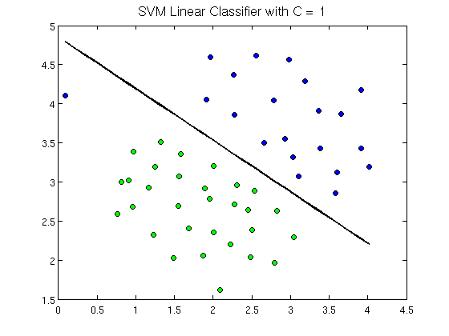
Linear Decision boundary (Perceptron)

Slide 56
Linear Decision boundary (Decision Tree)
t2
t3
t1
Income

Slide 57
Linear Decision boundary (K Nearest Neighbor)
O
x
Feature 2
O
x
x
O
Feature 1

Slide 58
Non-Linear Decision boundary
Decision
Boundary
Decision
Region 1
Decision
Region 2

Slide 59
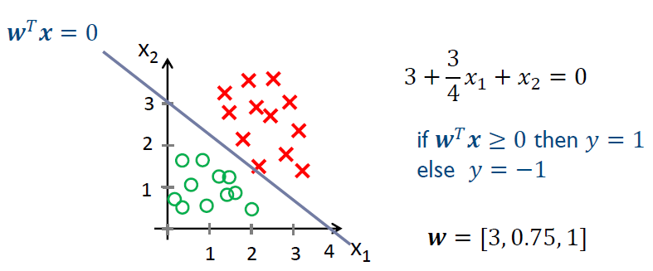
Decision boundary
Linear classifier

Slide 60
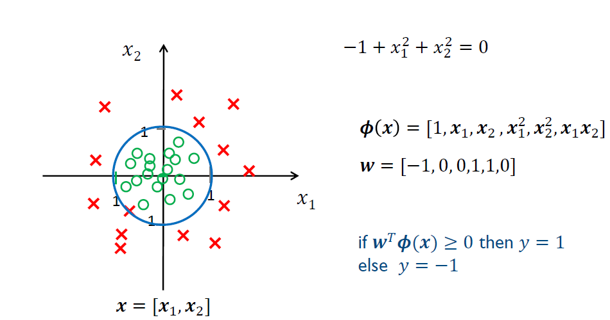
Non-linear decision boundary
Choose non-linear features
Classifier still linear in parameters 𝒘

Slide 61
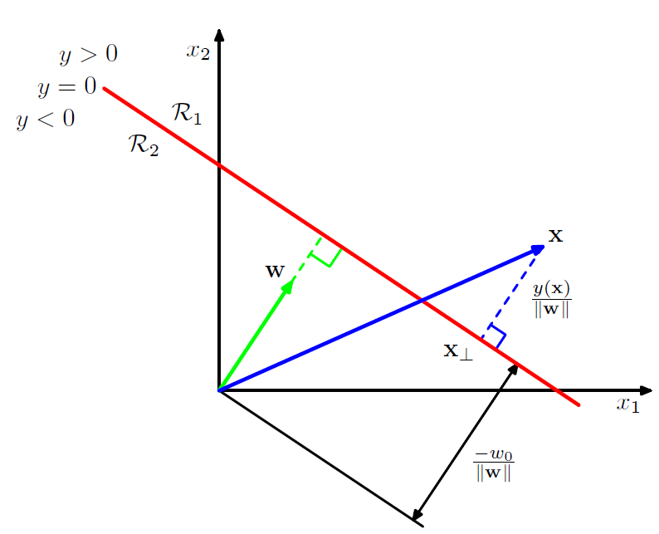
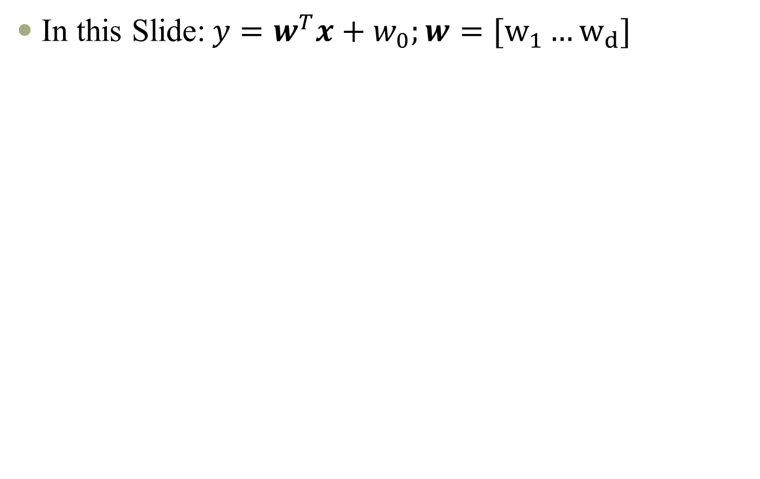
Linear boundary: geometry
In this Slide:$y=w^{T}x+w_{0};w=[w_{1}…w_{d}]$

Slide 62
Unsupervised Learning
Data has no labels (no “outputs”)
Clustering: Grouping similar instances
Goal is to find similarity among the data – to “discover” labels from the data itself
Examples:
Customer segmentation: given purchase behaviors and demographics, classify type of consumers for different marketing campaigns.
Image compression: Color quantization
Bioinformatics: Learning motifs

Slide 63
Reinforcement Learning
Learning a policy: A sequence of outputs
No supervised output but delayed reward
Credit assignment problem
Game playing
Robot in a maze
Multiple agents, partial observability, ...

Slide 64
APPENDIX

Slide 65
Learning Associations
Basket analysis:
P (Y | X ) probability that somebody who buys X also buys Y where X and Y are products/services.
Example: P ( chips | beer ) = 0.7

Slide 66
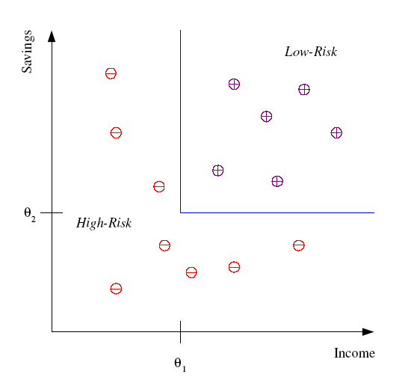
Classification
Example: Credit scoring
Differentiating between low-risk and high-risk customers from their income and savings
Discriminant: IF income > θ₁ AND savings > θ₂
THEN low-risk ELSE high-risk

Slide 67
Classification: Applications
Aka Pattern recognition
Face recognition: Pose, lighting, occlusion (glasses, beard), make-up, hair style
Character recognition: Different handwriting styles.
Speech recognition: Temporal dependency.
Medical diagnosis: From symptoms to illnesses
Biometrics: Recognition/authentication using physical and/or behavioral characteristics: Face, iris, signature, etc
...

Slide 68








Face Recognition
Training examples of a person
Test images

