Slide 1
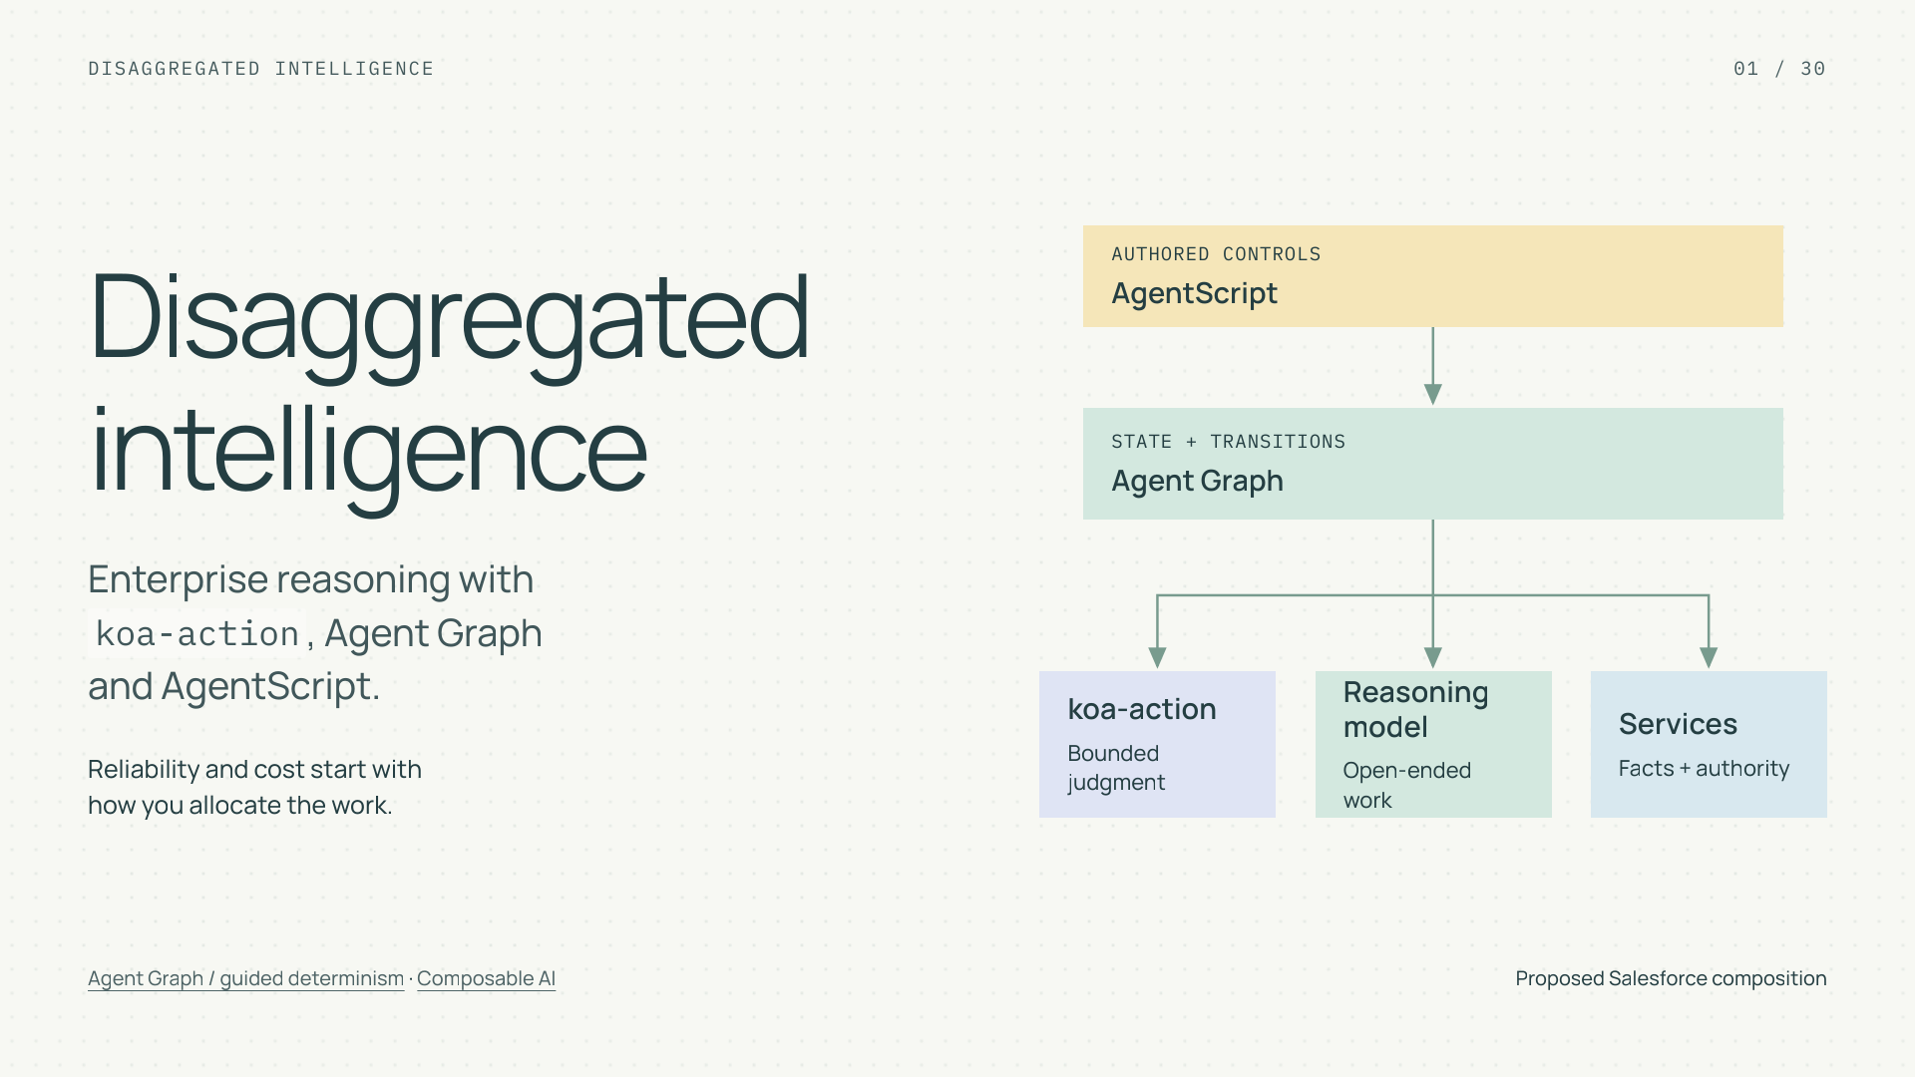
Notes:
Disaggregated intelligence
Section: Enterprise AI
Purpose: Introduce disaggregated intelligence as an engineering allocation problem.
Suggested speaking time: 0.7 minutes
TALKING POINTS
• System One is a useful engineering term for specialized models that answer bounded questions. It is not a claim about human cognition.
• The tutorial will construct a service workflow, inspect its failure boundaries, and define how reliability, cost, and speed would be evaluated.
• The Salesforce composition is proposed. Public sources do not establish a koa-action SDK, training interface, or measured benchmark.
Transition: First connect the architecture to the four benefits we want.
POWERPOINT EXPORT
This edition preserves the HTML slide design as one outlined SVG graphic with an embedded PNG fallback. Slide text is vector artwork, not editable PowerPoint paragraphs. Speaker notes remain editable. Use the companion HTML for interaction.
WEB REFERENCES
Agent Graph / guided determinism
https://engineering.salesforce.com/agentforces-agent-graph-toward-guided-determinism-with-hybrid-reasoning/
Composable AI
https://typesafe.ai/manifesto
SLIDE TEXT REFERENCE
DISAGGREGATED INTELLIGENCE
01 / 30
Disaggregated
intelligence
Enterprise reasoning with
koa-action, Agent Graph
and AgentScript.
Reliability and cost start with
how you allocate the work.
AUTHORED CONTROLS
AgentScript
STATE + TRANSITIONS
Agent Graph
koa-action
Bounded judgment
Reasoning model
Open-ended work
Services
Facts + authority
Agent Graph / guided determinism · Composable AI
Proposed Salesforce composition

Slide 2
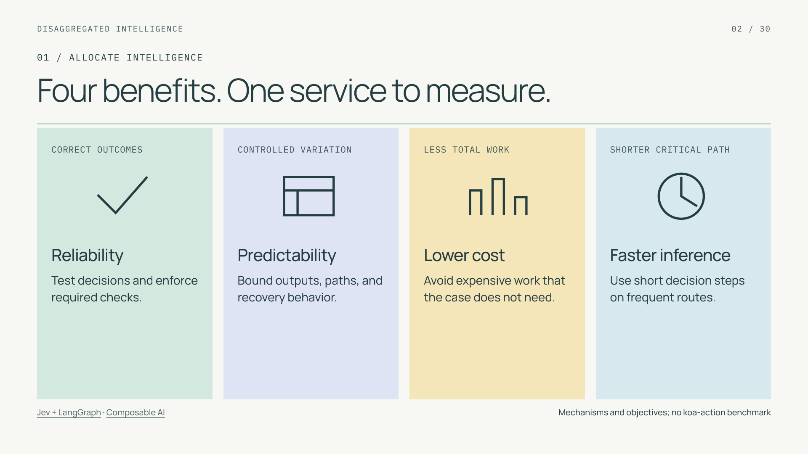
Notes:
Four benefits. One service to measure.
Section: 01
Purpose: Connect requested benefits to concrete mechanisms.
Suggested speaking time: 1 minutes
TALKING POINTS
• Significantly lower decision cost and faster inference are the opportunity behind specialization. Their size must be established for the deployed workload.
• Reliability means acceptable outcomes. Predictability includes stable output contracts and controlled paths; it is not proof that the semantic answer is correct.
• The same complete customer case remains the unit of value. Extra handoffs can consume a primitive-level saving.
Transition: Follow one case through the rest of the tutorial.
POWERPOINT EXPORT
This edition preserves the HTML slide design as one outlined SVG graphic with an embedded PNG fallback. Slide text is vector artwork, not editable PowerPoint paragraphs. Speaker notes remain editable. Use the companion HTML for interaction.
WEB REFERENCES
Jev + LangGraph
https://www.langchain.com/blog/building-prod-with-jev-and-langgraph
Composable AI
https://typesafe.ai/manifesto
SLIDE TEXT REFERENCE
DISAGGREGATED INTELLIGENCE
02 / 30
01 / ALLOCATE INTELLIGENCE
Four benefits. One service to measure.
CORRECT OUTCOMES
Reliability
Test decisions and enforce required checks.
CONTROLLED VARIATION
Predictability
Bound outputs, paths, and recovery behavior.
LESS TOTAL WORK
Lower cost
Avoid expensive work that the case does not need.
SHORTER CRITICAL PATH
Faster inference
Use short decision steps on frequent routes.
Jev + LangGraph · Composable AI
Mechanisms and objectives; no koa-action benchmark

Slide 3
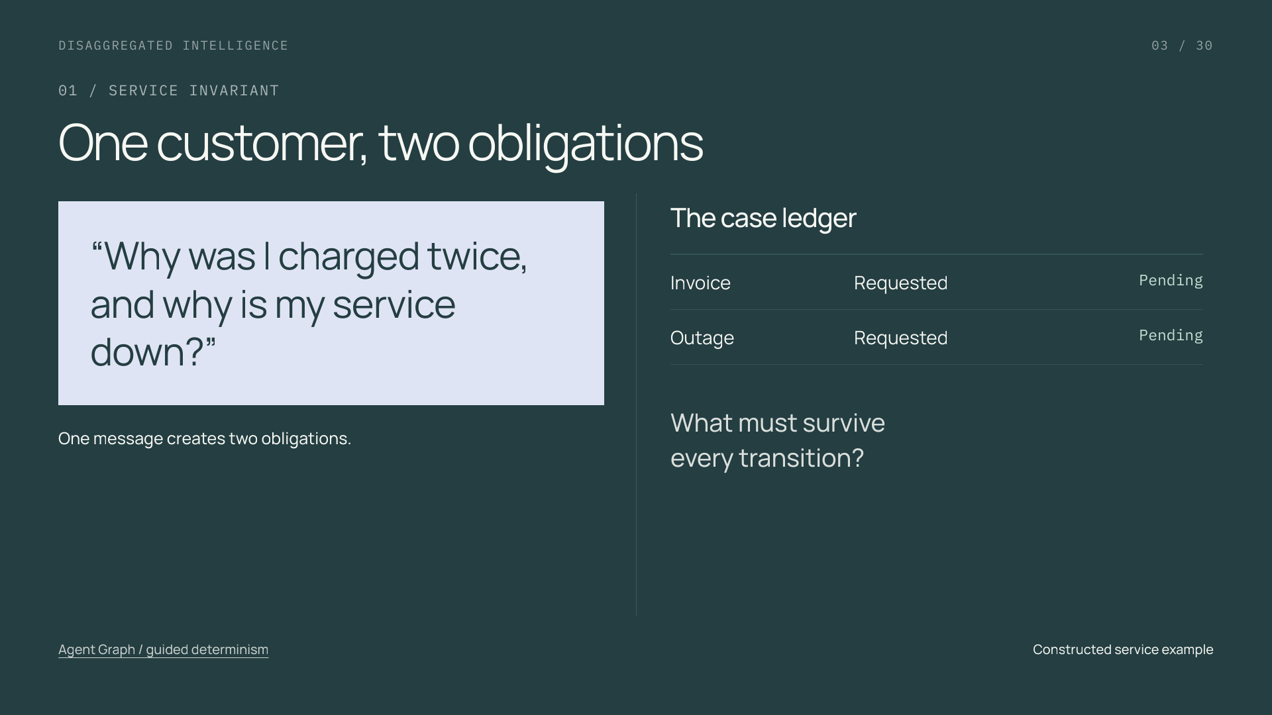
Notes:
One customer, two obligations
Section: 01
Purpose: Establish the recurring case and its invariant.
Suggested speaking time: 1.1 minutes
TALKING POINTS
• Ask the audience to name the invariant: neither request should disappear when the agent changes topics.
• A task may be resolved, withdrawn by the customer, or handed off with ownership recorded. These are different statuses; handoff does not equal resolution.
• This is a constructed example used to explain state and routing, not a reported customer deployment.
Transition: Assign an owner to each kind of work.
POWERPOINT EXPORT
This edition preserves the HTML slide design as one outlined SVG graphic with an embedded PNG fallback. Slide text is vector artwork, not editable PowerPoint paragraphs. Speaker notes remain editable. Use the companion HTML for interaction.
WEB REFERENCES
Agent Graph / guided determinism
https://engineering.salesforce.com/agentforces-agent-graph-toward-guided-determinism-with-hybrid-reasoning/
SLIDE TEXT REFERENCE
DISAGGREGATED INTELLIGENCE
03 / 30
01 / SERVICE INVARIANT
One customer, two obligations
“Why was I charged twice,
and why is my service down?”
One message creates two obligations.
The case ledger
Invoice
Requested
Pending
Outage
Requested
Pending
What must survive
every transition?
Agent Graph / guided determinism
Constructed service example

Slide 4
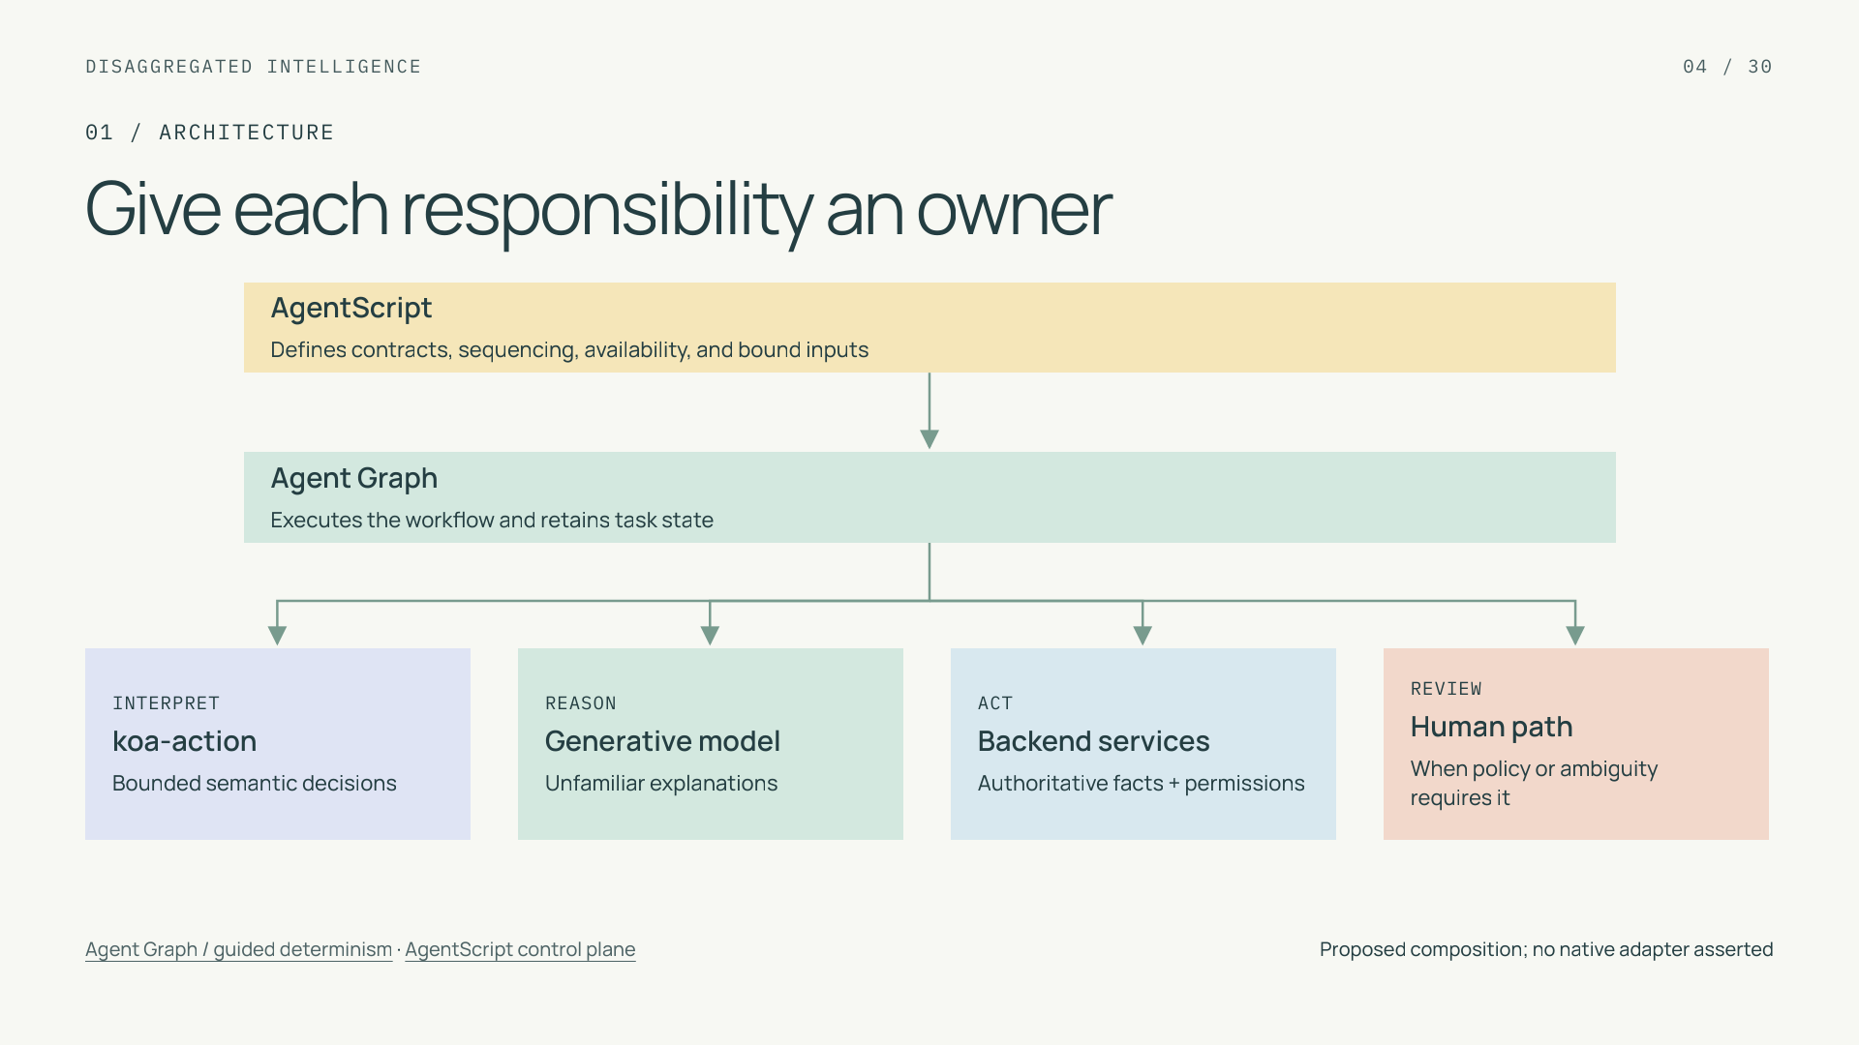
Notes:
Give each responsibility an owner
Section: 01
Purpose: Distinguish models, execution, configuration, and authority.
Suggested speaking time: 1 minutes
TALKING POINTS
• AgentScript is the authoring and control language; Agent Graph is the managed runtime that executes configured behavior.
• The models produce interpretations or explanations. Backend services retain authority over access and writes, while human review is an explicit branch.
• The diagram denotes coordination, not ownership of every component by a model. Each case invokes only the components its configured path needs.
Transition: Now move process rules from prose into inspectable structure.
POWERPOINT EXPORT
This edition preserves the HTML slide design as one outlined SVG graphic with an embedded PNG fallback. Slide text is vector artwork, not editable PowerPoint paragraphs. Speaker notes remain editable. Use the companion HTML for interaction.
WEB REFERENCES
Agent Graph / guided determinism
https://engineering.salesforce.com/agentforces-agent-graph-toward-guided-determinism-with-hybrid-reasoning/
AgentScript control plane
https://www.salesforce.com/blog/agent-script-control-plane/
SLIDE TEXT REFERENCE
DISAGGREGATED INTELLIGENCE
04 / 30
01 / ARCHITECTURE
Give each responsibility an owner
AgentScript
Defines contracts, sequencing, availability, and bound inputs
Agent Graph
Executes the workflow and retains task state
INTERPRET
koa-action
Bounded semantic decisions
REASON
Generative model
Unfamiliar explanations
ACT
Backend services
Authoritative facts + permissions
REVIEW
Human path
When policy or ambiguity requires it
Agent Graph / guided determinism · AgentScript control plane
Proposed composition; no native adapter asserted

Slide 5
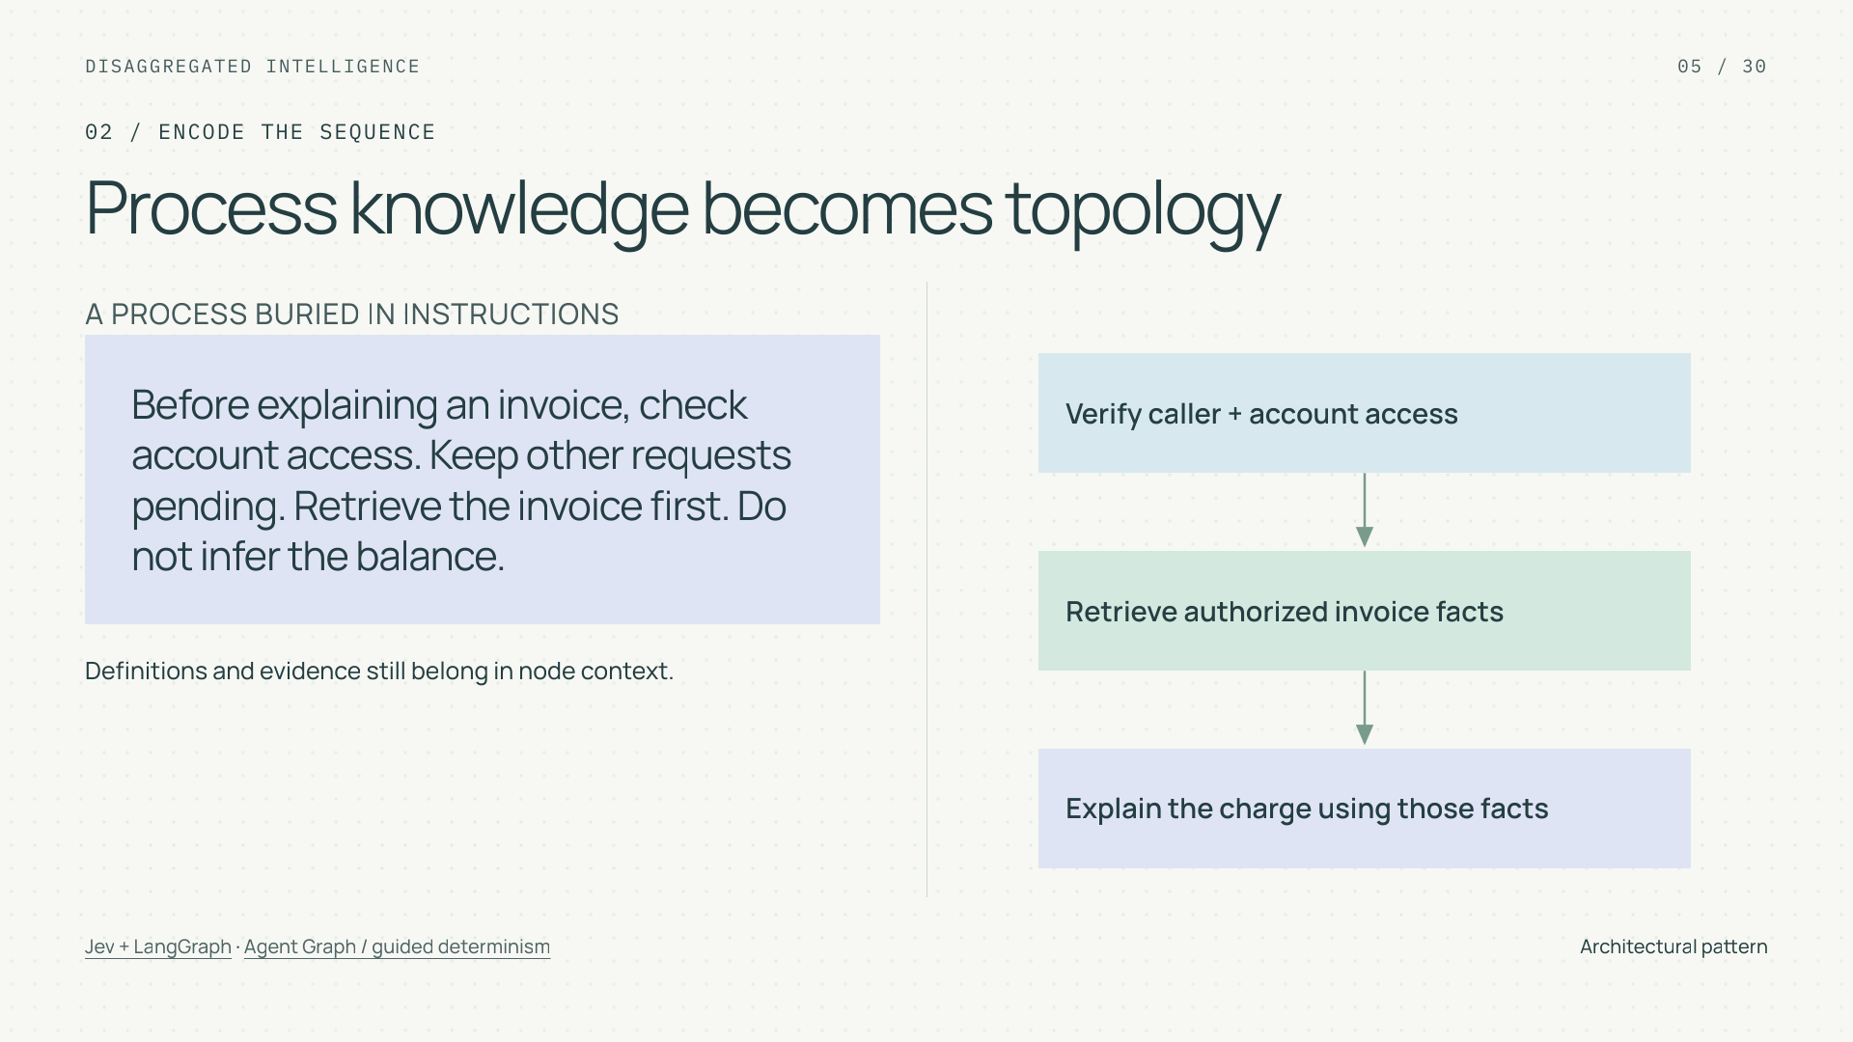
Notes:
Process knowledge becomes topology
Section: 02
Purpose: Teach which decisions, in which order, over which state.
Suggested speaking time: 1 minutes
TALKING POINTS
• Topology encodes procedural domain knowledge: which step may run, what must precede it, and where its input facts come from.
• The transformation does not remove all domain knowledge from prompts. Category definitions and authorized facts remain necessary within model calls.
• A graph can enforce a poor process consistently. Review and test the topology itself.
Transition: Locate the runtime within the broader agent harness.
POWERPOINT EXPORT
This edition preserves the HTML slide design as one outlined SVG graphic with an embedded PNG fallback. Slide text is vector artwork, not editable PowerPoint paragraphs. Speaker notes remain editable. Use the companion HTML for interaction.
WEB REFERENCES
Jev + LangGraph
https://www.langchain.com/blog/building-prod-with-jev-and-langgraph
Agent Graph / guided determinism
https://engineering.salesforce.com/agentforces-agent-graph-toward-guided-determinism-with-hybrid-reasoning/
SLIDE TEXT REFERENCE
DISAGGREGATED INTELLIGENCE
05 / 30
02 / ENCODE THE SEQUENCE
Process knowledge becomes topology
A PROCESS BURIED IN INSTRUCTIONS
Before explaining an invoice, check account access. Keep other requests pending. Retrieve the invoice first. Do not infer the balance.
Definitions and evidence still belong in node context.
Verify caller + account access
Retrieve authorized invoice facts
Explain the charge using those facts
Jev + LangGraph · Agent Graph / guided determinism
Architectural pattern

Slide 6
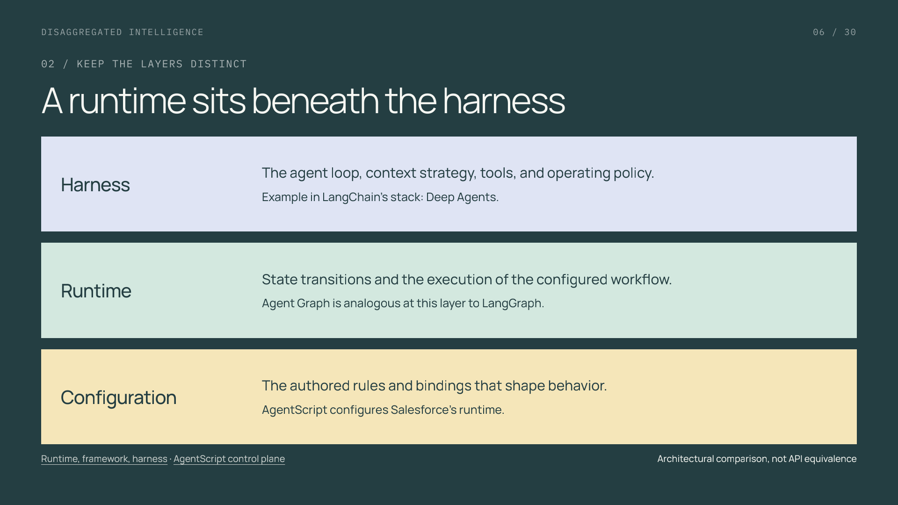
Notes:
A runtime sits beneath the harness
Section: 02
Purpose: Prevent runtime/harness/configuration conflation.
Suggested speaking time: 1 minutes
TALKING POINTS
• LangChain distinguishes its framework, LangGraph runtime, and Deep Agents harness. The comparison helps locate responsibilities.
• In this Salesforce example the configured agent is the broader harness, with Agent Graph providing runtime execution and AgentScript authoring control.
• This is an architectural analogy, not LangGraph API compatibility or a claim that Agent Graph ships Deep Agents defaults. The public AgentScript repo contains tooling, not the managed runtime.
Transition: Define the first decision before selecting its integration.
POWERPOINT EXPORT
This edition preserves the HTML slide design as one outlined SVG graphic with an embedded PNG fallback. Slide text is vector artwork, not editable PowerPoint paragraphs. Speaker notes remain editable. Use the companion HTML for interaction.
WEB REFERENCES
Runtime, framework, harness
https://www.langchain.com/blog/deep-agents-vs-langchain-vs-langgraph
AgentScript control plane
https://www.salesforce.com/blog/agent-script-control-plane/
SLIDE TEXT REFERENCE
DISAGGREGATED INTELLIGENCE
06 / 30
02 / KEEP THE LAYERS DISTINCT
A runtime sits beneath the harness
Harness
The agent loop, context strategy, tools, and operating policy.
Example in LangChain’s stack: Deep Agents.
Runtime
State transitions and the execution of the configured workflow.
Agent Graph is analogous at this layer to LangGraph.
Configuration
The authored rules and bindings that shape behavior.
AgentScript configures Salesforce’s runtime.
Runtime, framework, harness · AgentScript control plane
Architectural comparison, not API equivalence

Slide 7
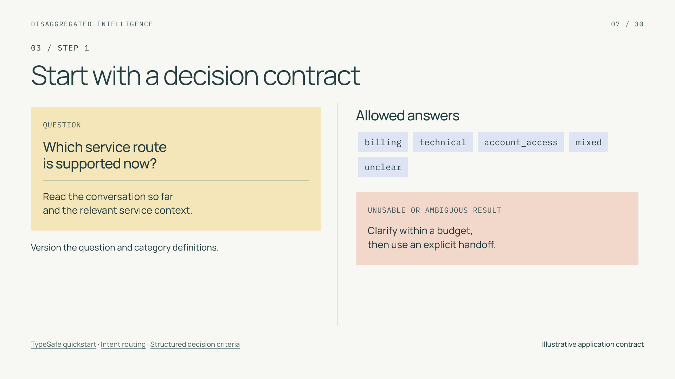
Notes:
Start with a decision contract
Section: 03
Purpose: Give a bounded task a testable contract.
Suggested speaking time: 1 minutes
TALKING POINTS
• The labels are application choices, not a documented koa-action response schema. Mixed and unclear are first-class outcomes.
• Provide positive and negative examples at the category boundaries. The same contract controls labeling and evaluation.
• A timeout or malformed result must not default into a business transaction. Specify its fallback separately from semantic ambiguity.
Transition: Match the question to the right primitive.
POWERPOINT EXPORT
This edition preserves the HTML slide design as one outlined SVG graphic with an embedded PNG fallback. Slide text is vector artwork, not editable PowerPoint paragraphs. Speaker notes remain editable. Use the companion HTML for interaction.
WEB REFERENCES
TypeSafe quickstart
https://docs.typesafe.ai/introduction/quickstart
Intent routing
https://docs.typesafe.ai/patterns/intent-routing
Structured decision criteria
https://docs.typesafe.ai/primitives/advanced
SLIDE TEXT REFERENCE
DISAGGREGATED INTELLIGENCE
07 / 30
03 / STEP 1
Start with a decision contract
QUESTION
Which service route
is supported now?
Read the conversation so far
and the relevant service context.
Version the question and category definitions.
Allowed answers
billingtechnicalaccount_accessmixedunclear
UNUSABLE OR AMBIGUOUS RESULT
Clarify within a budget,
then use an explicit handoff.
TypeSafe quickstart · Intent routing · Structured decision criteria
Illustrative application contract

Slide 8
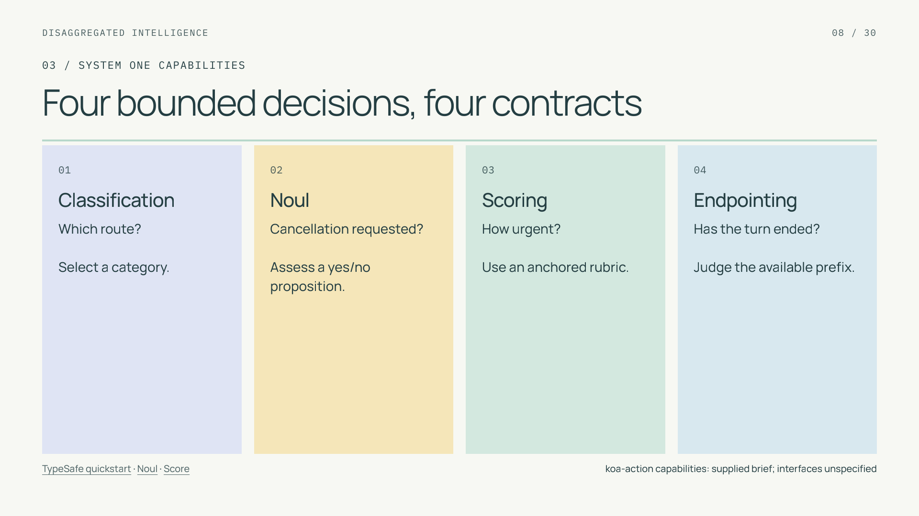
Notes:
Four bounded decisions, four contracts
Section: 03
Purpose: Cover the four user-specified koa-action capabilities.
Suggested speaking time: 1 minutes
TALKING POINTS
• The user brief supplies classification, noul, scoring, and semantic endpointing as koa-action capabilities.
• TypeSafe documents analogous decision concepts, but its SDK fields, batching, calibration, and training claims do not define a Salesforce interface.
• Each primitive needs its own target and error measure. A rubric score and the probability of a binary proposition are not interchangeable.
Transition: Make that semantic distinction tangible.
POWERPOINT EXPORT
This edition preserves the HTML slide design as one outlined SVG graphic with an embedded PNG fallback. Slide text is vector artwork, not editable PowerPoint paragraphs. Speaker notes remain editable. Use the companion HTML for interaction.
WEB REFERENCES
TypeSafe quickstart
https://docs.typesafe.ai/introduction/quickstart
Noul
https://docs.typesafe.ai/primitives/noul
Score
https://docs.typesafe.ai/primitives/score
SLIDE TEXT REFERENCE
DISAGGREGATED INTELLIGENCE
08 / 30
03 / SYSTEM ONE CAPABILITIES
Four bounded decisions, four contracts
01
Classification
Which route?
Select a category.
02
Noul
Cancellation requested?
Assess a yes/no proposition.
03
Scoring
How urgent?
Use an anchored rubric.
04
Endpointing
Has the turn ended?
Judge the available prefix.
TypeSafe quickstart · Noul · Score
koa-action capabilities: supplied brief; interfaces unspecified

Slide 9
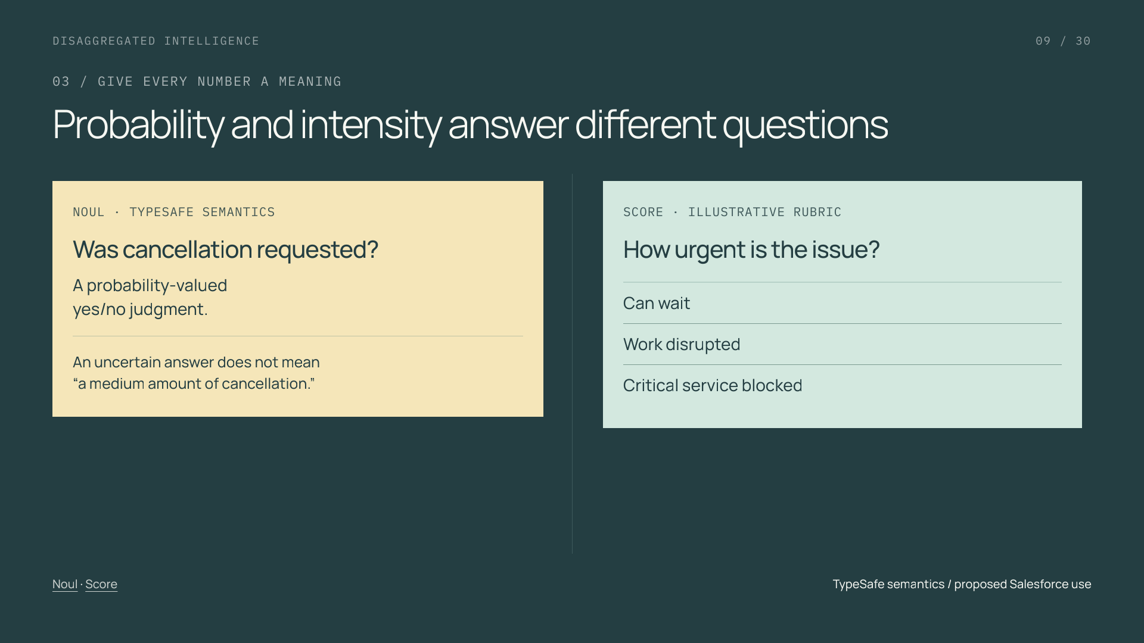
Notes:
Probability and intensity answer different questions
Section: 03
Purpose: Explain binary proposition estimates versus severity rubrics.
Suggested speaking time: 1 minutes
TALKING POINTS
• TypeSafe’s Noul is the probability of the yes answer; its Score uses ordered rubric levels and can be fractional.
• A mean rubric score can hide different distributions. Preserve the output meaning that the downstream rule actually uses.
• The corresponding koa-action fields, ranges, and calibration require their own verified contract. No numeric Salesforce response is shown here.
Transition: A decision about when to respond has an additional time boundary.
POWERPOINT EXPORT
This edition preserves the HTML slide design as one outlined SVG graphic with an embedded PNG fallback. Slide text is vector artwork, not editable PowerPoint paragraphs. Speaker notes remain editable. Use the companion HTML for interaction.
WEB REFERENCES
Noul
https://docs.typesafe.ai/primitives/noul
Score
https://docs.typesafe.ai/primitives/score
SLIDE TEXT REFERENCE
DISAGGREGATED INTELLIGENCE
09 / 30
03 / GIVE EVERY NUMBER A MEANING
Probability and intensity answer different questions
NOUL · TYPESAFE SEMANTICS
Was cancellation requested?
A probability-valued
yes/no judgment.
An uncertain answer does not mean
“a medium amount of cancellation.”
SCORE · ILLUSTRATIVE RUBRIC
How urgent is the issue?
Can wait
Work disrupted
Critical service blocked
Noul · Score
TypeSafe semantics / proposed Salesforce use

Slide 10
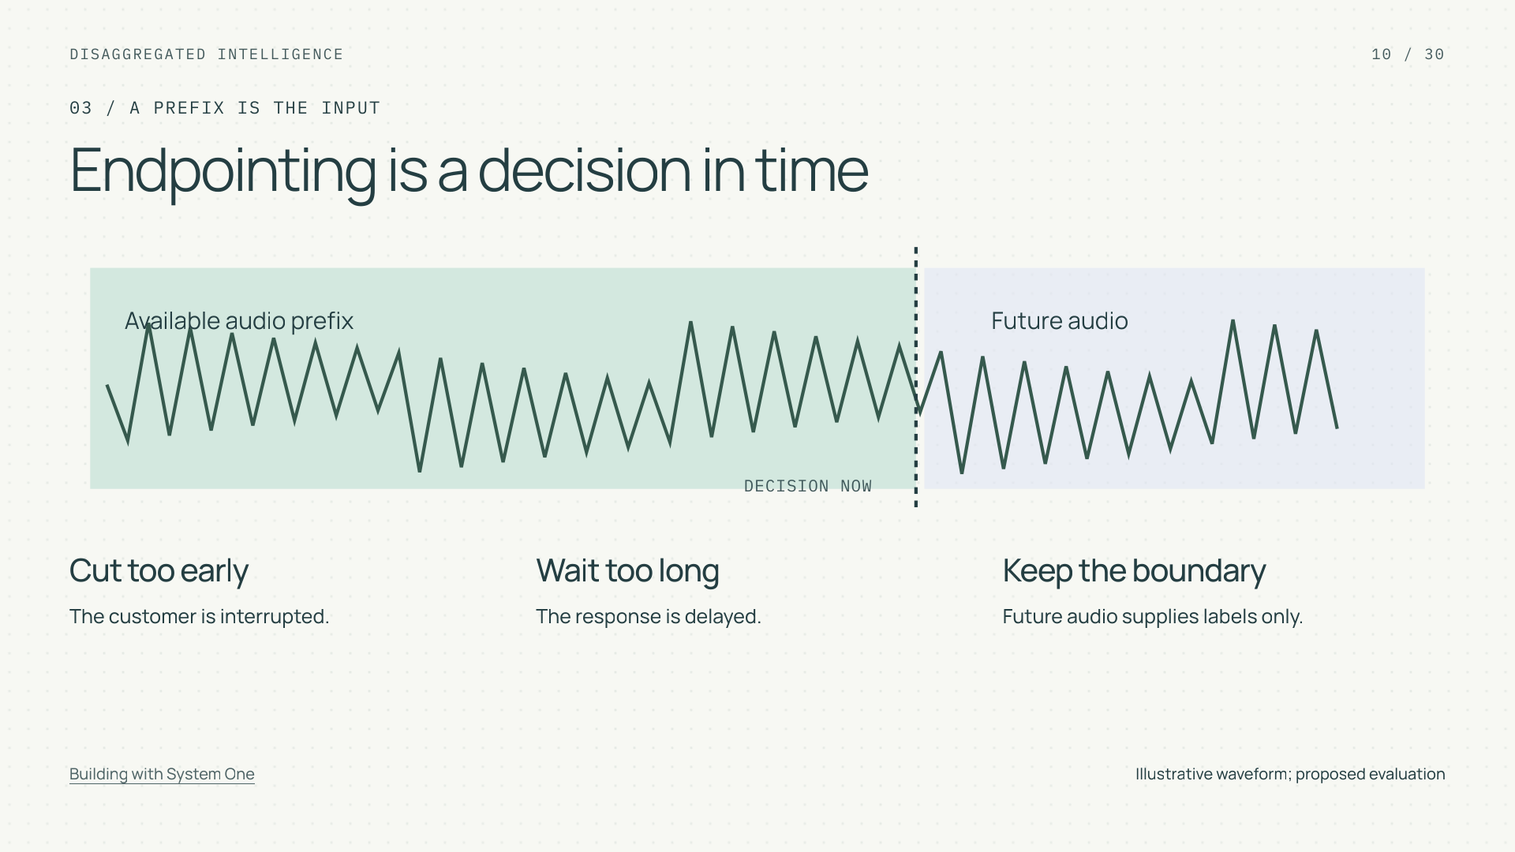
Notes:
Endpointing is a decision in time
Section: 03
Purpose: Explain semantic endpointing and temporal leakage.
Suggested speaking time: 1 minutes
TALKING POINTS
• The waveform is illustrative. The task asks whether a spoken turn has ended using only the available prefix.
• Future speech may establish the reference label, but it must not become part of the earlier input.
• Measure premature cutoff and delay separately. Keep all prefixes of a conversation together when splitting data.
Transition: Next decide which decisions may run in parallel.
POWERPOINT EXPORT
This edition preserves the HTML slide design as one outlined SVG graphic with an embedded PNG fallback. Slide text is vector artwork, not editable PowerPoint paragraphs. Speaker notes remain editable. Use the companion HTML for interaction.
WEB REFERENCES
Building with System One
https://docs.typesafe.ai/concepts/how-to-build-with-system-one
SLIDE TEXT REFERENCE
DISAGGREGATED INTELLIGENCE
10 / 30
03 / A PREFIX IS THE INPUT
Endpointing is a decision in time
Available audio prefix
Future audio
DECISION NOW
Cut too early
The customer is interrupted.
Wait too long
The response is delayed.
Keep the boundary
Future audio supplies labels only.
Building with System One
Illustrative waveform; proposed evaluation

Slide 11
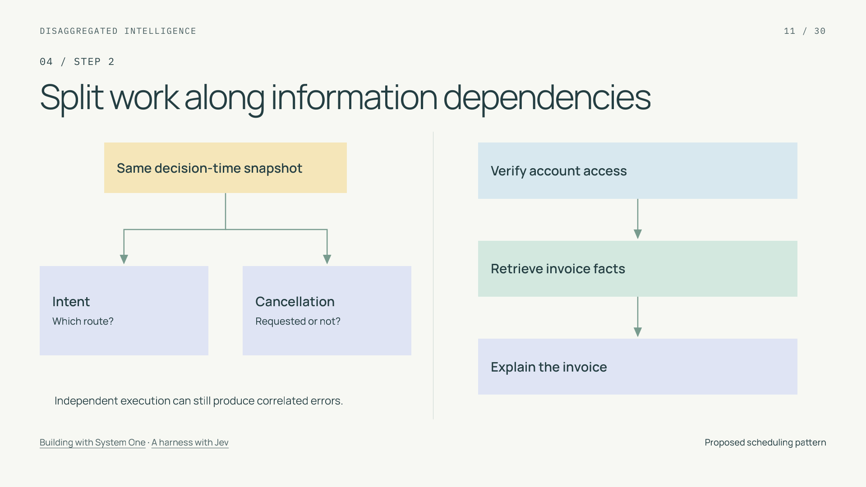
Notes:
Split work along information dependencies
Section: 04
Purpose: Separate execution independence from causality.
Suggested speaking time: 1 minutes
TALKING POINTS
• Independent questions can read the same snapshot; a later step that needs a new fact must wait for that fact.
• This is a workflow-design pattern, not a claim about a native koa-action batching API.
• Parallel question execution does not imply statistically independent errors. Missing evidence can affect several judgments at once.
Transition: Make each node’s evidence window explicit.
POWERPOINT EXPORT
This edition preserves the HTML slide design as one outlined SVG graphic with an embedded PNG fallback. Slide text is vector artwork, not editable PowerPoint paragraphs. Speaker notes remain editable. Use the companion HTML for interaction.
WEB REFERENCES
Building with System One
https://docs.typesafe.ai/concepts/how-to-build-with-system-one
A harness with Jev
https://www.langchain.com/blog/building-a-harness-with-jev
SLIDE TEXT REFERENCE
DISAGGREGATED INTELLIGENCE
11 / 30
04 / STEP 2
Split work along information dependencies
Same decision-time snapshot
Intent
Which route?
Cancellation
Requested or not?
Independent execution can still produce correlated errors.
Verify account access
Retrieve invoice facts
Explain the invoice
Building with System One · A harness with Jev
Proposed scheduling pattern

Slide 12
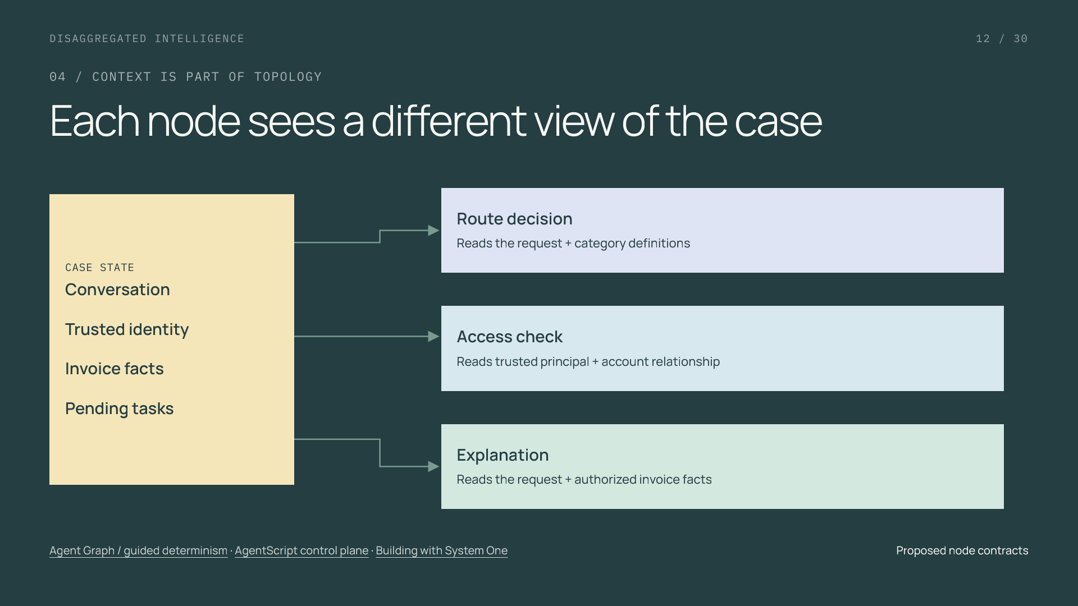
Notes:
Each node sees a different view of the case
Section: 04
Purpose: Teach context boundaries as authored data dependencies.
Suggested speaking time: 1 minutes
TALKING POINTS
• Graph design determines what information exists before a node runs and which part of state it receives.
• A customer-provided account identifier does not become a verified identity because it appears in a model output.
• Narrowing context can reduce unnecessary processing, but removing a required fact can reduce quality. Version and evaluate the context selection.
Transition: Use that state to preserve the mixed request.
POWERPOINT EXPORT
This edition preserves the HTML slide design as one outlined SVG graphic with an embedded PNG fallback. Slide text is vector artwork, not editable PowerPoint paragraphs. Speaker notes remain editable. Use the companion HTML for interaction.
WEB REFERENCES
Agent Graph / guided determinism
https://engineering.salesforce.com/agentforces-agent-graph-toward-guided-determinism-with-hybrid-reasoning/
AgentScript control plane
https://www.salesforce.com/blog/agent-script-control-plane/
Building with System One
https://docs.typesafe.ai/concepts/how-to-build-with-system-one
SLIDE TEXT REFERENCE
DISAGGREGATED INTELLIGENCE
12 / 30
04 / CONTEXT IS PART OF TOPOLOGY
Each node sees a different view of the case
CASE STATE
Conversation
Trusted identity
Invoice facts
Pending tasks
Route decision
Reads the request + category definitions
Access check
Reads trusted principal + account relationship
Explanation
Reads the request + authorized invoice facts
Agent Graph / guided determinism · AgentScript control plane · Building with System One
Proposed node contracts

Slide 13
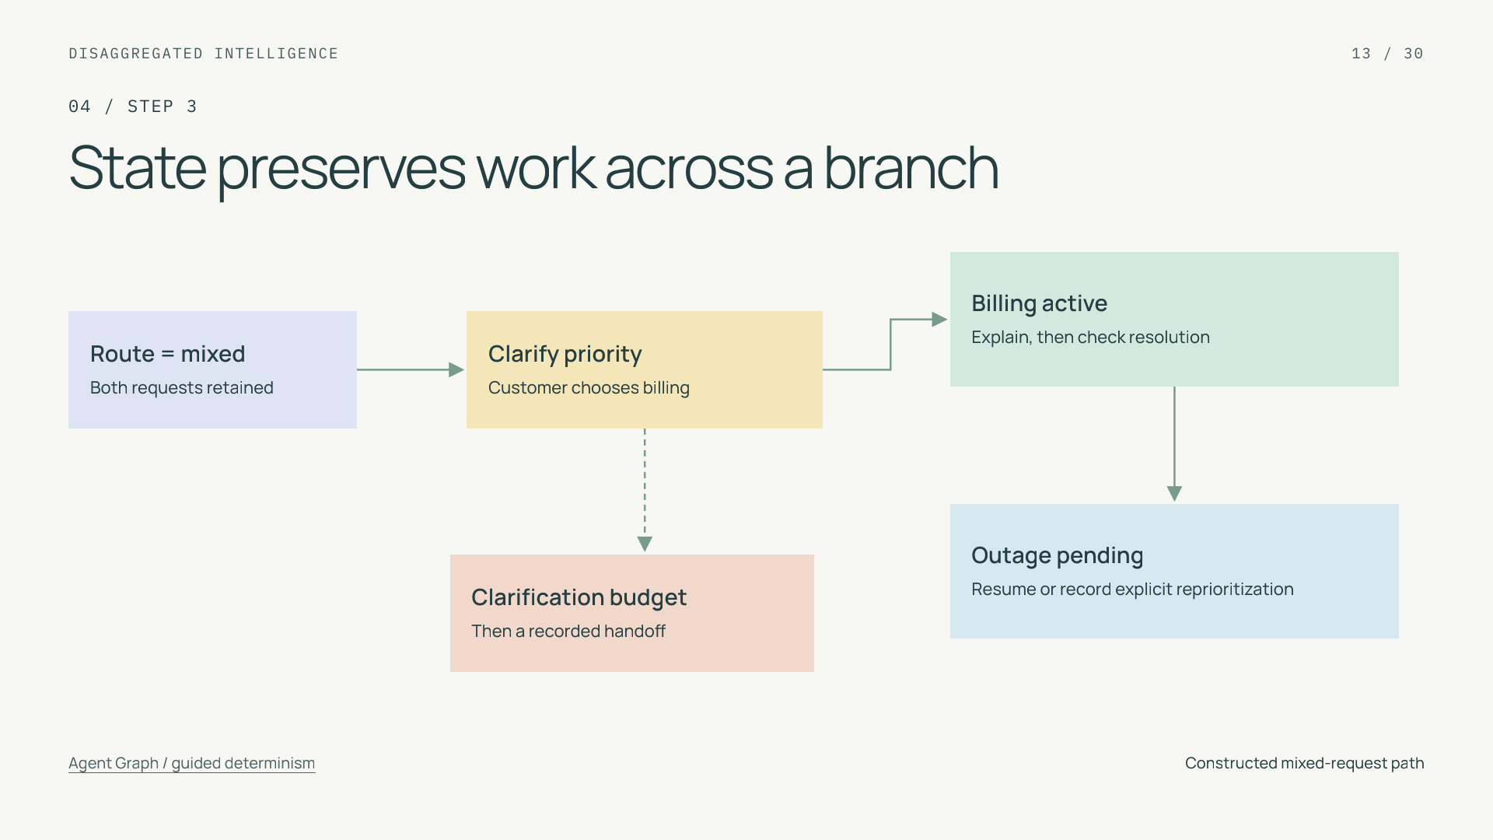
Notes:
State preserves work across a branch
Section: 04
Purpose: Make persistent obligations visible.
Suggested speaking time: 1 minutes
TALKING POINTS
• The application records requested, active, resolved, and handed-off task states separately.
• An explanation is an event, not a proof of resolution. The completion rule should reference the actual business outcome or customer confirmation.
• The clarification loop has a time or turn budget. A handoff retains outstanding work and receiving ownership.
Transition: This is where neural interpretation meets explicit control.
POWERPOINT EXPORT
This edition preserves the HTML slide design as one outlined SVG graphic with an embedded PNG fallback. Slide text is vector artwork, not editable PowerPoint paragraphs. Speaker notes remain editable. Use the companion HTML for interaction.
WEB REFERENCES
Agent Graph / guided determinism
https://engineering.salesforce.com/agentforces-agent-graph-toward-guided-determinism-with-hybrid-reasoning/
SLIDE TEXT REFERENCE
DISAGGREGATED INTELLIGENCE
13 / 30
04 / STEP 3
State preserves work across a branch
Route = mixed
Both requests retained
Clarify priority
Customer chooses billing
Billing active
Explain, then check resolution
Outage pending
Resume or record explicit reprioritization
Clarification budget
Then a recorded handoff
Agent Graph / guided determinism
Constructed mixed-request path

Slide 14
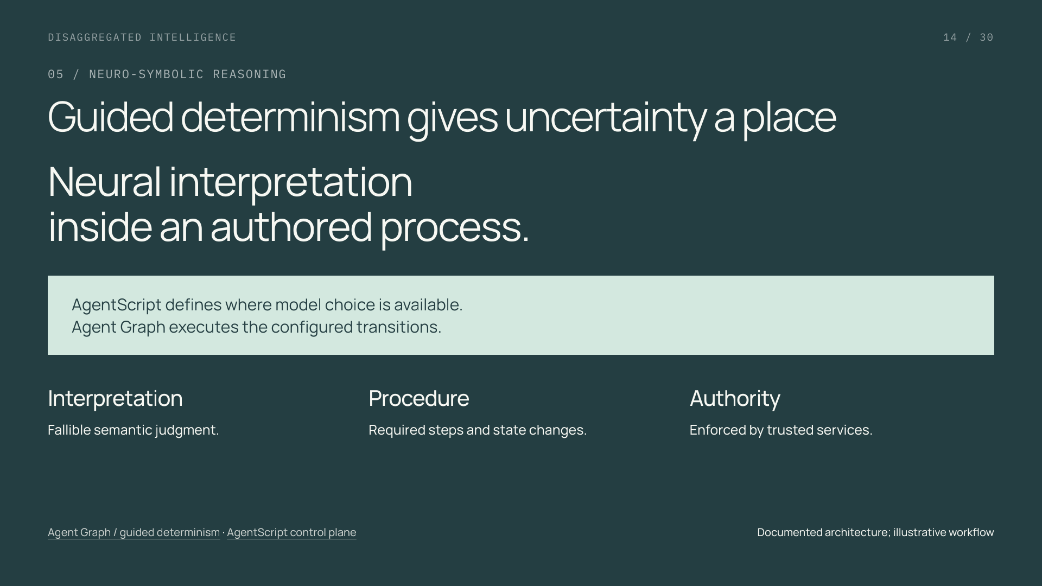
Notes:
Guided determinism gives uncertainty a place
Section: 05
Purpose: Explain neuro-symbolic reasoning in plain terms.
Suggested speaking time: 1 minutes
TALKING POINTS
• Neuro-symbolic reasoning combines learned interpretation with explicit software rules and state.
• Guided determinism describes constraints on the effect of model judgments. It does not guarantee perfect classification, identical prose, or eventual completion.
• The configuration and the model can evolve independently when their boundary is explicit and tested.
Transition: Three AgentScript concepts make that boundary concrete.
POWERPOINT EXPORT
This edition preserves the HTML slide design as one outlined SVG graphic with an embedded PNG fallback. Slide text is vector artwork, not editable PowerPoint paragraphs. Speaker notes remain editable. Use the companion HTML for interaction.
WEB REFERENCES
Agent Graph / guided determinism
https://engineering.salesforce.com/agentforces-agent-graph-toward-guided-determinism-with-hybrid-reasoning/
AgentScript control plane
https://www.salesforce.com/blog/agent-script-control-plane/
SLIDE TEXT REFERENCE
DISAGGREGATED INTELLIGENCE
14 / 30
05 / NEURO-SYMBOLIC REASONING
Guided determinism gives uncertainty a place
Neural interpretation
inside an authored process.
AgentScript defines where model choice is available.
Agent Graph executes the configured transitions.
Interpretation
Fallible semantic judgment.
Procedure
Required steps and state changes.
Authority
Enforced by trusted services.
Agent Graph / guided determinism · AgentScript control plane
Documented architecture; illustrative workflow

Slide 15
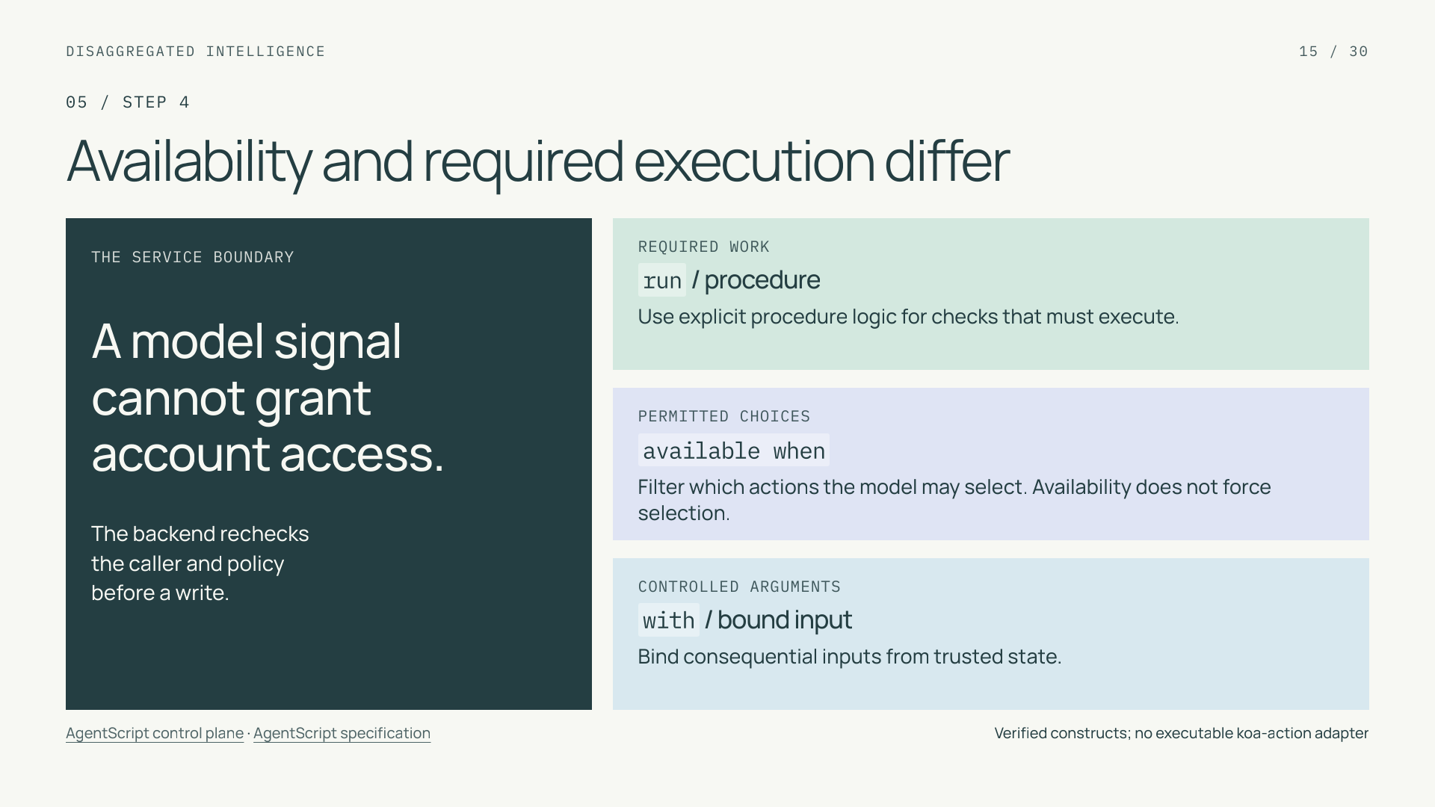
Notes:
Availability and required execution differ
Section: 05
Purpose: Teach precise AgentScript control semantics.
Suggested speaking time: 1 minutes
TALKING POINTS
• These are language constructs, not a runnable integration. Action definitions, dialect, and deployment configuration are omitted.
• An availability guard controls the offered action set. Required verification belongs in deterministic procedure logic and must also be enforced by the business service.
• Bind trusted account context rather than allowing model extraction to establish authority. No email-found lookup alone is sufficient authentication.
Transition: Walk the proposed request through all of its owners.
POWERPOINT EXPORT
This edition preserves the HTML slide design as one outlined SVG graphic with an embedded PNG fallback. Slide text is vector artwork, not editable PowerPoint paragraphs. Speaker notes remain editable. Use the companion HTML for interaction.
WEB REFERENCES
AgentScript control plane
https://www.salesforce.com/blog/agent-script-control-plane/
AgentScript specification
https://github.com/salesforce/agentscript/blob/main/SPEC.md
SLIDE TEXT REFERENCE
DISAGGREGATED INTELLIGENCE
15 / 30
05 / STEP 4
Availability and required execution differ
THE SERVICE BOUNDARY
A model signal
cannot grant
account access.
The backend rechecks
the caller and policy
before a write.
REQUIRED WORK
run / procedure
Use explicit procedure logic for checks that must execute.
PERMITTED CHOICES
available when
Filter which actions the model may select. Availability does not force selection.
CONTROLLED ARGUMENTS
with / bound input
Bind consequential inputs from trusted state.
AgentScript control plane · AgentScript specification
Verified constructs; no executable koa-action adapter

Slide 16
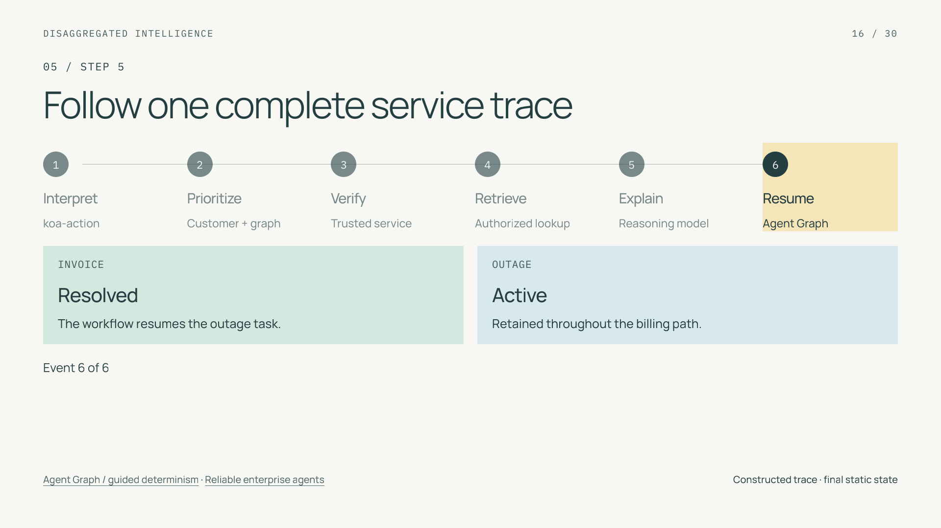
Notes:
Follow one complete service trace
Section: 05
Purpose: Make ordered state transitions concrete.
Suggested speaking time: 1.4 minutes
TALKING POINTS
• This is an interactive constructed trace. Advance through owners and watch both ledger entries.
• In the favorable path the customer confirms the invoice explanation. Without confirmation or another declared resolution condition, it stays open.
• An accepted handoff records ownership and work remaining; it should not be counted as a resolved task.
Transition: Now design the non-happy paths.
POWERPOINT EXPORT
This edition preserves the HTML slide design as one outlined SVG graphic with an embedded PNG fallback. Slide text is vector artwork, not editable PowerPoint paragraphs. Speaker notes remain editable. Use the companion HTML for interaction.
STATIC TRACE: Event 6 of 6. Invoice: Resolved; outage: Active. The workflow resumes the outage task.
Walkthrough: capture both requested obligations, prioritize billing, verify access, retrieve authorized facts, explain, confirm resolution, and resume the unresolved outage. The last state leaves the outage active and unresolved.
WEB REFERENCES
Agent Graph / guided determinism
https://engineering.salesforce.com/agentforces-agent-graph-toward-guided-determinism-with-hybrid-reasoning/
Reliable enterprise agents
https://engineering.salesforce.com/building-enterprise-ai-agents-that-are-both-autonomous-and-reliable/
SLIDE TEXT REFERENCE
DISAGGREGATED INTELLIGENCE
16 / 30
05 / STEP 5
Follow one complete service trace
1
Interpret
koa-action
2
Prioritize
Customer + graph
3
Verify
Trusted service
4
Retrieve
Authorized lookup
5
Explain
Reasoning model
6
Resume
Agent Graph
INVOICE
Resolved
The workflow resumes the outage task.
OUTAGE
Active
Retained throughout the billing path.
Event 6 of 6
Agent Graph / guided determinism · Reliable enterprise agents
Constructed trace · final static state

Slide 17
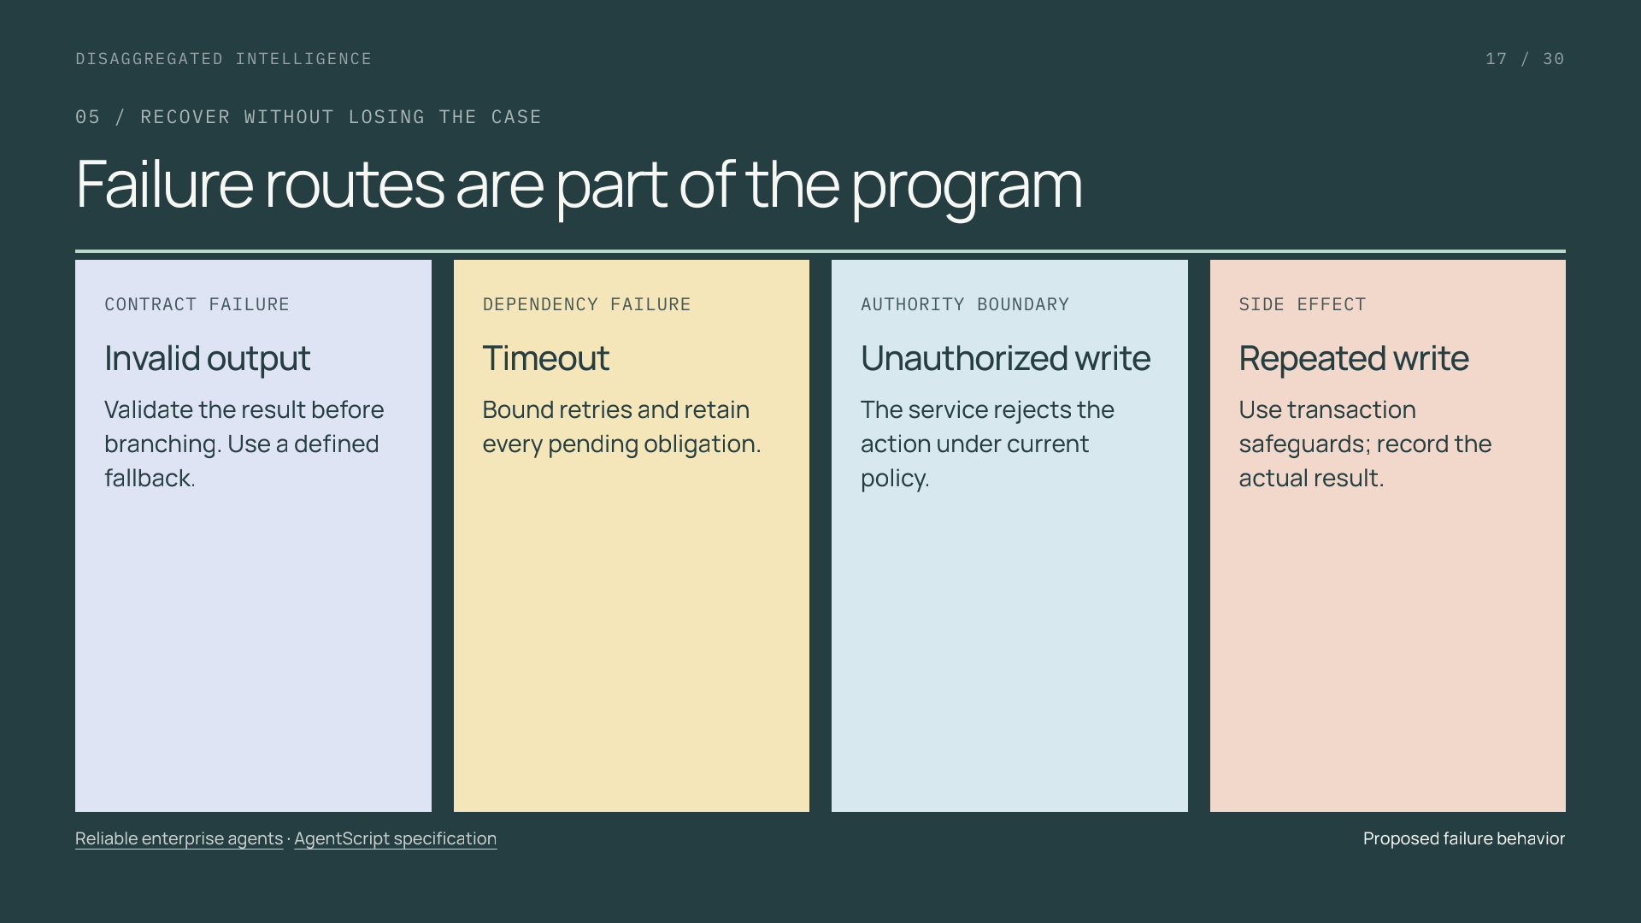
Notes:
Failure routes are part of the program
Section: 05
Purpose: Connect reliability to failure contracts.
Suggested speaking time: 1 minutes
TALKING POINTS
• A graph needs meaningful timeout, invalid-output, and handoff routes rather than a default business action.
• A resumed workflow can reuse a recorded decision, but this alone does not guarantee exactly-once external side effects.
• Transaction-specific safeguards belong in the service performing the write. Recovery must retain the unfinished tasks.
Transition: A valid decision can still be semantically wrong.
POWERPOINT EXPORT
This edition preserves the HTML slide design as one outlined SVG graphic with an embedded PNG fallback. Slide text is vector artwork, not editable PowerPoint paragraphs. Speaker notes remain editable. Use the companion HTML for interaction.
WEB REFERENCES
Reliable enterprise agents
https://engineering.salesforce.com/building-enterprise-ai-agents-that-are-both-autonomous-and-reliable/
AgentScript specification
https://github.com/salesforce/agentscript/blob/main/SPEC.md
SLIDE TEXT REFERENCE
DISAGGREGATED INTELLIGENCE
17 / 30
05 / RECOVER WITHOUT LOSING THE CASE
Failure routes are part of the program
CONTRACT FAILURE
Invalid output
Validate the result before branching. Use a defined fallback.
DEPENDENCY FAILURE
Timeout
Bound retries and retain every pending obligation.
AUTHORITY BOUNDARY
Unauthorized write
The service rejects the action under current policy.
SIDE EFFECT
Repeated write
Use transaction safeguards; record the actual result.
Reliable enterprise agents · AgentScript specification
Proposed failure behavior

Slide 18
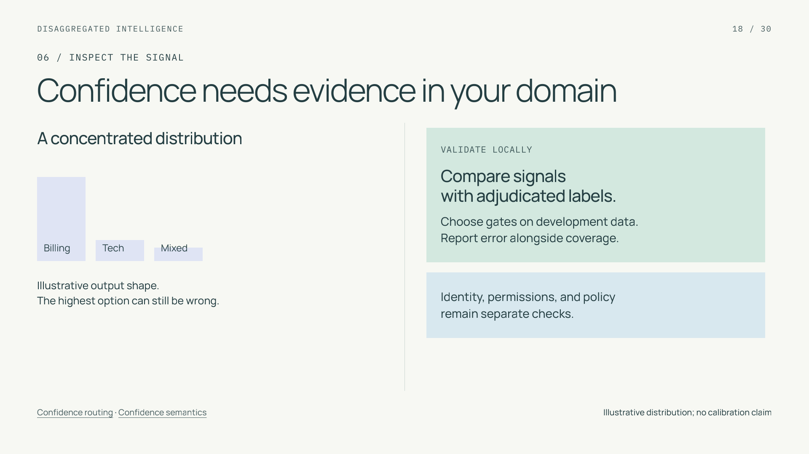
Notes:
Confidence needs evidence in your domain
Section: 06
Purpose: Distinguish signal concentration from correctness and permission.
Suggested speaking time: 1 minutes
TALKING POINTS
• TypeSafe defines Choice and Score confidence from distribution concentration. Noul has no separate confidence field.
• The picture is schematic and does not display a returned koa-action distribution. Any provider signal needs a specified meaning and local validation.
• A score cannot authorize a business action. Numerical gates are application operating points, not universal constants.
Transition: Explore what a stricter gate does to a small labeled sample.
POWERPOINT EXPORT
This edition preserves the HTML slide design as one outlined SVG graphic with an embedded PNG fallback. Slide text is vector artwork, not editable PowerPoint paragraphs. Speaker notes remain editable. Use the companion HTML for interaction.
WEB REFERENCES
Confidence routing
https://docs.typesafe.ai/patterns/confidence-routing
Confidence semantics
https://docs.typesafe.ai/confidence
SLIDE TEXT REFERENCE
DISAGGREGATED INTELLIGENCE
18 / 30
06 / INSPECT THE SIGNAL
Confidence needs evidence in your domain
A concentrated distribution
Billing
Tech
Mixed
Illustrative output shape.
The highest option can still be wrong.
VALIDATE LOCALLY
Compare signals
with adjudicated labels.
Choose gates on development data.
Report error alongside coverage.
Identity, permissions, and policy
remain separate checks.
Confidence routing · Confidence semantics
Illustrative distribution; no calibration claim

Slide 19
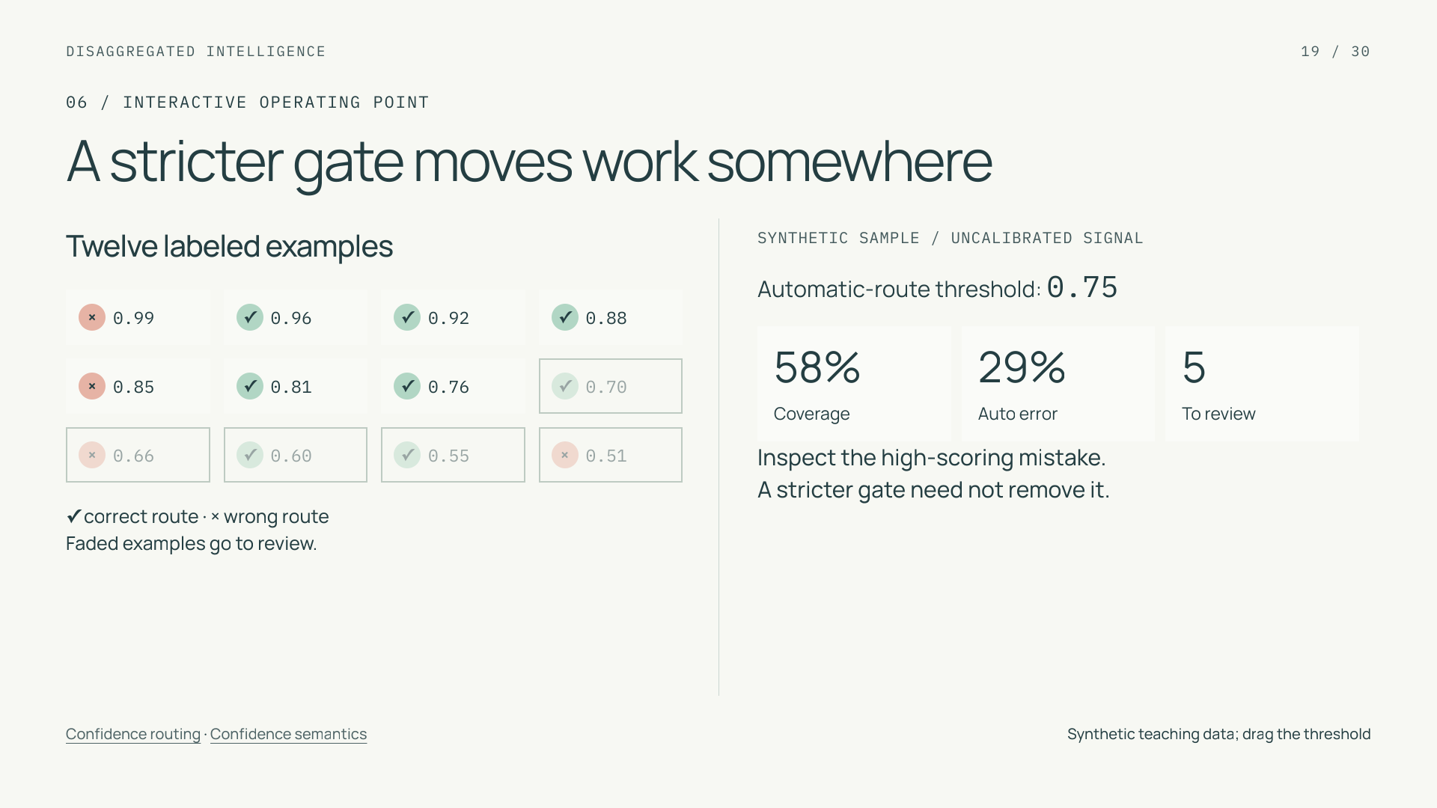
Notes:
A stricter gate moves work somewhere
Section: 06
Purpose: Teach selection, error rate, and coverage without fabricated evidence.
Suggested speaking time: 1.3 minutes
TALKING POINTS
• All twelve cases and their scores are constructed teaching data. The signal is uncalibrated and is not a real koa-action field.
• Automatic coverage is accepted cases divided by twelve. Automatic error uses only accepted cases; at zero accepted cases it is undefined.
• A high-scoring error remains when the threshold rises. Escalations still consume capacity, and errors need not decline monotonically on this sample.
Transition: Next account for the work that the routing gate adds and avoids.
POWERPOINT EXPORT
This edition preserves the HTML slide design as one outlined SVG graphic with an embedded PNG fallback. Slide text is vector artwork, not editable PowerPoint paragraphs. Speaker notes remain editable. Use the companion HTML for interaction.
STATIC CONFIDENCE EXAMPLE: threshold 0.75. The twelve examples and scores are constructed teaching data. The HTML slider changes which examples are automated; a high-scoring mistake can survive a stricter gate. Threshold selection requires independent calibration and evaluation.
WEB REFERENCES
Confidence routing
https://docs.typesafe.ai/patterns/confidence-routing
Confidence semantics
https://docs.typesafe.ai/confidence
SLIDE TEXT REFERENCE
DISAGGREGATED INTELLIGENCE
19 / 30
06 / INTERACTIVE OPERATING POINT
A stricter gate moves work somewhere
Twelve labeled examples
×
0.99
✓
0.96
✓
0.92
✓
0.88
×
0.85
✓
0.81
✓
0.76
✓
0.70
×
0.66
✓
0.60
✓
0.55
×
0.51
✓ correct route · × wrong route
Faded examples go to review.
SYNTHETIC SAMPLE / UNCALIBRATED SIGNAL
Automatic-route threshold: 0.75
58%
Coverage
29%
Auto error
5
To review
Inspect the high-scoring mistake.
A stricter gate need not remove it.
Confidence routing · Confidence semantics
Synthetic teaching data; drag the threshold

Slide 20
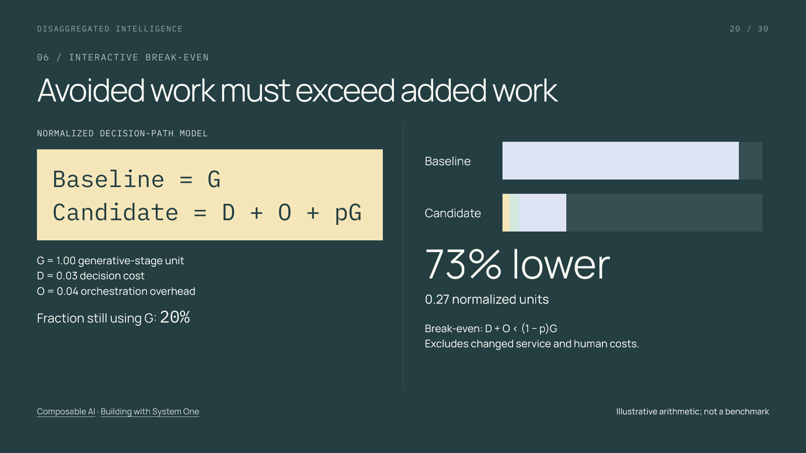
Notes:
Avoided work must exceed added work
Section: 06
Purpose: Explain conditional economics with transparent algebra.
Suggested speaking time: 1.3 minutes
TALKING POINTS
• The numbers are arbitrary normalized units for illustration, not prices, measurements, or a koa-action performance estimate.
• The model assumes the same generative-stage cost G whenever invoked. Candidate cost is decision cost plus added orchestration plus p times G.
• When p approaches one, the added decision can make the path more expensive. Evaluate whole-case costs separately, including tools, retries, human handling, and unresolved obligations.
Transition: Inference latency has an equally important boundary.
POWERPOINT EXPORT
This edition preserves the HTML slide design as one outlined SVG graphic with an embedded PNG fallback. Slide text is vector artwork, not editable PowerPoint paragraphs. Speaker notes remain editable. Use the companion HTML for interaction.
STATIC COST EXAMPLE: 20% of routes still use the expensive routing stage. With invented normalized units G=1, D=0.03 and O=0.04, candidate cost is 0.27 versus 1.00 (73% lower for this routing stage only). At 93% fallback the candidate breaks even; at 100% it costs 1.07, or 7% more. This excludes later explanation, service work and changed human costs; it is not a vendor benchmark.
WEB REFERENCES
Composable AI
https://typesafe.ai/manifesto
Building with System One
https://docs.typesafe.ai/concepts/how-to-build-with-system-one
SLIDE TEXT REFERENCE
DISAGGREGATED INTELLIGENCE
20 / 30
06 / INTERACTIVE BREAK-EVEN
Avoided work must exceed added work
NORMALIZED DECISION-PATH MODEL
Baseline = G
Candidate = D + O + pG
G = 1.00 generative-stage unit
D = 0.03 decision cost
O = 0.04 orchestration overhead
Fraction still using G: 20%
Baseline
Candidate
73% lower
0.27 normalized units
Break-even: D + O < (1 − p)G
Excludes changed service and human costs.
Composable AI · Building with System One
Illustrative arithmetic; not a benchmark

Slide 21
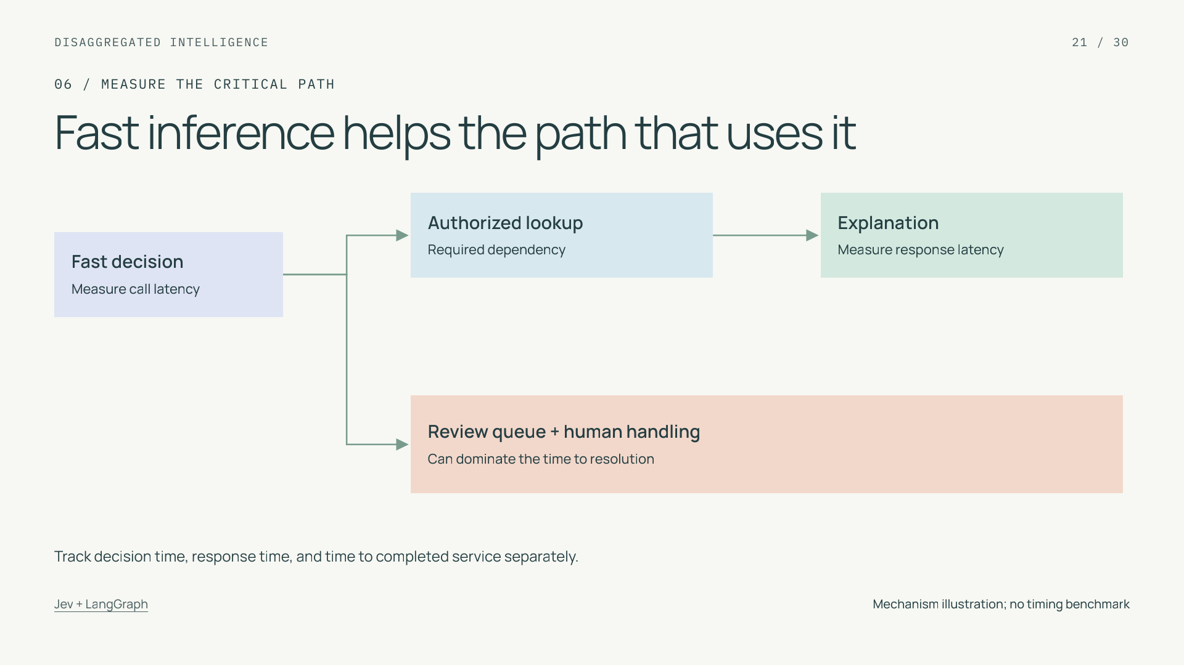
Notes:
Fast inference helps the path that uses it
Section: 06
Purpose: Separate primitive speed from workflow speed.
Suggested speaking time: 1 minutes
TALKING POINTS
• Specialized inference can shorten a repeated semantic step. A faster classifier does not by itself establish faster service resolution.
• Client-observed call latency includes transport and retries; parallel branches affect critical-path duration differently from serial dependencies.
• Measure distribution tails as well as typical latency at the relevant load. Include unfinished cases when reporting resolution, rather than averaging completed cases alone.
Transition: Apply the control model to a deliberately incomplete design.
POWERPOINT EXPORT
This edition preserves the HTML slide design as one outlined SVG graphic with an embedded PNG fallback. Slide text is vector artwork, not editable PowerPoint paragraphs. Speaker notes remain editable. Use the companion HTML for interaction.
WEB REFERENCES
Jev + LangGraph
https://www.langchain.com/blog/building-prod-with-jev-and-langgraph
SLIDE TEXT REFERENCE
DISAGGREGATED INTELLIGENCE
21 / 30
06 / MEASURE THE CRITICAL PATH
Fast inference helps the path that uses it
Fast decision
Measure call latency
Authorized lookup
Required dependency
Explanation
Measure response latency
Review queue + human handling
Can dominate the time to resolution
Track decision time, response time, and time to completed service separately.
Jev + LangGraph
Mechanism illustration; no timing benchmark

Slide 22
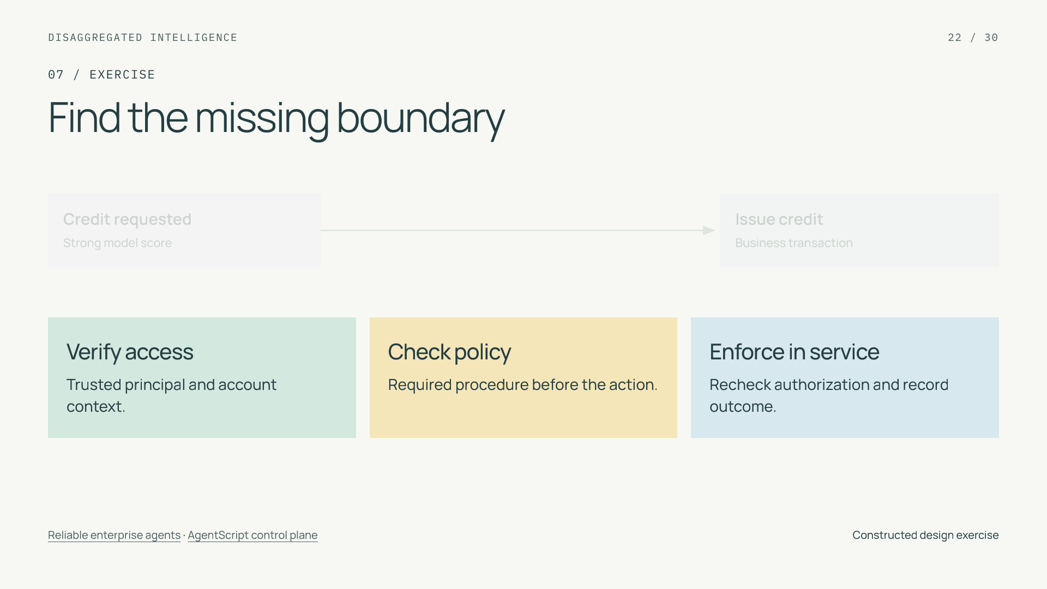
Notes:
Find the missing boundary
Section: 07
Purpose: Check whether the learner can separate prediction from authority.
Suggested speaking time: 1.3 minutes
TALKING POINTS
• Allow a short pause before revealing the repair. The initial diagram is intentionally incomplete.
• The strongest answer identifies both authored ordering and independent backend enforcement. Raising the classifier threshold alone does not repair the design.
• Also retain pending tasks and specify a bounded fallback. A credit operation has consequences outside the model response.
Transition: Training examples must respect the same decision boundaries.
POWERPOINT EXPORT
This edition preserves the HTML slide design as one outlined SVG graphic with an embedded PNG fallback. Slide text is vector artwork, not editable PowerPoint paragraphs. Speaker notes remain editable. Use the companion HTML for interaction.
STATIC EXERCISE: the repair is revealed. Before showing the repair, ask what is missing between a predicted credit request and a financial action. The repair verifies account access, checks policy, and enforces authorization in the service. The diagram size correction is export-only for the first HTML edition.
WEB REFERENCES
Reliable enterprise agents
https://engineering.salesforce.com/building-enterprise-ai-agents-that-are-both-autonomous-and-reliable/
AgentScript control plane
https://www.salesforce.com/blog/agent-script-control-plane/
SLIDE TEXT REFERENCE
DISAGGREGATED INTELLIGENCE
22 / 30
07 / EXERCISE
Find the missing boundary
Credit requested
Strong model score
Issue credit
Business transaction
Verify access
Trusted principal and account context.
Check policy
Required procedure before the action.
Enforce in service
Recheck authorization and record outcome.
Reliable enterprise agents · AgentScript control plane
Constructed design exercise

Slide 23
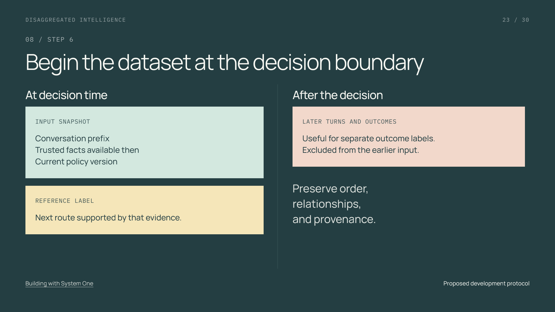
Notes:
Begin the dataset at the decision boundary
Section: 08
Purpose: Prevent future information leaking into model features.
Suggested speaking time: 1 minutes
TALKING POINTS
• Freeze the source snapshot and reconstruct what the routing node could actually access at the timestamp.
• Use independently adjudicated route labels, including mixed and unclear cases. Reviewers labeling the next step see the decision-time evidence.
• Record redaction, filtering, and derived examples. Preserving the source does not mean transformations leave the model-visible distribution unchanged.
Transition: Separate fitting and selection from final evaluation.
POWERPOINT EXPORT
This edition preserves the HTML slide design as one outlined SVG graphic with an embedded PNG fallback. Slide text is vector artwork, not editable PowerPoint paragraphs. Speaker notes remain editable. Use the companion HTML for interaction.
WEB REFERENCES
Building with System One
https://docs.typesafe.ai/concepts/how-to-build-with-system-one
SLIDE TEXT REFERENCE
DISAGGREGATED INTELLIGENCE
23 / 30
08 / STEP 6
Begin the dataset at the decision boundary
At decision time
INPUT SNAPSHOT
Conversation prefix
Trusted facts available then
Current policy version
REFERENCE LABEL
Next route supported by that evidence.
After the decision
LATER TURNS AND OUTCOMES
Useful for separate outcome labels.
Excluded from the earlier input.
Preserve order,
relationships,
and provenance.
Building with System One
Proposed development protocol

Slide 24
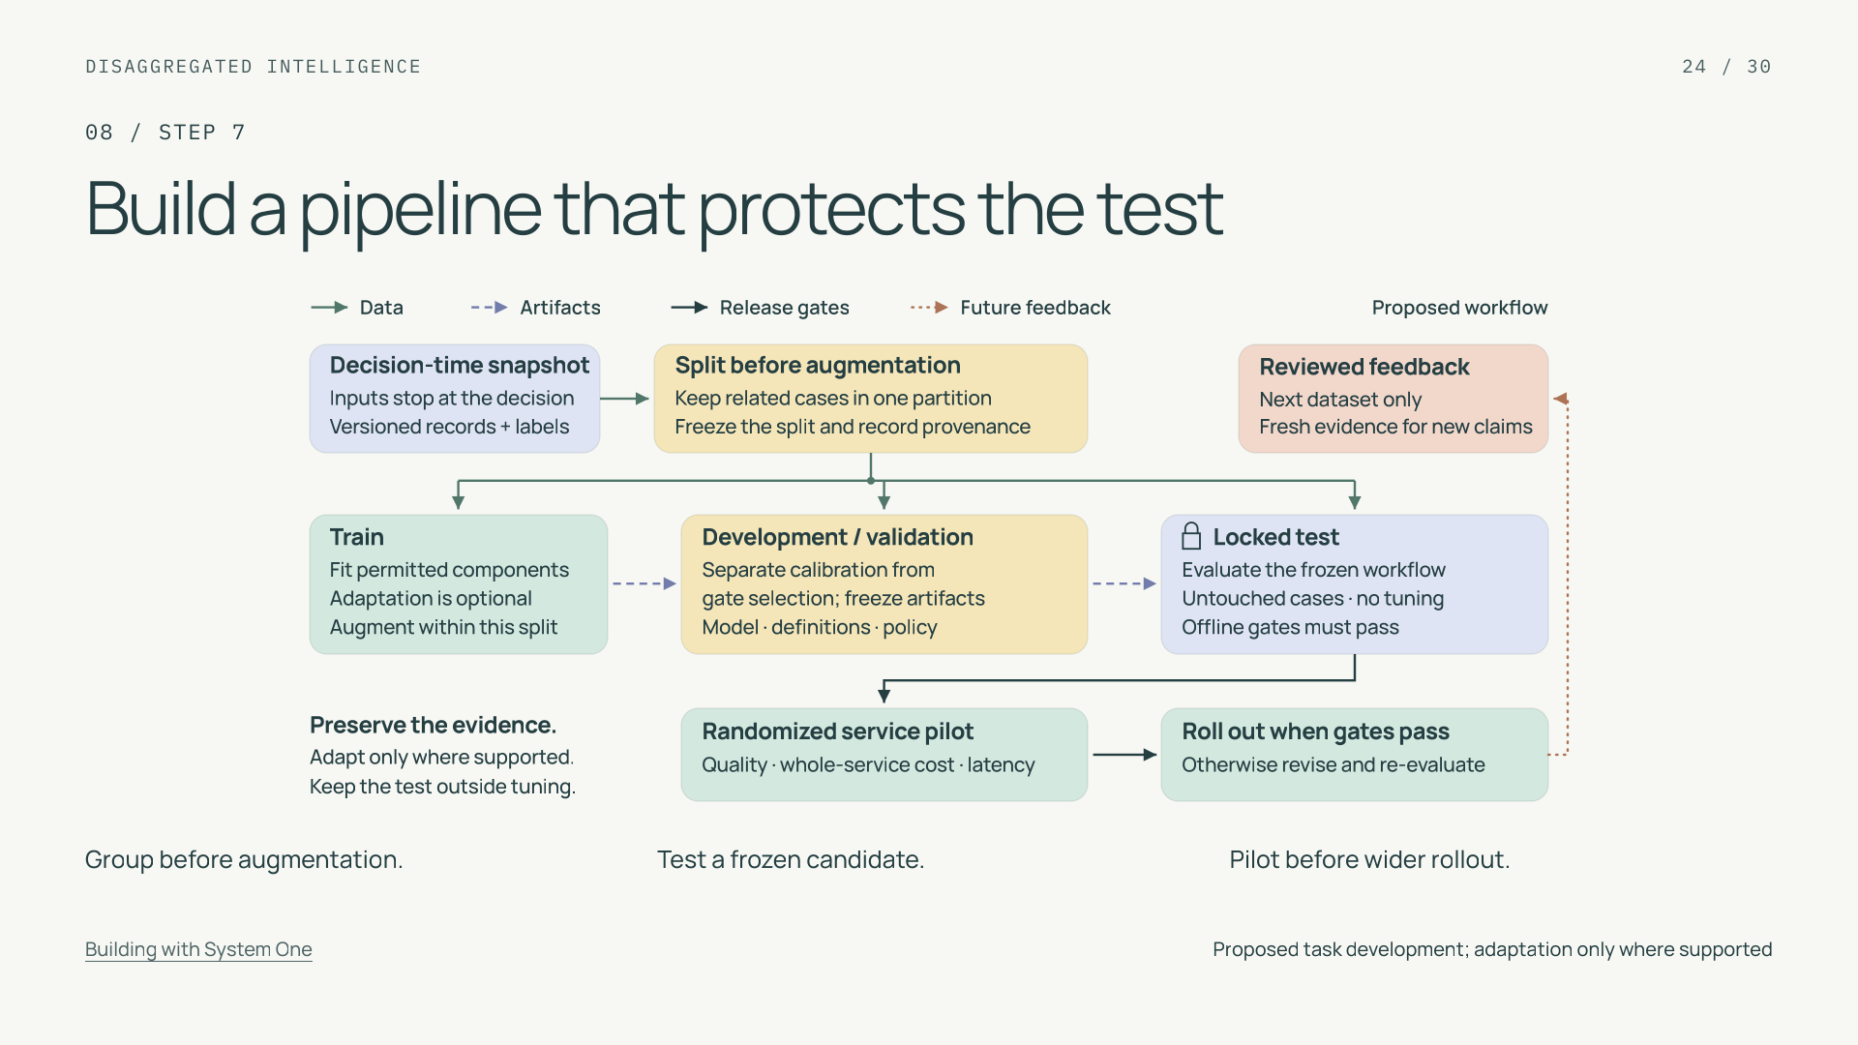
Notes:
Build a pipeline that protects the test
Section: 08
Purpose: Explain the complete leakage-resistant task-development pipeline.
Suggested speaking time: 1.3 minutes
TALKING POINTS
• This is a proposed development pipeline, not koa-action pretraining. Direct adaptation is optional and conditional on supported access.
• Train data fits permitted components. Development data uses separate calibration and gate-selection subsets. Locked test data evaluates the frozen model and policy.
• Offline gates qualify the candidate for a randomized service pilot. Broader rollout needs pilot quality and economic evidence; reviewed feedback enters only a future dataset.
Transition: The split itself must match the deployment claim.
POWERPOINT EXPORT
This edition preserves the HTML slide design as one outlined SVG graphic with an embedded PNG fallback. Slide text is vector artwork, not editable PowerPoint paragraphs. Speaker notes remain editable. Use the companion HTML for interaction.
WEB REFERENCES
Building with System One
https://docs.typesafe.ai/concepts/how-to-build-with-system-one
SLIDE TEXT REFERENCE
DISAGGREGATED INTELLIGENCE
24 / 30
08 / STEP 7
Build a pipeline that protects the test
Group before augmentation.
Test a frozen candidate.
Pilot before wider rollout.
Building with System One
Proposed task development; adaptation only where supported

Slide 25
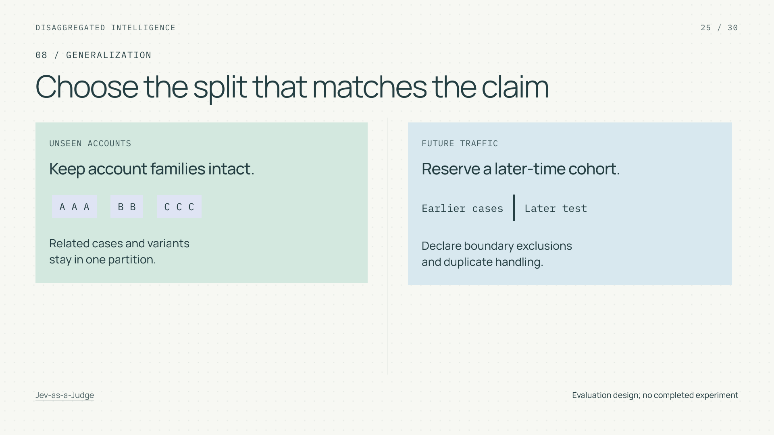
Notes:
Choose the split that matches the claim
Section: 08
Purpose: Distinguish independent cases from repeated observations.
Suggested speaking time: 1 minutes
TALKING POINTS
• Unseen-account performance and future-traffic performance are different claims and may need separate tests.
• Assign related cases and near duplicates together, and generate training augmentations only after partitioning.
• One conversation evaluated many times still represents one customer situation. Repeated judgments estimate repeatability, not generalization over new cases.
Transition: Define what evidence would earn a rollout.
POWERPOINT EXPORT
This edition preserves the HTML slide design as one outlined SVG graphic with an embedded PNG fallback. Slide text is vector artwork, not editable PowerPoint paragraphs. Speaker notes remain editable. Use the companion HTML for interaction.
WEB REFERENCES
Jev-as-a-Judge
https://www.langchain.com/blog/jev-agent-evals-langsmith
SLIDE TEXT REFERENCE
DISAGGREGATED INTELLIGENCE
25 / 30
08 / GENERALIZATION
Choose the split that matches the claim
UNSEEN ACCOUNTS
Keep account families intact.
A A A
B B
C C C
Related cases and variants
stay in one partition.
FUTURE TRAFFIC
Reserve a later-time cohort.
Earlier cases
Later test
Declare boundary exclusions
and duplicate handling.
Jev-as-a-Judge
Evaluation design; no completed experiment

Slide 26
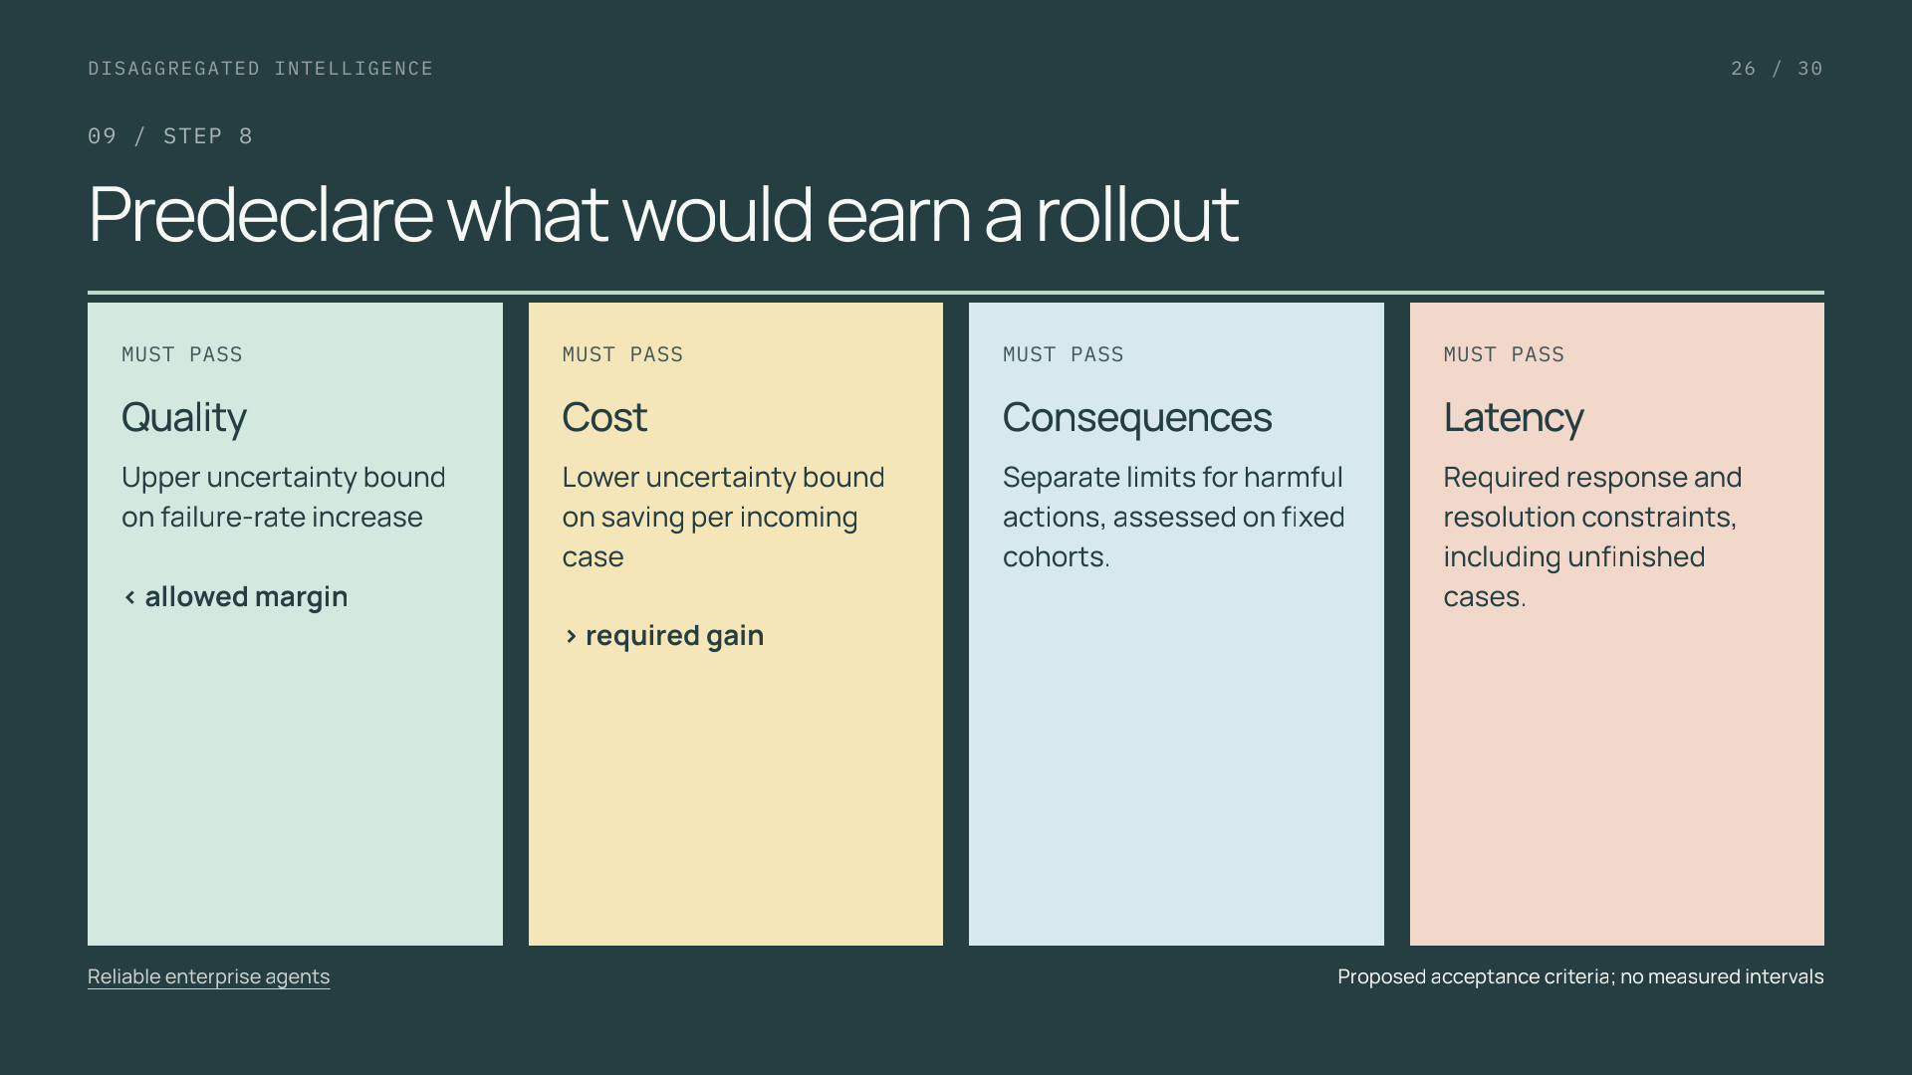
Notes:
Predeclare what would earn a rollout
Section: 09
Purpose: Make reliability and cost a joint acceptance question.
Suggested speaking time: 1 minutes
TALKING POINTS
• The null is unacceptable quality loss OR insufficient saving. A nonsignificant quality difference does not establish acceptable equivalence.
• Define a failed case as an incorrect outcome or any requested task unresolved by the fixed deadline. Count every incoming case once.
• Choose sample size and uncertainty methods before testing. Define consequential-error cohorts from independent evidence, not each model’s selected action branch.
Transition: Use offline and service experiments for different questions.
POWERPOINT EXPORT
This edition preserves the HTML slide design as one outlined SVG graphic with an embedded PNG fallback. Slide text is vector artwork, not editable PowerPoint paragraphs. Speaker notes remain editable. Use the companion HTML for interaction.
WEB REFERENCES
Reliable enterprise agents
https://engineering.salesforce.com/building-enterprise-ai-agents-that-are-both-autonomous-and-reliable/
SLIDE TEXT REFERENCE
DISAGGREGATED INTELLIGENCE
26 / 30
09 / STEP 8
Predeclare what would earn a rollout
MUST PASS
Quality
Upper uncertainty bound on failure-rate increase
< allowed margin
MUST PASS
Cost
Lower uncertainty bound on saving per incoming case
> required gain
MUST PASS
Consequences
Separate limits for harmful actions, assessed on fixed cohorts.
MUST PASS
Latency
Required response and resolution constraints, including unfinished cases.
Reliable enterprise agents
Proposed acceptance criteria; no measured intervals

Slide 27
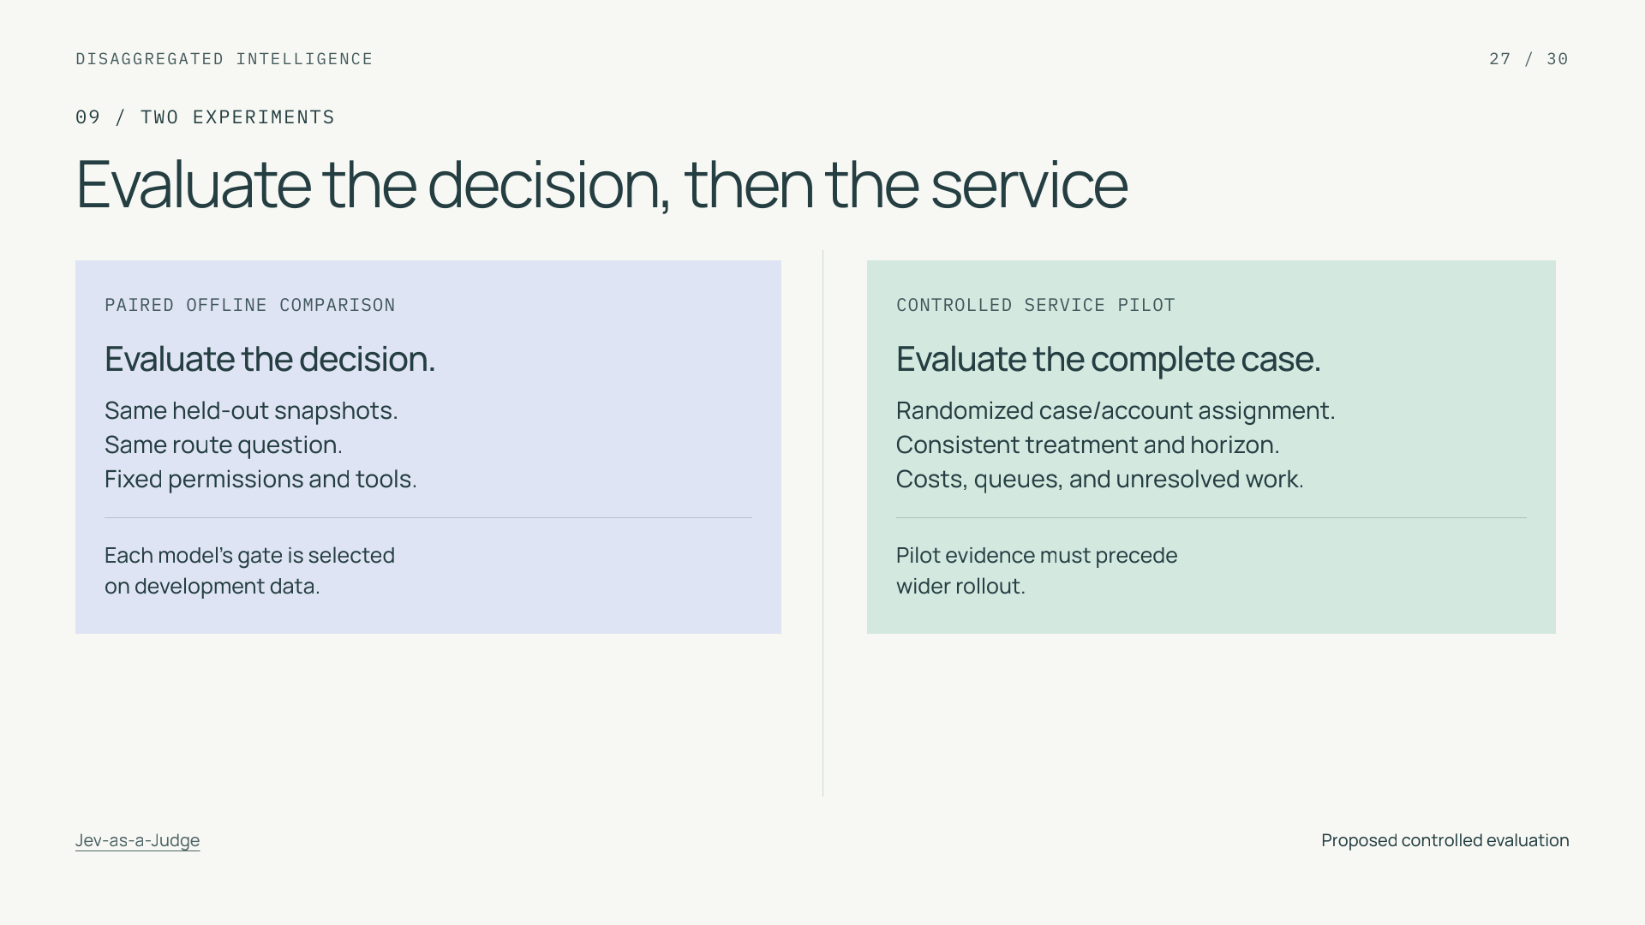
Notes:
Evaluate the decision, then the service
Section: 09
Purpose: Prevent offline results being overextended to service economics.
Suggested speaking time: 1 minutes
TALKING POINTS
• Offline replay isolates the bounded decision. It cannot estimate how changed dialogue affects customers or how escalations affect queue capacity.
• In the pilot, keep assignment stable and account for related cases and interference through shared queues. Use the same observation horizon in both arms.
• Report observed operating cost per incoming case with resolution and coverage. Disclose setup and maintenance costs separately; total ownership estimates need an explicit volume and horizon.
Transition: When an outcome fails, diagnose the responsible boundary.
POWERPOINT EXPORT
This edition preserves the HTML slide design as one outlined SVG graphic with an embedded PNG fallback. Slide text is vector artwork, not editable PowerPoint paragraphs. Speaker notes remain editable. Use the companion HTML for interaction.
WEB REFERENCES
Jev-as-a-Judge
https://www.langchain.com/blog/jev-agent-evals-langsmith
SLIDE TEXT REFERENCE
DISAGGREGATED INTELLIGENCE
27 / 30
09 / TWO EXPERIMENTS
Evaluate the decision, then the service
PAIRED OFFLINE COMPARISON
Evaluate the decision.
Same held-out snapshots.
Same route question.
Fixed permissions and tools.
Each model’s gate is selected
on development data.
CONTROLLED SERVICE PILOT
Evaluate the complete case.
Randomized case/account assignment.
Consistent treatment and horizon.
Costs, queues, and unresolved work.
Pilot evidence must precede
wider rollout.
Jev-as-a-Judge
Proposed controlled evaluation

Slide 28
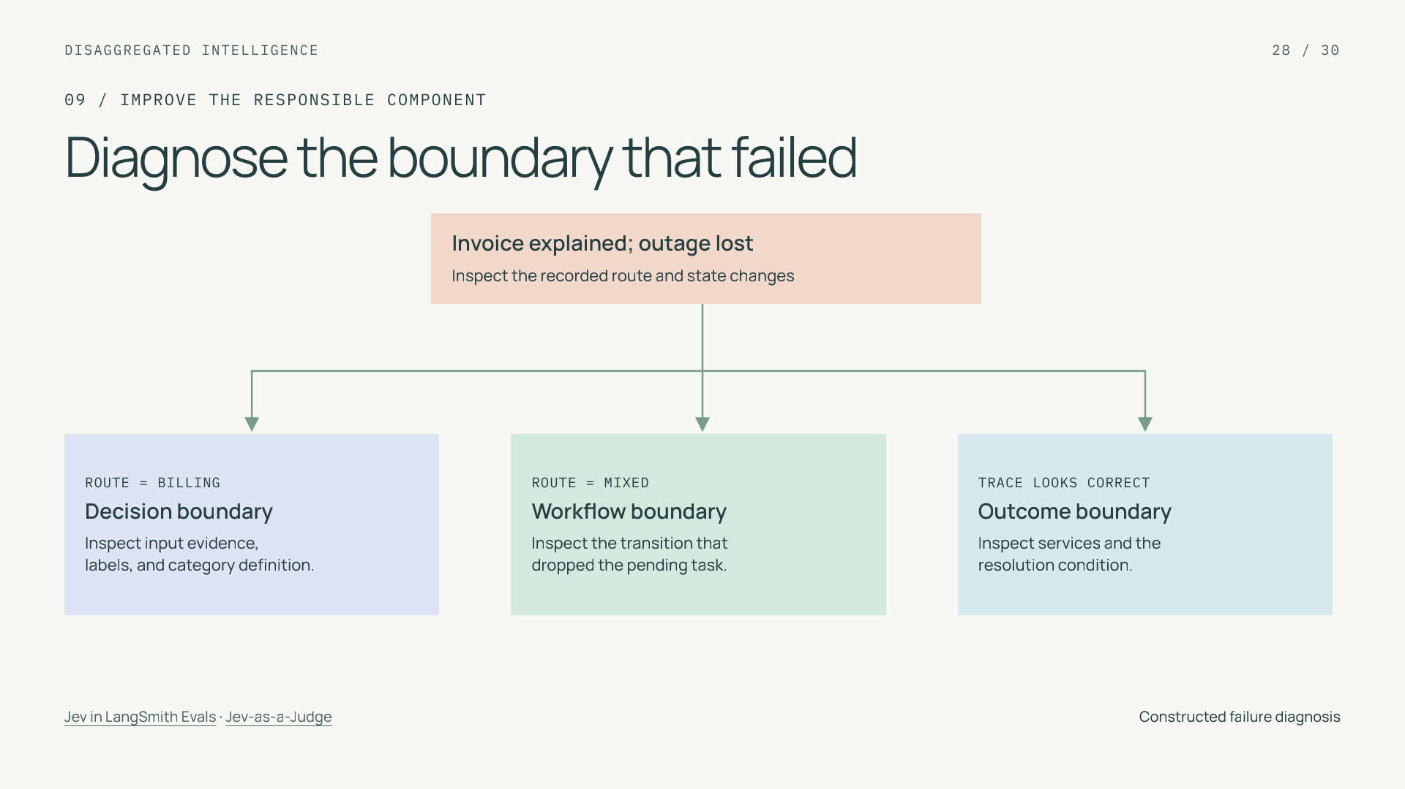
Notes:
Diagnose the boundary that failed
Section: 09
Purpose: Connect disaggregation to targeted learning from failure.
Suggested speaking time: 1 minutes
TALKING POINTS
• A wrong route can motivate better decision data. A correct mixed route followed by dropped state calls for a workflow repair.
• Offline semantic judges can prioritize traces, but require validation against independent references. Repeatability is a separate property from correctness.
• Sample apparent successes as well as escalations. A post-run evaluation score cannot prevent an action that has already happened.
Transition: Finish by identifying one worthwhile first change.
POWERPOINT EXPORT
This edition preserves the HTML slide design as one outlined SVG graphic with an embedded PNG fallback. Slide text is vector artwork, not editable PowerPoint paragraphs. Speaker notes remain editable. Use the companion HTML for interaction.
WEB REFERENCES
Jev in LangSmith Evals
https://www.langchain.com/blog/jev-is-now-available-in-langsmith-evals
Jev-as-a-Judge
https://www.langchain.com/blog/jev-agent-evals-langsmith
SLIDE TEXT REFERENCE
DISAGGREGATED INTELLIGENCE
28 / 30
09 / IMPROVE THE RESPONSIBLE COMPONENT
Diagnose the boundary that failed
Invoice explained; outage lost
Inspect the recorded route and state changes
ROUTE = BILLING
Decision boundary
Inspect input evidence,
labels, and category definition.
ROUTE = MIXED
Workflow boundary
Inspect the transition that
dropped the pending task.
TRACE LOOKS CORRECT
Outcome boundary
Inspect services and the
resolution condition.
Jev in LangSmith Evals · Jev-as-a-Judge
Constructed failure diagnosis

Slide 29
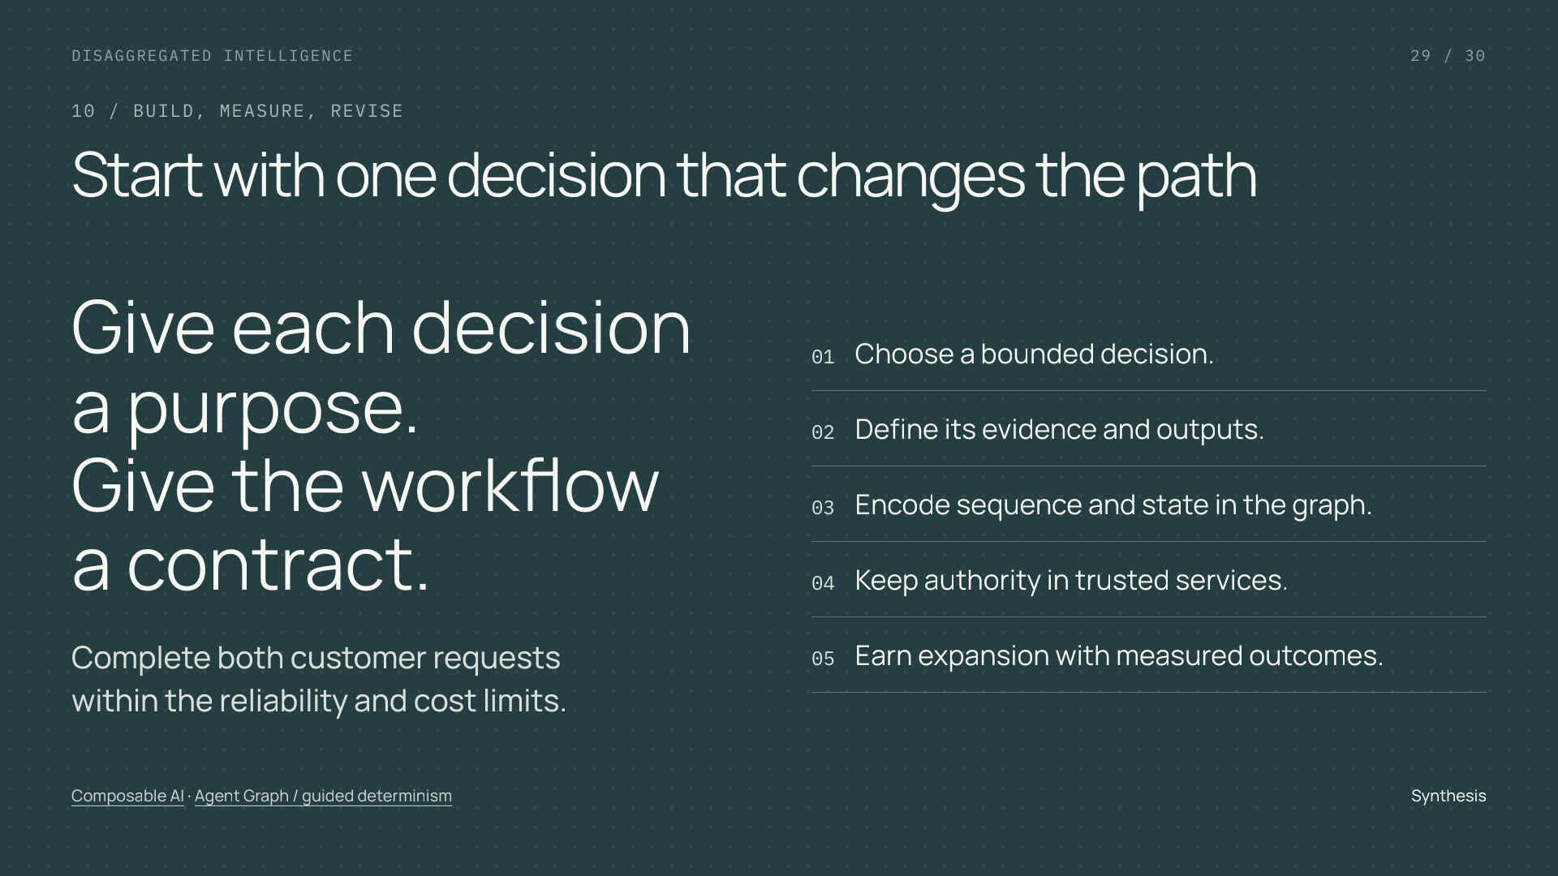
Notes:
Start with one decision that changes the path
Section: 10
Purpose: Give the audience a bounded practical next step.
Suggested speaking time: 0.7 minutes
TALKING POINTS
• The tutorial’s central claim is an allocation principle: specialize judgment where it earns its place, retain general reasoning where needed, and make control explicit.
• Predictable contracts and runtime paths create an inspectable system; correctness and economics still require evidence from complete cases.
• The next engineering artifact is a decision contract and a small graph, followed by held-out evaluation and a controlled pilot.
Transition: Use the source notes and full blog for the details behind this tutorial.
POWERPOINT EXPORT
This edition preserves the HTML slide design as one outlined SVG graphic with an embedded PNG fallback. Slide text is vector artwork, not editable PowerPoint paragraphs. Speaker notes remain editable. Use the companion HTML for interaction.
WEB REFERENCES
Composable AI
https://typesafe.ai/manifesto
Agent Graph / guided determinism
https://engineering.salesforce.com/agentforces-agent-graph-toward-guided-determinism-with-hybrid-reasoning/
SLIDE TEXT REFERENCE
DISAGGREGATED INTELLIGENCE
29 / 30
10 / BUILD, MEASURE, REVISE
Start with one decision that changes the path
Give each decision
a purpose.
Give the workflow
a contract.
Complete both customer requests
within the reliability and cost limits.
01Choose a bounded decision.
02Define its evidence and outputs.
03Encode sequence and state in the graph.
04Keep authority in trusted services.
05Earn expansion with measured outcomes.
Composable AI · Agent Graph / guided determinism
Synthesis

Slide 30
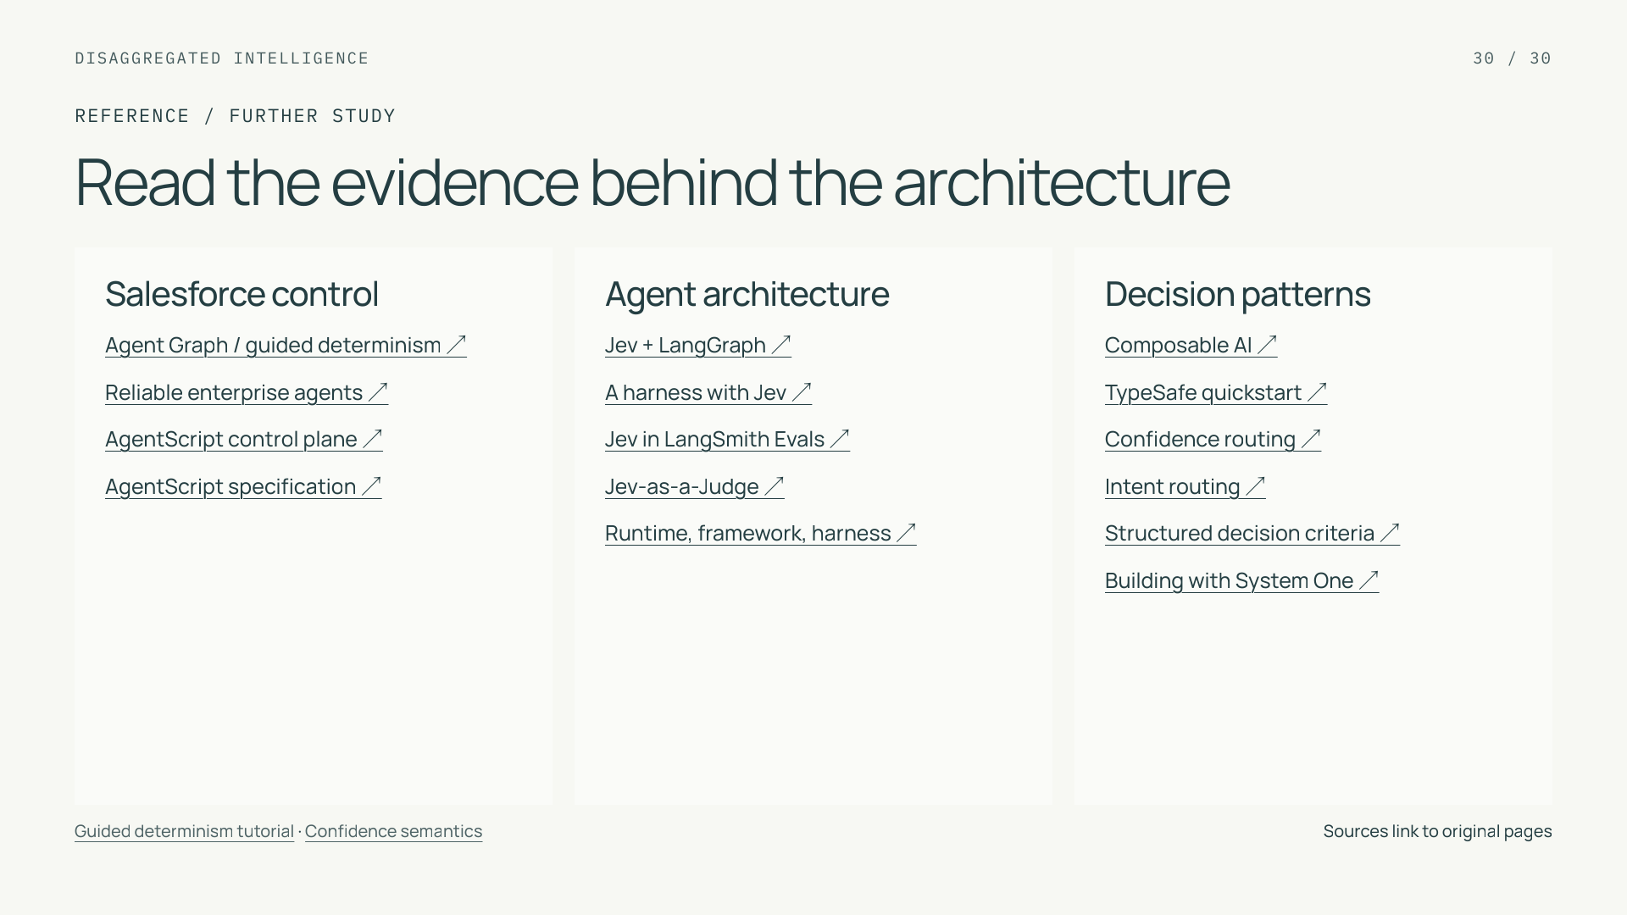
Notes:
Read the evidence behind the architecture
Section: Reference
Purpose: Provide inspectable source provenance and product boundaries.
Suggested speaking time: 0.5 minutes
TALKING POINTS
• The complete research ledger covers all sixteen requested web resources plus the final local blog and supplementary primary documentation.
• The Salesforce stack roles are grounded in the user brief and public graph/language resources; integration examples and training protocols remain proposals.
• No koa-action benchmark, SDK contract, fine-tuning access, or native adapter is asserted. The diagrams and numeric interactions are independently authored teaching examples.
Transition: End of tutorial.
POWERPOINT EXPORT
This edition preserves the HTML slide design as one outlined SVG graphic with an embedded PNG fallback. Slide text is vector artwork, not editable PowerPoint paragraphs. Speaker notes remain editable. Use the companion HTML for interaction.
WEB REFERENCES
Agent Graph / guided determinism ↗
https://engineering.salesforce.com/agentforces-agent-graph-toward-guided-determinism-with-hybrid-reasoning/
Reliable enterprise agents ↗
https://engineering.salesforce.com/building-enterprise-ai-agents-that-are-both-autonomous-and-reliable/
AgentScript control plane ↗
https://www.salesforce.com/blog/agent-script-control-plane/
AgentScript specification ↗
https://github.com/salesforce/agentscript/blob/main/SPEC.md
Jev + LangGraph ↗
https://www.langchain.com/blog/building-prod-with-jev-and-langgraph
A harness with Jev ↗
https://www.langchain.com/blog/building-a-harness-with-jev
Jev in LangSmith Evals ↗
https://www.langchain.com/blog/jev-is-now-available-in-langsmith-evals
Jev-as-a-Judge ↗
https://www.langchain.com/blog/jev-agent-evals-langsmith
Runtime, framework, harness ↗
https://www.langchain.com/blog/deep-agents-vs-langchain-vs-langgraph
Composable AI ↗
https://typesafe.ai/manifesto
TypeSafe quickstart ↗
https://docs.typesafe.ai/introduction/quickstart
Confidence routing ↗
https://docs.typesafe.ai/patterns/confidence-routing
Intent routing ↗
https://docs.typesafe.ai/patterns/intent-routing
Structured decision criteria ↗
https://docs.typesafe.ai/primitives/advanced
Building with System One ↗
https://docs.typesafe.ai/concepts/how-to-build-with-system-one
Guided determinism tutorial
https://everythingagents.org/topics/guided-determinism
Confidence semantics
https://docs.typesafe.ai/confidence
SLIDE TEXT REFERENCE
DISAGGREGATED INTELLIGENCE
30 / 30
REFERENCE / FURTHER STUDY
Read the evidence behind the architecture
Salesforce control
Agent Graph / guided determinism ↗
Reliable enterprise agents ↗
AgentScript control plane ↗
AgentScript specification ↗
Agent architecture
Jev + LangGraph ↗
A harness with Jev ↗
Jev in LangSmith Evals ↗
Jev-as-a-Judge ↗
Runtime, framework, harness ↗
Decision patterns
Composable AI ↗
TypeSafe quickstart ↗
Confidence routing ↗
Intent routing ↗
Structured decision criteria ↗
Building with System One ↗
Guided determinism tutorial · Confidence semantics
Sources link to original pages

