Slide 1
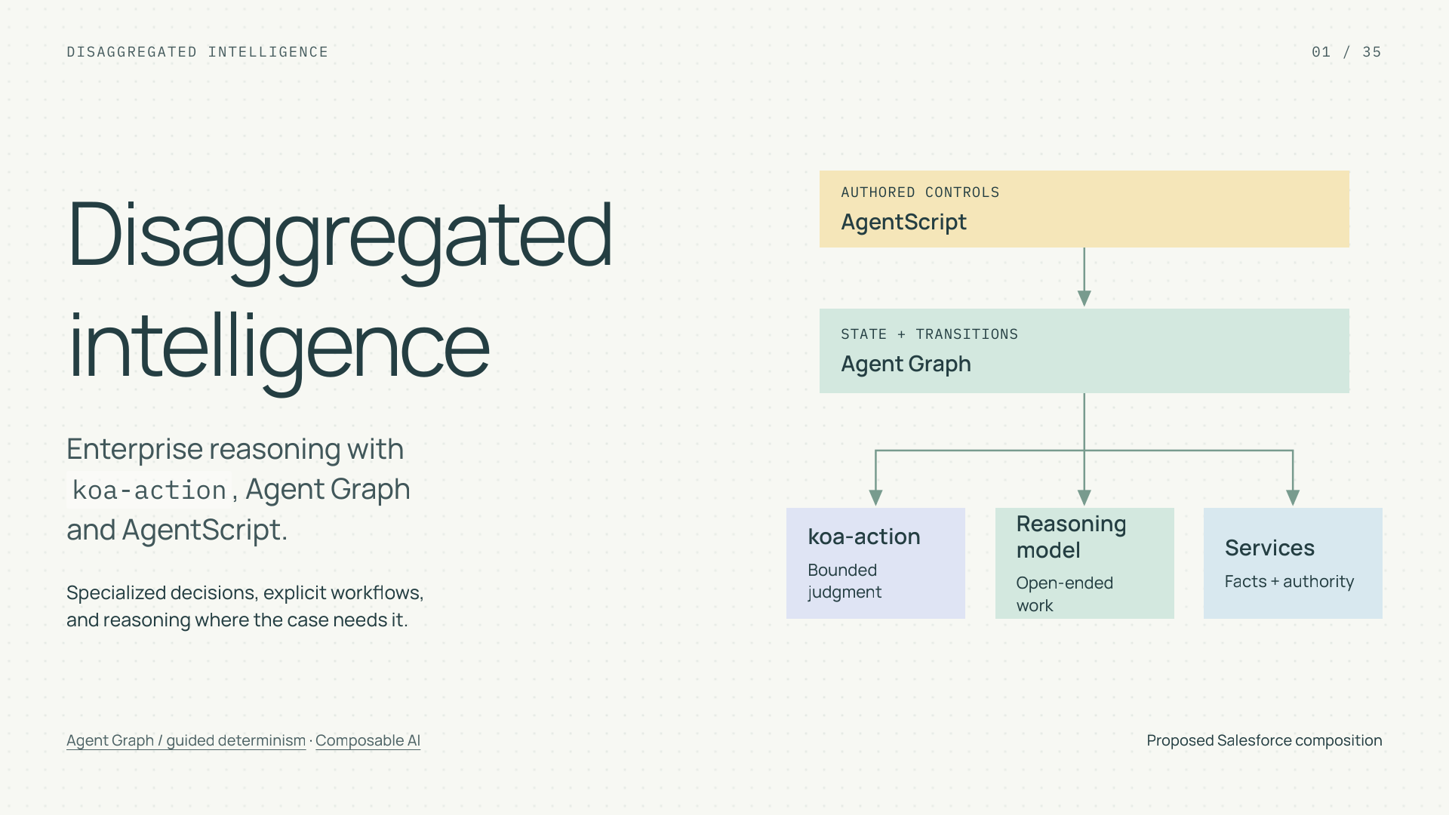
Notes:
Disaggregated intelligence
Section: Enterprise AI
Purpose: Introduce disaggregated intelligence as an engineering allocation problem.
Suggested speaking time: 0.7 minutes
TALKING POINTS
• System One is a useful engineering term for specialized models that answer bounded questions. It is not a claim about human cognition.
• The tutorial will construct a service workflow, inspect its failure boundaries, and define how reliability, cost, and speed would be evaluated.
• The Salesforce composition is proposed. Public sources do not establish a koa-action SDK, training interface, or measured benchmark.
Transition: First connect the architecture to the four benefits we want.
POWERPOINT EXPORT
This edition preserves the HTML slide design as one outlined SVG graphic with an embedded PNG fallback. Slide text is vector artwork, not editable PowerPoint paragraphs. Speaker notes remain editable. Use the companion HTML for interaction.
WEB REFERENCES
Agent Graph / guided determinism
https://engineering.salesforce.com/agentforces-agent-graph-toward-guided-determinism-with-hybrid-reasoning/
Composable AI
https://typesafe.ai/manifesto
SLIDE TEXT REFERENCE
DISAGGREGATED INTELLIGENCE
01 / 35
Disaggregated
intelligence
Enterprise reasoning with
koa-action, Agent Graph
and AgentScript.
Specialized decisions, explicit workflows,
and reasoning where the case needs it.
AUTHORED CONTROLS
AgentScript
STATE + TRANSITIONS
Agent Graph
koa-action
Bounded judgment
Reasoning model
Open-ended work
Services
Facts + authority
Agent Graph / guided determinism · Composable AI
Proposed Salesforce composition

Slide 2
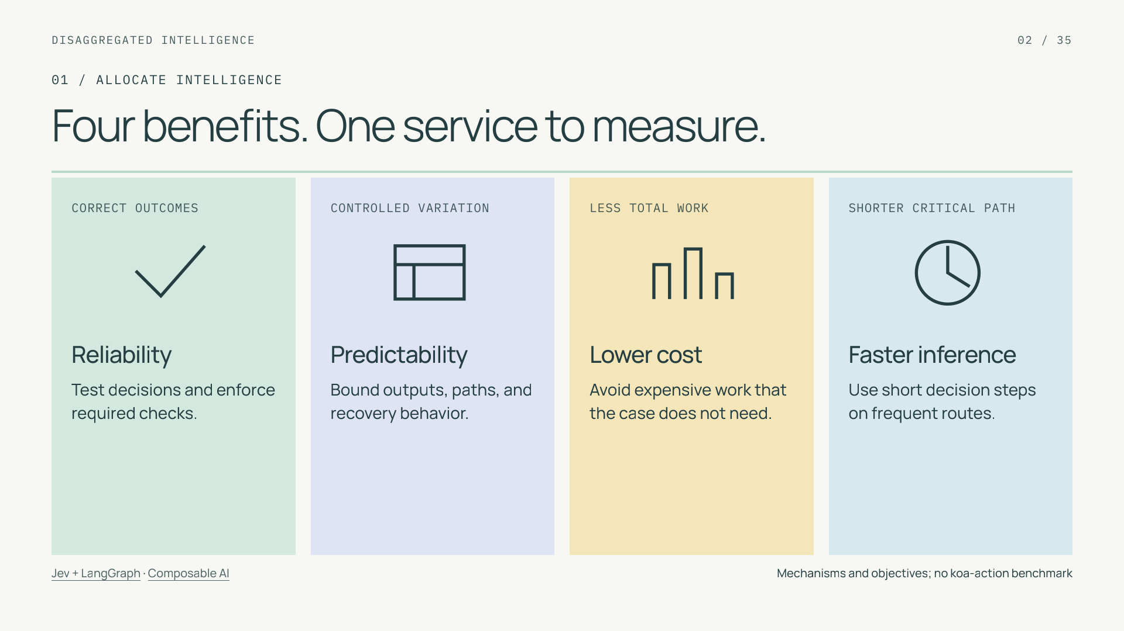
Notes:
Four benefits. One service to measure.
Section: 01
Purpose: Connect requested benefits to concrete mechanisms.
Suggested speaking time: 1 minutes
TALKING POINTS
• Significantly lower decision cost and faster inference are the opportunity behind specialization. Their size must be established for the deployed workload.
• Reliability means acceptable outcomes. Predictability includes output-shape contracts, permitted paths, and repeated-answer variation. Assess those separately from semantic correctness.
• The same complete customer case remains the unit of value. Extra handoffs can consume a primitive-level saving.
Transition: Follow one case through the rest of the tutorial.
POWERPOINT EXPORT
This edition preserves the HTML slide design as one outlined SVG graphic with an embedded PNG fallback. Slide text is vector artwork, not editable PowerPoint paragraphs. Speaker notes remain editable. Use the companion HTML for interaction.
WEB REFERENCES
Jev + LangGraph
https://www.langchain.com/blog/building-prod-with-jev-and-langgraph
Composable AI
https://typesafe.ai/manifesto
SLIDE TEXT REFERENCE
DISAGGREGATED INTELLIGENCE
02 / 35
01 / ALLOCATE INTELLIGENCE
Four benefits. One service to measure.
CORRECT OUTCOMES
Reliability
Test decisions and enforce required checks.
CONTROLLED VARIATION
Predictability
Bound outputs, paths, and recovery behavior.
LESS TOTAL WORK
Lower cost
Avoid expensive work that the case does not need.
SHORTER CRITICAL PATH
Faster inference
Use short decision steps on frequent routes.
Jev + LangGraph · Composable AI
Mechanisms and objectives; no koa-action benchmark

Slide 3
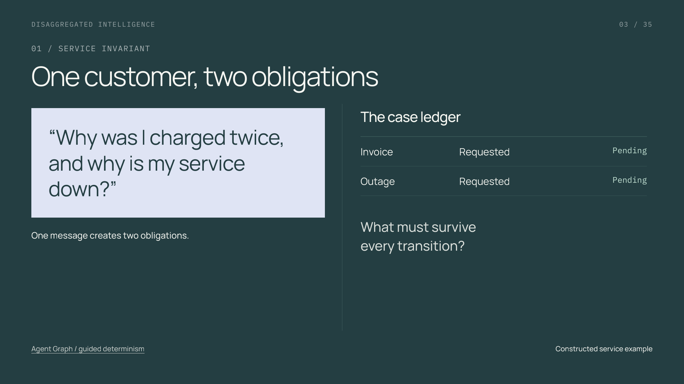
Notes:
One customer, two obligations
Section: 01
Purpose: Establish the recurring case and its invariant.
Suggested speaking time: 1.1 minutes
TALKING POINTS
• Ask the audience to name the invariant: neither request should disappear when the agent changes topics.
• A task may be resolved, withdrawn by the customer, or handed off with ownership recorded. These are different statuses; handoff does not equal resolution.
• This is a constructed example used to explain state and routing, not a reported customer deployment.
Transition: Assign an owner to each kind of work.
POWERPOINT EXPORT
This edition preserves the HTML slide design as one outlined SVG graphic with an embedded PNG fallback. Slide text is vector artwork, not editable PowerPoint paragraphs. Speaker notes remain editable. Use the companion HTML for interaction.
WEB REFERENCES
Agent Graph / guided determinism
https://engineering.salesforce.com/agentforces-agent-graph-toward-guided-determinism-with-hybrid-reasoning/
SLIDE TEXT REFERENCE
DISAGGREGATED INTELLIGENCE
03 / 35
01 / SERVICE INVARIANT
One customer, two obligations
“Why was I charged twice,
and why is my service down?”
One message creates two obligations.
The case ledger
Invoice
Requested
Pending
Outage
Requested
Pending
What must survive
every transition?
Agent Graph / guided determinism
Constructed service example

Slide 4
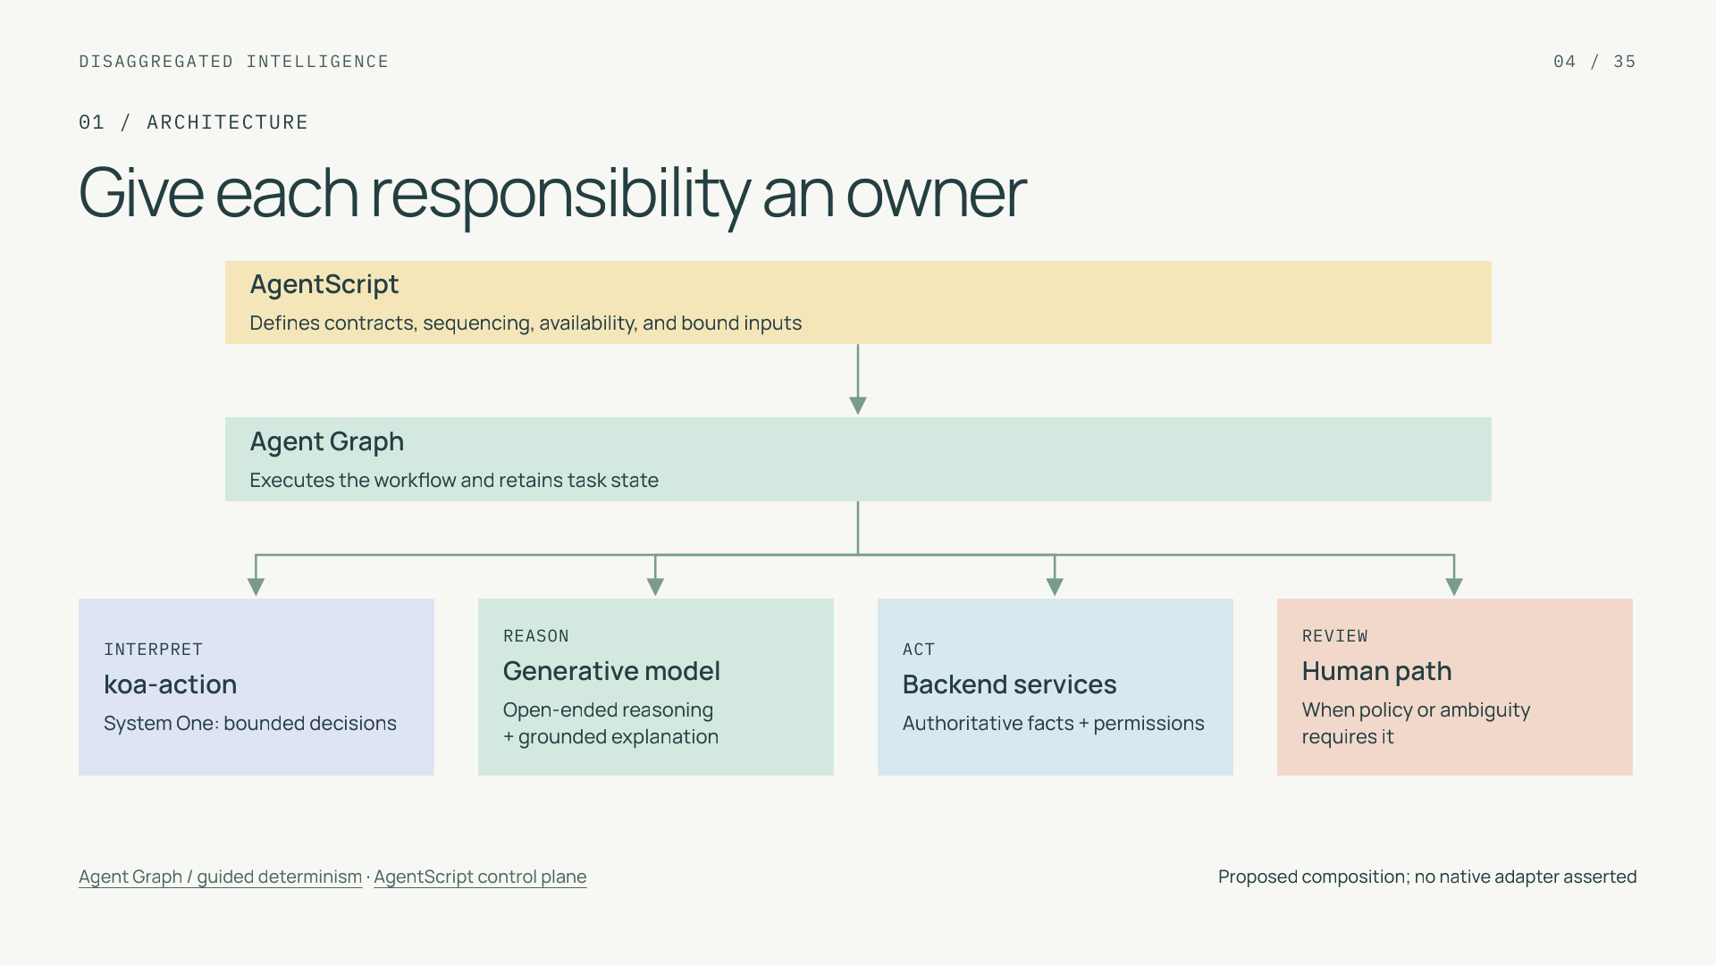
Notes:
Give each responsibility an owner
Section: 01
Purpose: Distinguish models, execution, configuration, and authority.
Suggested speaking time: 1 minutes
TALKING POINTS
• AgentScript is the authoring and control language; Agent Graph is the managed runtime that executes configured behavior.
• The models produce interpretations or explanations. Backend services retain authority over access and writes, while human review is an explicit branch.
• The diagram denotes coordination, not ownership of every component by a model. Each case invokes only the components its configured path needs.
Transition: Now move process rules from prose into inspectable structure.
POWERPOINT EXPORT
This edition preserves the HTML slide design as one outlined SVG graphic with an embedded PNG fallback. Slide text is vector artwork, not editable PowerPoint paragraphs. Speaker notes remain editable. Use the companion HTML for interaction.
WEB REFERENCES
Agent Graph / guided determinism
https://engineering.salesforce.com/agentforces-agent-graph-toward-guided-determinism-with-hybrid-reasoning/
AgentScript control plane
https://www.salesforce.com/blog/agent-script-control-plane/
SLIDE TEXT REFERENCE
DISAGGREGATED INTELLIGENCE
04 / 35
01 / ARCHITECTURE
Give each responsibility an owner
AgentScript
Defines contracts, sequencing, availability, and bound inputs
Agent Graph
Executes the workflow and retains task state
INTERPRET
koa-action
System One: bounded decisions
REASON
Generative model
Open-ended reasoning
+ grounded explanation
ACT
Backend services
Authoritative facts + permissions
REVIEW
Human path
When policy or ambiguity requires it
Agent Graph / guided determinism · AgentScript control plane
Proposed composition; no native adapter asserted

Slide 5
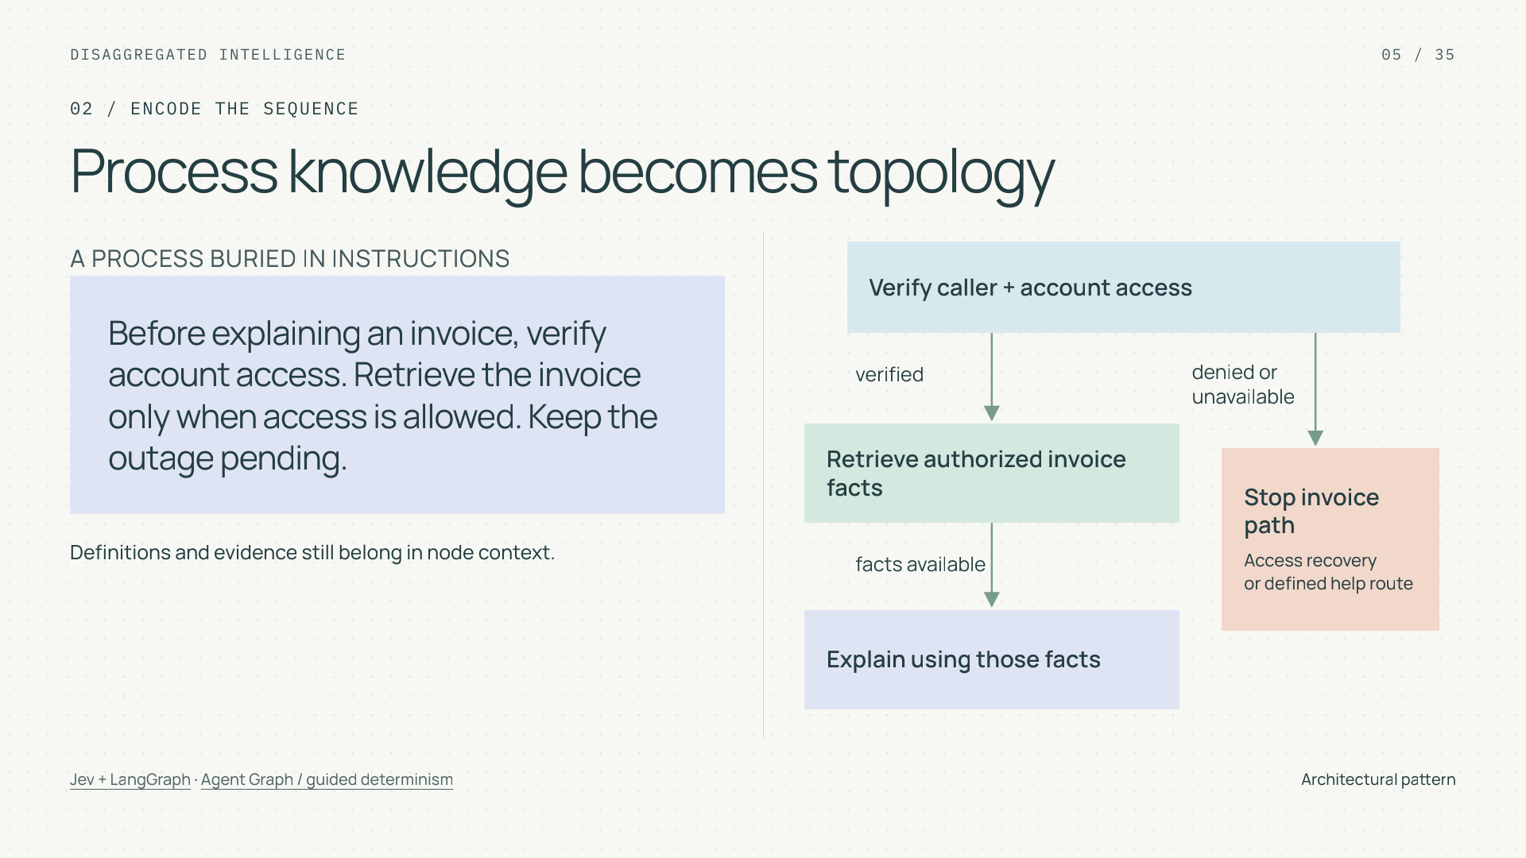
Notes:
Process knowledge becomes topology
Section: 02
Purpose: Teach which decisions, in which order, over which state.
Suggested speaking time: 1 minutes
TALKING POINTS
• Topology encodes procedural domain knowledge: which step may run, what must precede it, and where its input facts come from.
• The transformation does not remove all domain knowledge from prompts. Category definitions and authorized facts remain necessary within model calls.
• A graph can enforce a poor process consistently. Review and test the topology itself.
Transition: Apply that idea to a product return with the same business safeguards in both architectures.
POWERPOINT EXPORT
This edition preserves the HTML slide design as one outlined SVG graphic with an embedded PNG fallback. Slide text is vector artwork, not editable PowerPoint paragraphs. Speaker notes remain editable. Use the companion HTML for interaction.
WEB REFERENCES
Jev + LangGraph
https://www.langchain.com/blog/building-prod-with-jev-and-langgraph
Agent Graph / guided determinism
https://engineering.salesforce.com/agentforces-agent-graph-toward-guided-determinism-with-hybrid-reasoning/
SLIDE TEXT REFERENCE
DISAGGREGATED INTELLIGENCE
05 / 35
02 / ENCODE THE SEQUENCE
Process knowledge becomes topology
A PROCESS BURIED IN INSTRUCTIONS
Before explaining an invoice, verify account access. Retrieve the invoice only when access is allowed. Keep the outage pending.
Definitions and evidence still belong in node context.
Verify caller + account access
Retrieve authorized invoice facts
Explain using those facts
Stop invoice path
Access recovery
or defined help route
verified
denied or
unavailable
facts available
Jev + LangGraph · Agent Graph / guided determinism
Architectural pattern

Slide 6
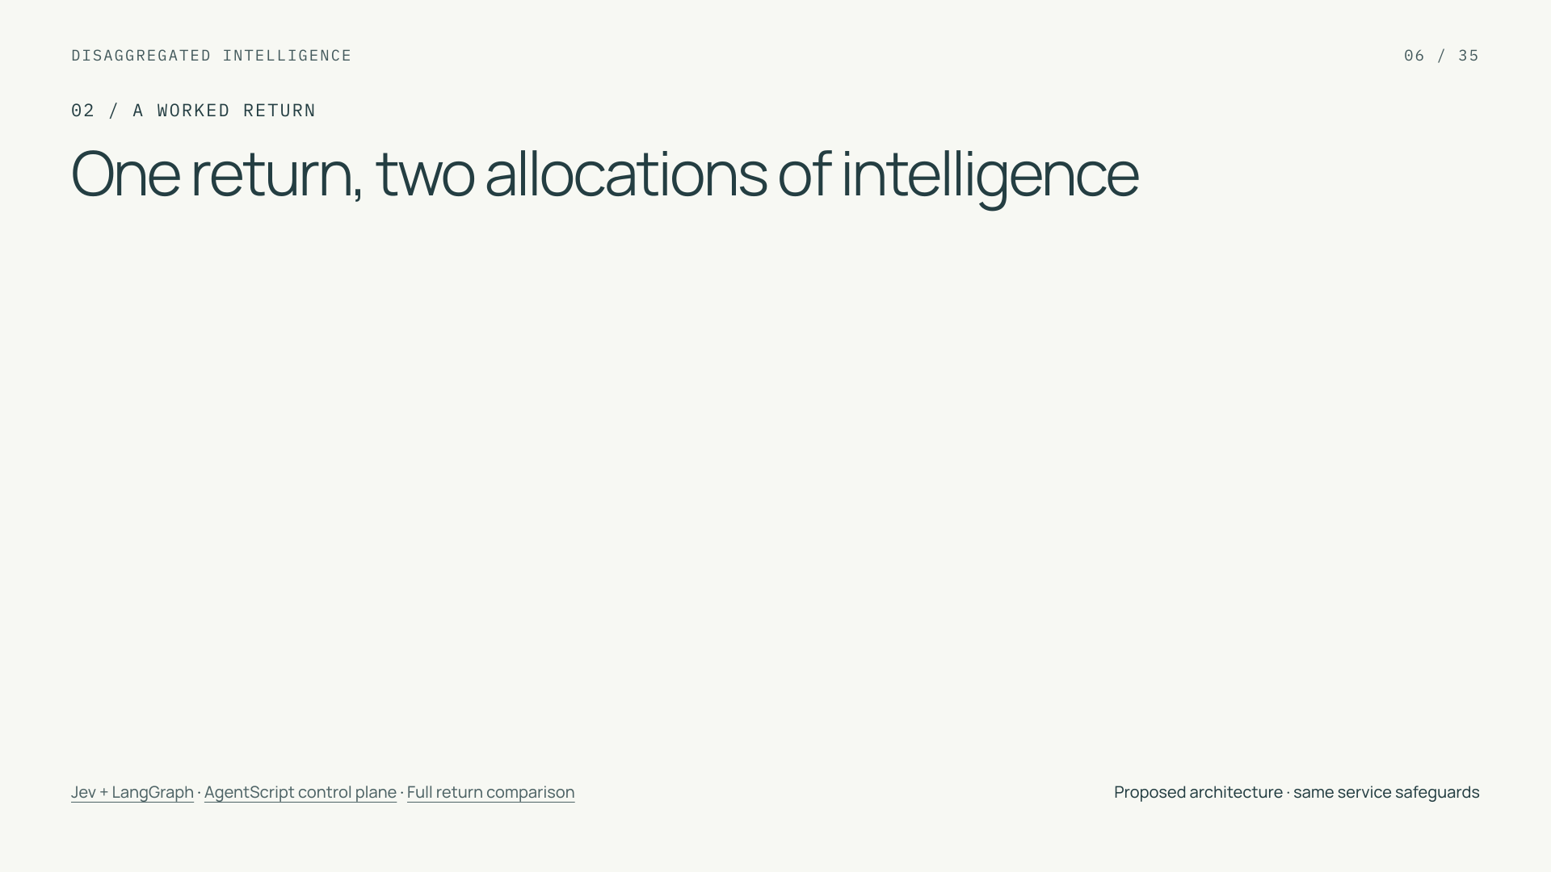



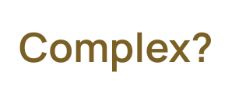







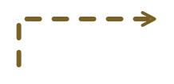















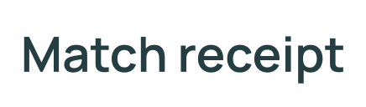
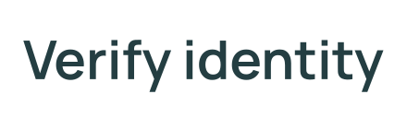

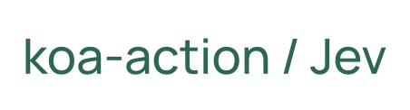




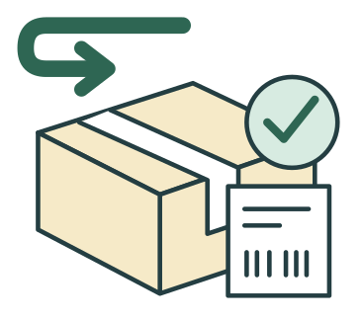






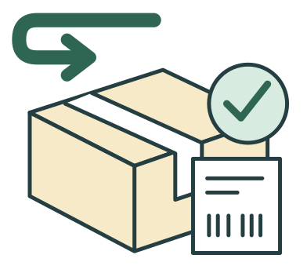






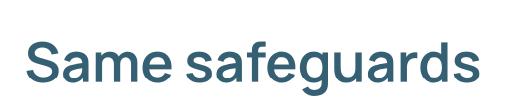


Notes:
One return, two allocations of intelligence
Section: 02
Purpose: Make the allocation of inference visible while holding service safeguards constant.
Suggested speaking time: 1.2 minutes
TALKING POINTS
• Start with the customer and the parcel: I want to return these headphones. The four numbered scenes are an identity card, a matched receipt, a policy clipboard and an authorized return label. The final scene includes customer confirmation and the backend write, expanded on the policy slide.
• Read the left-hand numbers clockwise. Purple arrows revisit the large frontier chip as each service result becomes context for another proposed next step. This is the selected wrapper architecture; its trusted services can still enforce all the same safeguards.
• Follow the right-hand green path from identity to receipt, through the smaller System One chip, down to policy and left to the return label. AgentScript configures Agent Graph to execute known dependencies. The unnumbered semantic switch interprets the return reason; it does not grant identity, ownership or eligibility.
• koa-action and Jev illustrate the bounded-decision role, without implying a shared schema or native Salesforce adapter. This routine path shows fewer frontier decisions; it is not a measured price, latency or reliability claim. Count any later generated message in whole-case cost.
• The small dotted complex-case cue continues on the next slide. Failed authentication goes to sign-in or denial; a receipt mismatch goes to verification. Neither calls for a more powerful model to replace evidence.
Transition: Expand the exception branch to see when frontier reasoning is actually justified.
POWERPOINT EXPORT
COMPONENT POWERPOINT
This slide uses a fixed vector frame plus separate, independently movable vector illustrations, labels and connectors. Labels are outlined artwork, not native editable text. Speaker notes remain editable. Every vector object has an embedded PNG fallback. Use the Selection Pane to select named parts. Connectors are independent objects; they do not automatically follow moved illustrations. Other slides retain their complete-frame vector artwork.
WEB REFERENCES
Jev + LangGraph
https://www.langchain.com/blog/building-prod-with-jev-and-langgraph
AgentScript control plane
https://www.salesforce.com/blog/agent-script-control-plane/
LOCAL COMPANION REFERENCES
Full return comparison — diagrams/returns-comparison.svg
These identifiers refer to the accompanying repository and are not broken file hyperlinks.
SLIDE TEXT REFERENCE
DISAGGREGATED INTELLIGENCE
06 / 35
02 / A WORKED RETURN
One return, two allocations of intelligence
Jev + LangGraph · AgentScript control plane · Full return comparison
Proposed architecture · same service safeguards

Slide 7
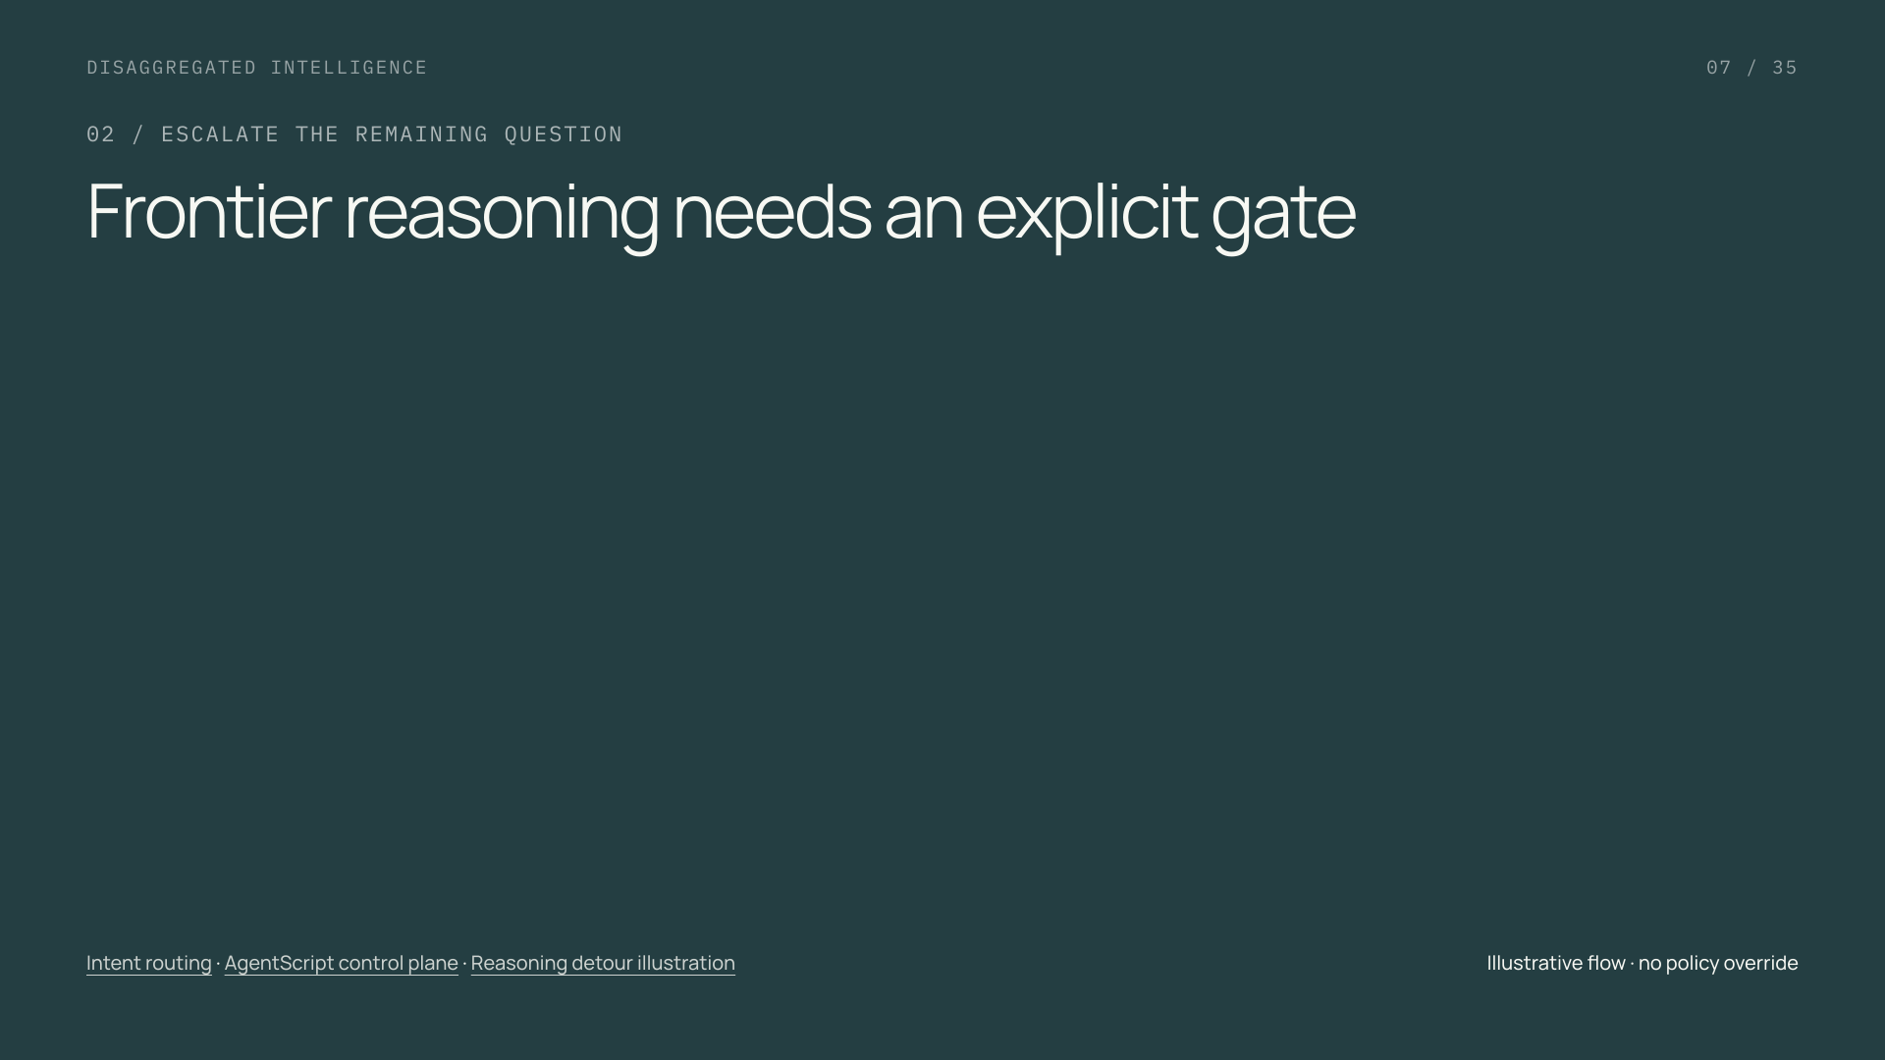

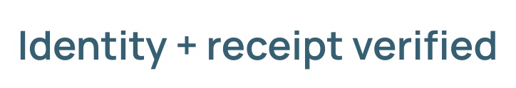





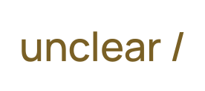



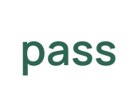

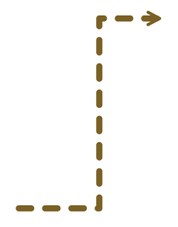






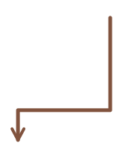

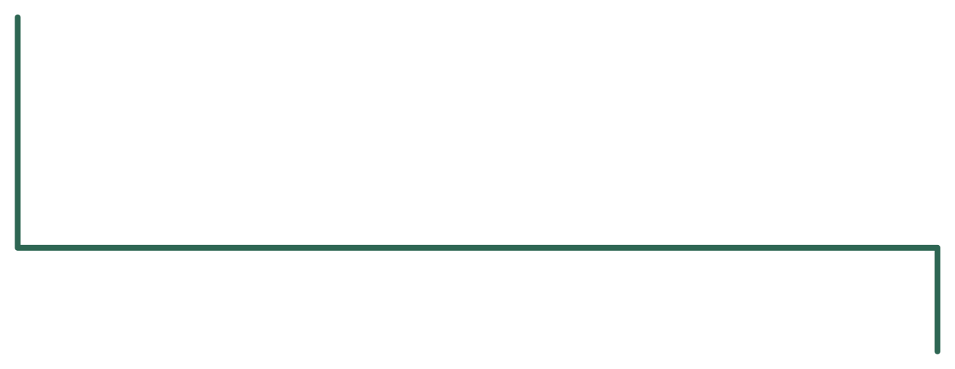


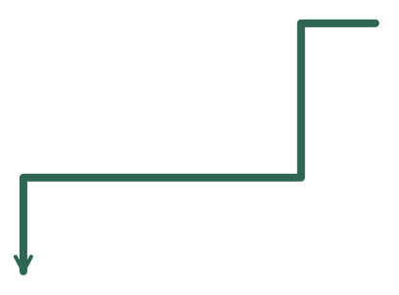





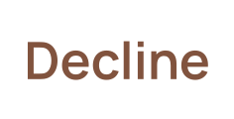


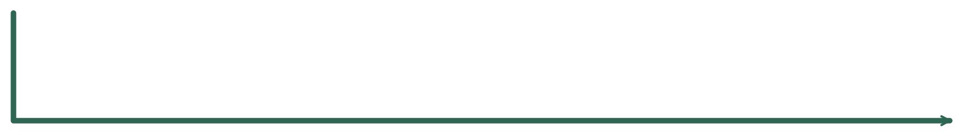










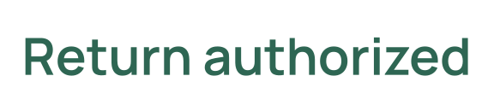
Notes:
Frontier reasoning needs an explicit gate
Section: 02
Purpose: Show frontier reasoning as a gated interpretation branch with no shortcut to authorization.
Suggested speaking time: 1.5 minutes
TALKING POINTS
• The checked ID in the corner is a precondition: identity and purchase ownership are already verified. Read the green lower road first; routine cases go directly to policy. The small chip is a bounded semantic decision, not a transaction authority.
• Follow the dotted detour only for an unclear or complex request. The person asks one useful clarification, and the clipboard checks known policy and required evidence. The cross declines known ineligibility; the pause holds missing evidence. The green resolved branch avoids frontier reasoning.
• Suppose a request mixes a completed repair, an open replacement offer and a conditional return. Verify the repair and replacement records first. If the facts are available but the remaining customer intent still needs substantive interpretation, a scoped frontier proposal can assist an authorized reviewer.
• The purple chip receives authorized facts and the remaining question, then produces a proposal for human review. The reviewer can validate or hold. A green return arrow carries only validated information back to the same policy. The customer and parcel at the lower right show confirmation followed by service authorization; neither model nor reviewer can override policy.
• Invalid or timed-out model outputs take bounded technical recovery and then human handling, not an unbounded reasoning loop. Preserve any other requested task through the return branch. A successful backend write, not a recommendation, is the final authorization.
Transition: Now make the business rule concrete: loyalty changes eligibility and shipping independently of the model.
POWERPOINT EXPORT
COMPONENT POWERPOINT
This slide uses a fixed vector frame plus separate, independently movable vector illustrations, labels and connectors. Labels are outlined artwork, not native editable text. Speaker notes remain editable. Every vector object has an embedded PNG fallback. Use the Selection Pane to select named parts. Connectors are independent objects; they do not automatically follow moved illustrations. Other slides retain their complete-frame vector artwork.
WEB REFERENCES
Intent routing
https://docs.typesafe.ai/patterns/intent-routing
AgentScript control plane
https://www.salesforce.com/blog/agent-script-control-plane/
LOCAL COMPANION REFERENCES
Reasoning detour illustration — diagrams/returns-fallback.svg
These identifiers refer to the accompanying repository and are not broken file hyperlinks.
SLIDE TEXT REFERENCE
DISAGGREGATED INTELLIGENCE
07 / 35
02 / ESCALATE THE REMAINING QUESTION
Frontier reasoning needs an explicit gate
Intent routing · AgentScript control plane · Reasoning detour illustration
Illustrative flow · no policy override

Slide 8
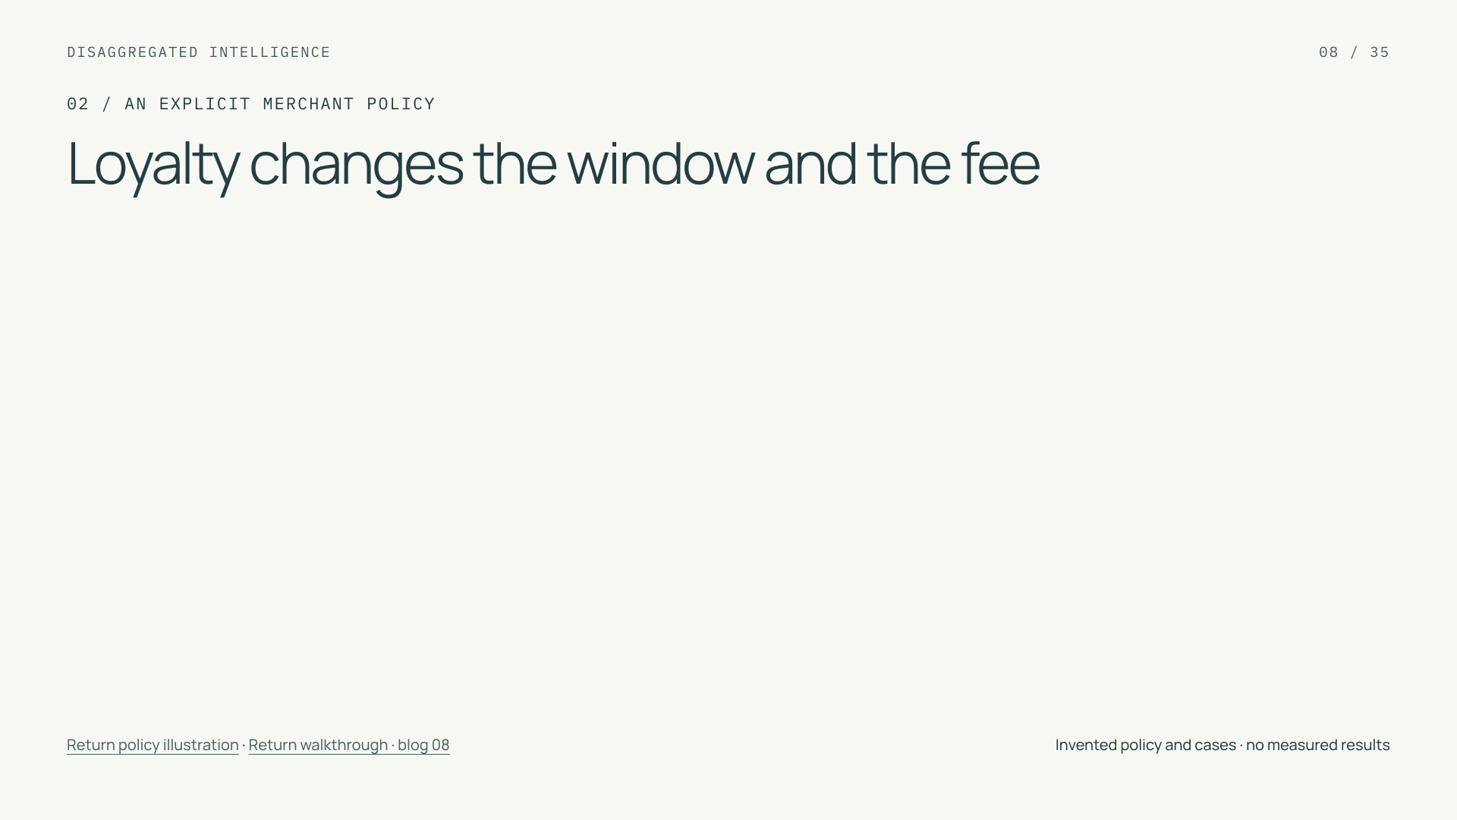
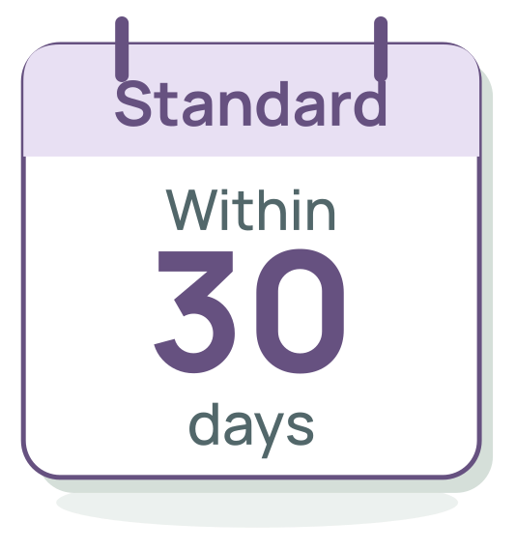
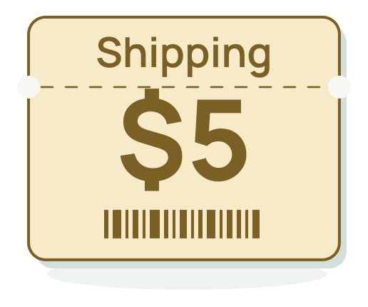
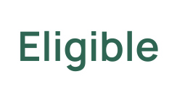
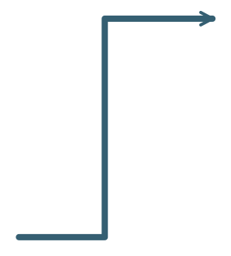






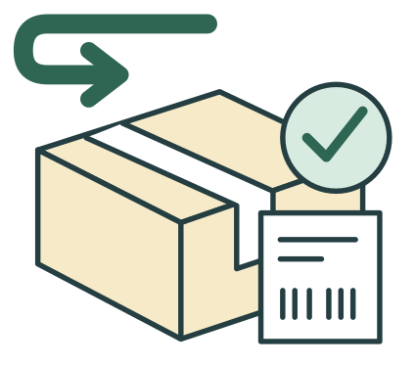



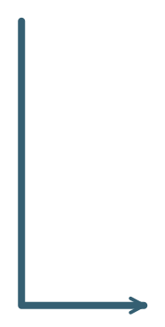


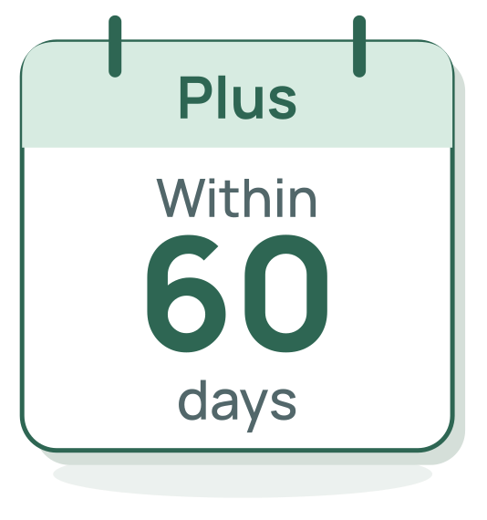
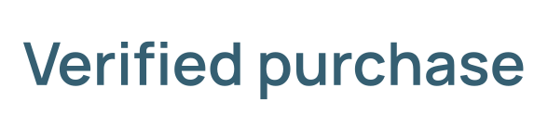
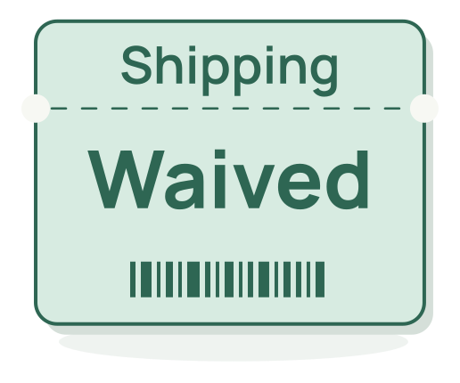




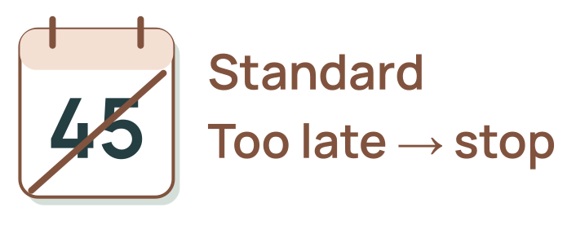

Notes:
Loyalty changes the window and the fee
Section: 02
Purpose: Separate trusted eligibility and fee rules from semantic interpretation and from transaction success.
Suggested speaking time: 1.2 minutes
TALKING POINTS
• Read the physical objects from left to right. The checked identity card and receipt establish a verified purchase. The calendars are the two invented loyalty windows; the perforated shipping tickets show the resulting fee. These are teaching rules, not Salesforce product policy.
• The identity and order services establish the customer, owned receipt, item and available unreturned quantity. Tier comes from a current authorized membership lookup. An unknown tier does not default to Standard. Missing facts and manual review hold the case.
• Compare the immutable request-received timestamp to the authoritative delivery deadline in the declared merchant time zone. Clarification time must not turn an on-time request into a late request.
• The Standard calendar allows requests within 30 days and shows a five-dollar shipping ticket. The Plus calendar allows 60 days and shows waived shipping. For example, Standard day 18 and Plus day 45 qualify, subject to all other checks. The crossed Standard day-45 calendar stops without frontier reasoning.
• For an eligible return, obtain confirmation of item, quantity and shipping terms. The backend rechecks current access, policy, tier and quantity; changed terms require renewed confirmation. Use a stable idempotency key and reconcile an unknown write outcome before retrying. Return authorized means the service issued a return ID and the confirmed shipping label. Inspection and any refund settlement happen later. Semantic judgment chooses a route, while rules and service results establish the business outcome.
Transition: With the worked graph in view, locate its runtime and configuration within the broader agent harness.
POWERPOINT EXPORT
COMPONENT POWERPOINT
This slide uses a fixed vector frame plus separate, independently movable vector illustrations, labels and connectors. Labels are outlined artwork, not native editable text. Speaker notes remain editable. Every vector object has an embedded PNG fallback. Use the Selection Pane to select named parts. Connectors are independent objects; they do not automatically follow moved illustrations. Other slides retain their complete-frame vector artwork.
LOCAL COMPANION REFERENCES
Return policy illustration — diagrams/returns-policy.svg
Return walkthrough · blog 08 — blog/08-building-prod.md
These identifiers refer to the accompanying repository and are not broken file hyperlinks.
SLIDE TEXT REFERENCE
DISAGGREGATED INTELLIGENCE
08 / 35
02 / AN EXPLICIT MERCHANT POLICY
Loyalty changes the window and the fee
Return policy illustration · Return walkthrough · blog 08
Invented policy and cases · no measured results

Slide 9
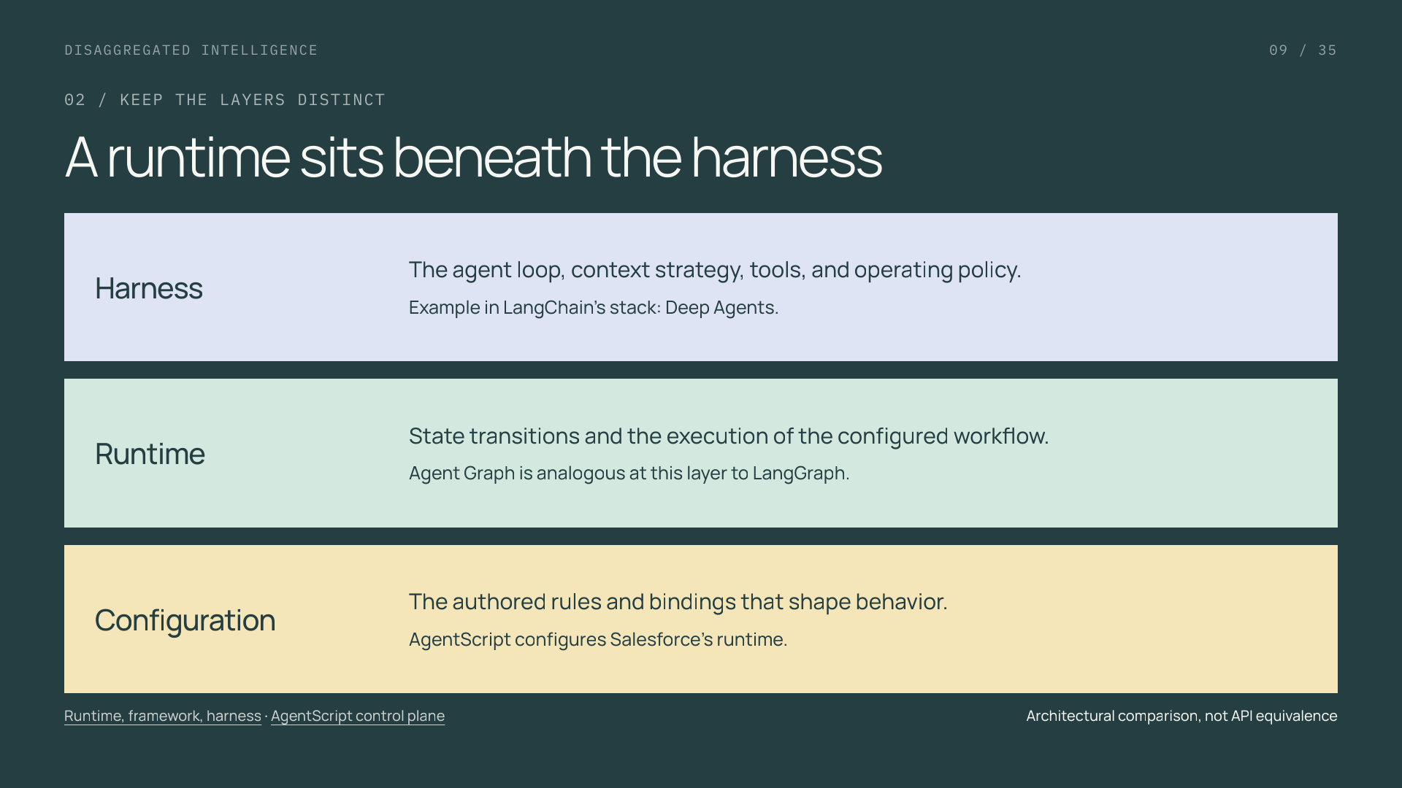
Notes:
A runtime sits beneath the harness
Section: 02
Purpose: Prevent runtime/harness/configuration conflation.
Suggested speaking time: 1 minutes
TALKING POINTS
• LangChain distinguishes its framework, LangGraph runtime, and Deep Agents harness. The comparison helps locate responsibilities.
• In this Salesforce example the configured agent is the broader harness, with Agent Graph providing runtime execution and AgentScript authoring control.
• This is an architectural analogy, not LangGraph API compatibility or a claim that Agent Graph ships Deep Agents defaults. The public AgentScript repo contains tooling, not the managed runtime.
Transition: Define the first decision before selecting its integration.
POWERPOINT EXPORT
This edition preserves the HTML slide design as one outlined SVG graphic with an embedded PNG fallback. Slide text is vector artwork, not editable PowerPoint paragraphs. Speaker notes remain editable. Use the companion HTML for interaction.
WEB REFERENCES
Runtime, framework, harness
https://www.langchain.com/blog/deep-agents-vs-langchain-vs-langgraph
AgentScript control plane
https://www.salesforce.com/blog/agent-script-control-plane/
SLIDE TEXT REFERENCE
DISAGGREGATED INTELLIGENCE
09 / 35
02 / KEEP THE LAYERS DISTINCT
A runtime sits beneath the harness
Harness
The agent loop, context strategy, tools, and operating policy.
Example in LangChain’s stack: Deep Agents.
Runtime
State transitions and the execution of the configured workflow.
Agent Graph is analogous at this layer to LangGraph.
Configuration
The authored rules and bindings that shape behavior.
AgentScript configures Salesforce’s runtime.
Runtime, framework, harness · AgentScript control plane
Architectural comparison, not API equivalence

Slide 10
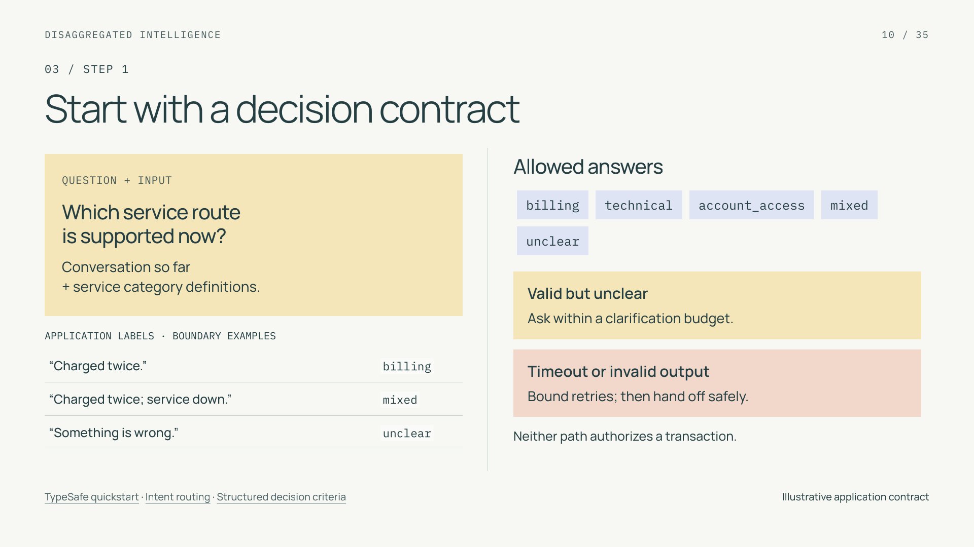
Notes:
Start with a decision contract
Section: 03
Purpose: Give a bounded task a testable contract.
Suggested speaking time: 1 minutes
TALKING POINTS
• The labels are application choices, not a documented koa-action response schema. Mixed and unclear are first-class outcomes.
• Provide positive and negative examples at the category boundaries. The same contract controls labeling and evaluation.
• A timeout or malformed result must not default into a business transaction. Specify its fallback separately from semantic ambiguity.
Transition: Match the question to the right primitive.
POWERPOINT EXPORT
This edition preserves the HTML slide design as one outlined SVG graphic with an embedded PNG fallback. Slide text is vector artwork, not editable PowerPoint paragraphs. Speaker notes remain editable. Use the companion HTML for interaction.
WEB REFERENCES
TypeSafe quickstart
https://docs.typesafe.ai/introduction/quickstart
Intent routing
https://docs.typesafe.ai/patterns/intent-routing
Structured decision criteria
https://docs.typesafe.ai/primitives/advanced
SLIDE TEXT REFERENCE
DISAGGREGATED INTELLIGENCE
10 / 35
03 / STEP 1
Start with a decision contract
QUESTION + INPUT
Which service route
is supported now?
Conversation so far
+ service category definitions.
APPLICATION LABELS · BOUNDARY EXAMPLES
“Charged twice.” billing
“Charged twice; service down.” mixed
“Something is wrong.” unclear
Allowed answers
billingtechnicalaccount_accessmixedunclear
Valid but unclear
Ask within a clarification budget.
Timeout or invalid output
Bound retries; then hand off safely.
Neither path authorizes a transaction.
TypeSafe quickstart · Intent routing · Structured decision criteria
Illustrative application contract

Slide 11
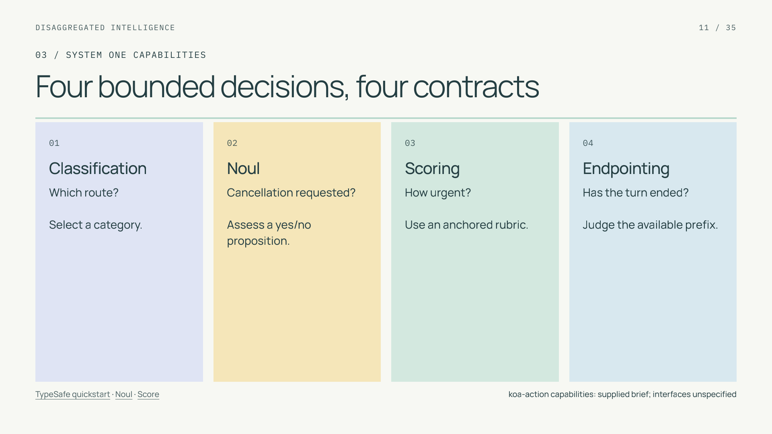
Notes:
Four bounded decisions, four contracts
Section: 03
Purpose: Cover the four user-specified koa-action capabilities.
Suggested speaking time: 1 minutes
TALKING POINTS
• This tutorial uses koa-action for classification, noul, scoring, and semantic endpointing, following the capability framing supplied for the Salesforce composition.
• TypeSafe documents analogous decision concepts, but its SDK fields, batching, calibration, and training claims do not define a Salesforce interface.
• Each primitive needs its own target and error measure. A rubric score and the probability of a binary proposition are not interchangeable.
Transition: Make that semantic distinction tangible.
POWERPOINT EXPORT
This edition preserves the HTML slide design as one outlined SVG graphic with an embedded PNG fallback. Slide text is vector artwork, not editable PowerPoint paragraphs. Speaker notes remain editable. Use the companion HTML for interaction.
WEB REFERENCES
TypeSafe quickstart
https://docs.typesafe.ai/introduction/quickstart
Noul
https://docs.typesafe.ai/primitives/noul
Score
https://docs.typesafe.ai/primitives/score
SLIDE TEXT REFERENCE
DISAGGREGATED INTELLIGENCE
11 / 35
03 / SYSTEM ONE CAPABILITIES
Four bounded decisions, four contracts
01
Classification
Which route?
Select a category.
02
Noul
Cancellation requested?
Assess a yes/no proposition.
03
Scoring
How urgent?
Use an anchored rubric.
04
Endpointing
Has the turn ended?
Judge the available prefix.
TypeSafe quickstart · Noul · Score
koa-action capabilities: supplied brief; interfaces unspecified

Slide 12
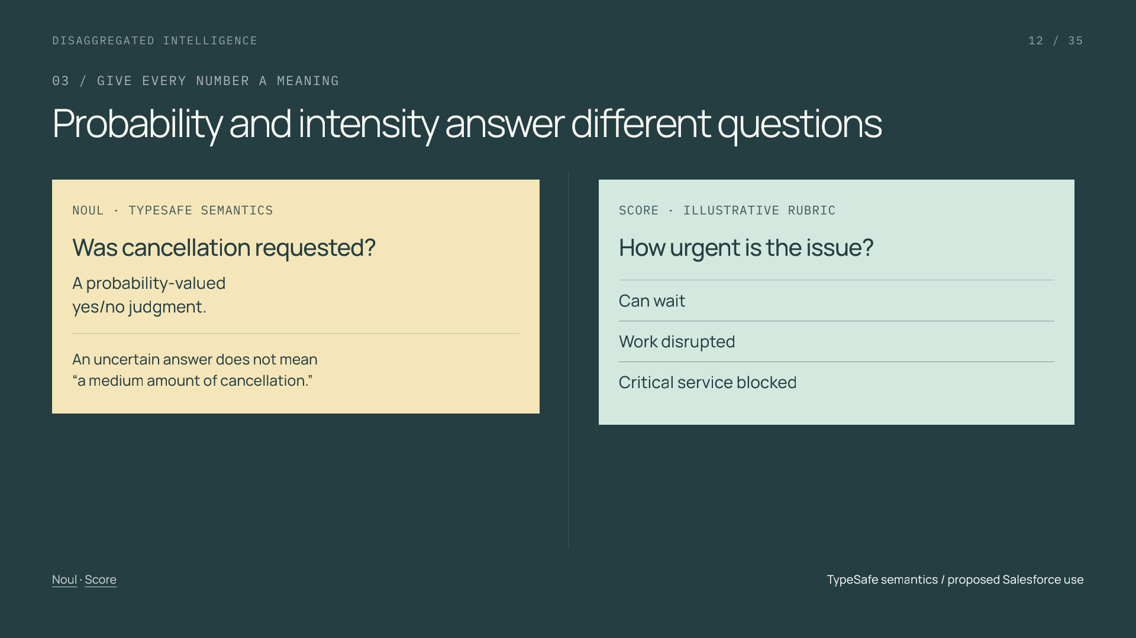
Notes:
Probability and intensity answer different questions
Section: 03
Purpose: Explain binary proposition estimates versus severity rubrics.
Suggested speaking time: 1 minutes
TALKING POINTS
• TypeSafe’s Noul is the probability of the yes answer; its Score uses ordered rubric levels and can be fractional.
• A mean rubric score can hide different distributions. Preserve the output meaning that the downstream rule actually uses.
• The corresponding koa-action fields, ranges, and calibration require their own verified contract. No numeric Salesforce response is shown here.
Transition: A decision about when to respond has an additional time boundary.
POWERPOINT EXPORT
This edition preserves the HTML slide design as one outlined SVG graphic with an embedded PNG fallback. Slide text is vector artwork, not editable PowerPoint paragraphs. Speaker notes remain editable. Use the companion HTML for interaction.
WEB REFERENCES
Noul
https://docs.typesafe.ai/primitives/noul
Score
https://docs.typesafe.ai/primitives/score
SLIDE TEXT REFERENCE
DISAGGREGATED INTELLIGENCE
12 / 35
03 / GIVE EVERY NUMBER A MEANING
Probability and intensity answer different questions
NOUL · TYPESAFE SEMANTICS
Was cancellation requested?
A probability-valued
yes/no judgment.
An uncertain answer does not mean
“a medium amount of cancellation.”
SCORE · ILLUSTRATIVE RUBRIC
How urgent is the issue?
Can wait
Work disrupted
Critical service blocked
Noul · Score
TypeSafe semantics / proposed Salesforce use

Slide 13
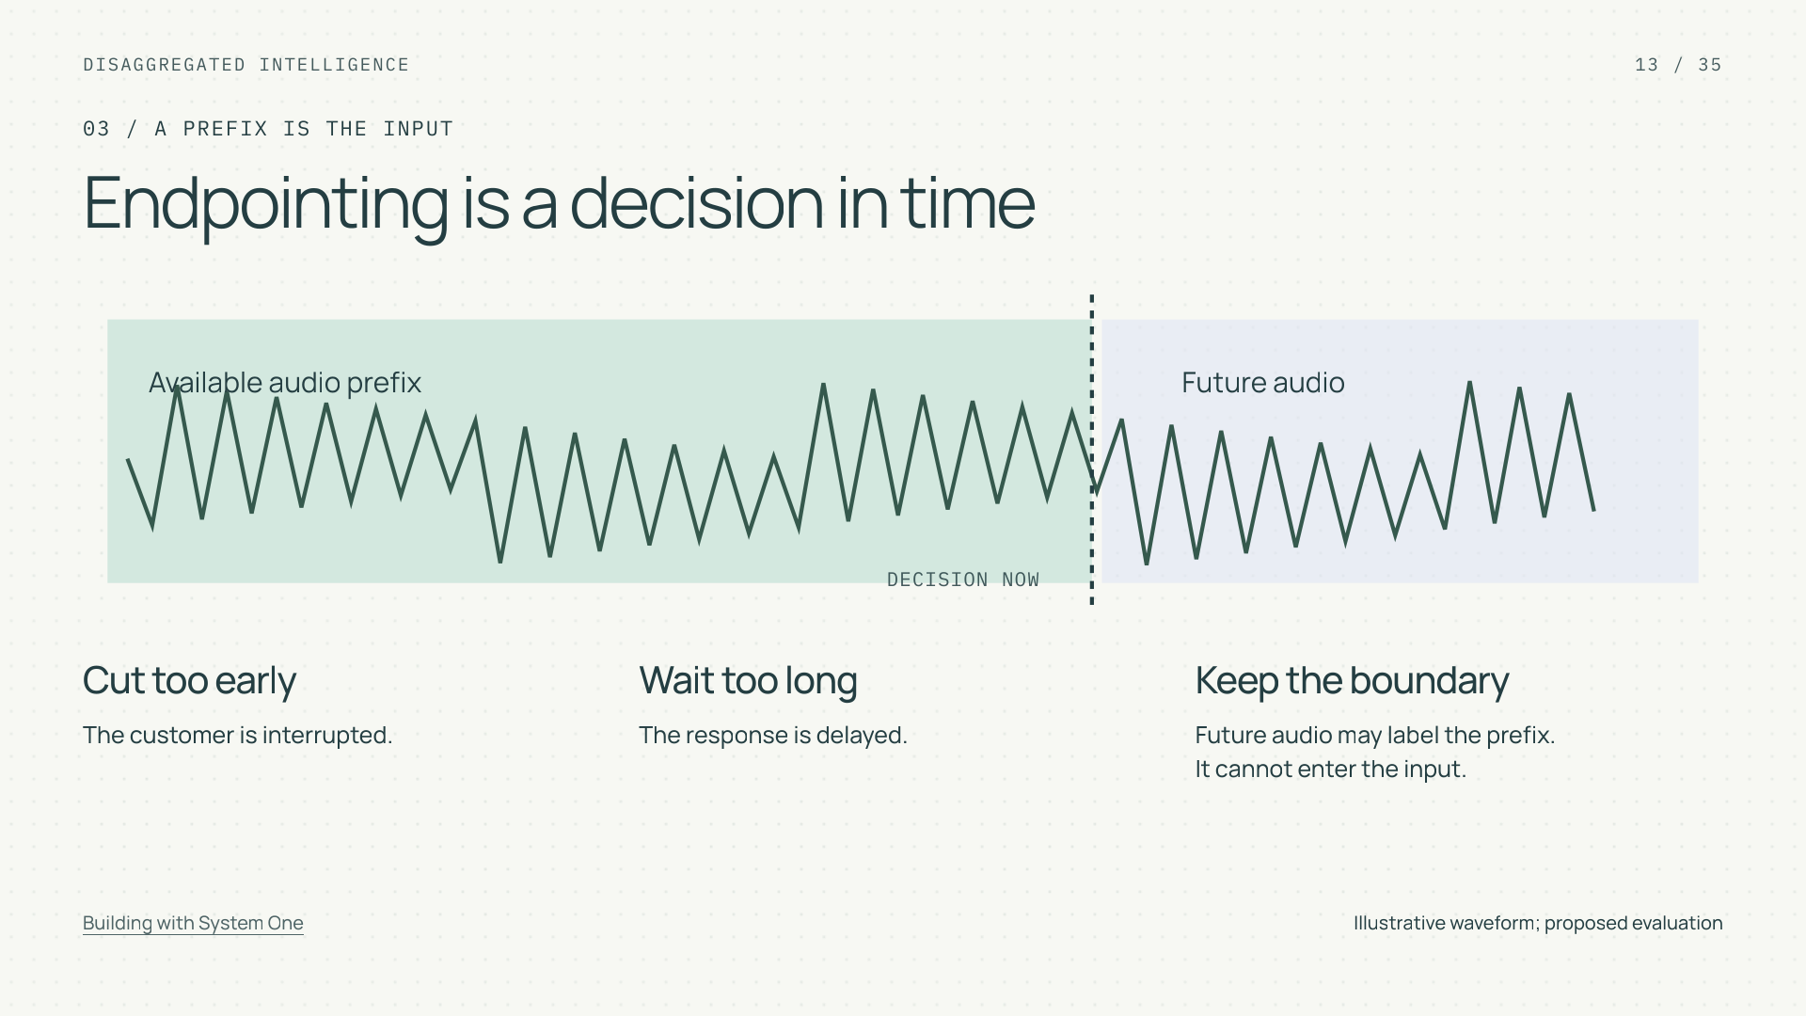
Notes:
Endpointing is a decision in time
Section: 03
Purpose: Explain semantic endpointing and temporal leakage.
Suggested speaking time: 1 minutes
TALKING POINTS
• The waveform is illustrative. The task asks whether a spoken turn has ended using only the available prefix.
• Future speech may establish the reference label, but it must not become part of the earlier input.
• Measure premature cutoff and delay separately. Keep all prefixes of a conversation together when splitting data.
Transition: Next decide which decisions may run in parallel.
POWERPOINT EXPORT
This edition preserves the HTML slide design as one outlined SVG graphic with an embedded PNG fallback. Slide text is vector artwork, not editable PowerPoint paragraphs. Speaker notes remain editable. Use the companion HTML for interaction.
WEB REFERENCES
Building with System One
https://docs.typesafe.ai/concepts/how-to-build-with-system-one
SLIDE TEXT REFERENCE
DISAGGREGATED INTELLIGENCE
13 / 35
03 / A PREFIX IS THE INPUT
Endpointing is a decision in time
Available audio prefix
Future audio
DECISION NOW
Cut too early
The customer is interrupted.
Wait too long
The response is delayed.
Keep the boundary
Future audio may label the prefix.
It cannot enter the input.
Building with System One
Illustrative waveform; proposed evaluation

Slide 14
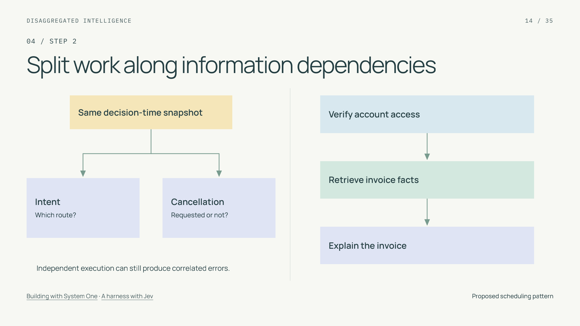
Notes:
Split work along information dependencies
Section: 04
Purpose: Separate execution independence from causality.
Suggested speaking time: 1 minutes
TALKING POINTS
• Independent questions can read the same snapshot; a later step that needs a new fact must wait for that fact.
• This is a workflow-design pattern, not a claim about a native koa-action batching API.
• Parallel question execution does not imply statistically independent errors. Missing evidence can affect several judgments at once.
Transition: Make each node’s evidence window explicit.
POWERPOINT EXPORT
This edition preserves the HTML slide design as one outlined SVG graphic with an embedded PNG fallback. Slide text is vector artwork, not editable PowerPoint paragraphs. Speaker notes remain editable. Use the companion HTML for interaction.
WEB REFERENCES
Building with System One
https://docs.typesafe.ai/concepts/how-to-build-with-system-one
A harness with Jev
https://www.langchain.com/blog/building-a-harness-with-jev
SLIDE TEXT REFERENCE
DISAGGREGATED INTELLIGENCE
14 / 35
04 / STEP 2
Split work along information dependencies
Same decision-time snapshot
Intent
Which route?
Cancellation
Requested or not?
Independent execution can still produce correlated errors.
Verify account access
Retrieve invoice facts
Explain the invoice
Building with System One · A harness with Jev
Proposed scheduling pattern

Slide 15
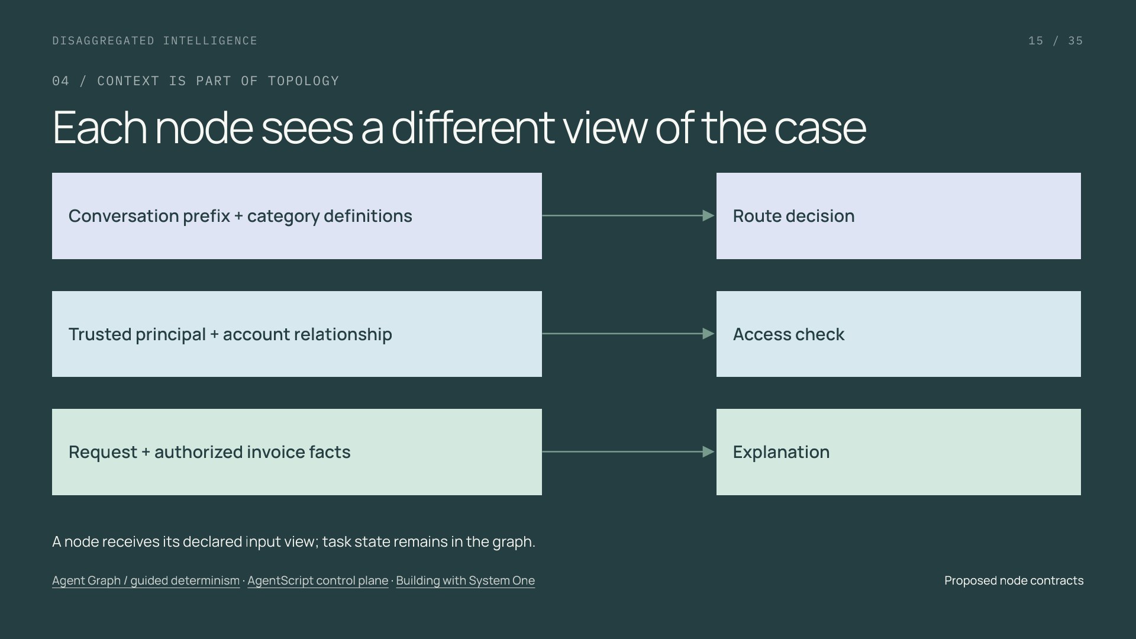
Notes:
Each node sees a different view of the case
Section: 04
Purpose: Teach context boundaries as authored data dependencies.
Suggested speaking time: 1 minutes
TALKING POINTS
• Graph design determines what information exists before a node runs and which part of state it receives.
• A customer-provided account identifier does not become a verified identity because it appears in a model output.
• Narrowing context can reduce unnecessary processing, but removing a required fact can reduce quality. Version and evaluate the context selection.
Transition: Use that state to preserve the mixed request.
POWERPOINT EXPORT
This edition preserves the HTML slide design as one outlined SVG graphic with an embedded PNG fallback. Slide text is vector artwork, not editable PowerPoint paragraphs. Speaker notes remain editable. Use the companion HTML for interaction.
WEB REFERENCES
Agent Graph / guided determinism
https://engineering.salesforce.com/agentforces-agent-graph-toward-guided-determinism-with-hybrid-reasoning/
AgentScript control plane
https://www.salesforce.com/blog/agent-script-control-plane/
Building with System One
https://docs.typesafe.ai/concepts/how-to-build-with-system-one
SLIDE TEXT REFERENCE
DISAGGREGATED INTELLIGENCE
15 / 35
04 / CONTEXT IS PART OF TOPOLOGY
Each node sees a different view of the case
Conversation prefix + category definitions
Route decision
Trusted principal + account relationship
Access check
Request + authorized invoice facts
Explanation
A node receives its declared input view; task state remains in the graph.
Agent Graph / guided determinism · AgentScript control plane · Building with System One
Proposed node contracts

Slide 16
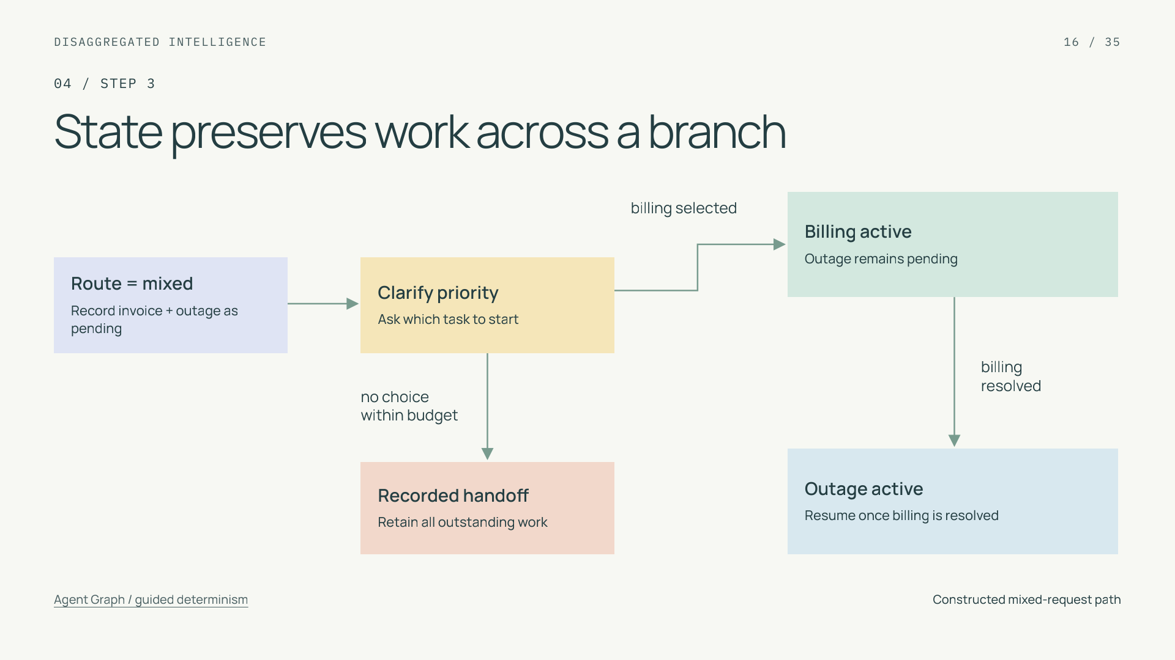
Notes:
State preserves work across a branch
Section: 04
Purpose: Make persistent obligations visible.
Suggested speaking time: 1 minutes
TALKING POINTS
• The application records requested, active, resolved, and handed-off task states separately.
• An explanation is an event, not a proof of resolution. The completion rule should reference the actual business outcome or customer confirmation.
• The clarification loop has a time or turn budget. A handoff retains outstanding work and receiving ownership.
Transition: This is where neural interpretation meets explicit control.
POWERPOINT EXPORT
This edition preserves the HTML slide design as one outlined SVG graphic with an embedded PNG fallback. Slide text is vector artwork, not editable PowerPoint paragraphs. Speaker notes remain editable. Use the companion HTML for interaction.
WEB REFERENCES
Agent Graph / guided determinism
https://engineering.salesforce.com/agentforces-agent-graph-toward-guided-determinism-with-hybrid-reasoning/
SLIDE TEXT REFERENCE
DISAGGREGATED INTELLIGENCE
16 / 35
04 / STEP 3
State preserves work across a branch
Route = mixed
Record invoice + outage as pending
Clarify priority
Ask which task to start
Billing active
Outage remains pending
Outage active
Resume once billing is resolved
Recorded handoff
Retain all outstanding work
billing selected
no choice
within budget
billing
resolved
Agent Graph / guided determinism
Constructed mixed-request path

Slide 17
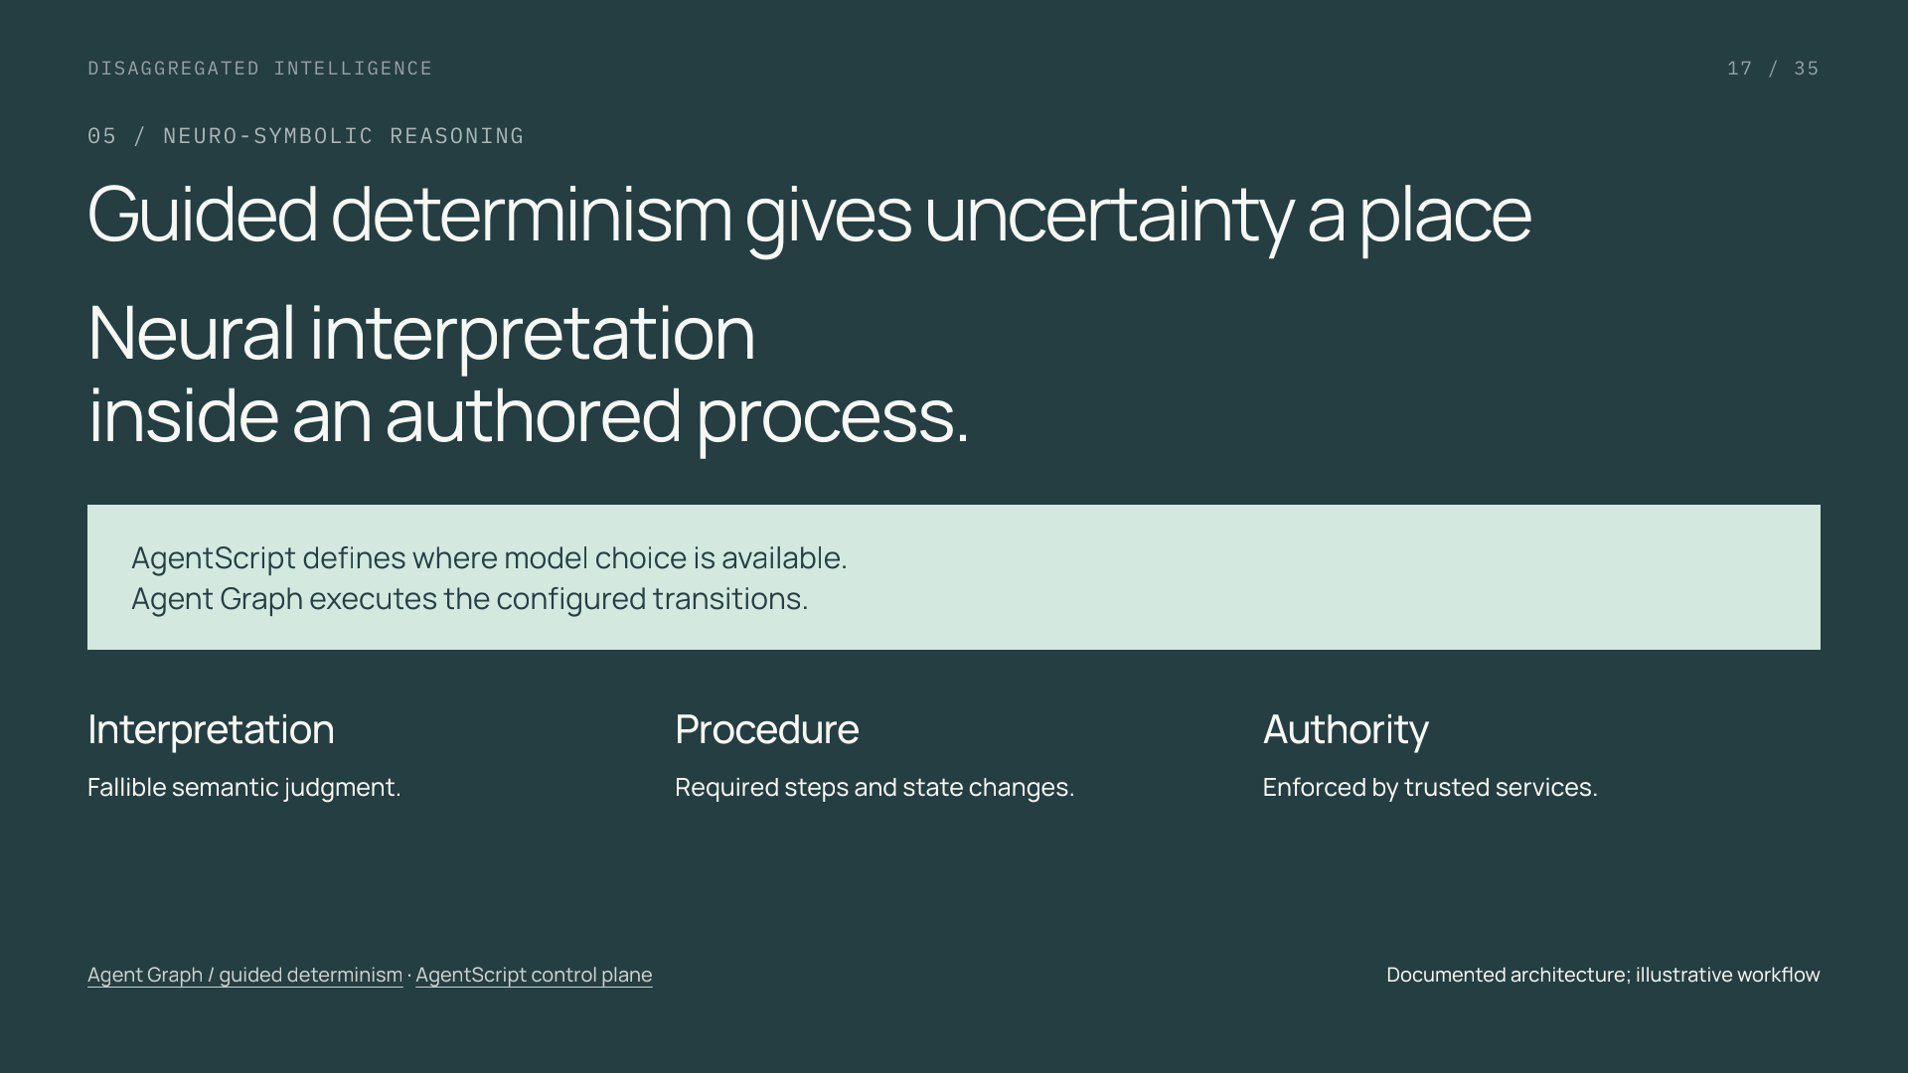
Notes:
Guided determinism gives uncertainty a place
Section: 05
Purpose: Explain neuro-symbolic reasoning in plain terms.
Suggested speaking time: 1 minutes
TALKING POINTS
• Neuro-symbolic reasoning combines learned interpretation with explicit software rules and state.
• Guided determinism describes constraints on the effect of model judgments. It does not guarantee perfect classification, identical prose, or eventual completion.
• The configuration and the model can evolve independently when their boundary is explicit and tested.
Transition: Three AgentScript concepts make that boundary concrete.
POWERPOINT EXPORT
This edition preserves the HTML slide design as one outlined SVG graphic with an embedded PNG fallback. Slide text is vector artwork, not editable PowerPoint paragraphs. Speaker notes remain editable. Use the companion HTML for interaction.
WEB REFERENCES
Agent Graph / guided determinism
https://engineering.salesforce.com/agentforces-agent-graph-toward-guided-determinism-with-hybrid-reasoning/
AgentScript control plane
https://www.salesforce.com/blog/agent-script-control-plane/
SLIDE TEXT REFERENCE
DISAGGREGATED INTELLIGENCE
17 / 35
05 / NEURO-SYMBOLIC REASONING
Guided determinism gives uncertainty a place
Neural interpretation
inside an authored process.
AgentScript defines where model choice is available.
Agent Graph executes the configured transitions.
Interpretation
Fallible semantic judgment.
Procedure
Required steps and state changes.
Authority
Enforced by trusted services.
Agent Graph / guided determinism · AgentScript control plane
Documented architecture; illustrative workflow

Slide 18
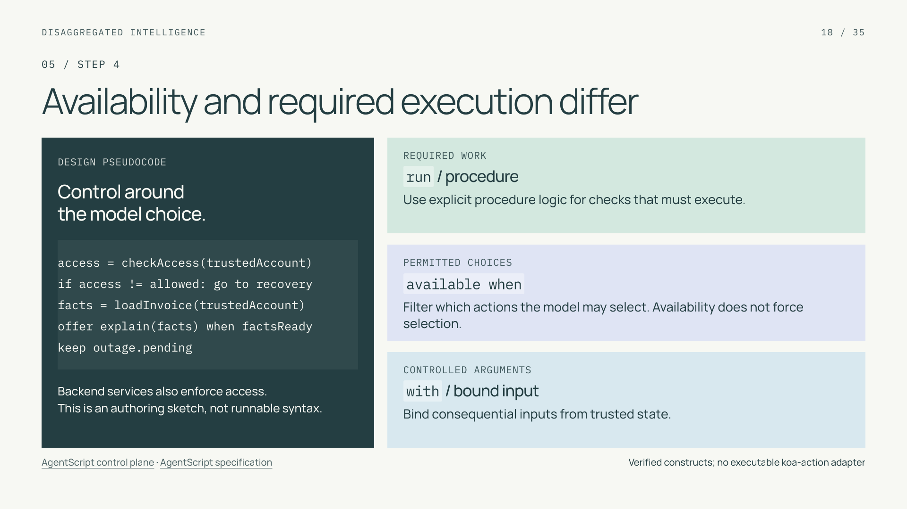
Notes:
Availability and required execution differ
Section: 05
Purpose: Teach precise AgentScript control semantics.
Suggested speaking time: 1 minutes
TALKING POINTS
• These are language constructs, not a runnable integration. Action definitions, dialect, and deployment configuration are omitted.
• An availability guard controls the offered action set. Required verification belongs in deterministic procedure logic and must also be enforced by the business service.
• Bind trusted account context rather than allowing model extraction to establish authority. No email-found lookup alone is sufficient authentication.
• The left sketch is language-neutral design pseudocode, not valid AgentScript syntax or a documented adapter. It connects the required procedure, failure route, action gate and trusted argument binding to this case.
Transition: Walk the proposed request through all of its owners.
POWERPOINT EXPORT
This edition preserves the HTML slide design as one outlined SVG graphic with an embedded PNG fallback. Slide text is vector artwork, not editable PowerPoint paragraphs. Speaker notes remain editable. Use the companion HTML for interaction.
WEB REFERENCES
AgentScript control plane
https://www.salesforce.com/blog/agent-script-control-plane/
AgentScript specification
https://github.com/salesforce/agentscript/blob/main/SPEC.md
SLIDE TEXT REFERENCE
DISAGGREGATED INTELLIGENCE
18 / 35
05 / STEP 4
Availability and required execution differ
DESIGN PSEUDOCODE
Control around
the model choice.
access = checkAccess(trustedAccount)
if access != allowed: go to recovery
facts = loadInvoice(trustedAccount)
offer explain(facts) when factsReady
keep outage.pending
Backend services also enforce access.
This is an authoring sketch, not runnable syntax.
REQUIRED WORK
run / procedure
Use explicit procedure logic for checks that must execute.
PERMITTED CHOICES
available when
Filter which actions the model may select. Availability does not force selection.
CONTROLLED ARGUMENTS
with / bound input
Bind consequential inputs from trusted state.
AgentScript control plane · AgentScript specification
Verified constructs; no executable koa-action adapter

Slide 19
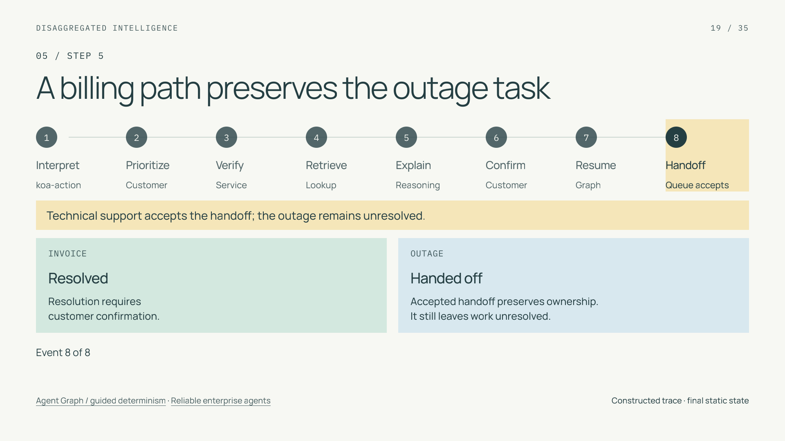
Notes:
A billing path preserves the outage task
Section: 05
Purpose: Follow a constructed mixed-intent case and distinguish completion from accepted handoff.
Suggested speaking time: 1.6 minutes
TALKING POINTS
• The same customer asks about an invoice and an outage. The constructed classifier output is mixed, so the graph records two pending obligations.
• Advance to Explain: delivering the response leaves the invoice awaiting confirmation. Only the next event meets this example’s resolution condition.
• The graph resumes the outage task, then an identified queue accepts the handoff. The outage remains unresolved; the whole customer case is not yet complete.
• At the handoff, point out that the workflow preserved work and recorded a receiving owner. The service still owes the customer an outage outcome.
Transition: Now design the non-happy paths.
POWERPOINT EXPORT
This edition preserves the HTML slide design as one outlined SVG graphic with an embedded PNG fallback. Slide text is vector artwork, not editable PowerPoint paragraphs. Speaker notes remain editable. Use the companion HTML for interaction.
STATIC TRACE: Event 8 of 8. Invoice: Resolved; outage: Handed off. Technical support accepts the handoff; the outage remains unresolved.
Walkthrough: capture both requested obligations, prioritize billing, verify access, retrieve authorized facts, explain, confirm resolution, and resume the unresolved outage. The last state records technical support accepting the handoff; it does not claim the outage is resolved.
WEB REFERENCES
Agent Graph / guided determinism
https://engineering.salesforce.com/agentforces-agent-graph-toward-guided-determinism-with-hybrid-reasoning/
Reliable enterprise agents
https://engineering.salesforce.com/building-enterprise-ai-agents-that-are-both-autonomous-and-reliable/
SLIDE TEXT REFERENCE
DISAGGREGATED INTELLIGENCE
19 / 35
05 / STEP 5
A billing path preserves the outage task
1
Interpret
koa-action
2
Prioritize
Customer
3
Verify
Service
4
Retrieve
Lookup
5
Explain
Reasoning
6
Confirm
Customer
7
Resume
Graph
8
Handoff
Queue accepts
Technical support accepts the handoff; the outage remains unresolved.
INVOICE
Resolved
Resolution requires
customer confirmation.
OUTAGE
Handed off
Accepted handoff preserves ownership.
It still leaves work unresolved.
Event 8 of 8
Agent Graph / guided determinism · Reliable enterprise agents
Constructed trace · final static state

Slide 20
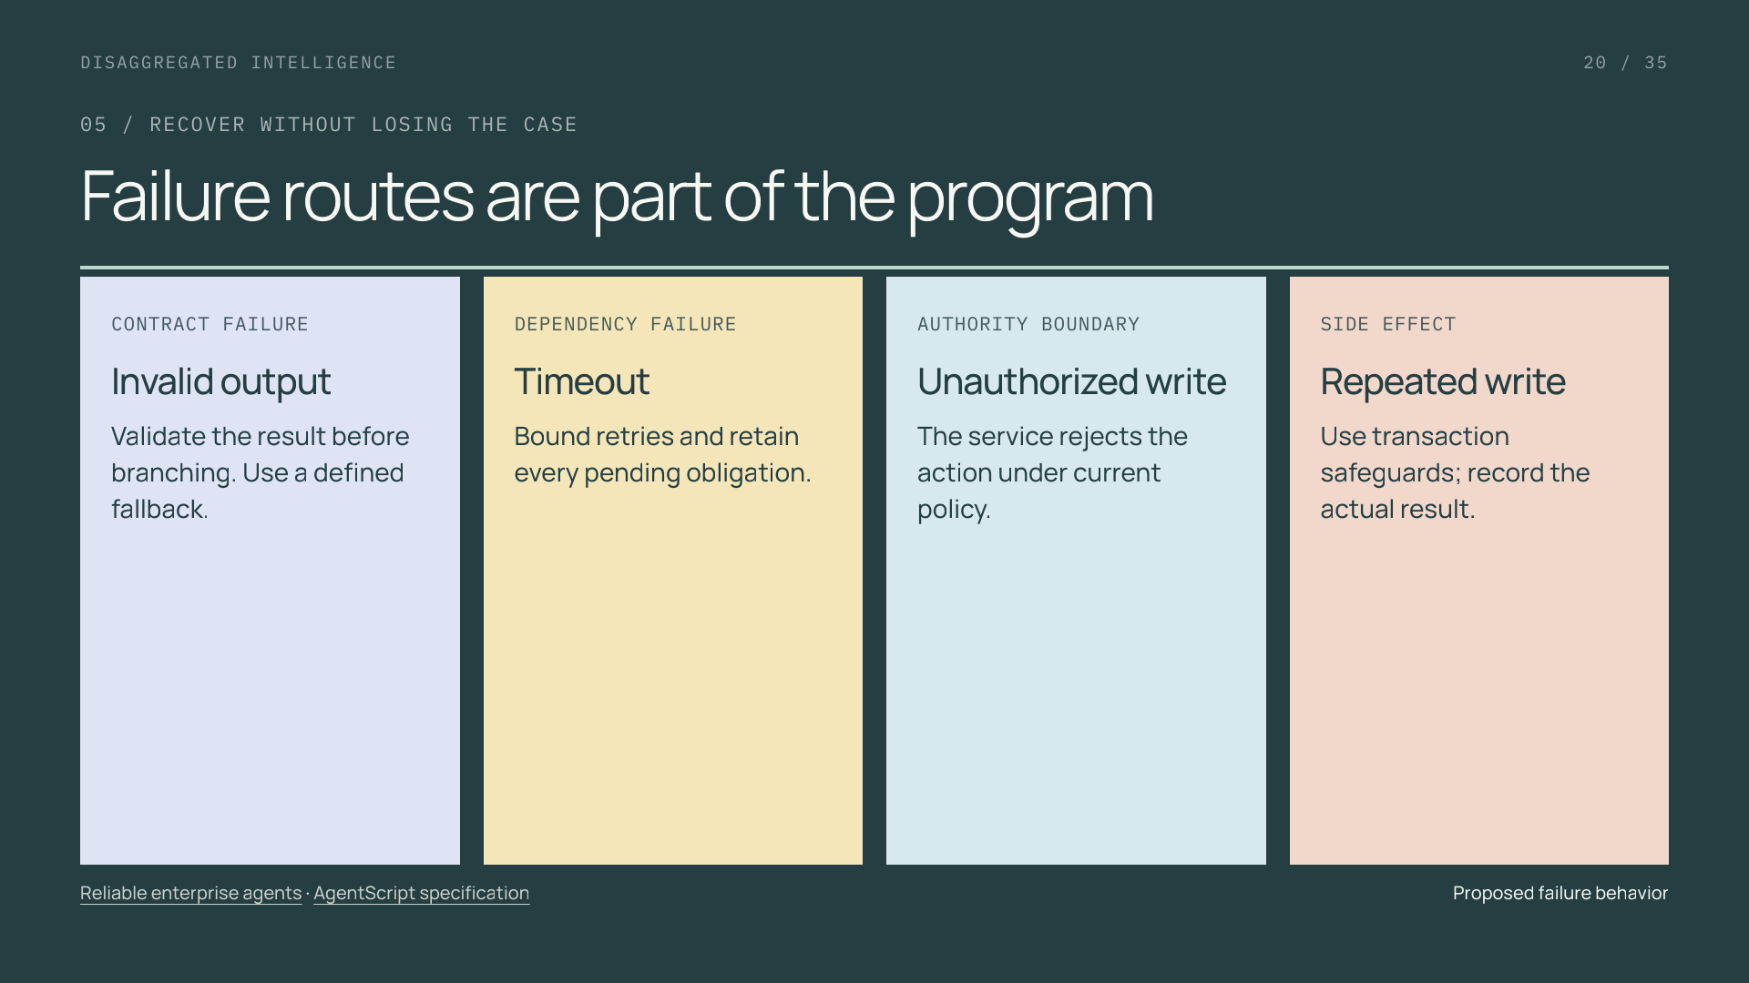
Notes:
Failure routes are part of the program
Section: 05
Purpose: Connect reliability to failure contracts.
Suggested speaking time: 1 minutes
TALKING POINTS
• A graph needs meaningful timeout, invalid-output, and handoff routes rather than a default business action.
• A resumed workflow can reuse a recorded decision, but this alone does not guarantee exactly-once external side effects.
• Transaction-specific safeguards belong in the service performing the write. Recovery must retain the unfinished tasks.
Transition: A valid decision can still be semantically wrong.
POWERPOINT EXPORT
This edition preserves the HTML slide design as one outlined SVG graphic with an embedded PNG fallback. Slide text is vector artwork, not editable PowerPoint paragraphs. Speaker notes remain editable. Use the companion HTML for interaction.
WEB REFERENCES
Reliable enterprise agents
https://engineering.salesforce.com/building-enterprise-ai-agents-that-are-both-autonomous-and-reliable/
AgentScript specification
https://github.com/salesforce/agentscript/blob/main/SPEC.md
SLIDE TEXT REFERENCE
DISAGGREGATED INTELLIGENCE
20 / 35
05 / RECOVER WITHOUT LOSING THE CASE
Failure routes are part of the program
CONTRACT FAILURE
Invalid output
Validate the result before branching. Use a defined fallback.
DEPENDENCY FAILURE
Timeout
Bound retries and retain every pending obligation.
AUTHORITY BOUNDARY
Unauthorized write
The service rejects the action under current policy.
SIDE EFFECT
Repeated write
Use transaction safeguards; record the actual result.
Reliable enterprise agents · AgentScript specification
Proposed failure behavior

Slide 21
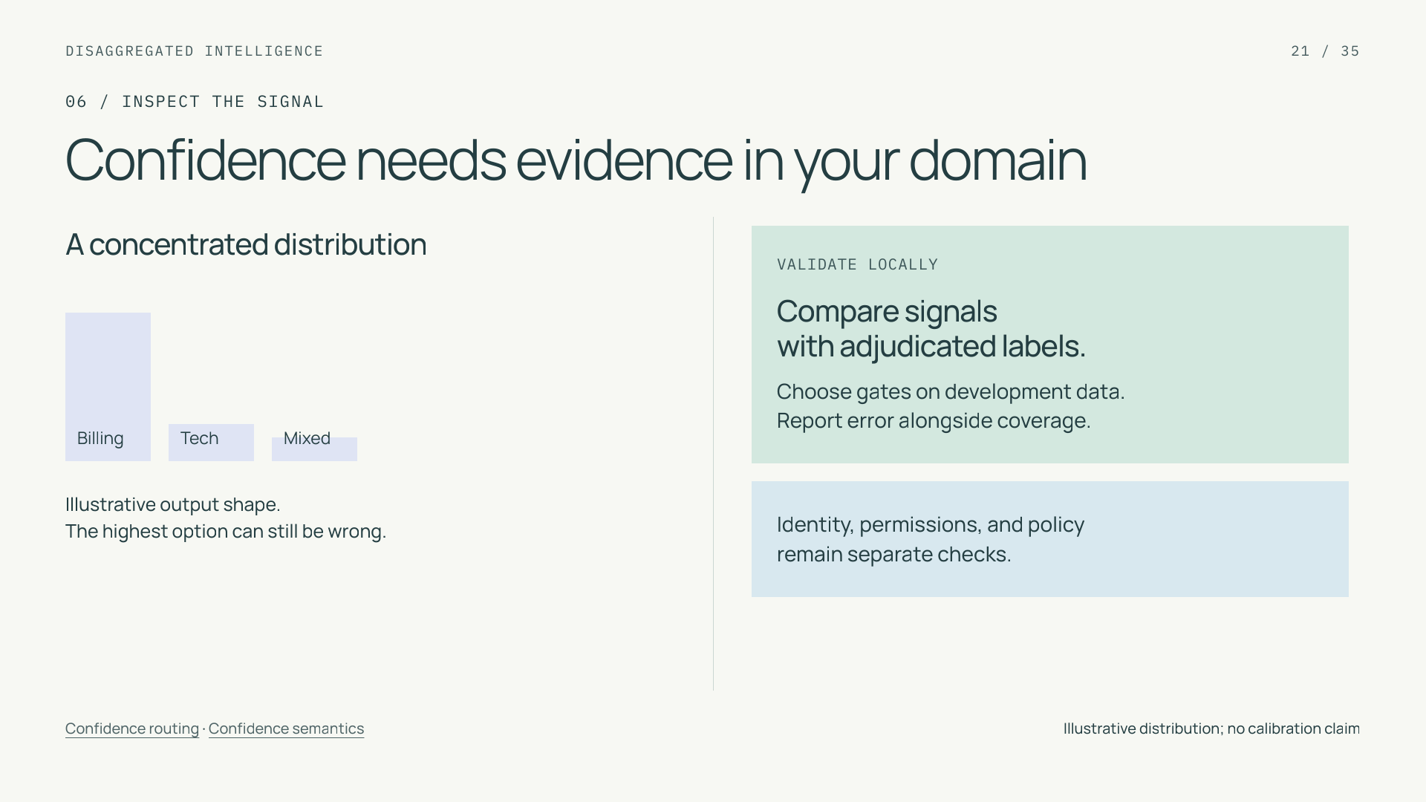
Notes:
Confidence needs evidence in your domain
Section: 06
Purpose: Distinguish signal concentration from correctness and permission.
Suggested speaking time: 1 minutes
TALKING POINTS
• TypeSafe defines Choice and Score confidence from distribution concentration. Noul has no separate confidence field.
• The picture is schematic and does not display a returned koa-action distribution. Any provider signal needs a specified meaning and local validation.
• A score cannot authorize a business action. Numerical gates are application operating points, not universal constants.
Transition: Explore what a stricter gate does to a small labeled sample.
POWERPOINT EXPORT
This edition preserves the HTML slide design as one outlined SVG graphic with an embedded PNG fallback. Slide text is vector artwork, not editable PowerPoint paragraphs. Speaker notes remain editable. Use the companion HTML for interaction.
WEB REFERENCES
Confidence routing
https://docs.typesafe.ai/patterns/confidence-routing
Confidence semantics
https://docs.typesafe.ai/confidence
SLIDE TEXT REFERENCE
DISAGGREGATED INTELLIGENCE
21 / 35
06 / INSPECT THE SIGNAL
Confidence needs evidence in your domain
A concentrated distribution
Billing
Tech
Mixed
Illustrative output shape.
The highest option can still be wrong.
VALIDATE LOCALLY
Compare signals
with adjudicated labels.
Choose gates on development data.
Report error alongside coverage.
Identity, permissions, and policy
remain separate checks.
Confidence routing · Confidence semantics
Illustrative distribution; no calibration claim

Slide 22
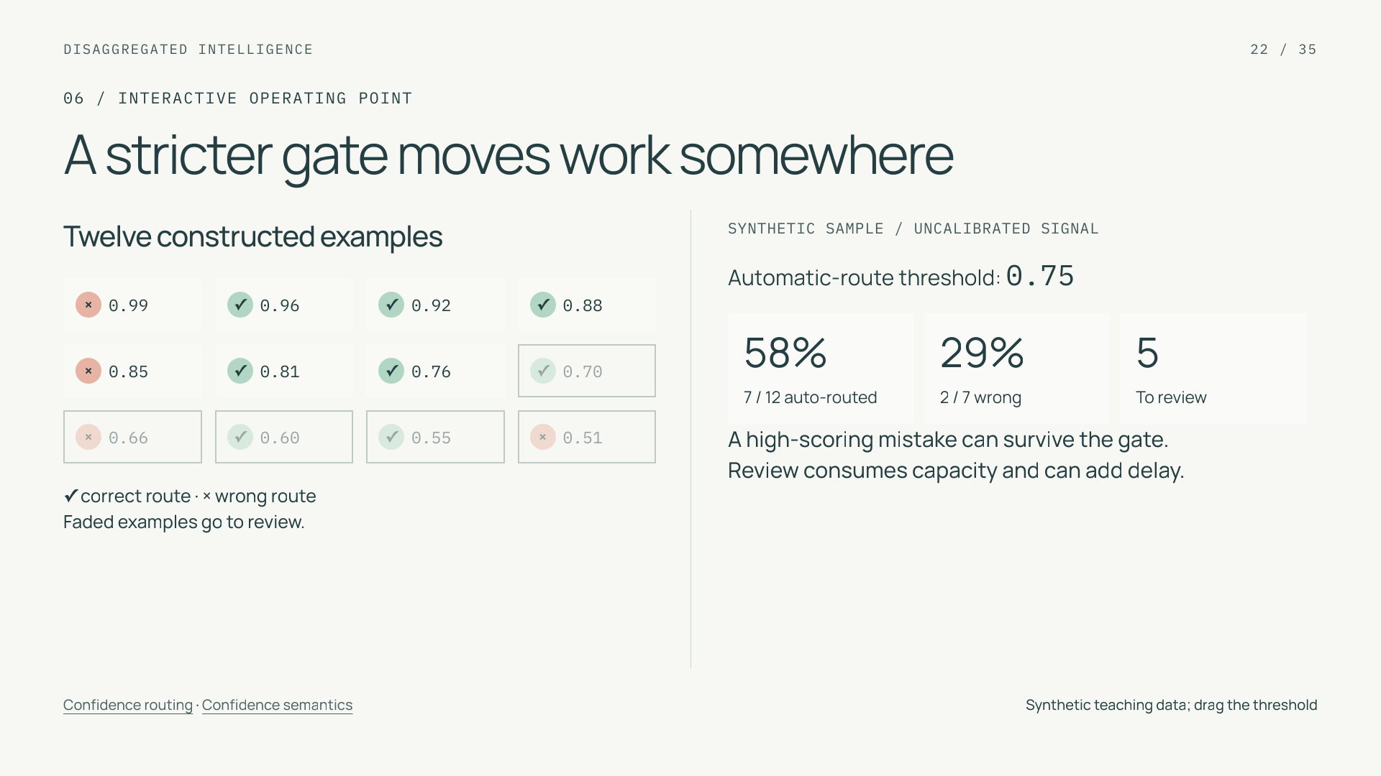
Notes:
A stricter gate moves work somewhere
Section: 06
Purpose: Teach selection, error rate, and coverage without fabricated evidence.
Suggested speaking time: 1.6 minutes
TALKING POINTS
• All twelve cases and their scores are constructed teaching data. The signal is uncalibrated and is not a real koa-action field.
• Automatic routing coverage is accepted routing decisions divided by twelve. Automatic error uses only accepted decisions; with zero accepted decisions it is undefined. This is a routing metric, not completed-case automation.
• A high-scoring error remains when the threshold rises. Escalations still consume capacity, and errors need not decline monotonically on this sample.
Transition: Next account for the work that the routing gate adds and avoids.
POWERPOINT EXPORT
This edition preserves the HTML slide design as one outlined SVG graphic with an embedded PNG fallback. Slide text is vector artwork, not editable PowerPoint paragraphs. Speaker notes remain editable. Use the companion HTML for interaction.
STATIC CONFIDENCE EXAMPLE: threshold 0.75. The twelve examples and scores are constructed teaching data. The HTML slider changes which examples are auto-routed at this decision point; a high-scoring mistake can survive a stricter gate. Threshold selection requires independent calibration and evaluation.
WEB REFERENCES
Confidence routing
https://docs.typesafe.ai/patterns/confidence-routing
Confidence semantics
https://docs.typesafe.ai/confidence
SLIDE TEXT REFERENCE
DISAGGREGATED INTELLIGENCE
22 / 35
06 / INTERACTIVE OPERATING POINT
A stricter gate moves work somewhere
Twelve constructed examples
×
0.99
✓
0.96
✓
0.92
✓
0.88
×
0.85
✓
0.81
✓
0.76
✓
0.70
×
0.66
✓
0.60
✓
0.55
×
0.51
✓ correct route · × wrong route
Faded examples go to review.
SYNTHETIC SAMPLE / UNCALIBRATED SIGNAL
Automatic-route threshold: 0.75
58%
7 / 12 auto-routed
29%
2 / 7 wrong
5
To review
A high-scoring mistake can survive the gate.
Review consumes capacity and can add delay.
Confidence routing · Confidence semantics
Synthetic teaching data; drag the threshold

Slide 23

Notes:
Savings depend on avoiding expensive work
Section: 06
Purpose: Explain conditional economics with transparent algebra.
Suggested speaking time: 1.6 minutes
TALKING POINTS
• This isolates the routing call replaced by a specialized decision. G does not include the later model call that explains the invoice. Every constant is invented for teaching.
• At p=0.20, candidate routing cost is 0.27 of one baseline unit. At p=0.93 the paths break even; at p=1, adding a decision makes the routing stage 7% more expensive.
• Whole-case savings must include any changed explanations, tools, retries, human work and unresolved obligations. Added development and maintenance investment also needs an explicit volume and horizon.
• The review queue in the previous synthetic gate example and the general-model routing fallback G here are different destinations. Measure the actual destination chosen by each workflow.
Transition: Inference latency has an equally important boundary.
POWERPOINT EXPORT
This edition preserves the HTML slide design as one outlined SVG graphic with an embedded PNG fallback. Slide text is vector artwork, not editable PowerPoint paragraphs. Speaker notes remain editable. Use the companion HTML for interaction.
STATIC COST EXAMPLE: 20% of routes still use the expensive routing stage. With invented normalized units G=1, D=0.03 and O=0.04, candidate cost is 0.27 versus 1.00 (73% lower for this routing stage only). At 93% fallback the candidate breaks even; at 100% it costs 1.07, or 7% more. This excludes later explanation, service work and changed human costs; it is not a vendor benchmark.
WEB REFERENCES
Composable AI
https://typesafe.ai/manifesto
Building with System One
https://docs.typesafe.ai/concepts/how-to-build-with-system-one
SLIDE TEXT REFERENCE
DISAGGREGATED INTELLIGENCE
23 / 35
06 / INTERACTIVE BREAK-EVEN
Savings depend on avoiding expensive work
ROUTING STEP ONLY · INVENTED UNIT COSTS
Baseline = G
Candidate = D + O + pG
G = 1.00 expensive routing call
D = 0.03 specialized decision
O = 0.04 added orchestration
Routes still using G: 20%
HYPOTHETICAL ROUTING-STAGE ARITHMETIC
Baseline
Candidate
73% lower
0.27 normalized units
Break-even: D + O = (1 − p)G
Later explanation and service work excluded.
Composable AI · Building with System One
Illustrative arithmetic; no measured cost claim

Slide 24

Notes:
Fast inference helps the path that uses it
Section: 06
Purpose: Separate primitive speed from workflow speed.
Suggested speaking time: 1 minutes
TALKING POINTS
• Specialized inference can shorten a repeated semantic step. A faster classifier does not by itself establish faster service resolution.
• Client-observed call latency includes transport and retries; parallel branches affect critical-path duration differently from serial dependencies.
• Measure distribution tails as well as typical latency at the relevant load. Include unfinished cases when reporting resolution, rather than averaging completed cases alone.
Transition: Apply the control model to a deliberately incomplete design.
POWERPOINT EXPORT
This edition preserves the HTML slide design as one outlined SVG graphic with an embedded PNG fallback. Slide text is vector artwork, not editable PowerPoint paragraphs. Speaker notes remain editable. Use the companion HTML for interaction.
WEB REFERENCES
Jev + LangGraph
https://www.langchain.com/blog/building-prod-with-jev-and-langgraph
SLIDE TEXT REFERENCE
DISAGGREGATED INTELLIGENCE
24 / 35
06 / MEASURE THE CRITICAL PATH
Fast inference helps the path that uses it
Fast decision
Measure call latency
Authorized lookup
Required dependency
Explanation
Measure response latency
Review queue + human handling
Can dominate the time to resolution
Track decision time, response time, and time to completed service separately.
Jev + LangGraph
Mechanism illustration; no timing benchmark

Slide 25

Notes:
Find the missing boundary
Section: 07
Purpose: Check whether the learner can separate prediction from authority.
Suggested speaking time: 1.3 minutes
TALKING POINTS
• Allow a short pause before revealing the repair. The initial diagram is intentionally incomplete.
• The strongest answer identifies both authored ordering and independent backend enforcement. Raising the classifier threshold alone does not repair the design.
• Also retain pending tasks and specify a bounded fallback. A credit operation has consequences outside the model response.
Transition: Training examples must respect the same decision boundaries.
POWERPOINT EXPORT
This edition preserves the HTML slide design as one outlined SVG graphic with an embedded PNG fallback. Slide text is vector artwork, not editable PowerPoint paragraphs. Speaker notes remain editable. Use the companion HTML for interaction.
STATIC EXERCISE: the repair is revealed. Before showing the repair, ask what is missing between a predicted credit request and a financial action. The repair verifies account access, checks policy, and enforces authorization in the service. The diagram size correction is export-only for the first HTML edition.
WEB REFERENCES
Reliable enterprise agents
https://engineering.salesforce.com/building-enterprise-ai-agents-that-are-both-autonomous-and-reliable/
AgentScript control plane
https://www.salesforce.com/blog/agent-script-control-plane/
SLIDE TEXT REFERENCE
DISAGGREGATED INTELLIGENCE
25 / 35
07 / EXERCISE
Find the missing boundary
Credit requested
Strong model score
Issue credit
Business transaction
Verify access
Trusted principal and account context.
Check policy
Required procedure before the action.
Enforce in service
Recheck authorization and record outcome.
Reliable enterprise agents · AgentScript control plane
Constructed design exercise

Slide 26

Notes:
Begin the dataset at the decision boundary
Section: 08
Purpose: Prevent future information leaking into model features.
Suggested speaking time: 1 minutes
TALKING POINTS
• Freeze the source snapshot and reconstruct what the routing node could actually access at the timestamp.
• Use independently adjudicated route labels, including mixed and unclear cases. Reviewers labeling the next step see the decision-time evidence.
• Record redaction, filtering, and derived examples. Preserving the source does not mean transformations leave the model-visible distribution unchanged.
Transition: Separate fitting and selection from final evaluation.
POWERPOINT EXPORT
This edition preserves the HTML slide design as one outlined SVG graphic with an embedded PNG fallback. Slide text is vector artwork, not editable PowerPoint paragraphs. Speaker notes remain editable. Use the companion HTML for interaction.
LOCAL COMPANION REFERENCES
Tutorial evaluation protocol — blog/08-building-prod.md
These identifiers refer to the accompanying repository and are not broken file hyperlinks.
SLIDE TEXT REFERENCE
DISAGGREGATED INTELLIGENCE
26 / 35
08 / STEP 6
Begin the dataset at the decision boundary
At decision time
INPUT SNAPSHOT
Conversation prefix
Trusted facts available then
Current policy version
REFERENCE LABEL
Next route supported by that evidence.
After the decision
LATER TURNS AND OUTCOMES
Useful for separate outcome labels.
Excluded from the earlier input.
Preserve order,
relationships,
and provenance.
Tutorial evaluation protocol
Proposed development protocol

Slide 27

Notes:
Split examples before developing the decision
Section: 08
Purpose: Show independent data partitions and keep related examples together before fitting or augmentation.
Suggested speaking time: 1.1 minutes
TALKING POINTS
• This is proposed task development, not a description of koa-action foundation-model training or a supported fine-tuning interface. If direct adaptation is unavailable, retain the fixed model and develop its application configuration.
• Inputs contain only the conversation prefix and trusted state available at the decision time. Route labels use that evidence. Later outcomes or future audio may establish separate outcome or endpoint targets; they cannot enter the earlier model input. Preserve timestamps, record order, and the derivation manifest.
• Group related cases and duplicates before assigning partitions. Create augmentations afterward and keep every variant in its source partition. Account-level groups and later-time cohorts answer different generalization questions.
• Fit learned transforms and any permitted adaptation on training data. Separate calibration fitting from gate selection within development data. The locked test is excluded from all iteration. The solid branches carry different samples, not successive copies of one dataset.
Transition: Now follow the frozen artifacts and the evidence needed for release.
POWERPOINT EXPORT
This edition preserves the HTML slide design as one outlined SVG graphic with an embedded PNG fallback. Slide text is vector artwork, not editable PowerPoint paragraphs. Speaker notes remain editable. Use the companion HTML for interaction.
LOCAL COMPANION REFERENCES
Tutorial evaluation protocol — blog/08-building-prod.md
These identifiers refer to the accompanying repository and are not broken file hyperlinks.
SLIDE TEXT REFERENCE
DISAGGREGATED INTELLIGENCE
27 / 35
08 / TRAINING PIPELINE — PRESERVE THE PARTITIONS
Split examples before developing the decision
Decision-time snapshot
Inputs stop at the decision.
Versioned records and labels.
Group, then split
Before augmentation.
Preserve record relationships.
Family rule
Source + its variants
stay in one partition.
Separate sample partitions
Train
Fit permitted components.
Adaptation is optional.
Augment training data only.
Development
Use separate subsets for
calibration and gate selection.
Locked test
Keep examples untouched.
No fitting or gate tuning.
Route labels use decision-time evidence; later outcomes belong to separate targets.
Tutorial evaluation protocol
Proposed task development; adaptation only where supported

Slide 28

Notes:
Freeze the workflow before earning release
Section: 08
Purpose: Separate model artifacts, locked evaluation, and live-service qualification.
Suggested speaking time: 1.1 minutes
TALKING POINTS
• The purple dashed arrow carries frozen model and configuration artifacts. A separate green arrow carries untouched examples into the locked evaluation. The artifacts include model version, learned transforms, decision definitions, thresholds, and the workflow policy.
• Passing offline gates qualifies the candidate for a randomized service pilot. The black arrows indicate release qualification; the offline test examples do not become the pilot traffic. Use equivalent permissions, tools, and service requirements for the baseline and candidate.
• Predeclare the pilot assignment unit, observation horizon, failure definition, quality margin, minimum worthwhile saving, and latency limits. Keep related cases assigned consistently and account for interference through shared review queues.
• Roll out only when the predefined pilot gates pass. Track cost per incoming case beside resolution and automatic coverage, including unfinished work. Reviewed feedback goes to a future dataset. If tuning follows a failure, evaluate the new candidate with fresh untouched evidence.
• The full standalone illustration remains available as assets/training-pipeline.svg and assets/training-pipeline.png; these focus views enlarge its two teaching responsibilities without changing its semantics.
Transition: Choose the grouping or time split that matches the deployment claim.
POWERPOINT EXPORT
This edition preserves the HTML slide design as one outlined SVG graphic with an embedded PNG fallback. Slide text is vector artwork, not editable PowerPoint paragraphs. Speaker notes remain editable. Use the companion HTML for interaction.
LOCAL COMPANION REFERENCES
Tutorial evaluation protocol — blog/08-building-prod.md
These identifiers refer to the accompanying repository and are not broken file hyperlinks.
SLIDE TEXT REFERENCE
DISAGGREGATED INTELLIGENCE
28 / 35
08 / TRAINING PIPELINE — QUALIFY THE CANDIDATE
Freeze the workflow before earning release
Freeze the selected candidate
Untouched test cases
Frozen artifacts
Model and transforms.
Decision definitions.
Routing policy and gates.
Artifacts
Locked evaluation
Paired decision comparison.
Use untouched examples.
Predeclare offline gates.
Pass gates
Randomized pilot
Compare complete cases.
Quality, cost, and latency.
Keep assignment consistent.
Broader rollout
Only if pilot gates pass.
Track unfinished work.
Feedback
Next dataset
Reviewed feedback only.
Fresh tests for new claims.
A revision starts
a new candidate.
Retest before a new claim.
Tutorial evaluation protocol
Proposed qualification gates; no measured deployment result

Slide 29

Notes:
Choose the split that matches the claim
Section: 08
Purpose: Distinguish independent cases from repeated observations.
Suggested speaking time: 1 minutes
TALKING POINTS
• Unseen-account performance and future-traffic performance are different claims and may need separate tests.
• Assign related cases and near duplicates together, and generate training augmentations only after partitioning.
• One conversation evaluated many times still represents one customer situation. Repeated judgments estimate repeatability, not generalization over new cases.
Transition: Define what evidence would earn a rollout.
POWERPOINT EXPORT
This edition preserves the HTML slide design as one outlined SVG graphic with an embedded PNG fallback. Slide text is vector artwork, not editable PowerPoint paragraphs. Speaker notes remain editable. Use the companion HTML for interaction.
WEB REFERENCES
Jev-as-a-Judge
https://www.langchain.com/blog/jev-agent-evals-langsmith
LOCAL COMPANION REFERENCES
Tutorial evaluation protocol — blog/08-building-prod.md
These identifiers refer to the accompanying repository and are not broken file hyperlinks.
SLIDE TEXT REFERENCE
DISAGGREGATED INTELLIGENCE
29 / 35
08 / GENERALIZATION
Choose the split that matches the claim
UNSEEN ACCOUNTS
Keep account families intact.
A A A
B B
C C C
Related cases and variants
stay in one partition.
FUTURE TRAFFIC
Reserve a later-time cohort.
Earlier cases
Later test
Declare boundary exclusions
and duplicate handling.
Tutorial evaluation protocol · Jev-as-a-Judge
Evaluation design; no completed experiment

Slide 30

Notes:
Lower cost must come with acceptable quality
Section: 09
Purpose: Explain the joint acceptance rule with schematic intervals and the whole-case outcome.
Suggested speaking time: 2 minutes
TALKING POINTS
• These ranges are schematic shapes, not results, effect sizes, or measurement precision. Their only purpose is to show how a predeclared limit is compared with an uncertainty bound. Limits and the analysis method must be chosen before testing.
• On the left, the upper bound on the increase in failed-case rate reaches beyond the maximum allowed loss. Quality has not passed even if the point estimate might look reassuring. On the right, the lower bound on saving per incoming case clears the minimum required gain. Both conditions must pass before rollout, so this candidate waits.
• The worked trace has an invoice resolved and an outage handed off with work still outstanding. At the fixed service deadline that is an incomplete case. An incorrect outcome or any unresolved requested task counts as a failed case; count each incoming case once.
• Consequential-action limits and response/resolution latency limits are additional gates. Assess harmful actions across all incoming cases and an independently defined relevant cohort shared by both systems. Record unresolved cases rather than averaging only completed service.
• The formal joint null is unacceptable quality loss OR insufficient saving. Failure to find a significant quality difference is insufficient evidence of acceptable equivalence. Predeclare sample size, grouping, and the uncertainty method; retain the statistical detail in the companion notes.
Transition: First isolate the decision on held-out snapshots, then measure the whole service in a controlled pilot.
POWERPOINT EXPORT
This edition preserves the HTML slide design as one outlined SVG graphic with an embedded PNG fallback. Slide text is vector artwork, not editable PowerPoint paragraphs. Speaker notes remain editable. Use the companion HTML for interaction.
LOCAL COMPANION REFERENCES
Tutorial evaluation protocol — blog/08-building-prod.md
These identifiers refer to the accompanying repository and are not broken file hyperlinks.
SLIDE TEXT REFERENCE
DISAGGREGATED INTELLIGENCE
30 / 35
09 / STEP 8 · EARN ROLLOUT
Lower cost must come with acceptable quality
Schematic decision rule · no measured results
Quality: upper end must stay below the limit
Uncertainty range
Allowed loss
More quality loss →
This range crosses the margin.
Quality remains uncertain.
Cost: lower end must exceed the target
Uncertainty range
Required saving
More saving per case →
This range clears the required gain.
Cost passes; rollout still waits.
Count the whole case: invoice resolved + outage pending
= incomplete at the deadline.
Harm limits must also pass.
Assess all cases and the same relevant cohort.
Latency limits must also pass.
Include unfinished cases and resolution time.
Tutorial evaluation protocol
Schematic acceptance rule; no empirical intervals

Slide 31

Notes:
Evaluate the decision, then the service
Section: 09
Purpose: Prevent offline results being overextended to service economics.
Suggested speaking time: 1.5 minutes
TALKING POINTS
• Offline replay isolates the bounded decision. It cannot estimate how changed dialogue affects customers or how escalations affect queue capacity.
• In the pilot, keep assignment stable and account for related cases and interference through shared queues. Use the same observation horizon in both arms.
• Report observed operating cost per incoming case with resolution and coverage. Disclose setup and maintenance costs separately; total ownership estimates need an explicit volume and horizon.
• Case automation counts incoming cases completed by the deadline without staff handling. Routing coverage counts decisions accepted automatically at one gate. A model fallback can remain automatic; an accepted routing decision can still lead to an unresolved case.
Transition: When an outcome fails, diagnose the responsible boundary.
POWERPOINT EXPORT
This edition preserves the HTML slide design as one outlined SVG graphic with an embedded PNG fallback. Slide text is vector artwork, not editable PowerPoint paragraphs. Speaker notes remain editable. Use the companion HTML for interaction.
LOCAL COMPANION REFERENCES
Tutorial evaluation protocol — blog/08-building-prod.md
These identifiers refer to the accompanying repository and are not broken file hyperlinks.
SLIDE TEXT REFERENCE
DISAGGREGATED INTELLIGENCE
31 / 35
09 / TWO EXPERIMENTS
Evaluate the decision, then the service
PAIRED OFFLINE COMPARISON
Evaluate the decision.
Same held-out snapshots.
Same route question.
Fixed permissions and tools.
Each model’s gate is selected
on development data.
CONTROLLED SERVICE PILOT
Evaluate the complete case.
Randomized case/account assignment.
Consistent treatment and horizon.
Costs, queues, and unresolved work.
Pilot evidence must precede
wider rollout.
Tutorial evaluation protocol
Proposed controlled evaluation

Slide 32

Notes:
Diagnose the boundary that failed
Section: 09
Purpose: Connect disaggregation to targeted learning from failure.
Suggested speaking time: 1 minutes
TALKING POINTS
• A wrong route can motivate better decision data. A correct mixed route followed by dropped state calls for a workflow repair.
• Offline semantic judges can prioritize traces, but require validation against independent references. Repeatability is a separate property from correctness.
• Sample apparent successes as well as escalations. A post-run evaluation score cannot prevent an action that has already happened.
Transition: Finish by identifying one worthwhile first change.
POWERPOINT EXPORT
This edition preserves the HTML slide design as one outlined SVG graphic with an embedded PNG fallback. Slide text is vector artwork, not editable PowerPoint paragraphs. Speaker notes remain editable. Use the companion HTML for interaction.
WEB REFERENCES
Jev in LangSmith Evals
https://www.langchain.com/blog/jev-is-now-available-in-langsmith-evals
Jev-as-a-Judge
https://www.langchain.com/blog/jev-agent-evals-langsmith
SLIDE TEXT REFERENCE
DISAGGREGATED INTELLIGENCE
32 / 35
09 / IMPROVE THE RESPONSIBLE COMPONENT
Diagnose the boundary that failed
Invoice explained; outage lost
Inspect the recorded route and state changes
ROUTE = BILLING
Decision boundary
Inspect input evidence,
labels, and category definition.
ROUTE = MIXED
Workflow boundary
Inspect the transition that
dropped the pending task.
TRACE LOOKS CORRECT
Outcome boundary
Inspect services and the
resolution condition.
Jev in LangSmith Evals · Jev-as-a-Judge
Constructed failure diagnosis

Slide 33

Notes:
Start with one decision that changes the path
Section: 10
Purpose: Give the audience a bounded practical next step.
Suggested speaking time: 0.7 minutes
TALKING POINTS
• The tutorial’s central claim is an allocation principle: specialize judgment where it earns its place, retain general reasoning where needed, and make control explicit.
• Predictable contracts and runtime paths create an inspectable system; correctness and economics still require evidence from complete cases.
• The next engineering artifact is a decision contract and a small graph, followed by held-out evaluation and a controlled pilot.
• Build assignment: draft the route question, mixed and unclear examples, the node’s input view, its guarded failure edge, and a full-case acceptance rule. The handout records this compact artifact.
Transition: Use the source notes and full blog for the details behind this tutorial.
POWERPOINT EXPORT
This edition preserves the HTML slide design as one outlined SVG graphic with an embedded PNG fallback. Slide text is vector artwork, not editable PowerPoint paragraphs. Speaker notes remain editable. Use the companion HTML for interaction.
WEB REFERENCES
Composable AI
https://typesafe.ai/manifesto
Agent Graph / guided determinism
https://engineering.salesforce.com/agentforces-agent-graph-toward-guided-determinism-with-hybrid-reasoning/
SLIDE TEXT REFERENCE
DISAGGREGATED INTELLIGENCE
33 / 35
10 / BUILD, MEASURE, REVISE
Start with one decision that changes the path
Give each decision
a purpose.
Give the workflow
a contract.
Complete both customer requests
within the reliability and cost limits.
01Write one bounded route question.
02Label mixed and unclear examples.
03Declare the node’s input view.
04Draw the guarded failure route.
05Define complete-case acceptance.
Composable AI · Agent Graph / guided determinism
Synthesis

Slide 34

Notes:
Read the evidence behind the architecture
Section: Reference
Purpose: Provide inspectable source provenance and product boundaries.
Suggested speaking time: 0.5 minutes
TALKING POINTS
• The complete research ledger covers all sixteen requested web resources plus the final local blog and supplementary primary documentation.
• The Salesforce stack roles are grounded in the user brief and public graph/language resources; integration examples and training protocols remain proposals.
• No koa-action benchmark, SDK contract, fine-tuning access, or native adapter is asserted. The diagrams and numeric interactions are independently authored teaching examples.
Transition: End of tutorial.
POWERPOINT EXPORT
This edition preserves the HTML slide design as one outlined SVG graphic with an embedded PNG fallback. Slide text is vector artwork, not editable PowerPoint paragraphs. Speaker notes remain editable. Use the companion HTML for interaction.
WEB REFERENCES
Agent Graph / guided determinism ↗
https://engineering.salesforce.com/agentforces-agent-graph-toward-guided-determinism-with-hybrid-reasoning/
Reliable enterprise agents ↗
https://engineering.salesforce.com/building-enterprise-ai-agents-that-are-both-autonomous-and-reliable/
AgentScript control plane ↗
https://www.salesforce.com/blog/agent-script-control-plane/
AgentScript specification ↗
https://github.com/salesforce/agentscript/blob/main/SPEC.md
Jev + LangGraph ↗
https://www.langchain.com/blog/building-prod-with-jev-and-langgraph
A harness with Jev ↗
https://www.langchain.com/blog/building-a-harness-with-jev
Jev in LangSmith Evals ↗
https://www.langchain.com/blog/jev-is-now-available-in-langsmith-evals
Jev-as-a-Judge ↗
https://www.langchain.com/blog/jev-agent-evals-langsmith
Runtime, framework, harness ↗
https://www.langchain.com/blog/deep-agents-vs-langchain-vs-langgraph
Composable AI ↗
https://typesafe.ai/manifesto
TypeSafe quickstart ↗
https://docs.typesafe.ai/introduction/quickstart
Confidence routing ↗
https://docs.typesafe.ai/patterns/confidence-routing
Intent routing ↗
https://docs.typesafe.ai/patterns/intent-routing
Structured decision criteria ↗
https://docs.typesafe.ai/primitives/advanced
Building with System One ↗
https://docs.typesafe.ai/concepts/how-to-build-with-system-one
Guided determinism tutorial
https://everythingagents.org/topics/guided-determinism
Confidence semantics
https://docs.typesafe.ai/confidence
LOCAL COMPANION REFERENCES
All sources and claim boundaries ↗ — research/source-ledger.md
Tutorial handout and notes ↗ — tutorial-handout.md
Tutorial evaluation protocol ↗ — blog/07-building-prod.md
Full training pipeline ↗ — assets/training-pipeline.svg
These identifiers refer to the accompanying repository and are not broken file hyperlinks.
SLIDE TEXT REFERENCE
DISAGGREGATED INTELLIGENCE
34 / 35
REFERENCE / FURTHER STUDY
Read the evidence behind the architecture
Salesforce control
Agent Graph / guided determinism ↗
Reliable enterprise agents ↗
AgentScript control plane ↗
AgentScript specification ↗
All sources and claim boundaries ↗
Tutorial handout and notes ↗
Agent architecture
Jev + LangGraph ↗
A harness with Jev ↗
Jev in LangSmith Evals ↗
Jev-as-a-Judge ↗
Runtime, framework, harness ↗
Decision patterns
Composable AI ↗
TypeSafe quickstart ↗
Confidence routing ↗
Intent routing ↗
Structured decision criteria ↗
Building with System One ↗
Tutorial evaluation protocol ↗
Full training pipeline ↗
Guided determinism tutorial · Confidence semantics
Sources link to original pages

Slide 35

























Notes:
Reuse the pieces to build another workflow
Section: Appendix
Purpose: Provide a reusable visual vocabulary for another enterprise workflow.
Suggested speaking time: 0.5 minutes
TALKING POINTS
• This optional appendix is a component library. Each illustration in the PowerPoint is a separate named vector object that can be copied, resized and rearranged.
• The three return slides also keep their objects and routes separate. Open the Selection Pane to select an illustration, label or arrow without moving the frame.
• Move a node with its label, then reposition its connectors. These are vector arrow objects, not connectors that automatically reroute. Labels are outlined vector objects; speaker notes remain editable text.
• Calendars and shipping tickets on the policy slide are reusable units with their printed values kept together. The companion SVG assets retain editable source text for revising the rule.
• Keep the meaning of an object consistent: chips interpret, service checks establish facts, the person confirms, and the authorized parcel appears only after a successful service write.
Transition: Use this vocabulary to sketch another workflow with the same separation of interpretation and authority.
POWERPOINT EXPORT
COMPONENT POWERPOINT
This slide uses a fixed vector frame plus separate, independently movable vector illustrations, labels and connectors. Labels are outlined artwork, not native editable text. Speaker notes remain editable. Every vector object has an embedded PNG fallback. Use the Selection Pane to select named parts. Connectors are independent objects; they do not automatically follow moved illustrations. Other slides retain their complete-frame vector artwork.
LOCAL COMPANION REFERENCES
Reusable return components — assets/components/README.md
These identifiers refer to the accompanying repository and are not broken file hyperlinks.
SLIDE TEXT REFERENCE
DISAGGREGATED INTELLIGENCE
35 / 35
APPENDIX / A REUSABLE VISUAL VOCABULARY
Reuse the pieces to build another workflow
Reusable return components
Reusable vector components · optional appendix

