Slide 1
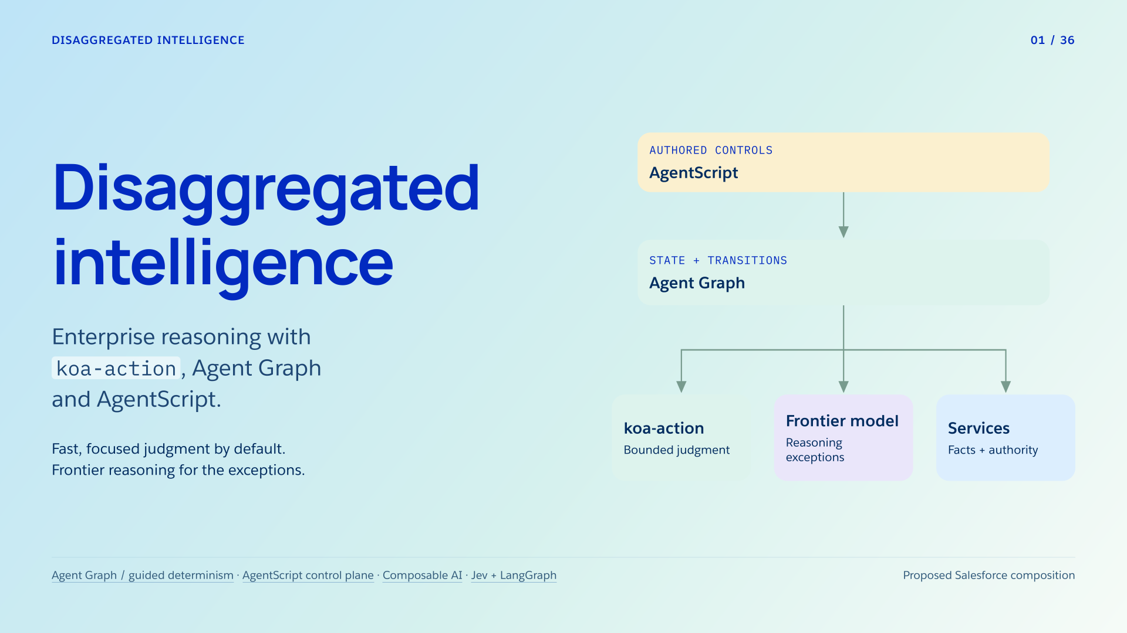
Notes:
Disaggregated intelligence
Section: Enterprise AI
Purpose: Introduce disaggregated intelligence as an engineering allocation problem.
Suggested speaking time: 0.7 minutes
TALKING POINTS
• Disaggregated intelligence assigns different jobs to components suited to them. Services establish facts and authority; specialized models supply bounded semantic judgments; the runtime coordinates the resulting work.
• For Agentforce, AgentScript authors the controls, Agent Graph executes the workflow, and koa-action supplies focused decisions under an evaluated application contract. Frontier reasoning remains available for difficult interpretation.
• Choose the least expensive component that meets the decision’s quality and latency requirements, then measure the whole service. Reliability, predictability, lower cost and faster inference are the goals; their realized gains require evidence.
• System One names a model role here, not human cognition. This composition is proposed: public sources reviewed do not establish a koa-action SDK, native adapter, training interface or benchmark.
Transition: Follow one product-aftercare case from authority checks to complete-case evaluation.
POWERPOINT EXPORT
This edition preserves the HTML slide design as one outlined SVG graphic with an embedded PNG fallback. Slide text is vector artwork, not editable PowerPoint paragraphs. Speaker notes remain editable. Use the companion HTML for interaction.
WEB REFERENCES
Agent Graph / guided determinism
https://engineering.salesforce.com/agentforces-agent-graph-toward-guided-determinism-with-hybrid-reasoning/
AgentScript control plane
https://www.salesforce.com/blog/agent-script-control-plane/
Composable AI
https://typesafe.ai/manifesto
Jev + LangGraph
https://www.langchain.com/blog/building-prod-with-jev-and-langgraph
SLIDE TEXT REFERENCE
DISAGGREGATED INTELLIGENCE
01 / 36
Disaggregated
intelligence
Enterprise reasoning with
koa-action
, Agent Graph
and AgentScript.
Fast, focused judgment by default.
Frontier reasoning for the exceptions.
Authored controls
AgentScript
State + transitions
Agent Graph
koa-action
Bounded judgment
Frontier model
Reasoning exceptions
Services
Facts + authority
Agent Graph / guided determinism
·
AgentScript control plane
·
Composable AI
·
Jev + LangGraph
Proposed Salesforce composition

Slide 2
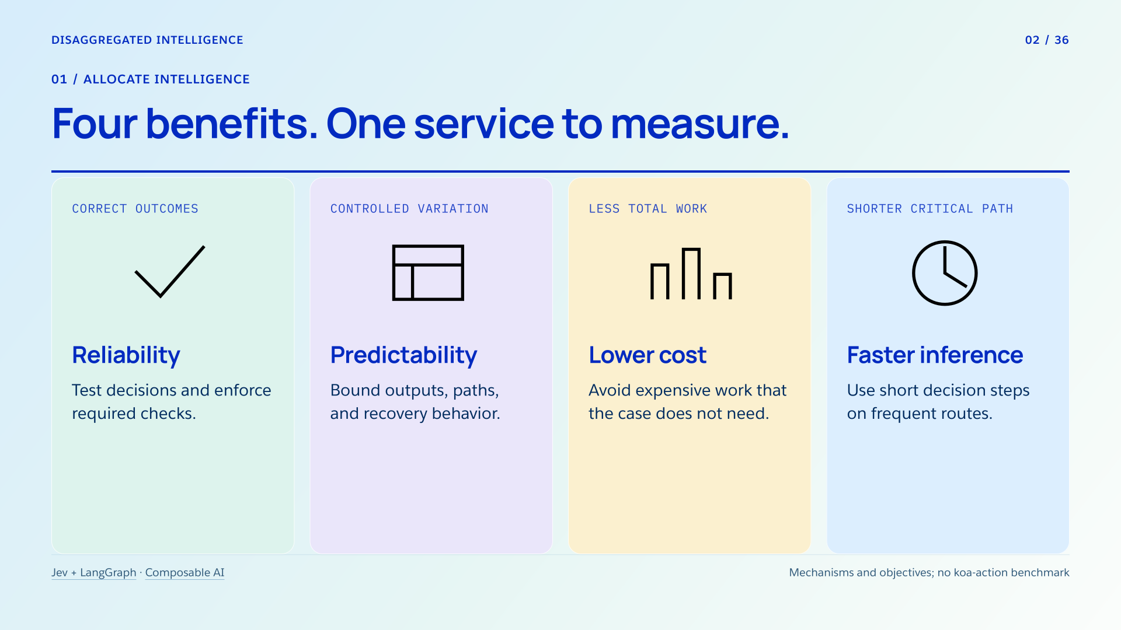
Notes:
Four benefits. One service to measure.
Section: 01
Purpose: Connect requested benefits to concrete mechanisms.
Suggested speaking time: 1 minutes
TALKING POINTS
• Specialization creates an opportunity for much lower decision cost and faster inference when a bounded task does not require frontier reasoning. The workload and accepted error rate determine the gain.
• Agent Graph makes permitted paths and recovery behavior inspectable, while AgentScript expresses the controls around model choice. Required service checks still execute. Predictable control does not itself establish semantic correctness.
• Keep the complete customer case as the unit of value. A fast exchange route that loses the requested cable return fails the service, even if its local classifier is accurate.
Transition: Follow one case through the rest of the tutorial.
POWERPOINT EXPORT
This edition preserves the HTML slide design as one outlined SVG graphic with an embedded PNG fallback. Slide text is vector artwork, not editable PowerPoint paragraphs. Speaker notes remain editable. Use the companion HTML for interaction.
WEB REFERENCES
Jev + LangGraph
https://www.langchain.com/blog/building-prod-with-jev-and-langgraph
Composable AI
https://typesafe.ai/manifesto
SLIDE TEXT REFERENCE
DISAGGREGATED INTELLIGENCE
02 / 36
01 / Allocate intelligence
Four benefits. One service to measure.
Correct outcomes
Reliability
Test decisions and enforce required checks.
Controlled variation
Predictability
Bound outputs, paths, and recovery behavior.
Less total work
Lower cost
Avoid expensive work that the case does not need.
Shorter critical path
Faster inference
Use short decision steps on frequent routes.
Jev + LangGraph
·
Composable AI
Mechanisms and objectives; no koa-action benchmark

Slide 3
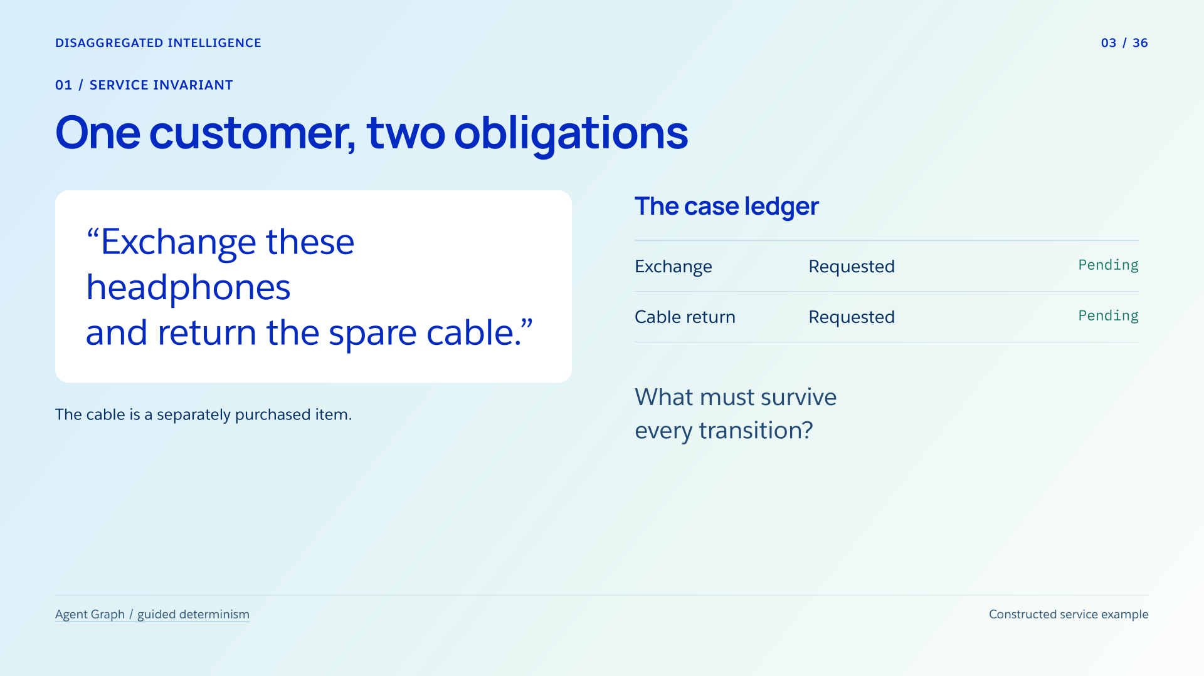
Notes:
One customer, two obligations
Section: 01
Purpose: Establish the recurring case and its invariant.
Suggested speaking time: 1.1 minutes
TALKING POINTS
• The purchase records establish that the spare cable was purchased separately, so its return concerns a complete purchased item. A cable removed from the headphone kit would require the component handler instead.
• The customer asks for an exchange AND a cable return. Preserve both obligations and their item references; finishing the first cannot erase the second.
• This case is a constructed teaching example. Later we will stop the trace after an exchange authorization while the cable task is active, so the whole case remains unfinished.
Transition: Assign an owner to each kind of work.
POWERPOINT EXPORT
This edition preserves the HTML slide design as one outlined SVG graphic with an embedded PNG fallback. Slide text is vector artwork, not editable PowerPoint paragraphs. Speaker notes remain editable. Use the companion HTML for interaction.
WEB REFERENCES
Agent Graph / guided determinism
https://engineering.salesforce.com/agentforces-agent-graph-toward-guided-determinism-with-hybrid-reasoning/
SLIDE TEXT REFERENCE
DISAGGREGATED INTELLIGENCE
03 / 36
01 / Service invariant
One customer, two obligations
“Exchange these headphones
and return the spare cable.”
The cable is a separately purchased item.
The case ledger
Exchange
Requested
Pending
Cable return
Requested
Pending
What must survive
every transition?
Agent Graph / guided determinism
Constructed service example

Slide 4
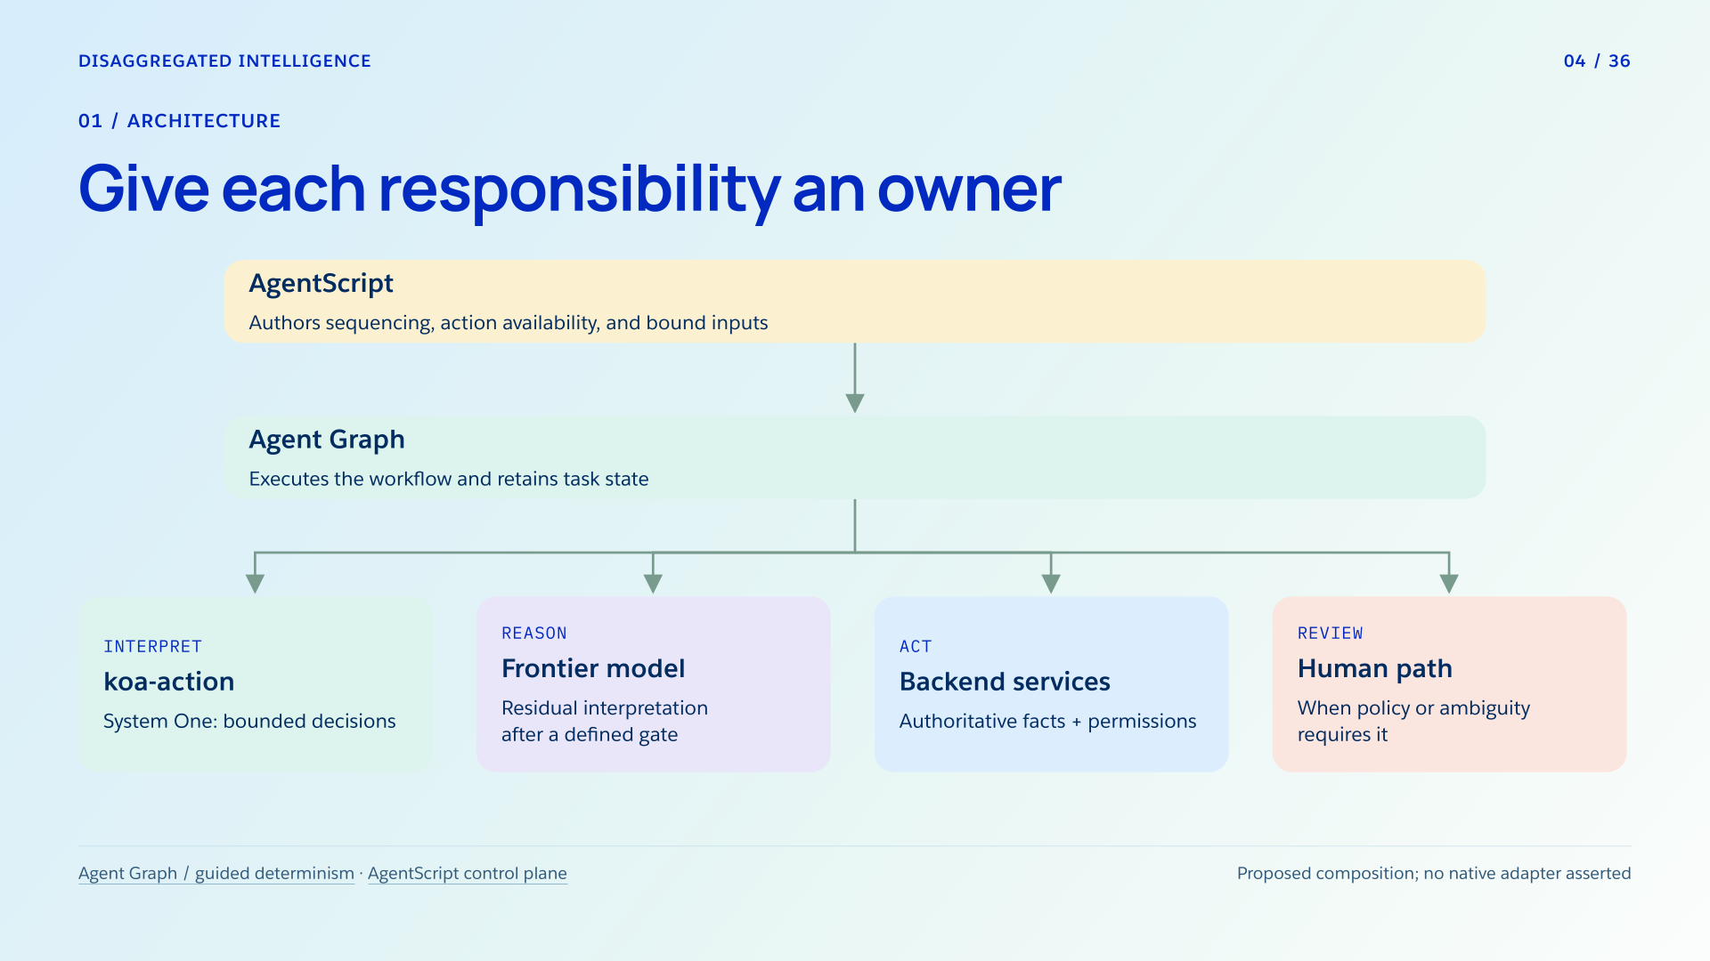
Notes:
Give each responsibility an owner
Section: 01
Purpose: Distinguish models, execution, configuration, and authority.
Suggested speaking time: 1 minutes
TALKING POINTS
• The throughline is allocation plus coordination. koa-action supplies a bounded interpretation; Agent Graph coordinates task state and escalation; AgentScript configures the controls that constrain each judgment’s effect.
• Backend services establish identity, ownership, stock and policy outcomes. They also enforce their requirements when writing. A high model score cannot substitute for any of these results.
• A clear exchange or kit-component return may use System One and a configured handler without frontier reasoning. A request can have many business steps while remaining easy to interpret.
• The human branch handles configured review and unresolved cases. A reviewer’s interpretation does not invent a missing handler or confer policy-override authority.
Transition: Now move process rules from prose into inspectable structure.
POWERPOINT EXPORT
This edition preserves the HTML slide design as one outlined SVG graphic with an embedded PNG fallback. Slide text is vector artwork, not editable PowerPoint paragraphs. Speaker notes remain editable. Use the companion HTML for interaction.
WEB REFERENCES
Agent Graph / guided determinism
https://engineering.salesforce.com/agentforces-agent-graph-toward-guided-determinism-with-hybrid-reasoning/
AgentScript control plane
https://www.salesforce.com/blog/agent-script-control-plane/
SLIDE TEXT REFERENCE
DISAGGREGATED INTELLIGENCE
04 / 36
01 / Architecture
Give each responsibility an owner
AgentScript
Authors sequencing, action availability, and bound inputs
Agent Graph
Executes the workflow and retains task state
Interpret
koa-action
System One: bounded decisions
Reason
Frontier model
Residual interpretation
after a defined gate
Act
Backend services
Authoritative facts + permissions
Review
Human path
When policy or ambiguity requires it
Agent Graph / guided determinism
·
AgentScript control plane
Proposed composition; no native adapter asserted

Slide 5
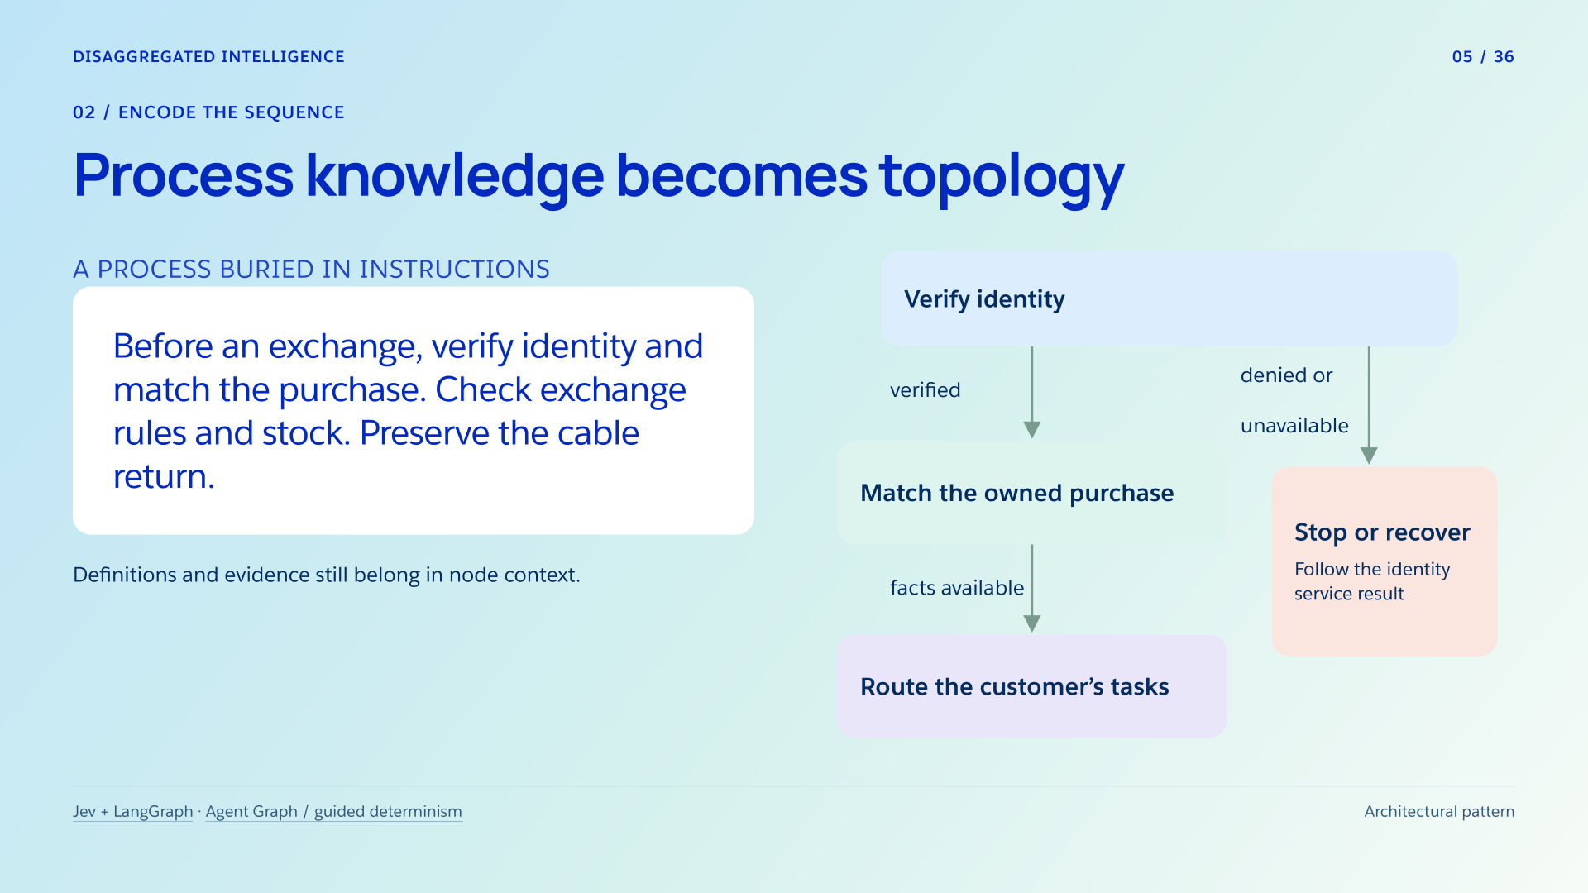
Notes:
Process knowledge becomes topology
Section: 02
Purpose: Teach which decisions, in which order, over which state.
Suggested speaking time: 1 minutes
TALKING POINTS
• Procedural domain knowledge enters topology: the nodes and transitions specify what runs first, which evidence each step sees and where it can go next.
• The small graph previews the shared front desk. Verified identity allows protected purchase lookup. Missing sessions, rejection and unavailable services have distinct routes, expanded on the next illustration.
• Live purchase facts remain in application records, business policy remains explicit code or configuration, and category definitions remain in the semantic node’s context. Moving process dependencies into a graph does not eliminate these inputs.
• Review the graph itself. It can consistently encode an incorrect policy or accidentally lose a requested task.
Transition: Expand the front desk, then follow three familiar request types.
POWERPOINT EXPORT
This edition preserves the HTML slide design as one outlined SVG graphic with an embedded PNG fallback. Slide text is vector artwork, not editable PowerPoint paragraphs. Speaker notes remain editable. Use the companion HTML for interaction.
WEB REFERENCES
Jev + LangGraph
https://www.langchain.com/blog/building-prod-with-jev-and-langgraph
Agent Graph / guided determinism
https://engineering.salesforce.com/agentforces-agent-graph-toward-guided-determinism-with-hybrid-reasoning/
SLIDE TEXT REFERENCE
DISAGGREGATED INTELLIGENCE
05 / 36
02 / Encode the sequence
Process knowledge becomes topology
A process buried in instructions
Before an exchange, verify identity and match the purchase. Check exchange rules and stock. Preserve the cable return.
Definitions and evidence still belong in node context.
Verify identity
Match the owned purchase
Route the customer’s tasks
Stop or recover
Follow the identity
service result
verified
denied or
unavailable
facts available
Jev + LangGraph
·
Agent Graph / guided determinism
Architectural pattern

Slide 6
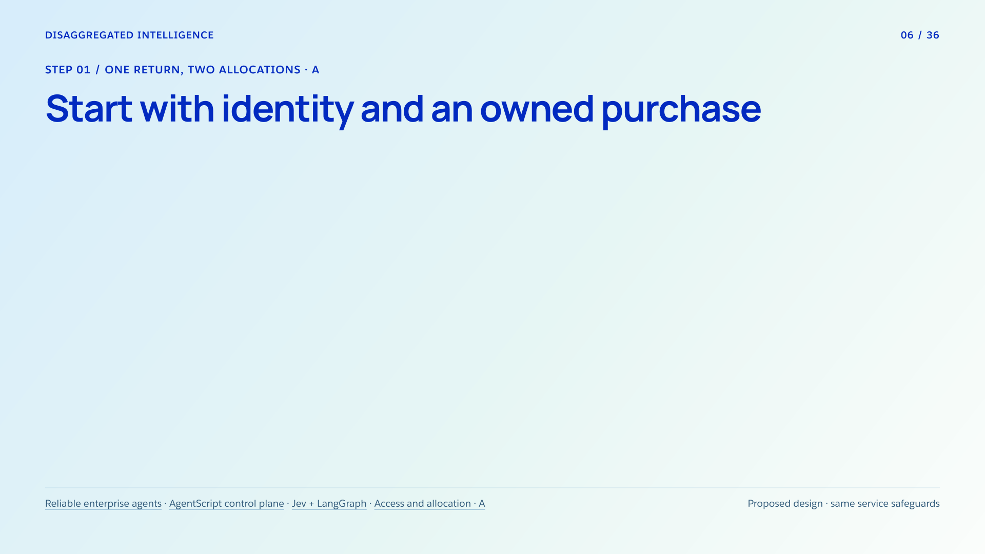



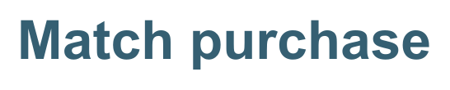


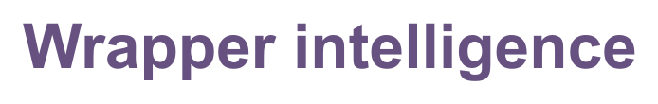













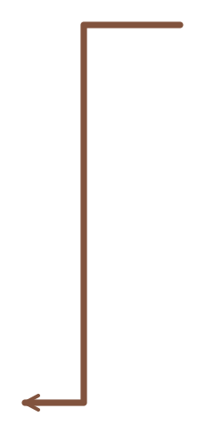
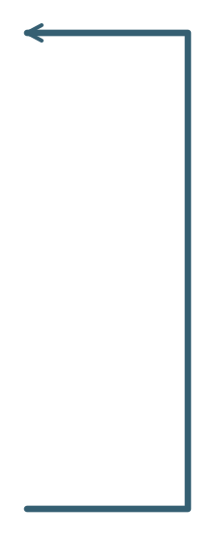
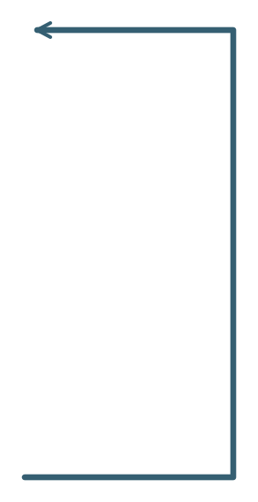





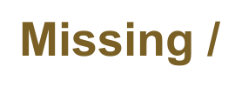



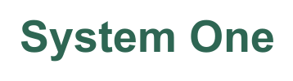

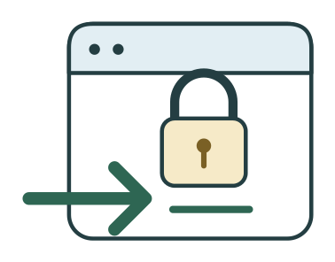





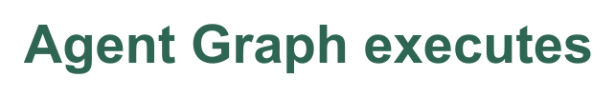

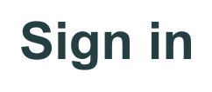
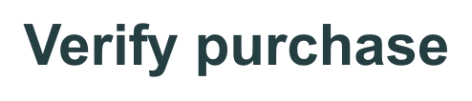

Notes:
Start with identity and an owned purchase
Section: Step 01
Purpose: Separate authoritative access gates from the choice of model allocation.
Suggested speaking time: 1.2 minutes
TALKING POINTS
• Follow the shared front desk before comparing models. The identity service supplies a result. Verified access permits protected purchase lookup; neither model grants authentication.
• The no-login branch goes through secure sign-in and returns to the same identity check. The denied branch stops protected work and can offer permitted account support. A service outage also holds or takes bounded recovery; unknown does not mean verified.
• The matched purchase binds owned line items to the authenticated customer. Missing identifiers or a mismatch go to purchase verification and recheck. Only a verified purchase reaches page B; item or kit-component binding can still need clarification there.
• Both architecture choices retain these safeguards. In the selected wrapper design, frontier inference proposes the next step around each service result. In the disaggregated design, authored transitions carry the known process and call a small decision model only for bounded meaning.
• Agent Graph coordinates execution and state. AgentScript configures the control. This is an architectural comparison with LangGraph, not an API compatibility claim or a hosted LangGraph implementation. More predictable transitions create an opportunity for cheaper, faster handling; measurement must establish the gain.
Transition: With access and purchase established, identify the requested remedy and affected unit.
POWERPOINT EXPORT
COMPONENT POWERPOINT
This slide uses a fixed vector frame plus separate, independently movable vector illustrations, labels and connectors. Labels are outlined artwork, not native editable text. Speaker notes remain editable. Every vector object has an embedded PNG fallback. Use the Selection Pane to select named parts. Connectors are independent objects; they do not automatically follow moved illustrations. Other slides retain their complete-frame vector artwork.
WEB REFERENCES
Reliable enterprise agents
https://engineering.salesforce.com/building-enterprise-ai-agents-that-are-both-autonomous-and-reliable/
AgentScript control plane
https://www.salesforce.com/blog/agent-script-control-plane/
Jev + LangGraph
https://www.langchain.com/blog/building-prod-with-jev-and-langgraph
LOCAL COMPANION REFERENCES
Access and allocation · A — diagrams/returns-comparison-access.svg
These identifiers refer to the accompanying repository and are not broken file hyperlinks.
SLIDE TEXT REFERENCE
DISAGGREGATED INTELLIGENCE
06 / 36
Step 01 / One return, two allocations · A
Start with identity and an owned purchase
Reliable enterprise agents
·
AgentScript control plane
·
Jev + LangGraph
·
Access and allocation · A
Proposed design · same service safeguards

Slide 7
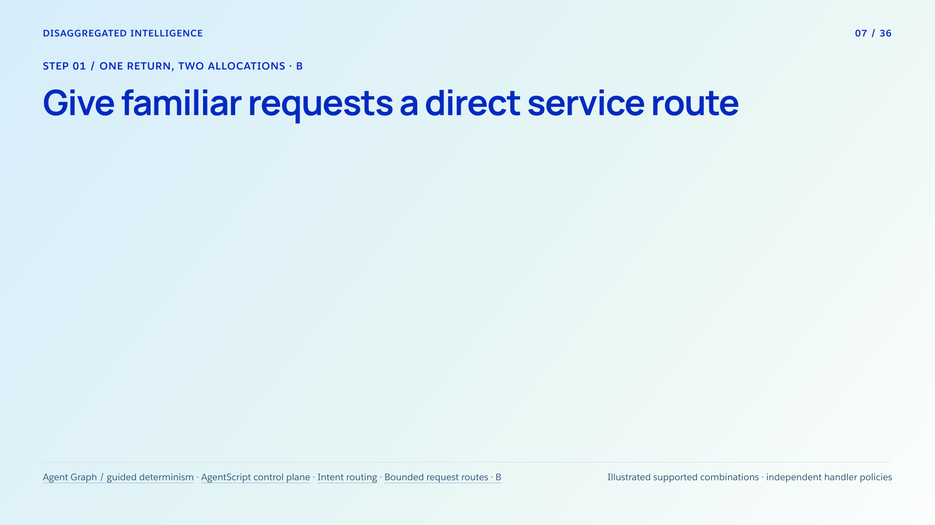

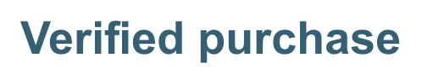




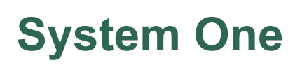
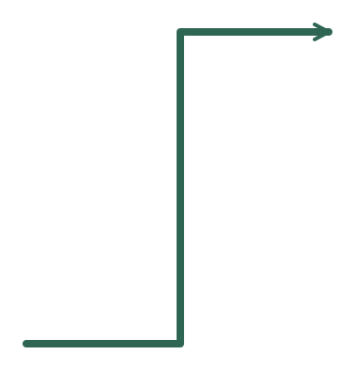







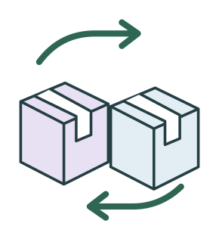





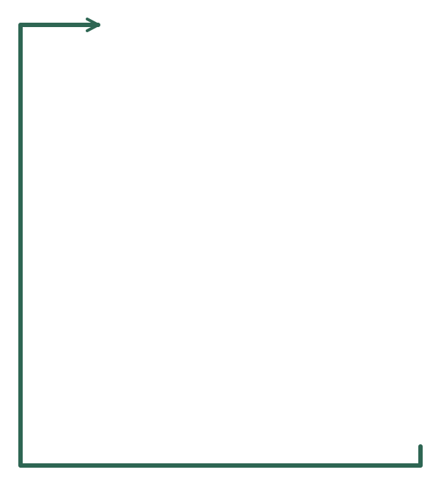






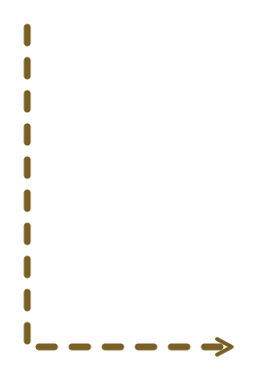









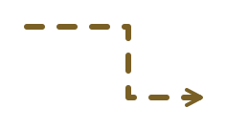






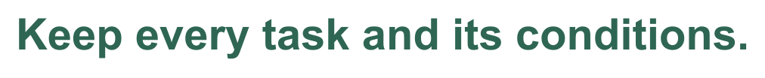
Notes:
Give familiar requests a direct service route
Section: Step 01
Purpose: Show that a familiar exchange or kit-part return can use bounded judgment and a configured service route.
Suggested speaking time: 1.4 minutes
TALKING POINTS
• The small chip answers bounded questions: what remedy is requested, which owned item or kit component is affected, and whether the meaning is clear enough. An authored supported-combination mapping chooses a handler. The three pictured mappings are whole-item return, whole-item exchange and kit-component return.
• The open headphone kit means the complete purchased product; the highlighted cable means one component of that kit. A spare cable purchased as its own line item is an ordinary whole-item return. In the ongoing two-task case, the purchase service has established that the spare cable was bought separately.
• A clear exchange goes to exchange rules and inventory. A clear kit-component return goes to component identity and kit-part rules. Both can be handled without frontier interpretation. Their terms are independent of the whole-item return policy on the later calendar slide.
• The graph follows only registered handlers. Component exchange is a different combination; if the merchant has not registered it, configured specialist handling receives the correctly understood request. Neither model invents a policy or supported route.
• The eligible-quote junction describes a common finish for each selected task. It does not merge their rules. Confirm the exact action and terms; the service rechecks before issuing the corresponding authorization. Missing facts hold and known ineligibility follows the affected handler.
• Clarification can settle an ambiguous item or remedy and return to reassessment. Only meaning that remains unresolved can enter reasoning gate C. Keep AND obligations, OR choices and IF conditions. An exchange for blue if in stock, otherwise return, can be authored logic: unknown stock holds, and only the selected alternative may commit.
Transition: Expand the exception path and examine what must hold before frontier interpretation is useful.
POWERPOINT EXPORT
COMPONENT POWERPOINT
This slide uses a fixed vector frame plus separate, independently movable vector illustrations, labels and connectors. Labels are outlined artwork, not native editable text. Speaker notes remain editable. Every vector object has an embedded PNG fallback. Use the Selection Pane to select named parts. Connectors are independent objects; they do not automatically follow moved illustrations. Other slides retain their complete-frame vector artwork.
WEB REFERENCES
Agent Graph / guided determinism
https://engineering.salesforce.com/agentforces-agent-graph-toward-guided-determinism-with-hybrid-reasoning/
AgentScript control plane
https://www.salesforce.com/blog/agent-script-control-plane/
Intent routing
https://docs.typesafe.ai/patterns/intent-routing
LOCAL COMPANION REFERENCES
Bounded request routes · B — diagrams/returns-comparison-routing.svg
These identifiers refer to the accompanying repository and are not broken file hyperlinks.
SLIDE TEXT REFERENCE
DISAGGREGATED INTELLIGENCE
07 / 36
Step 01 / One return, two allocations · B
Give familiar requests a direct service route
Agent Graph / guided determinism
·
AgentScript control plane
·
Intent routing
·
Bounded request routes · B
Illustrated supported combinations · independent handler policies

Slide 8
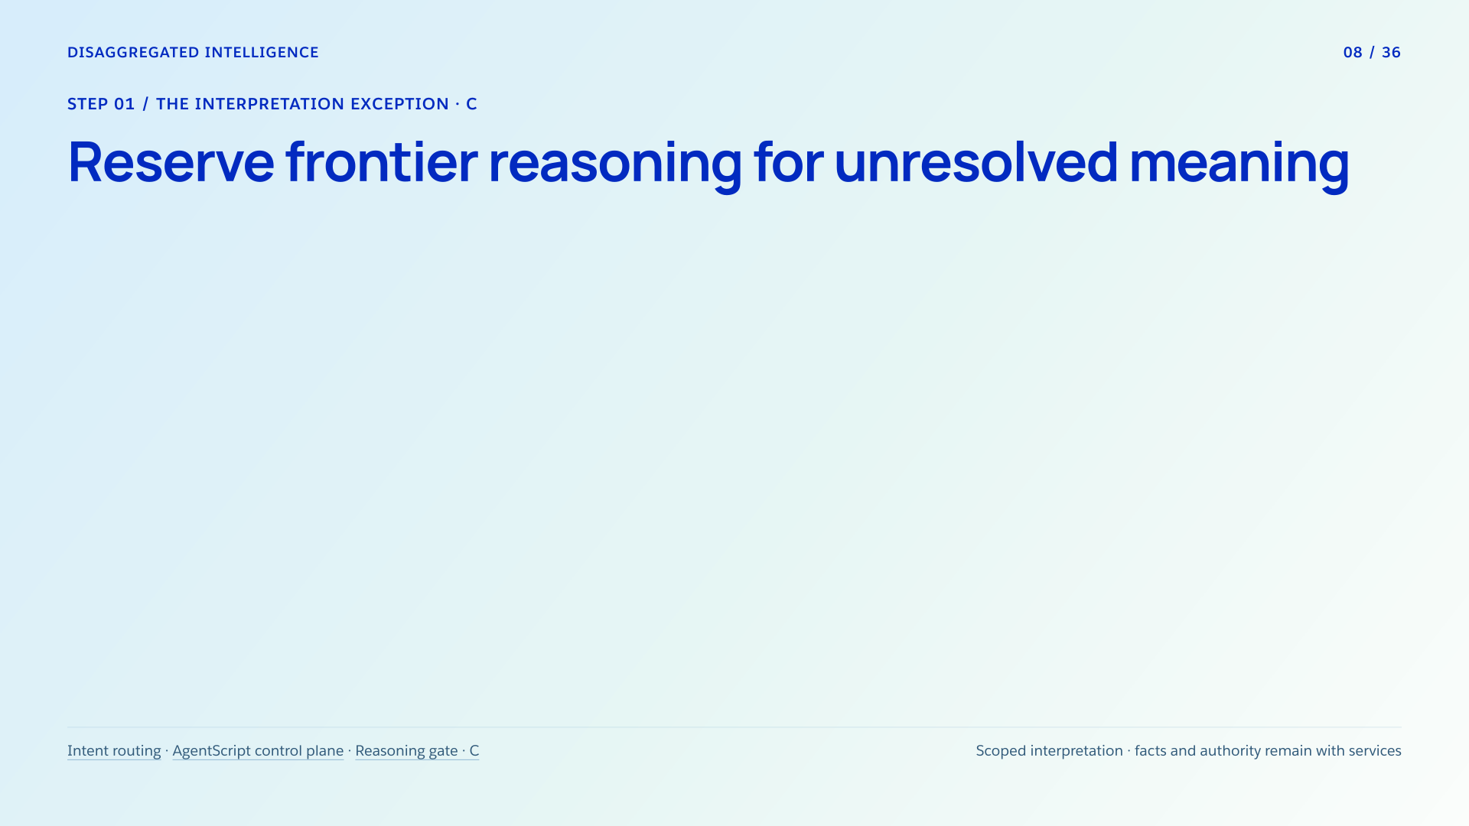

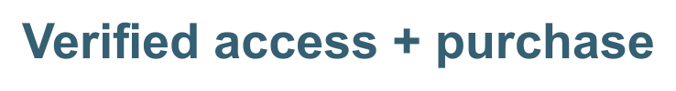
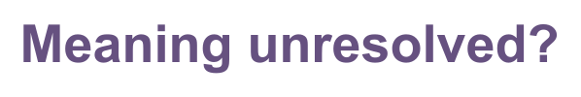








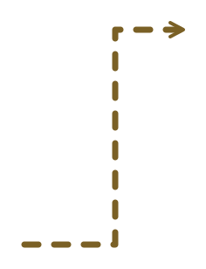




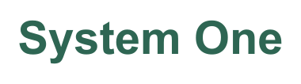


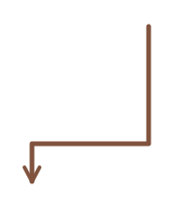
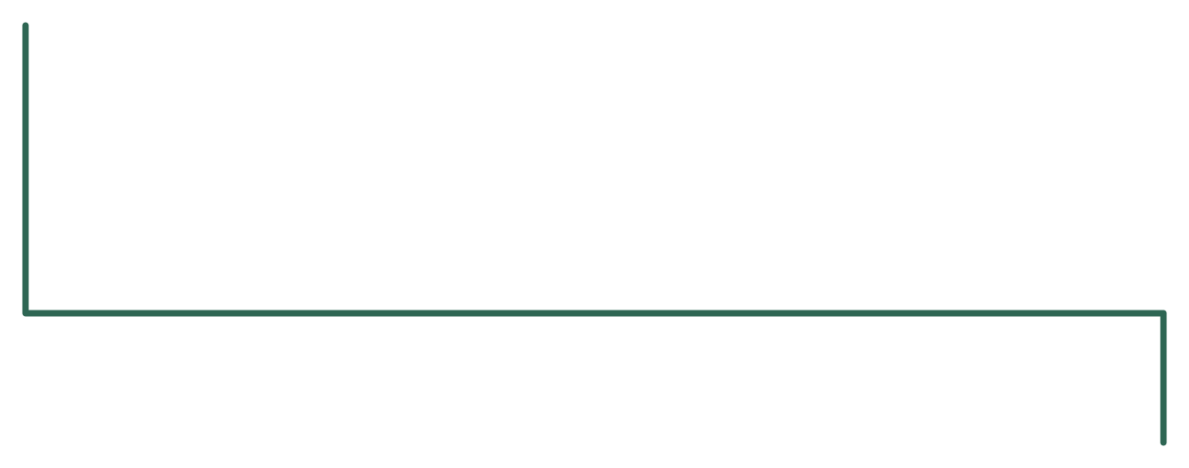
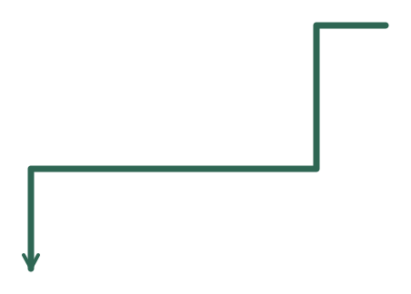









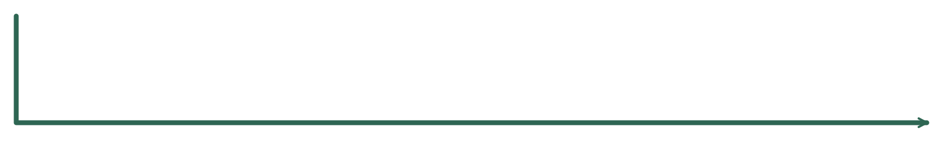


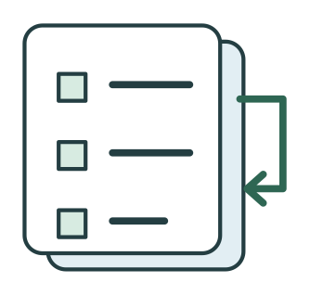

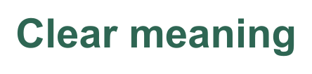







Notes:
Reserve frontier reasoning for unresolved meaning
Section: Step 01
Purpose: Make the frontier model a scoped interpretation resource with explicit preconditions and a guarded return path.
Suggested speaking time: 1.5 minutes
TALKING POINTS
• The verified-access and purchase label is a precondition. Read the green route first: clear meaning reaches the authored mapping and its appropriate handler. An unsupported combination goes to configured specialist handling rather than an invented route.
• The detour first asks one useful clarification. If that resolves the meaning, reassess the task and follow its handler without frontier reasoning. More business steps, an exchange, a component request, or a familiar if-condition does not itself make interpretation difficult.
• Facts and checks are branch-aware. Obtain missing evidence from authoritative services; hold when it cannot be obtained. Apply known mandatory rules for the affected handler. A whole-item return deadline does not globally reject an exchange or kit-component request.
• Only substantive interpretation that remains after clarification, with the relevant facts and known checks satisfied, reaches one scoped frontier attempt. It receives the authorized history and remaining question, then proposes a task structure; it does not replace service facts.
• A human validates item references and AND, OR and IF relationships, or holds the case. Validated interpretation re-enters the same supported-combination mapping and the applicable handler. Neither human validation nor model output grants a policy override.
• Only an eligible selected task reaches confirmed terms and an authoritative service write. Bound technical recovery, reconcile an unknown write outcome, and retain every unfinished obligation. Measure the cost of this detour, including any added review, in whole-case evaluation.
Transition: Scope a concrete policy to one handler so that its rules cannot spill into other remedies.
POWERPOINT EXPORT
COMPONENT POWERPOINT
This slide uses a fixed vector frame plus separate, independently movable vector illustrations, labels and connectors. Labels are outlined artwork, not native editable text. Speaker notes remain editable. Every vector object has an embedded PNG fallback. Use the Selection Pane to select named parts. Connectors are independent objects; they do not automatically follow moved illustrations. Other slides retain their complete-frame vector artwork.
WEB REFERENCES
Intent routing
https://docs.typesafe.ai/patterns/intent-routing
AgentScript control plane
https://www.salesforce.com/blog/agent-script-control-plane/
LOCAL COMPANION REFERENCES
Reasoning gate · C — diagrams/returns-reasoning-gate.svg
These identifiers refer to the accompanying repository and are not broken file hyperlinks.
SLIDE TEXT REFERENCE
DISAGGREGATED INTELLIGENCE
08 / 36
Step 01 / The interpretation exception · C
Reserve frontier reasoning for unresolved meaning
Intent routing
·
AgentScript control plane
·
Reasoning gate · C
Scoped interpretation · facts and authority remain with services

Slide 9
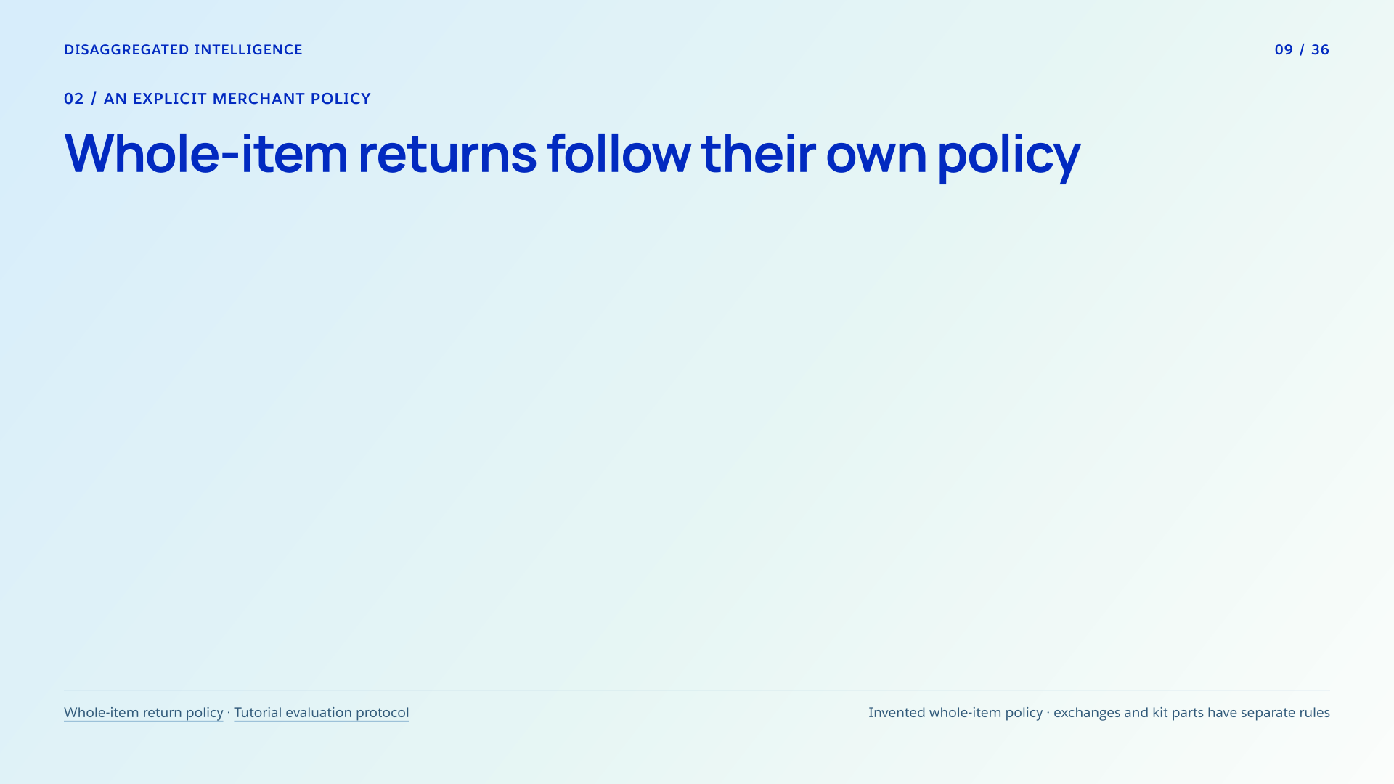
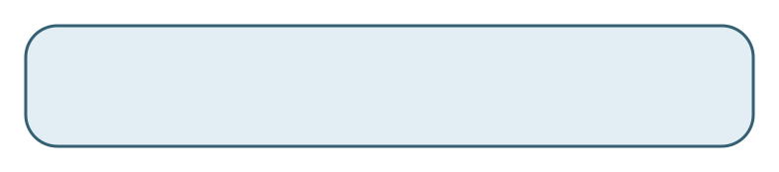
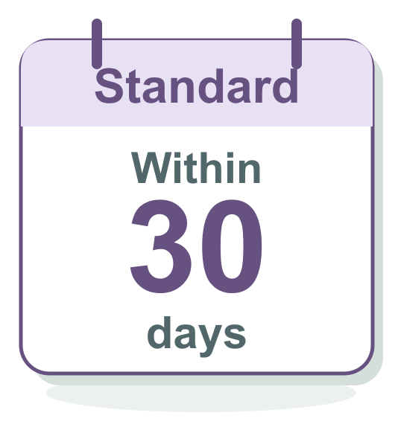

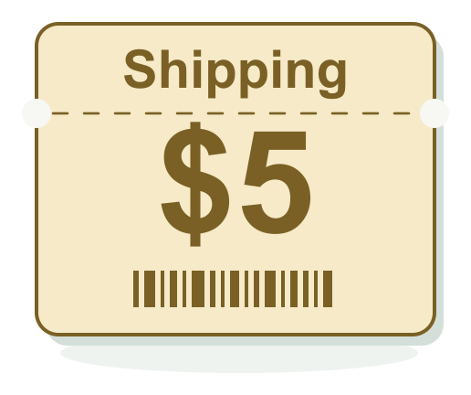
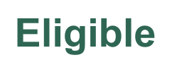

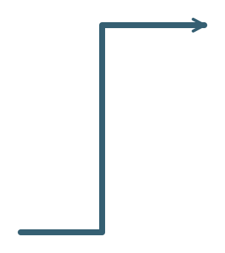

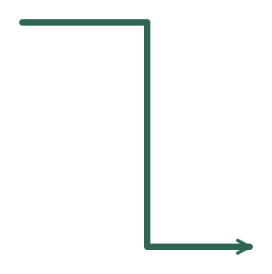




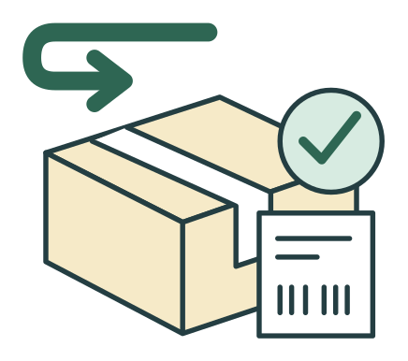



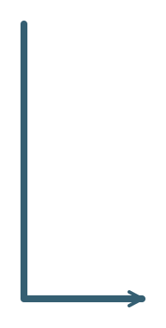


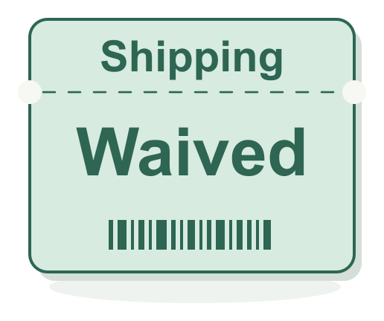
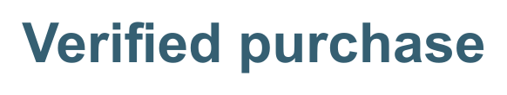

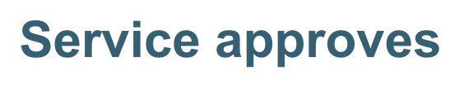

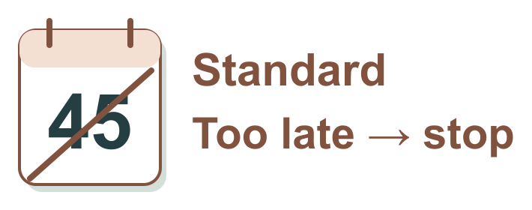
Notes:
Whole-item returns follow their own policy
Section: 02
Purpose: Separate trusted eligibility and fee rules from semantic interpretation and from transaction success.
Suggested speaking time: 1.2 minutes
TALKING POINTS
• The scope label matters: this invented merchant table applies only to whole-item returns. A separate service owns exchange rules; kit-component returns have their own rules and terms. These values are not Salesforce product policy.
• A verified owned purchase provides the delivery time, original request time, loyalty tier, item eligibility and available unreturned quantity. Missing or contradictory required facts stay pending. Keep the original request timestamp through retries and handoffs.
• Standard permits an eligible request within 30 days inclusive and quotes five-dollar shipping. Plus permits 60 days inclusive and waives shipping. Standard day 18 and Plus day 45 can qualify if the other rules hold; Standard day 45 fails this ordinary return window.
• Confirm the specific items, quantity and quote. The backend rechecks authority, policy and accepted terms before recording an idempotent return authorization. Changed terms require renewed confirmation; a label in this drawing means authorization, not completed shipping or settled refund.
• A known rule failure does not justify a frontier appeal. A separate eligible task can continue under its own policy while the declined task retains its outcome. This scoped service authority makes the authored route predictable.
Transition: Now connect the illustrated application to the runtime, authored controls and model contracts beneath it.
POWERPOINT EXPORT
COMPONENT POWERPOINT
This slide uses a fixed vector frame plus separate, independently movable vector illustrations, labels and connectors. Labels are outlined artwork, not native editable text. Speaker notes remain editable. Every vector object has an embedded PNG fallback. Use the Selection Pane to select named parts. Connectors are independent objects; they do not automatically follow moved illustrations. Other slides retain their complete-frame vector artwork.
LOCAL COMPANION REFERENCES
Whole-item return policy — diagrams/returns-whole-item-policy.svg
Tutorial evaluation protocol — blog/09-building-prod.md
These identifiers refer to the accompanying repository and are not broken file hyperlinks.
SLIDE TEXT REFERENCE
DISAGGREGATED INTELLIGENCE
09 / 36
02 / An explicit merchant policy
Whole-item returns follow their own policy
Whole-item return policy
·
Tutorial evaluation protocol
Invented whole-item policy · exchanges and kit parts have separate rules

Slide 10

Notes:
A runtime sits beneath the harness
Section: 02
Purpose: Prevent runtime/harness/configuration conflation.
Suggested speaking time: 1 minutes
TALKING POINTS
• Once judgments and services are separated, the runtime coordinates state and decides which configured step executes next. Agent Graph occupies that runtime role in Agentforce.
• AgentScript authors the controls around model choice. The wider agent harness also includes context strategy, tools, operational policy and recovery.
• LangChain’s distinction among its framework, LangGraph runtime and Deep Agents harness provides an architectural analogy. It does not imply LangGraph API compatibility or Deep Agents defaults in Agentforce.
• The public AgentScript repository contains language tooling; Salesforce’s managed runtime is a separate component.
Transition: Define the first decision before selecting its integration.
POWERPOINT EXPORT
This edition preserves the HTML slide design as one outlined SVG graphic with an embedded PNG fallback. Slide text is vector artwork, not editable PowerPoint paragraphs. Speaker notes remain editable. Use the companion HTML for interaction.
WEB REFERENCES
Runtime, framework, harness
https://www.langchain.com/blog/deep-agents-vs-langchain-vs-langgraph
AgentScript control plane
https://www.salesforce.com/blog/agent-script-control-plane/
SLIDE TEXT REFERENCE
DISAGGREGATED INTELLIGENCE
10 / 36
02 / Keep the layers distinct
A runtime sits beneath the harness
Harness
The agent loop, context strategy, tools, and operating policy.
Example in LangChain’s stack: Deep Agents.
Runtime
State transitions and the execution of the configured workflow.
Agent Graph is analogous at this layer to LangGraph.
Configuration
The authored rules and bindings that shape behavior.
AgentScript configures Salesforce’s runtime.
Runtime, framework, harness
·
AgentScript control plane
Architectural comparison, not API equivalence

Slide 11

Notes:
Separate the remedy, the unit and the uncertainty
Section: 03
Purpose: Give a bounded task a testable contract.
Suggested speaking time: 1 minutes
TALKING POINTS
• Separate requested remedy, purchased-unit scope and interpretation status. Exchange does not mean difficult; a whole-item return can still be ambiguous.
• The three familiar supported combinations shown earlier are whole-item return, whole-item exchange and kit-component return. These examples are not an exhaustive provider taxonomy. A component exchange is one request, supported only if its own handler and policy are configured.
• Tie every task to verified candidate items and preserve AND, OR and IF relationships. AND retains every obligation; OR waits for a choice; IF evaluates the customer’s actual condition using authoritative facts.
• These are conceptual application fields, not a documented koa-action response schema. A timeout or malformed result uses bounded technical recovery and must not default into a transaction.
Transition: Match the question to the right primitive.
POWERPOINT EXPORT
This edition preserves the HTML slide design as one outlined SVG graphic with an embedded PNG fallback. Slide text is vector artwork, not editable PowerPoint paragraphs. Speaker notes remain editable. Use the companion HTML for interaction.
WEB REFERENCES
TypeSafe quickstart
https://docs.typesafe.ai/introduction/quickstart
Intent routing
https://docs.typesafe.ai/patterns/intent-routing
Structured decision criteria
https://docs.typesafe.ai/primitives/advanced
SLIDE TEXT REFERENCE
DISAGGREGATED INTELLIGENCE
11 / 36
03 / Step 1
Separate the remedy, the unit and the uncertainty
Bounded semantic question
What work is
the customer requesting?
Conversation prefix
+ verified candidate items.
Conceptual labels · boundary examples
“Swap for blue.”
exchange
“Only the kit cable.”
component
“Return this one.”
clarify unit
Keep three fields distinct
Remedy
Unit
Interpretation
Clear + supported
Graph selects the applicable handler.
Meaning unclear
Ask one useful clarification.
Unsupported combinations use a configured specialist.
Invalid output follows bounded recovery.
TypeSafe quickstart
·
Intent routing
·
Structured decision criteria
Illustrative application contract

Slide 12

Notes:
Four bounded decisions, four contracts
Section: 03
Purpose: Cover the four user-specified koa-action capabilities.
Suggested speaking time: 1 minutes
TALKING POINTS
• This tutorial uses koa-action for classification, noul, scoring, and semantic endpointing, following the capability framing supplied for the Salesforce composition.
• TypeSafe documents analogous decision concepts, but its SDK fields, batching, calibration, and training claims do not define a Salesforce interface.
• Each primitive needs its own target and error measure. A rubric score and the probability of a binary proposition are not interchangeable.
Transition: Make that semantic distinction tangible.
POWERPOINT EXPORT
This edition preserves the HTML slide design as one outlined SVG graphic with an embedded PNG fallback. Slide text is vector artwork, not editable PowerPoint paragraphs. Speaker notes remain editable. Use the companion HTML for interaction.
WEB REFERENCES
TypeSafe quickstart
https://docs.typesafe.ai/introduction/quickstart
Noul
https://docs.typesafe.ai/primitives/noul
Score
https://docs.typesafe.ai/primitives/score
SLIDE TEXT REFERENCE
DISAGGREGATED INTELLIGENCE
12 / 36
03 / System One capabilities
Four bounded decisions, four contracts
01
Classification
Which route?
Select a category.
02
Noul
Return requested?
Assess a yes/no proposition.
03
Scoring
How urgent is this case?
Use an anchored rubric.
04
Endpointing
Has the turn ended?
Judge the available prefix.
TypeSafe quickstart
·
Noul
·
Score
koa-action capabilities: supplied brief; interfaces unspecified

Slide 13

Notes:
Probability and intensity answer different questions
Section: 03
Purpose: Explain binary proposition estimates versus severity rubrics.
Suggested speaking time: 1 minutes
TALKING POINTS
• TypeSafe’s Noul is the probability of the yes answer; its Score uses ordered rubric levels and can be fractional.
• A mean rubric score can hide different distributions. Preserve the output meaning that the downstream rule actually uses.
• The corresponding koa-action fields, ranges, and calibration require their own verified contract. No numeric Salesforce response is shown here.
Transition: A decision about when to respond has an additional time boundary.
POWERPOINT EXPORT
This edition preserves the HTML slide design as one outlined SVG graphic with an embedded PNG fallback. Slide text is vector artwork, not editable PowerPoint paragraphs. Speaker notes remain editable. Use the companion HTML for interaction.
WEB REFERENCES
Noul
https://docs.typesafe.ai/primitives/noul
Score
https://docs.typesafe.ai/primitives/score
SLIDE TEXT REFERENCE
DISAGGREGATED INTELLIGENCE
13 / 36
03 / Give every number a meaning
Probability and intensity answer different questions
Noul · TypeSafe semantics
Was a return requested?
A probability-valued
yes/no judgment.
An uncertain answer does not mean
“a medium amount of returning.”
Score · illustrative rubric
How urgent is the case?
Can wait
Use disrupted
Essential use blocked
Noul
·
Score
TypeSafe semantics / proposed Salesforce use

Slide 14

Notes:
Endpointing is a decision in time
Section: 03
Purpose: Explain semantic endpointing and temporal leakage.
Suggested speaking time: 1 minutes
TALKING POINTS
• Imagine the spoken request: Exchange these headphones … and return the spare cable. Ending the turn at the pause can drop the second obligation before the routing model sees it.
• The waveform is illustrative. Semantic endpointing asks whether the spoken turn has ended using only the available audio prefix. Future speech may establish the reference label, but must not enter the earlier input.
• Measure premature cutoff and delay separately. Keep all prefixes from a conversation together when splitting data; a fast endpointing call still needs the right decision-time evidence.
Transition: Next decide which decisions may run in parallel.
POWERPOINT EXPORT
This edition preserves the HTML slide design as one outlined SVG graphic with an embedded PNG fallback. Slide text is vector artwork, not editable PowerPoint paragraphs. Speaker notes remain editable. Use the companion HTML for interaction.
WEB REFERENCES
Building with System One
https://docs.typesafe.ai/concepts/how-to-build-with-system-one
SLIDE TEXT REFERENCE
DISAGGREGATED INTELLIGENCE
14 / 36
03 / A prefix is the input
Endpointing is a decision in time
Available audio prefix
Future audio
Decision now
Cut too early
The customer is interrupted.
Wait too long
The response is delayed.
Keep the boundary
Future audio may label the prefix.
It cannot enter the input.
Building with System One
Illustrative waveform; proposed evaluation

Slide 15

Notes:
Split work along information dependencies
Section: 04
Purpose: Separate execution independence from causality.
Suggested speaking time: 1 minutes
TALKING POINTS
• Two bounded questions may read the same authorized snapshot without depending on one another’s output. This is a workflow-design pattern, not a claim about native koa-action batching.
• A task that needs a new service fact must wait. Protected purchase retrieval follows verified identity; selecting an affected item depends on the authorized candidate list.
• Independent execution does not imply statistically independent errors. Missing context can affect remedy and urgency together. Two requested transactions also cannot be assumed safe to commit in parallel.
Transition: Make each node’s evidence window explicit.
POWERPOINT EXPORT
This edition preserves the HTML slide design as one outlined SVG graphic with an embedded PNG fallback. Slide text is vector artwork, not editable PowerPoint paragraphs. Speaker notes remain editable. Use the companion HTML for interaction.
WEB REFERENCES
Building with System One
https://docs.typesafe.ai/concepts/how-to-build-with-system-one
A harness with Jev
https://www.langchain.com/blog/building-a-harness-with-jev
SLIDE TEXT REFERENCE
DISAGGREGATED INTELLIGENCE
15 / 36
04 / Step 2
Split work along information dependencies
Same decision-time snapshot
Remedy
Return or exchange?
Urgency
Which rubric level?
Independent execution can still produce correlated errors.
Verify identity
Match owned purchase
Bind the affected item
Building with System One
·
A harness with Jev
Proposed scheduling pattern

Slide 16

Notes:
Each node sees a different view of the case
Section: 04
Purpose: Teach context boundaries as authored data dependencies.
Suggested speaking time: 1 minutes
TALKING POINTS
• Agent Graph determines when evidence exists and which view of state each node receives. AgentScript authors the relevant controls and bindings.
• A model interprets the request using the conversation prefix and authorized candidate items. Its proposed item reference must be validated; it cannot make the customer the owner of an order.
• The selected handler obtains its own rules, stock and terms. Narrow context can reduce work, but excluding a required fact can reduce quality. Version and evaluate the input view.
Transition: Use that state to preserve the mixed request.
POWERPOINT EXPORT
This edition preserves the HTML slide design as one outlined SVG graphic with an embedded PNG fallback. Slide text is vector artwork, not editable PowerPoint paragraphs. Speaker notes remain editable. Use the companion HTML for interaction.
WEB REFERENCES
Agent Graph / guided determinism
https://engineering.salesforce.com/agentforces-agent-graph-toward-guided-determinism-with-hybrid-reasoning/
AgentScript control plane
https://www.salesforce.com/blog/agent-script-control-plane/
Building with System One
https://docs.typesafe.ai/concepts/how-to-build-with-system-one
SLIDE TEXT REFERENCE
DISAGGREGATED INTELLIGENCE
16 / 36
04 / Context is part of topology
Each node sees a different view of the case
Prefix + task definitions + verified items
Task interpretation
Trusted principal + purchase reference
Ownership check
Selected task + service policy + stock
Eligible offer or denial
A node receives its declared input view; task state remains in the graph.
Agent Graph / guided determinism
·
AgentScript control plane
·
Building with System One
Proposed node contracts

Slide 17

Notes:
State preserves work across a branch
Section: 04
Purpose: Make persistent obligations visible.
Suggested speaking time: 1 minutes
TALKING POINTS
• In this AND request, both tasks stay in graph state. The customer starts with the exchange; the cable return waits and then resumes after the exchange service records its authorized result.
• OR and IF have different semantics. Keep alternatives until one is selected or its stated condition is met. Inactive alternatives are unselected or untriggered, not unresolved obligations.
• For Exchange for blue if in stock; otherwise return, unknown stock remains pending. A different exchange-policy denial does not silently activate the stock-conditioned alternative. Only the selected action may commit.
• A time or turn budget bounds priority clarification. A handoff records receiving ownership and every outstanding obligation; it does not finish the customer’s work.
Transition: This is where neural interpretation meets explicit control.
POWERPOINT EXPORT
This edition preserves the HTML slide design as one outlined SVG graphic with an embedded PNG fallback. Slide text is vector artwork, not editable PowerPoint paragraphs. Speaker notes remain editable. Use the companion HTML for interaction.
WEB REFERENCES
Agent Graph / guided determinism
https://engineering.salesforce.com/agentforces-agent-graph-toward-guided-determinism-with-hybrid-reasoning/
SLIDE TEXT REFERENCE
DISAGGREGATED INTELLIGENCE
17 / 36
04 / Step 3
State preserves work across a branch
Two AND tasks
Record exchange + cable return
Clarify priority
Ask which task to start
Exchange active
Cable return stays pending
Cable return active
Resume after exchange authorization
Recorded handoff
Retain all outstanding work
exchange selected
no choice
within budget
exchange
authorized
Agent Graph / guided determinism
Constructed mixed-request path

Slide 18

Notes:
Guided determinism gives uncertainty a place
Section: 05
Purpose: Explain neuro-symbolic reasoning in plain terms.
Suggested speaking time: 1 minutes
TALKING POINTS
• Neuro-symbolic reasoning combines learned interpretation with explicit software state and rules. System One contributes the judgment; AgentScript authors its permitted effect; Agent Graph executes the resulting path.
• Guided determinism makes the transition constraints inspectable. Classification remains fallible, and explicit controls alone do not guarantee eventual completion.
• The semantic model, route definitions and business services can evolve at their own boundaries when the composition is versioned and tested.
Transition: Three AgentScript concepts make that boundary concrete.
POWERPOINT EXPORT
This edition preserves the HTML slide design as one outlined SVG graphic with an embedded PNG fallback. Slide text is vector artwork, not editable PowerPoint paragraphs. Speaker notes remain editable. Use the companion HTML for interaction.
WEB REFERENCES
Agent Graph / guided determinism
https://engineering.salesforce.com/agentforces-agent-graph-toward-guided-determinism-with-hybrid-reasoning/
AgentScript control plane
https://www.salesforce.com/blog/agent-script-control-plane/
SLIDE TEXT REFERENCE
DISAGGREGATED INTELLIGENCE
18 / 36
05 / Neuro-symbolic reasoning
Guided determinism gives uncertainty a place
Neural interpretation
inside an authored process.
AgentScript defines where model choice is available.
Agent Graph executes the configured transitions.
Interpretation
Fallible semantic judgment.
Procedure
Required steps and state changes.
Authority
Enforced by trusted services.
Agent Graph / guided determinism
·
AgentScript control plane
Documented architecture; illustrative workflow

Slide 19

Notes:
Availability and required execution differ
Section: 05
Purpose: Teach precise AgentScript control semantics.
Suggested speaking time: 1 minutes
TALKING POINTS
• The left sketch is language-neutral design pseudocode, not runnable AgentScript or a documented koa-action adapter. Action definitions, dialect and deployment configuration are omitted. The requireOwnedOrder helper stops for verification or hold unless authoritative ownership is established.
• Required identity, purchase and applicable policy checks belong in authored procedure logic. An available-when condition filters model choices; it does not force the check to execute.
• Bound inputs use trusted service state for consequential identifiers and entitlements. Services independently enforce authority and current policy when committing.
• The selected handler follows its own rules, obtains customer confirmation, rechecks accepted terms and records the actual service result. Graph state retains the other task.
Transition: Walk the proposed request through all of its owners.
POWERPOINT EXPORT
This edition preserves the HTML slide design as one outlined SVG graphic with an embedded PNG fallback. Slide text is vector artwork, not editable PowerPoint paragraphs. Speaker notes remain editable. Use the companion HTML for interaction.
WEB REFERENCES
AgentScript control plane
https://www.salesforce.com/blog/agent-script-control-plane/
AgentScript specification
https://github.com/salesforce/agentscript/blob/main/SPEC.md
SLIDE TEXT REFERENCE
DISAGGREGATED INTELLIGENCE
19 / 36
05 / Step 4
Availability and required execution differ
Design pseudocode
Control around
the model choice.
identity = verifySession()
if identity != verified: return recovery
purchase = requireOwnedOrder(identity)
tasks = interpretAndValidate(purchase)
run selectedHandler(tasks)
Backend services also enforce access.
This is an authoring sketch, not runnable syntax.
Required work
run
/ procedure
Use explicit procedure logic for checks that must execute.
Permitted choices
available when
Filter which actions the model may select. Availability does not force selection.
Controlled arguments
with
/ bound input
Bind consequential inputs from trusted state.
AgentScript control plane
·
AgentScript specification
Verified constructs; no executable koa-action adapter

Slide 20

Notes:
Authorize the exchange, then resume the cable return
Section: 05
Purpose: Follow the aftercare case while distinguishing interpretation, confirmation, service authorization and unfinished work.
Suggested speaking time: 1.6 minutes
TALKING POINTS
• The eight events follow the same customer case: Exchange these headphones and return the spare cable. The cable is a separately purchased item, not a component removed from the headphone kit.
• First the identity service verifies access, then the order service matches the owned purchase. System One proposes the two AND tasks and their item references; the graph validates that each has a supported handler.
• The customer chooses the exchange first. Exchange rules, stock and terms produce an eligible offer, leaving the task Awaiting confirmation. These are the exchange service’s rules, not the invented whole-item return table.
• Customer confirmation still precedes authorization. The service rechecks authority, policy, stock and accepted terms, then records the exchange ID. Authorized means that service outcome, not a shipped replacement or settled refund.
• Finally Agent Graph activates the cable return. The exchange is Authorized and the cable return is Active. The full case remains unfinished. This clear supported path needs no frontier call; unresolved interpretation has its separate gated route.
Transition: Now design the non-happy paths.
POWERPOINT EXPORT
This edition preserves the HTML slide design as one outlined SVG graphic with an embedded PNG fallback. Slide text is vector artwork, not editable PowerPoint paragraphs. Speaker notes remain editable. Use the companion HTML for interaction.
STATIC TRACE: Event 8 of 8. Exchange: Authorized; cable return: Active. Agent Graph resumes the cable return. Its policy, confirmation, and authorization are unfinished.
Walkthrough: verify identity, match the owned purchase, interpret both AND tasks, prioritize the exchange, check exchange policy and stock, confirm its terms, obtain a service-issued exchange ID after rechecks, and resume the cable return. The cable is a separately purchased line item. Its return remains unfinished; exchange authorization does not claim completed shipping.
WEB REFERENCES
Agent Graph / guided determinism
https://engineering.salesforce.com/agentforces-agent-graph-toward-guided-determinism-with-hybrid-reasoning/
Reliable enterprise agents
https://engineering.salesforce.com/building-enterprise-ai-agents-that-are-both-autonomous-and-reliable/
SLIDE TEXT REFERENCE
DISAGGREGATED INTELLIGENCE
20 / 36
05 / Step 5
Authorize the exchange, then resume the cable return
1
Verify identity
Service
2
Match purchase
Service
3
Interpret
System One
4
Prioritize
Customer
5
Policy + stock
Service
6
Confirm
Customer
7
Authorize
Service
8
Resume
Agent Graph
Agent Graph resumes the cable return. Its policy, confirmation, and authorization are unfinished.
Exchange
Authorized
Confirmation precedes a recheck
and the service-issued exchange ID.
Cable return
Active
A separately purchased item.
Still unfinished when this trace ends.
Next event →
Reset
Event 8 of 8
Agent Graph / guided determinism
·
Reliable enterprise agents
Constructed trace · final static state

Slide 21

Notes:
Failure routes are part of the program
Section: 05
Purpose: Connect reliability to failure contracts.
Suggested speaking time: 1 minutes
TALKING POINTS
• A graph needs meaningful timeout, invalid-output, and handoff routes rather than a default business action.
• A resumed workflow can reuse a recorded decision, but this alone does not guarantee exactly-once external side effects.
• Transaction-specific safeguards belong in the service performing the write. Recovery must retain the unfinished tasks.
Transition: A valid decision can still be semantically wrong.
POWERPOINT EXPORT
This edition preserves the HTML slide design as one outlined SVG graphic with an embedded PNG fallback. Slide text is vector artwork, not editable PowerPoint paragraphs. Speaker notes remain editable. Use the companion HTML for interaction.
WEB REFERENCES
Reliable enterprise agents
https://engineering.salesforce.com/building-enterprise-ai-agents-that-are-both-autonomous-and-reliable/
AgentScript specification
https://github.com/salesforce/agentscript/blob/main/SPEC.md
SLIDE TEXT REFERENCE
DISAGGREGATED INTELLIGENCE
21 / 36
05 / Recover without losing the case
Failure routes are part of the program
Contract failure
Invalid output
Validate the result before branching. Use a defined fallback.
Dependency failure
Timeout
Bound retries and retain every pending obligation.
Authority boundary
Unauthorized write
The service rejects the action under current policy.
Side effect
Repeated write
Use transaction safeguards; record the actual result.
Reliable enterprise agents
·
AgentScript specification
Proposed failure behavior

Slide 22

Notes:
Confidence needs evidence in your domain
Section: 06
Purpose: Distinguish signal concentration from correctness and permission.
Suggested speaking time: 1 minutes
TALKING POINTS
• This schematic focuses on the remedy question for one task: return, exchange or other. Purchased-unit scope and task relationships remain separate fields, so parts is not a competing remedy label.
• TypeSafe defines Choice and Score confidence from distribution concentration. Noul has no separate confidence field. A concentrated answer distribution can still be wrong.
• The picture is not a returned koa-action distribution. Validate any provider signal against independently adjudicated labels and choose gates on development data. A numerical score does not establish identity, eligibility or permission.
Transition: Explore what a stricter gate does to a small labeled sample.
POWERPOINT EXPORT
This edition preserves the HTML slide design as one outlined SVG graphic with an embedded PNG fallback. Slide text is vector artwork, not editable PowerPoint paragraphs. Speaker notes remain editable. Use the companion HTML for interaction.
WEB REFERENCES
Confidence routing
https://docs.typesafe.ai/patterns/confidence-routing
Confidence semantics
https://docs.typesafe.ai/confidence
SLIDE TEXT REFERENCE
DISAGGREGATED INTELLIGENCE
22 / 36
06 / Inspect the signal
Confidence needs evidence in your domain
A concentrated distribution
Return
Exchange
Other
Illustrative output shape.
The highest option can still be wrong.
Validate locally
Compare signals
with adjudicated labels.
Choose gates on development data.
Report error alongside coverage.
Identity, permissions, and policy
remain separate checks.
Confidence routing
·
Confidence semantics
Illustrative distribution; no calibration claim

Slide 23

Notes:
A stricter gate moves work somewhere
Section: 06
Purpose: Teach selection, error rate, and coverage without fabricated evidence.
Suggested speaking time: 1.6 minutes
TALKING POINTS
• All twelve cases and their scores are constructed teaching data. The signal is uncalibrated and is not a real koa-action field.
• Automatic routing coverage is accepted routing decisions divided by twelve. Automatic error uses only accepted decisions; with zero accepted decisions it is undefined. This is a routing metric, not completed-case automation.
• A high-scoring error remains when the threshold rises. Escalations still consume capacity, and errors need not decline monotonically on this sample.
Transition: Next account for the work that the routing gate adds and avoids.
POWERPOINT EXPORT
This edition preserves the HTML slide design as one outlined SVG graphic with an embedded PNG fallback. Slide text is vector artwork, not editable PowerPoint paragraphs. Speaker notes remain editable. Use the companion HTML for interaction.
STATIC CONFIDENCE EXAMPLE: threshold 0.75. The twelve examples and scores are constructed teaching data. The HTML slider changes which examples are auto-routed at this decision point; a high-scoring mistake can survive a stricter gate. Threshold selection requires independent calibration and evaluation.
WEB REFERENCES
Confidence routing
https://docs.typesafe.ai/patterns/confidence-routing
Confidence semantics
https://docs.typesafe.ai/confidence
SLIDE TEXT REFERENCE
DISAGGREGATED INTELLIGENCE
23 / 36
06 / Interactive operating point
A stricter gate moves work somewhere
Twelve constructed examples
×
0.99
✓
0.96
✓
0.92
✓
0.88
×
0.85
✓
0.81
✓
0.76
✓
0.70
×
0.66
✓
0.60
✓
0.55
×
0.51
✓ correct route · × wrong route
Faded examples go to review.
Synthetic sample / uncalibrated signal
Automatic-route threshold:
0.75
58%
7 / 12 auto-routed
29%
2 / 7 wrong
5
To review
A high-scoring mistake can survive the gate.
Review consumes capacity and can add delay.
Confidence routing
·
Confidence semantics
Synthetic teaching data; drag the threshold

Slide 24

Notes:
Savings depend on avoiding expensive work
Section: 06
Purpose: Explain conditional economics with transparent algebra.
Suggested speaking time: 1.6 minutes
TALKING POINTS
• This isolates a routing decision replaced by a specialized model. Every constant is invented for teaching; G is one expensive routing call, D is specialized judgment, O is added orchestration and p is the fraction still requiring G.
• At p=0.20 the candidate routing cost is 0.27 normalized units, 73% below the one-unit baseline. At p=0.93 they break even. If every case still needs G, adding D and O makes the routing stage 7% more expensive.
• Familiar exchange and return paths can use service offers and standard messages without frontier generation. Any generated explanation, tool call, retry, review, reconciliation or unfinished obligation must enter whole-case accounting.
• The prior synthetic review queue and the frontier routing fallback G here are distinct destinations. Measure actual routes and their capacity costs. Setup and maintenance need an explicit volume and horizon for a total-cost claim.
Transition: Inference latency has an equally important boundary.
POWERPOINT EXPORT
This edition preserves the HTML slide design as one outlined SVG graphic with an embedded PNG fallback. Slide text is vector artwork, not editable PowerPoint paragraphs. Speaker notes remain editable. Use the companion HTML for interaction.
STATIC COST EXAMPLE: 20% of routes still use the expensive routing stage. With invented normalized units G=1, D=0.03 and O=0.04, candidate cost is 0.27 versus 1.00 (73% lower for this routing stage only). At 93% fallback the candidate breaks even; at 100% it costs 1.07, or 7% more. This excludes later explanation, service work and changed human costs; it is not a vendor benchmark.
WEB REFERENCES
Composable AI
https://typesafe.ai/manifesto
Building with System One
https://docs.typesafe.ai/concepts/how-to-build-with-system-one
SLIDE TEXT REFERENCE
DISAGGREGATED INTELLIGENCE
24 / 36
06 / Interactive break-even
Savings depend on avoiding expensive work
Routing step only · invented unit costs
Baseline = G
Candidate = D + O + pG
G = 1.00 expensive routing call
D = 0.03 specialized decision
O = 0.04 added orchestration
Routes still using G:
20%
20% · saves
93% · even
100% · costs more
Hypothetical routing-stage arithmetic
Baseline
Candidate
73% lower
0.27 normalized units
Break-even: D + O = (1 − p)G
Later messages and service work excluded.
Composable AI
·
Building with System One
Illustrative arithmetic; no measured cost claim

Slide 25

Notes:
Fast inference helps the path that uses it
Section: 06
Purpose: Separate primitive speed from workflow speed.
Suggested speaking time: 1 minutes
TALKING POINTS
• The diagram begins after identity and ownership are established. System One interprets the task, then its handler checks the applicable rules and prepares an offer. A familiar route can use a standard message rather than frontier generation.
• Specialized inference may shorten a repeated semantic step. Complete-case latency also includes services, customer confirmation, recovery and human queues. Measure decision latency, response latency and completion time separately.
• Report latency distributions at the relevant load, including transport and retries. Retain unfinished cases in service-time analysis rather than averaging completed cases alone.
Transition: Apply the control model to a deliberately incomplete design.
POWERPOINT EXPORT
This edition preserves the HTML slide design as one outlined SVG graphic with an embedded PNG fallback. Slide text is vector artwork, not editable PowerPoint paragraphs. Speaker notes remain editable. Use the companion HTML for interaction.
WEB REFERENCES
Jev + LangGraph
https://www.langchain.com/blog/building-prod-with-jev-and-langgraph
SLIDE TEXT REFERENCE
DISAGGREGATED INTELLIGENCE
25 / 36
06 / Measure the critical path
Fast inference helps the path that uses it
Fast decision
Measure call latency
Handler checks
Policy + stock + quote
Customer offer
Measure response latency
Review queue + human handling
Can dominate the time to resolution
Track decision time, response time, and time to completed service separately.
Jev + LangGraph
Mechanism illustration; no timing benchmark

Slide 26

Notes:
Find the missing boundary
Section: 07
Purpose: Check whether the learner can separate prediction from authority.
Suggested speaking time: 1.3 minutes
TALKING POINTS
• The initial design is intentionally incomplete: recognizing an exchange request immediately reaches a business write. Allow a short pause, then reveal the missing controls.
• A strong model score cannot repair missing identity and ownership checks, exchange policy and stock checks, or customer confirmation of the offered terms. Place required steps in authored control and enforce their results again in the service.
• Retain the cable return through this repair. Reconcile an unknown exchange-write outcome before retrying, using transaction safeguards appropriate to the service.
Transition: Training examples must respect the same decision boundaries.
POWERPOINT EXPORT
This edition preserves the HTML slide design as one outlined SVG graphic with an embedded PNG fallback. Slide text is vector artwork, not editable PowerPoint paragraphs. Speaker notes remain editable. Use the companion HTML for interaction.
STATIC EXERCISE: the repair is revealed. A predicted exchange request must still pass verified access, owned-purchase matching, exchange rules, inventory, confirmed terms, and service authorization. The model score is not permission to transact.
WEB REFERENCES
Reliable enterprise agents
https://engineering.salesforce.com/building-enterprise-ai-agents-that-are-both-autonomous-and-reliable/
AgentScript control plane
https://www.salesforce.com/blog/agent-script-control-plane/
SLIDE TEXT REFERENCE
DISAGGREGATED INTELLIGENCE
26 / 36
07 / Exercise
Find the missing boundary
Exchange requested
Strong model score
Create exchange
Business transaction
Hide the repair
Verify access
Identity and owned purchase.
Check policy
Exchange rules, stock, terms + confirmation.
Enforce in service
Recheck authorization and record outcome.
Reliable enterprise agents
·
AgentScript control plane
Constructed design exercise

Slide 27

Notes:
Begin the dataset at the decision boundary
Section: 08
Purpose: Prevent future information leaking into model features.
Suggested speaking time: 1 minutes
TALKING POINTS
• Freeze the source snapshot and reconstruct what the semantic node could access at the decision time: conversation prefix, verified candidate items and relevant current state.
• Independent reviewers label remedy, purchased-unit scope, interpretation status and AND/OR/IF relationships. Keep the separately purchased cable distinct from a cable inside a kit.
• A later clarification cannot leak into an earlier input. Preserve record order, timestamps and derivation links. Document filtering and redaction because they can change the model-visible distribution.
Transition: Separate fitting and selection from final evaluation.
POWERPOINT EXPORT
This edition preserves the HTML slide design as one outlined SVG graphic with an embedded PNG fallback. Slide text is vector artwork, not editable PowerPoint paragraphs. Speaker notes remain editable. Use the companion HTML for interaction.
LOCAL COMPANION REFERENCES
Tutorial evaluation protocol — blog/09-building-prod.md
These identifiers refer to the accompanying repository and are not broken file hyperlinks.
SLIDE TEXT REFERENCE
DISAGGREGATED INTELLIGENCE
27 / 36
08 / Step 6
Begin the dataset at the decision boundary
At decision time
Input snapshot
Conversation prefix
Trusted facts available then
Current policy version
Reference label
Remedy, unit and task relationships
supported by that evidence.
After the decision
Later turns and outcomes
Useful for separate outcome labels.
Excluded from the earlier input.
Preserve order,
relationships,
and provenance.
Tutorial evaluation protocol
Proposed development protocol

Slide 28

Notes:
Split examples before developing the decision
Section: 08
Purpose: Show independent data partitions and keep related examples together before fitting or augmentation.
Suggested speaking time: 1.1 minutes
TALKING POINTS
• This is proposed task development, not a description of koa-action foundation-model training or a supported fine-tuning interface. If direct adaptation is unavailable, retain the fixed model and develop its application configuration.
• Inputs contain only the conversation prefix and trusted state available at the decision time. Route labels use that evidence. Later outcomes or future audio may establish separate outcome or endpoint targets; they cannot enter the earlier model input. Preserve timestamps, record order, and the derivation manifest.
• Group related cases and duplicates before assigning partitions. Create augmentations afterward and keep every variant in its source partition. Account-level groups and later-time cohorts answer different generalization questions.
• Fit learned transforms and any permitted adaptation on training data. Separate calibration fitting from gate selection within development data. The locked test is excluded from all iteration. The solid branches carry different samples, not successive copies of one dataset.
Transition: Now follow the frozen artifacts and the evidence needed for release.
POWERPOINT EXPORT
This edition preserves the HTML slide design as one outlined SVG graphic with an embedded PNG fallback. Slide text is vector artwork, not editable PowerPoint paragraphs. Speaker notes remain editable. Use the companion HTML for interaction.
LOCAL COMPANION REFERENCES
Tutorial evaluation protocol — blog/09-building-prod.md
These identifiers refer to the accompanying repository and are not broken file hyperlinks.
SLIDE TEXT REFERENCE
DISAGGREGATED INTELLIGENCE
28 / 36
08 / Training pipeline — Preserve the partitions
Split examples before developing the decision
Decision-time snapshot
Inputs stop at the decision.
Versioned records and labels.
Group, then split
Before augmentation.
Preserve record relationships.
Family rule
Source + its variants
stay in one partition.
Separate sample partitions
Train
Fit permitted components.
Adaptation is optional.
Augment training data only.
Development
Use separate subsets for
calibration and gate selection.
Locked test
Keep examples untouched.
No fitting or gate tuning.
Route labels use decision-time evidence; later outcomes belong to separate targets.
Tutorial evaluation protocol
Proposed task development; adaptation only where supported

Slide 29

Notes:
Freeze the workflow before earning release
Section: 08
Purpose: Separate model artifacts, locked evaluation, and live-service qualification.
Suggested speaking time: 1.1 minutes
TALKING POINTS
• The purple dashed arrow carries frozen model and configuration artifacts. A separate green arrow carries untouched examples into the locked evaluation. The artifacts include model version, learned transforms, decision definitions, thresholds, and the workflow policy.
• Passing offline gates qualifies the candidate for a randomized service pilot. The black arrows indicate release qualification; the offline test examples do not become the pilot traffic. Use equivalent permissions, tools, and service requirements for the baseline and candidate.
• Predeclare the pilot assignment unit, observation horizon, failure definition, quality margin, minimum worthwhile saving, and latency limits. Keep related cases assigned consistently and account for interference through shared review queues.
• Roll out only when the predefined pilot gates pass. Track cost per incoming case beside resolution and automatic coverage, including unfinished work. Reviewed feedback goes to a future dataset. If tuning follows a failure, evaluate the new candidate with fresh untouched evidence.
• The full standalone illustration remains available as assets/training-pipeline.svg and assets/training-pipeline.png; these focus views enlarge its two teaching responsibilities without changing its semantics.
Transition: Choose the grouping or time split that matches the deployment claim.
POWERPOINT EXPORT
This edition preserves the HTML slide design as one outlined SVG graphic with an embedded PNG fallback. Slide text is vector artwork, not editable PowerPoint paragraphs. Speaker notes remain editable. Use the companion HTML for interaction.
LOCAL COMPANION REFERENCES
Tutorial evaluation protocol — blog/09-building-prod.md
These identifiers refer to the accompanying repository and are not broken file hyperlinks.
SLIDE TEXT REFERENCE
DISAGGREGATED INTELLIGENCE
29 / 36
08 / Training pipeline — Qualify the candidate
Freeze the workflow before earning release
Freeze the selected candidate
Untouched test cases
Frozen artifacts
Model and transforms.
Decision definitions.
Routing policy and gates.
Artifacts
Locked evaluation
Paired decision comparison.
Use untouched examples.
Predeclare offline gates.
Pass gates
Randomized pilot
Compare complete cases.
Quality, cost, and latency.
Keep assignment consistent.
Broader rollout
Only if pilot gates pass.
Track unfinished work.
Feedback
Next dataset
Reviewed feedback only.
Fresh tests for new claims.
A revision starts
a new candidate.
Retest before a new claim.
Tutorial evaluation protocol
Proposed qualification gates; no measured deployment result

Slide 30

Notes:
Choose the split that matches the claim
Section: 08
Purpose: Distinguish independent cases from repeated observations.
Suggested speaking time: 1 minutes
TALKING POINTS
• Unseen-account performance and future-traffic performance are different claims and may need separate tests.
• Assign related cases and near duplicates together, and generate training augmentations only after partitioning.
• One conversation evaluated many times still represents one customer situation. Repeated judgments estimate repeatability, not generalization over new cases.
Transition: Define what evidence would earn a rollout.
POWERPOINT EXPORT
This edition preserves the HTML slide design as one outlined SVG graphic with an embedded PNG fallback. Slide text is vector artwork, not editable PowerPoint paragraphs. Speaker notes remain editable. Use the companion HTML for interaction.
WEB REFERENCES
Jev-as-a-Judge
https://www.langchain.com/blog/jev-agent-evals-langsmith
LOCAL COMPANION REFERENCES
Tutorial evaluation protocol — blog/09-building-prod.md
These identifiers refer to the accompanying repository and are not broken file hyperlinks.
SLIDE TEXT REFERENCE
DISAGGREGATED INTELLIGENCE
30 / 36
08 / Generalization
Choose the split that matches the claim
Unseen accounts
Keep account families intact.
A A A
B B
C C C
Related cases and variants
stay in one partition.
Future traffic
Reserve a later-time cohort.
Earlier cases
Later test
Declare boundary exclusions
and duplicate handling.
Tutorial evaluation protocol
·
Jev-as-a-Judge
Evaluation design; no completed experiment

Slide 31

Notes:
Lower cost must come with acceptable quality
Section: 09
Purpose: Explain the joint acceptance rule with schematic intervals and the whole-case outcome.
Suggested speaking time: 2 minutes
TALKING POINTS
• These uncertainty ranges are schematic, not measured results. Predeclare the quality margin, required saving, sample size, grouping and analysis method before testing.
• Quality passes only when the upper uncertainty bound on increased failed-case rate lies below the allowed loss. Cost passes only when the lower bound on saving per incoming case exceeds the required gain. Both must pass; this picture’s candidate still waits.
• The worked trace ends with an Authorized exchange and an Active cable return. If that AND obligation remains unresolved at the fixed service deadline, the whole case is incomplete. Count each incoming case once.
• For OR or IF requests, only the selected or triggered action is an active obligation; inactive alternatives are unselected or untriggered. A justified policy denial can be a correct outcome. Define these statuses before evaluating.
• Consequential-error and latency limits are additional gates, using predeclared relevant cohorts independent of either system’s routes. Include unresolved work. The joint null is unacceptable quality loss OR insufficient saving; a nonsignificant difference cannot establish acceptable equivalence.
Transition: First isolate the decision on held-out snapshots, then measure the whole service in a controlled pilot.
POWERPOINT EXPORT
This edition preserves the HTML slide design as one outlined SVG graphic with an embedded PNG fallback. Slide text is vector artwork, not editable PowerPoint paragraphs. Speaker notes remain editable. Use the companion HTML for interaction.
LOCAL COMPANION REFERENCES
Tutorial evaluation protocol — blog/09-building-prod.md
These identifiers refer to the accompanying repository and are not broken file hyperlinks.
SLIDE TEXT REFERENCE
DISAGGREGATED INTELLIGENCE
31 / 36
09 / Step 8 · Earn rollout
Lower cost must come with acceptable quality
Schematic decision rule · no measured results
Quality: upper end must stay below the limit
Uncertainty range
Allowed loss
More quality loss →
This range crosses the margin.
Quality remains uncertain.
Cost: lower end must exceed the target
Uncertainty range
Required saving
More saving per case →
This range clears the required gain.
Cost passes; rollout still waits.
Count the whole case:
exchange authorized + cable return active
= incomplete at the deadline.
Harm limits must also pass.
Assess all cases and the same relevant cohort.
Latency limits must also pass.
Include unfinished cases and resolution time.
Tutorial evaluation protocol
Schematic acceptance rule; no empirical intervals

Slide 32

Notes:
Evaluate the decision, then the service
Section: 09
Purpose: Prevent offline results being overextended to service economics.
Suggested speaking time: 1.5 minutes
TALKING POINTS
• Offline replay isolates the bounded decision. It cannot estimate how changed dialogue affects customers or how escalations affect queue capacity.
• In the pilot, keep assignment stable and account for related cases and interference through shared queues. Use the same observation horizon in both arms.
• Report observed operating cost per incoming case with resolution and coverage. Disclose setup and maintenance costs separately; total ownership estimates need an explicit volume and horizon.
• Case automation counts incoming cases completed by the deadline without staff handling. Routing coverage counts decisions accepted automatically at one gate. A model fallback can remain automatic; an accepted routing decision can still lead to an unresolved case.
Transition: When an outcome fails, diagnose the responsible boundary.
POWERPOINT EXPORT
This edition preserves the HTML slide design as one outlined SVG graphic with an embedded PNG fallback. Slide text is vector artwork, not editable PowerPoint paragraphs. Speaker notes remain editable. Use the companion HTML for interaction.
LOCAL COMPANION REFERENCES
Tutorial evaluation protocol — blog/09-building-prod.md
These identifiers refer to the accompanying repository and are not broken file hyperlinks.
SLIDE TEXT REFERENCE
DISAGGREGATED INTELLIGENCE
32 / 36
09 / Two experiments
Evaluate the decision, then the service
Paired offline comparison
Evaluate the decision.
Same held-out snapshots.
Same route question.
Fixed permissions and tools.
Each model’s gate is selected
on development data.
Controlled service pilot
Evaluate the complete case.
Randomized case/account assignment.
Consistent treatment and horizon.
Costs, queues, and unresolved work.
Pilot evidence must precede
wider rollout.
Tutorial evaluation protocol
Proposed controlled evaluation

Slide 33

Notes:
Diagnose the boundary that failed
Section: 09
Purpose: Connect disaggregation to targeted learning from failure.
Suggested speaking time: 1 minutes
TALKING POINTS
• If only the exchange was proposed, inspect decision definitions and the authorized context for the omitted cable request. If both tasks were recorded, inspect the graph transition that dropped the cable task.
• A component return charged under the whole-item fee points to policy scope or handler selection. Executing both sides of an OR request points to a lost task relationship. Each failure has a different repair.
• Offline judges can prioritize traces, but require validation against independent references. Review apparent successes as well as escalations; post-run feedback cannot prevent a write that has already occurred.
Transition: Finish by identifying one worthwhile first change.
POWERPOINT EXPORT
This edition preserves the HTML slide design as one outlined SVG graphic with an embedded PNG fallback. Slide text is vector artwork, not editable PowerPoint paragraphs. Speaker notes remain editable. Use the companion HTML for interaction.
WEB REFERENCES
Jev in LangSmith Evals
https://www.langchain.com/blog/jev-is-now-available-in-langsmith-evals
Jev-as-a-Judge
https://www.langchain.com/blog/jev-agent-evals-langsmith
SLIDE TEXT REFERENCE
DISAGGREGATED INTELLIGENCE
33 / 36
09 / Improve the responsible component
Diagnose the boundary that failed
Exchange authorized; cable task lost
Inspect the recorded route and state changes
Only exchange recorded
Decision boundary
Inspect input evidence,
labels, and category definition.
Both tasks recorded
Workflow boundary
Inspect the transition that
dropped the pending task.
Trace looks correct
Outcome boundary
Inspect services and the
resolution condition.
Jev in LangSmith Evals
·
Jev-as-a-Judge
Constructed failure diagnosis

Slide 34

Notes:
Start with one decision that changes the path
Section: 10
Purpose: Give the audience a bounded practical next step.
Suggested speaking time: 0.7 minutes
TALKING POINTS
• The throughline is an Agentforce composition: koa-action supplies bounded semantic judgment, Agent Graph coordinates state and escalation, and AgentScript defines the controls. Trusted services retain facts and transaction authority.
• Frontier reasoning remains available when a scoped interpretation problem survives clarification and required evidence checks. Familiar exchanges and component returns can use their configured service routes directly.
• LangChain’s September 25, 2026 article attributes the unbundling argument to Jaya Gupta and advocates cheap by default, frontier on exception. Its three-year historical framing is not a measured survey, so this tutorial makes the allocation argument without turning it into a Salesforce development timeline.
• The practical artifact is a bounded decision contract and a small graph. Evaluate complete cases, including every active obligation, before claiming reliability, lower operating cost or shorter completion time.
Transition: Use the source notes and full blog for the details behind this tutorial.
POWERPOINT EXPORT
This edition preserves the HTML slide design as one outlined SVG graphic with an embedded PNG fallback. Slide text is vector artwork, not editable PowerPoint paragraphs. Speaker notes remain editable. Use the companion HTML for interaction.
WEB REFERENCES
Agent Graph / guided determinism
https://engineering.salesforce.com/agentforces-agent-graph-toward-guided-determinism-with-hybrid-reasoning/
AgentScript control plane
https://www.salesforce.com/blog/agent-script-control-plane/
Composable AI
https://typesafe.ai/manifesto
Jev + LangGraph
https://www.langchain.com/blog/building-prod-with-jev-and-langgraph
LOCAL COMPANION REFERENCES
Throughline source check — research/v5-throughline-source-check.md
These identifiers refer to the accompanying repository and are not broken file hyperlinks.
SLIDE TEXT REFERENCE
DISAGGREGATED INTELLIGENCE
34 / 36
10 / Build, measure, revise
Start with one decision that changes the path
Specialize judgment.
Author the controls.
Keep every task
accounted for.
Agentforce coordinates the work
within quality, cost and latency limits.
01
Write one bounded route question.
02
Label remedies, units and relationships.
03
Declare the node’s input view.
04
Draw the guarded failure route.
05
Define complete-case acceptance.
Agent Graph / guided determinism
·
AgentScript control plane
·
Composable AI
·
Jev + LangGraph
·
Throughline source check
Synthesis

Slide 35

Notes:
Read the evidence behind the architecture
Section: Reference
Purpose: Provide inspectable source provenance and product boundaries.
Suggested speaking time: 0.5 minutes
TALKING POINTS
• The source ledger covers the requested Salesforce, LangChain and TypeSafe resources. The v5 source check records the historical-attribution boundary and the separation between public Koa reasoning and the user-framed koa-action System One component.
• The direct exchange/component service design, merchant policy and proposed evaluation are authored teaching material. TypeSafe’s intent-routing example instead uses a specialist language model; this tutorial’s service mapping must earn its own evidence.
• No native koa-action adapter, common Jev/Salesforce schema, fine-tuning access, calibrated confidence output or benchmark is asserted. Consult blog 09 and the branching specification for the complete design contract.
Transition: End of tutorial.
POWERPOINT EXPORT
This edition preserves the HTML slide design as one outlined SVG graphic with an embedded PNG fallback. Slide text is vector artwork, not editable PowerPoint paragraphs. Speaker notes remain editable. Use the companion HTML for interaction.
WEB REFERENCES
Agent Graph / guided determinism ↗
https://engineering.salesforce.com/agentforces-agent-graph-toward-guided-determinism-with-hybrid-reasoning/
Reliable enterprise agents ↗
https://engineering.salesforce.com/building-enterprise-ai-agents-that-are-both-autonomous-and-reliable/
AgentScript control plane ↗
https://www.salesforce.com/blog/agent-script-control-plane/
AgentScript specification ↗
https://github.com/salesforce/agentscript/blob/main/SPEC.md
Jev + LangGraph ↗
https://www.langchain.com/blog/building-prod-with-jev-and-langgraph
A harness with Jev ↗
https://www.langchain.com/blog/building-a-harness-with-jev
Jev in LangSmith Evals ↗
https://www.langchain.com/blog/jev-is-now-available-in-langsmith-evals
Jev-as-a-Judge ↗
https://www.langchain.com/blog/jev-agent-evals-langsmith
Runtime, framework, harness ↗
https://www.langchain.com/blog/deep-agents-vs-langchain-vs-langgraph
Composable AI ↗
https://typesafe.ai/manifesto
TypeSafe quickstart ↗
https://docs.typesafe.ai/introduction/quickstart
Confidence routing ↗
https://docs.typesafe.ai/patterns/confidence-routing
Intent routing ↗
https://docs.typesafe.ai/patterns/intent-routing
Structured decision criteria ↗
https://docs.typesafe.ai/primitives/advanced
Building with System One ↗
https://docs.typesafe.ai/concepts/how-to-build-with-system-one
Guided determinism tutorial
https://everythingagents.org/topics/guided-determinism
Confidence semantics
https://docs.typesafe.ai/confidence
LOCAL COMPANION REFERENCES
All sources and claim boundaries ↗ — research/source-ledger.md
Tutorial handout and notes ↗ — tutorial-handout.md
Aftercare walkthrough + evaluation ↗ — blog/09-building-prod.md
Full training pipeline ↗ — assets/training-pipeline.svg
These identifiers refer to the accompanying repository and are not broken file hyperlinks.
SLIDE TEXT REFERENCE
DISAGGREGATED INTELLIGENCE
35 / 36
Reference / Further study
Read the evidence behind the architecture
Salesforce control
Agent Graph / guided determinism ↗
Reliable enterprise agents ↗
AgentScript control plane ↗
AgentScript specification ↗
All sources and claim boundaries ↗
Tutorial handout and notes ↗
Agent architecture
Jev + LangGraph ↗
A harness with Jev ↗
Jev in LangSmith Evals ↗
Jev-as-a-Judge ↗
Runtime, framework, harness ↗
Decision patterns
Composable AI ↗
TypeSafe quickstart ↗
Confidence routing ↗
Intent routing ↗
Structured decision criteria ↗
Building with System One ↗
Aftercare walkthrough + evaluation ↗
Full training pipeline ↗
Guided determinism tutorial
·
Confidence semantics
Sources link to original pages

Slide 36























Notes:
Reuse the visual vocabulary in another workflow
Section: Appendix
Purpose: Provide a reusable visual vocabulary for another enterprise workflow.
Suggested speaking time: 0.5 minutes
TALKING POINTS
• This optional appendix provides independently movable vector illustrations for another workflow. In PowerPoint, use the Selection Pane to select, copy, resize or rearrange a named object.
• The four workflow views and this library retain separate illustrations, labels and routes. Move a node and its label together, then reposition its connectors. The arrows are vector objects; they do not automatically reconnect.
• Labels are outlined vector artwork. The source SVG assets keep editable source text; speaker notes remain editable PowerPoint text. Calendars and shipping tickets preserve their printed values as a unit.
• Keep the meaning consistent when reusing a component: services establish authority, System One interprets bounded meaning, Agent Graph coordinates transitions and state, AgentScript authors the controls, and a frontier model proposes an interpretation only when the configured exception path calls for it.
Transition: Use this vocabulary to sketch another workflow with the same separation of interpretation and authority.
POWERPOINT EXPORT
COMPONENT POWERPOINT
This slide uses a fixed vector frame plus separate, independently movable vector illustrations, labels and connectors. Labels are outlined artwork, not native editable text. Speaker notes remain editable. Every vector object has an embedded PNG fallback. Use the Selection Pane to select named parts. Connectors are independent objects; they do not automatically follow moved illustrations. Other slides retain their complete-frame vector artwork.
LOCAL COMPANION REFERENCES
Reusable vector components — assets/components-v5/README.md
These identifiers refer to the accompanying repository and are not broken file hyperlinks.
SLIDE TEXT REFERENCE
DISAGGREGATED INTELLIGENCE
36 / 36
Appendix / A reusable visual vocabulary
Reuse the visual vocabulary in another workflow
Reusable vector components
Reusable vector objects · optional appendix

