Slide 1






Automatic String Data Validation with Pattern Discovery
Ziyan Han, Xinwei Lin, Peng Di, Chuan Xiao, Makoto Onizuka, Jiuzhang Liu, Rui Mao, and Jianbin Qin

Slide 2
Contents
1
Background & Motivation
2
Domain-Specific Language (DSL)
3
AutoPattern Framework
4
Experiments
5
Conclusion

Slide 3
Background
Why Data Validation Matters?
70%+
11%
2M+
Enterprise values are
semi-structured strings
Stack Overflow issues
related to data I/O errors
Config key-value records
at Ant Group
The Problem
Periodic data insertions in enterprise pipelines propagate quality issues downstream.
Existing tools (Deequ, TFDV, FlashProfile) struggle with nested, semi-structured strings.
Manual constraint authoring is time-consuming and cannot keep up with evolving data.

Slide 4
Motivation
Two Types of Errors
capture both structural and semantic patterns!

Slide 5
Domain-Specific Language (DSL)
Generalization Tree

Slide 6
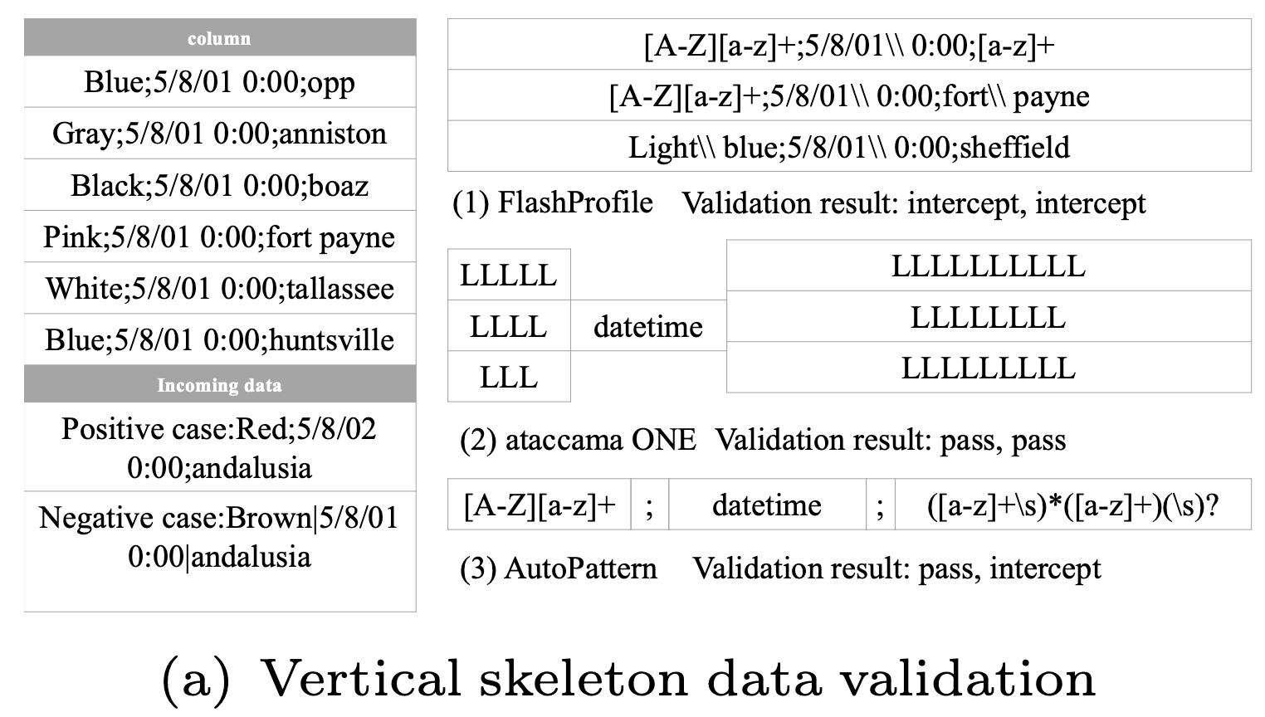
Domain-Specific Language (DSL)
Domain-Specific Language (DSL): a pattern language for semi-structured strings, organized via a generalization tree.
Align{S₁, S₂, ..., Sₙ}
Recursive{S}[sep, p]
Requires sub-patterns S₁ through Sₙ in fixed sequential order.
Captures vertical column alignment across multiple strings.
Repeats sub-pattern S separated by delimiter sep.
Optional count p and terminator.
Captures repetitive sub-structures.
Example Pattern
[A-Z][a-z]+ ; datetime ; ([a-z]+\s)*([a-z]+)(\s)?

Slide 7
Framework
AutoPattern: a self-validating data management system for automatic validation of semi-structured string data
Historical
Data D(t)
→
Skeleton
Extraction
→
Fine-grained
Refinement
→
Validation
Constraint
→
New Data
∆D(t+1)
①
Skeleton Extraction
Infer high-level structural skeletons via recursive and vertical splitting to capture nested, aligned relationships.
②
Fine-grained Refinement
Entropy-guided, character-level refinement over skeletons using a generalization tree to balance generalization and specification.
③
Validation & Update
Validate incoming data against learned patterns.
Incrementally update patterns with user feedback as data evolves.

Slide 8
Framework
AutoPattern: a self-validating data management system for automatic validation of semi-structured string data

Slide 9
Skeleton Extraction
Two complementary splitting strategies to capture structural skeletons
Recursive Splitting
Vertical Splitting
Identifies repetitive sub-structures
connected by delimiters
Input:
12/22/1976|08/21/1974|02/01/1984
01/29/1901|02/15/1983|10/12/1999
Discovered:
Recursive{datetime}[|]
Aligns tokens across strings
by positional columns
Input:
Blue;5/8/01 0:00;opp
Gray;5/8/01 0:00;anniston
Discovered:
Align{Color ; datetime ; city}

Slide 10
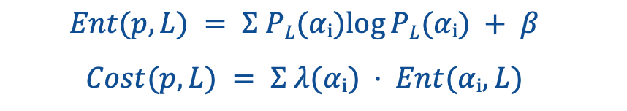
Fine-grained Refinement
Refining skeletons at character level to balance generality and specificity
Entropy-based Cost Function
$$Ent(p, L) = Σ PL(αᵢ)log⁡PL(αᵢ) + β$$
$$Cost(p, L) = Σ λ(αᵢ) · Ent(αᵢ, L)$$
Quantifies semantic richness of patterns.
Lower cost = better balance between generalization (accepting valid variants) and specification (rejecting errors).
Greedy Refinement Process
Skeleton
Pattern
→
Align to
Columns
→
Traverse
Generation
Tree ↓
→
Check
Match + Cost
→
Refined
Pattern

Slide 11
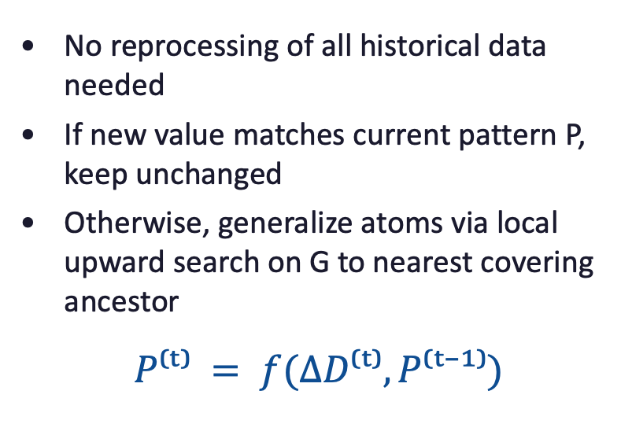
Adaptive Pattern Learning and Update
Data Augmentation
Incremental Update
Addressing Cold Start
Maintaining Accuracy Over Time
No reprocessing of all historical data needed
If new value matches current pattern P, keep unchanged
Otherwise, generalize atoms via local upward search on G to nearest covering ancestor
$$P⁽ᵗ⁾ = f(∆D⁽ᵗ⁾, P⁽ᵗ⁻¹⁾)$$
Limited historical data fails to capture future variations
Automatically generates boundary-like synthetic instances from the generalization tree
Inverse of pattern inference: synthesizes data from patterns by traversing generation tree G to leaf nodes
Reduces early false negatives with minimal human effort

Slide 12
Experimental Setup
Datasets
Dataset | Keys | Description
Kaggle | 214 | CSV columns from Kaggle
Random | 1,000 | Nested strings with random delimiters
Enterprise | 1,000 | Industrial platform, ~2M key-value records
Baselines
Deequ — Spark-based data quality library
FIDEX — Example-driven filter synthesizer
TFDV — TensorFlow Data Validation
xSystem — Branch-and-merge pattern extraction
FlashProfile — Program induction for regex-like patterns

Slide 13
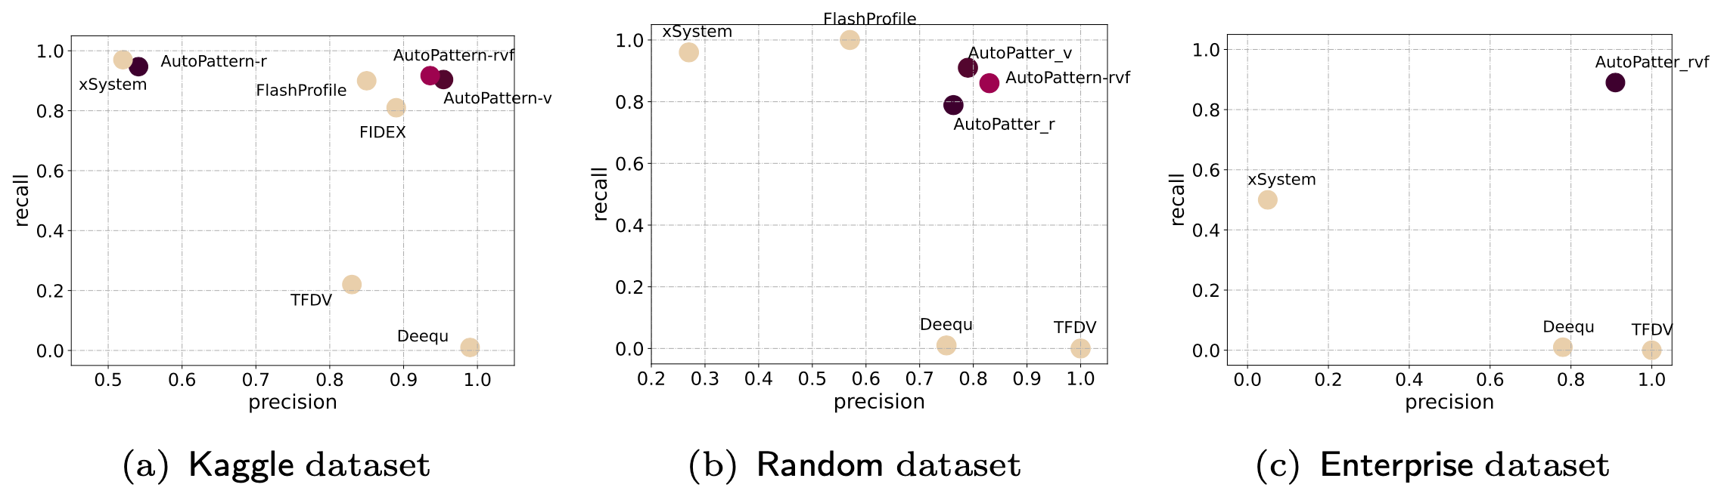
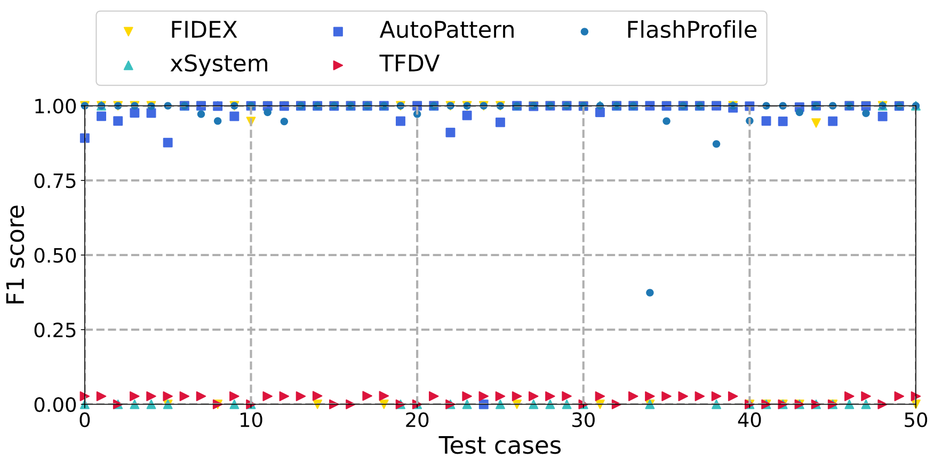
Experimental Results
Performance Evaluation
AutoPattern achieves an average precision of 0.91 and a recall of 0.89.
Combining recursive and vertical splitting is essential.
Baselines have critical weaknesses, e.g., FlashProfile degrades on nested data; FIDEX times out on industrial-scale strings.

Slide 14
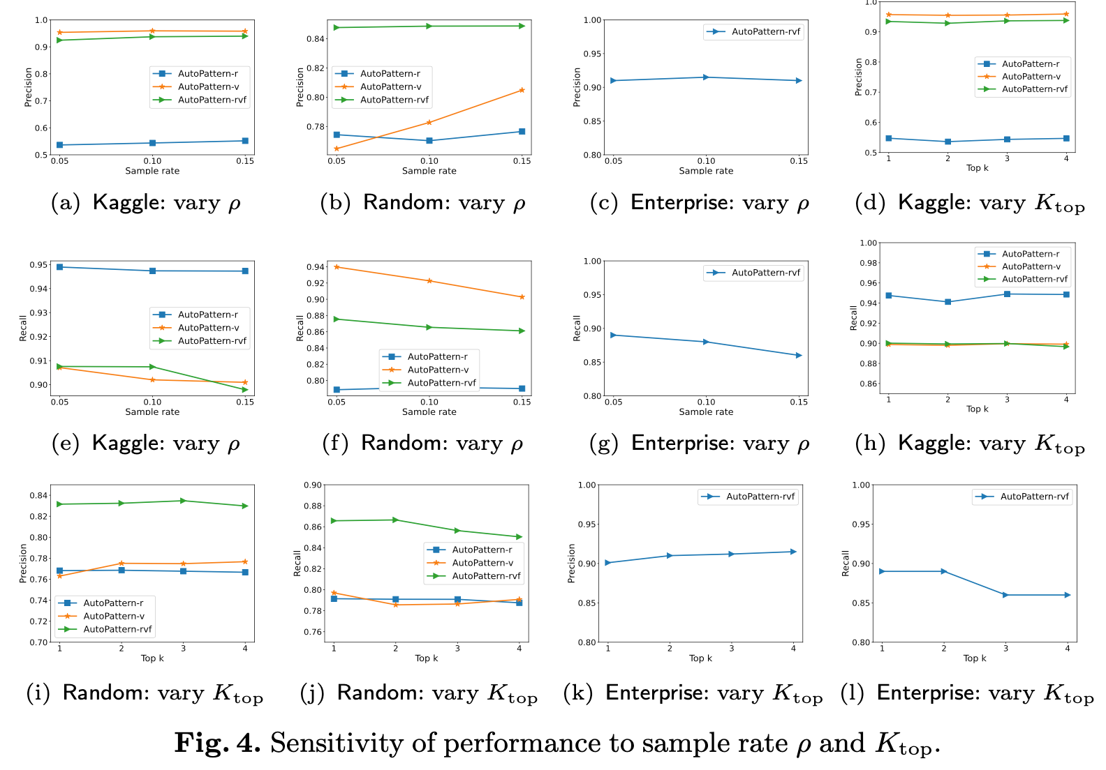
Experimental Results
Sensitivity of performance to sample rate ρ and K_{top}
AutoPattern is robust w.r.t.
(1) sample rate ρ;
(2) the number of learned patterns K_{top} used for validation

Slide 15
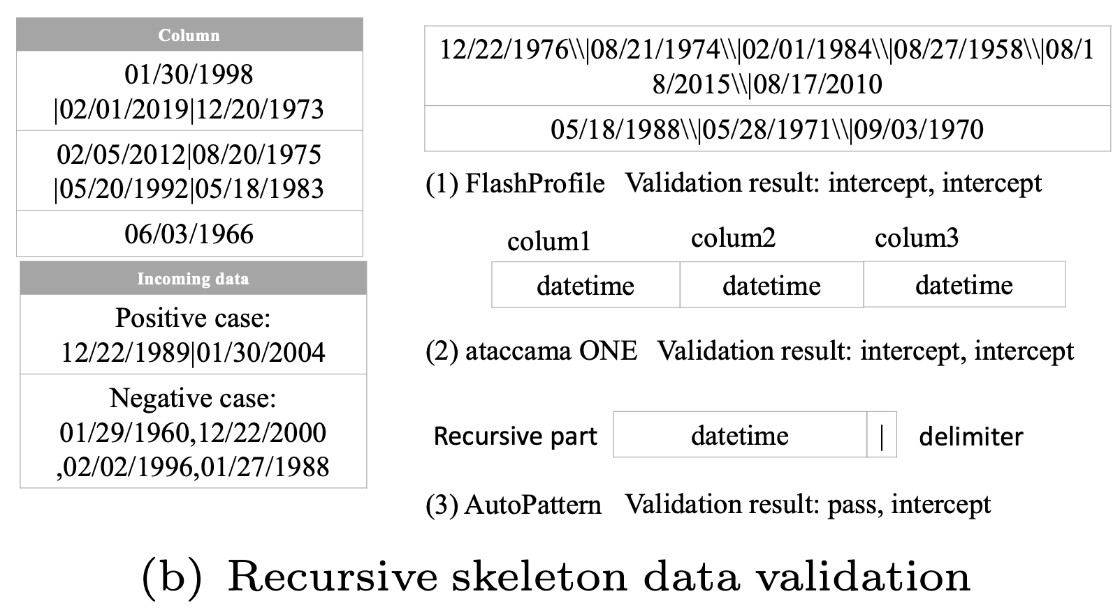
Experimental Results
Case Study: Ant Group Inc.
Deployed on Ant Group's config platform — Monitoring ~2M configuration changes
AutoPattern captures both structure and semantics, unlike FlashProfile (structure only) and Ataccama One (falls back to enumeration)
Effective error interception in production, with Significantly less maintenance effort

Slide 16
Conclusion
1
A pattern-centric DSL supporting recursive and aligned structures for semi-structured strings
2
Skeleton extraction combining recursive and vertical splitting for structural pattern discovery
3
Fine-grained semantic refinement balancing generalization and specification at character level
4
Data augmentation and incremental update mechanisms for cold start and evolving data streams
5
Extensive evaluation: 0.91 precision, 0.89 recall, outperforming all competitive baselines

Slide 17
Thank You!
Q & A

