Slide 1
PML

Slide 2
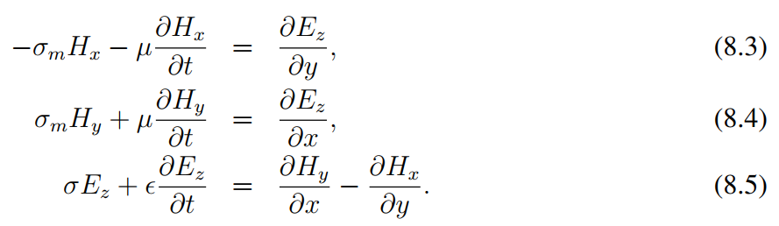
TMz maxwell equations

Slide 3
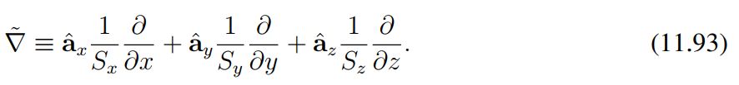

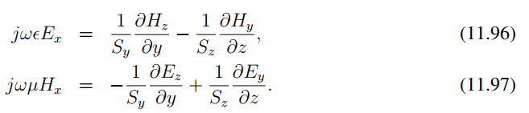
PML construction

Slide 4
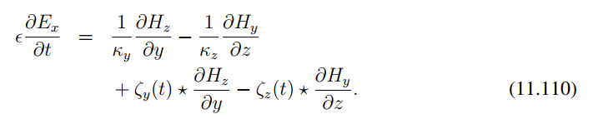


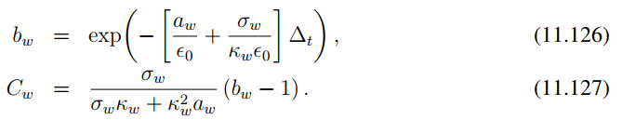
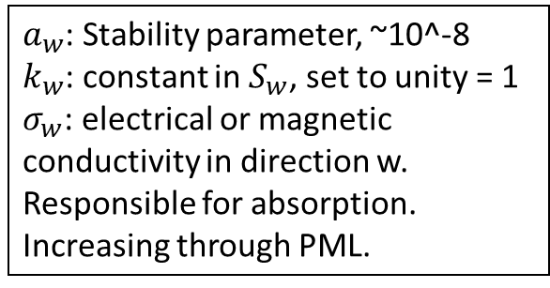
PML for Ex
$a_{w}$: Stability parameter, ~10^-8
$k_{w}$: constant in $S_{w}$, set to unity = 1
$σ_{w}$: electrical or magnetic conductivity in direction w. Responsible for absorption. Increasing through PML.

