Slide 1
Operating Systems (Homework 1)
Multi-threaded sorting application
These lecture materials are modified from the lecture notes
written by A. Silberschatz, P. Galvin and G. Gagne.
Spring, 2016

Slide 2
Outline
1. Objectives
2. What to do ?
3. How to write a program
4. Schedule
5. Evaluation

Slide 3
Objectives
Writing a multi-threaded program
pthread_create
pthread_join
pthread_exit

Slide 4
What to do ?
Write a multi-threaded program that works as follows:
1. A list of integers is divided into three smaller lists of equal size
2. Three separate threads (sorting threads) sort each sublist using a sorting algorithm of your choice
3. Three sublists are merged by the forth thread (a merging thread) which merges three sublists into a single sorted list

Slide 5
Requirements
1. The global array is shared by each thread
2. The programming project requires passing parameters to each of the sorting threads
Starting index, Ending index
7, 12,19,3,18,4,2,6,15,8
7,12,19
3,18,4
2,6,15,8
2,3,4,6,7,8,12,15,18,19

Slide 6
Requirements
3. The merging thread must wait until three sorting threads calculate their results
Use a spin lock (busy looping) mechanism

Slide 7
How to write a program ? (Hint)
POSIX thread programming (1)
Thread creation
1> Prototype
#include <pthread.h>
int pthread_create( pthread_t* tid, pthread_attr_t *attr, (void *) f, void *arg);
Roles
Creates a new thread and runs the thread routine f with an input argument of arg
When pthread_create returns, argument tid contains the ID of the newly created thread

Slide 8
POSIX thread programming (2)
Terminating the threads
Prototype
#include <pthread.h>
int pthread_exit(void *thread_return);
Roles
Terminating the thread with a return value of thread_return that will be transferred to pthread_join

Slide 9
POSIX thread programming (2)
Reaping terminated threads
Prototype
#include <pthread.h>
int pthread_join(pthread_t tid, void *thread_return);
Roles
pthread_join function blocks until thread tid terminates
It is similar to wait function but can only wait for a specific thread to terminate

Slide 10
S/W architecture
main thread
call pthread_create()
peer thread
call pthread_join()
pthread_exit()
pthread_join() returns

Slide 11
How to pass parameters to threads ?
typedef struct
{
int from_index;
int to_index;
} parameters;
parameters *data = (parameters *) malloc (sizeof(parameters));
data->from_index = 0;
data->to_index = 4;
int pthread_create( pthread_t* tid, pthread_attr_t *attr, (void *) f, void *arg);

Slide 12
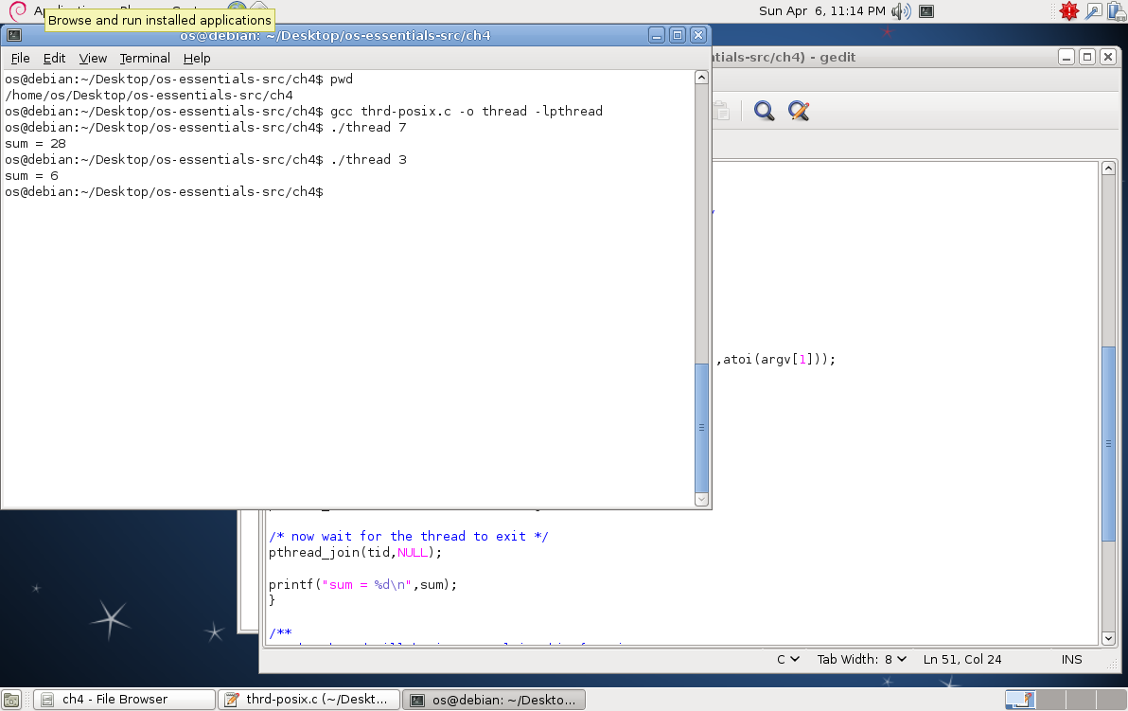
http://people.westminstercollege.edu/faculty/ggagne/osc/vm/index.html

Slide 13
Schedule
약 3주
데드라인: 4월 23일 오후 23:59
실제로는 4월 22일 오후 23:59 임
이후에는 어떤 경우에도 안 받으니, 하루 전에 미리 제출할 것을 권유함
What to submit ?
보고서
별도 평가 예정이니, 자세히 쓸 것
source file, 출력 image

Slide 14
Evaluation
조교가 테스트하는 방법
sorting input.txt
output.txt
1 3 4 10 400 500
Check point
Thread 3개 생성 여부 확인
Data splitting 여부
Spin lock 사용 여부
1 3 10 4 500 400

