Slide 1
COMPANY A / CONSULTING PROOF OF CONCEPT
Retain contribution.
Not just customers.
Risk
≠
value
A value-aware service-recovery strategy, grounded in 100,000 customer records—and designed to earn its right to scale.
philopateer | GCI World 2026 | Local Python / CPU analysis
Company A is anonymous. Model evidence is observed; intervention economics are explicitly conditional.

Slide 2
Approve evidence—not a blanket discount campaign
SAMPLE BENCHMARK
CONDITIONAL ECONOMICS
MANAGEMENT DECISION
+42.4%
$3.7k
Pilot first.
Earn the rollout.
More churned recurring value
captured than risk-only.
Sample top 10% of rows;
not a deployment forecast
or measured savings.
At 2% assumed churn in a
100,000-customer cohort.
Nominal 10% outreach; costs,
response and population
transport are unverified.
Test opt-in service recovery
against usual care. The pilot
buys causal learning—not
proof of profitable rollout.
Decision ladder: risk-only → value-aware triage → causal incremental-profit targeting.
Keep the verified LightGBM baseline; scale only after fully loaded contribution and harm gates pass.
[D1, S5–S6] Sample and deployment regimes are separate. Economics are conditional USD-equivalent assumptions. Risk ≠ response. 02

Slide 3
Retention economics matter more than contact volume
CURRENT MARKET CONTEXT
COST DISCIPLINE PRECEDENT
0.93% / 2.72%
30% lower
T-Mobile FY2025 postpaid / prepaid [S1].
Monthly rate uses average customers.
Postpaid phone ARPU: $50.37 per month.
AT&T: 0.90%; beginning-month denominator [S2].
Verizon reports improved promotional retention cost, Q3 2026 vs prior year.
Management claim—not causal evidence. [S3]
6% → 10% churn
Implication for Company A
Offer useful, permission-based help.
Measure adverse effects and all costs.
Keep an untreated comparison group.
A specific randomized plan-recommendation campaign
increased three-month churn—not a universal effect. [S4]
[S1–S4] Carrier segments, denominators and horizons differ. None establishes Company A prevalence or this workflow’s treatment effect. 03

Slide 4
100,000 customers; a useful sample, not a live forecast
100,000
49.56%
Days 31–60
Customers; 100 merged columns.
No unmatched or duplicate IDs.
Observed sample churn.
Not a population churn estimate.
Label window after observation.
Not cumulative 60-day churn.
What we can establish
What must be acquired
Behavioral segments, held-out risk ranking and recurring-value prioritization.
133 invalid negative handset ages are handled; billing credits are not blindly deleted.
Current dates, live baseline, true margins, offer costs, household linkage and randomized treatment outcomes.
Currency and sampling design are unverified.
[D1–D2] Original data audit. Customer-ID order varies with tenure and churn; random holdout is not temporal validation. Source files preserved and fingerprinted. 04

Slide 5
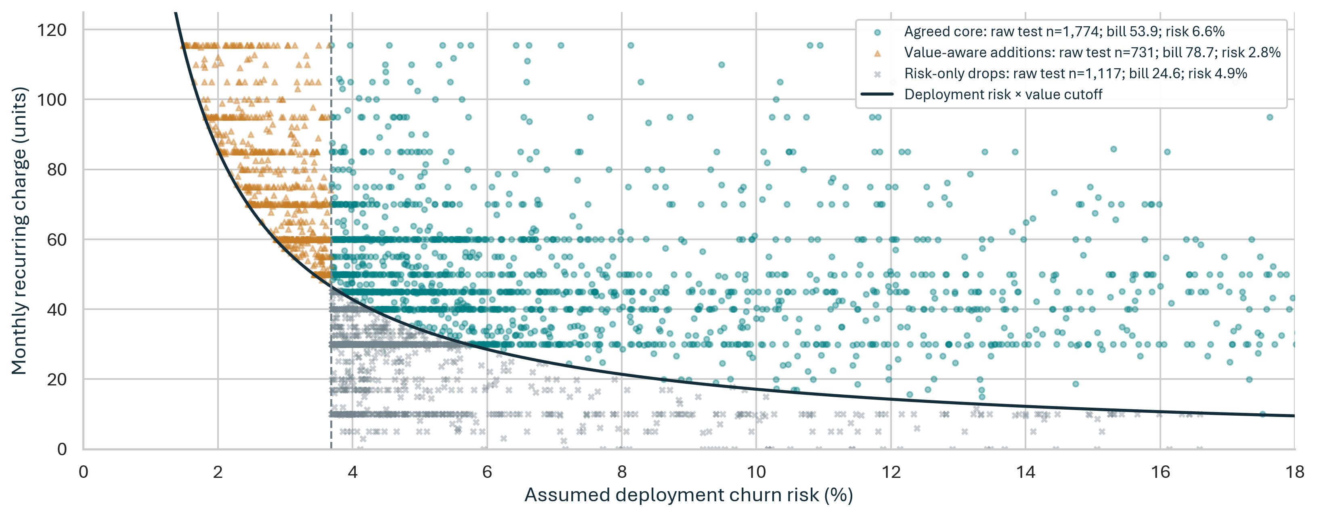
Risk ≠ value: who gets the discretionary call?
Deployment scenario: 2% prior; risk and value-aware cutoffs frozen on calibration rows. Mandatory defect remediation is not rationed.
Value-aware triage adds higher-bill accounts and drops lower-bill ones—not a causal claim about who will respond.
[D1, M5–M6] Raw n are sample counts; bill/model-risk means are deployment-weighted. No point subsampling; axes crop the display. 05

Slide 6
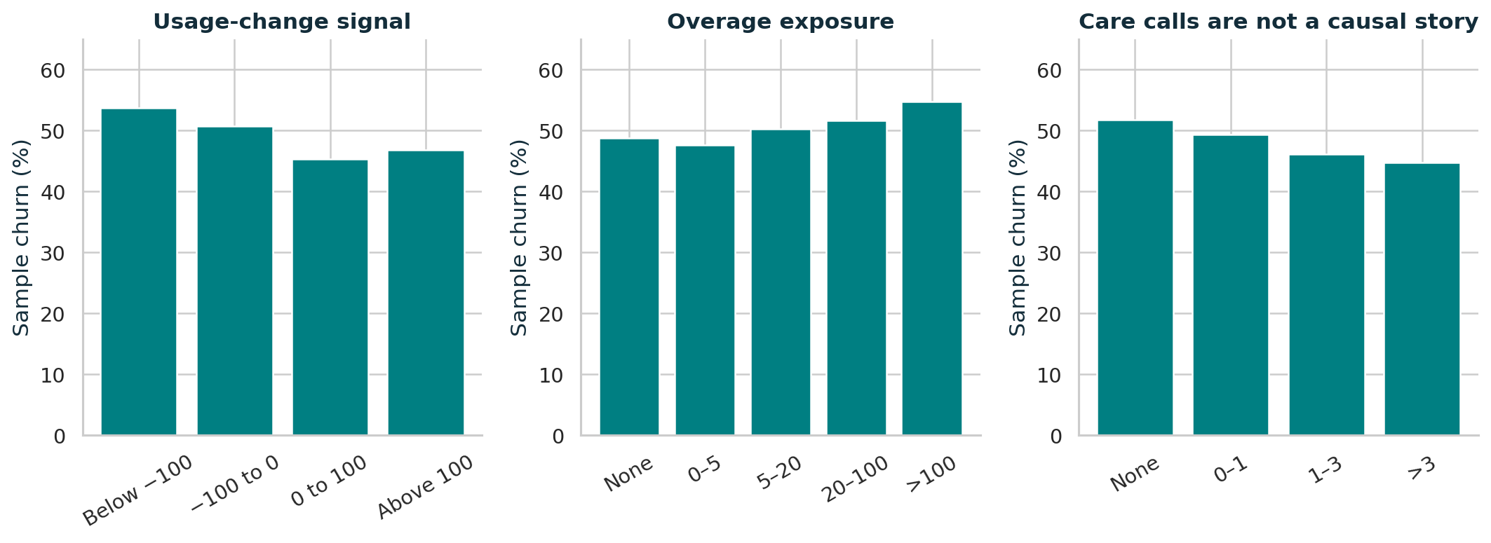
Diagnose the issue before choosing the remedy
Training-sample patterns suggest questions for an agent—not automatic price cuts, device swaps or causal conclusions.
Usage decline → ask what changed. Overage exposure → explain the bill. Care activity → verify whether the issue was resolved.
[D1–D2] Training n=60,000. Usage-change units are ambiguous; raw thresholds are not labeled percentages. Overage values are dataset monetary units. 06

Slide 7
Separate selection, calibration and final testing
Previously evaluated baseline test reused; enhancement decisions frozen before the descriptive final batch. Original split preserved.
60,000
15,000
10,000
15,000
Train the candidates
Select by ROC-AUC
Calibrate; set policy
Final held-out test
87 operational features
Headroom gate: baseline retained
Sensitive fields excluded; operational proxies remain.
Credit-card AUC 0.657; ownership 0.607;
high ordinal income 0.627 (fold-local label).
Missing targets dropped; subgroup audit ≠ fairness.
No Range fields or inferred Mean windows.
Repeated 2 × 5 non-test CV on 75,000 rows.
Best blend mean ΔAUC: +0.001085.
Corrected 95% CI: −0.000032 to +0.002203.
Tail/convergence gates also failed.
No challenger promoted; no ceiling established.
[D1, M1–M8] Local CPU; seed 20261028. Headroom intervals are exploratory, pointwise—not selection-adjusted. Proxy prediction does not prove independence. 07

Slide 8
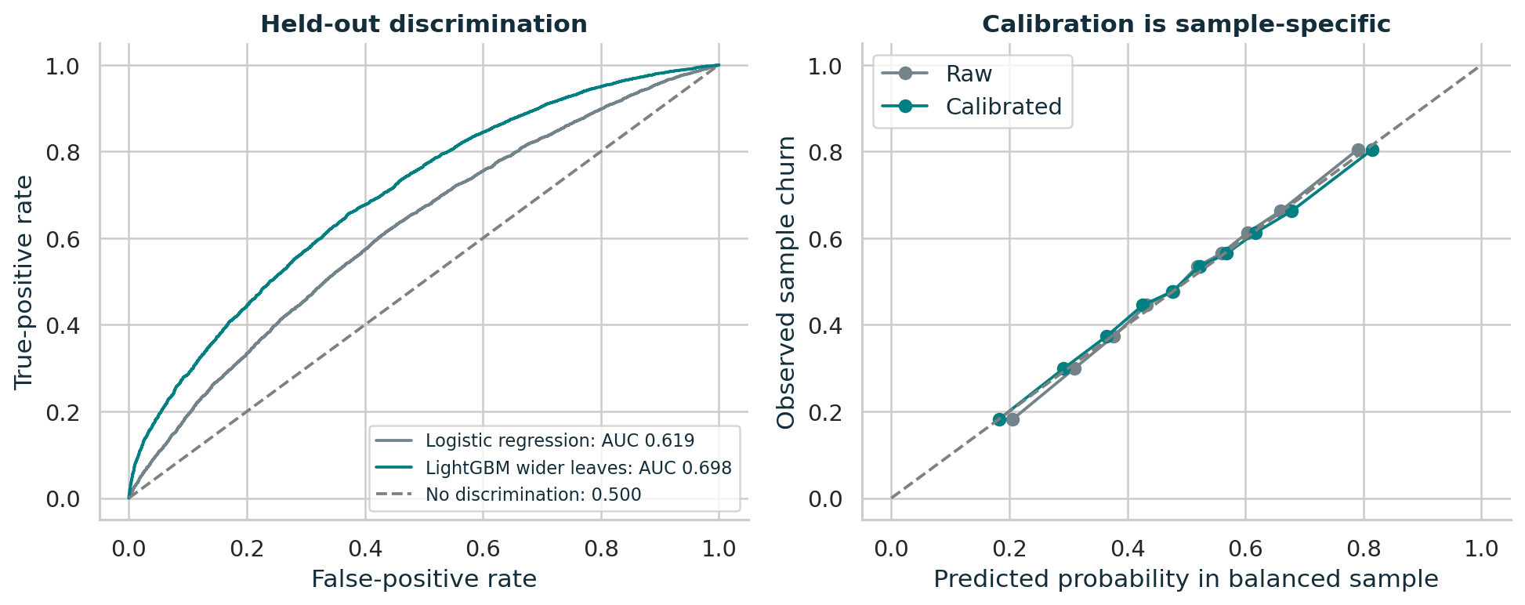
Retained LightGBM: original held-out AUC 0.6978
Original baseline reference; 15,000 reused test customers. No challenger passed the non-test gate; the chart is unchanged.
95% AUC interval: 0.6899–0.7055
Accuracy: 64.02%
Brier score: 0.2195
Ranking signal is useful for triage. Sample-calibrated probabilities are not deployment prevalence or treatment responsiveness.
[D1, M1–M2] Accuracy uses threshold 0.5. AUC interval: 300 test-row bootstrap replicates, conditional on fitted model. Refitting uncertainty not included. 08

Slide 9
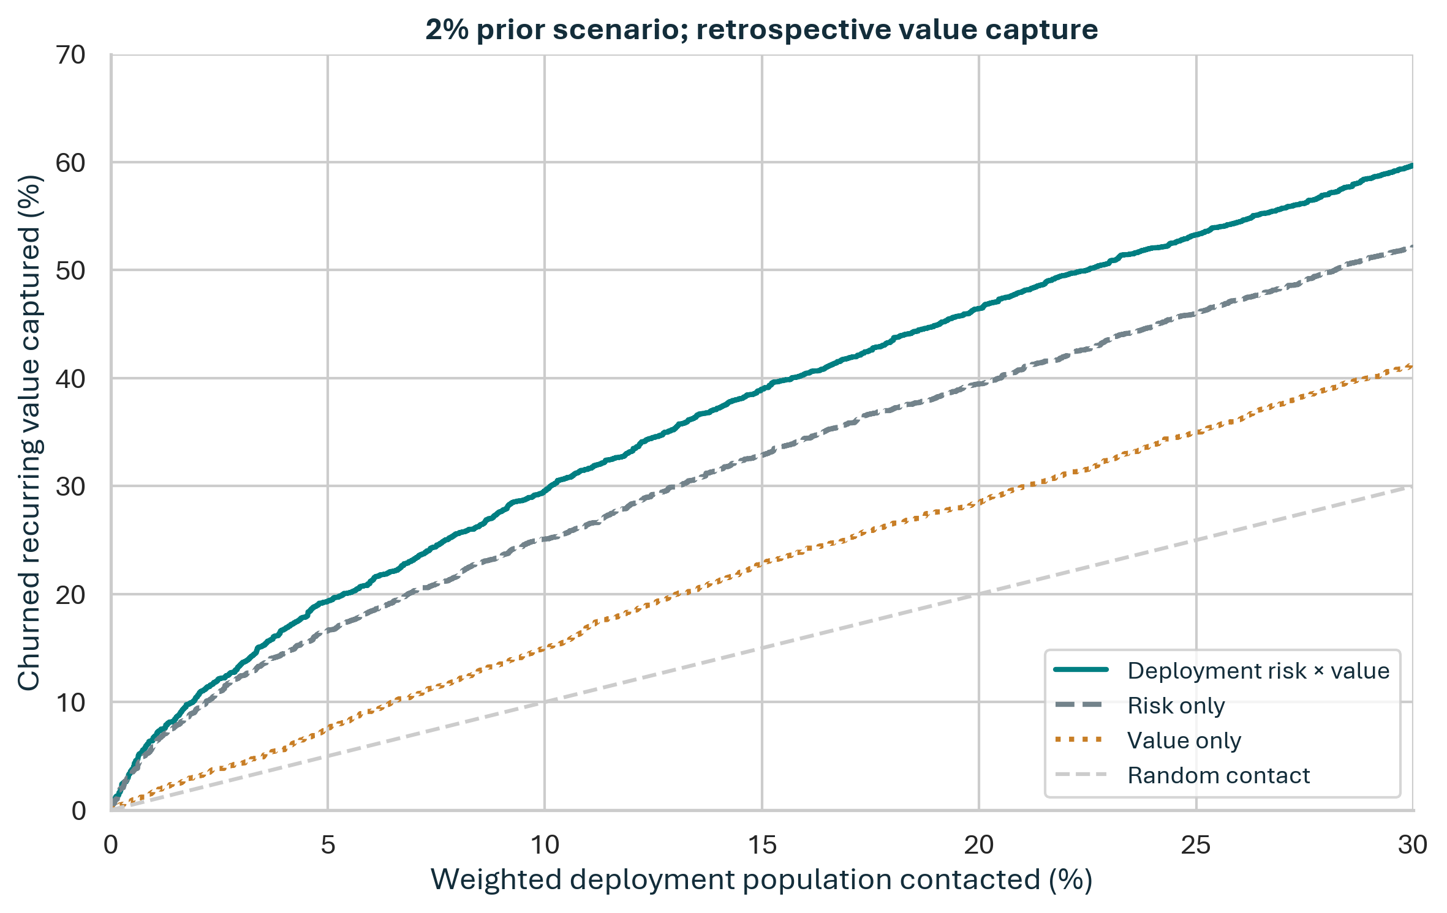
Nominal 10% outreach captures 29.5% of churned value
2% deployment scenario: population-weighted cutoff frozen on calibration. This is not the sample top-decile comparison.
DEPLOYMENT-WEIGHTED VALUE CAPTURE
29.5% Value-aware
15.0% Value only
25.6% Risk only
+15.4% relative to risk only.
95% conditional paired interval:
+11.3% to +19.7%.
Separate sample benchmark: top 1,500 rows capture 20.8% vs 14.6% of churned value; +42.4% relative gain—not retention lift.
[D1, S6, M5] Curve: stable-rank diagnostic; headline: frozen cutoff. Population transport is unverified; conditional intervals exclude refit/selection uncertainty. 09

Slide 10
One service workflow. A mandatory remediation floor.
Service-Fix Floor — verified defects are never rationed
Remediate every verified billing/network defect regardless of bill size, discretionary selection or campaign arm.
Value-aware ranking only rations scarce proactive outreach; verify consent and linked-account assignment.
Billing check
Network check
Handset check
Digital residual
582 raw rows
68.7 mean bill
23.4% at-risk value
266 raw rows
59.7 mean bill
10.4% at-risk value
791 raw rows
62.9 mean bill
30.7% at-risk value
866 raw rows
64.7 mean bill
35.5% at-risk value
Verify the bill and recent
revenue change. Explain
and resolve; no inferred
promotion expiry.
Inspect failed-call signals.
Confirm a live issue before
escalation; missing data
is not a verified defect.
Age >365 days flags an
opt-in health check.
No automatic replacement
or equipment-failure claim.
Permission-based digital
check for remaining cases.
Not uniformly low usage;
no proactive billing call.
Exclusive precedence: billing → network → handset → residual. These are action hypotheses, not diagnosed causes.
Sample counts; mean bills and value shares weighted to the 2% scenario. No automatic subsidy or plan switch.
[D1, S4–S8] Frozen calibration routing; descriptive reused-test queues. Comparable diagnostic/agent workflows establish feasibility, not savings. 10

Slide 11
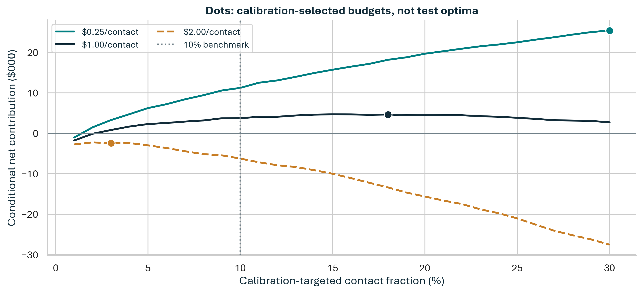
A conditional $3.7k business case—not a forecast
Hypothetical 100,000-customer cohort; about 9,985 weighted contacts at nominal 10%. Budget unchanged; no test-selected optimum.
ALL ARE ASSUMPTIONS
2% deployment churn
20% of would-be churners
prevented
6 months × 60% margin
$1 per contact; $5k fixed
No blanket subsidy
Net 95% interval: $2.8k–$4.7k
Conditional scenario: 95 prevented → $31.2k retained revenue → $18.7k gross contribution.
No-contact alternative: zero without campaign launch.
[D1, S6, M5] Dots are calibration-selected budgets, not test optima. Costs and benefits are population-weighted; transport/response are unverified. USD-equivalent, not actual currency. 11

Slide 12
Small cost changes can erase the entire return
Net contribution in USD-equivalent thousands; 2% assumed churn, 100,000-customer cohort, $5,000 fixed cost.
$1 / contact
$2 / contact
$5 / contact
Break-even cost
$1.38 / contact
10% prevented
−5.6
−15.6
−45.6
Break-even prevention
16.0%
20% prevented
+3.7
−6.2
−36.2
30% prevented
+13.1
+3.1
−26.8
Prior stress, same base costs:
1% → −5.6k
2% → +3.7k
5% → +30.7k
No-contact means zero without campaign launch; an empty launched list still incurs fixed cost.
Verify live prevalence, fully loaded support costs and causal effectiveness before committing funds.
[D1, M5–M6] Editable scenario sensitivity, not a confidence interval. Prevention is assumed; break-even holds all other base assumptions fixed. 12

Slide 13
Fund causal learning—not an assumed profitable rollout.
Two disjoint learning stages
Binary learning ≠ profit proof
Core: 7,872 linked accounts/arm in both + rv_only.
$12,872 contact/startup envelope.
Expansion: risk_only 2,000/arm; exploration 1,000/arm.
$3,000 incremental envelope; not powered contrasts.
Core needs 15,744 unique accounts across larger portfolios/cohorts.
No duplicated rv_only enrollment; acquire household linkage.
Costs exclude unquoted consent, linkage, follow-up and engineering.
Calibration simulation (planning proxy):
adjusted contribution needs 80,000/arm;
unadjusted not 80% powered through
160,000/arm. No validated longitudinal
CUPED or household-clustered power.
Re-estimate using live data.
Randomize linked clusters 50/50; log joint enrollment × assignment propensities, costs and outcomes.
HT/IPW Bayes-minus-risk: only both cancels; weight incremental value in rv_only minus risk_only by deployment mass.
Exploration supports below-cutoff learning; no unbiased claim for unconsented or unobserved accounts.
Scale: cluster-robust 95% lower bound of fully loaded incremental contribution >0 and no harm.
Extend: interval overlaps zero, positive upper bound, no harm, prospectively approved sample/budget cap.
Stop: upper bound ≤0, infeasible costs or harm. Serious consent/complaint events escalate independently.
[D1, S4–S6, M7] Binary plan: two-sided α=5%, power=80%, 10% follow-up allowance; not profit-powered.
Harm stratum: low usage AND zero overage AND zero care; missing ≠ zero. Looks at 50%/100%; one-sided Fisher p≤0.005 each plus positive churn difference (familywise ≤0.01). 13

Slide 14
References | Market and comparable implementations
[S1] T-Mobile US. 2025 Annual Report / Form 10-K (published 2026). Churn and ARPU definitions.
https://s29.q4cdn.com/310188824/files/doc_financials/2025/ar/2025-TMUS-Annual-Report-Final-Web.pdf
FY2025 monthly churn: postpaid phone 0.93%, prepaid 2.72%. Benchmarks do not set Company A’s baseline.
[S2] AT&T. 2025 Form 10-K (9 February 2026). Mobility statistics and device-financing discussion.
https://www.sec.gov/Archives/edgar/data/732717/000073271726000120/t-20251231.htm
Operator churn definitions differ; device-financing maturity is not the same as handset age.
[S3] Verizon. Third-quarter 2026 results (26 October 2026). Retention cost and subsidy discipline.
https://www.verizon.com/about/news/verizon-delivers-another-record-breaking-quarter
30% promotional-retention-cost improvement is management-reported, not an experimental treatment effect.
[S7] MCE Systems. Vodafone Turkey launches Advanced Device Care by MCE and Techpo (26 May 2020).
https://www.mce.systems/articles/vodafone-turkey-launches-advanced-device-care-by-mce-and-techpo
Named diagnostics deployment in >1,000 stores. Vendor case supports feasibility, not quantified causal churn impact.
[S8] PegaWorld iNspire (2023). Vodafone’s value-driven retention experience in assisted and digital channels.
https://www.pega.com/insights/resources/pegaworld-inspire-2023-how-vodafone-uses-pega-deliver-value-driven-retention
Operator/vendor workflow description. No reported percentage gain is transferred into Company A’s economics.
All sources accessed 28 October 2026. Full evidence register, caveats and additional method URLs are provided in references.txt. 14

Slide 15
References | Methods, data and interpretation
[S4] Ascarza, Iyengar & Schleicher (2016). Plan Recommendations; JMR 53(1), 46–60.
Randomized intervention: 6% control vs 10% treated three-month churn—not a universal service-contact effect.
[S5] Ascarza (2018). Retention Futility; JMR 55(1), 80–98.
Risk and treatment responsiveness differ; Company A has no treatment labels.
[S6] Lemmens & Gupta (2020). Managing Churn to Maximize Profits; Marketing Science 39(5), 956–973.
Incremental cash flow after all intervention costs—not risk scores alone—is the commercial objective.
[M1] scikit-learn: evaluation and calibration.
[M2] LightGBM: local CPU boosting.
[M5] Saerens et al. (2002): prior adjustment.
[M6] Elkan (2001): costs / known-prior correction.
[M3] XGBoost; [M4] CatBoost: comparators.
[M7] Deng et al. (2013): pre-period adjustment.
[M8] Neslin et al. (2006): historical churn protocol.
No matched AUC ceiling or measured CUPED claimed.
[D1–D2] Supplied data, overview, assignment and tutorial; all analytical figures are original local outputs.
Reproduction: philopateer.ipynb; frozen split, seed, packages and input hashes. Full URLs and evidence-scope caveats: references.txt.
Qoder-assisted research, coding and drafting; computations executed locally. Full sources, caveats and assistance disclosure are in references.txt. 15

