Slide 1




The encyclopedia of Spanish provinces

Slide 2
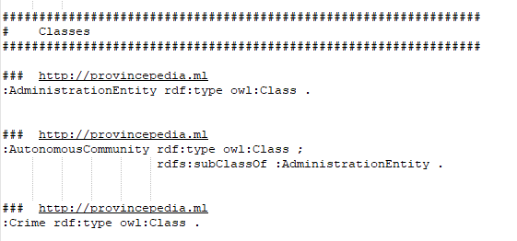
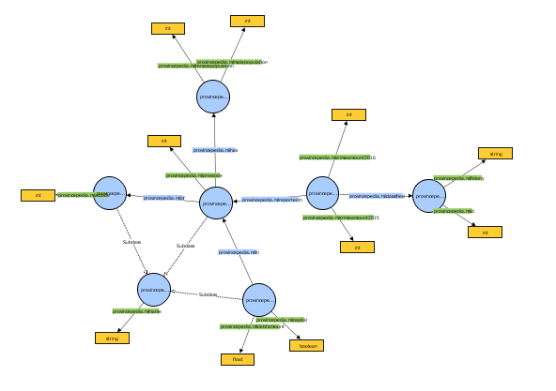
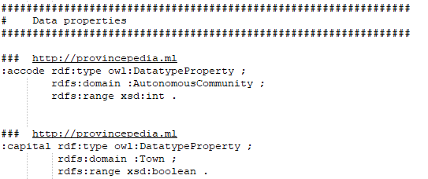
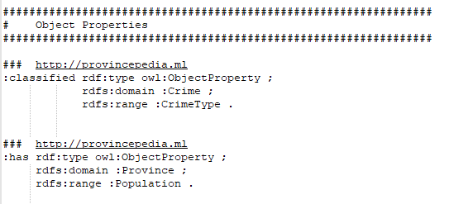
Ontology structure
Implemented in Protégé: 8 classes, 5 object properties and 11 data properties;
3 datasets initially chosen, from those 7 refined datasets waere later created and used though OpenRefine.

Slide 3
Modifications on the data(sets)
The raw datasets have been modified through openrefine to make them more readable and to be actually usable by the web application
The original datasets were:
The collection of the public debt for every city with related province and region of Spain;
The population records through last years grouped by semesters;
Crimes reported by each province and region ordered by the felony committed.

Slide 4
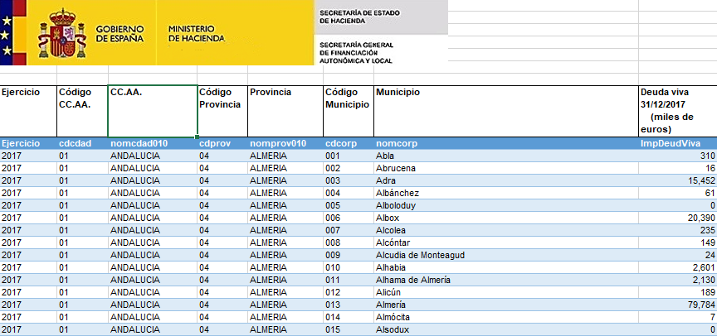
Original public debt dataset

Slide 5
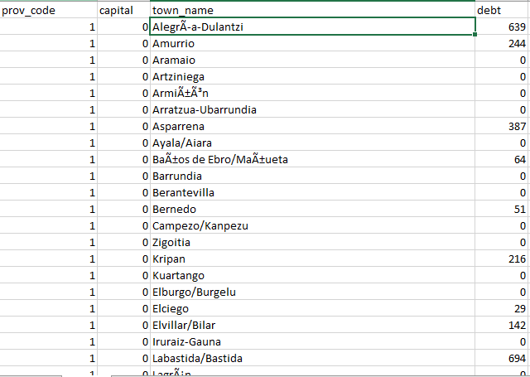
Implemented public debt dataset
Only the most recent data collected have been considered;
The total province informations have been eliminated because redundant and not useful;
For each city is present a new field capital that mark each province chief town.
All the other fields habe been removed

Slide 6
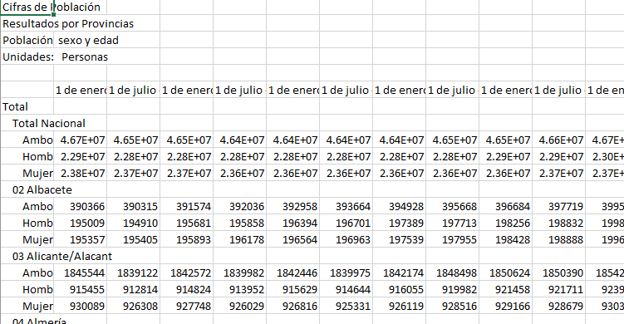
Original population dataset

Slide 7
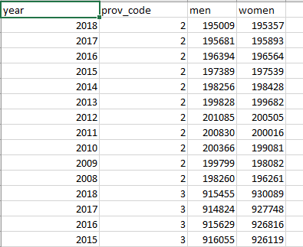
Implemented population dataset
Only the most recent data collected have been considered;
National informations have been eliminated because not useful;
A new field is added to identify the province of the town;
The field “Ambo” has been removed because redundant.

Slide 8
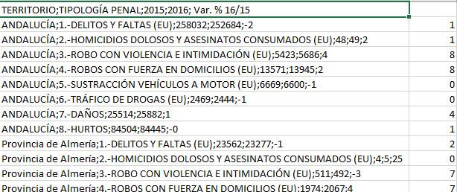
Original crime dataset

Slide 9
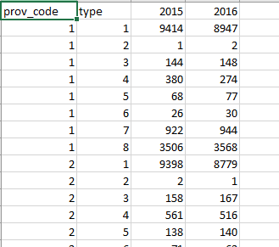
Implemented crime dataset
Only the most recent data collected have been considered: the fields “2015” and the percentual variation from 2015 to 2016 have been removed;
Only the total crimes reported in the province has been considered;
The territory field has been transformed in the code of the province in which the crime happened

Slide 10
Additional changes
Void cells have been eliminated;
Malformed data have been recovered and cleaned or (if that was not possible) removed;
To link the data of the different datasets, 3 more have been created:
The “ac” dataset links the name of each autonomous community to its code;
The “felonies” one connects the codes of the crime to their name and description;
The “prov” dataset is used to correlate the name and the id of each province to its corresponding autonomous community.

Slide 11
Conclusions
A web application based on a server of the kind “node.js” has been developed and deployed;
The hands-on have been realized in time, they can be seen in the application folder;
The project has changed since the beginning of the work:
Despite the initial idea of an encyclopaedia of all the cities, the found datasets were more suited for a encyclopaedia of the provinces instead: the project has been changed accordingly;

