Slide 1

CSA Computer & Antriebstechnik GmbH

Slide 2


Slide 3
Comparison to other version control systems

Slide 4
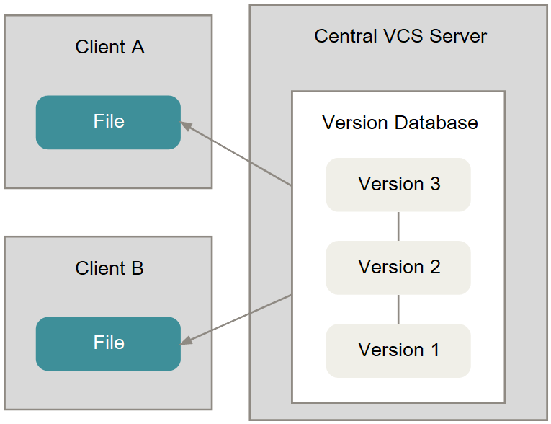
Central VCS

Slide 5
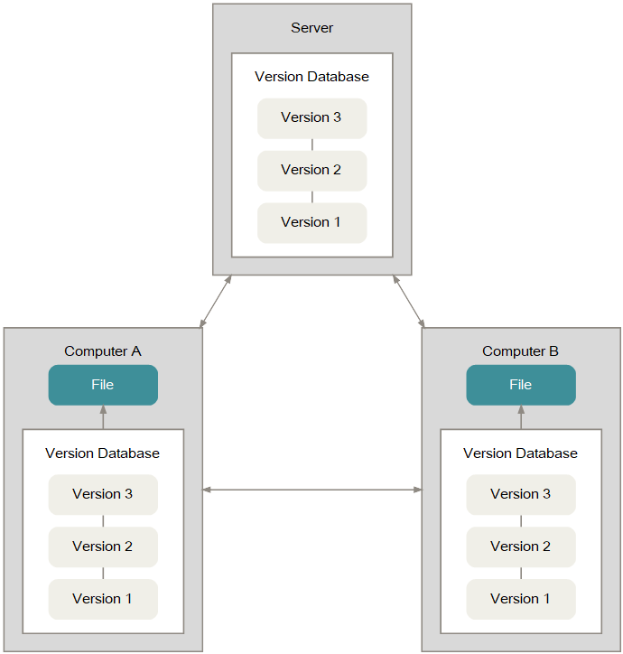
Distributed VCS

Slide 6
Advantages of DVCSs
No need to be connected to some central repository
Local changes to repository do not affect other participants
Every participant has a backup automatically
Better performance without need of network

Slide 7
Working with Git

Slide 8
Basic principles
All operations are done on the "current" branch
Most operations should be done with a clean working directory
As long as you did not publish your commits to a central one, you can change almost all of them
  Change the order of the commits
  Split or combine commits

Slide 9
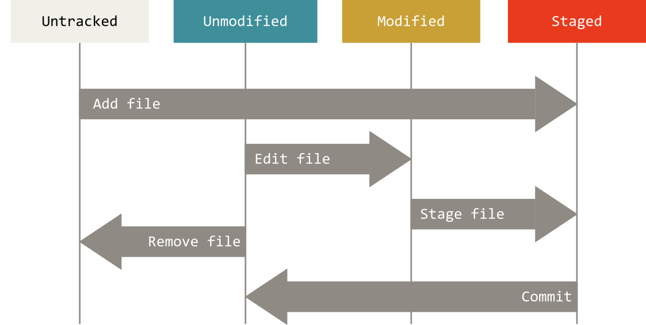
Basic principles
Lifecycle of a file

Slide 10
First steps
Basic command syntax:
$ git <verb>
Get help:
$ git help <verb>
$ git <verb> --help

Slide 11
First steps
Add file to repository
$ git add {file name}
Make a commit:
$ git commit -m "{commit message}"

Slide 12
First steps
Modify a file
$ git add {file name}
$ git commit -m "{commit message}"

Slide 13
First steps
.gitignore
Should be added at the very beginning
  Ideally with the first commit
Large collection of templates on GitHub
Notes:
  Affects only "untracked" files
  No effect to files that are already in the repository (and modified)

Slide 14
Branching

Slide 15
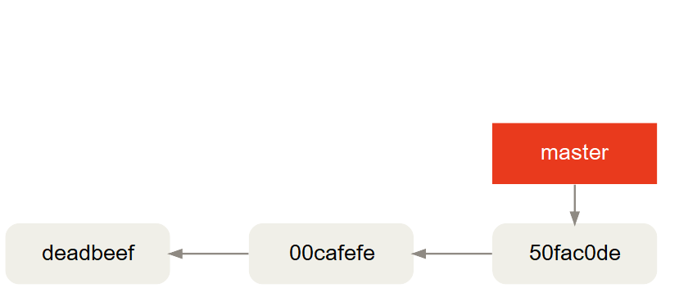
Introduction
Branches are lightwheight – they are just pointers

Slide 16
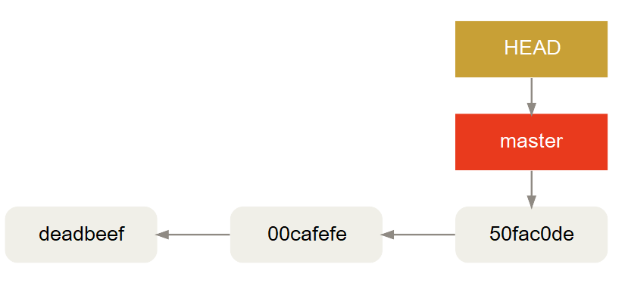
Introduction
HEAD pointer represents "current position"

Slide 17
Introduction
"master" branch
  Default branch
  Created with first commit automatically
  Nothing more special about "master"

Slide 18
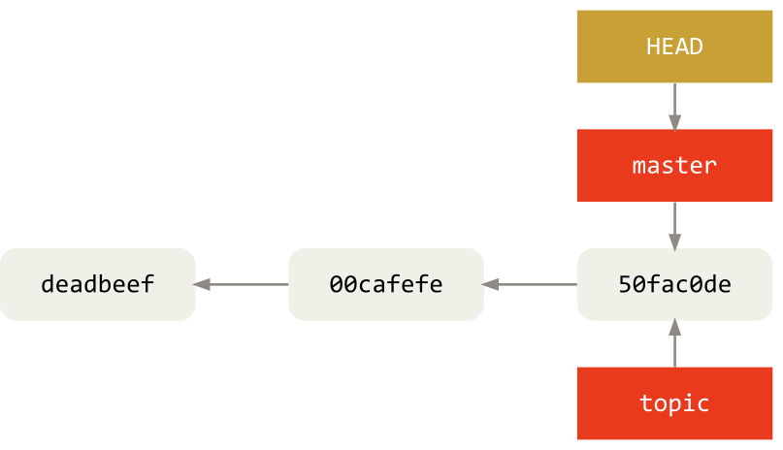
Create a branch
$ git branch topic

Slide 19
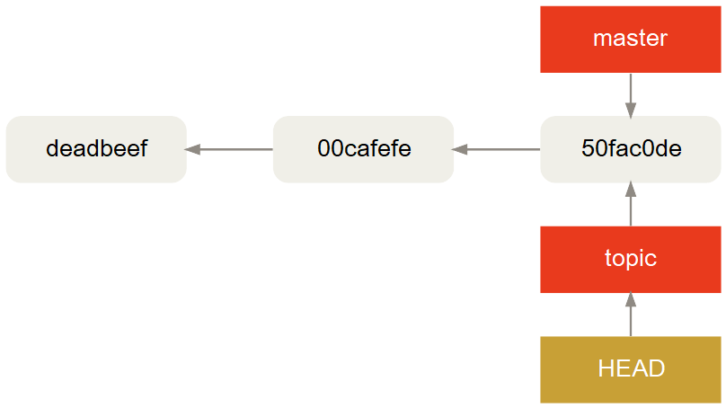
Switch branch
$ git checkout topic

Slide 20
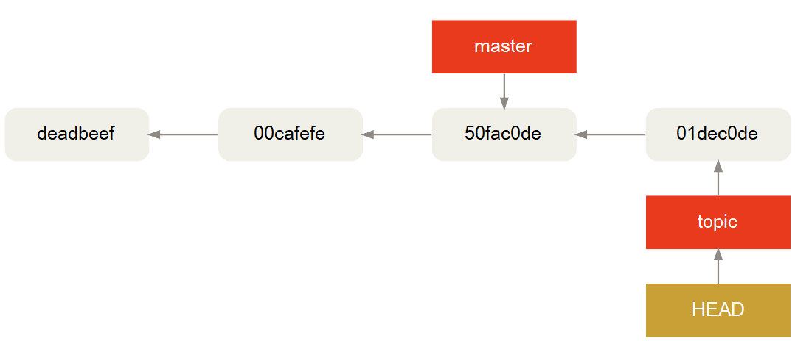
Committing on branches

Slide 21
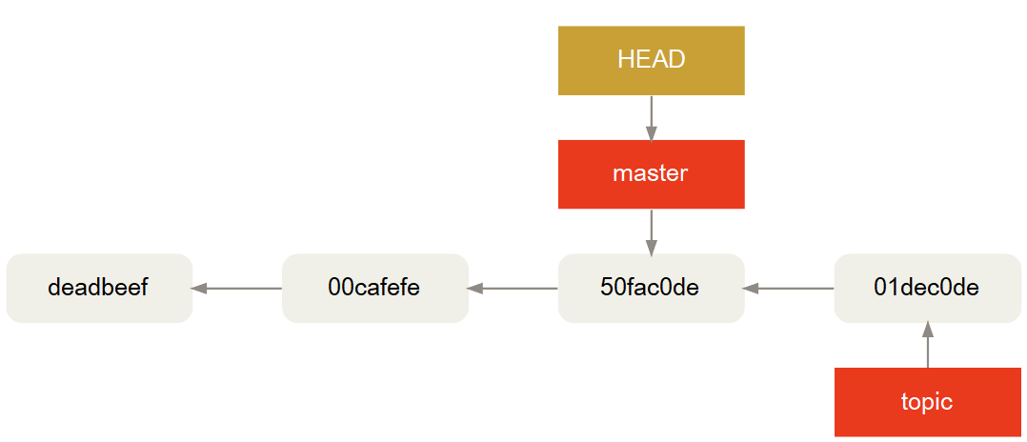
Committing on branches
Switch back to "master"

Slide 22
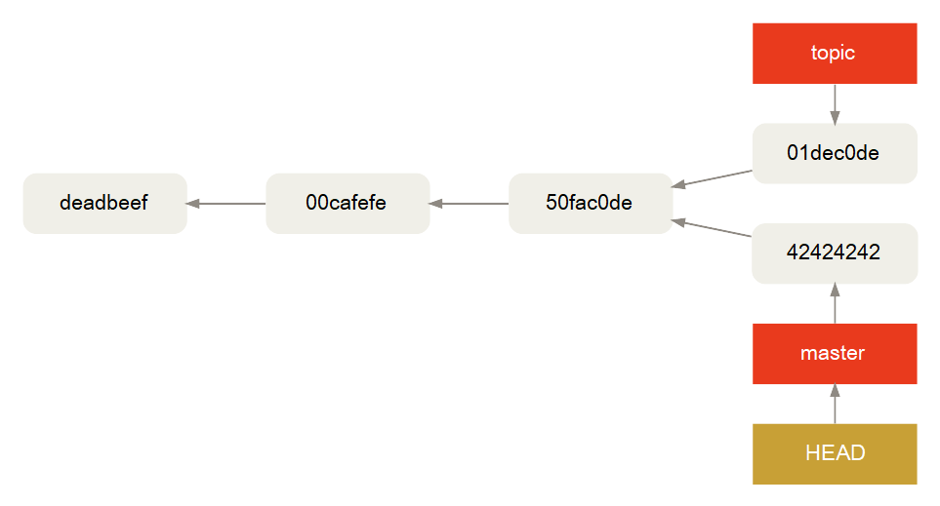
Committing on branches
Commit on "master"

Slide 23
Integration (merge and rebase)

Slide 24
Integration
3 merge strategies:
  Fast-Forward
  Recursive
  Rebase (use with caution)
Default is fast-foward if possibly
  Recursive if fast-forward is not possible

Slide 25
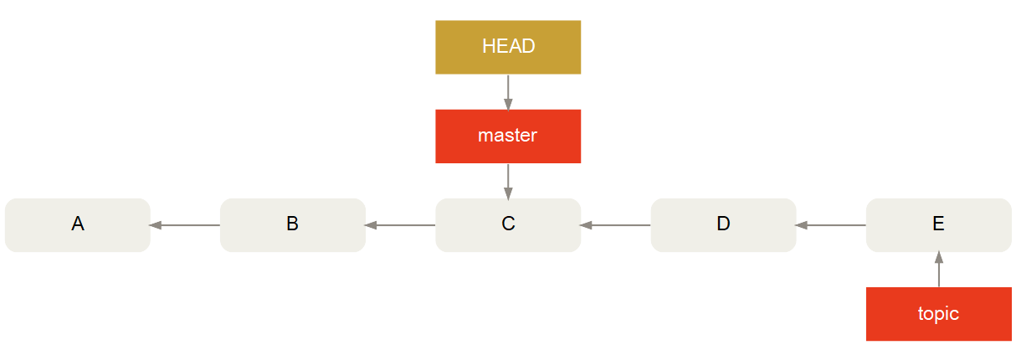
Fast-forward merge
Possible if history did not diverge

Slide 26
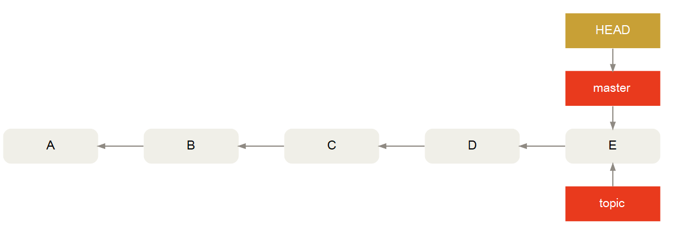
Fast-forward merge
After merge:

Slide 27
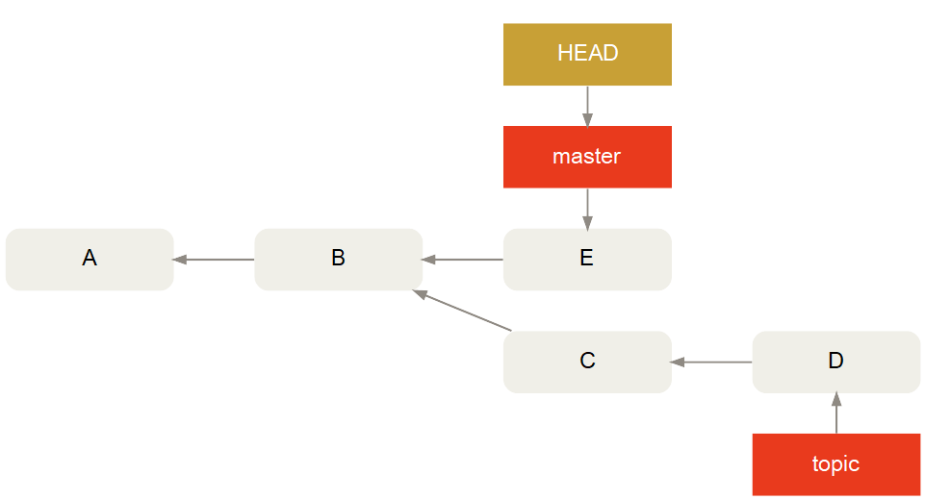
Recursive merge
History is diverged:

Slide 28
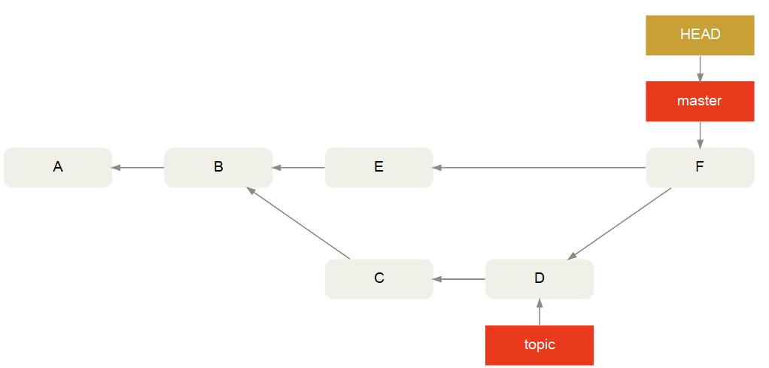
Recursive merge
New commit for merge:

Slide 29
Rebase
Change commit history!
All the things possible!
  Change the order of commits
  Split commits
  Merge multiple commits to one
  Make a diverged history linear

Slide 30
Rebase
But use with caution!
No big problem with unpublished repositories
At published repositories:
  Other people have to reproduce your rebase
  If not:
    Repositories get screwed up
    People will hate you

Slide 31
Rebase
Diverged history again:

Slide 32
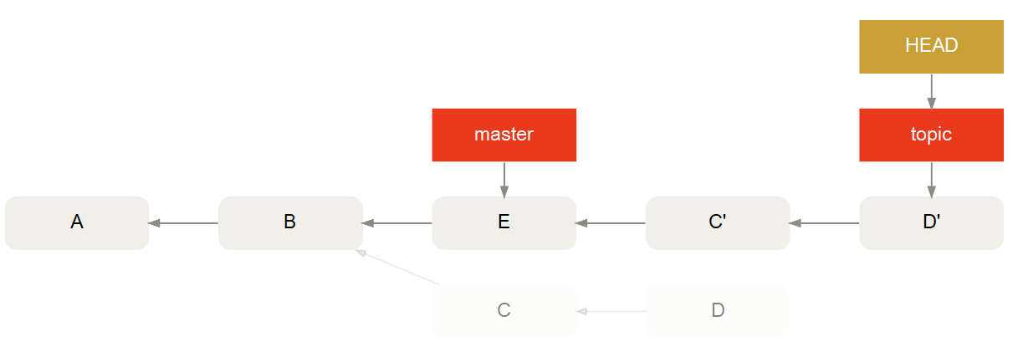
Rebase
Diverged history made linear:

Slide 33
Rebase
Lightweight
$ git commit --amend
Correct last commit
  Change / add / delete files as intended
  Change last commit message
Better alternative to "correction commits"
  If commit is not published yet!

Slide 34
Rebase
Nuclear option
$ git filter-branch
Change whole history
  That is reachable by the HEAD pointer
A command or script is executed at every commit
E.g. for deleting build artefacts out of history

Slide 35
Rebase
Notes
Backup your repository if you are not sure
Participants have to prepare:
  Publish the current state of work
  Backup the repositories
  Rebase the private repositories to the public rebase
    Or clone a fresh repository

Slide 36
Merge conflicts
Same as other VCSs
Git will not perform automatic commit
User must resolve conflict
  Edit conflicted file
  Mark as resolved:
  $ git add {conflicted file}

Slide 37
Remote repositories

Slide 38
Remote repositories
Basics
Needed when multiple participants work on the same project
No need for any special server
Nothing more than directory with certain data
  Much like a personal repository
  But without working copy

Slide 39
Remote repositories
Basics
Any place is legit for a "remote" repository, e.g.:
  HTTP server
  Network file share
  Even local hard drive
Remote has to be registered in personal repository
  Multiple remotes are possible
  Default is named "origin"

Slide 40
Remote repositories
Basic commands
Initialize new remote:
$ git init --bare
Clone from remote:
$ git clone {URL} {directory}

Slide 41
Remote repositories
Basic commands
"Push" to remote:
$ git push {remote name} {branch name}
Get changes from remote:
  Without touching your local changes:
  $ git fetch {remote name}
  With merge to the current branch:
  $ git pull {remote name}

Slide 42
Technical background

Slide 43
Technical background
Subdirectory ".git" contains whole repository
If ".git" is deleted, the repository is deleted
Remote is ".git" in project root

Slide 44
Technical background
Plumbing and porcelain
Git has many low level commands
  To manipulate the underlying data model
  Because of history
  Enables:
    Messing up repository completely
    Repairing a messed up repository
    Looking in internals of repository
User friendly "porcelain" commands came later

Slide 45
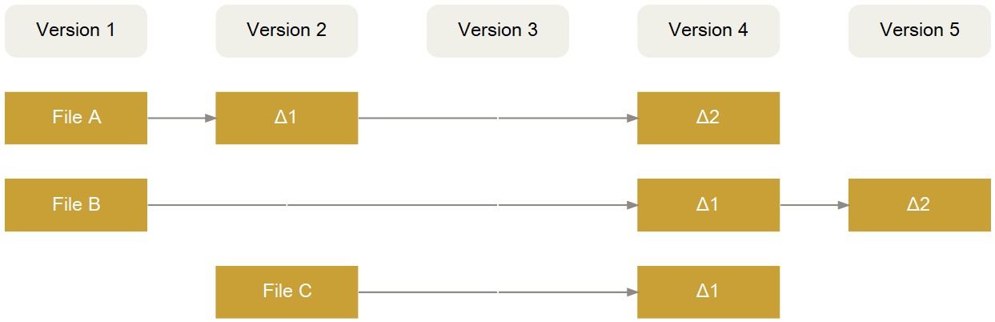
Technical background
Storing revision history
Possible:

Slide 46
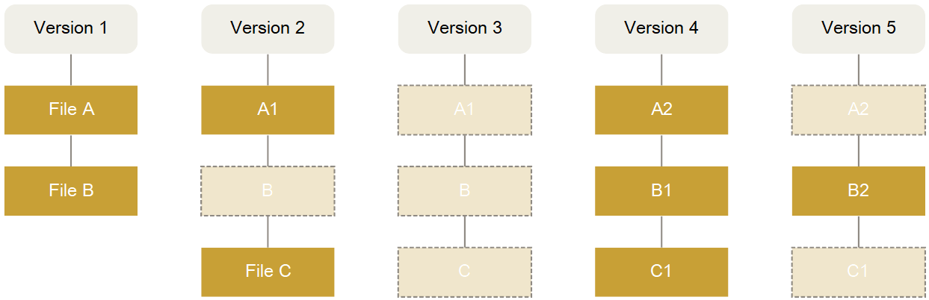
Technical background
Storing revision history
Used by Git:

Slide 47
Technical background
Objects
Repository consists of "objects" and "pointers"
Objects contain data addressed by SHA1 hash
4 object types:
  Blob
  Tree
  Commit
  Tag

Slide 48
Technical background
Commit objects
Commits contain:
  Pointers
    Corresponding Tree object
    Parent commit
  Author
  Committer
  Message

Slide 49
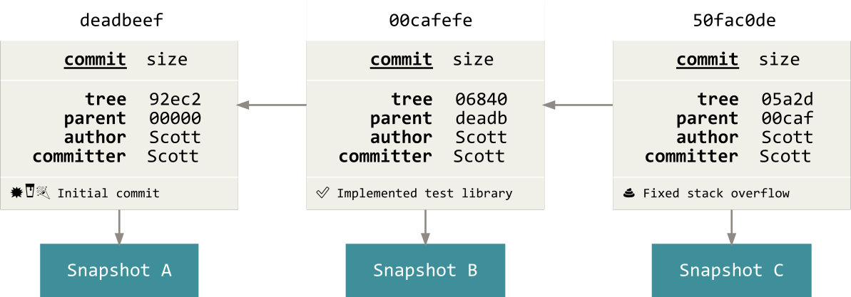
Technical background
Commit objects
Commits are linked to a directed acyclic graph

Slide 50
Technical background
Tree objects
Represents contents of a directory
Mapping between file names and object hashes
Contains pointers to:
  Tree objects (sub trees)
  Blob objects

Slide 51
Technical background
Tag objects
To mark an object as trusted by Tag creator
Contains:
  Pointer to another object
  Type of pointed object
  Tag creator
  Tag message
  Optionally GPG signature

Slide 52
Technical background
Pointers, pointers, pointers
Cumbersome to operate with SHA1 hashes
Multiple pointers in every repository
Pointers are managed automatically ususally

Slide 53
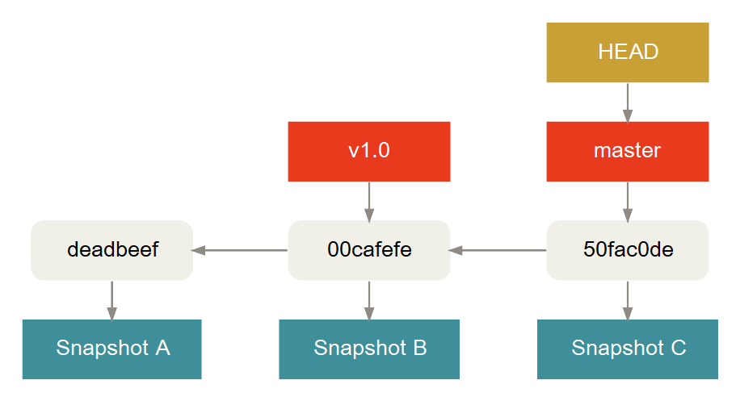
Technical background
Pointers, pointers, pointers

Slide 54
Technical background
Pointers, pointers, pointers
HEAD pointer
  "Current" object in the repository
    Directly or (usually) indirectly
  Working copy is compared against "current" object
  "git checkout" manipulates HEAD pointer

Slide 55
Technical background
Pointers, pointers, pointers
Detached HEAD pointer
  HEAD points to a branch pointer usually
  Possible to "checkout" everything, e.g. commits, tags
  All things possibly:
    Create commits
    Create branches
  Beware of making branchless commits

Slide 56
Technical background
Pointers, pointers, pointers
Branch pointer
  Points always to a commit
    Considered last commit of branch
  As many branch pointers possible as desired
  Deleting a banch pointer is trivial
    If commits are still reachable via other branch pointers
    If not:
      Deletion has to be forced
      Commits can be lost

Slide 57
Technical background
Pointers, pointers, pointers
Tag
  Object with some properties of a pointer
  Points to considered trustworthy object
  HEAD can point to it
    It is detached

Slide 58
Workflows

Slide 59
Workflows
Branching
Centralized VCSs
  Unusual
  If made, then with big caution
Decentralized VCSs
  Regulary
  Usual to have many branches
  In fact, every participant has his own branch

Slide 60
Workflows
Branching
2 extremes:
  "Master only workflow"
    Everything is made on a single branch line
  GitFlow
    Multiple eternal living branches
    Multiple short living feature branches

Slide 61
Workflows
Branching
"Master only workflow"
  Appropriate for individuals or very small teams
  If either:
    Breaking changes can be accepted
    A QA mechanism exists

Slide 62
Workflows
Branching
GitFlow
  Eternal branches
    "master": For release
    "develop": Current state
  Temporary branches
    Release branches: For stabilization
    Feature branches: For features that are implemented currently

Slide 63

Workflows
Branching

Slide 64
Workflows
Remote repositories in teams
"Blessed repository" for every project
3 common basic models:
  1 public repository that is used by everyone
  Integration manager
  Benelovent dictator

Slide 65
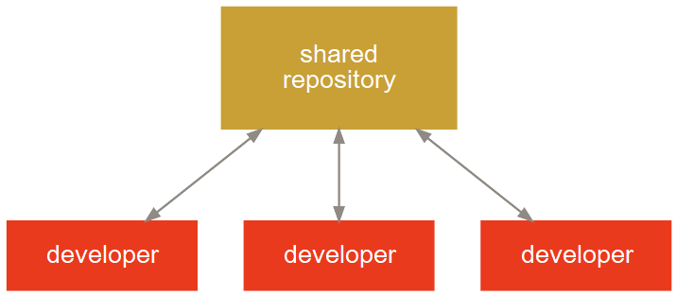
Workflows
Remote repositories in teams
Centralized:

Slide 66
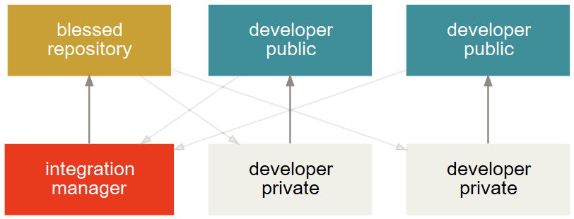
Workflows
Remote repositories in teams
Integration Manager:

Slide 67
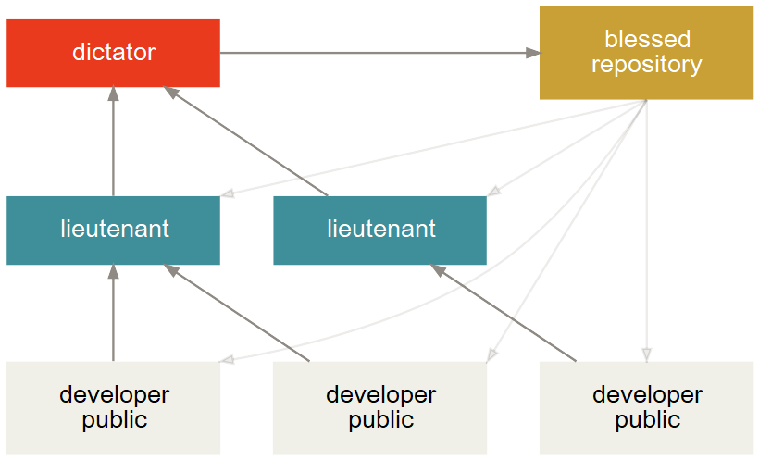
Workflows
Remote repositories in teams
Benevolent Dictator:

Slide 68
Addtional Tools
Git Extensions
  GUI for Git
posh-git
  Extension for PowerShell
BFG Repo-Cleaner
  Clean up repository history

