Slide 1
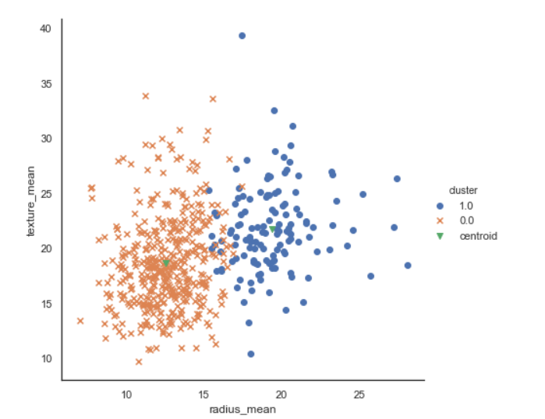
Kmeans
Number of points in cluster=438,131

Slide 2
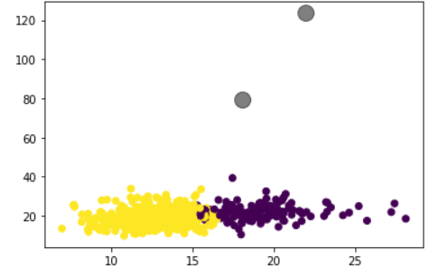
2. K medoids
Number of points in cluster: 430,139

Slide 3
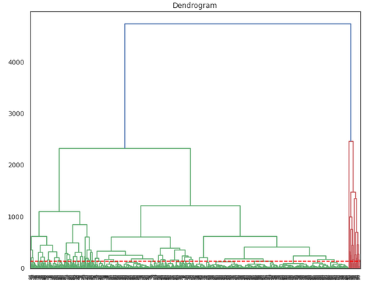
3. Hierarchical Clustering(Complete)

Slide 4
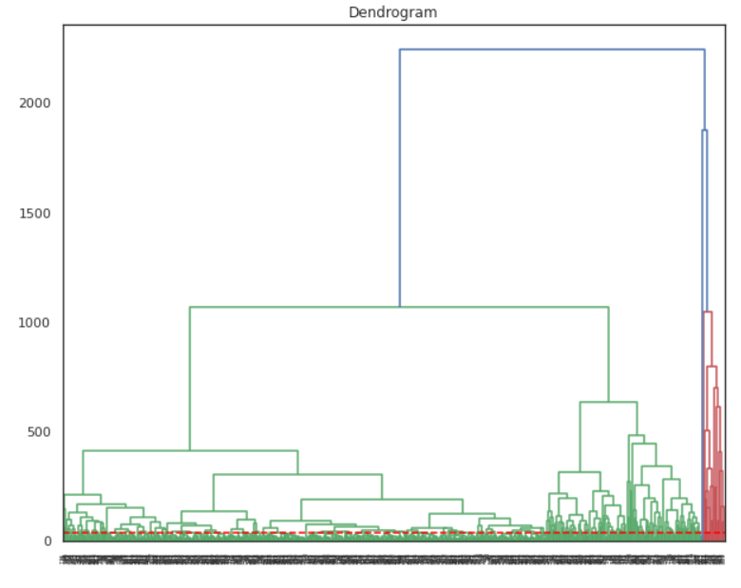
Average Linkage

Slide 5
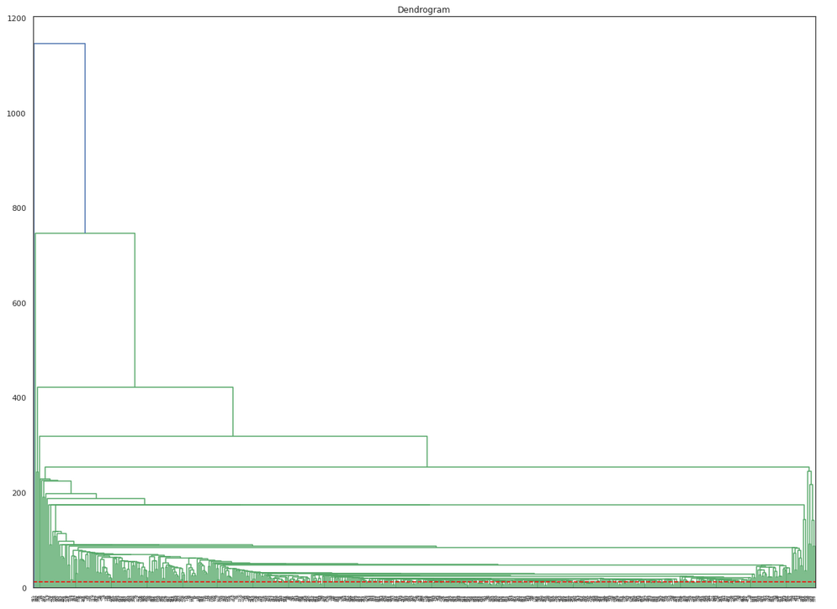
Single Linkage

Slide 6
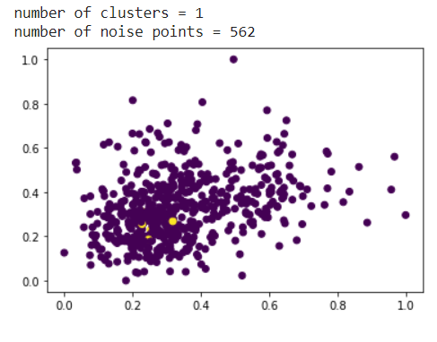
DBSCAN(Eps = 0.2, minPoints = 6)
number of clusters = 1
number of noise points = 562

Slide 7
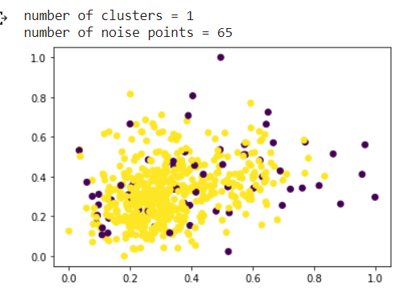
Eps = 0.5, minPonts = 6
number of clusters = 1
number of noise points = 65

Slide 8
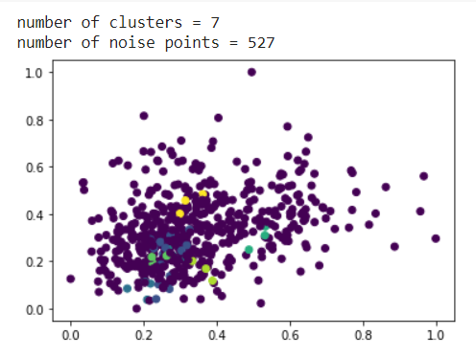
Eps = 0.2, minPoints = 3
number of clusters = 7
number of noise points = 527

