Slide 1

LIME: Breast Cancer Classification
AIX360 vs InterpretML
Presented by Philipp Scholl & Amine Ben Ayed

Slide 2
Overview
The Data
The Model
AIX360 vs InterpretML

Slide 3
The Data
The Data
Breast Cancer Wisconsin (Diagnostic) Database [1]
✓ tabular data
✓ 569 rows/instances
✓ 30 numerical attributes
✓ Digitized image of a fine needle aspirate (FNA) of a breast mass
✓ Classification, 2-class
✓ Target classes:
▪ Malignant (0) – 212 instances
▪ Benign (1) – 357 instances
Notes:
Dr. William H. Wolberg]
University of Wisconsin]
1995

Slide 4
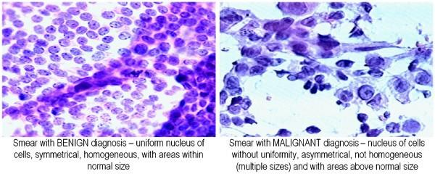
Example of an image scan [2]
The Data

Slide 5
Features (30)
The Data
For all cells on an image:
mean, standard error and worst (mean of three largest) of:
compactness
concavity
concave points
symmetry
fractal dimension
radius
texture
perimeter
area
smoothness

Slide 6
The Model
The Model
Source code from github [3]
Implemented with scikit-learn
Classification models (with test accuracy)
Random Forest (97.2%)
Neural Network (97.2%)
Support Vector Machine (95.8%)

Slide 7
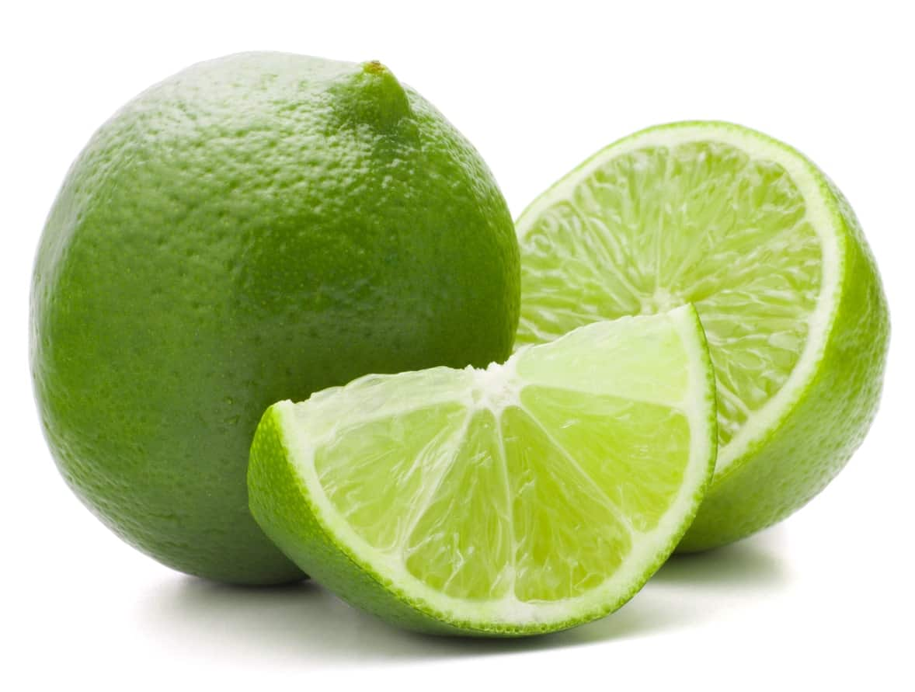
LIME: Local Interpretable Model-Agnostic Explanations
Lime

Slide 8

AIX360 vs InterpretML
Lime

Slide 9

Implementation - AIX360
Lime
Only one data row for explanation
Discretize continuous features
LIME can also be invoked directly
No difference
Notes:
Invoke via aix360 wrapper class or directly
Arguments:
Data
feature_names
class_name
discretize_continuous

Slide 10
InterpretML
Lime
Multiple data rows for explanation
No class names
Notes:
Invoke via InterpretML wrapper class
Arguments:
predict_fn
Data
feature_names
random_state

Slide 11
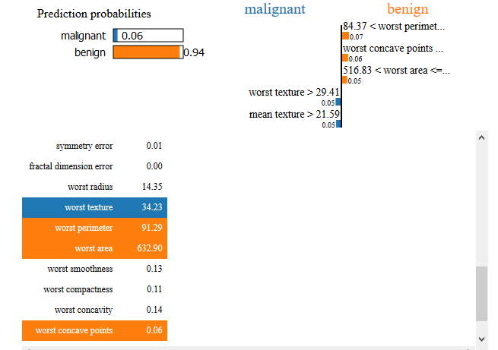
Display – AIX360
Lime
Notebook graphic
Single data row
Class names
Prediction probabilities for both classes
Explanations to long for display

Slide 12
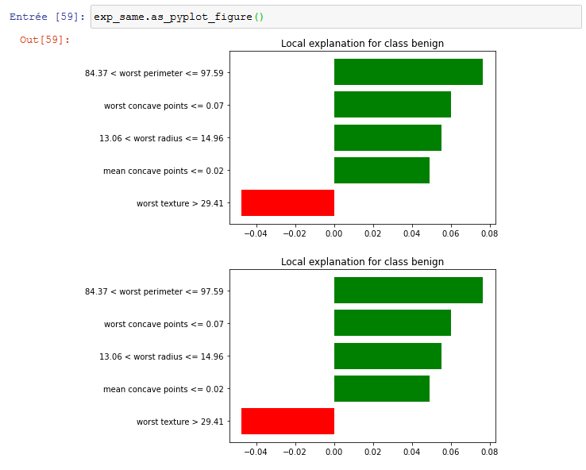
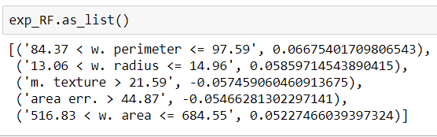
Display – AIX360
Lime
Pyplot
List

Slide 13
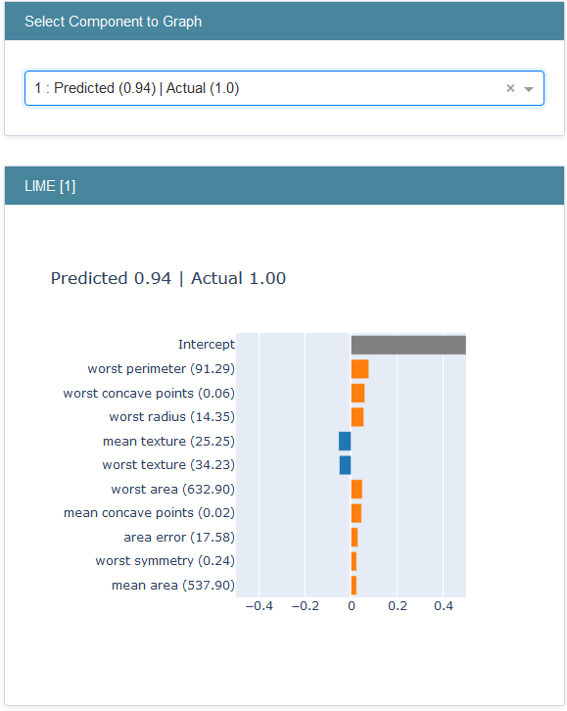
InterpretML
Lime
Multiple data rows
Shows prediction value

Slide 14
AIX360-Multiple instances
Lime

Slide 15
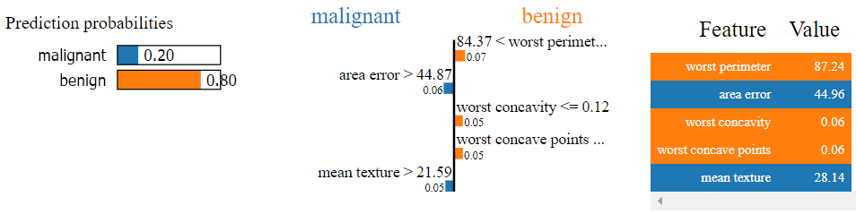
Interpretation - AIX360
Lime
Discretization of features into quartiles:
84.37 < worst perimeter <= 97.59
Quartile: ~50% ~75% (benign)
Describes behavior of local linear model

Slide 16
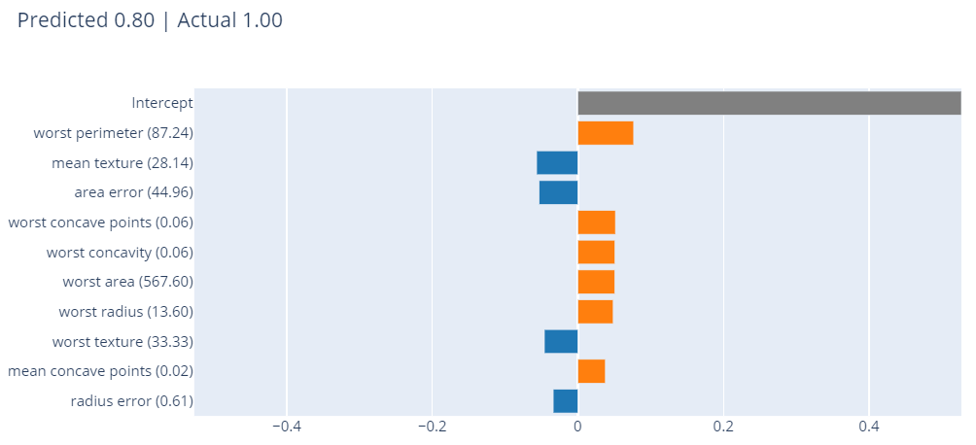
Interpretation - InterpretML
Lime
Bigger value for worst perimeter more benign?
No discretization wrong interpretation?

Slide 17
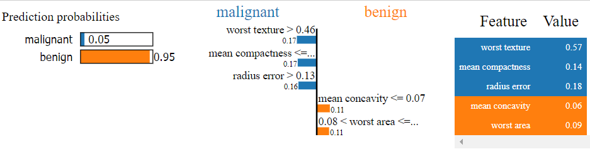
Support Vector Machine
Lime
Feature weights don’t add up
Scaled data in model training
Not useful for explanation!

Slide 18
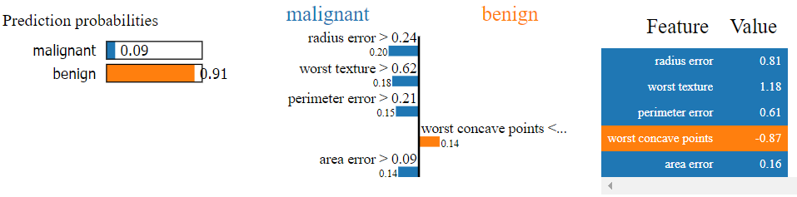
Neural Network
Lime
Negative feature values
Standardized data in model training
Not useful for explanation!

Slide 19
Our conclusion
For tabular data, AIX360 is the better tool:
More intuitive explanation
Graphically
Discretization
More output options for explanations
Better documentation (original LIME)

Slide 20

Thank you for your attention

Slide 21
Sources
[1] https://archive.ics.uci.edu/ml/datasets/Breast+Cancer+Wisconsin+(Diagnostic)
[2] https://towardsdatascience.com/knn-3-coding-our-breast-cancer-classifier-503b804988f8
[3] https://github.com/Elhamkesh/Breast-Cancer-Scikitlearn

