Slide 1
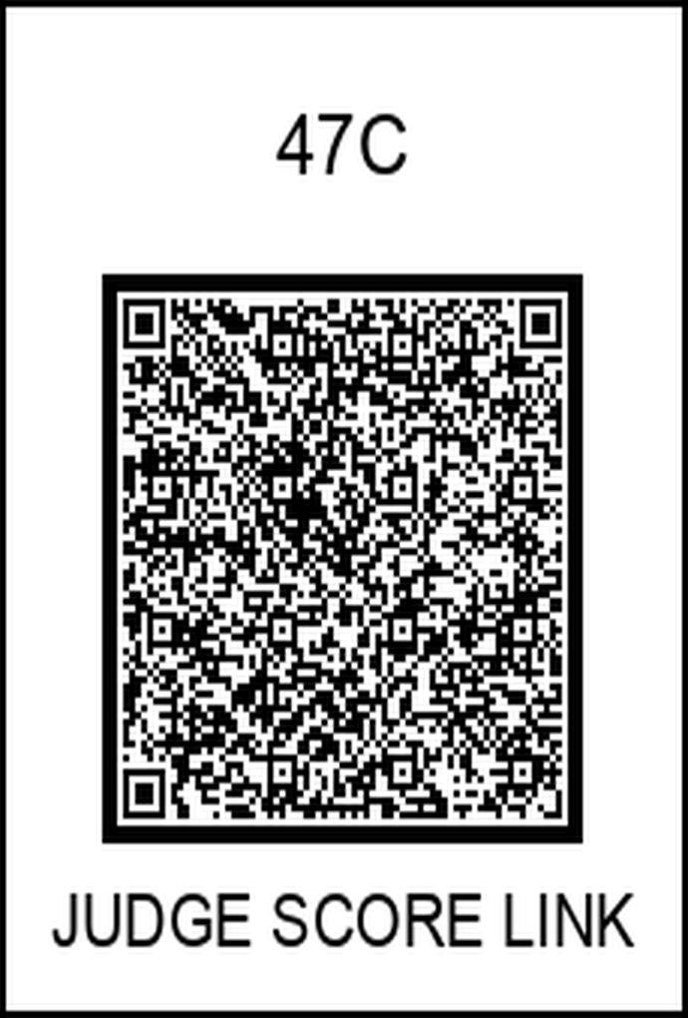
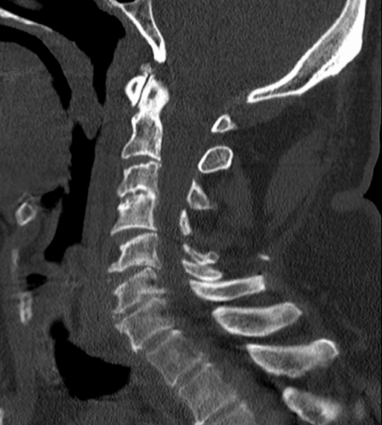
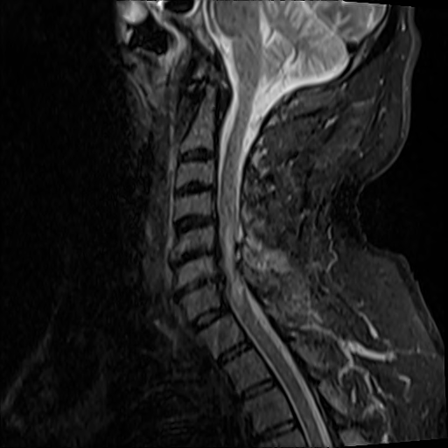
Hickam’s Dictum: A Patient Can Injure His Spinal
Cord However He Damn Well Pleases
Jon Schulze, DO, Song-Ah Baek, OMS-I
Saint Agnes Medical Center, Fresno, CA; CHSU-COM, Clovis, CA
Introduction
Imaging Findings
Discussion
Hickam's Dictum states: “A patient can have as many diseases as he damn well pleases”. SCIWORA is a spinal cord injury without radiographic abnormality (only CT/XR). Delirium Tremens is severe form of alcohol withdrawal that can have multiple presentations. Below is a case of a 58 year old male with both pathologies.
It can be challenging to evaluate patients with multiple overlapping acute pathologies. This SCI went undiagnosed for multiple reasons:
Rarity of this specific injury due to ground-level fall
Obfuscation of initial physical exam
Distrust of pt’s subjective information
Patient compliance
Search satisfaction
The rarity of this case was the most significant factor contributing to the delayed diagnosis. 58 year old men do not simply fall from ground level and injure their spinal cord, especially without a vertebral fracture. The suspected mechanism is a combination of a cord strain in a whiplash like injury, with the cord being pinched due to severe central canal stenosis, resulting in a straining force.
Case Description
A 58 year old male, with past medical history of depression and alcohol abuse, presented to the ED after a ground level fall. His trauma workup was negative other than mild facial abrasions. He was also noted to be in the early stages of alcohol withdrawal, with tremors, severe abdominal pain, nausea, and progressive hallucinations. He also had complaints of weakness and numbness of his hands and legs. Physical exam also had questionable hyperreflexia, however tremors obfuscated this finding.
After 5 days of treatment for his DT’s, his weakness and numbness persisted. He was clearly noted to be hyperreflexive at various levels, and there was growing concern for a spinal cord injury (SCI) in the cervical region. An MRI (figure 2) identified a spinal cord signal abnormality in the region of concern.
He was subsequently transferred emergently for neurosurgical intervention, and received a C4-C7 laminectomy with fusion the following day, and was discharged a few weeks later.
Figure 1: Sagittal CT - Vertebral column shows significant degenerative changes and central canal narrowing, but no fractures, dislocations, or malalignments
References
Szwedowski D, Walecki J. Spinal Cord Injury without Radiographic Abnormality (SCIWORA) - Clinical and Radiological Aspects. Pol J Radiol. 2014 Dec 8;79:461-4. doi: 10.12659/PJR.890944. PMID: 25505497; PMCID: PMC4262055.
Chuang CH, Chen PC, Bai CH, Wu YL, Tsai MC, Li CY. Association between Spinal Cord Injury and Alcohol Dependence: A Population-Based Retrospective Cohort Study. J Pers Med. 2022 Mar 16;12(3):473. doi: 10.3390/jpm12030473. PMID: 35330471; PMCID: PMC8950331.
Karsy M, Hawryluk G. Modern Medical Management of Spinal Cord Injury. Curr Neurol Neurosci Rep. 2019 Jul 30;19(9):65. doi: 10.1007/s11910-019-0984-1. PMID: 31363857.
Figure 2: Sagittal MRI/STIR - Hyperintense signal abnormality in the region of C5-C7. Increased signal in posterior neck signifying possible soft tissue injury
Notes:
CT image: shows a LACK of a fracture, dislocation, malalignment. degenerative changes are severe, but not outlandish
MR: bright signal from c5-c7. Also note the bright CSF (seen below the cerebellum), which should completely surround a health cord, as it does around C1 and T2, but that bright signal is noticeable absent around c5-c7 as well. The bright region in the posterior soft tissues hints at possible whiplash type injury.
GLF = ground level fall
“Search satisfaction is the tendency to prematurely stop searching after early findings satisfy the reader”
“Zebra Retreat bias: A reader will not make a rare diagnosis, which is otherwise supported by the available evidence due to a lack of confidence.”
https://radiopaedia.org/articles/cognitive-bias-in-diagnostic-radiology?lang=us
Obfuscation: The severe tremors made it unclear if the physical exam finding was indeed hyperreflexia, or if it was just a manifestation from the SEVERE tremors
Compliance: Pt initially refused MR, then could not tolerate, and eventually needed MR under anesthesia, which required NPO status, all delaying imaging
SCIWORA: https://www.uptodate.com/contents/spinal-cord-injury-without-radiographic-abnormality-sciwora-in-children?search=sciwora&source=search_result&selectedTitle=1%7E13&usage_type=default&display_rank=1
sciwora has mostly been described in pediatrics.
SCIWORA is a terrible name. “radiographic abnormality” does not include MR for some dumb reason. Is also only related to “abnormalities” that could “typically” lead to an SCI, so the severe degenerative changes do not count towards an abnormality, which again shows that SCIWORA is a terrible acronym.
https://pmc.ncbi.nlm.nih.gov/articles/PMC8950331/#B1-jpm-12-00473 (great article!)
https://pubmed.ncbi.nlm.nih.gov/31363857/ (another great article!)

