Slide 1

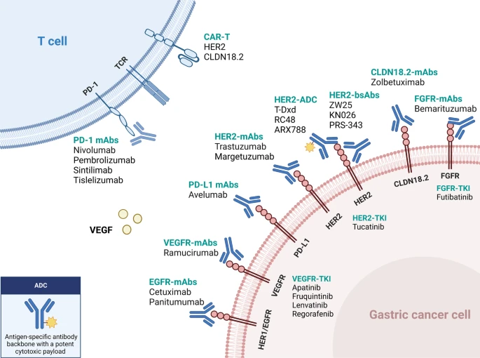
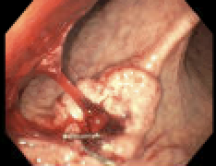



Delays in Management with Typical Case of
Gastric Adenocarcinoma: A Case Report
Sravan Vemuri, MD; Celise Ferreira, MD; Muhamad Oum, MD; Medhi Hakimipour, MD; Anupama Poliyedath, MD;
Internal Medicine Residency, Saint Agnes Medical Center, Fresno, CA
Saint Agnes Medical Center, Fresno, CA
Introduction
Discussion
Gastric adenocarcinoma (GA) remains one of the most common cancers globally with decreasing mortality rates. There is higher incidence amongst females in comparison to men. Several risk factors exist such as higher salt intake >16 g/day, ingestion of N-nitroso compounds, low dietary folate, smoking, obesity, infections, and genetic factors. Infections of GA include H. pylori and EBV. Genetic factors such as Peutz-Jeghers syndrome, FAP, GA and proximal polyposis of the stomach, Hereditary diffuse GA and Li-Fraumeni syndrome were all associated with the development of GA [4]. A study published in the Scandinavian Journal of Gastroenterology indicates that performing biopsies during emergency gastroscopy does not increase the risk of re-bleeding and facilitates early pathological diagnosis and clinical intervention. Furthermore, FIGHT trial in phase 2 evaluated combination of bemarituzumab plus mFOLFOX6 in patients led to numerically longer median progression free survival and overall survival compared to mFOLFOX6 alone. The efficacy was increased by 10% in patients with tumor cell overexpression of FGFR2b [5]. Gastric adenocarcinoma is the fifth leading cause of cancer in the world affecting females more than men with incidence higher in East Asia. We encountered an individual who presented with the pathognomonic signs and symptoms such as anemia, large volume hematemesis and melanotic stools. Upon further testing with biomarker panel, MSI, PD-L1, and TMB were positive while HER2/neu was negative. Dostarlimab and pembrolizumab not started. Lparoscopic total gastrectomy with Roux-y anastomosis and D1 + lymphadenopathy. Presented with Post-op hemoperitoneum. In addition, completed adjuvant chemotherapy. He takes cholestyramine, compazine/zofran and sucralfate. Advised to avoid raw foods while on chemotherapy, vitamin and iron supplementation as well as routine laboratory workup to prevent recurrence. Avoiding biopsy delay during his admission and bio-makers would have reduced hospital and financial resources.
Gastric cancer, or gastric adenocarcinoma, is a common cancer in the world ranking fifth amongst the cancers. Globally there were more than a million cases and 769,0000 deaths associated with gastric cancer. There was a two-fold higher incidence in females compared to men, varied by geographic area. Eastern Europe (EE) and Eastern Asia (EA) demonstrated the highest incidence rate at 13.2 and 32.5 per 100,000 females, respectively. The global cancer observatory (GLOBOCAN) reports a declining number of deaths associated with gastric cancer. According to the International Agency for Research on Cancer (IARC), gastric cancer is the second leading cause of cancer related deaths following lung cancer [1].
Figure 1: Various latest treatments in the management of gastric cancer.
Case presentation
A 54-year-old male with family history of cancer, cirrhosis and diabetes in the father, and health care deprivation for the previous 10 years, presented to the hospital on 01/26/2024 with complaints of dizziness, weakness, and melena, with onset in December 2023. He had smoked cigarettes for approximately 19 years of 0.5 pack/day. He is a painter by profession. On admission, his hemoglobin was 7.4. The patient progressed with large-volume hematemesis while in the emergency department. He also underwent emergent EGD that reported one spurting cratered gastric ulcer with a visible vessel at the incisura (Figure 2). The lesion was 15 mm by 20 mm in largest dimension. Three hemostatic clips were placed. However, no biopsy was performed at the time. Due to recurrent hematemesis, he underwent IR embolization of the left gastric artery. He was discharged on PPI and instructed to follow up with Gastroenterology for a repeat EGD in 6 weeks. A gastroenterology referral was sent on 2/6/2024 at the first post-discharge visit to establish care, however insurance delays meant EGD/colonoscopy was not able to be completed until 5/28/2024 (Figure 2b).
CT/PET scan on 07/05/2024 showed malignant stomach lesion with intense uptake. No other regional adenopathy or signs of metastases. A follow-up EGD reported a nonbleeding cratered ulcer in the gastric body over 25 mm with irregular margins. The ulcer was described as malignant appearing. Multiple biopsies were obtained. Pathology showed poorly differentiated adenocarcinoma with lymphoid stroma. A rare form of H Pylori was identified.
Figure 2a (left): Spurting gastric ulcer with a visible ulcer. Cook clips placed.
Figure 2b (right): Regular z- line., non-bleeding gastric ulcer.
The patient was referred to Oncology and General Surgery. A biomarker panel was performed, showing mismatch repairs, MSI, PD-L1, TMB, but negative HER2/neu. CT PET on 7/05 demonstrate a malignant stomach lesion with intense uptake, however, no regional adenopathy or signs of metastatic disease were observed. The patient was admitted to Surgery for total gastric resection on August 15th, 2024, followed by diagnostic lap exploration afterward and evacuation of hemoperitoneum with uneventful recovery. The operative pathology report showed poorly differentiated adenocarcinoma signet ring type, ulcerated, 8 cm in size. Additionally, it demonstrated diffuse chronic gastritis. All margins and lymph nodes were negative for malignancy. Histologic grade was G3 with 50% signet-ring cells with penetration of subserosal connective tissue, pT3 and pN0 category. The patient staged at T3 N0 M0. He started adjuvant chemotherapy in November 2024.

