Slide 1

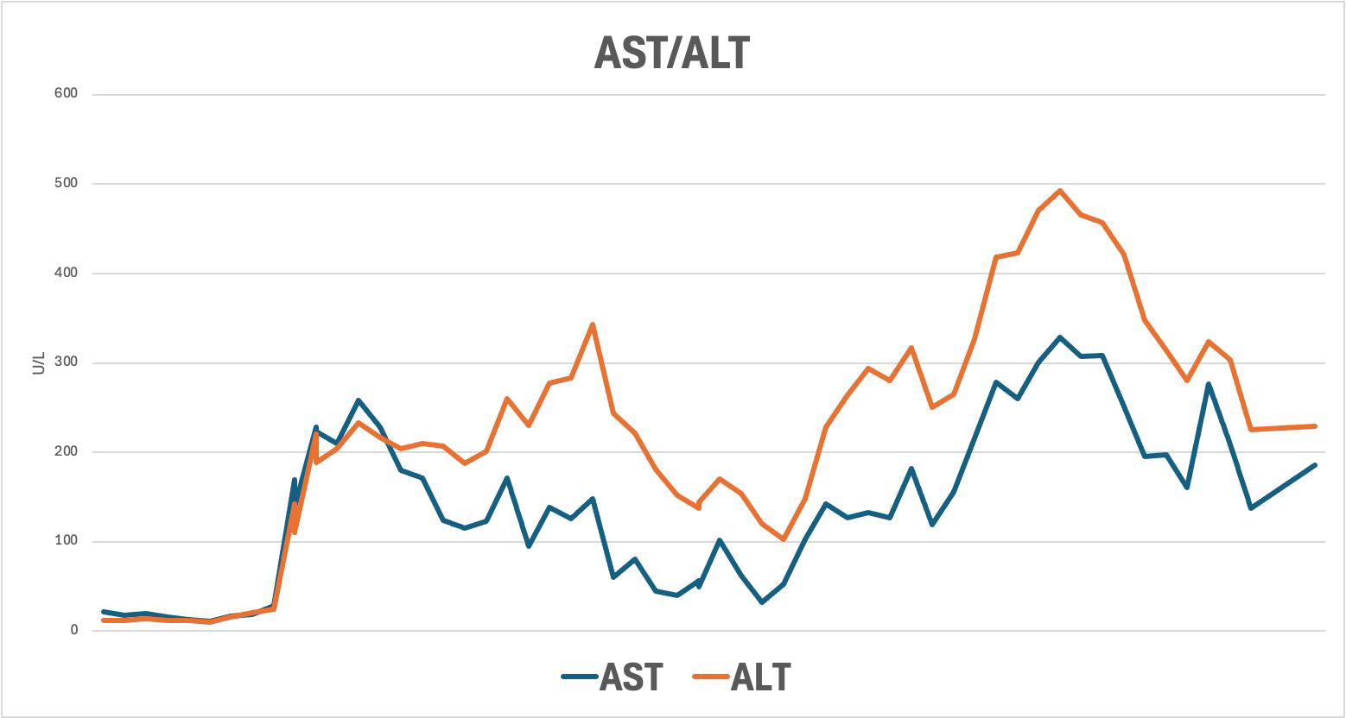
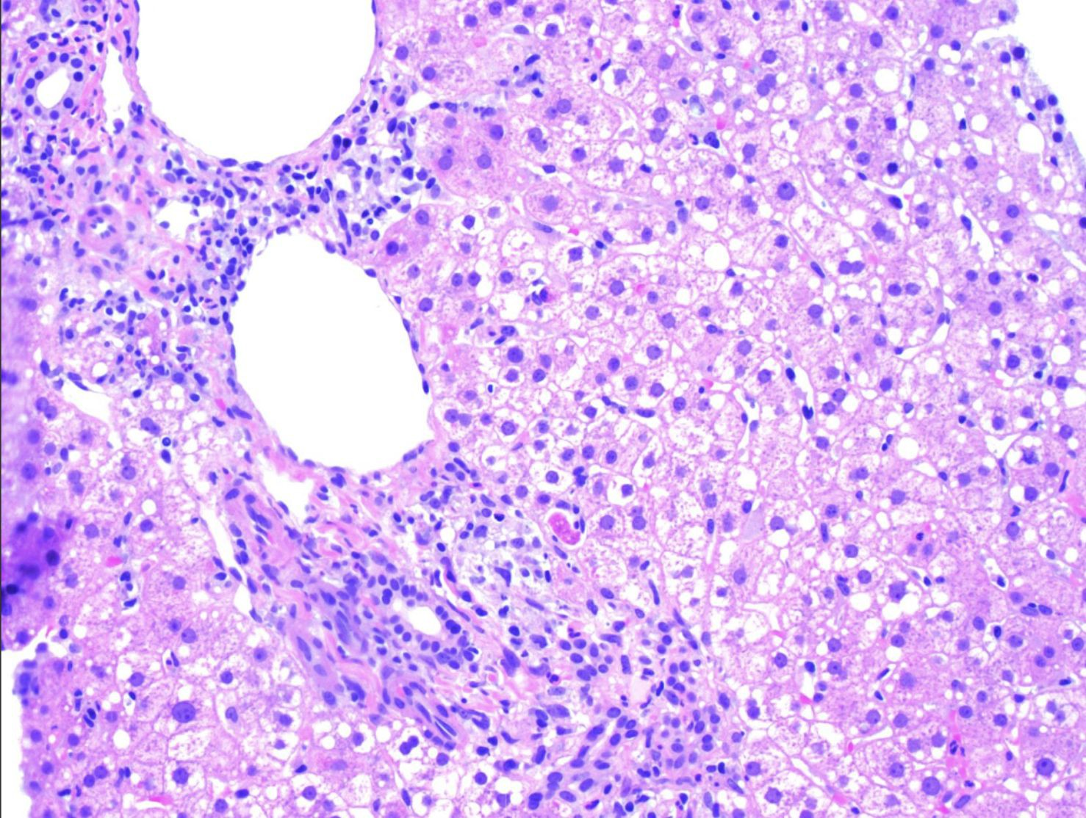
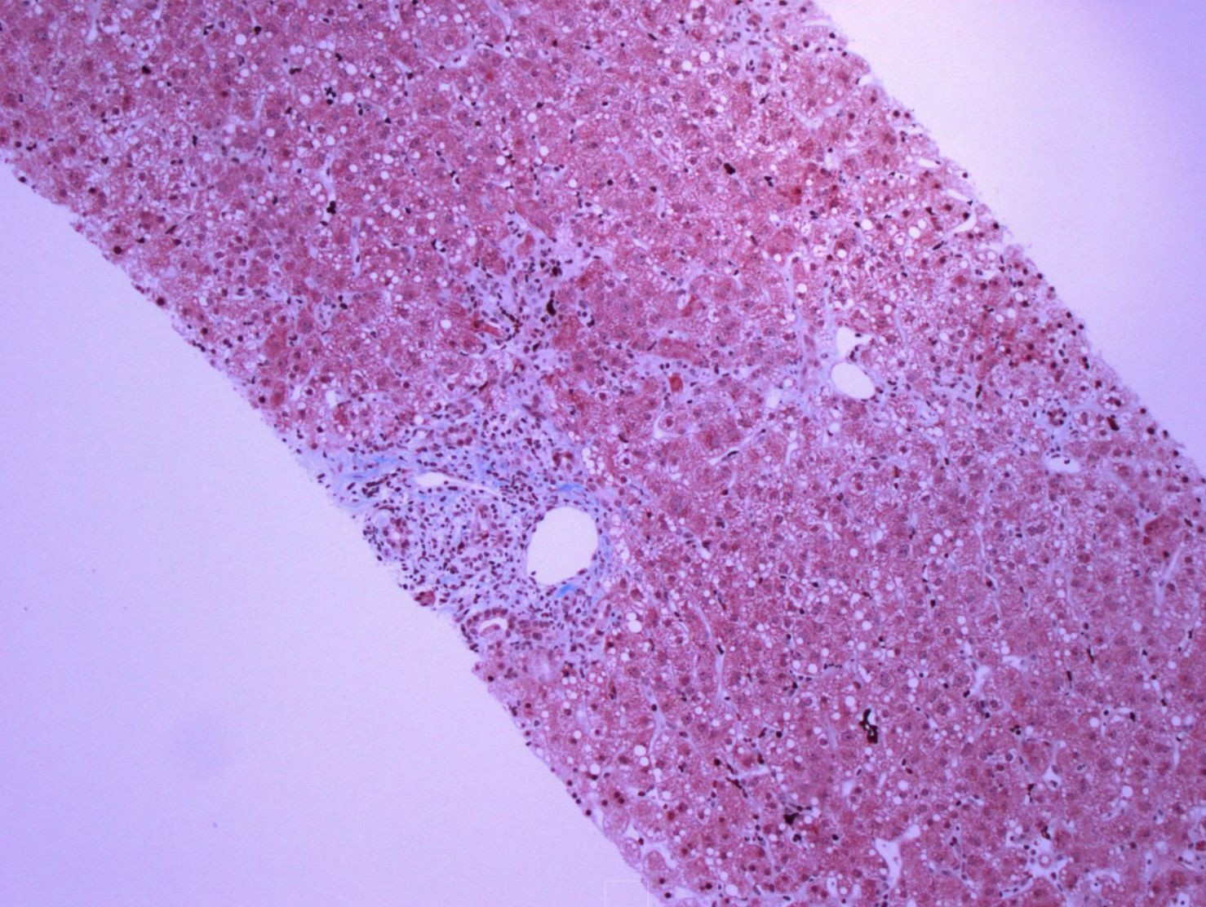
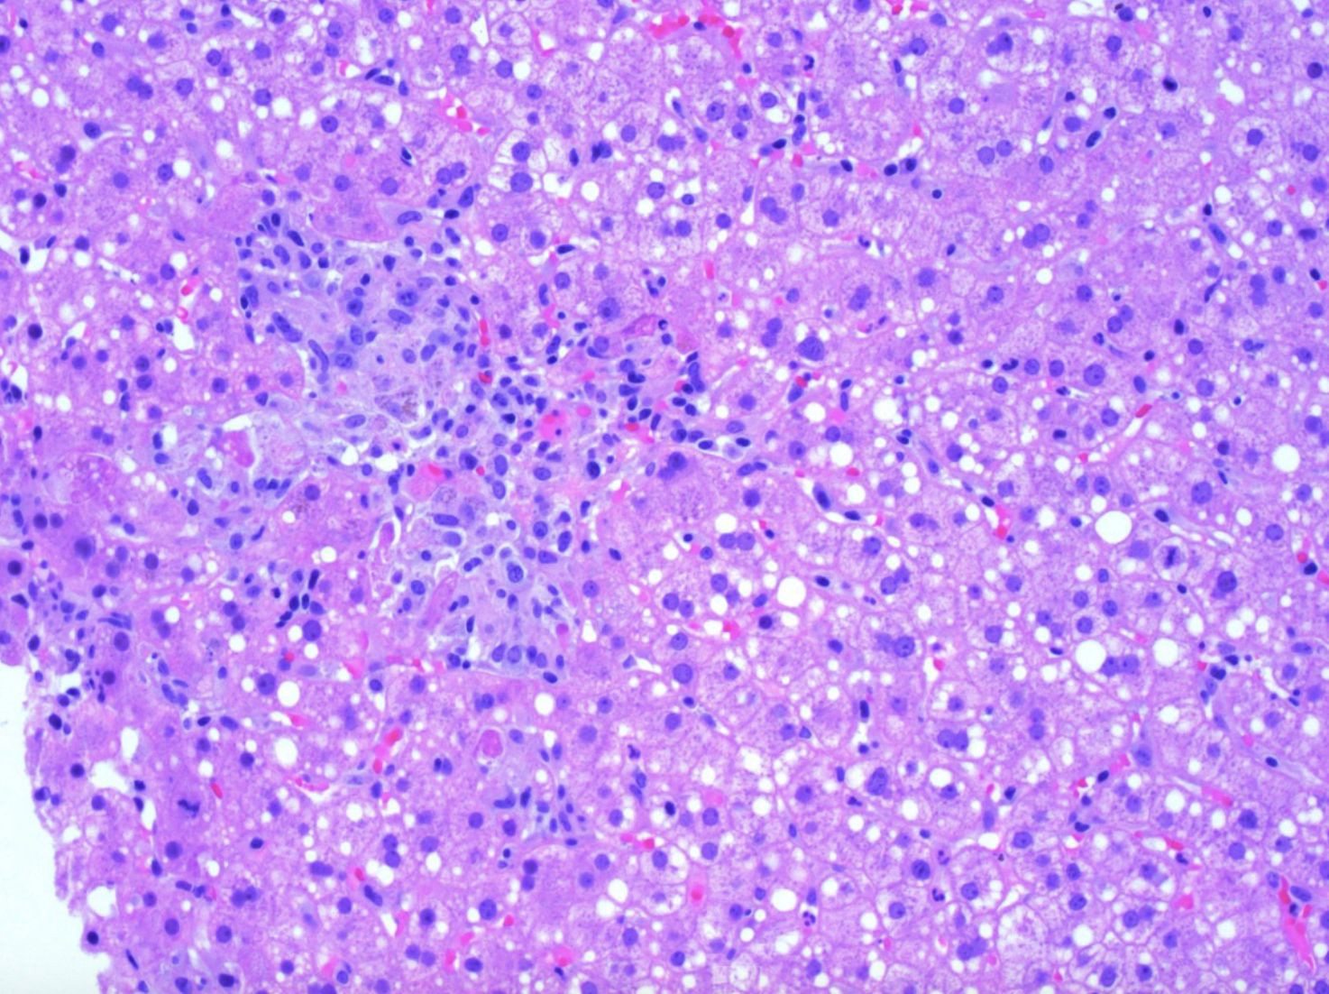
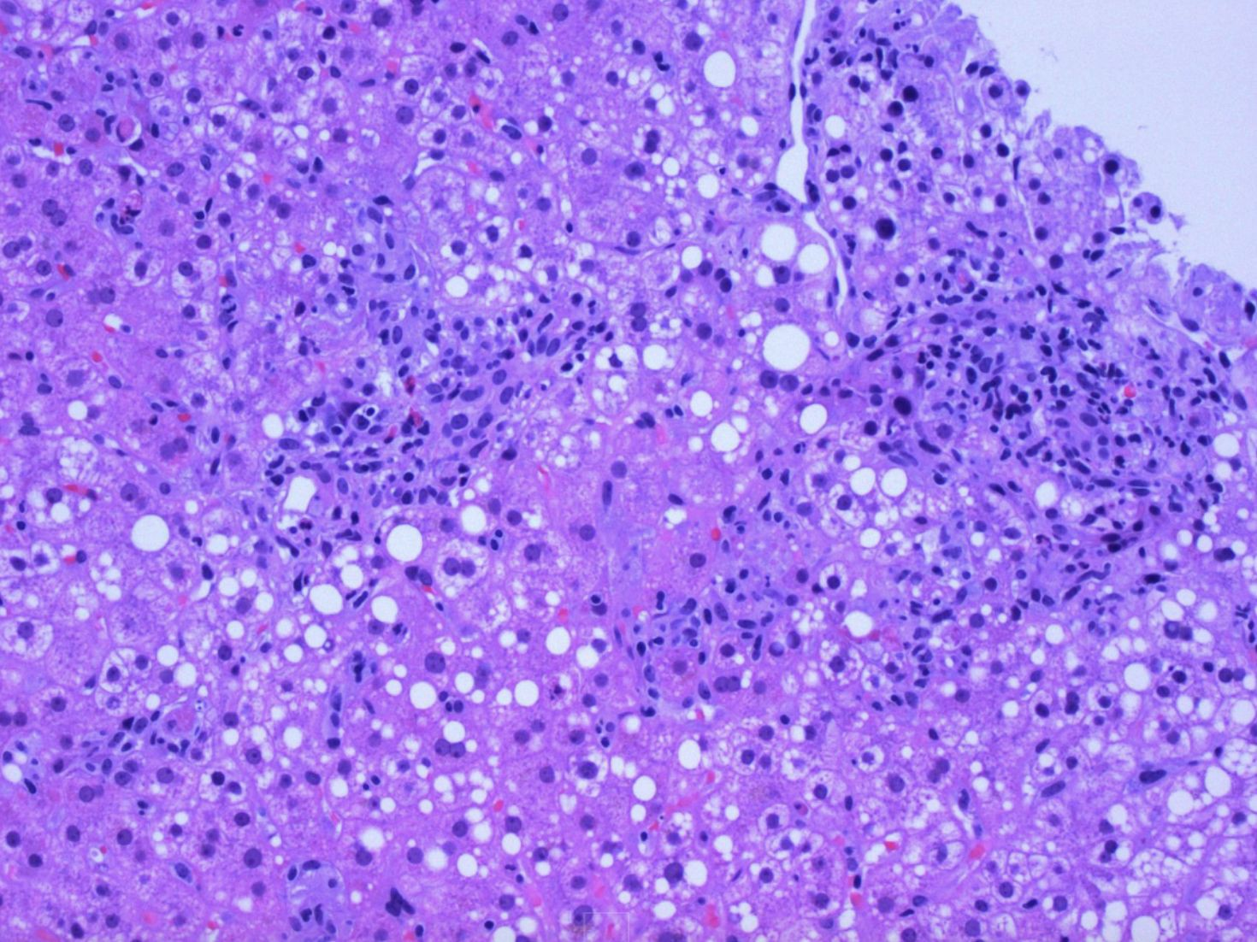
Exploring Hepatotoxicity:
A Case Report of Piperacillin/Tazobactam-Induced Liver Injury
Zunayet Karim², Alina Truong¹, Aishwarya Vemulapalli¹, Arianna Crediford², Nicholas Gill², Abdullah Kadan²
¹California Northstate University, College of Medicine, Elk Grove, CA ²St. Agnes Medical Center, Fresno, CA
Clinical Presentation & Management
We present a case of a 46-year-old female with a history of status asthmaticus presented
with tachypnea, hypoxia, and respiratory acidosis. Piperacillin-tazobactam (Zosyn) initiated for suspected RLL pneumonia noted on chest x-ray. Initial management included intramuscular epinephrine, magnesium, albuterol, CPAP, BiPAP, intravenous Solu-Medrol, and Precedex.
During her ICU stay, she developed respiratory alkalosis and oliguria, requiring hemodialysis. Laboratory results showed mildly elevated AST, ALT, and total bilirubin (see Figure 1), with imaging revealing hepatomegaly. She was treated for acute liver failure with N-acetylcysteine and received antibiotics for pneumonia. A liver biopsy suggested
drug-induced hepatic steatosis (Figure 2).
Her course was further complicated by severe oropharyngeal dysphagia, necessitating nasogastric tube (NGT) placement. She was continued on Solu-Medrol 10 mg daily and remains in physical therapy.
(a)
(c)
(c)
(b)
Figure 1 (a-c): Trends in liver function markers during hospitalization.
ALP.
Total bilirubin.
AST/ALT.
(a)
(b)
Discussion
Piperacillin-tazobactam comprises of a fourth-generation, extended-spectrum penicillin and a beta-lactamase inhibitor. Literature has previously indicated rare occurrences of idiosyncratic liver
injury in individuals who receive piperacillin, yet this antibiotic combination has not definitively linked to hepatotoxicity.
Other antibiotic combinations, most commonly amoxicillin/clavulanate, have demonstrated a relatively high number of incidences of drug induced liver injury. In general, however, research on antibiotics linked to drug-induced liver injury (DILI) is considerably restricted. Additionally, DILI often manifests in patients already experiencing liver damage, complicating efforts to establish a definitive correlation between antibiotic usage and liver injury.
This case study thus contributes to elucidating the potential exacerbation of the clinical condition of critically ill patients following administration of piperacillin-tazobactam. While acknowledged for its antimicrobial efficacy, the manifestation of adverse effects prompts critical appraisal of its utility within the intensive care setting. With limited research in this area, further investigation is warranted to better understand and mitigate the risk of liver injury associated with piperacillin-tazobactam therapy.
(c)
(d)
References
Abdullah AS. Piperacillin-tazobactam-induced cholestatic jaundice: a report of 2 cases with brief literature review. Gastroenterol Hepatol Open Access. 2018;9(2):52–53. DOI: 10.15406/ghoa.2018.09.00293
Figure 2 (a-d): Histological sections of the liver demonstrating drug-induced liver injury, characterized by hepatocellular steatosis with large vacuoles.
Park, J. H., Hong, S., Jun, D. W., Yoon, J. H., Lee, K. N., Lee, H. L., Lee, O. Y., Yoon, B. C., & Choi, H. S. (2021). Prevalence and clinical characteristics of
antibiotics associated drug induced liver injury. Annals of translational medicine, 9(8), 642. https://doi.org/10.21037/atm-20-5144

