Slide 1

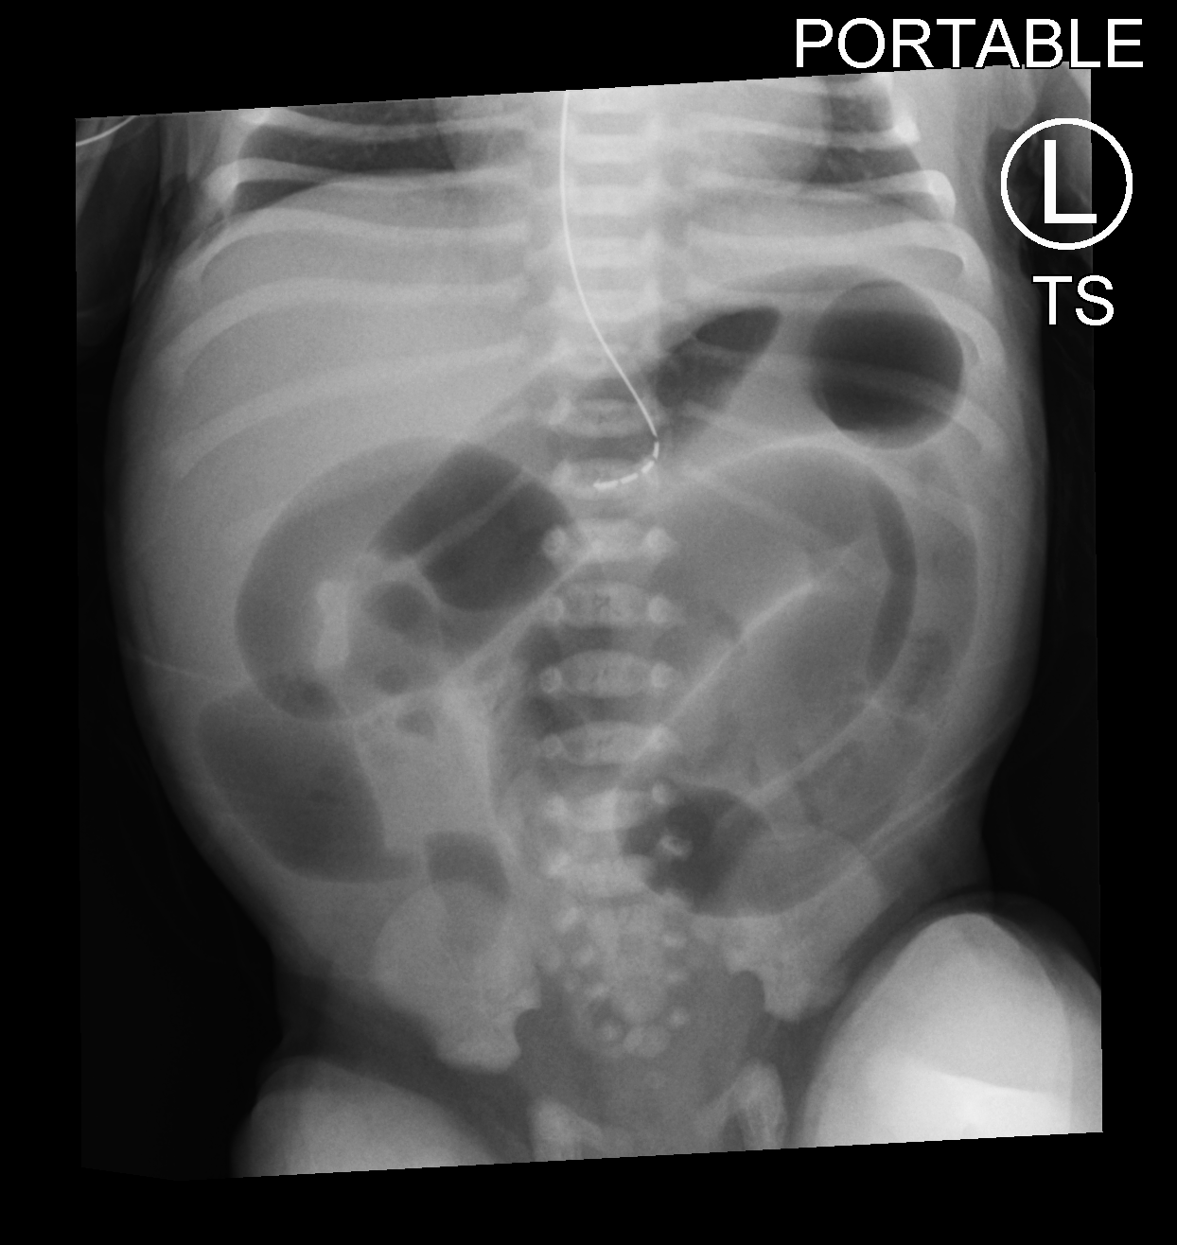
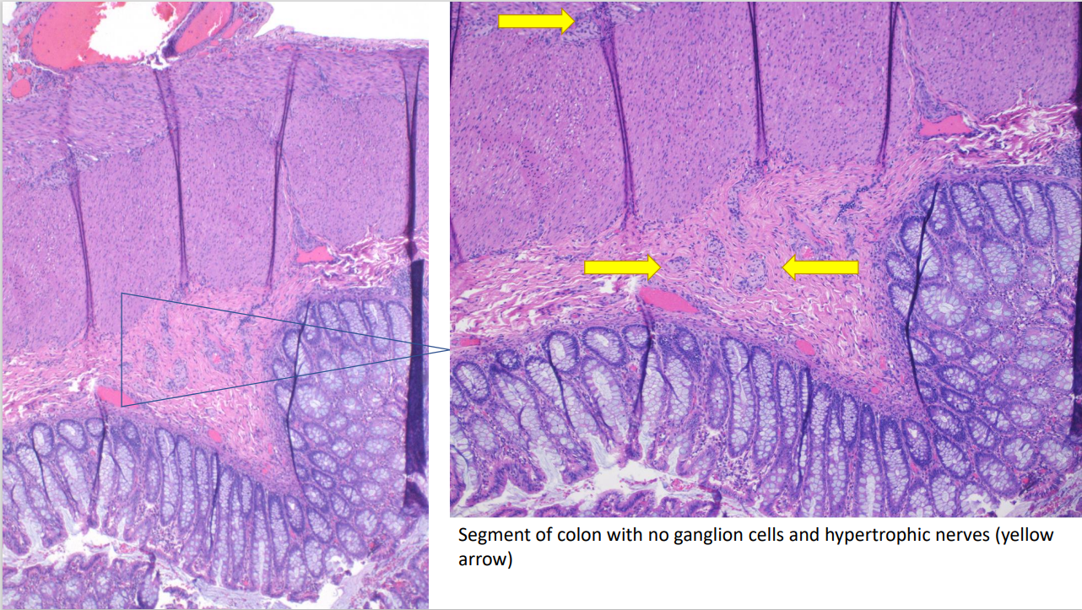
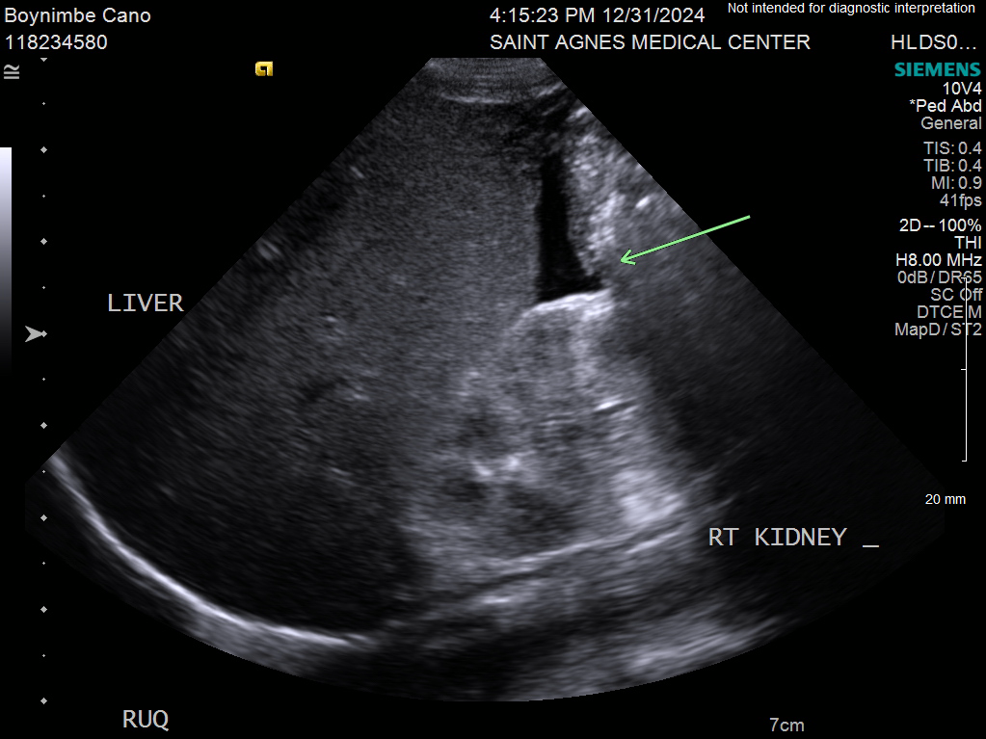
Diagnostic Challenge in Neonatal Vomiting: Case Report
Donghui Park¹, Phillip Kim¹, Cristo Salazar², Shelby Wong¹, Pulak Agrawal²
¹St. Agnes Medical Center, ²Valley Children's Hospital
Introduction
Case Presentation
Discussion
Neonatal Bowel Obstruction:
Symptoms: Constipation, nausea, vomiting, irritability, feeding intolerance.
Etiology: Ranges from benign conditions (e.g., meconium ileus) to emergent ones (e.g., midgut volvulus, Hirschsprung disease).
Importance of Timely Imaging: Crucial for early diagnosis and treatment.
Hirschsprung Disease (HD):
Cause: Absence of ganglion cells in Auerbach’s and Meissner’s plexus in the terminal rectum.
Leads to: Constipation and intestinal obstruction.
Diagnosis: Confirmed by rectal biopsy, showing absence of ganglion cells in the submucosa and muscularis of the terminal rectum.
Case Report Highlights:
Patient: Neonate born to a mother with antenatal microcytic anemia.
Condition: Diagnosed with small bowel obstruction, later confirmed as Hirschsprung disease.
Discussion Points:
Association between antenatal conditions and neonatal bowel obstruction.
Importance of early imaging for proper diagnosis and timely intervention.
A full-term male neonate, born via normal spontaneous vaginal delivery to a 27-year-old mother with antenatal microcytic anemia, presented at 24 hours of life with bilious vomiting and an inability to pass stool. The mother's pregnancy was otherwise unremarkable, with a normal NIPT screen, though she did develop microcytic anemia in the 2nd trimester, without obvious blood loss or malabsorption. Initial Apgar scores were 8 and 9 at 1 and 5 minutes, respectively. Physical examination revealed a distended abdomen and decreased bowel sounds.
Bowel sounds were present until 1600 of Day 1, and abdominal ultrasound (Figure 1) was performed to rule out midgut volvulus with malrotation. Imaging showed nonspecific ascites, the whirlpool sign was absent. No bowel sounds heard when examined bedside at 1700, NICU was consulted. An NG tube was placed to decompress the bowel, and subsequent Abdominal X-ray (Figure 2) showed dilated small bowel loops. The newborn was transferred to the NICU of Valley Children’s Hospital for further workup and possible surgical intervention.
Neonatal Bowel Obstruction:
Encompasses a variety of pathologies with varying imaging findings depending on obstruction location.
Timely imaging and decision-making are crucial to avoid long-term impairment of the patient's quality of life.
Bowel obstruction patterns in neonates may be atypical, requiring advanced studies like barium enemas.
Imaging Findings in the Case:
Initial imaging showed diffuse bowel dilatation, suggesting small bowel atresia.
Absence of a whirlpool sign on ultrasound reduced suspicion for midgut volvulus.
Ascites, polyhydramnios, and intrauterine volvulus were not present antenatally, adding to diagnostic confusion.
Maternal Factors:
The mother had iron deficiency anemia (hemoglobin 9.9 g/dL at 24 weeks gestation).
Severe anemia can negatively affect fetal development.
Iron is critical for the development of the enteric nervous system (ENS), which controls gut motility.
Potential Link Between Iron Deficiency and Hirschsprung's Disease:
Maternal iron deficiency could impair neural crest cell migration and differentiation, potentially leading to aganglionosis in the distal colon, characteristic of HD.
Further research is needed to explore the relationship between maternal anemia and HD, including the effects of iron deficiency on ENS development and the genetic mechanisms involved.
Clinical Implications:
The case highlights a diagnostic gap and calls for further investigation into treatment strategies for neonatal bowel obstruction, particularly in the context of maternal health.
Final Diagnosis:
The neonate was diagnosed with Hirschsprung's Disease (HD) after appropriate surgical intervention.
Ganglion cells were found in the proximal colon, but absent distally, confirming HD.
Figure 2. Abdominal X-Ray. Obtained after a NG tube insertion. There is dilatation of the stomach and multiple small bowel loops without definite evidence of significant gas within the colon.
Figure 3. Rectal suction biopsy showing absence of ganglion cells in the distal segment of colon and hypertrophic nerves (yellow arrows)
References
Figure 1. Abdominal Ultrasound of the Right Upper Quadrant. Targeted sonographic evaluation of the abdomen demonstrates a small amount of ascites
Available upon request

