Slide 1

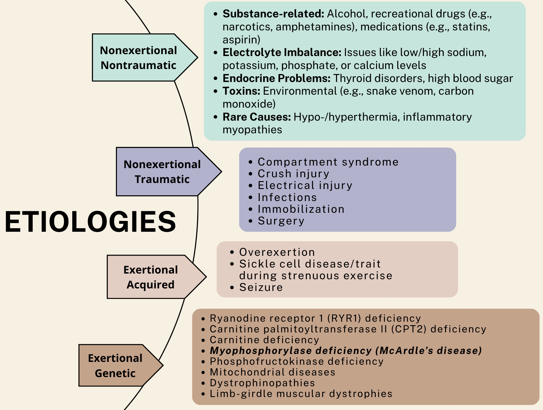
Importance of Genetic Testing In Exertional Rhabdomyolysis To Rule Out McArdle Disease
Ronald Roque, MD, Maria Abeysekera, MD, Phillip Kim, MD
Saint Agnes Medical Center-Fresno, Department of Family Medicine
INTRODUCTION
DISCUSSION
Glycogen Storage Disease Type V (McArdle disease) is rare inherited disorder characterized by a lack of the enzyme myophosphorylase. This enzyme is essential for the breakdown of glycogen in skeletal muscle, and its deficiency leads to impaired energy production during anaerobic activity.
Symptoms of McArdle disease often emerge during teenage years or early adulthood and commonly include difficulty tolerating exercise, muscle cramping, rapid fatigue, and dark urine (myoglobinuria) after intense physical activity. Although the condition is non-progressive, it can significantly limit physical activity and affect quality of life. Diagnosis is often delayed due to symptom overlap with other neuromuscular disorders, and is confirmed through genetic testing or muscle biopsy demonstrating absent myophosphorylase activity.
This report highlights a case of a 24-year-old woman with a background of polycystic ovary syndrome (PCOS) who experienced bilateral thigh and lower back pain following a vigorous cycling session, accompanied by hematuria, leading to possible diagnosis of Glycogen Storage Disease Type V.
McArdle disease results from mutations in the PYGM gene, leading to a deficiency of myophosphorylase—an enzyme essential for glycogen breakdown in muscle. Genetic testing is critical for diagnosis and management, particularly given the disease’s phenotypic variability and its frequent misdiagnosis.
Historically considered rare, McArdle disease was estimated to affect approximately 1 in 100,000 individuals. However, recent advances in next-generation sequencing have challenged this view. Studies by Castro et al. and Nogales-Gadea et al. demonstrated that analysis of pathogenic variants in the PYGM gene suggests a significantly higher prevalence, possibly around 1 in 50,000, with many cases remaining undiagnosed under current clinical practices. Similarly, Santalla et al. highlighted a growing number of reported cases despite prolonged diagnostic delays, further supporting the likelihood of underdiagnosis in traditional epidemiological models.
Despite its importance, genetic testing is not routinely performed in all rhabdomyolysis cases. It is typically reserved for patients with suggestive clinical features—such as recurrent or unprovoked episodes, or a family history of muscle disorders. In specialized centers, genetic testing is employed in roughly 30% of such cases. However, in general practice, where most rhabdomyolysis is attributed to trauma, drug use, or intense physical activity, the use of genetic testing remains limited. Although spinning-induced rhabdomyolysis is increasingly recognized, it is estimated to account for less than 5% of all exertional rhabdomyolysis cases.
Another notable challenge in McArdle disease is the significant diagnostic delay. Despite symptoms usually beginning in childhood, diagnosis is often not made until adulthood. The median age of diagnosis is around 33 years.This delay emphasizes the gap between symptom onset and clinical recognition.
CASE
CONCLUSION
24-year-old female with a history of PCOS who came to the ED with bilateral thigh pain and back pain after an intense cycling class, with gross hematuria. Two days later, she developed shortness of breath and nausea. Personal, social, and family history were unremarkable. At ED, she was conscious, coherent, and appeared well hydrated. Tenderness on palpation of proximal muscles of the lower extremity. Vital signs were stable. Diagnostics were notable for:
Creatine kinase (CK): 84,177 U/L
Aspartate aminotransferase (AST): 880 U/L
Alanine aminotransferase (ALT): 219 U/L
Urinalysis: proteinuria & hematuria
She was admitted for Exertional Rhabdomyolysis.
Patient was initially placed on a sodium bicarbonate drip with D5W running at 150 cc/hr, but her CK increased to over 100,000 U/L. Hydration rate was increased to 250 cc/hr, after which CK levels began to downtrend.
She was subsequently discharged with a diagnosis of Exertional Rhabdomyolysis and advised to maintain oral hydration.
In the outpatient setting, her repeat creatine kinase was normal. There was suspicion of genetic disorder on further review of family history. To rule out other causes of rhabdomyolysis, genetic testing was ordered which was positive for a PYGM gene related to Glycogen Storage V Disease. The patient was then referred to a physical therapist, geneticist, and neurologist for further management.
This case underscores the importance of considering inherited metabolic disorders, such as Glycogen Storage Disease Type V (McArdle disease), in patients presenting with exertional rhabdomyolysis—particularly in the absence of trauma, substance use, or other common triggers. Although often underdiagnosed due to symptom overlap with more prevalent conditions, early recognition and genetic confirmation can significantly alter the clinical course by enabling appropriate activity modification, patient education, and specialist referral.
As demonstrated in this case, prompt hydration and supportive management can lead to recovery, but long-term outcomes are optimized when the underlying etiology is addressed. Increased clinical awareness and more widespread use of genetic testing in select cases of rhabdomyolysis may reduce diagnostic delays and improve patient outcomes.
REFERENCES
DiMauro S, Haller RG. Muscle glycogenoses: an overview. Acta Myol. 2012;31(3):228–33.
Quinlivan R, Buckley J, James M, et al. McArdle disease: a clinical review. J Neurol Neurosurg Psychiatry. 2010;81(11):1182–1188.
Elghobashy M, et al. Genetic diagnosis in late-onset McArdle disease. Front Neurol. 2025;16:123456.
Castro-Gago M, et al. Prevalence of McArdle disease through genetic analysis. Mol Genet Metab. 2015;114(4):424–428.
Nogales-Gadea G, et al. Undiagnosed McArdle disease in population-based cohorts. Neurology. 2015;85(7):576–578.
Voermans NC, et al. Genetic testing in rhabdomyolysis. J Neurol. 2024;271(1):15–24.
Cutler TS, et al. Spinning-induced rhabdomyolysis: a review. Am J Med. 2016;129(5):484–487.
Scalco RS, et al. Diagnostic timeline in McArdle disease. Muscle Nerve. 2017;55(5):659–662.
El-Sadi F, Izenberg A. Rhabdomyolysis: A practical approach to diagnosis and management. Practical Neurology. 2019;19(10):34–37.

