Slide 1

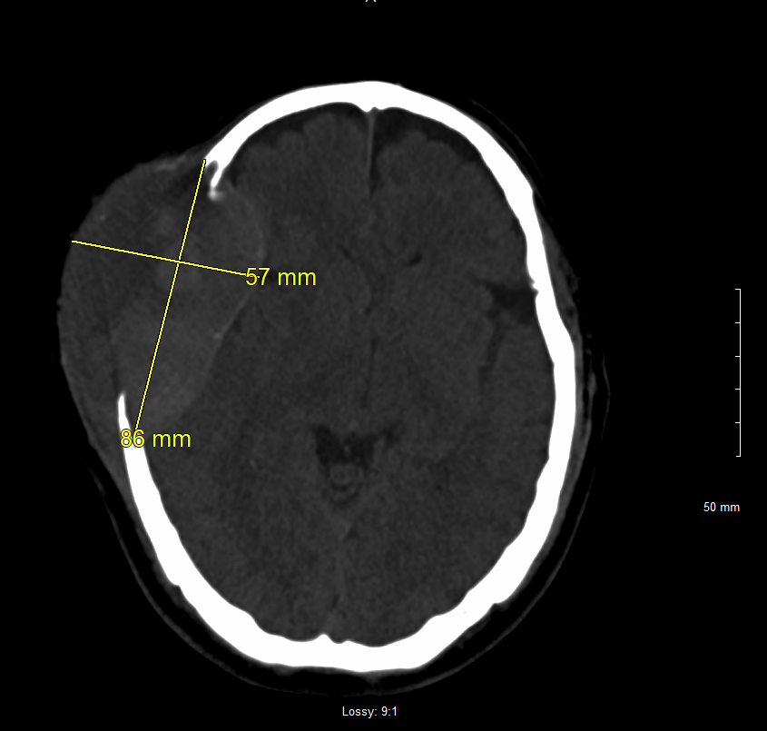
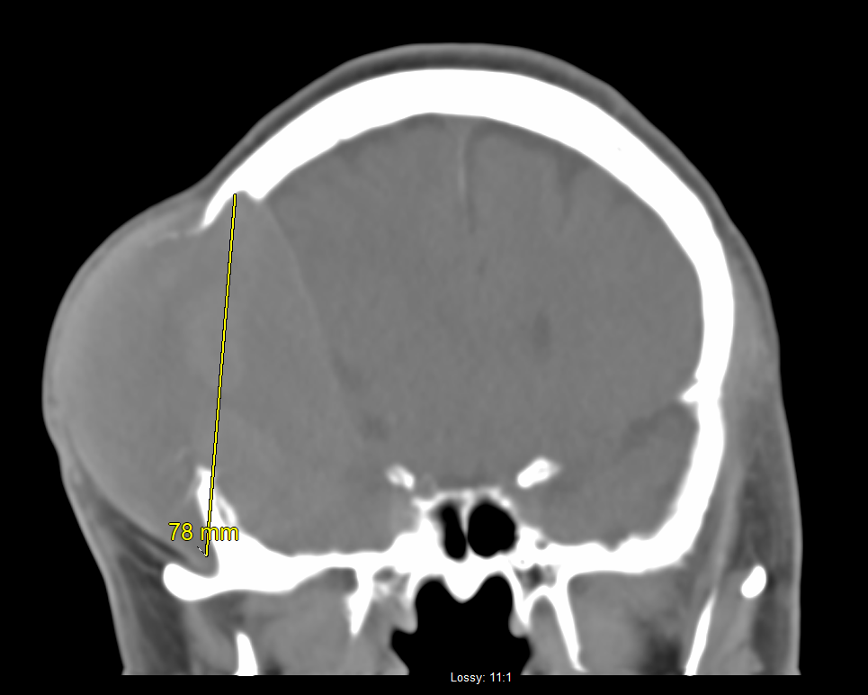
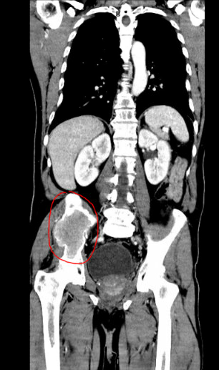
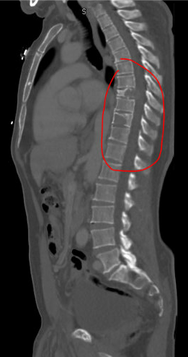
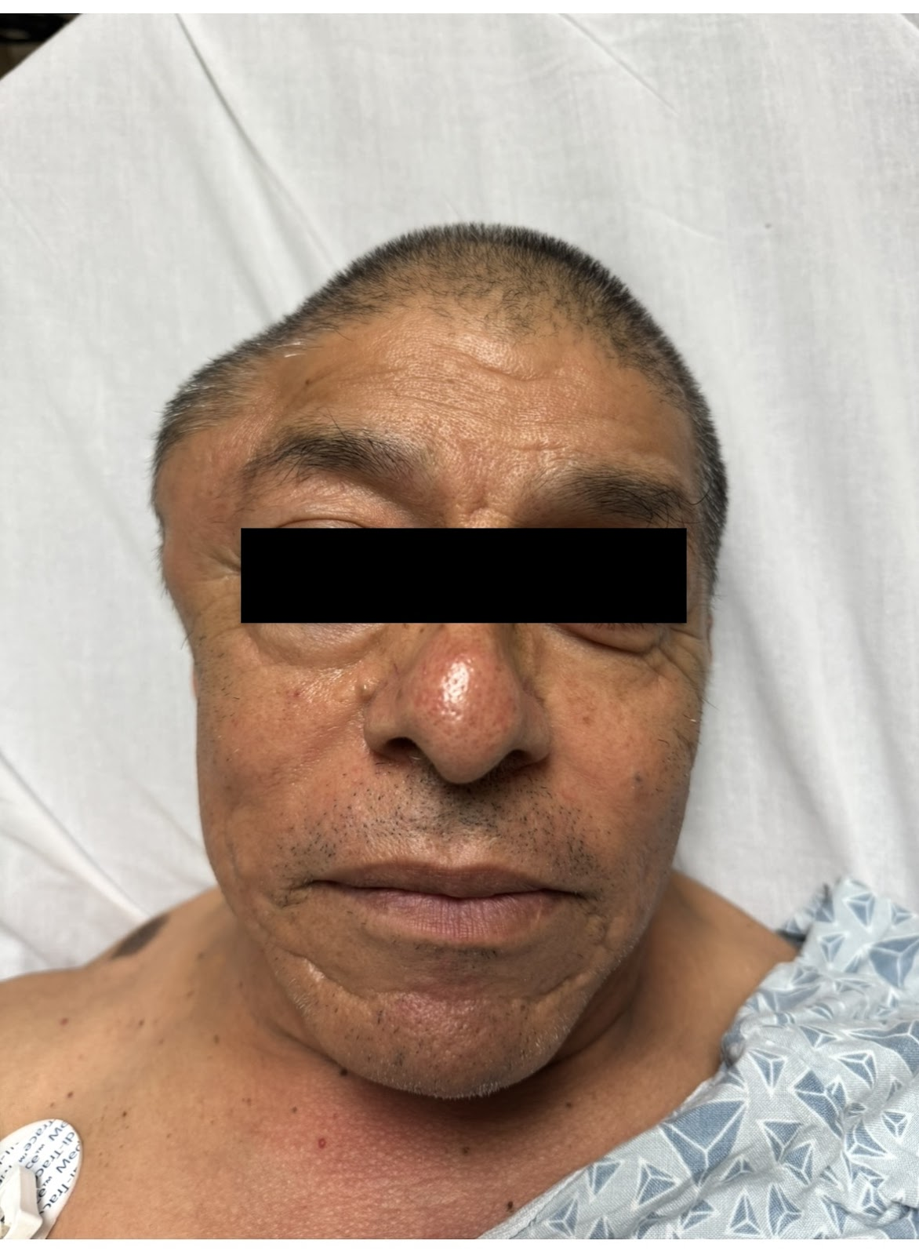

A Rare CNS Presentation of Extramedullary Multiple Myeloma
Sriram Cherukupalli, DO, MS¹; Nikita Chalaka, DO¹; Monica Le², BS; Ruqayya Gill, DO¹; Mark Krel, DO, MPH, FACS, FCNS³
Saint Agnes Medical Center¹, California Health Sciences University², Community Neurosciences Institute³
Introduction
Hospital Course
Multiple myeloma is a malignant plasma cell disorder characterized by the clonal proliferation of plasma cells within the bone marrow, leading to multisystemic organ damage [1]. Patients with multiple myeloma may present with nonspecific symptoms but can also be asymptomatic and exhibit the common tetrad of laboratory abnormalities defined by the CRAB criteria: hypercalcemia, renal impairment, anemia, and bone lesions [1-3]. This report presents a rare case of extramedullary multiple myeloma manifesting as a scalp mass, a presentation seldom described in the literature.
Initial labs in the Emergency Department were notable for pancytopenia, with a macrocytic anemia, as well as hypercalcemia.
CT head (Figure 1) demonstrated a large (> 8 cm) heterogenous mass in the right calvarium causing a 7 mm leftward midline shift.
Patient was transferred to Community Regional Medical Center in Fresno, CA for neurosurgical services where additional imaging studies and labs were done.
CT Chest Abdomen pelvis (Figure 2) showed 1) an ill-defined 1.6 x 0.7 cm masslike endobronchial thickening in the left mainstem bronchus, 2) a large osseous mass with periosteal reaction in the right ilium, and 3) lytic lesions at T10 and T7 vertebral bodies with a pathologic fracture of the T7 vertebral body.
MRI Brain showed a large extra-axial calvarium based mass with periosteal involvement in the right frontotemporal lobe with significant mass effect on the underlying cortex and a 7 mm midline shift to the left. The mass also extended into the right lateral orbital wall with associated mass effect on the right lateral rectus.
MRI Cervical Spine showed multiple small marrow-replacing lesions and an expansile lesion of C7 which contacted the cord.
MRI Thoracic Spine (Figure 3) showed extensive osseous metastatic disease with 1) an expansile lesion in the T8 vertebral body, 2) epidural extension anteriorly contributing to spinal canal stenosis with mass effect upon the cord at T8, 3) a mildly expansile lesion in the right T7 vertebral body, and 4) an expansile lesion partially visualized at the C7 vertebral body with cord encroachment.
MRI Lumbar Spine demonstrated extensive osseous metastatic disease involving the lumbar spine and a partially visualized expansile mass involving the right iliac bone.
Labs were significant for elevated IgA and continued to demonstrate hypercalcemia, which was treated with calcitonin, and a macrocytic anemia.
A core biopsy of the expansile right iliac lytic mass was positive for a plasma cell neoplasm and the patient was ultimately diagnosed with multiple myeloma. In the setting of extensive, multifocal disease, surgical intervention was not pursued due to limited anticipated benefit.
Back at Saint Agnes Medical Center, treatment was started with Bortezomib, a proteasome inhibitor used to treat multiple myeloma, and Dexamethasone, a corticosteroid. A bone marrow biopsy was also done. The patient was subsequently discharged from the hospital with outpatient oncology follow up.
Figure 1. CT head without contrast demonstrating an 8 cm heterogenous mass in the right calvarium with a 7 mm leftward midline shift at the foramen of Monro.
Patient Presentation
A 47-year-old male with no significant past medical history presented to the Saint Agnes Medical Center Emergency Department due to swelling to the right side of his head which he first noticed 3 months prior. He also reported some unsteadiness while ambulating for the past month.
Figure 2. Osseous mass with periosteal reaction in the right ilium seen on CT.
Figure 3. MRI thoracic spine
Discussion
On physical exam, the patient had a fluctuant mass to the right side of his scalp, as pictured on the right. He also appeared to have a limp while ambulating. No other focal neurologic deficits were noted.
This case highlights the uncommon initial presentation of multiple myeloma (MM) as a solitary, painless mass accompanied by mild gait instability. Although MM is primarily a bone marrow-based plasma cell neoplasm, approximately 0.5% to 4.8% of cases present with extramedullary disease, with a higher incidence reported in relapsed or refractory cases [7]. Cutaneous and soft tissue plasmacytomas, especially those presenting in the calvarium, dura, or cranial base are rare with an often poor prognosis [9].
Our patient’s presentation with hypercalcemia and pancytopenia in conjunction with widespread osseous involvement satisfied multiple CRAB criteria, supporting the diagnosis of MM. This was ultimately confirmed via core biopsy of an iliac lesion which demonstrated clonal plasma cells. In addition, imaging revealed a large calvarial mass exerting significant mass effect on the right cerebral hemisphere and orbital structures. The epidural extension and evolving cord compression may have contributed to our patient’s ataxia.
Subsequent systemic workup demonstrated diffuse skeletal involvement and marrow infiltration, consistent with advanced-stage multiple myeloma with spinal involvement. The Immunoglobulin panel resulted in an elevated IgA which suggested a rare and aggressive subtype of MM, IgA myeloma, which accounts for approximately 24% of MM cases [5] and is associated with particularly unfavorable outcomes [6].
Notably, epidural extension, a form of extramedullary involvement observed in this case, is indicative of a markedly poor prognosis with a reported median survival of approximately 4-6 months [8]. Treatment is largely palliative and focused on symptom control while maintaining neurologic function.
References

