Slide 1

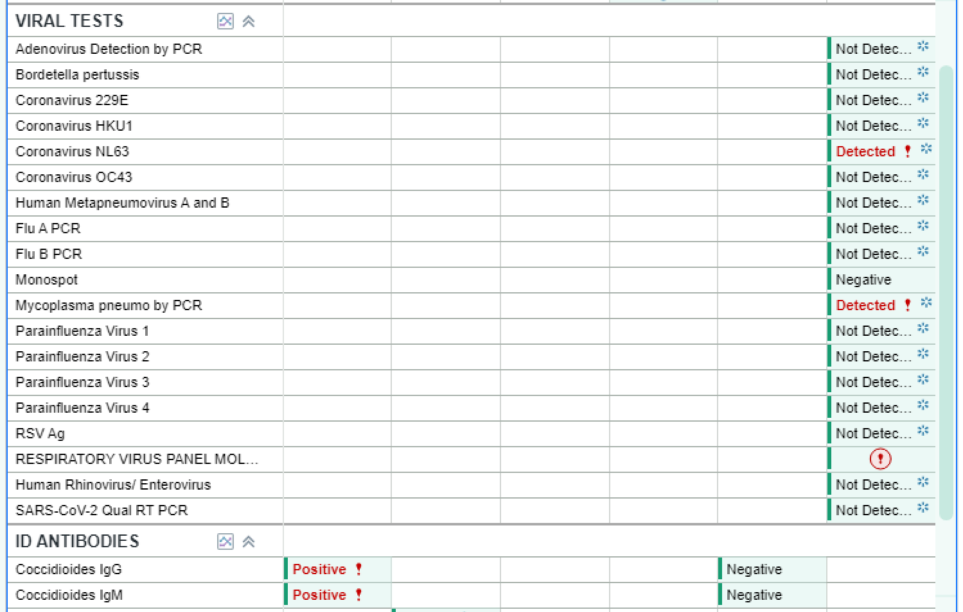
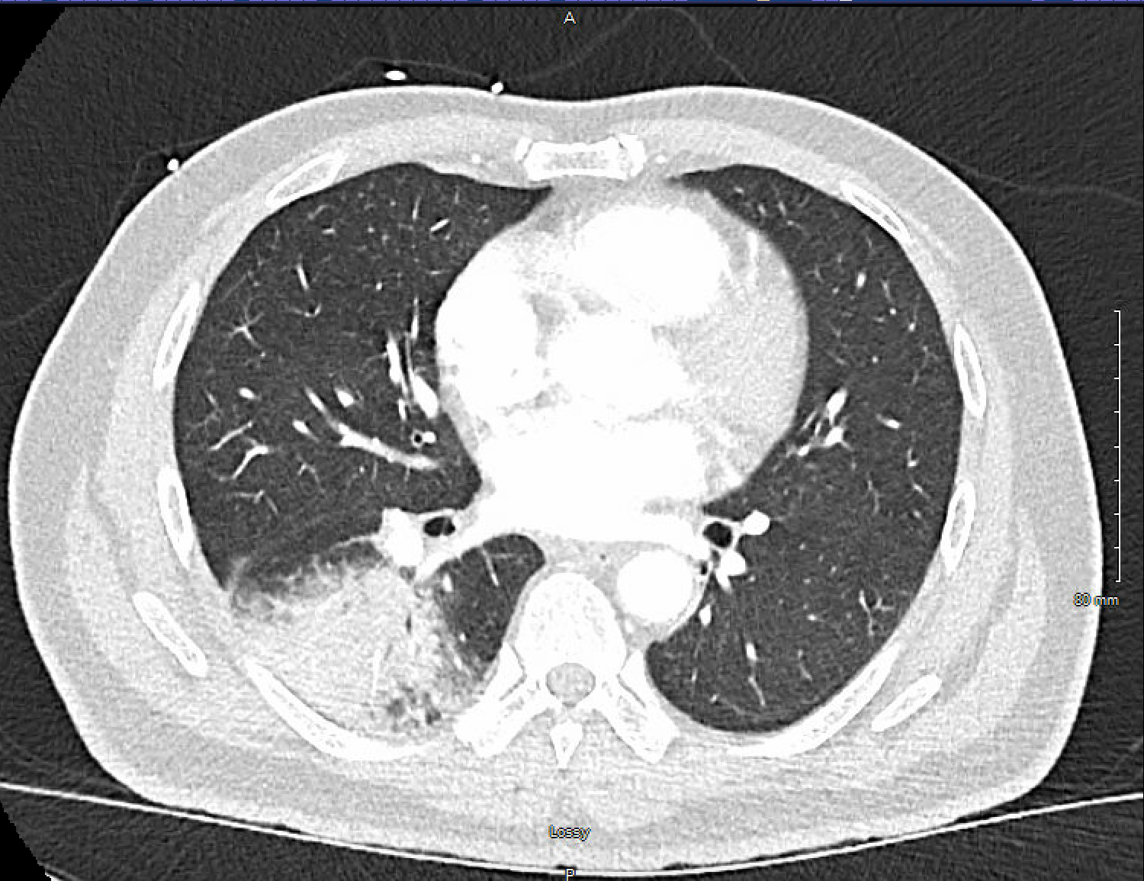
Three in One: A Case Report of Pulmonary Co-infection With a Virus, a Bacterium, and a Fungus in an Immunocompetent Adult
Ahmad B. Al-Zughoul & Mohammed G. Elhassan
Saint Agnes Medical Center
Table: The results of the microbiological tests used to make the diagnosis of triple-pulmonary co-infection.
Abstract
Case Presentation
Results
Pneumonia, a common cause of morbidity and mortality in the United States and worldwide, is usually caused by a single pathogen but co-infection is common. Nevertheless, there are no or very few reported cases of triple acute co-infection with a virus, a bacterium, and a fungus in an immunocompetent patient without underlying chronic lung disease. Here we discuss a case in which an otherwise healthy, elderly male exhibited a triple co-infection with coronavirus NL63, Coccidioides immitis or Coccidioides posadasii (also known as a cause of Valley Fever), and Mycoplasma Pneumoniae. We discuss the insight this clinical course can provide on future diagnosis and management of pulmonary coinfections.
Chief complaints
Cough and Shortness of breath
HPI
61 year old otherwise healthy male presented to SAMC ED for evaluation of shortness of breath and cough with associated skin rash. Patient reported constant and dull 5/10 right lower back pain that started 3 days prior to arrival, worse with coughing and improved with pain medication. He used an icy hot patch which helped a little bit, but soon after, he started having rash at the site of patch which was urticarial in nature and itchy then spread out to the rest of the back and upper shoulder and inner arms. Patient also endorsed SOB with dry cough and fever starting last Sunday 9/29/25. Patient's daughter had some form of viral upper respiratory tract infection 2 weeks prior to admission.
Physical Exam
Vitals: febrile (38.8ºC or 101.8ºF) and tachycardic (115 bpm)
HEENT: mild pharyngeal erythema
Chest: Decreased BS on L side with Rhonchi on R Side, coarse crackles at the lung bases
Skin: Rash (Back rash that seems urticarial on right lower back and maculopapular on the rest of the back, inner arms, and shoulders) present.
Labs
Leukocytosis of 15.0 K/mcl (normal 4.5 - 11.0 K/mcl) with neutrophilia at 12.22 K/mcl (normal 2.6 - 8.2 K/mcl), and mild eosinophilia of 0.36 K/mcl (normal 00.0 - 0.35 K/mcl)
Multiplex polymerase chain reaction (PCR) respiratory panel called BioFire was performed on a nasopharyngeal swab sample and it was positive for Mycoplasma Pneumoniae and coronavirus NL63 (Table 1).
Images
Chest X-ray: right lower lung infiltrate, confirmed with CT chest as well, which did not show pleural effusion or lymphadenopathy (Figure).
Initial Diagnosis
Community-acquired pneumonia (CAP) treated with Azithromycin 500 milligrams IV and ceftriaxone 1 gram IV and levofloxacin 750 mg IV to cover for the possibility of macrolide-resistant Mycoplasma Pneumoniae
Further testing
Coccidioides spp. immunoglobulin M (IgM) and immunoglobulin G (IgG) detected using Enzyme-immunoassay (EIA) came back negative. The patient was still having a cough and fever five days into admission with a high total white blood count at 17.5 k/mcl with increased eosinophilia at 1.08 K/mcl. Given a high clinical suspicion for acute pulmonary Coccidioidomycosis, screening IgM and IgG antibodies with the same EIA were repeated and both came back positive.
Final diagnosis and management: Patient was started and discharged the following day on fluconazole 200 mg tablet by mouth daily for three months.
- The presence of multiple respiratory pathogens can potentially complicate the clinical course and management of pneumonia
- Clinicians should be aware of the sensitivity and specificity of microbiological tests used to diagnose specific respiratory pathogens in their institution in order to make informed management decisions for their patients
- Negative serology for Coccidioidomycosis does not entirely rule out acute Coccidioidomycosis infections. When in doubt, repeat serology can be helpful
What We Learned
References
Kang L, Jing W, Liu J, Liu M: Trends of global and regional aetiologies, risk factors and mortality of lower respiratory infections from 1990 to 2019: an analysis for the Global Burden of Disease Study 2019. Respirology. 2023, 28:166-75. 10.1111/resp.14389
Figure: CT scan of the chest showing right lower lobe consolidation.
Jiang W, Wu M, Zhou J, et al.: Etiologic spectrum and occurrence of coinfections in children hospitalized with community-acquired pneumonia. BMC Infect Dis. 2017, 17:787. 10.1186/s12879-017-2891-x

