Slide 1

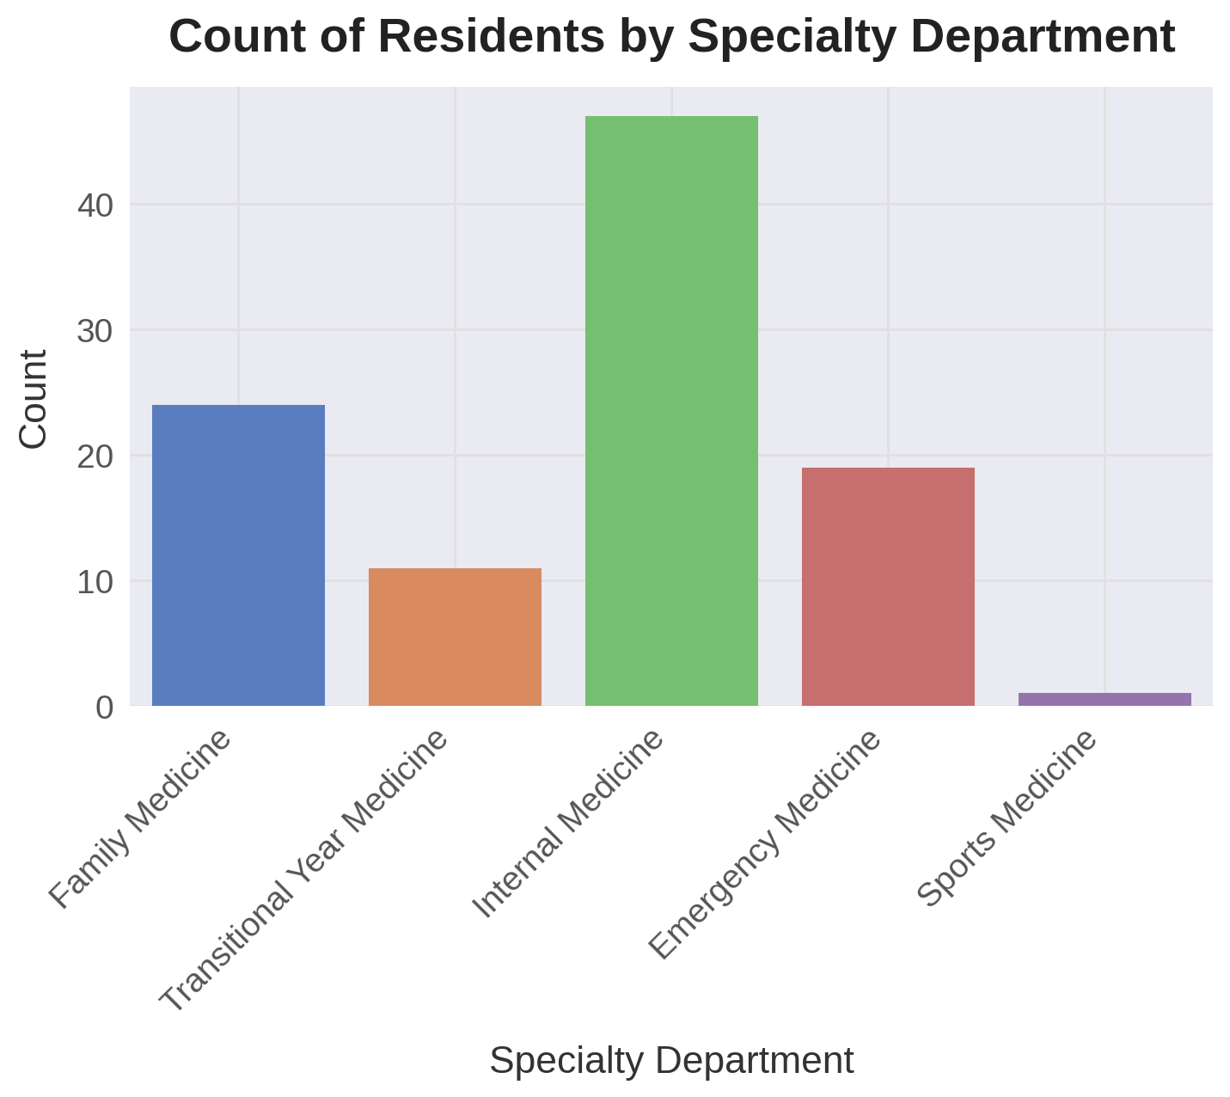
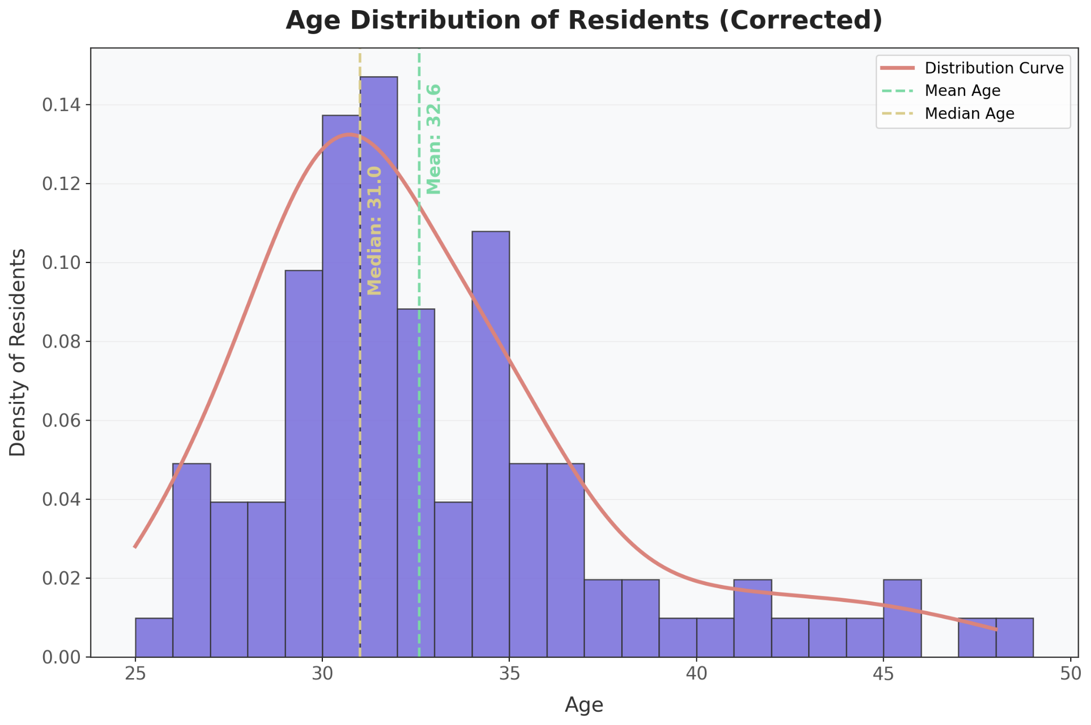
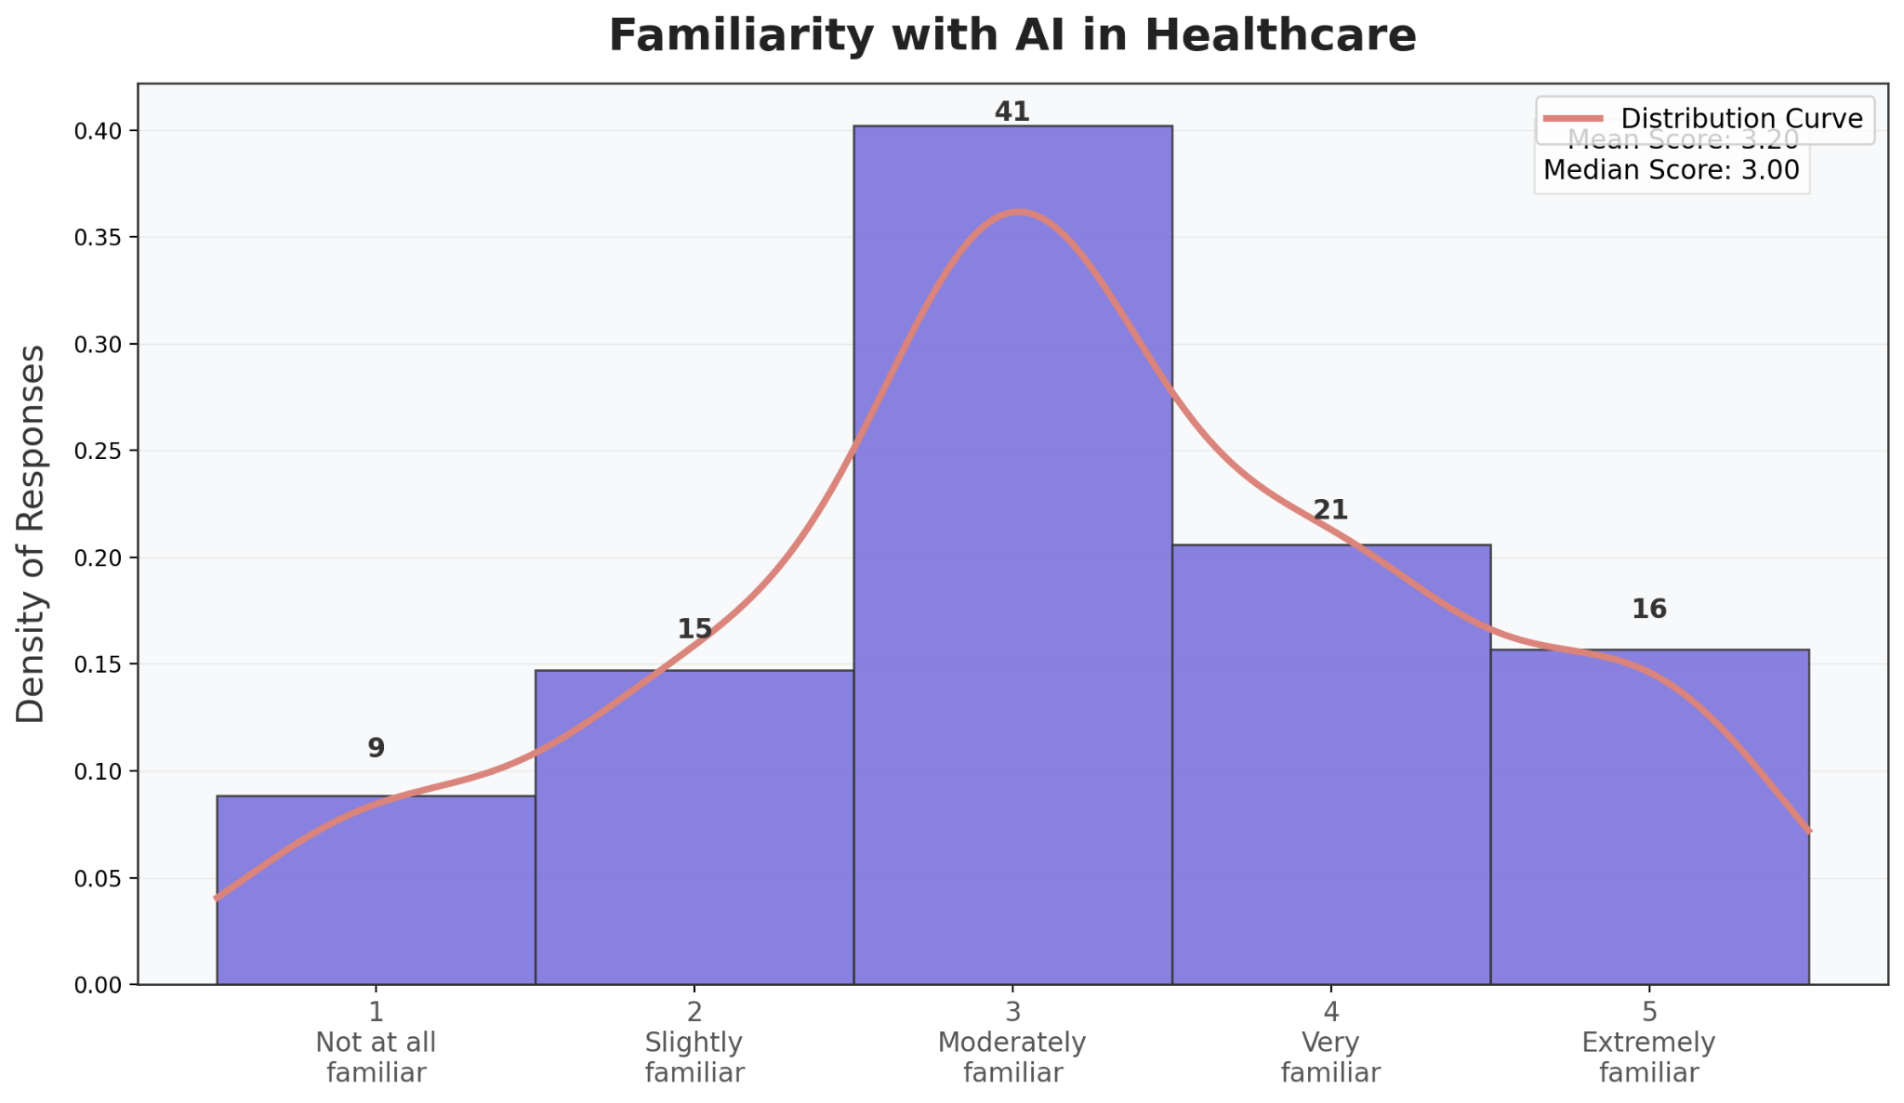
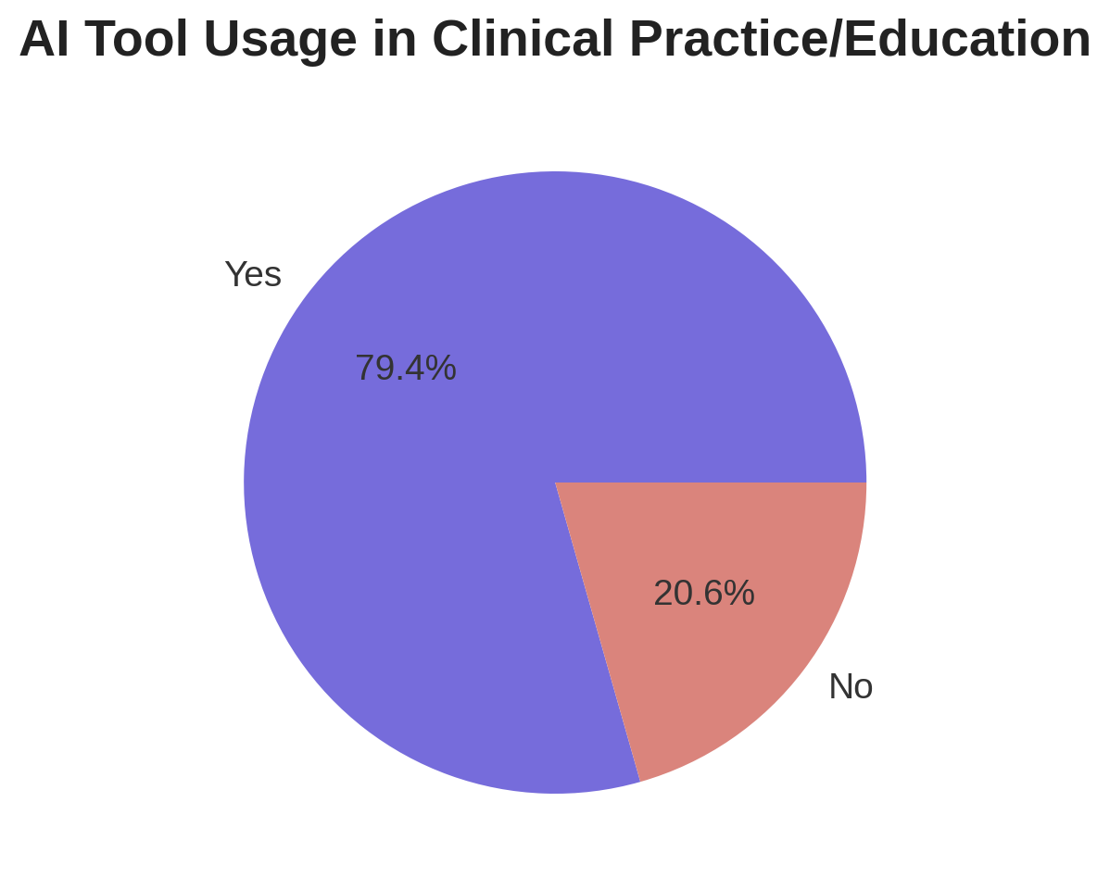
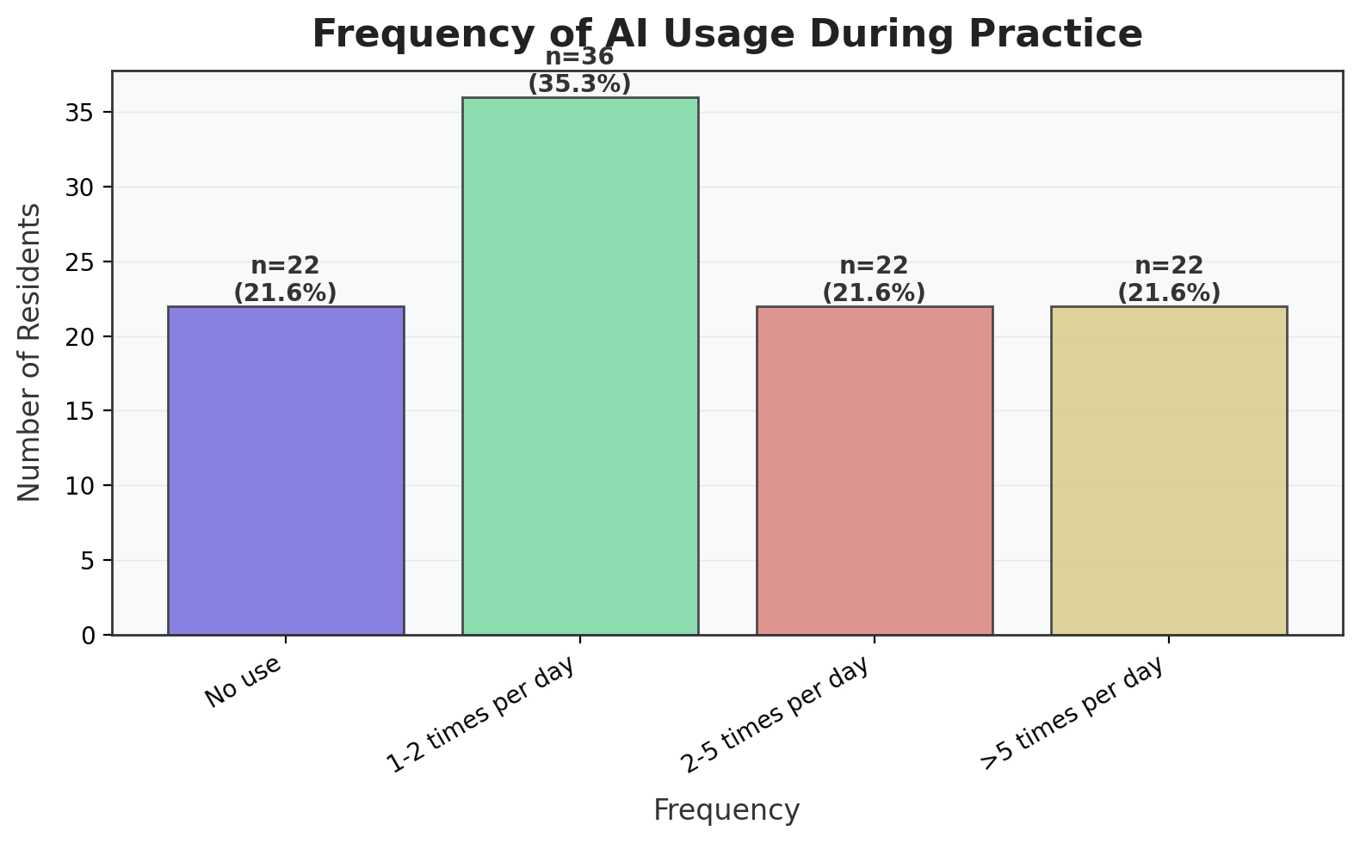
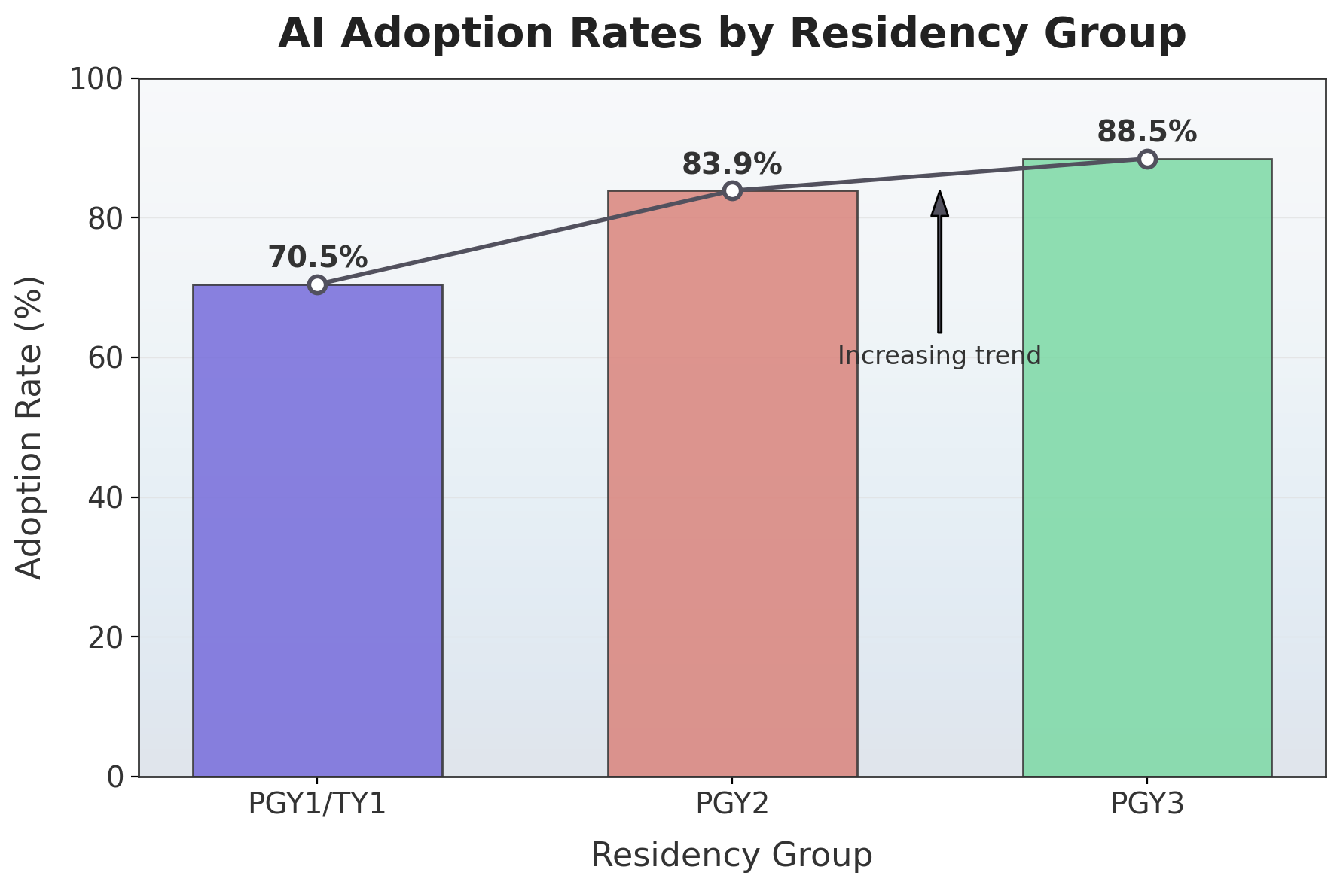
Understanding Adoption & Utility of Artificial Intelligence in Medical Residency Education: A Multi-Specialty Quantitative Study
Gabriel Allaf, DO, Phillip Kim MD, MPH, Mohammed Elhassan, MD
Saint Agnes Medical Center, Department of Family and Internal Medicine
Introduction
Results
AI Adoption Increases with Training: PGY1 (70.5%) to PGY2 (83.9%) to PGY3 (88.5%)
Usage Frequency: 79.4% of residents use AI daily; 1–2x/day most common
Clinical Impact:
81.2% noted improved diagnostic skills
60% reported improved time management (avg. score ≥4 on 5-point Likert)
Most Used Models: Open Evidence AI, ChatGPT
Most Helpful Functions: Clinical question resolution, research support, patient note writing
Barriers: Top 3: Lack of standardized datasets, ethical concerns, insufficient training
Artificial Intelligence (AI) is transforming clinical decision-making, medical education, and healthcare communication
Medical students are increasingly exposed to AI fundamentals, but resident-level adoption and perceptions remain underexplored
Residents are uniquely positioned at the intersection of learning and independent clinical practice
AI tools — including language models, documentation assistants, and clinical support systems — are being integrated into clinical environments
Understanding resident perspectives on AI use is essential to: tailor future curricula and faculty development as well as support safe and evidence-based integration of AI into patient care
This study evaluates:
AI familiarity, usage, & confidence across specialties
Clinical impact on diagnostic reasoning and time management
Barriers to adoption and training preferences
How AI usage evolves with residency progression
Discussion & Conclusion
High rate of AI adoption across all specialties
Usage and perceived benefit increase progressively with each residency year
~80% of residents use AI tools daily in clinical or educational contexts
Most commonly cited benefits: Improved diagnostic accuracy and Enhanced time management
AI is increasingly integrating into resident workflows, especially by PGY2–PGY3
Methodology
Cross-sectional study was conducted at St. Agnes Medical Center. A 28-item survey was distributed to all 119 residents across five residency programs:
Internal Medicine (47 residents)
Family Medicine (24 residents)
Emergency Medicine (19 residents)
Transitional Year Medicine (11 residents)
A total of 102 residents (85.7%) completed the survey. Items assessed:
AI familiarity and confidence (Likert scale 1–5)
Frequency and platform of AI tool use
Perceived impact on clinical performance (diagnostic accuracy, time management)
Most helpful AI functions and models
Barriers to adoption
Quantitative data were analyzed using descriptive statistics, logistic regression, and correlation matrices. Subgroup analyses examined adoption by residency year, gender, and specialty. All visualizations and inferential statistics were conducted using Julius AI, with supplemental interpretation and refinement using GPT-4 (ChatGPT) to ensure data clarity and reproducibility
Limitations & Recommendations
Single-center study limits generalizability
Small sample from certain specialties
Self-reported data introduces potential for response bias
Cross-sectional design does not establish causality
Limited longitudinal insight into how perceptions or usage evolve post-residency
Incorporate structured AI training early in residency
Include AI ethics and safety modules in graduate medical education
Improve access to trusted AI platforms through institutional support
References
References can be provided upon request
Acknowledgements
Special thanks to the residents and faculty of St. Agnes Medical Center from the Family Medicine, Internal Medicine, Emergency Medicine, Sports Medicine, and Transitional Year programs for their participation and support in distributing the survey. Data analytics were performed using Julius AI and GPT-4 (ChatGPT).

