Slide 1


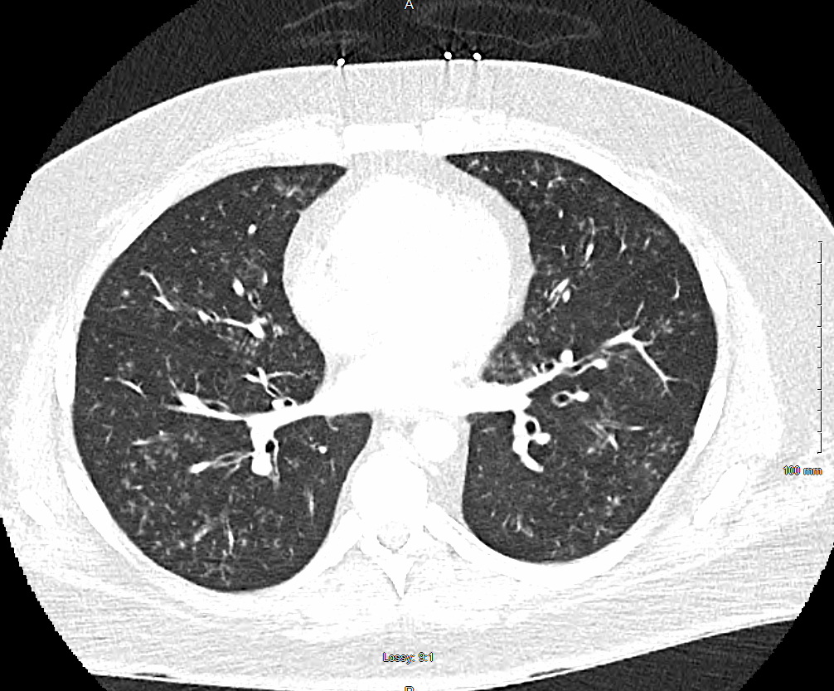
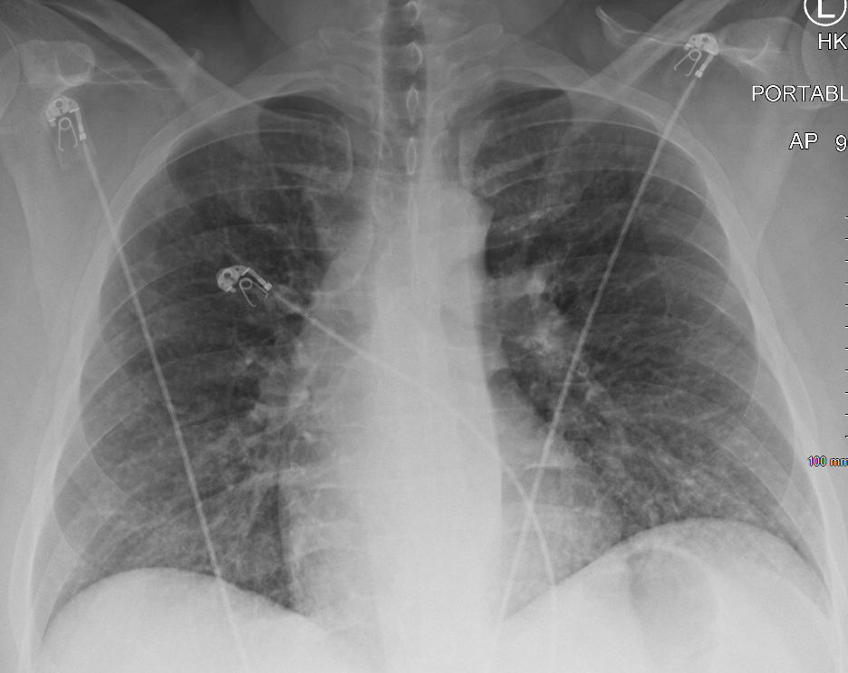

When Mycoplasma Pneumoniae Defies Expectations: An Uncommon Case of Severe Pneumonia
Ji-Il Jeon MD, Andrew Clark MD, Ayesha Shahzad MD, Hamna Javed MD, Mehar Kahlon MD, Pushpalatha Arakere MD, Bakht Roshan MD
Infectious Disease Consultant, Saint Agnes Medical Center, Fresno, California
Saint Agnes Medical Center, Fresno, CA
INTRODUCTION
WBC | 50.4 | Iron | 143
RBC | 3.17 | Ferritin | 1635
Hemoglobin | 9.6 | Iron Sat | 72
Hematocrit | 28.3 | Transferrin | 143
MCV | 89.3 | TIBC | 200
NRBC | 5.3 | Haptoglobin | <30
NRBC Abs | 2.68 | Retic Ct Abs | 0.12
Cocci IgG | Neg | Proteinase 3 Ab | <1.0
Cocci IgM | Neg | DAT IgG | Positive
MPO Ab | <1.0 | DAT C3 | Positive
Chlamydia PNA | Not Detected | Cold Hemaglutinins | Nonreactive
Hepatitis A Ab IgM | Nonreactive | Respiratory Viral Panel | Negative
Hepatitis B Surface Ag | Nonreactive | SARS-COV2 Qual RT PCR | Not Detected
Hepatitis B Core IgM | Nonreactive | Human Rhinovirus | Not Detected
Hepatits C Ab | Nonreactive | Rapid Influenza A | Negative
CCP Ab | <16 | Rapid Influenza B | Negative
Rheumatoid Factor | <10 | Mycoplasma Pneumo IgG | 3.84
Myeloperoxidase Ab | <1.0 | Mycoplasma Pneumo IgM | 4678
CONCLUSION
Mycoplasma pneumoniae is a leading cause of atypical pneumonia, especially among children and young adults. The prevalence rate is estimated to be 1.8% among hospitalized adults with pneumonia [1], though the actual prevalence rate may be underreported due to mild or no symptoms, and underdiagnosis [5,7]. It spreads through airborne droplets, with the highest incidence typically occurring in late summer and fall. Clinical presentations vary widely, ranging from mild respiratory symptoms to severe pneumonia, and may include extrapulmonary complications affecting the hematologic, neurologic, and cardiac systems. Diagnosis primarily relies on nucleic acid amplification tests (NAATs) and serological assays. Macrolides remain the first-line treatment; however, increasing resistance—particularly in the Western Pacific region, where rates have reached 53.4%—has prompted greater use of tetracyclines and fluoroquinolones. In severe cases, adjunctive therapies such as corticosteroids or intravenous immunoglobulin (IVIG) may be necessary. Due to the often mild or asymptomatic nature of the infection, many cases go undetected, complicating surveillance and diagnosis.
M. pneumoniae can present with pulmonary and extra-pulmonary symptoms. Pathogenesis behind some clinical manifestations is not well understood. This case highlights the potential for M. pneumoniae to present with significant hematologic complications and underscores the importance of maintaining a broad differential.
Diagnostic testing is generally reserved for severe or atypical cases. Nucleic acid amplification tests (NAATs), the preferred method, is not readily available as the serology testing. Treatment depends on disease severity. Mild cases require only supportive care, but more severe cases require antibiotic treatments. Macrolide is the first-line treatment. There is a global rise in macrolide resistance, varies from 53.4% in the Western Pacific and 2.1% on the U.S. West Coast [4,13]. Further research is warranted to optimize treatment strategies and expand access to accurate diagnostic testing.
Sodium | 130 | Calcium | 8.7
Potassium | 3.8 | Phosphorus | 2.3
Chloride | 92 | AST | 26
CO2 | 28 | ALT | 18
Anion Gap | 10 | Alk Phos | 115
Glucose | 393 | Total Protein | 7.5
BUN | 27 | Albumin | 3.5
Creatinine | 1.17 | Total Bilirubin | 4.6
Calculated GFR | 81 | Bilirubin, Direct | 1.2
BUN/Cr ratio | 23.1 | Bilirubin, Indirect | 3.4
Table 2: Further laboratory evaluations
Peripheral Blood Smear: Macrocytic hypochromatic anemia, nucleated red blood cells, leukocytosis with left shifted, atypical lymphocytes, thrombocytopenia
Table 1: Labs on presentation
CASE PRESENTATION
A 40-year-old male with a medical history significant for alcohol use disorder, hypertension, type 2 diabetes mellitus, depression, anxiety, and obesity presented with a 3-week history of productive cough and progressive dyspnea. His illness began with flu-like symptoms, including fever, rhinorrhea, sore throat, and ear pain. Notably, his nephew experienced similar symptoms that resolved without intervention. Despite treatment with dextromethorphan-guaifenesin and supportive care by his primary care provider, his symptoms persisted.
Initial testing for COVID-19, influenza, and group A Streptococcus was negative.In the emergency department, he was found to be tachycardic with a heart rate in the 160s, diaphoretic, and wheezing on auscultation. He also reported fatigue, unintentional weight loss, chest tightness, pallor, and a productive cough with green-to-white sputum. He endorsed occasional tobacco use, chronic marijuana use for over a decade, and a brief history of vaping. He denied intravenous drug use or recent travel. He was unvaccinated against influenza and COVID-19 and worked in aluminum product assembly. Initial labs are shown in Table 1. Electrocardiogram revealed sinus tachycardia, and chest X-ray (Figure 1) showed no acute abnormalities. However, a CT angiogram of the chest (Figure 2), while ruling out pulmonary embolism, revealed diffuse centrilobular nodules with a tree-in-bud pattern bilaterally. Physical examination was notable for bilateral wheezing, persistent tachycardia, and left axillary lymphadenopathy.The patient was admitted for further evaluation and management.
Empiric therapy was initiated with ceftriaxone, levofloxacin, and fluconazole, along with intravenous methylprednisolone for presumed severe community-acquired pneumonia and consideration of hypersensitivity pneumonitis. Further laboratory evaluation (Table 2) revealed a significant hemoglobin drop from 16 g/dL to 9.6 g/dL, prompting an anemia workup, which confirmed autoimmune hemolytic anemia. Mycoplasma pneumoniae testing returned positive, leading to a change in antibiotics to doxycycline and discontinuation of fluconazole. Left axillary ultrasound was unremarkable.
The patient’s condition improved with treatment, and supplemental oxygen was weaned off. He was discharged with doxycycline 100 mg twice daily for 14 days and prednisone 60 mg daily for 30 days. Outpatient follow-up was arranged with hematology, infectious disease, and his primary care physician within one week.
Figure 1: Chest XR on admission; No acute cardiopulmonary process
Figure 2: CTA Chest on Admission; Diffuse centrilobular nodules with tree-in-bud configuration
DISCUSSION
Mycoplasma pneumoniae is a well-recognized cause of atypical respiratory infections, often presenting with nonspecific or mild symptoms. While leukocytosis occurs in roughly 25% of cases, marked leukemoid reactions are rare. In this case, a middle-aged patient presented with profound leukocytosis (>50,000/µL), axillary lymphadenopathy, weight loss, and severe anemia—findings that raised concern for hematologic malignancy. However, serologic testing confirmed M. pneumoniae infection, and further workup revealed autoimmune hemolytic anemia (AIHA). The extreme leukocytosis was attributed to a severe leukemoid reaction, which improved following initiation of doxycycline.
A study in the U.S. reported a prevalence of 1.8% in hospitalized adults, while rates in children range from 2% to 35% during epidemics [1,3]. Around 30% of symptomatic individuals develop pneumonia, and 25% may experience extrapulmonary complications affecting the skin, gastrointestinal tract, musculoskeletal, cardiac, renal, hematopoietic, ocular, and nervous systems [6,9,12]. Hematologic manifestations include mild autoimmune hemolysis due to cold agglutinin disease, which may cause intravascular or intrahepatic hemolysis.The exact mechanism by which M. pneumoniae induces anti-I autoantibodies remains unknown [11]. The suspected mechanisms of other extrapulmonary complications involve direct bacterial invasion and immune cross-reactivity [22-25].
Diagnostic testing is generally reserved for severe or atypical cases. Nucleic acid amplification tests (NAATs) are the preferred method, while serology can be useful but requires paired acute and convalescent samples to confirm diagnosis [5]. Cold agglutinin titers and Coombs tests can support diagnosis.Imaging findings are nonspecific; chest X-rays may show patchy opacities, and CT scans can reveal tree-in-bud opacities [5].
Treatment depends on disease severity. Mild cases require only supportive care, and moderate to severe cases may require antibiotic treatments. M. pneumoniae lacks a cell wall, antibiotics target protein synthesis (macrolides, tetracyclines) or DNA replication (fluoroquinolones) [4,5]. Macrolides are first-line agents, but rising resistance is a concern. In the U.S., resistance ranged from 18.3% in the South and East to 2.1% in the West [13].
References
Jain S, Self WH, Wunderink RG, et al. Community-Acquired Pneumonia Requiring Hospitalization among U.S. Adults. N Engl J Med. 2015;373(5):415-427. doi:10.1056/NEJMoa1500245
Shimizu T. Nihon Saikingaku Zasshi. 2015;70(4):369-374. doi:10.3412/jsb.70.369
Kim K, Jung S, Kim M, Park S, Yang H, Lee E. Global Trends in the Proportion of Macrolide-Resistant Mycoplasma pneumoniae Infections: A Systematic Review and Meta-analysis. JAMA Netw Open. 2022;5(7):e2220949. doi:10.1001/jamanetworkopen.2022.20949
Atkinson T, Balish M, & Waites Ken. Epidemiology, clinical manifestations, pathogenesis and laboratory detection of Mycoplasma pneumoniae infections. Federation of European Microbiological Societies 2008; 32: 956-973. DOI:10.1111/j.1574-6976.2008.00129.
Liu EM, Janigian RH. Mycoplasma pneumoniae: The Other Masquerader. JAMA Ophthalmol. 2013;131(2):251–253. doi:10.1001/jamaophthalmol.2013.586
Spuesens EB, Fraaij PL, Visser EG, et al. Carriage of Mycoplasma pneumoniae in the upper respiratory tract of symptomatic and asymptomatic children: an observational study. PLoS Med. 2013;10(5):e1001444. doi:10.1371/journal.pmed.1001444
Pereyre S, Goret J, Bébéar C. Mycoplasma pneumoniae: Current Knowledge on Macrolide Resistance and Treatment. Front Microbiol. 2016;7:974. Published 2016 Jun 22. doi:10.3389/fmicb.2016.00974
Waites KB, Talkington DF. Mycoplasma pneumoniae and its role as a human pathogen. Clin Microbiol Rev. 2004;17(4):697-728. doi:10.1128/CMR.17.4.697-728.2004
Geissler RG, Köbberling J. Kälteagglutininkrankheit [Cold agglutinin disease]. Klin Wochenschr. 1988;66(7):277-283. doi:10.1007/BF01727512
Loomes LM, Uemura K, Childs RA, et al. Erythrocyte receptors for Mycoplasma pneumoniae are sialylated oligosaccharides of Ii antigen type. Nature. 1984;307(5951):560-563. doi:10.1038/307560a0
Mansel, J. Keith et al. Mycoplasma pneumoniae Pneumonia. CHEST, Volume 95, Issue 3, 639 - 646
Waites KB, Ratliff A, Crabb DM, et al. Macrolide-Resistant Mycoplasma pneumoniae in the United States as Determined from a National Surveillance Program. J Clin Microbiol. 2019;57(11):e00968-19. Published 2019 Oct 23. doi:10.1128/JCM.00968-19
Bajantri B, Venkatram S, Diaz-Fuentes G. Mycoplasma pneumoniae: A Potentially Severe Infection. J Clin Med Res. 2018;10(7):535-544. doi:10.14740/jocmr3421w
14. Koskiniemi M. CNS manifestations associated with Mycoplasma pneumoniae infections: summary of cases at the University of Helsinki and review. Clin Infect Dis. 1993;17 Suppl 1(Suppl 1):S52-S57. doi:10.1093/clinids/17.supplement_1.s52
15. Tsiodras S, Kelesidis I, Kelesidis T, Stamboulis E, Giamarellou H. Central nervous system manifestations of Mycoplasma pneumoniae infections. J Infect. 2005;51(5):343-354. doi:10.1016/j.jinf.2005.07.005
16. Smith R, Eviatar L. Neurologic manifestations of Mycoplasma pneumoniae infections: diverse spectrum of diseases. A report of six cases and review of the literature. Clin Pediatr (Phila). 2000;39(4):195-201. doi:10.1177/000992280003900401
17. Santos RP, Silva M, Vieira AP, Brito C. Mycoplasma pneumoniae-induced rash and mucositis: a recently described entity. BMJ Case Rep. 2017;2017:bcr2017220768. Published 2017 Aug 22. doi:10.1136/bcr-2017-220768
18. Bhoopalan SV, Chawla V, Hogan MB, Wilson NW, Das SU. Bullous Skin Manifestations of Mycoplasma pneumoniae Infection: A Case Series. J Investig Med High Impact Case Rep. 2017;5(3):2324709617727759. Published 2017 Sep 8. doi:10.1177/2324709617727759
19. Vujic I, Shroff A, Grzelka M, et al. Mycoplasma pneumoniae-associated mucositis--case report and systematic review of literature. J Eur Acad Dermatol Venereol. 2015;29(3):595-598. doi:10.1111/jdv.12392
20. Amode R, Ingen-Housz-Oro S, Ortonne N, et al. Clinical and histologic features of Mycoplasma pneumoniae-related erythema multiforme: A single-center series of 33 cases compared with 100 cases induced by other causes. J Am Acad Dermatol. 2018;79(1):110-117. doi:10.1016/j.jaad.2018.03.013
21. Szymanski M, Petric M, Saunders FE, Tellier R. Mycoplasma pneumoniae pericarditis demonstrated by polymerase chain reaction and electron microscopy. Clin Infect Dis. 2002;34(1):E16-E17. doi:10.1086/338158
22. Paz A, Potasman I. Mycoplasma-associated carditis. Case reports and review. Cardiology. 2002;97(2):83-88. doi:10.1159/000057677
23. Scapini JP, Flynn LP, Sciacaluga S, Morales L, Cadario ME. Confirmed Mycoplasma pneumoniae endocarditis. Emerg Infect Dis. 2008;14(10):1664-1665. doi:10.3201/eid1410.080157
24. Nagashima M, Higaki T, Satoh H, Nakano T. Cardiac thrombus associated with Mycoplasma pneumoniae infection. Interact Cardiovasc Thorac Surg. 2010;11(6):849-851. doi:10.1510/icvts.2010.242115
25. Foy HM, Kenny GE, Cooney MK, Allan ID. Long-term epidemiology of infections with Mycoplasma pneumoniae. J Infect Dis. 1979;139(6):681-687. doi:10.1093/infdis/139.6.681

