Slide 1
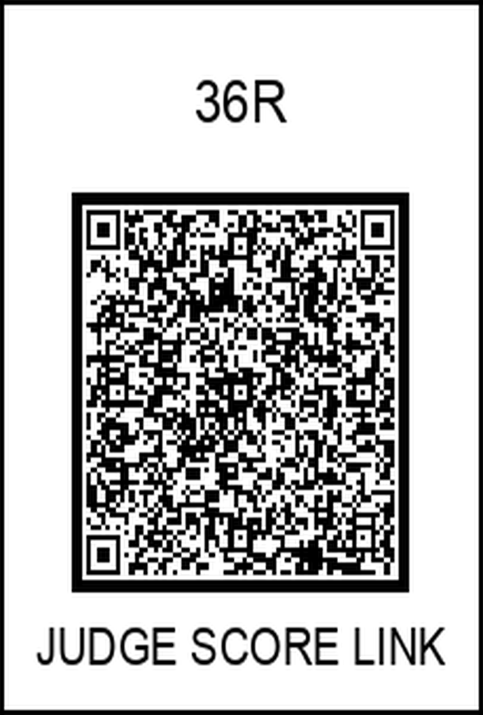
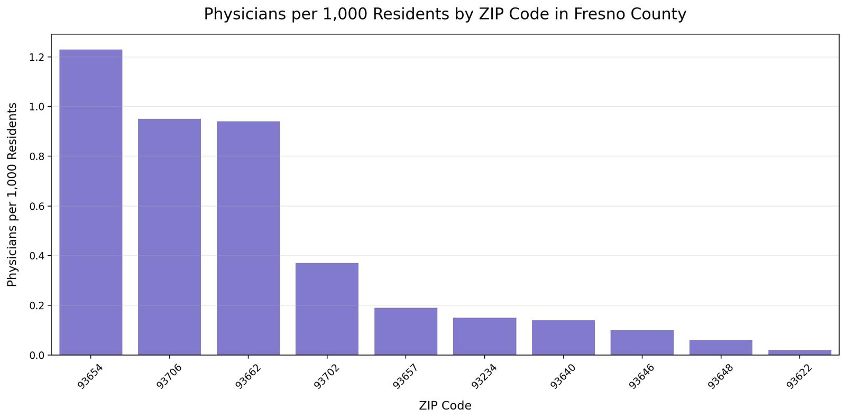
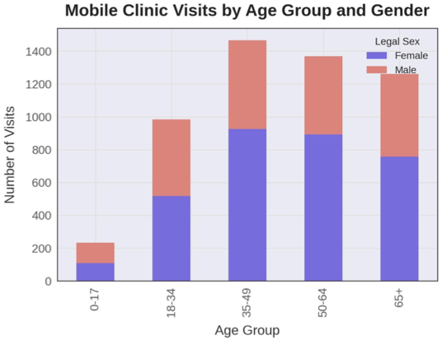
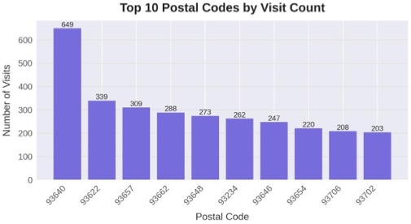
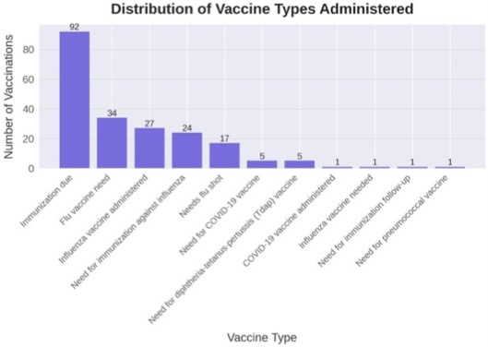
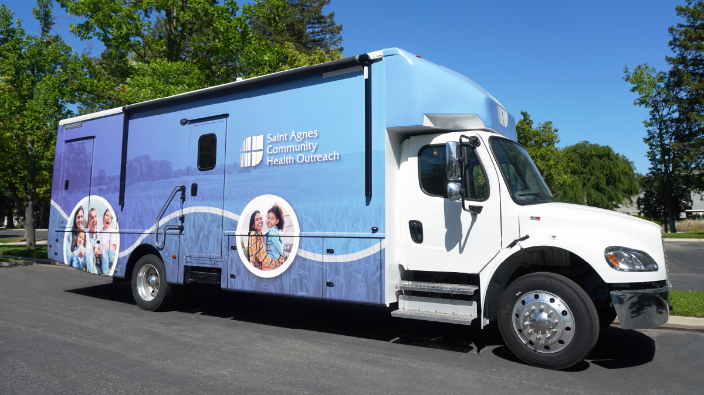
Faces of Care-Central Valley Mobile Clinic Outreach
Tarab Mansoor, Gabriel Allaf, Michael Moya, Jusel Ruelan, Phillip Kim
Department of Family Medicine – Saint Agnes Medical Center
Introduction
gender and age distribution. Insights gained from this analysis are intended to inform program enhancements, support targeted resource allocation, and optimize outreach strategies to further advance health equity across the Central Valley.
COVID-19 vaccines. ZIP code 93640-Mendota recorded the highest number of mobile clinic visits and is notable for having less than 0.2 physicians per 1,000 residents, emphasizing the critical need for mobile health services in this region. Visual representations of visit distribution, vaccination types, and demographic breakdowns are provided through bar charts and tables included in this poster.
Discussion
Healthcare disparities in California’s Central Valley represent a significant public health challenge, driven by socioeconomic barriers and insufficient healthcare infrastructure. Limited availability of primary care physicians further compounds these issues, leaving many communities underserved and vulnerable. In response to these challenges, Fresno County funded the development of a mobile health unit, operated in partnership with Saint Agnes Medical Center, to provide critical healthcare services to underserved communities across the region. The mobile clinic van delivers preventive services, vaccinations, and health education directly to neighborhoods facing substantial barriers to care. This poster presents an evaluation of the impact, reach, and demographic profile of the mobile health unit’s initiatives across various counties in the Central Valley region.
These findings highlight the importance of using systematic, data-driven surveys to guide resource allocation, ensuring that mobile health initiatives are strategically targeted to areas of greatest need. Scientific analysis of service delivery patterns allows for more effective planning, better healthcare outcomes, and a more equitable distribution of resources.
Recommendations
Targeted Resource Allocation: Prioritize funding and staffing resources toward the most underserved zip codes, particularly those with fewer than one physician per 1,000 residents.
Structured and Consistent Outreach: Develop and implement a standardized schedule for mobile clinic visits to ensure consistent access to care and strengthen community trust.
Enhanced Documentation Practices: Improve documentation workflows within Epic to ensure accurate, real-time integration of mobile clinic data with follow-up care and referral networks.
Ongoing Monitoring and Evaluation: Establish a feedback loop for performance metrics and population health outcomes to continuously optimize mobile health operations.
On-site Clinical Support: Allocate a dedicated medical assistant or nurse to mobile units to conduct initial intake, including vital signs and basic health assessments, to improve clinical efficiency and continuity of care.
Purpose
Results
The mission of the mobile health unit is to improve healthcare access for underserved populations by delivering essential medical services directly to the community. The purpose of this study is to serve as an initial survey of the mobile health unit’s outreach efforts, with a focus on tracking key healthcare delivery metrics. Specifically, this study aims to document the number of vaccines administered, identify zip codes with the highest volume of clinic visits, assess physician availability per capita across service areas, and analyze the demographic profile of patients, including
Between October 2023 and April 2025, the mobile health unit recorded over 5,000 patient visits. The age and gender distribution among patients was relatively balanced, with a slight predominance of female patients, as detailed in the accompanying table. Among the services provided, the flu vaccine was by far the most commonly administered, followed by Tdap and
References
California Health Care Foundation. (2022). California physician supply and distribution. https://www.chcf.org
Centers for Disease Control and Prevention. (2023). Vaccination coverage among adults in the United States. https://www.cdc.gov/vaccines/imz-managers/coverage/adultvaxview/
National Association of Community Health Centers. (2022). The role of mobile clinics in increasing access to care. https://www.nachc.org
Acknowledgements
Mehdi Hakimipour, MD, Andrea Ortiz

