Slide 1

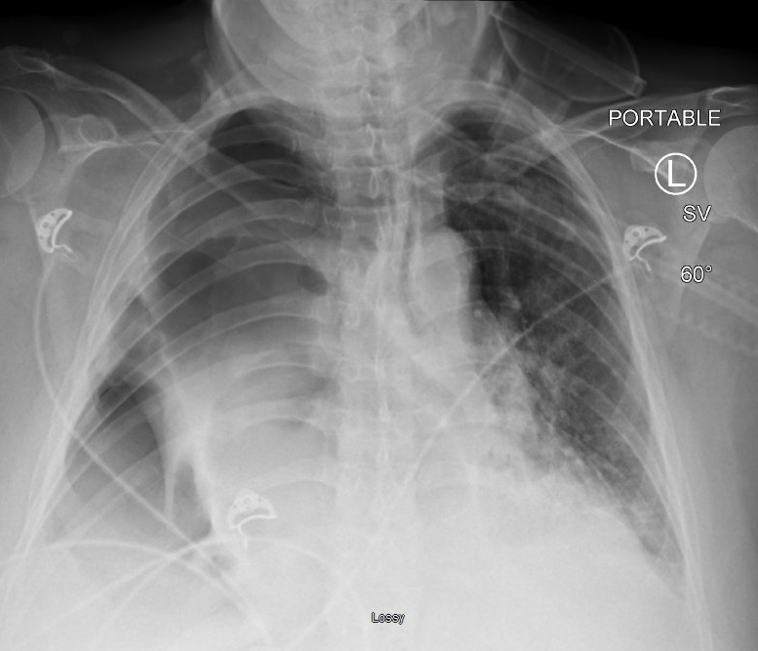
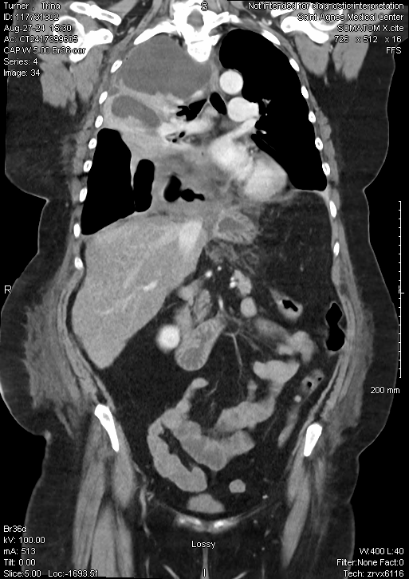
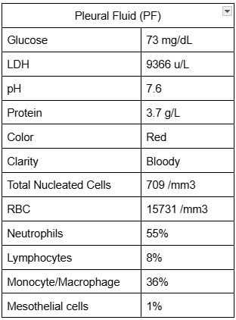
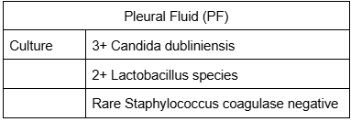
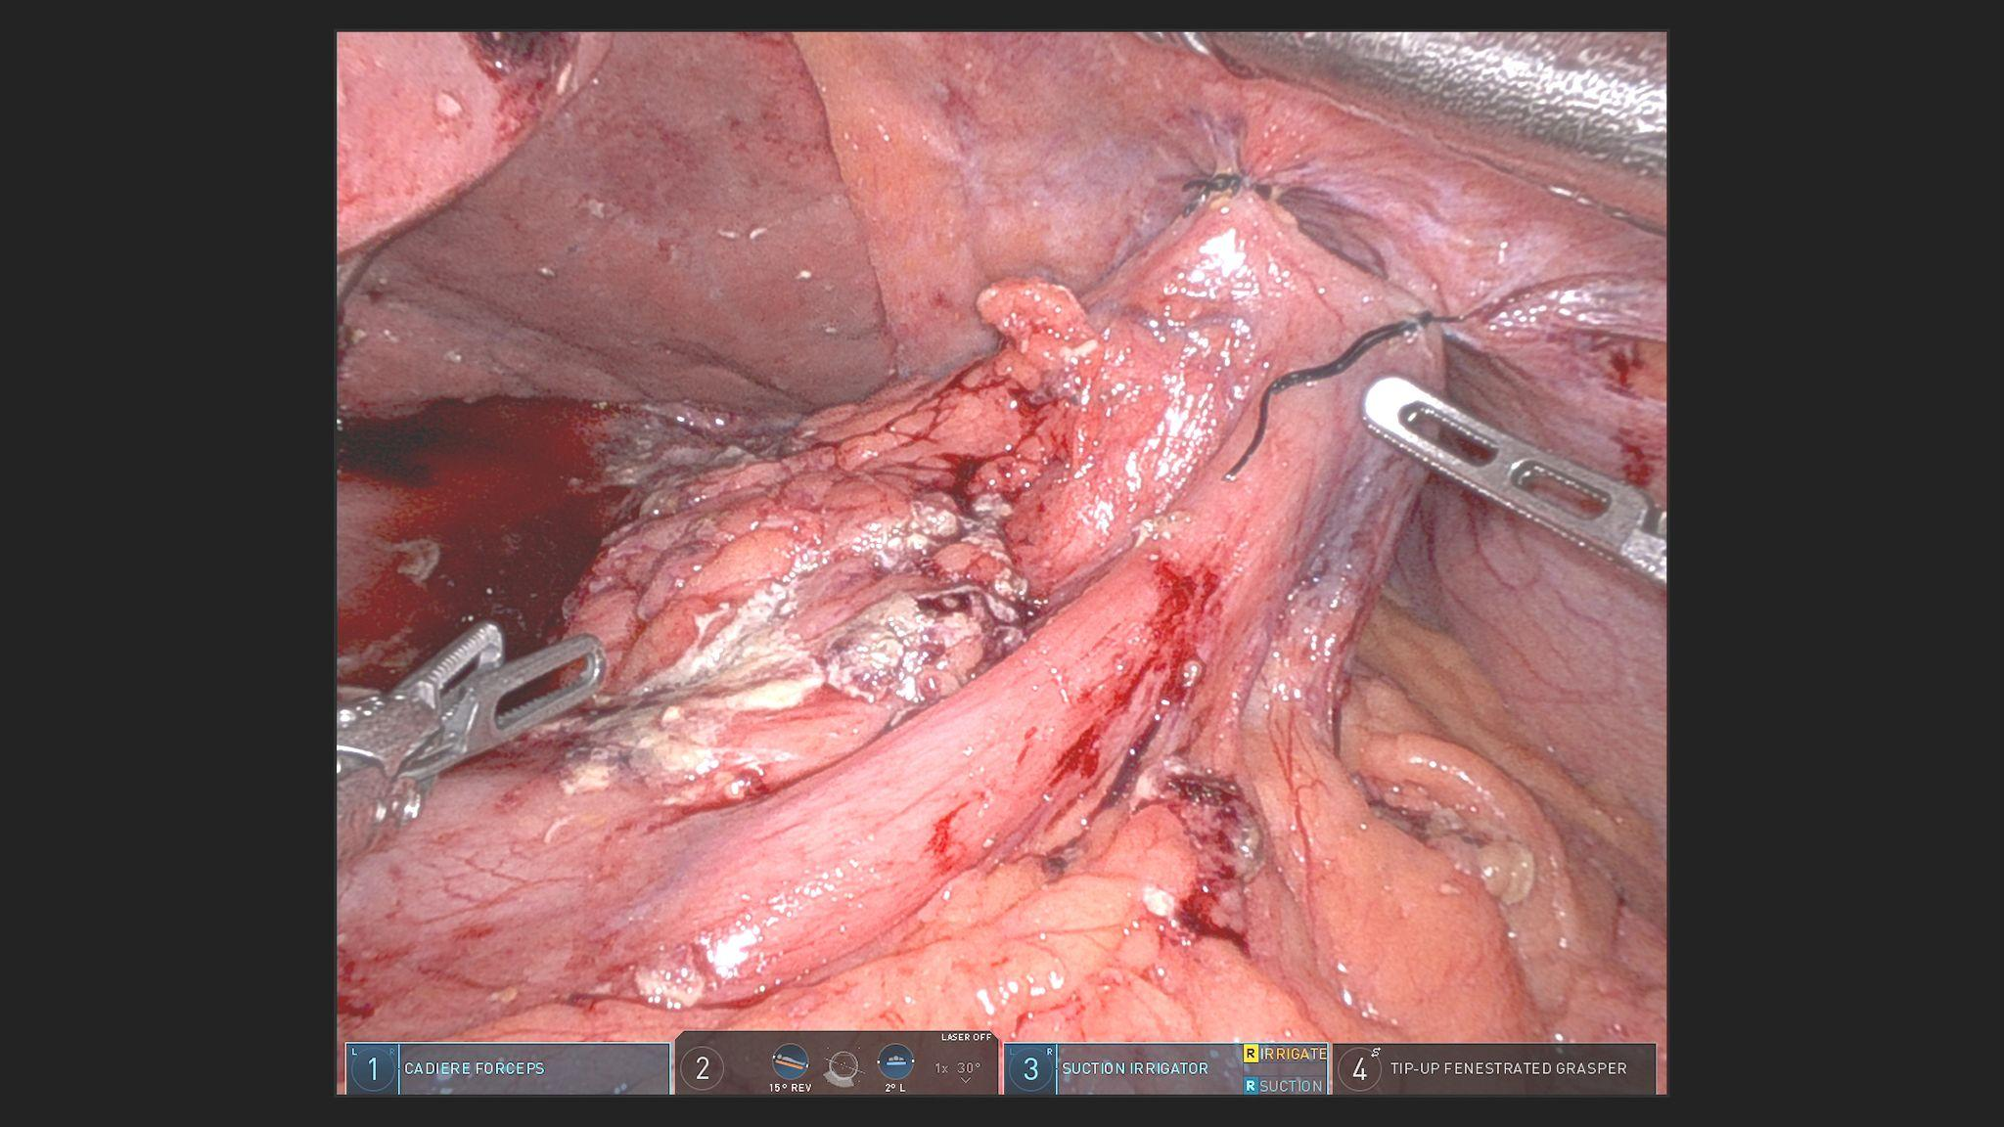
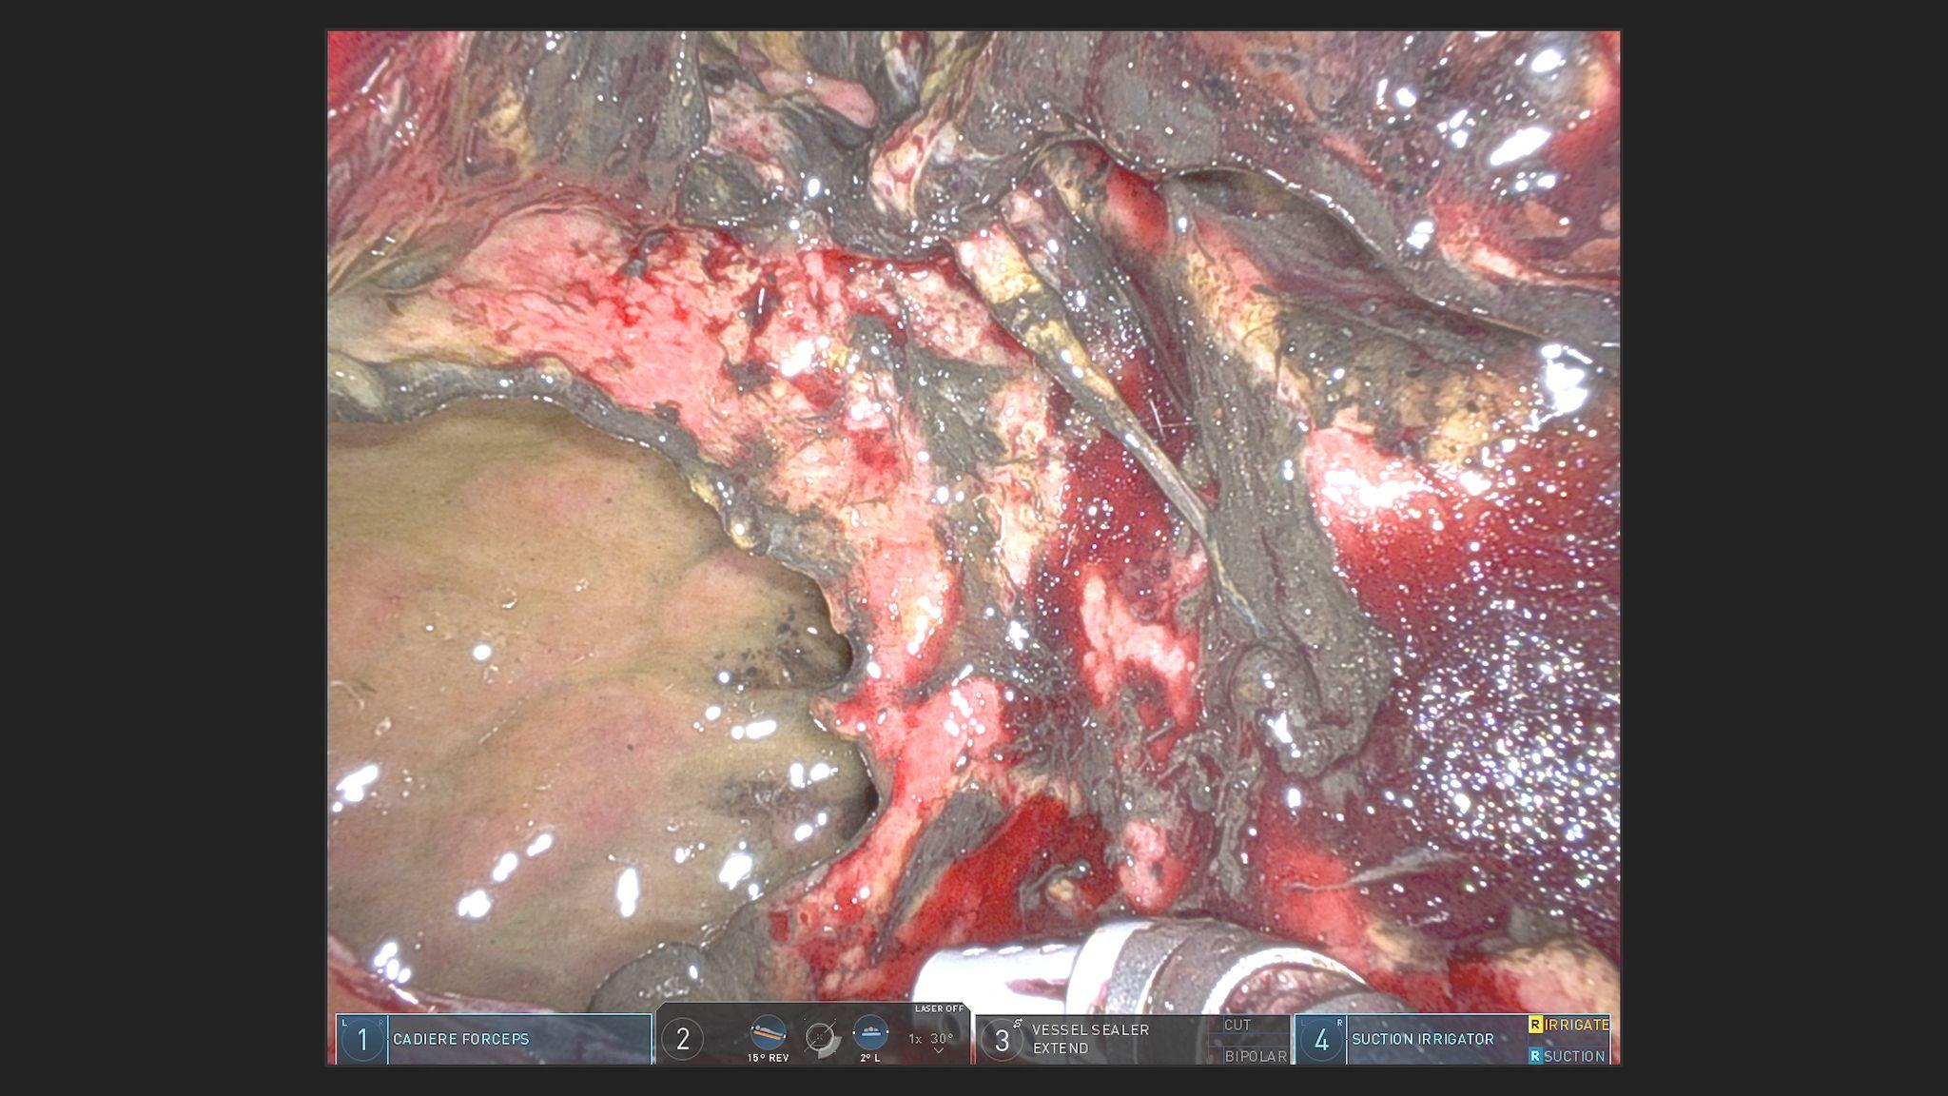
A Case of Tension Hydropneumothorax secondary to
Gastric Content following Hiatal Hernia Repair
Haemi Lee, Lauren Ma, Hamna Javed, Catalin Nicola Saint Agnes Medical Center, Fresno, CA
Introduction
Hospital Course - Cont'd
A Type IV paraesophageal hernia is characterized by the herniation of organs other than the stomach, such as the colon, omentum, pancreas, or small intestine, into the hernia sac.
Although it represents less than 5% of all hiatal hernias [1], it can present with a range of symptoms and has a higher rate of postoperative complications and recurrence (12-65%) compared to other types of hernias. This poses unique clinical and technical challenges for physicians in managing the condition.
Day 20-23: Resolution of fever, decreasing pressor demands, left pleural effusion seen on CXR, left chest tube placement, extubation (Day 23)
Day 24-29: Increased residuals on G tube feeding with constant nausea, intrapleural tPA & DNase q12h (Day 28-31)
Day 30: XR UGI findings of contrast pooling in the distal esophagus consistent with stenosis
Day 32: EGD findings of dehiscence at Roux en Y GJ anastomosis
Day 36: Repeat EGD with distal esophageal stent placement
Day 37-40: All chest tubes removed, Downgrade to medical floor
Day 51: EGD with stent removal, 4 cm dehiscence seen at G-J anastomosis noted
Day 53: EGD performed with second stent placement; stent to stay in place for 6 weeks
Day 54-59: Tolerating tube feeding
Day 60: Discharge to home with home health with plan to repeat EGD
Case Presentation
Figure 1a: Moderate right-sided pleural effusion with a distinct area of lucency at the lung margin, indicative of hydropneumothorax. Leftward deviation of the trachea, suggesting a substantial accumulation of air and fluid within the pleural space.
A 59-year-old woman with a history of tobacco use, anxiety disorder, gastrointestinal (GI) bleeding, gastroesophageal reflux disease (GERD), and obesity (BMI 34.3) was admitted for elective hiatal hernia repair.
The initial operation revealed a type IV hiatal hernia with omentum, stomach, and colon herniating into mediastinum.
On post-op day 7, due to ongoing shortness of breath and right chest pain, Computed tomography (CT) chest, abdomen, and pelvis with contrast was performed, suggesting recurrent stomach herniation into the right thorax with suspected perforation.
Figure 1b: Multiloculated right pleural effusion with passive atelectasis and leftward deviation of the main trachea. The presence of air within the bowel, observed in a supradiaphragmatic position, is suggestive of a hiatal hernia.
Discussion
Hospital Course
Type IV paraesophageal hernias are particularly prone to recurrence after initial surgery and are associated with higher morbidity, mortality, and rates of re-operation [2]. The recurrence rate following paraesophageal hernia repair ranges widely, from 0% to 66% [3].
This case highlights a rare sequence of events - including recurrent
hernia repairs, gastric perforation, empyema, and eventual partial
gastrectomy with Roux-en-Y gastric bypass - that emphasize the
importance of clinician vigilance and maintaining a high index of
suspicion for postoperative complications.
In this case, the reason for the early recurrence is unclear, but the patient did have notable risk factors, including a high BMI and tobacco use, along with a prolonged history of untreated paraesophageal hernia.
Additionally, preoperative data was limited; only a chest X-ray and CT scan- performed at an outside facility - were available, with no access to those images in our EMR.
Day 1: Laparoscopic Diaphragmatic Hernia Repair (#1)
Day 2-7: Not able wean off O2, poor IS (~750mL) with shallow breathing
Day 8: Returned to OR for CT findings of recurred stomach herniation into right thorax, had Laparoscopic Repair of Recurrent Diaphragmatic Hernia (#2), however no perforation visualized on field
Day 9-10: ICU upgrade, V/S notable for tachypnea (RR 29), tachycardia (HR 123), fever (BT 103.6F), hypotension (BP 46/25, MAP 33), hypoxemia (SpO2 51% on RA), Intubated, Pressors started, Rt chest tube inserted for CXR finding of tension hydropneumothorax, drained 2 L of dark-red and green fluid
Day 11: Taken back to OR for another CT findings of recurred stomach herniation with stomach perforation, underwent Robotic Repair of Recurrent Diaphragmatic Hernia, Gastric Perforation Repair, Gastrostomy Tube placement, Partial Gastrectomy with Roux En Y (#3)
Day 12 -18: Decreasing chest tube output despite tPA/DNase, constant leukocytosis (11-19k) with persistent fever (101.4F) with increased demand of pressors, (Day 14) IV Fluconazole 400mg q12h and IV Unasyn 2g q24h for positive PF culture results of Candida Dubliensis and Lactobacillus
Day 19: Right Video-Assisted Thoracoscopic Surgery Converted to Open Thoracotomy, with Evacuation of Purulent Material, Tube Thoracostomy (#4)
Table 2: PF culture
Table 1: PF findings
References
[1] Laparoscopic treatment of type iii and iv hiatal hernia - authors' experience. Migaczewski M, Grzesiak-Kuik A, Pędziwiatr M, Budzyński A. Wideochir Inne Tech Maloinwazyjne. 2014;9:157–163. doi: 10.5114/wiitm.2014.41625
[2] El-Magd, ES.A., Elgeidie, A., Elmahdy, Y. et al. Impact of laparoscopic repair on type III/IV giant paraesophageal hernias: a
single-center experience. Hernia 27, 1555–1570 (2023). https://doi.org/10.1007/s10029-023-02851-7
[3] Dallemagne B, Kohnen L, Perretta S, et al. Laparoscopic repair of paraesophageal hernia. Long-term follow-up reveals good
clinical outcome despite high radiological recurrence rate. Ann Surg 2011;253:291-6.
Figure 2a: Herniated stomach with intact prior gastropexy sutures seen in mediastinum
Figure 2b: Large perforation of right mediastinal pleura, with contamination of mediastinum with gastric contents

