Slide 1

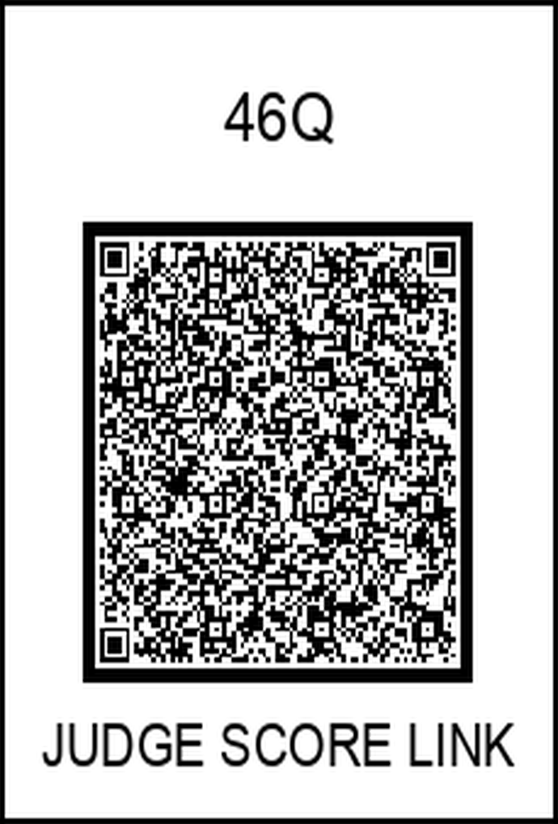
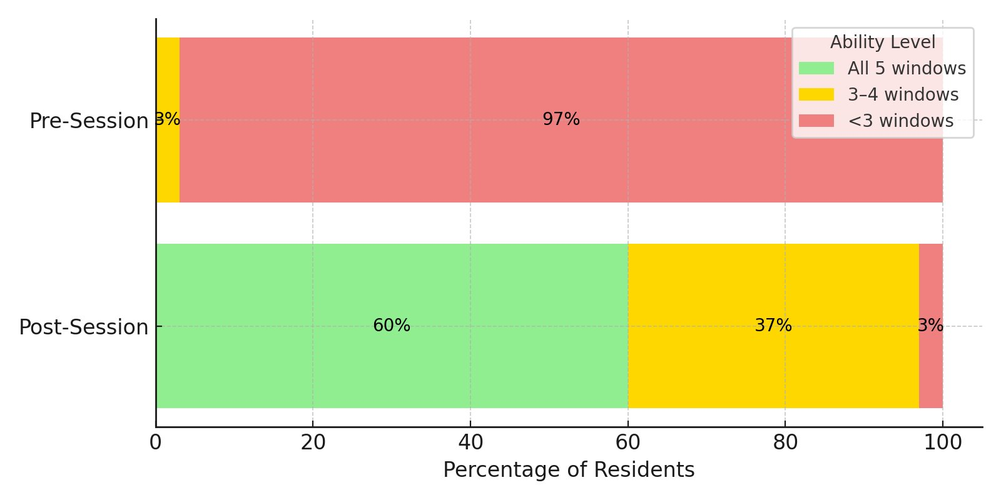
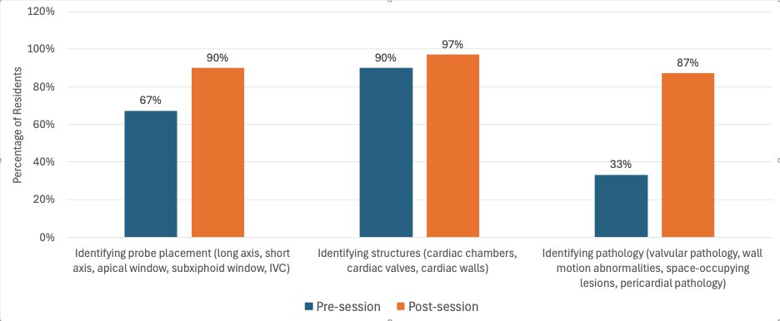
Quality Improvement Project: Bedside Echocardiography Utilization In Clinical Practice Among Internal Medicine Residents
Saif Srouji, MD ; Yazan Haroun, MD ; Nathanael Reyes, MD ; Advisor: Anupama Poliyedath, MD
Graduate Medical Education Internal Medicine – Saint Agnes Medical Center, Fresno, CA
Introduction
Results
Discussion
The importance of bedside echocardiography in modern physician practice can not be overstated. Practice guidelines have well established recommendations for the use of POCUS as it is reliable and easy to perform with the right expertise.
Stemming from our strong belief in the importance of acquiring this important skill during residency, and our desire to build a framework for initiation of such a rotation at our residency program, we present this quality improvement (QI) project. Our goal was to survey our residents to gauge their interest in improving their POCUS skills, and to demonstrate that theoretical and hands-on POCUS training will be beneficial for their practice, in the aim to improve the overall quality of patient care.
A total of 30 internal medicine residents from all classes (PGY1-3) at Saint Agnes Medical Center (Fresno) participated in this QI project. (n=30)
Initial Survey:
29 out of 30 residents (97%) reported that they have interest in attending educational sessions on bedside echocardiography utilization, while 21 residents (70%) said that they plan to incorporate POCUS in their future clinical practice.
Only 15 residents (50%) reported having previous experience with using bedside echocardiography.
17 residents (57%) said that they have difficulty producing different cardiac windows, and an overwhelming 28 residents (93%) reported that they have difficulty identifying disease processes on echocardiography imaging.
Pre Vs. Post Educational Session:
Figure 1: Residents' ability to identify cardiac windows (Pre vs. Post Session)​
Figure 2: Residents' ability to identify probe placement, cardiac structures, and pathology (Pre vs. Post Session)​
Post activity survey:
25 residents (83%) reported that this educational session improved their knowledge, while 2 residents (7%) reported that this educational session was not helpful, and 3 residents (10%) did not provide an answer to this question.
27 residents (90%) conveyed interest in attending hands-on sessions to receive beside echocardiography training sessions, while 3 residents (10%) did not provide an answer to this question.
Currently, our internal medicine residents are exposed to bedside echocardiography during their critical care rotation. We believe that this limited exposure is suboptimal and is better supplemented by an official POCUS curriculum.​
​
There has been multiple studies directed towards internal medicine residents reporting promising results.​ In one prospective observational study conducted on 101 residents, a POCUS workshop was implemented and was followed by 12 months of independent practice. This study showed a significant (p<0.001) 20.8% increase in mean knowledge assessment scores immediately after training. A score decline was noted at 12 months, however the knowledge baseline remained significantly improved from 30.5% to 50.4% at 12 months. [1] ​
​In another study, a focused cardiac ultrasound curriculum was developed and supplemented by an assessment tool. This study included a total of 116 residents. The study reported a mean change of knowledge of 13% in the group who received the curriculum, vs a mere 7% in those wo did not (p <0.0001).The mean change in confidence scores was 0.99 vs 0.39 respectively (p 0.046). [2]​
​
Moreover, a single-center prospective study including 193 resident physicians introduced an echocardiography report interpretation course. This study reported that average scores after the course had significantly improved (2.9 ± 1.3 vs 4.3 ± 1.3; p <0.001). [3]​
Methodology
The QI project was implemented in 6 phases:
Phase 1: Internal Medicine residents were surveyed regarding bedside echocardiography experience, current use, interest in attending educational sessions, plans to utilize POCUS in future practice and confidence in obtaining and interpreting echocardiography imaging.
Phase 2: The residents were asked to take a knowledge assessment exam where they were expected to answer questions relating to correct use of echocardiography, ability to produce and identify common cardiac windows, identifying cardiac structures and ability to identify different abnormal/diseased findings on imaging.
Phase 3: The residents attended an educational session that demonstrated the correct use of bedside echocardiography.
Phase 4: The residents then took a knowledge assessment exam after attending the educational session.
Phase 5: The residents were surveyed for their feedback on the usefulness of this educational session and their interest in attending hands-on sessions to further supplement their practical experience with POCUS.
Phase 6: Results from surveys and exams before and after the educational session were collected and compared to assess for improvement in resident knowledge.
Future Considerations
Considering the overwhelming positive response to this educational session, and the strong interest from a large number of residents in receiving hands-on training with bedside echocardiography, we aim to expand this quality improvement project next year to include hands-on teaching sessions to analyze the benefit of these practical sessions, in addition to re-test knowledge retention at 6 & 12 month intervals.​
We hope that this future sim-lab experience would lay down the grounds for starting an official POCUS curriculum in our internal medicine residency program. ​
References
Town JA, Bergl PA, Narang A, McConville JF. Internal Medicine Residents' Retention of Knowledge and Skills in Bedside Ultrasound. J Grad Med Educ. 2016;8(4):553-557. doi:10.4300/JGME-D-15-00383.1​
Gopal D, Baston C, Adusumalli S, Jagasia D, Prenner S. Focused Cardiac Ultrasound Curriculum for Internal Medicine Residents. POCUS J. 2021;6(1):29-32. Published 2021 Apr 22. doi:10.24908/pocus.v6i1.14759​
3. Yang LT, Tsai MH, Sheng WH, Yu JY, Ho YL. Echocardiography interpretation training and internal medicine milestones: A pilot study. Journal of the Formosan Medical Association. Published online January 7, 2025. doi:https://doi.org/10.1016/j.jfma.2024.12.038​

