Slide 1



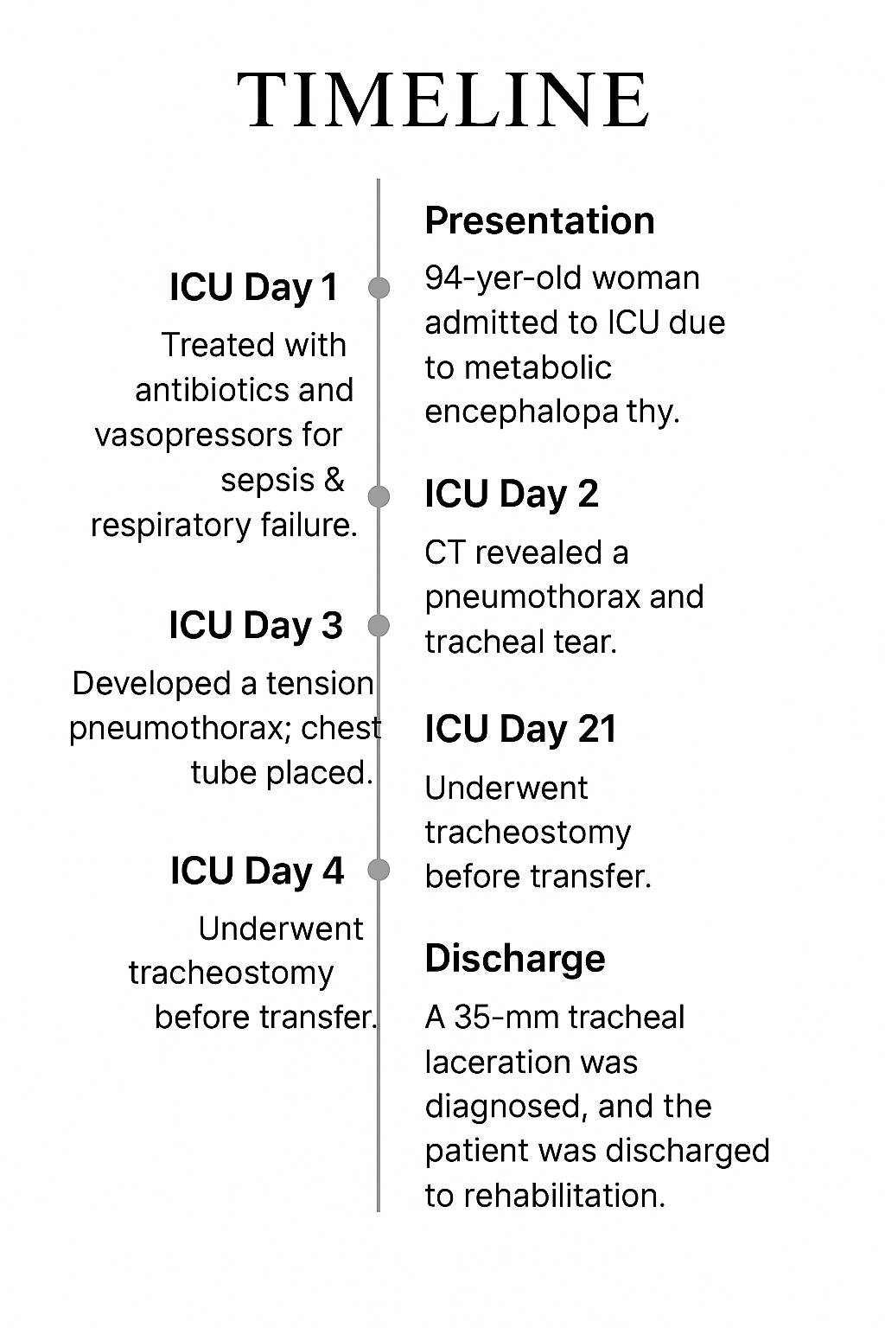
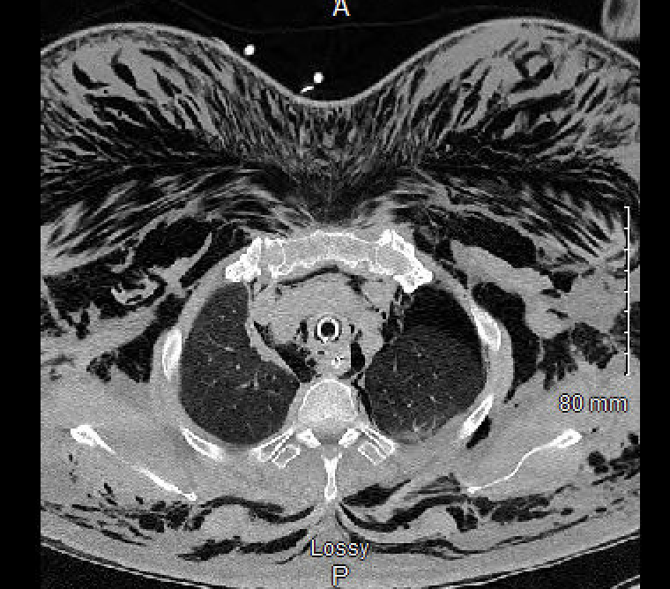
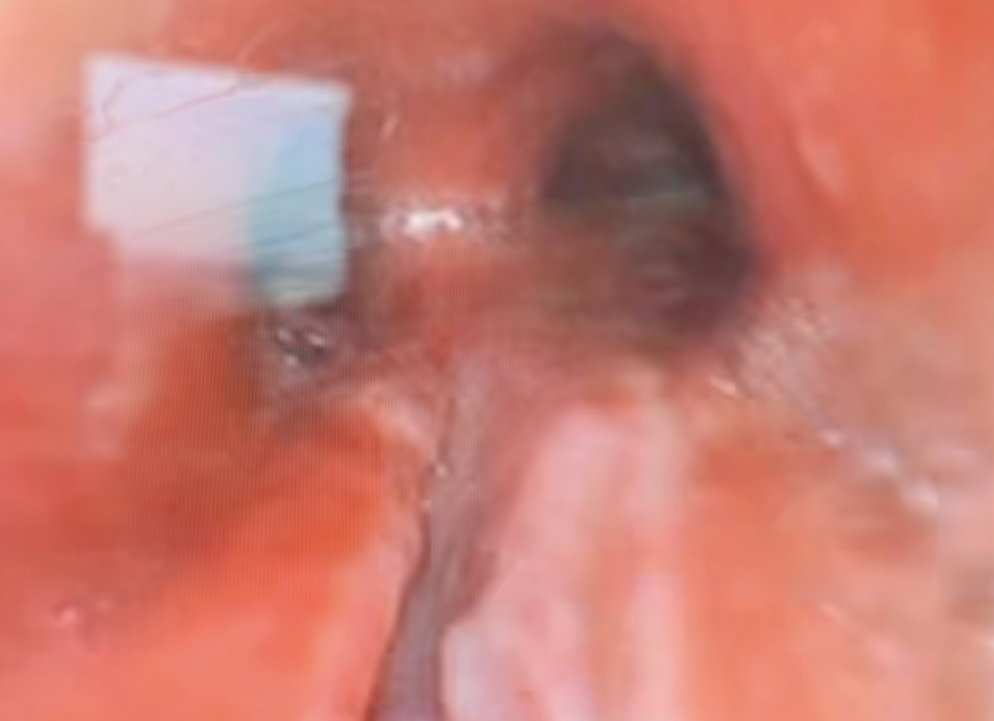
Tube, Tear and Triage: Navigating
Tracheal Rupture in a Critical Patient
Ayesha Shahzad MD, Alexander Fair DO, Hamna Javed MD, Celise Nardes Ferreira MD, Mahwish Sheikh MD, Talal Arab MD, Saqib Rashid MD
Saint Agnes Medical Center, Fresno, CA
Introduction
Figure 2
Tracheal rupture is a rare but serious complication of endotracheal intubation, more common in emergency settings and elderly patients.It has a reported incidence of 0.005% [1, 2]. A high acuity low occurrence event, clinicians must identify those at risk and maintain a high degree of suspicion to identify tracheal rupture early as aggressive treatment measures may be indicated to prevent mediastinitis, development of tracheoesophageal fistula, or prolonged hospital stay in critical care units [3]. Management ranges from surgical repair to conservative treatment based on injury severity and clinical stability [4–6].
Discussion
Case Presentation
This case underscores the rare but serious risk of posterior tracheal rupture following emergent intubation, particularly in elderly patients with underlying respiratory compromise. Tracheal injury may manifest as subcutaneous emphysema, pneumothorax, or ventilatory instability, warranting prompt diagnosis via CT and bronchoscopy. While traditionally managed surgically, select stable cases may be treated conservatively. In this patient, the rupture was likely multifactorial—primarily due to inflammatory damage from recent COVID-19 infection, compounded by concurrent RSV and Influenza A. The distal posterior location of the tear, absence of high ventilatory pressures, properly sized equipment, and lack of prior tracheal pathology or procedural trauma suggests a pathogenesis rooted in viral-induced mucosal friability. Bronchoscopy revealed extensive circumferential soft tissue fragility, reinforcing this hypothesis. This case highlights the need for early recognition, a multidisciplinary approach, and individualized treatment strategies in managing post-intubation tracheal injuries.
A 84-year-old female with a history of asthma who presented with acute metabolic encephalopathy. She was found to be hypoxic, hypertensive, and tachycardic with a GCS of 3, necessitating emergent intubation. Multiple attempts were required, and initial chest X-ray revealed right mainstem intubation and right middle lobe consolidation. She was diagnosed with COVID-19, RSV and Influenza A. The initial attempt was with video laryngoscopy, but the tube was unable to be advanced past the vocal cords, the second attempt was via direct laryngoscopy with a smaller diameter endotracheal tube, of note a bougie or rigid stylet was never used.
After tube repositioning, ventilation improved. Labs were consistent with acute hypoxic hypercapnic respiratory failure in the setting of sepsis; she received ceftriaxone and azithromycin and was started on vasopressors. Imaging and physical exam on ICU day 1 revealed extensive subcutaneous emphysema, pneumomediastinum, and a suspected tracheal injury. CT imaging confirmed a moderate left-sided pneumothorax and posterior tracheal wall defect near the carina (Figure 2). Bronchoscopy visualized a mucosal flap, confirming the diagnosis (Figure 1).
On ICU day 3, the patient developed a tension pneumothorax with profound acidosis (pH 6.98), requiring chest tube placement, sedation, paralysis, and increased ventilator support. Transfer to a higher level of care was delayed due to bed availability. On ICU day 21, a tracheostomy was performed, allowing for successful transfer. At the tertiary facility, she was diagnosed with a 35 mm posterior tracheal laceration extending to the carina. Due to her stable clinical course, surgical intervention was deferred in favor of conservative management. The patient improved and was discharged to a rehabilitation facility. This case illustrates the risk of tracheal rupture during difficult intubation in elderly patients and emphasizes the value of early imaging, bronchoscopy, and multidisciplinary coordination in managing complex airway injuries.
Figure 1
Conclusion
Tracheal rupture is a rare but serious complication of intubation, particularly in elderly patients. Although the exact cause may be unclear, early identification of risk factors and prompt diagnosis are crucial to prevent severe outcomes such as tracheoesophageal fistula. Management should be individualized based on patient condition, ranging from surgical repair to conservative therapy. Clinicians must maintain a high index of suspicion following difficult intubations, and multidisciplinary collaboration is key to optimizing patient outcomes. Further research is needed to improve prevention and diagnostic strategies.
References
.Lim H, Kim JH, Kim D, Lee J, Son JS, Kim DC, Ko S. Tracheal rupture after endotracheal intubation - A report of three cases -. Korean J Anesthesiol. 2012 Mar;62(3):277-80. doi: 10.4097/kjae.2012.62.3.277. Epub 2012 Mar 21. PMID: 22474557; PMCID: PMC3315660.
Passera E, Orlandi R, Calderoni M, Cassina EM, Cioffi U, Guttadauro A, Libretti L, Pirondini E, Rimessi A, Tuoro A and Raveglia F (2023) Post-intubation iatrogenic tracheobronchial injuries: The state of art. Front. Surg. 10:1125997. doi: 10.3389/fsurg.2023.1125997
Carbognani, P., Bobbio, A., Cattelani, L., Internullo, E., Caporale, D., & Rusca, M. (2004). Management of postintubation membranous tracheal rupture. The Annals of thoracic surgery, 77(2), 406-409.
Conti M, et al. Ann Thorac Surg. 2006;81(4):1484–7.
ardillo G, et al. Chest. 2010;138(5):1279–85.
Hofmann HS, et al. Ann Thorac Surg. 2002;73(3):806–10.

