Slide 1

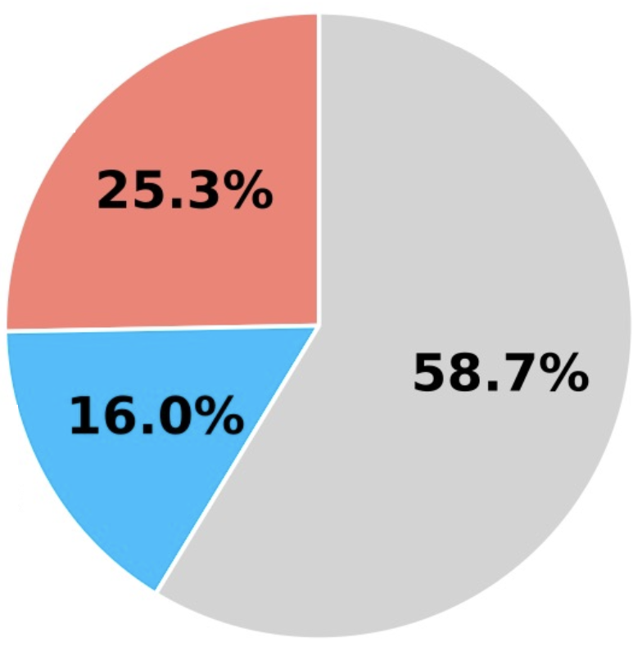


High Mortality Risk in Gram-Negative Hemodialysis
Catheter Tip Infections the Urgent Need for Early Detection
Kamalpreet Gill MD, Celise Nardes Ferreira MD, Ajaypreet Singh MD, Shahab Dian MD
Internal Medicine Residency
Saint Agnes Medical Center, Fresno, CA
Introduction
3-Month Mortality in HD Patients by Bacteremia
Discussion
Infections of hemodialysis (HD) catheter tips caused by Gram-negative bacteria, particularly Enterobacter species, can be serious and even life-threatening. These infections typically start with localized colonization and can quickly escalate to systemic bacteremia, posing a significant early mortality risk. Studies show a three-month mortality rate of approximately 25.3% for Gram-negative bacteremia in HD patients, compared to 16% for Gram-positive bacteremia. If left untreated, initial infections can lead to severe complications like sepsis and endocarditis and may require catheter removal and replacement. This highlights the urgent need for quick diagnosis and effective treatment to prevent serious outcomes.
Our patient experienced recurrent fevers and flu-like symptoms despite a prior hospital visit one month earlier, where he was discharged due to low suspicion of infection—marked by the absence of fever, normal leukocyte count, no signs of infection at the catheter site, and negative blood cultures. Upon his latest visit to the emergency department, he was diagnosed with HD catheter tip infection with Enterobacter cloacae. Notably, he had a history of similar symptoms and Enterococcus faecalis bacteremia nine months prior. This patient also had additional risk factors for catheter-related infections (CRI) including a history of DVT and a previous bacteremia episode, which significantly heightens the risk of microbial colonization. Literature indicates that Gram-positive organisms account for 55.7% to 66% of CRI, while Gram-negative organisms, like Enterobacter species, are less common, representing about 26.7% of cases. Enterobacter cloacae infections in tunneled HD catheter tips are rare without accompanying bacteremia, as they typically originate from environmental sources. Untreated HD catheter tip infections with Gram-negative bacteria can lead to significant morbidity and mortality. Effective management is crucial to prevent severe complications. Early recognition and aggressive treatment are vital, requiring both systemic antibiotics and catheter management, including removal and replacement at a different site. The Kidney Disease Outcomes Quality Initiative guidelines recommend a 10 to 14-day course of antibiotics for CRI, even in the absence of bacteremia.
Gram-negative bacteremia
Gram-positive bacteremia
Other/Survived
Case Presentation
A 46-year-old man with autosomal dominant polycystic kidney disease and end-stage renal disease on hemodialysis presented with episodic fevers up to 104°F and flu-like symptoms for one month occurring during HD sessions. His past medical history included enterococcus faecalis bacteremia and right subclavian deep vein thrombosis (DVT) on Eliquis. He had previously visited the emergency department for similar symptoms but was discharged without evidence of infection. Upon readmission, he had a 103.1°F fever, persistent myalgia, no leukocytosis, and a clean catheter site. An extensive workup—including chest X-ray, CT abdomen/pelvis, viral panel, urine analysis, transthoracic echocardiogram and blood cultures were all negative. His fever subsided after acetaminophen. Infectious disease recommended culturing the hemodialysis catheter tip, which grew fewer than 15,000 colonies of Enterobacter cloacae. After catheter removal, his symptoms resolved, follow-up blood cultures were negative, and he received a new tunneled catheter. He completed a 3-day course of Zosyn and Vancomycin but was not continued on antibiotics afterward. A repeat ultrasound duplex of the right upper extremity couldn’t confirm persistent DVT. He was discharged symptom free, with no recurrence during subsequent hemodialysis sessions.
References
1. Dalgaard, L. S., Nørgaard, M., Jespersen, B., Jensen-Fangel, S., Østergaard, L. J., Schønheyder, H. C., & Søgaard, O. S. (2015). Risk and Prognosis of Bloodstream Infections among Patients on Chronic Hemodialysis: A Population-Based Cohort Study. PLoS ONE, 10(4), e0124547. https://doi.org/10.1371/journal.pone.0124547
2. Liang, X., Liu, Y., Chen, B., Li, P., Zhao, P., Liu, Z., & Wang, P. (2021). Central venous disease increases the risk of microbial colonization in hemodialysis catheters. Frontiers in Medicine, 8. https://doi.org/10.3389/fmed.2021.645539
3. Lok, C. E., Huber, T. S., Lee, T., Shenoy, S., Yevzlin, A. S., Abreo, K., Allon, M., Asif, A., Astor, B. C., Glickman, M. H., Graham, J., Moist, L. M., Rajan, D. K., Roberts, C., Vachharajani, T. J., & Valentini, R. P. (2020). KDOQI Clinical Practice Guideline for Vascular Access: 2019 update. American Journal of Kidney Diseases, 75(4), S1–S164. https://doi.org/10.1053/j.ajkd.2019.12.001
4. Murray, E. C., Marek, A., Thomson, P. C., & Coia, J. E. (2015). Gram-negative bacteraemia in haemodialysis. Nephrology Dialysis Transplantation, 30(7), 1202–1208. https://doi.org/10.1093/ndt/gfv205
5. Van Eck Van Der Sluijs, A., Oosterheert, J. J., Ekkelenkamp, M. B., Hoepelman, I. M., & Peters, E. J. G. (2011). Bacteremic complications of intravascular catheter tip colonization with Gram-negative micro-organisms in patients without preceding bacteremia. European Journal of Clinical Microbiology & Infectious Diseases, 31(6), 1027–1033. https://doi.org/10.1007/s10096-011-1401-0

