Slide 1

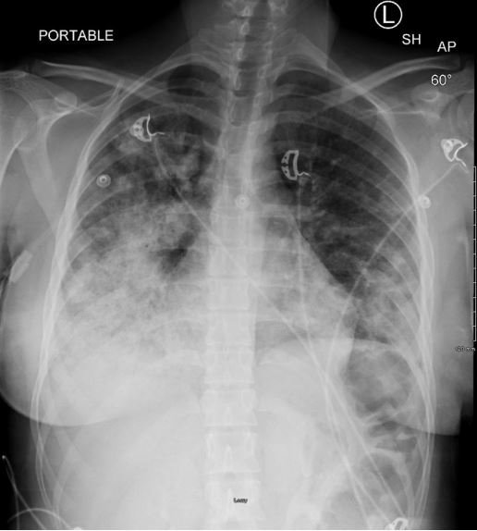
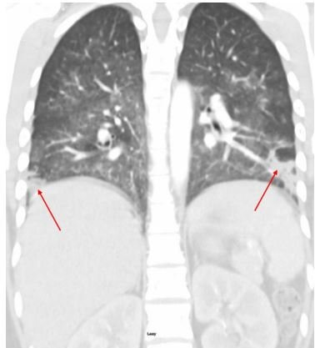
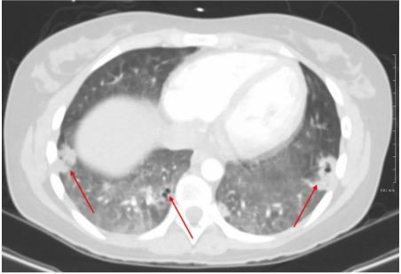
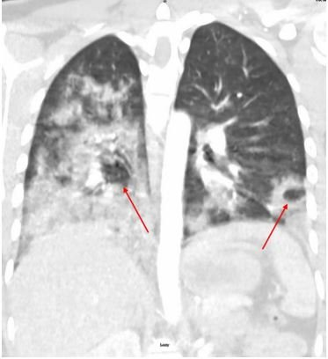
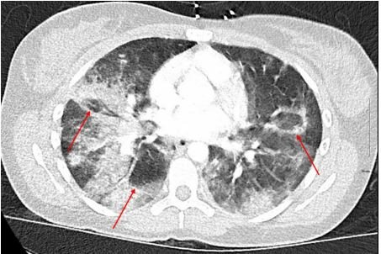


A Case of Granulomatosis with Polyangiitis in a 20-year-old Female
Martin Young, MD, MS; Gullerana Ahmad, MD; Erick Melara MD; Shareen Purewal, BS; Ruqayya Gill, DO​
Emergency Medicine Residency, Saint Agnes Medical Center, Fresno, CA
Introduction
Work Up and Management
Conclusion
Granulomatosis with Polyangiitis (GPA), formerly Wegener’s granulomatosis, is a rare, potentially life-threatening autoimmune vasculitis characterized by inflammation of blood vessels and granuloma formation, often leading to organ damage. It commonly affects the respiratory tract but can involve multiple systems. Though the exact cause is unknown, GPA is believed to result from an abnormal immune response. Treatment typically includes corticosteroids and immunosuppressive agents. GPA most often occurs in Caucasian males aged 30–50 and is associated with a history of autoimmune disease. This case is notable for its presentation in a previously healthy 20-year-old female—an uncommon demographic for GPA.
Initial ED labs revealed hyponatremia (127), elevated LDH (279), hypophosphatemia (1.9), leukocytosis (12.3), and anemia (Hgb 7.4 to 6.3), requiring transfusion. Chest imaging showed multifocal consolidation and cavitary lesions, suggesting pneumonia or diffuse alveolar hemorrhage (DAH). These findings, alongside respiratory failure, hemoptysis, and anemia, raised concerns for opportunistic infections, fungal pneumonias, and vasculitis. Autoimmune testing confirmed PR3-ANCA positivity, strongly indicating Granulomatosis with Polyangiitis (GPA).​Bronchoscopy confirmed granulomatous inflammation. During her two-week ICU stay, she received plasmapheresis, high-dose corticosteroids, Rituxan, and Bactrim prophylaxis. She was transferred for higher-level care but was downgraded, making her ineligible for the ICU transfer. After two additional weeks in the hospital, she was discharged with outpatient follow-up in transplant, pulmonology, and rheumatology.​
Seven days post-discharge, she presented with left leg pain and edema, diagnosed with a left femoral vein DVT. She was treated with anticoagulation and interventional radiology consultation, discharged after a three-day stay.
This case involves a previously healthy 20-year-old female who initially presented with anemia and arthralgias, later returning in respiratory failure, pneumosepsis, and worsened anemia. Although systemic vasculitis was not initially suspected, imaging revealed cavitary lesions and a drop in hemoglobin likely due to diffuse alveolar hemorrhage (DAH), prompting a comprehensive autoimmune workup and treatment. Granulomatosis with polyangiitis (GPA) is a potentially fatal condition, with 80% of cases leading to death within a year without appropriate treatment, underscoring the importance of early diagnosis to prevent irreversible organ damage. While GPA typically presents in the fourth to sixth decades of life, this case highlights the need to consider it in younger patients presenting with pneumonia, respiratory failure, and hemoptysis. Hemoptysis and cavitary lesions in GPA are often caused by alveolar hemorrhage and necrotizing granulomas, which can mimic severe pneumonia.
Patient Presentation
Cxr Day1: Small volume bilateral pleural effusions with associated atelectasis and consolidations
A 20-year-old Hispanic female with a history of anemia presented to the ED with three days of joint stiffness, worse in the morning. Vitals showed sinus tachycardia (HR 104); she appeared pale but had no joint swelling or deformities. Labs revealed anemia (Hgb 7.4) and elevated inflammatory markers (ESR 67, CRP 38.3). She was discharged with iron, ondansetron, and ibuprofen.​
Four days later, she returned with fever (100.9°F), tachycardia (HR 152), hemoptysis, and respiratory distress (SpO₂ 85% on room air), requiring high-flow oxygen. She appeared ill and near respiratory failure. Differential included PE, pneumonia, sepsis, coccidioidomycosis, and coagulopathies. Sepsis workup, broad-spectrum antibiotics, antifungals, and CT angiography were initiated; critical care was consulted due to rapid decompensation and was admitted to the ICU as an intubation watch.
Key Points
1. Patients presenting with hemoptysis, concern for pneumosepsis, and in respiratory failure should include a systemic vasculitis in the differential diagnosis. ​
​
2. An early multimodal treatment approach of high-dose steroids, biologics, immunosuppression, and plasmapheresis may prove to be lifesaving.​
​
3. Timely resuscitation and escalation of care are critical, especially in patients with atypical or evolving presentations. This case highlights the importance of clinical judgment—despite not meeting traditional ICU admission criteria, the patient’s rapid deterioration and overall clinical picture warranted higher-level care. Early sepsis management, including transfusion and broad-spectrum coverage, should not be delayed. When concern persists despite inconclusive findings, proactive communication and early critical care consultation can significantly impact outcomes.
CT Chest Day 1: Large multifocal consolidation throughout the right upper lobe and bilateral lower lobes and additional smaller patchy opacities in the left upper lobe are compatible with severe multifocal pneumonia or asymmetric pulmonary edema. Red arrows showing cavitary lesions.
CT Chest Day 30: Significant interval decrease of bilateral consolidations and compared to prior exam. However, there is diffuse groundglass opacities predominantly in the central lungs with multiple nodules/masses with central cavitations. These findings may be seen GPA given patient history. The diffuse groundglass opacities suggest superimposed infection or inflammation.

