Slide 1
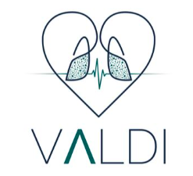


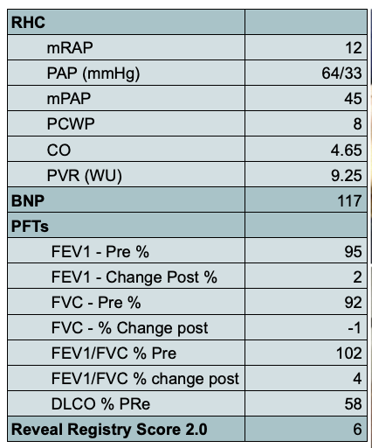
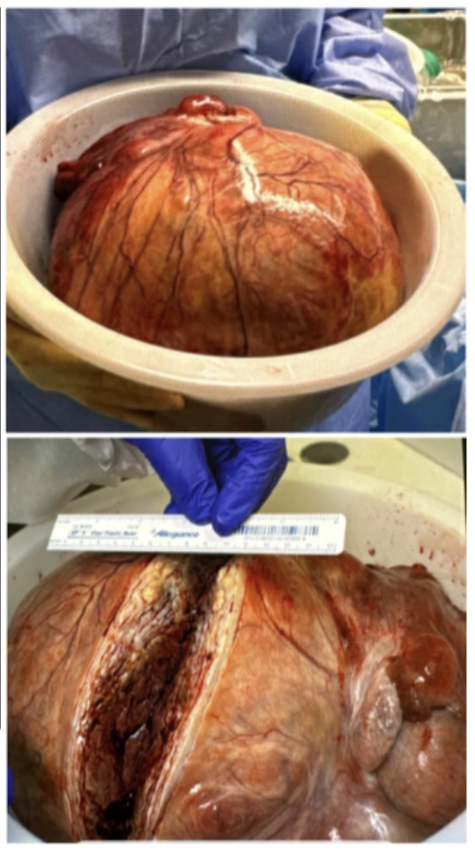
PHibroid: A Case of Pulmonary Hypertension
Induced by a Giant Uterine Leiomyoma
Hamna Javed, MD; Mahwish Sheikh, MD; Andrew Clark, MD; Aftab Arif, MD;
Vijay Balasubramanian MD, MRCP (UK), FCCP
Internal Medicine Residency, Saint Agnes Medical Center, Fresno, CA
Pulmonary & Critical Care Medicne, Valley Advanced Lung Disease Institute, Fresno, CA
Introduction
Pulmonary Arterial Hypertension(PAH) is a devastating disease that can affect young women. It is relatively rare. Delayed diagnosis can lead to Right heart failure and death. Patients with PAH can carry a high mortality risk associated with surgery. Uterine fibroids are common in young women as well. We present a case of a 28-year-old female who presented with a large Uterine fibroid and PAH simultaneously.
Case Presentation
A 28-year-old female presented to the pulmonary clinic due to worsening shortness of breath which was abrupt in onset along with a large abdominal pelvic mass. On presentation, she was noted to have 2+ pitting edema of bilateral lower extremities, cough, dizziness on bending, and bendopnea. She denied a history of VTE, prior pregnancies, or recreational drug use.
An echocardiogram revealed an EF of 50%, severely dilated right atrium and right ventricle with interatrial septal bowing towards the left atrium. The estimated RVSP was 70.5 mmHg. Right heart catheterization confirmed WHO Group I PAH with WHO FC III – Intermediate high-risk features. A CT abdomen showed a large conglomerate mass arising from the uterus or adnexa measuring 33 x 20 x 20 cm above 16 smaller masses with the largest one measuring 26 cm in diameter. CT Pulmonary angiogram was negative for pulmonary embolism but revealed enlargement of the main pulmonary artery. Surgery was recommended for the large Uterine fibroid. However, a new diagnosis of WHO Gp I PAH with Intermediate to high-risk features was also simultaneously diagnosed. A semi-elective surgery plan was planned. The patient was started on tadalafil 40 mg and macitentan 10 mg daily with excellent clinical response. She was admitted 3 days ahead of planned surgery and started on parenteral prostacyclin therapy (PPT)
She underwent resection of the large uterine fibroid with a successful outcome (figure 1). PPT was weaned off post-operatively. The table in Figure 1 depicts the patient's right heart catheterization, pulmonary function test, and lab results.
Image 1: Post-operative image of leiomyoma
Conclusion
PAH is well known to be associated with high peri-operative mortality. A systematic planned approach can certainly minimize this risk. In our patient, both diagnoses were made simultaneously and surgical resection was indicated for the large uterine mass. A comprehensive systematic evaluation and a multidisciplinary approach resulted in a favorable outcome.
Table 1: PAH findings including RHC, PFTs, labs and Reveal Lite 2 score
Discussion
References
Pulmonary arterial hypertension (PAH) is a progressive disease with high perioperative mortality risk, particularly in young women [1,[2]. Surgery in PAH patients requires careful multidisciplinary planning due to risks of right heart failure[3]. Our patient presented with simultaneous WHO Group I PAH and a massive uterine fibroid, requiring urgent but carefully coordinated intervention. Preoperative optimization with tadalafil, macitentan, and perioperative parenteral prostacyclin therapy was essential for surgical success[4, 5]. This case highlights the importance of early PAH diagnosis, individualized therapy, and comprehensive perioperative management to improve outcomes[6, 7].
Humbert M, Kovacs G, Hoeper MM, et al. 2022 ESC/ERS Guidelines for the diagnosis and treatment of pulmonary hypertension. Eur Heart J. 2022;43(38):3618-3731. doi:10.1093/eurheartj/ehac237
Hoeper MM, Pausch C, Grünig E, et al. Characterization of patients with pulmonary arterial hypertension at diagnosis in the modern management era: Data from the COMPERA registry. J Heart Lung Transplant. 2022;41(10):1174-1183. doi:10.1016/j.healun.2022.07.011
Price LC, Montani D, Jais X, et al. Noncardiothoracic nonobstetric surgery in patients with pulmonary hypertension: Data from the French Pulmonary Hypertension Registry. Eur Respir J. 2010;35(6):1294-1302. doi:10.1183/09031936.00013909
Parker WH. Etiology, symptomatology, and diagnosis of uterine myomas. Fertil Steril. 2007;87(4):725-736. doi:10.1016/j.fertnstert.2007.01.093
Galiè N, Channick RN, Granton J, et al. Combination of macitentan and tadalafil in pulmonary arterial hypertension. N Engl J Med. 2015;373(9):834-844. doi:10.1056/NEJMoa1413687
Minai OA, Yared JP, Kaw R, et al. Perioperative risk and management in patients with pulmonary hypertension. Chest. 2013;144(1):329-340. doi:10.1378/chest.12-1910 ↩
Tambakis A, Brown LM, Wirth JA, et al. Surgical outcomes in patients with pulmonary arterial hypertension: A comprehensive review. Pulm Circ. 2022;12(3):e12132. doi:10.1002/pul2.12132

