Slide 1

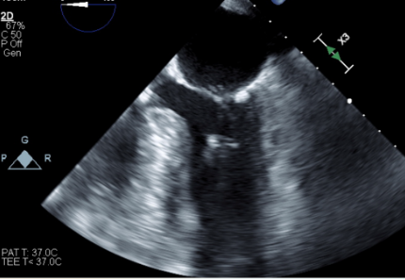
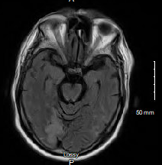
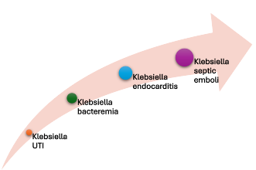

Mitral Valve Infective Endocarditis Caused by Klebsiella Aerogenes with
Septic Emboli to the Brain: A Rare Case Report
Nasrin Nikravangolsefid MD-MPH, Mahmut Unverdi MD, Bakht Roshan MD, Shahab Dian MD
Internal Medicine Department, Saint Agnes Medical Center, Fresno, CA
Introduction
Case Presentation
Endocarditis caused by non-HACEK gram negative bacteria, such as Klebsiella species, is a rare and life-threatening infection and often associated with poor outcomes in elderly patients.
Non-HACEK gram-negative organisms have a limited ability to form biofilms and a low affinity for the endocardial epithelium, which likely accounts for the infrequency of endocarditis cases attributed to these pathogens.
This case report describes an unusual presentation of Klebsiella endocarditis that developed following a Klebsiella urinary tract infection and was further complicated by septic emboli to the brain.
After transferring to a higher center, the thoracic spine MRI showed discitis and osteomyelitis at the T10/T11 level. He underwent T10/T11 laminectomies, washout, and decompression.
A 6-week course of gentamicin and ertapenem was initiated for antibiotic therapy.
Mitral valve replacement surgery was deferred due to deconditioning.
At the two-month follow-up, the patient’s symptoms had resolved, and cardiac surgery was planned for the next month.
Case Presentation
Discussion
Figure 1. TEE showed vegetation in the posterior mitral valve leaflet
A 76-year-old man presented with shortness of breath that began 6 days ago
PMH: hypertension, pulmonary embolism (on apixaban), and chronic back pain.
He recently returned from a trip to Oregon and reported feeling fatigue and fever.
Prior to admission, he was treated at another facility for a urinary tract infection caused by Klebsiella aerogenes sensitive to ciprofloxacin and discharged on ciprofloxacin and cephalexin.
Upon presentation, the patient exhibited worsening respiratory distress and severe back pain.
Initial vital signs o2 sat 80% on room air, improving to 94% on 6L/min NC
T 37.8°C, HR 108 bpm, BP 104/67 mmHg, RR 20 breaths/min
Physical examination: bilateral lung crackles, lower extremities mottling, and pitting edema.
Sinus tachycardia on EKG, borderline leukocytosis (WBC 10.3 x 10^3/µL), thrombocytopenia (platelets 67,000/µL), mildly elevated creatinine (1.35 mg/dL), ad hypokalemia (K 3.2 mEq/L)
Troponin levels, urinalysis and respiratory viral panel unremarkable
Chest radiography and CT angiography pulmonary vascular congestion and cardiomegaly, without evidence of pulmonary embolism.
Transthoracic echocardiography: severe aortic stenosis, hyperdynamic left ventricular systolic function with ejection fraction more than 70%
Treated with diuretics based on a diagnosis of acute hypoxic respiratory failure due to heart failure and volume overload.
2nd day, his condition deteriorated, with increased dyspnea, altered mental status, abdominal distension, and fever.
Blood cultures were drawn, and broad-spectrum antibiotic (Meropenem) was initiated.
Subsequent abdominal imaging and surgical evaluation confirmed colonic ileus.
On day 4, blood cultures grew Klebsiella aerogenes, a gram-negative bacillus.
Antibiotic therapy was adjusted to a higher dose of meropenem based on susceptibility testing.
TEE identified vegetation on the posterior mitral valve leaflet with moderate regurgitation.
Brain MRI performed due to persistent neurological symptoms, showed multiple acute and subacute infarcts in both anterior and posterior circulations, consistent with septic emboli.
Gentamicin was added to the meropenem regimen.
The patient's mental status and fever improved with treatment. However, given the need for urgent cardiac surgery for infective endocarditis, he was transferred to a higher-level care center for further management.
Gentamicin and meropenem were continued for two weeks until the transfer.
Non-HACEK gram-negative organisms generally have a low affinity for the endocardial epithelium, contributing to the relatively few reported cases of endocarditis.
In our patient, despite the absence of a prosthetic valve, endocarditis developed on the mitral valve, a rare occurrence in the literature.
Combination antibiotic therapy was started; however, there is limited data comparing the outcomes of combination therapy versus monotherapy for non-HACEK endocarditis, highlighting the need for further research.
References
Figure 2. Brain MRI showed acute and subacute infarcts in the anterior and posterior circulations
Parra JC, De Castro-Campos D, García PM, Samperio MO, Arriaza MM, De Alarcón A, Gutierrez-Carretero E, Alvarez MC, Meda JM, Sanchez MÁ, García RR. Non-HACEK gram negative bacilli endocarditis: Analysis of a national prospective cohort. European Journal of Internal Medicine. 2021 Oct 1;92:71-8.
Morpeth S, Murdoch D, Cabell CH, Karchmer AW, Pappas P, Levine D, Nacinovich F, Tattevin P, Fernández-Hidalgo N, Dickerman S, Bouza E. Non-HACEK gram-negative bacillus endocarditis. Annals of internal medicine. 2007 Dec 18;147(12):829-35.
Veve MP, McCurry ED, Cooksey GE, Shorman MA. Epidemiology and outcomes of non-HACEK infective endocarditis in the southeast United States. PLoS One. 2020 Mar 10;15(3):e0230199.
Ioannou P, Miliara E, Baliou S, Kofteridis DP. Infective endocarditis by Klebsiella species: a systematic review. J Chemother. 2021 Oct;33(6):365-374.

