Slide 1
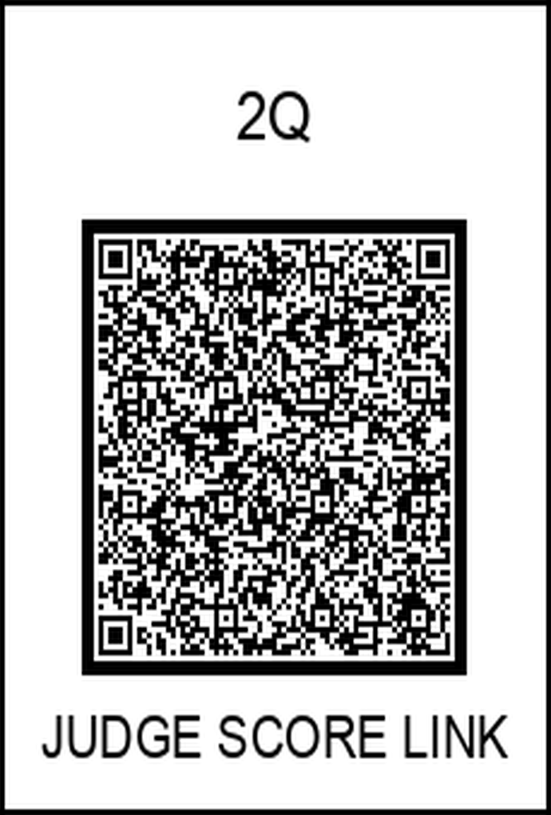
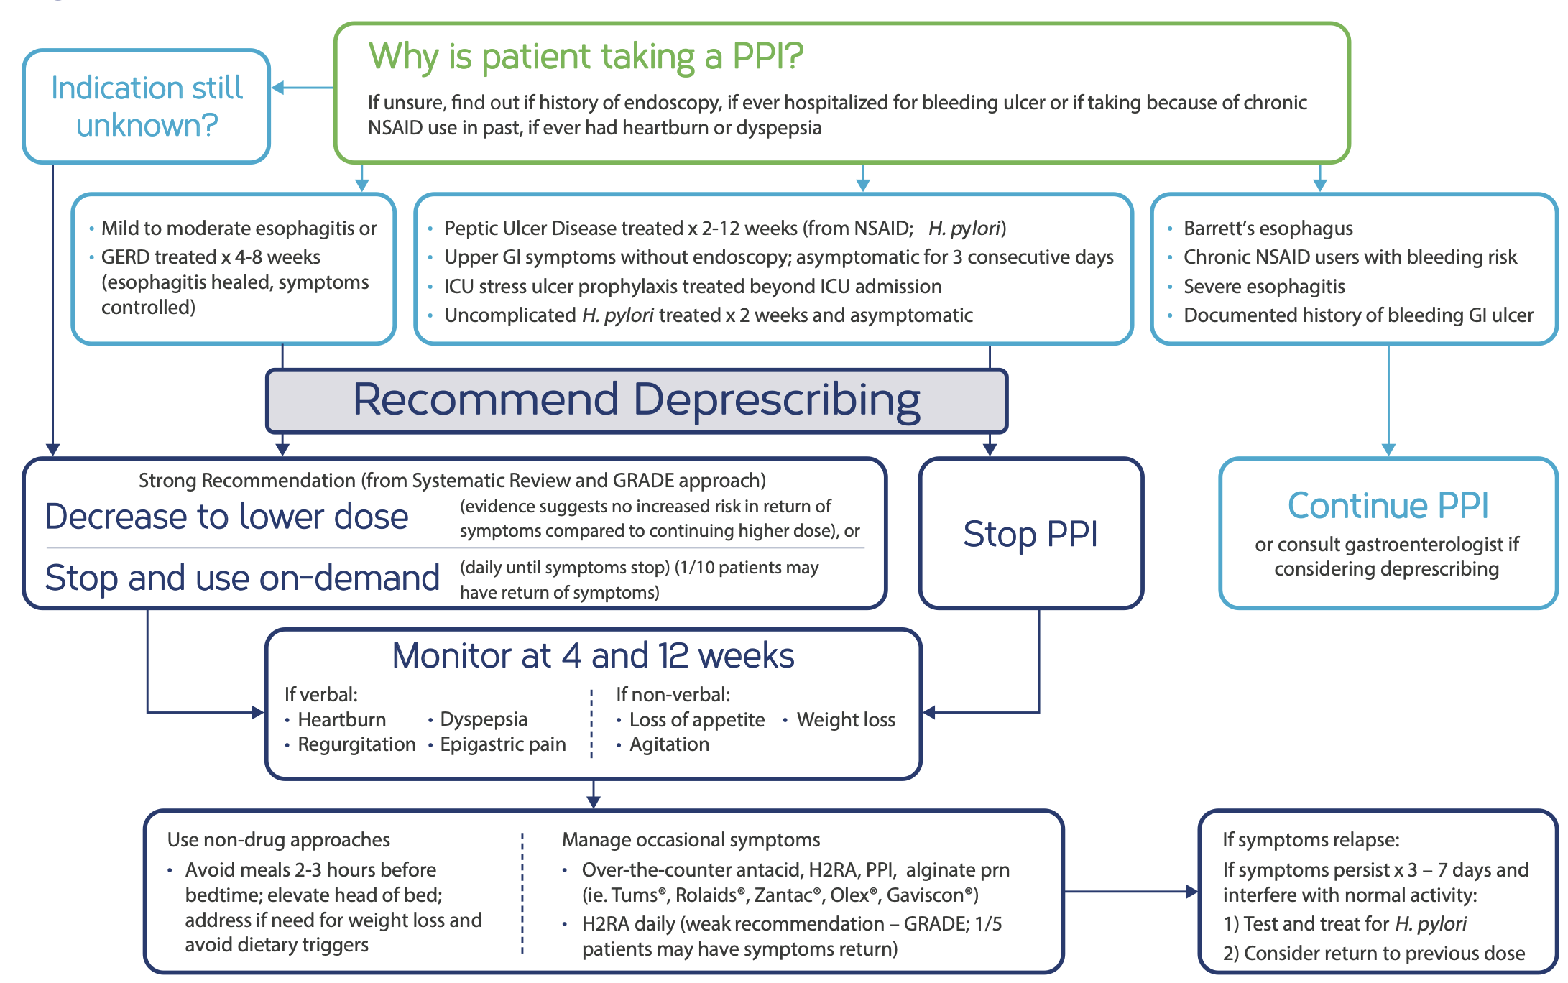
Reassessing the Need: A Quality Improvement Initiative for Appropriate PPI Prescribing
Ajaypreet Singh MD, Muhamad Oum MD, Kamalpreet Gill MD, Mehdi Hakimipour MD, Anupama Poliyedath MD
Introduction
Results
Proton pump inhibitors (PPIs) are some of the most commonly prescribed medications for treating conditions related to stomach acid, such as gastroesophageal reflux disease (GERD), erosive esophagitis, gastritis, peptic ulcers, and Barrett’s esophagus. They effectively reduce stomach acid and provide relief for many patients. Despite their effectiveness, there is increasing evidence that PPIs are often overused. Many times, they are prescribed without the right reasons or are continued longer than necessary. Current guidelines suggest using PPIs for a short period, usually 6 to 8 weeks. After this time, doctors should reassess the patient's symptoms and underlying condition. If symptoms come back, further tests, such as an esophagogastroduodenoscopy (EGD), may be needed to find the cause and plan the appropriate treatment. In practice, however, many patients stay on PPIs for a long time without proper follow-up or documentation of why they are taking them. This can lead to unnecessary risks. Long-term use of PPIs can cause problems such as nutrient deficiencies (like vitamin B12 and magnesium), a greater chance of fractures, dementia, kidney disease, and infections, including Clostridioides difficile.
Among the 120 patient charts reviewed, 77 patients (64%) were found to have been on PPI therapy for less than six months, consistent with guideline-directed short-term treatment. However, 43 patients (36%) had been on PPIs for more than six months without a clearly documented indication for ongoing use or evidence of recent reassessment. Many of these cases lacked documentation of follow-up evaluation, symptomatic review, or consideration for de-escalation.
Conclusion
Our quality improvement initiative, titled "PPI De-escalation," has revealed that inappropriate long-term use of PPIs is a prevalent issue within our outpatient clinic setting. This finding highlights the need for more structured and proactive management of patients receiving PPI therapy. In response, we have implemented a targeted educational intervention for resident physicians to increase awareness about the importance of regular medication review and appropriate de-escalation strategies.
Methodology
Recommendations
To better understand the patterns of PPI use within our practice and to identify opportunities for improvement, we conducted a retrospective chart review of 3,309 patients seen in our outpatient clinic. From this population, we identified 733 (22%) patients with a documented history of PPI prescriptions. We identified long-term PPI use ( >6 months), but due to time and resource limitations, a focused preliminary analysis was conducted on a randomly selected subset of 120 patients. Patient records were reviewed to assess the duration of PPI therapy and the clinical indications for continued use.
Key components of the initiative include:
Encouraging residents to assess the duration and indication of PPI use at every follow-up visit.
Reinforcing the importance of timely gastroenterology referrals for patients with persistent or complex symptoms.
Implementing step-down therapy when appropriate, such as reducing the PPI dose (e.g., from twice daily to once daily), switching to a less potent acid suppressant like H2-receptor antagonists (e.g., famotidine), or considering discontinuation when clinically feasible.

