Slide 1


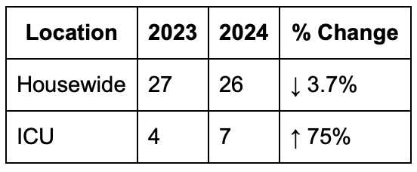
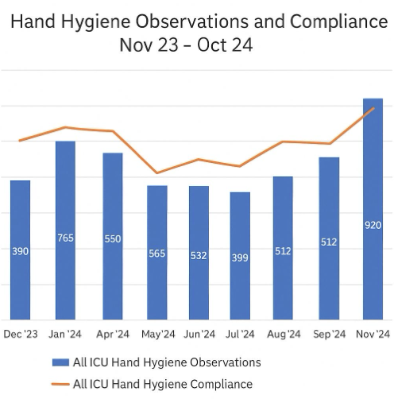

STOP THE SPREAD: A Quality Improvement Initiative to Reduce Hospital-Acquired
Clostridioides difficile Infections in a Community Hospital ICU
Kamalpreet Gill MD, Andrew Clark MD, Ajaypreet Singh MD, Aftab Arif MD,
Hamna Javed MD, Amritpal Nat MD, Pankaj Bharati MD
Saint Agnes Medical Center, Fresno, CA
Introduction
Results
Hospital-acquired Clostridioides difficile infections (HA-CDI) remain a leading cause of healthcare-associated diarrhea, linked to significant morbidity, extended hospital stays, and increased healthcare costs. In 2024, our 150-bed community hospital experienced a notable rise in HA-CDI rates, exceeding the National Healthcare Safety Network (NHSN) benchmark of 6.3 cases per 10,000 patient-days. Recognizing this trend as both a patient safety threat and a financial burden, a multidisciplinary Quality Improvement (QI) team was assembled. The team aimed to identify modifiable risk factors and implement targeted, evidence-based interventions to reduce HA-CDI incidence, particularly focusing on high-risk units such as the ICU, where early signs of increased vulnerability were already evident.
From 2023 to 2024, hospital-wide HA-CDI cases decreased slightly from 27 to 26 (↓3.7%), indicating stable overall performance. However, ICU cases increased from 4 to 7 (↑75%), highlighting a critical need for targeted ICU-specific interventions. ICU hand hygiene compliance steadily improved over the year, nearing 100% by November 2024. Peak observation counts in hand hygiene compliance in November (920 observations) aligned with the highest compliance, reinforcing the effectiveness of increased auditing and feedback. Notably, since implementing interventions, no HA-CDI cases were reported from January through March 2025.
Discussion
Despite a modest decline in house wide HA-CDI rates, the rise in ICU cases suggests a persistent vulnerability in critical care settings. Positive trends in hand hygiene and antibiotic stewardship demonstrate the value of real-time feedback, environmental monitoring, and staff education. Early 2025 data showing zero reported cases indicating promising outcomes; however, sustained success will depend on continued leadership support, monitoring, and adaptive strategies. Limitations such as single-site focus, short follow-up duration, and potential external factors underscore the need for broader studies and long-term assessment. Future directions may include patient engagement and expansion of interventions to other hospital units.
Methods
This QI project employed Plan-Do-Study-Act (PDSA) cycles starting January 2024 through 2026. The team—comprising physicians, residents, pharmacists, infection preventionists, nurses, environmental services, and educators—implemented four targeted interventions:
Environmental Cleaning Enhancements: Revised cleaning protocols using sporicidal agents and UV disinfection; monthly environmental cultures assessed compliance.
Hand Hygiene Monitoring: Real-time auditing with monthly feedback; unit-specific dashboards tracked compliance trends.
Antibiotic Stewardship: Daily prospective audits and prescriber-specific feedback for high-risk antibiotics (e.g., fluoroquinolones, clindamycin).
Contact Precautions: Reinforced PPE use, quarterly re-education on donning/doffing, and improved compliance monitoring.
References
McDonald LC, et al. Clinical Practice Guidelines for Clostridium difficile Infection in Adults and Children: 2017 Update by IDSA and SHEA. Clin Infect Dis. 2018;66(7):987–994.
Guh AY, Kutty PK. Clostridioides difficile Infection. Ann Intern Med. 2018;169(7):ITC49–ITC64.
Dubberke ER, et al. Strategies to Prevent Clostridium difficile Infections in Acute Care Hospitals: 2014 Update. Infect Control Hosp Epidemiol. 2014;35(S2):S48–S65.

