Slide 1
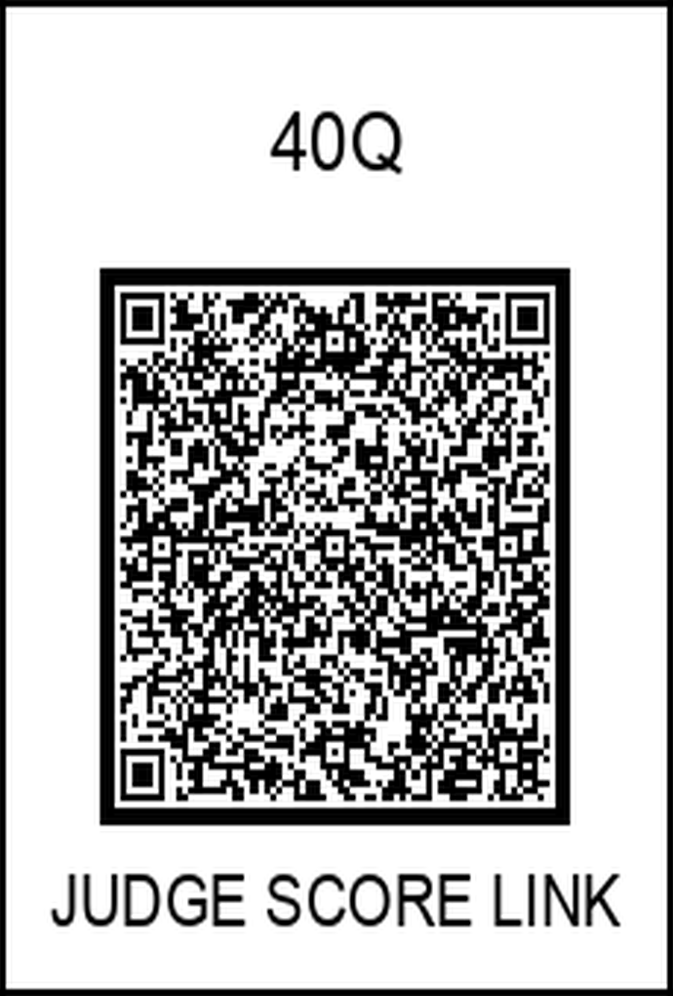
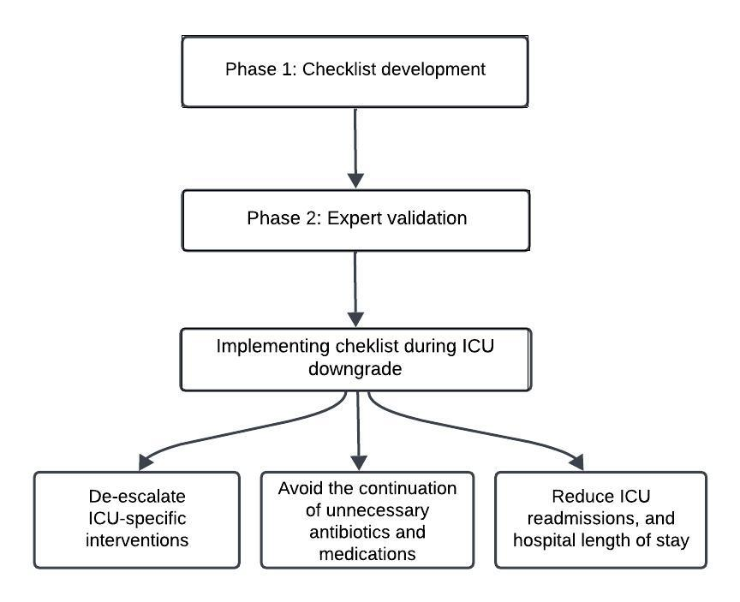

Development of a Checklist to Enhance ICU to General Medicine Ward Handoff
Nasrin Nikravangolsefid, Maryam Hadipour, Aramsadat Meraji, Anupama Poliyedath, Mehdi Hakimipour
Internal medicine department, Saint Agnes Medical Center, Fresno, CA
Introduction
Checklist Items
Transitions from the ICU to the general ward are high-risk events, with up to 19% of patients experiencing adverse events post-transfer, many of which are preventable.
Communication failures, such as omitted diagnoses, unclear care plans, and lack of follow-up on pending results, are a major contributor to these events.
Despite these risks, there is no widely adopted checklist specifically designed for ICU discharges in medical ICUs.
Checklists have proven effective in improving safety and outcomes across various clinical settings, including invasive procedures and shift handoff by standardizing communication and reducing errors.
Therefore, we aim to design a checklist to provide a framework to document and verify key handoff elements to improve teamwork, communication and reduce uncertainty and missed diagnostic and management items in high-volume settings.
Checklist items were developed from literature review and expert input, covering key domains for safe ICU-to-ward transitions:
Narrative Summary of ICU Stay
Medication Safety • Reconciliation of home medications • Evaluation of ICU-specific medications (e.g., broad-spectrum antibiotics, antipsychotics, sedatives): continuation vs. Discontinuation
Assessment of PUD prophylaxis: continuation vs. Discontinuation
Continuation vs. discontinuation of newly initiated anticoagulants or antiplatelet agents
Device and Fluid Management • Removal of central lines and indwelling urinary catheters if no longer indicated • Ongoing need for IV fluids and diuretic therapy: reassess continuation vs. Discontinuation
Evaluation of midodrine for blood pressure support
Nutrition and Rehabilitation • Determination of diet status: initiate vs. remain NPO based on indication • Identification of rehab needs (e.g., early PT/OT, discharge planning support)
Code Status and Goals of Care
Pending Items and Follow-Up Needs • Urgent Labs, imaging, consultations
Methods
The study will be conducted in 2 phases: checklist development, and Expert validation.
Phase 1 – Checklist Development
We performed a comprehensive literature review of ICU handoff tools, communication frameworks (e.g., I-PASS, SBAR), and current critical care guidelines. High-risk hand off domains were identified, including active problems, medications, devices, pending investigations, and follow-up plans. Based on these findings, we developed an initial draft of a structured ICU-to-ward handoff checklist.
Phase 2 – Expert Validation
We will distribute a survey to a multidisciplinary group of experts, including ICU attendings, hospitalists, residents, and senior nurses with experience in patient safety and care transitions. The survey used 5-point Likert scale questions to assess the importance, clarity, and feasibility of each checklist item, and included open-ended questions for additional input. The checklist will be revised based on this feedback to enhance usability and relevance.
We plan to conduct a second survey with the same or an expanded expert group to finalize the checklist. In a follow-up QI initiative, we will pilot the checklist on general medical wards. Residents will use it during ICU downgrades, and its impact will be evaluated by tracking outcomes such as ICU readmissions, communication errors, and hospital length of stay.
Flowchart of Study Phases and the Checklist’s Role in Enhancing Patient Safety
References
Scan and complete the survey
Merten H, Van Galen LS, Wagner C. Safe handover. Bmj. 2017 Oct 9;359.
Vukoja M, Dong Y, Adhikari NK, Schultz MJ, Arabi YM, Martin-Loeches I, Hache M, Gavrilovic S, Kashyap R, Gajic O. Checklist for early recognition and treatment of acute illness and injury: an exploratory multicenter international quality-improvement study in the ICUs with variable resources. Critical Care Medicine. 2021 Jun 1;49(6):e598-612.
Whytock CW, Atkinson MS. Increasing use of an endotracheal intubation safety checklist in the emergency department. BMJ Open Quality. 2021 Dec 1;10(4):e001575.
Dubosh NM, Carney D, Fisher J, Tibbles CD. Implementation of an emergency department sign-out checklist improves transfer of information at shift change. The Journal of emergency medicine. 2014 1;47(5):580-5.
Lashoher A, Schneider EB, Juillard C, Stevens K, Colantuoni E, Berry WR, Bloem C, Chadbunchachai W, Dharap S, Dy SM, Dziekan G. Implementation of the World Health Organization trauma care checklist program in 11 centers across multiple economic strata: effect on care process measures. World journal of surgery. 2017 Apr;41(4):954-62.

