Slide 1


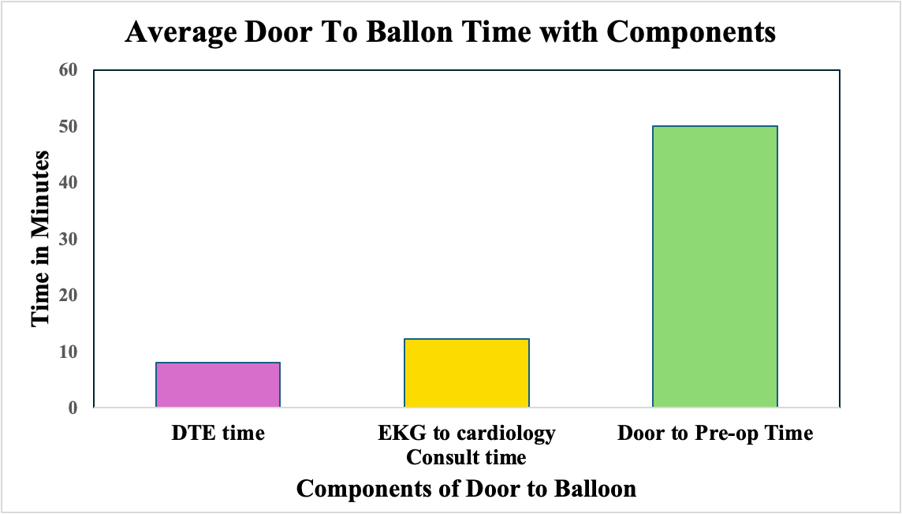
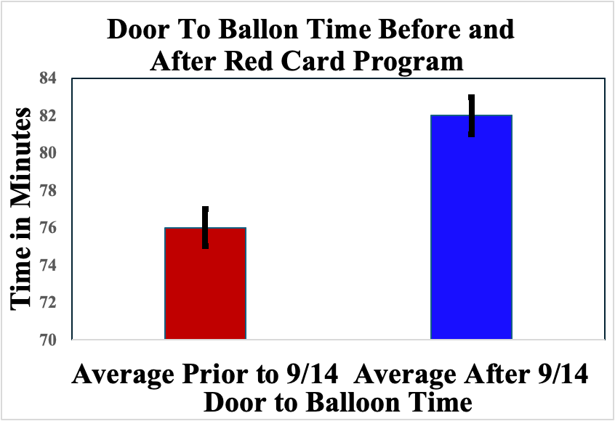
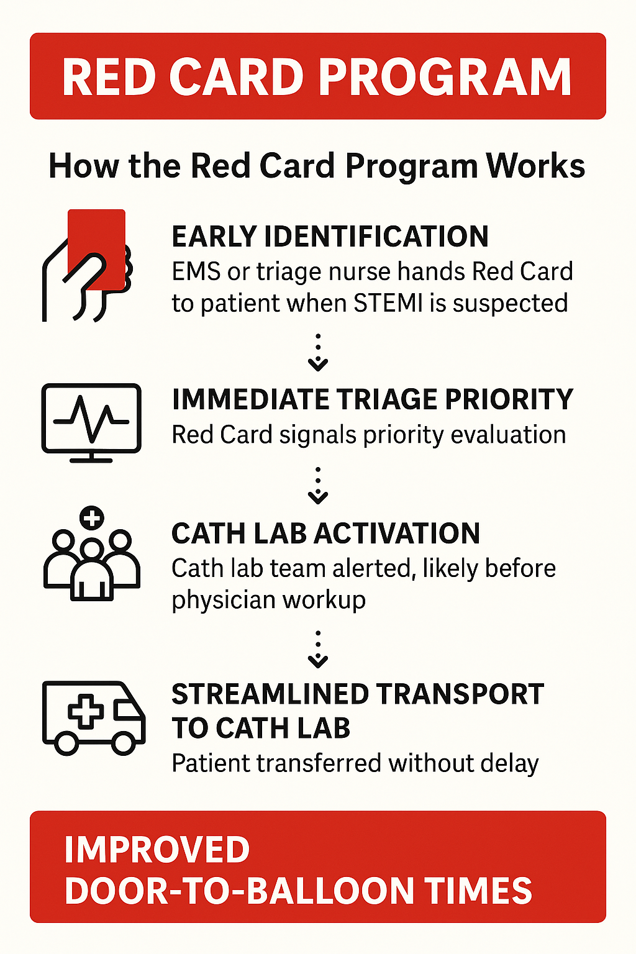
Time is Muscle: Does the Red Card Program
Improve Door to Balloon Time?
Sravan Vemuri, MD; Onkar Sandhu, MD; Mehdi Hakimipour, MD
Internal Medicine Residency, Saint Agnes Medical Center, Fresno, CA
Saint Agnes Medical Center, Fresno, CA
Introduction
Discussion
“Time is Muscle”: Early intervention through reperfusion therapy (ideally through PCI) is critical to minimize the amount of myocardial damage and thus maximizing patient outcomes.
Delayed treatment can lead to complications such as heart failure or death. Thus, timely diagnosis of STEMI and rapid cardiac cath lab activation is critical in determining morbidity and mortality.
Goal door to balloon time for PCI-capable hospital is 90 minutes.
Time delay in transmitting information: EKG needs to be taken by technician, interpreted by ER physician, and transmitted to cardiologist prior to cath lab activation. The multitude of steps leaves room for delay in door to balloon time.
Red card program has potential to decrease door to balloon time by prioritizing chest pain patients as potential STEMI cases with the goal door to EKG time being 10 minutes or less.
P-value of 0.32 indicates failure to reject the null hypothesis; thus, the data suggests there is not enough evidence to support the alternative hypothesis of an improvement in DTB time with initiation of the red card program.
Given SAMC is one of two STEMI receiving centers in Fresno County, the hospital receives transfer STEMI cases from peripheral hospitals such as John C. Fremont Hospital in Mariposa and Reedley Hospital. For our study, the DTB time for transfer patients was evaluated from the time of arrival to SAMC ER.
Factors that may traditionally be excluded from DTB analysis were included in our analysis. This includes technically difficult cases that may involve a delay in crossing the culprit lesion, delayed presentation, intubation, and arrest during diagnostic cath.
Communication delays can involve delay in ER reaching responsible cardiologist as well as delay in communication time between non-interventional and interventional cardiologist.
One outlier after 9/14 had door to EKG time of 164; thus, skewing this subcomponent’s data.
Figure 1: Evaluation of Door to Balloon Time components
Limitations
Methods
Analysis of raw data
Limited sample size
Future steps may involve:
Multicenter investigation in rural vs urban environment
Analysis of data from other community hospitals minimize confounding factors
Standardization of data for comorbidities
Acquire data from hospital with shortest DTB time as well as with highest incidence of PCI
p value = 0.32
Door to balloon time (DTB) data from a community hospital in the San Joaquin Valley of California for the calendar year 2024 was retroactively reviewed.
Red card program was initiated in September 2024, approximately three quarters into the calendar year.
Total of 127 STEMI cases were identified.
86 cases prior to red card program implementation
41 cases after red card program implementation.
Study intent: To determine if door to balloon times improved with initiation of the red card program.
Null hypothesis: There is no difference in DTB time with initiation of the red card program.
Alternative hypothesis: There is an improvement in DTB time with initiation of the red card program.
References
76 ±2.032 (±2.7%) [73.968 – 78.032]
82 ±2.032 (±2.5%) [79.968 – 84.032]
Figure 2: Comparison of Door to Balloon Time after implementation of red card program
Smith, J., Doe, A., & Brown, K. (2023). Door-to-balloon times under 90 min can be routinely achieved for patients transferred for ST-segment elevation myocardial infarction percutaneous coronary intervention in a rural setting. Journal of Rural Health, 39(2), 150-158.
Bradley, E. H., Herrin, J., Wang, Y., Barton, B. A., Webster, T. R., Mattera, J. A., Roumanis, S. A., Curtis, J. P., Nallamothu, B. K., & Krumholz, H. M. (2006). Strategies for reducing the door-to-balloon time in acute myocardial infarction. New England Journal of Medicine, 355(22), 2308–2320.
Bradley, E. H., Roumanis, S. A., Radford, M. J., Webster, T. R., McNamara, R. L., Mattera, J. A., Barton, B. A., Berg, D. N., Portnay, E. L., Moscovitz, H., Parkosewich, J., Holmboe, E. S., Blaney, M., & Krumholz, H. M. (2005). Achieving door-to-balloon times that meet quality guidelines: How do successful hospitals do it? Journal of the American College of Cardiology, 46(7), 1236–1241.
Hassan MO, Ahmed SA, Hassan MS, Köprülü D. Door-to-Balloon Time and Mortality Among Patients Undergoing Primary PCI, Challenges and Experience from Somalia's Largest PCI Center. Int J Gen Med. 2024 Jan 22;17:237-244. doi: 10.2147/IJGM.S448750. PMID: 38283076; PMCID: PMC10812143.
Results
Average Door to EKG time was 8 minutes
Despite implementation of red card program, door to EKG time decreased from 3.5 minutes to 10.2 minutes.
Average EKG to Cardiology Consult time was 12.5 minutes
Average Door to Pre-op time was 49 minutes
Red card program initiated on 9/14
Average DTB time prior to 9/14/2024 was 76 mins
Average DTB time after 9/14/2024 was 82 mins
Additional analysis showed SAMC’s median DTB time of 72 minutes was less than national median DTB time of 83 minutes

