Slide 1


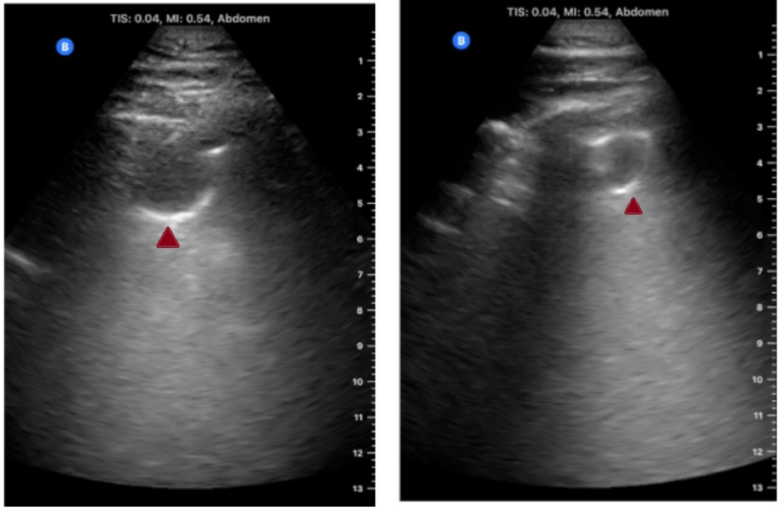
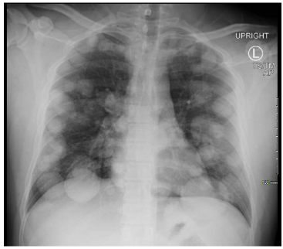
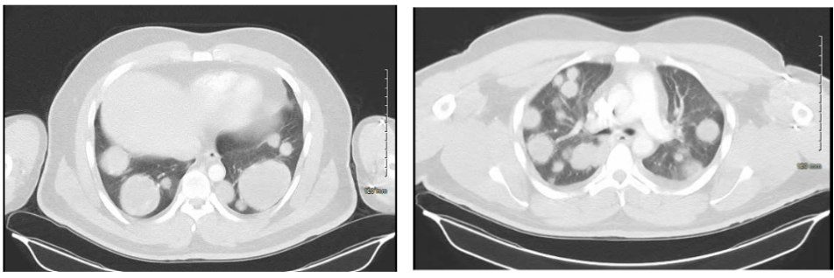
Point-of-Care Ultrasound Diagnosis of
Diffuse Pulmonary Metastases: The Cannonball Sign
Mahwish Sheikh¹, Hamna Javed¹, Moon Park², William Latson¹, Mohammad G. Elhassan¹
¹Internal Medicine Residency, Saint Agnes Medical Center, Fresno, CA
²Sleep Medicine Fellow, University of California San Francisco (Fresno), Fresno, CA
Abstract
Discussion
Cannonball pulmonary metastases are well-recognized on chest X-rays and CT scans due to their distinctive morphology, often indicating advanced disease and poor prognosis. However, their sonographic appearance on point-of-care ultrasound (POCUS) has not been widely described. We present a case of a 32-year-old male with a known history of mixed germ cell tumor of the testis, who presented with respiratory symptoms and nasopharyngeal swab was positive for COVID-19 infection. Still, lung POCUS exam showed innumerable, well-circumscribed pulmonary lesions, consistent with metastatic disease. The characteristic ultrasonographic features of these lesions helped differentiate them from being due to COVID-19 pneumonia. This case highlights the potential utility of POCUS in identifying pulmonary metastases at the bedside, particularly in resource-limited settings where advanced imaging may not be readily available.
Cannonball metastases, typically seen on chest radiography and CT, can also be visualized via POCUS, which is gaining recognition as a bedside diagnostic tool [1]. In this case, lesions appeared as well-defined, round, hypoechoic subpleural consolidations with hyperechoic margins and post-lesion enhancement—likely due to confluent B-lines—correlating with CT findings [2,3]. These lesions moved with respiration and contrasted with COVID-19-related subpleural consolidations, which are irregular, poorly circumscribed, and associated with thickened pleural lines and heterogenous B-lines. This case highlights the utility of lung POCUS for rapid bedside assessment of metastatic disease, particularly in settings where advanced imaging may be delayed or unavailable. It supports the growing role of POCUS in emergency and critical care for prompt diagnosis and clinical decision-making.
Figure 1: Sonographic cannonball metastasis in lungs, seen as round, subpleural consolidation with hyperechoic margin and post-lesion enhancement likely representing confluent B-lines.
Case Presentation
References
A 32-year-old man with a history of left testicular mixed germ cell tumor, status post-orchiectomy, presented with shortness of breath, cough, and hemoptysis. Exam revealed bilateral rales, leukocytosis, and a positive COVID-19 test. Point-of-care ultrasound (POCUS) showed multiple well-circumscribed bilateral lung lesions consistent with cannonball metastases and associated confluent B-lines (Figure1 images of POCUS exam). Chest X-ray and CT confirmed diffuse pulmonary metastases, small bilateral pleural effusions, liver lesions, and a necrotic retroperitoneal lymph node (Figure 2,3). Brain MRI was negative for metastasis. The patient began inpatient chemotherapy with bleomycin, cisplatin, and etoposide but developed acute hypoxic respiratory failure, neutropenic fever, DVT, and segmental pulmonary embolism, requiring ICU care. He improved with antibiotics and anticoagulation and was discharged on oral therapy.
Díaz-Gómez JL, Mayo PH, Koenig SJ. Point-of-Care Ultrasonography. N Engl J Med. 2021 Oct 21;385(17):1593-1602. doi: 10.1056/NEJMra1916062. PMID: 34670045.
Mojoli F, Bouhemad B, Mongodi S, Lichtenstein D. Lung ultrasound for critically ill patients. Am J Respir Crit Care Med 2019;199:701-714.
Yasukawa K, Minami T. Point-of-Care Lung Ultrasound Findings in Patients with COVID-19 Pneumonia. Am J Trop Med Hyg. 2020 Jun;102(6):1198-1202. doi: 10.4269/ajtmh.20-0280. PMID: 32333544; PMCID: PMC7253090.
Figure 2: Chest X-ray showed well-defined spherical nodules scattered across both lungs suspicious for metastatic disease.
Figure 3: CT chest, showing widespread, small and large bilateral pulmonary nodules compatible with metastatic disease.

