Slide 1



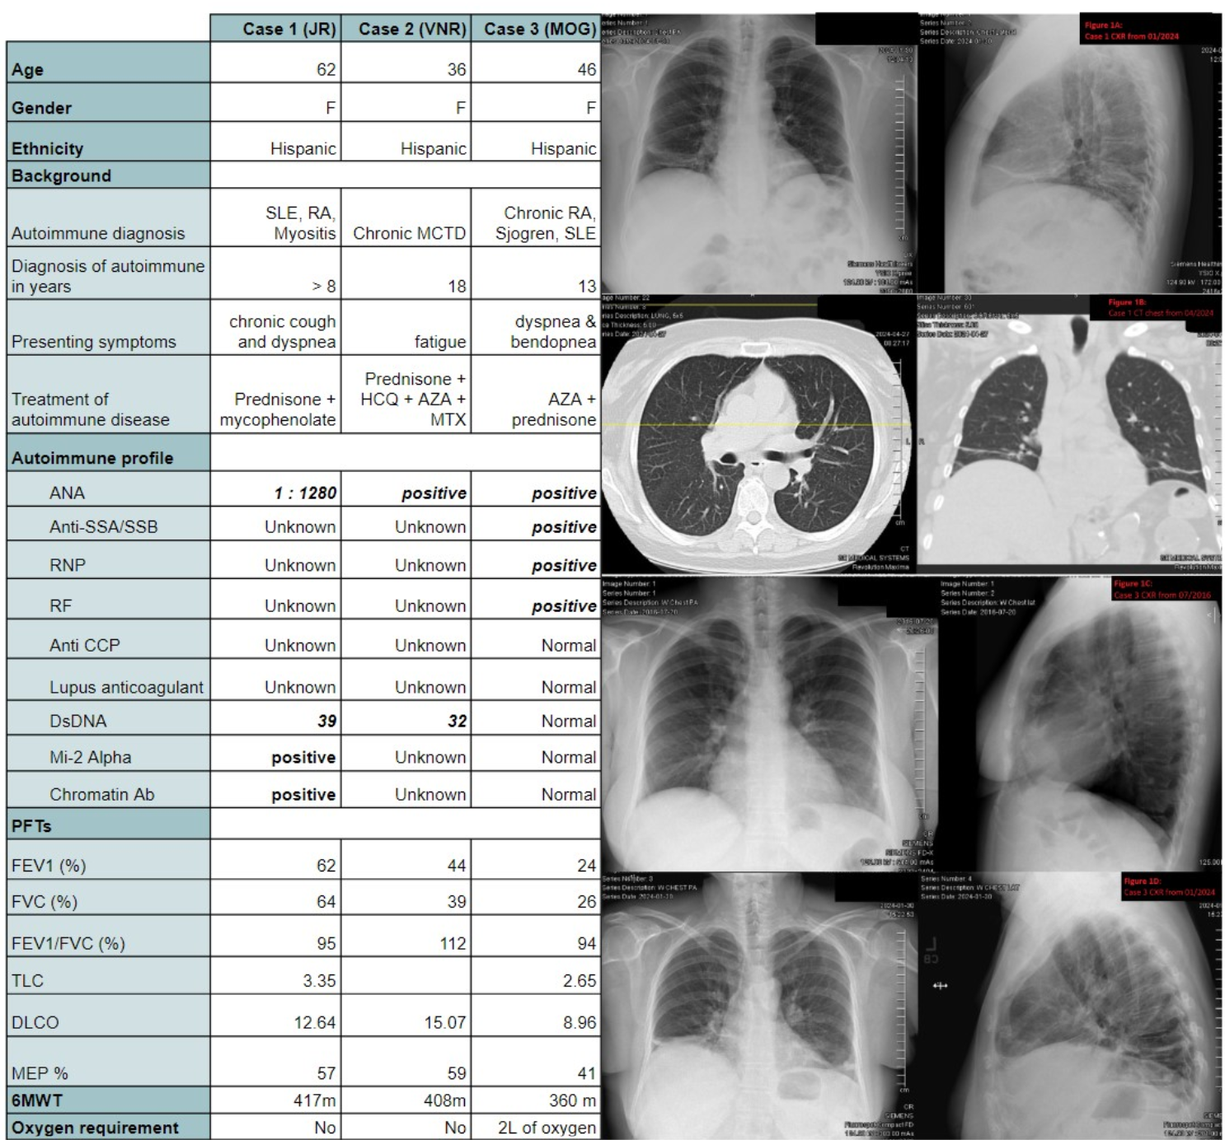
Honey! I Shrunk The Lungs!
Mahwish Sheikh, MD; Hamna Javed, MD; Andrew Clark, MD; Aftab Arif, MD;
Vijay Balasubramanian MD, MRCP (UK), FCCP Internal Medicine Residency, Saint Agnes Medical Center, Fresno, CA
Pulmonary & Critical Care Medicne, Valley Advanced Lung Disease Institute, Fresno, CA
Introduction
Shrinking lung syndrome (SLS) is a rare complication of systemic autoimmune disease - most notably in patients with systemic lupus erythematosus (SLE) [1]. Reduced lung volumes and a restrictive deficit on lung function testing are typical. It is a diagnosis of exclusion. The etiology remains unknown. We describe a case series of SLS associated with connective tissue diseases (CTD).
Case Presentation
Key patient demographics and Clinical characteristics are illustrated in Table 1.
Case 1: A 63-year-old female with rheumatoid arthritis (RA), and systemic lupus erythematosus (SLE) was evaluated for dyspnea. She had episodic chest pressure with associated chronic dry cough. Pulmonary function tests (PFTs) showed severe restrictive lung disease and very severe diffusion impairment. Chest x-ray showed chronic bibasilar linear atelectasis. CT Chest confirmed bibasilar atelectasis, and bronchiectasis in the mid to lower lungs with no signs of pulmonary fibrosis.
Case 2: A 36-year-old female with chronic mixed connective tissue disease (MCTD) for 17 years was evaluated for chronic dyspnea. PFTs over time revealed progressive restrictive lung disease patterns. HRCT of the chest showed apical minimal scarring bilaterally, and patchy paroxysmal bronchiectasis, and no signs of ILD.
Case 3: A 46-year-old female with chronic SLE, Sjogren syndrome, RA for 13 years was evaluated for chronic dyspnea, cough, and bendopnea. PFTs showed a severe chronic restrictive lung disease. HRCT chest showed mild bibasilar atelectasis, no ILD, and small lung volumes. She demonstrated a dramatic reduction in lung function over the last 2 years.
Table 1 illustrates key patient demographics and ILD-related clinical data.
Case Presentation cont.
References
Shrinking Lung Syndrome (SLS) is a rare and poorly understood complication of autoimmune diseases, most commonly systemic lupus erythematosus (SLE), characterized by unexplained dyspnea and progressive reductions in lung volumes without interstitial lung disease¹². The diagnosis is clinical and one of exclusion, often supported by serial pulmonary function tests and chest imaging³. Though its pathophysiology remains unclear, diaphragmatic dysfunction and pleuritis have been proposed⁴. Limited case reports underscore the need for increased awareness and early recognition, which may improve patient outcomes and guide the development of registries for better understanding disease progression and therapeutic strategies⁵.
Cañedo-Ayala M, Londoño J, Rojas-Villarraga A, Anaya J-M. Shrinking lung syndrome in autoimmune diseases: A narrative review. Clin Rheumatol. 2015;34(10):1637–1642. doi:10.1007/s10067-015-3022-3
Allen D, Fischer A, Todd N, et al. Shrinking lung syndrome as a manifestation of systemic lupus erythematosus: A case series and literature review. Chest. 2019;156(5):e127–e131. doi:10.1016/j.chest.2019.03.043
Mandell BF. Shrinking lung syndrome in systemic lupus erythematosus: A rare and often unrecognized manifestation. Lupus. 2016;25(12):1302–1304. doi:10.1177/0961203316651743 ↩
Yazici Y, Erkan D. Shrinking lung syndrome: What do we know and how should we treat it? Curr Rheumatol Rep. 2014;16(5):408. doi:10.1007/s11926-014-0408-7
Fortin PR, et al. Challenges and opportunities in rare autoimmune diseases: The case for longitudinal registries. Nat Rev Rheumatol. 2017;13(5):273–274. doi:10.1038/nrrheum.2017.38

