Slide 1
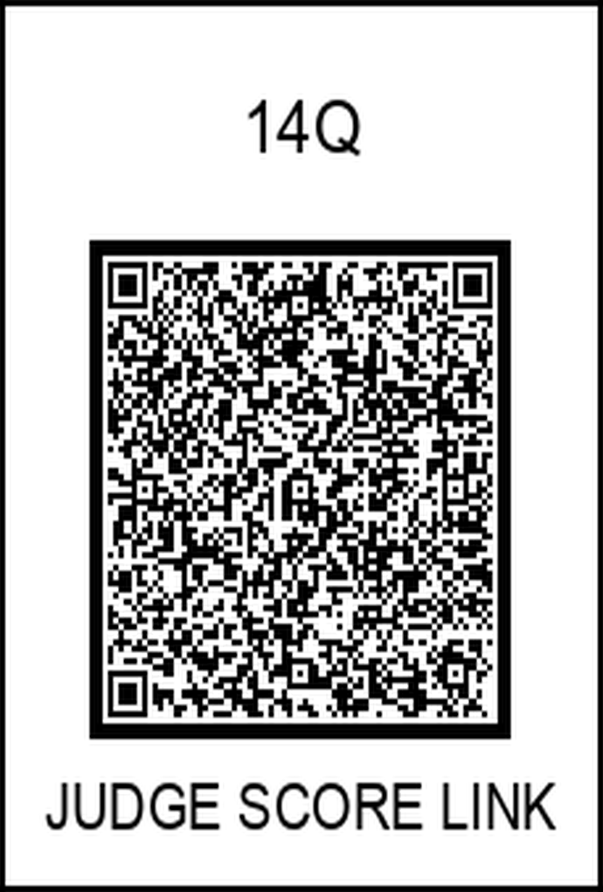
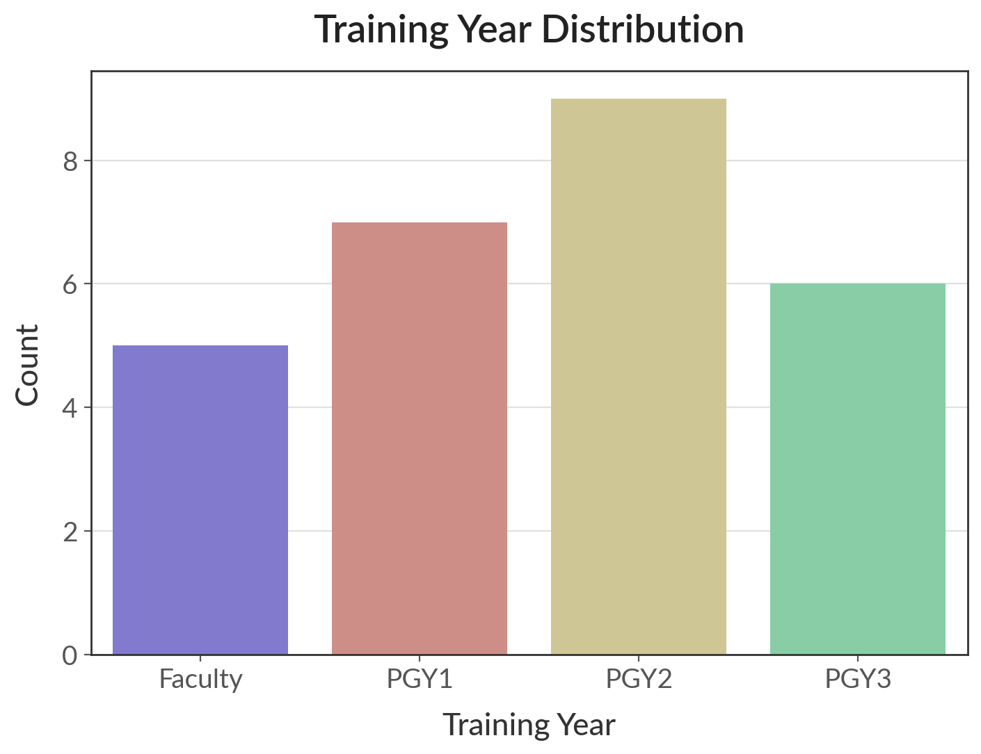
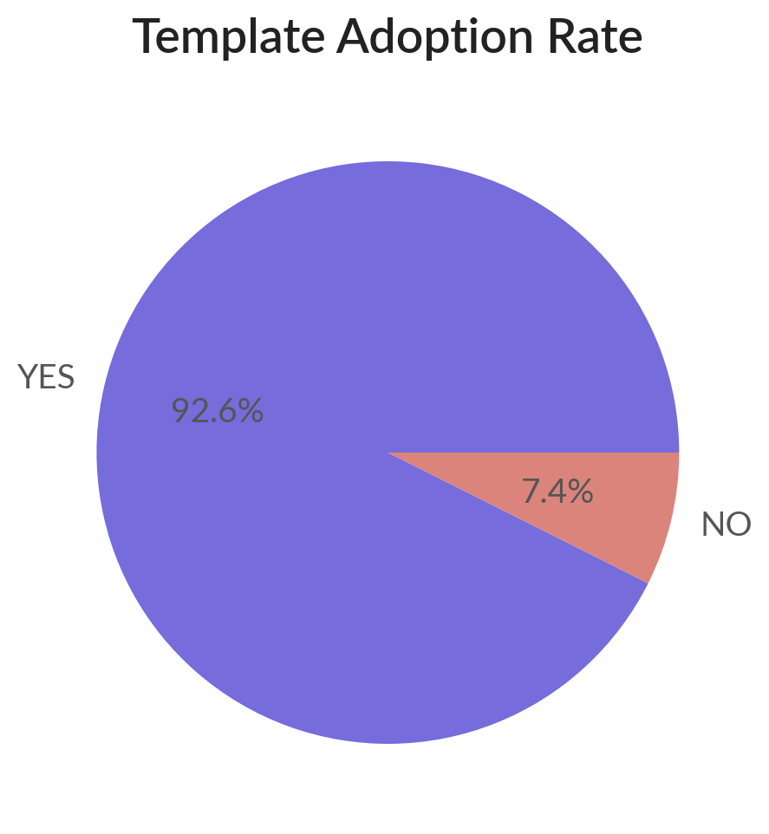
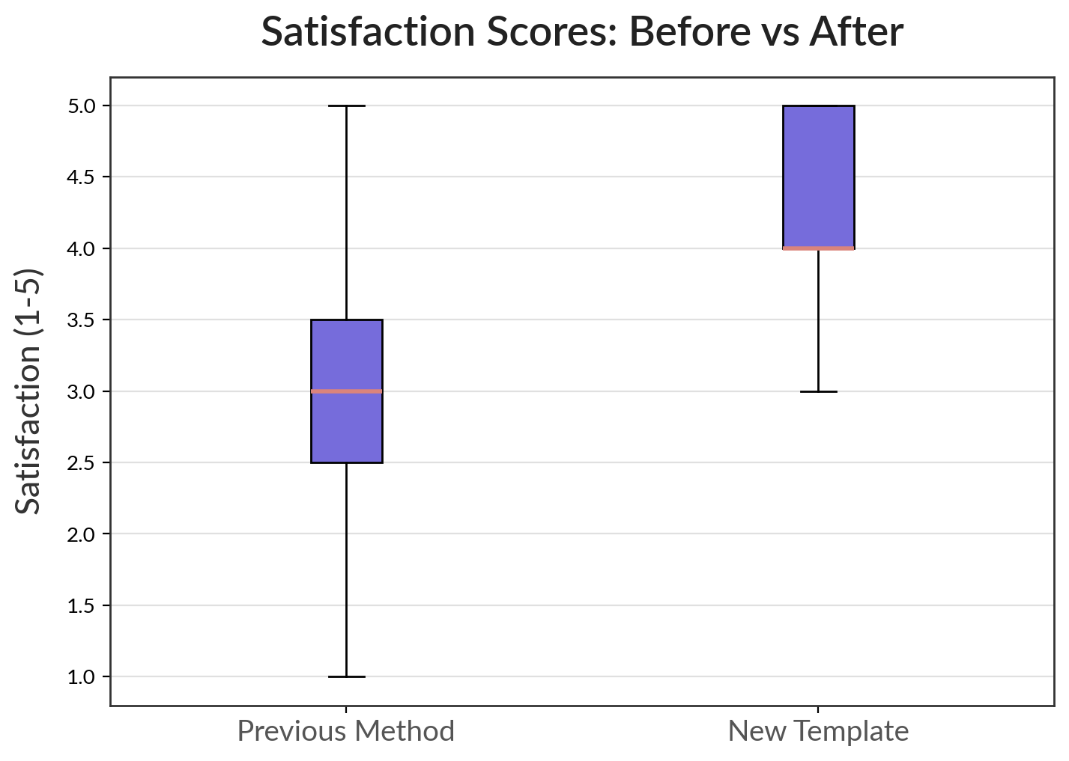
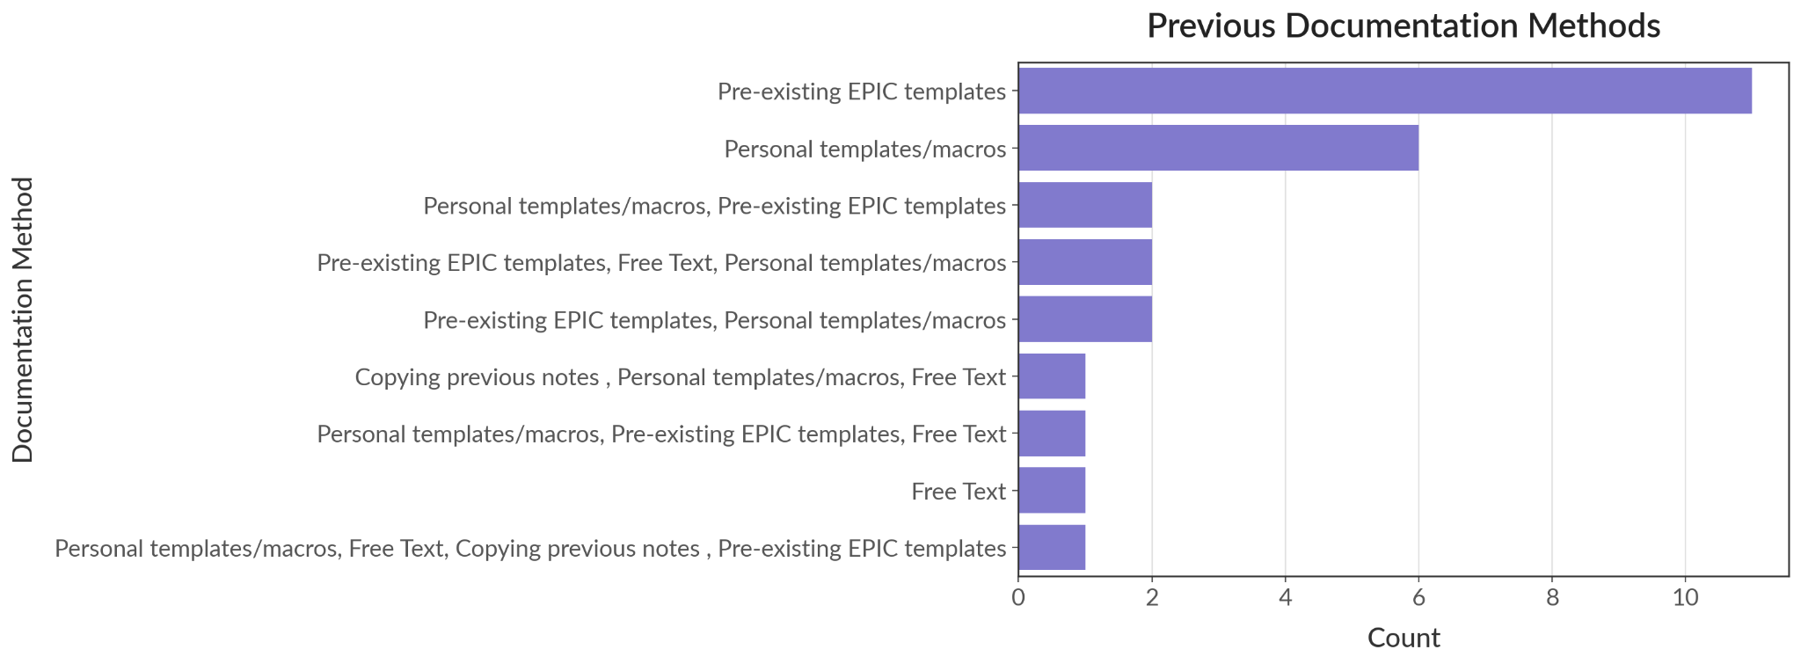
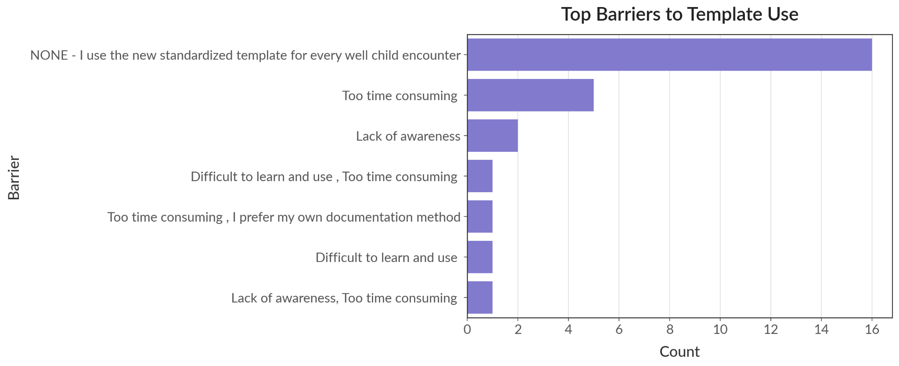
Improving Consistency & Quality of Well-Child Visit Documentation
Gabriel Allaf DO, Phillip Kim MD, MPH
Saint Agnes Medical Center, Department of Family Medicine
Introduction
Results Continued
Inconsistent documentation of well-child visits in residency clinics can lead to missed screenings, inadequate anticipatory guidance, and potential medicolegal risk.
Prior to this intervention, residents used varied documentation methods (e.g., copied notes, personal macros), which lacked standardization and completeness.
To improve the quality, efficiency, and comprehensiveness of well-child care, a standardized template was developed & implemented for visits from ages 0–17 years.
Impact on Patient Care:
52% reported significant improvement
33% noted some improvement
Barriers to Use (among non-daily users):
“Too time consuming” (5 respondents)
“Lack of awareness” (2)
“Difficult to learn” (2)
Support Preferences:
44% would benefit from more training
41% found the template easy enough without support
Limitations
Methodology
Single-Site Study: Conducted at one residency program (Family Medicine at Saint Agnes), which may limit generalizability to other institutions or specialties.
Self-Reported Data: Survey responses reflect subjective perceptions, which may introduce response bias or overestimate impact.
Lack of Pre-Post Chart Audit: Objective comparisons of documentation completeness (before vs. after implementation) were not performed.
Limited Longitudinal Follow-Up: The study did not assess long-term retention of template use or sustained behavior change beyond the initial months.
Non-Responder Bias: Two non-responding PGY3 residents may have differing views that were not captured.
Setting: Family Medicine Residency Clinic at Saint Agnes Medical Center
Timeline: September 2024 – April 2025
Intervention: Development and rollout of a custom-built Epic template covering all essential well-child components (e.g., vaccines, growth, development, anticipatory guidance)
Participants:
22 of 24 Family Medicine residents (PGY1–PGY3)
5 of 5 attendings (100% participation)
Tool: 28-item survey assessing:
Frequency and adoption of the template
Perceived impact on documentation quality, workflow, and patient care
Barriers and support needs
Discussion & Conclusion
The standardized Epic template was highly adopted by residents and attendings, with clear reported benefits in documentation consistency, quality, and completeness.
Project revealed that variability in documentation existed primarily due to inconsistent use of structured tools
Most residents found the template easy to use, though a subset still reported time or training barriers, especially earlier in their training.
This QI initiative successfully increased the standardization of well-child documentation in the residency clinic.
The template improved clinical efficiency and reduced the risk of missing preventive care components.
Template use was high across all training levels, with notable benefits in workflow and patient safety
Results
Template Usage:
93% respondents reported using the template
Most residents use the template in 1–2 well-child visits per week
Documentation Quality:
Mean satisfaction rating: 4.28 / 5
100% reported moderate to complete improvement in documentation quality
Workflow Impact: Mean efficiency rating: 4.04 / 5
Thoroughness of Documentation:
63% noted major improvement
30% reported minor improvement
Recommendations
Formalize template training as part of resident orientation and onboarding
Continue collecting feedback and update the template annually
Consider expanding the template to other pediatric visits (e.g., sports physicals or behavioral screenings)
Share the template with other departments or community clinics to increase standardization system-wide

