Slide 1
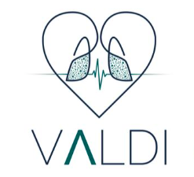


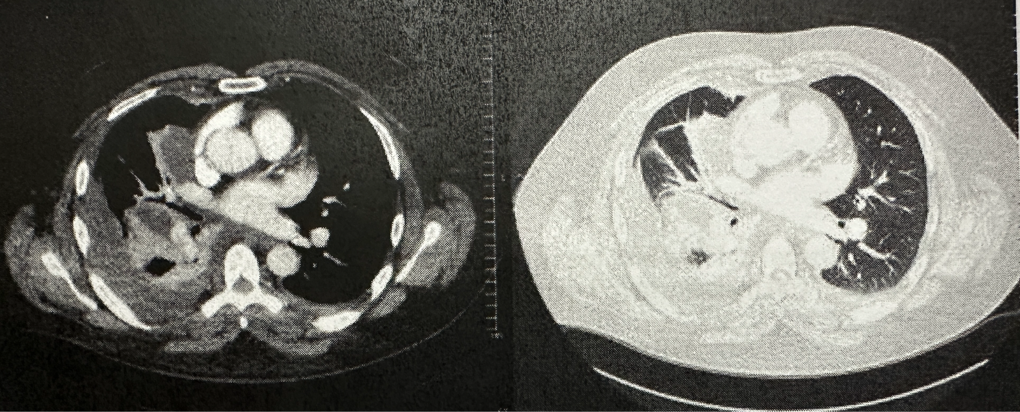
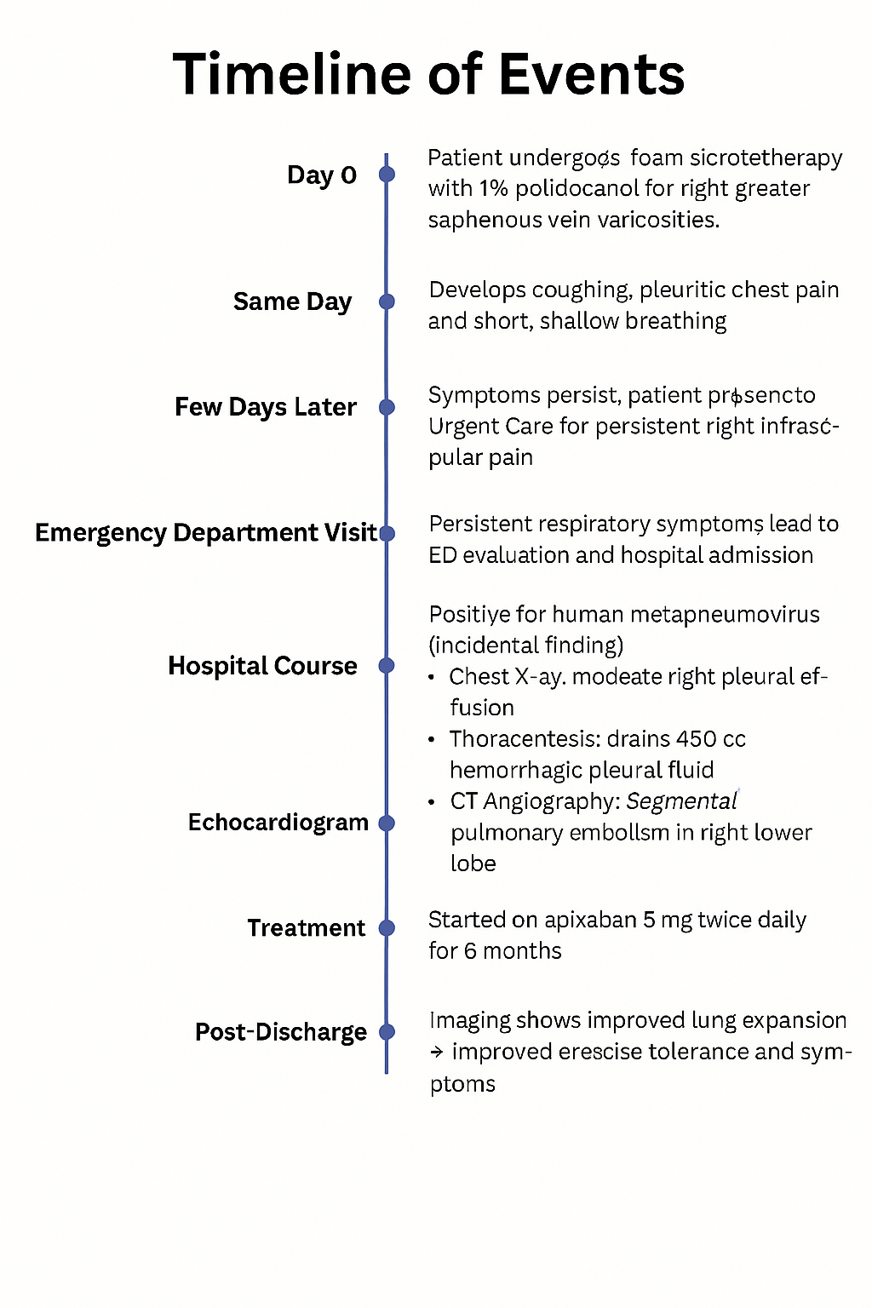
From Veins to Lungs: Acute Pulmonary Embolism After Foam Sclerotherapy
Andrew Clark, MD; Hamna Javed, MD; Mahwish Sheikh, MD; Aftab Arif, MD; Vijay Balasubramanian MD, MRCP (UK), FCCP
Internal Medicine Residency, Saint Agnes Medical Center, Fresno, CA
Pulmonary & Critical Care Medicine, Valley Advanced Lung Disease Institute, Fresno, CA
Introduction
Discussion
One minimally invasive method for treating varicose veins is foam sclerotherapy. Potential serious side effects include anaphylaxis and vascular incidents such as myocardial infarction, stroke, and thromboembolism. Temporary vision disruption, cutaneous necrosis, ulceration, minor vein thrombosis, thrombophlebitis, local neurological damage, and skin pigmentation are examples of minor side effects. This report details a pulmonary embolism that occurred following foam injection sclerotherapy for varicose veins.
Foam sclerotherapy is an effective, minimally invasive treatment for varicose veins but carries rare risks such as pulmonary embolism (PE)[1, 2]. In this case, PE likely resulted from sclerosant migration into the pulmonary circulation. Risk factors include higher foam volumes, large treatment areas, and multiple injections[3]. Although the European Consensus recommends using 6–8 mL of foam per session, actual practice varies[3]. Persistent respiratory symptoms following sclerotherapy should prompt immediate evaluation to detect serious complications[4].
Case Presentation
Image 1: CT angiogram of the chest showing a PE in the right lower lung lobe..
A 44-year-old male with a past medical history of hypertension and chronic venous insufficiency was evaluated in the pulmonary clinic after developing an acute pulmonary embolism (PE). Before the PE, the patient was able to exercise with no limitations however, he had noticeable varicose veins for which he underwent an intervention. After this intervention, he developed some pain in the right infrascapular region for which he went to Urgent Care for pain relief. He underwent foam injections and chemical ablation of the right greater saphenous vein using 1% polidocanol foam however, he developed complaints of coughing and pleuritic chest pain post-procedure. He was seen to be taking short, fast, and shallow breaths.
The symptoms did not resolve in the upcoming days so the patient presented to the emergency department with these complaints and was admitted. The lab tests also showed that he was human metapneumovirus positive but were otherwise unremarkable. BNP was 54. He was noted to have a pleural effusion on chest x-ray. He underwent a US-guided pleural effusion with 450 cc of hemorrhagic pleural fluid drained. An echocardiogram showed mild pulmonary hypertension with an ejection fraction of 50-55%. He underwent a CT angiography of the chest which showed a pulmonary embolus involving the right lower lobe segmental pulmonary arter (image 1)y. He also has consolidations in the right middle and lower lobes of the lung, loculated moderate right pleural effusion, and left basilar atelectasis.
He was started on treatment during his hospitalization and discharged on apixaban 5 mg twice daily for the next 6 months. An x-ray of the chest post-discharge showed improved expansion if the right lung. His endurance for exercise improved after treatment was started. He was determined to have an acute pulmonary embolism and likely viral pneumonia provoked by a varicose vein foam repair procedure. Image 2 shows a timeline of events for this patient.
Conclusion
Foam sclerotherapy is a minimally invasive and widely used treatment for varicose veins, offering excellent efficacy and faster recovery compared to surgery. However, although rare, serious complications like pulmonary embolism can occur and must be recognized promptly. Our case highlights the importance of careful foam volume administration, adherence to procedural guidelines, and vigilant post-procedural monitoring. Clinicians should maintain a high index of suspicion when patients present with respiratory symptoms after sclerotherapy to ensure early diagnosis and intervention. Despite the risks, foam sclerotherapy remains a safe option when performed cautiously, with appropriate patient education and follow-up in place.
References
Jia X, Mowatt G, Burr JM, Cassar K, Cook J, Fraser C. Systematic review of foam sclerotherapy for varicose veins. Br J Surg. 2007;94(8):925–936. doi:10.1002/bjs.5891
Bergan J, Pascarella L, Mekenas L. Venous disorders: treatment with sclerosant foam. J Cardiovasc Surg (Torino). 2006;47(1):9–18. PMID: 16434941
Breu FX, Guggenbichler S. European Consensus Meeting on Foam Sclerotherapy, April 4–6, 2003, Tegernsee, Germany. Dermatol Surg. 2004;30(5):709–717. doi:10.1111/j.1524-4725.2004.30209.x
Habib SF, Muhammad R, Koulaouzidis A, Gasem J. Pulmonary embolism after sclerotherapy treatment of bleeding varices. Ann Hepatol. 2008;7(1):91–93. PMID: 18376375
Image 2: Timeline of events for this patient.

