Slide 1


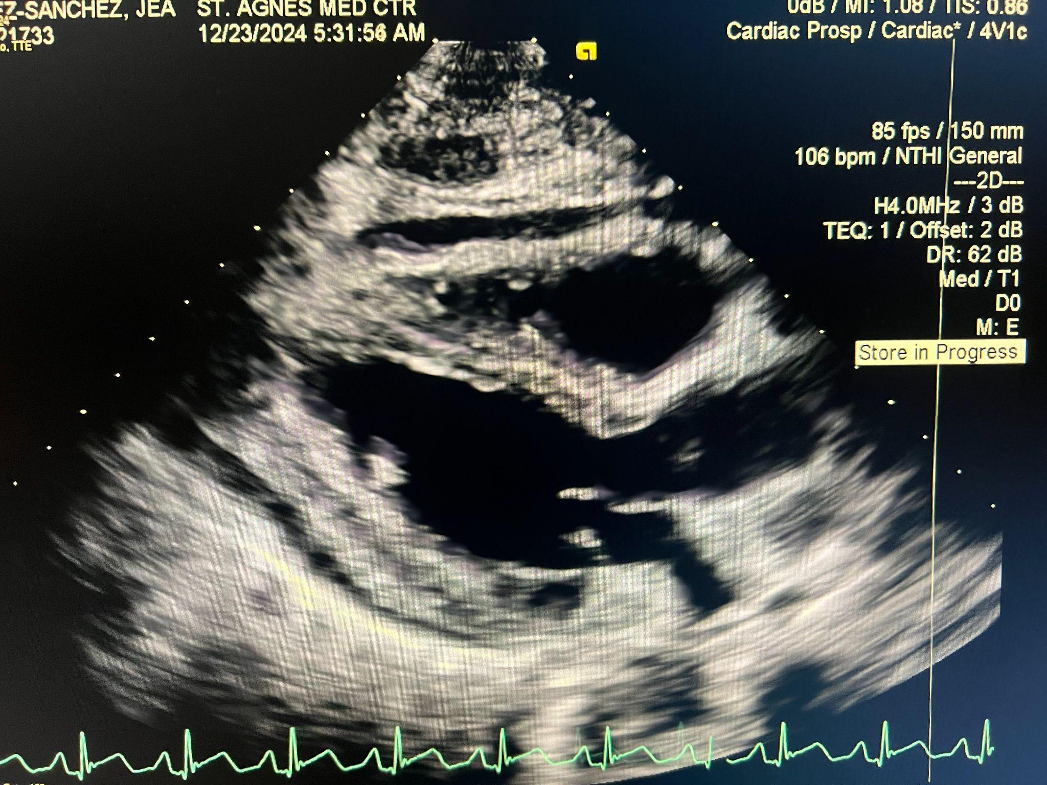
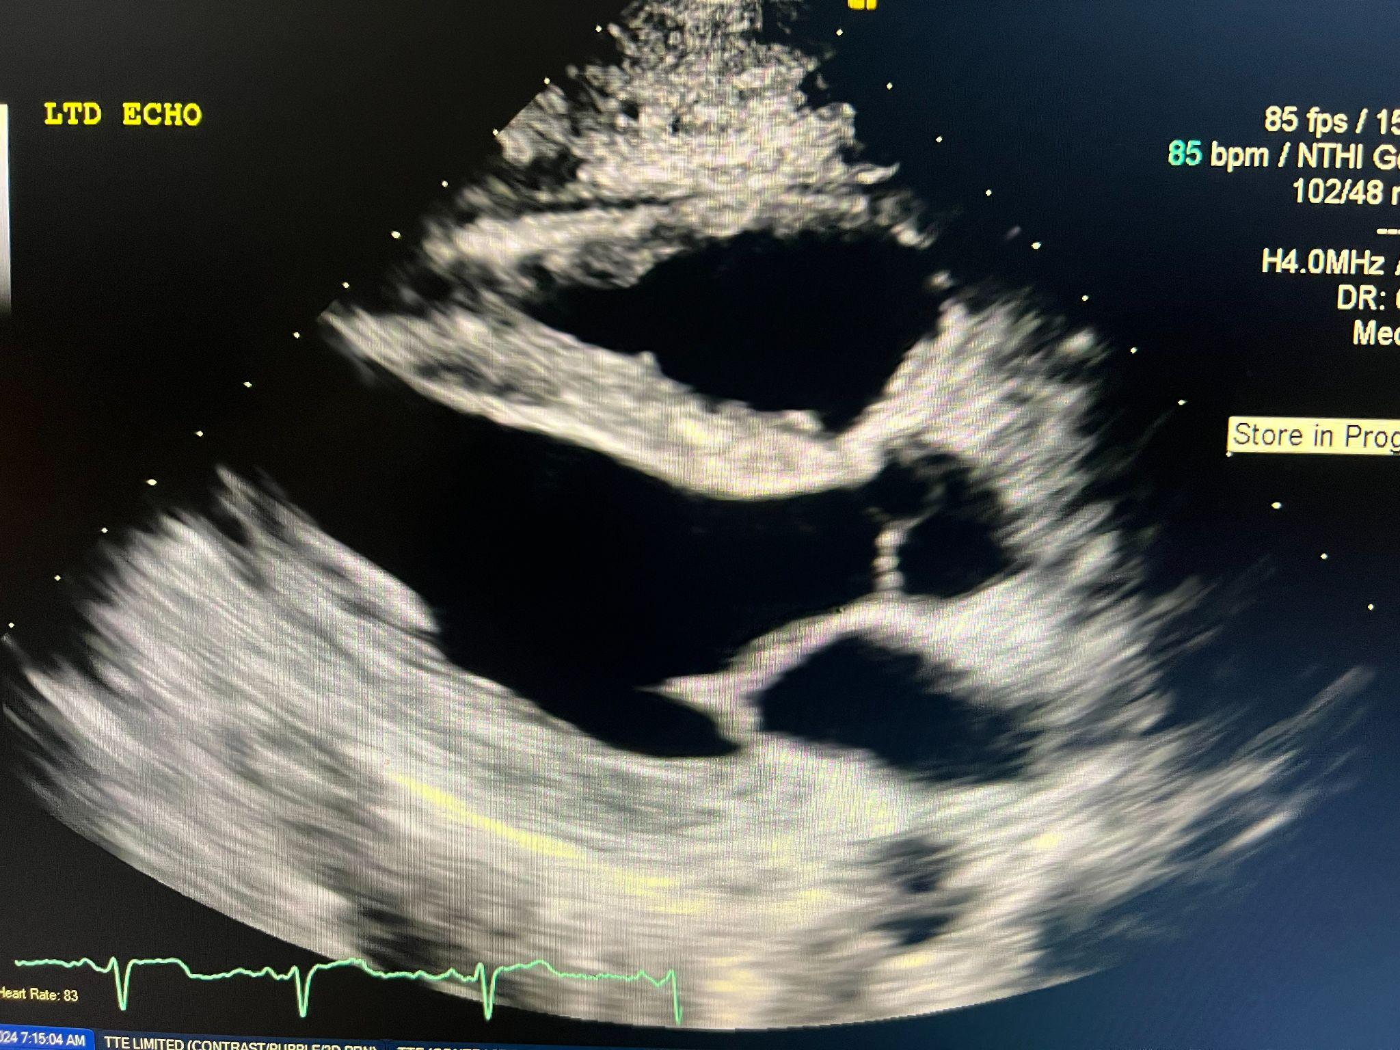

Influenza B–Induced Pericarditis with Pericardial Effusion and Early Tamponade Physiology: A Case Report
Tyler Stinson MD FAWM, Don Ha DO, Ashley Garispe DO
Saint Agnes Medical Center
Introduction
Transthoracic Echographies
Viral pericarditis is a common cause of pericardial inflammation, with enteroviruses and influenza viruses frequently implicated.¹ Influenza B, although less common than Influenza A in causing extrapulmonary manifestations, can result in pericardial involvement, including effusion and cardiac tamponade, particularly in immunocompromised or otherwise vulnerable patients.¹
Early recognition of tamponade physiology is critical to prevent hemodynamic compromise and subsequent morbidity and mortality.
Figure 1 (Left):
Initial TEE (parasternal long view) demonstrating small anterior and moderation posterior pericaridal effusions (arrows). No definitive findings of tamponade physiology.
Key: LA = left atrium; LV = left ventricle; RV = right ventricle
c
RV
Clinical Course
LV
LA
35 year old female with past medical history significant for hypothyroidism presented with cough, nausea, vomiting, generalized weakness and body aches for one week. She reported all members of her household had similar cold-like symptoms for the same duration. Due to her nausea and vomiting she had been unable to tolerate any oral intake including her home levothyroxine. Prior to presentation in the emergency department (ED) she endorsed two near-syncopal events (one with urinary incontinence) after forceful episodes of vomiting.
Triage Vitals:
HR 106, BP 103/79, RR 20, Temp 36.5C, SpO2 99% on room air
Figure 2 (Right):
Final TEE (parasternal long view) demonstrating resolution of previously seen effusions (see Figure 1).
Key: LA = left atrium; LV = left ventricle; RV = right ventricle
RV
Day 2: MICU Course
Patient had increasing norepinephrine requirements overnight and repeat TTE was performed.
Repeat TEE with moderate pericardial effusion and borderline tamponade physiology with diastolic right ventricular collapse.
She was taken to the cath lab and pericardiocentesis was performed.
300mL of serous fluid was removed.
LV
Day 1: ED Course
In the ED, the patient had an additional episode of vomiting with a near syncopal event. She experienced a second acute episode of nausea; shortly afterward, she became bradycardic to the 40’s and hypotensive. Fluid resuscitation was unsuccessful at reversing hypotension and she was started on peripheral norepinephrine. Bedside ultrasound demonstrated pericardial effusion with plethoric IVC concerning for cardiac tamponade physiology.
CT angiography of the chest, abdomen, and pelvis was negative for aortic dissection. EKG was without electrical alternans. Labs were largely unremarkable.
Cardiology was consulted for formal stat transthoracic echocardiogram (TTE) which revealed a small anterior and moderate posterior pericardial effusion without obvious tamponade physiology (Figure 1).
Empirically started on vancomycin and piperacillin/tazobactam. Levothyroxine IV initiated due to lack of oral tolerance.
After admission to MICU, Flu B resulted as positive making viral induced pericarditis with effusion the most likely diagnosis; the patient was started on oseltamivir and colchicine 0.6mg BID.
LA
Discussion
Mainstay treatment of pericarditis include aspirin and ibuprofen, along with colchicine which has shown to reduce the rate of recurrent episodes.¹ In rare circumstances where there is intolerance to aspirin and ibuprofen, low dose prednisone can be considered as higher doses are associated with more side effects, recurrence, and hospitalizations.²
However, when medical management does not suffice, a pericardiocentesis is useful in both the diagnosis and treatment of a pericardial effusion, with literature demonstrating that this procedure can be performed rapidly and safely with echo-guidance with low incidence of complications.^{3,5} In emergent situations with impending hemodynamic collapse, a blind approach can be considered and the literature has recognized a subxiphoid approach with the needle directed to the left mid clavicle at a 30° angle resulting in the highest success rate while reducing complication rates.⁴
In conclusion, this case demonstrates the importance of including pericarditis with subsequent effusion on the differential diagnosis in patients with viral symptoms. While rare, pericardial tamponade can develop which requires early intervention to prevent morbidity and mortality.
Day 3: Medicine Course
She was successfully weaned off norepinephrine and stable for downgrade to telemetry.
Repeat TEE demonstrated resolution of pericardial effusion without reaccumulation (Figure 2).
Day 4: Discharge & Outpatient Follow-up
Clinical course continued to improve and she was stable for discharge home with instructions to take colchicine 0.6mg BID x3 months and cardiology follow-up in one week.
References
Notes:
Garispe Edits with new QR code
Summary of my edits:
Content changes: I added references # to the introduction. Under ED course, I added results for: Flu B, CTa, EKG, Labs. Also added “Figure 1 & 2” to this section so the reader knows which ECHO’s to look at. I changed all ECHO’s to TTE which is spelled out in this section so this helps with space/abbreviation. Added an image section for the ECHOs with figure labels. In the conclusion, I condensed the study findings and added in a section to tie in the case teaching point from the intro. I deleted all the references listed - this needs to be made into a QR Code. Changes some phrasing and details throughout.
Cosmetic/formating changes: I changed the font sizing throughout the document. The section locations and sizes have changed too. For the patient’s hospital course, I tried to change it in a flow chart style to organize it better (gives some color). Added some arrows and labels to the TEE images. Added GME logo.
To-do’s:
-Make a QR code of the references and add it to the area I highlighted yellow.
-Proof read one more time.
-If you want any other changes, create a duplicate slide so we can track changes draft to draft.

