Slide 1



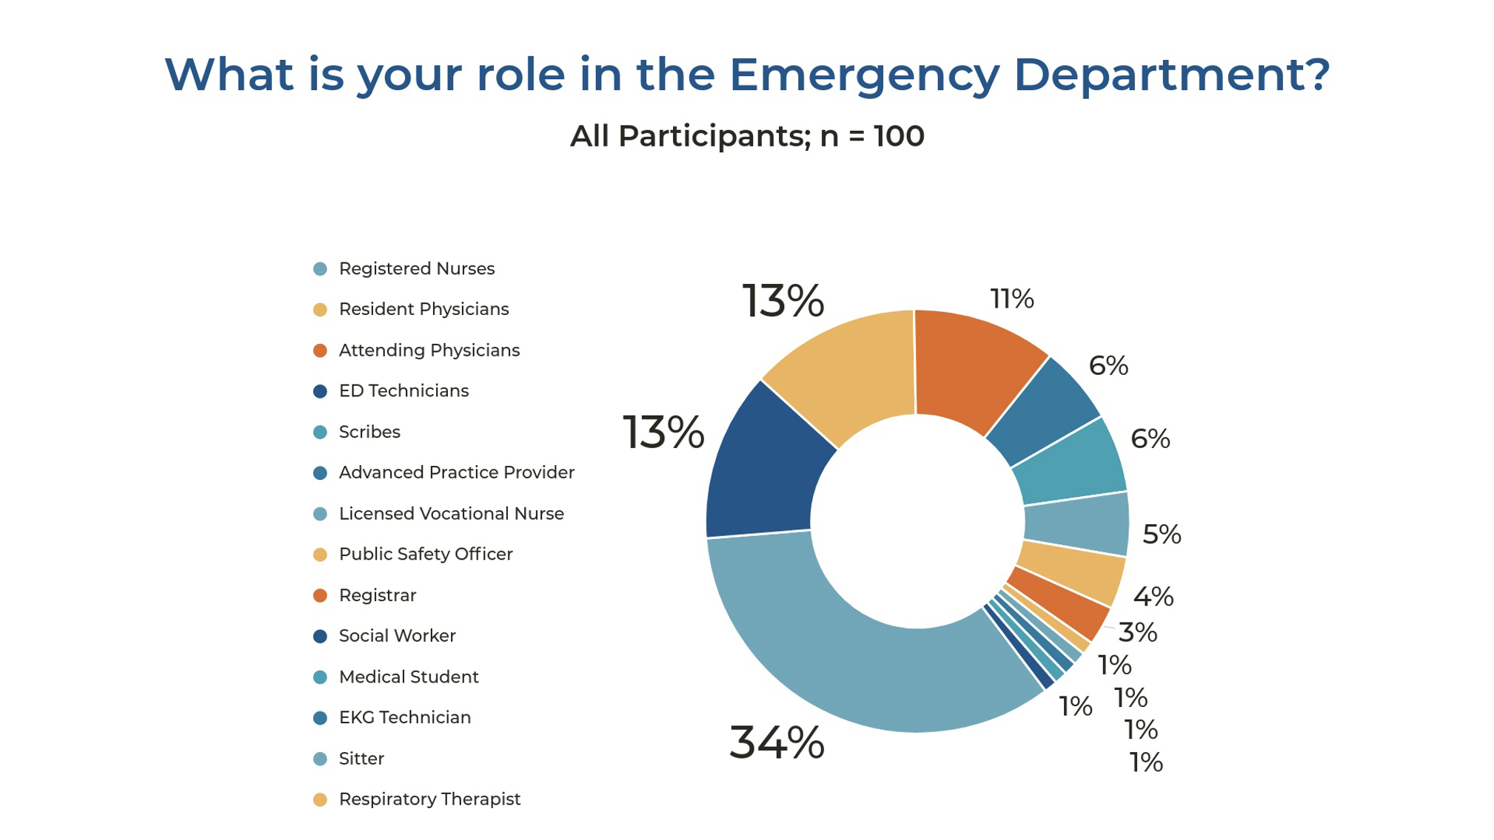
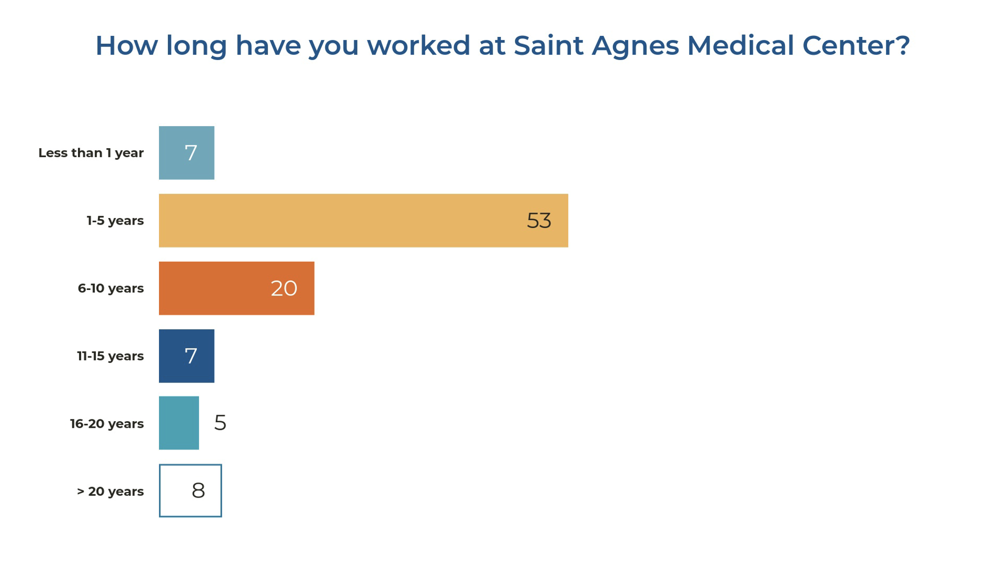
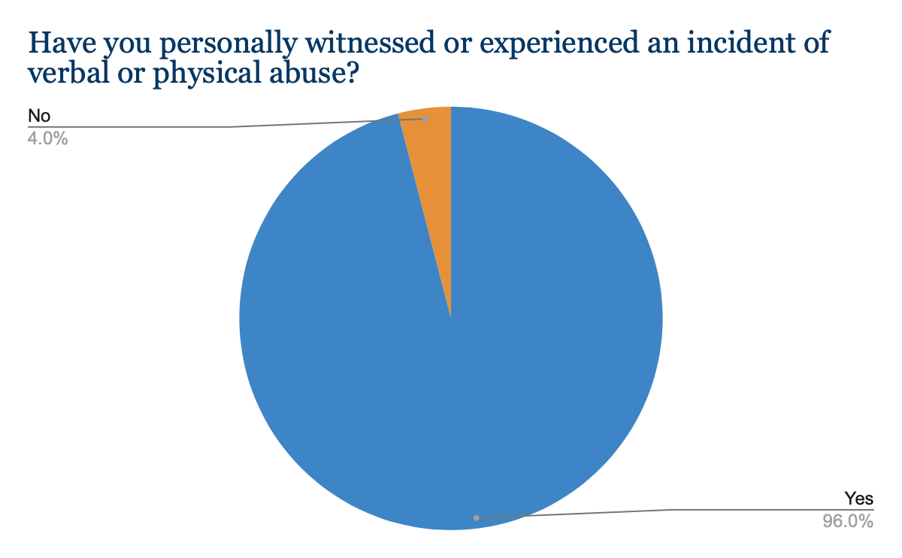
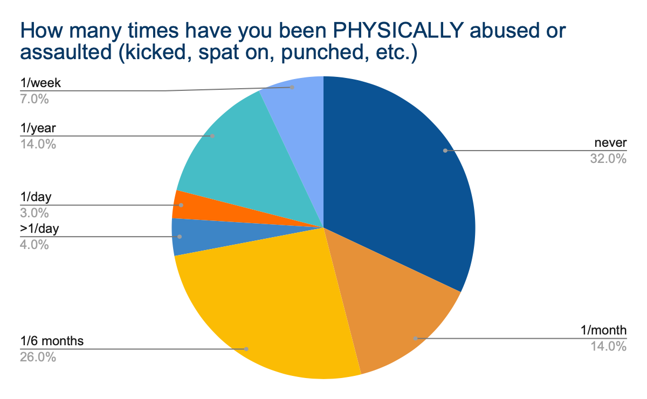
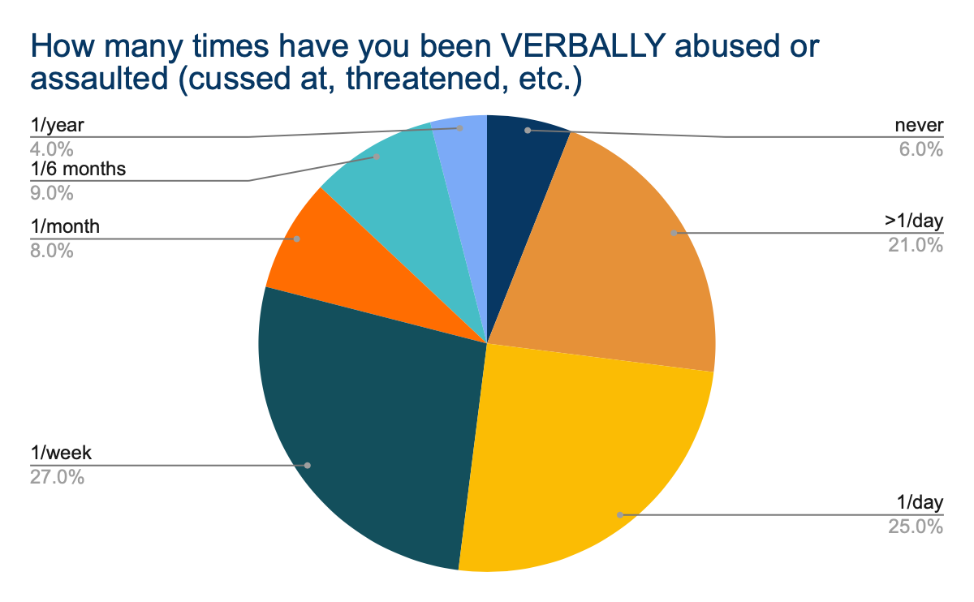
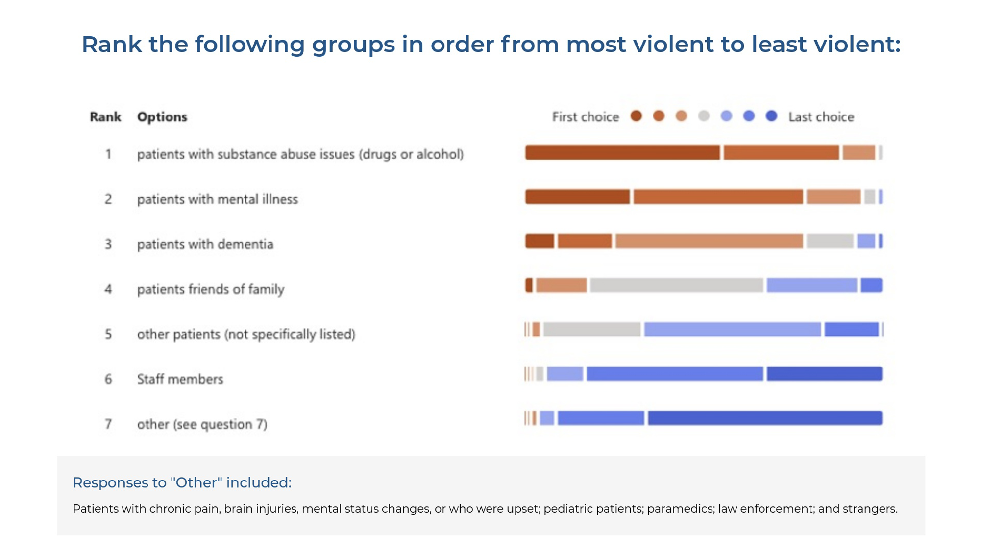
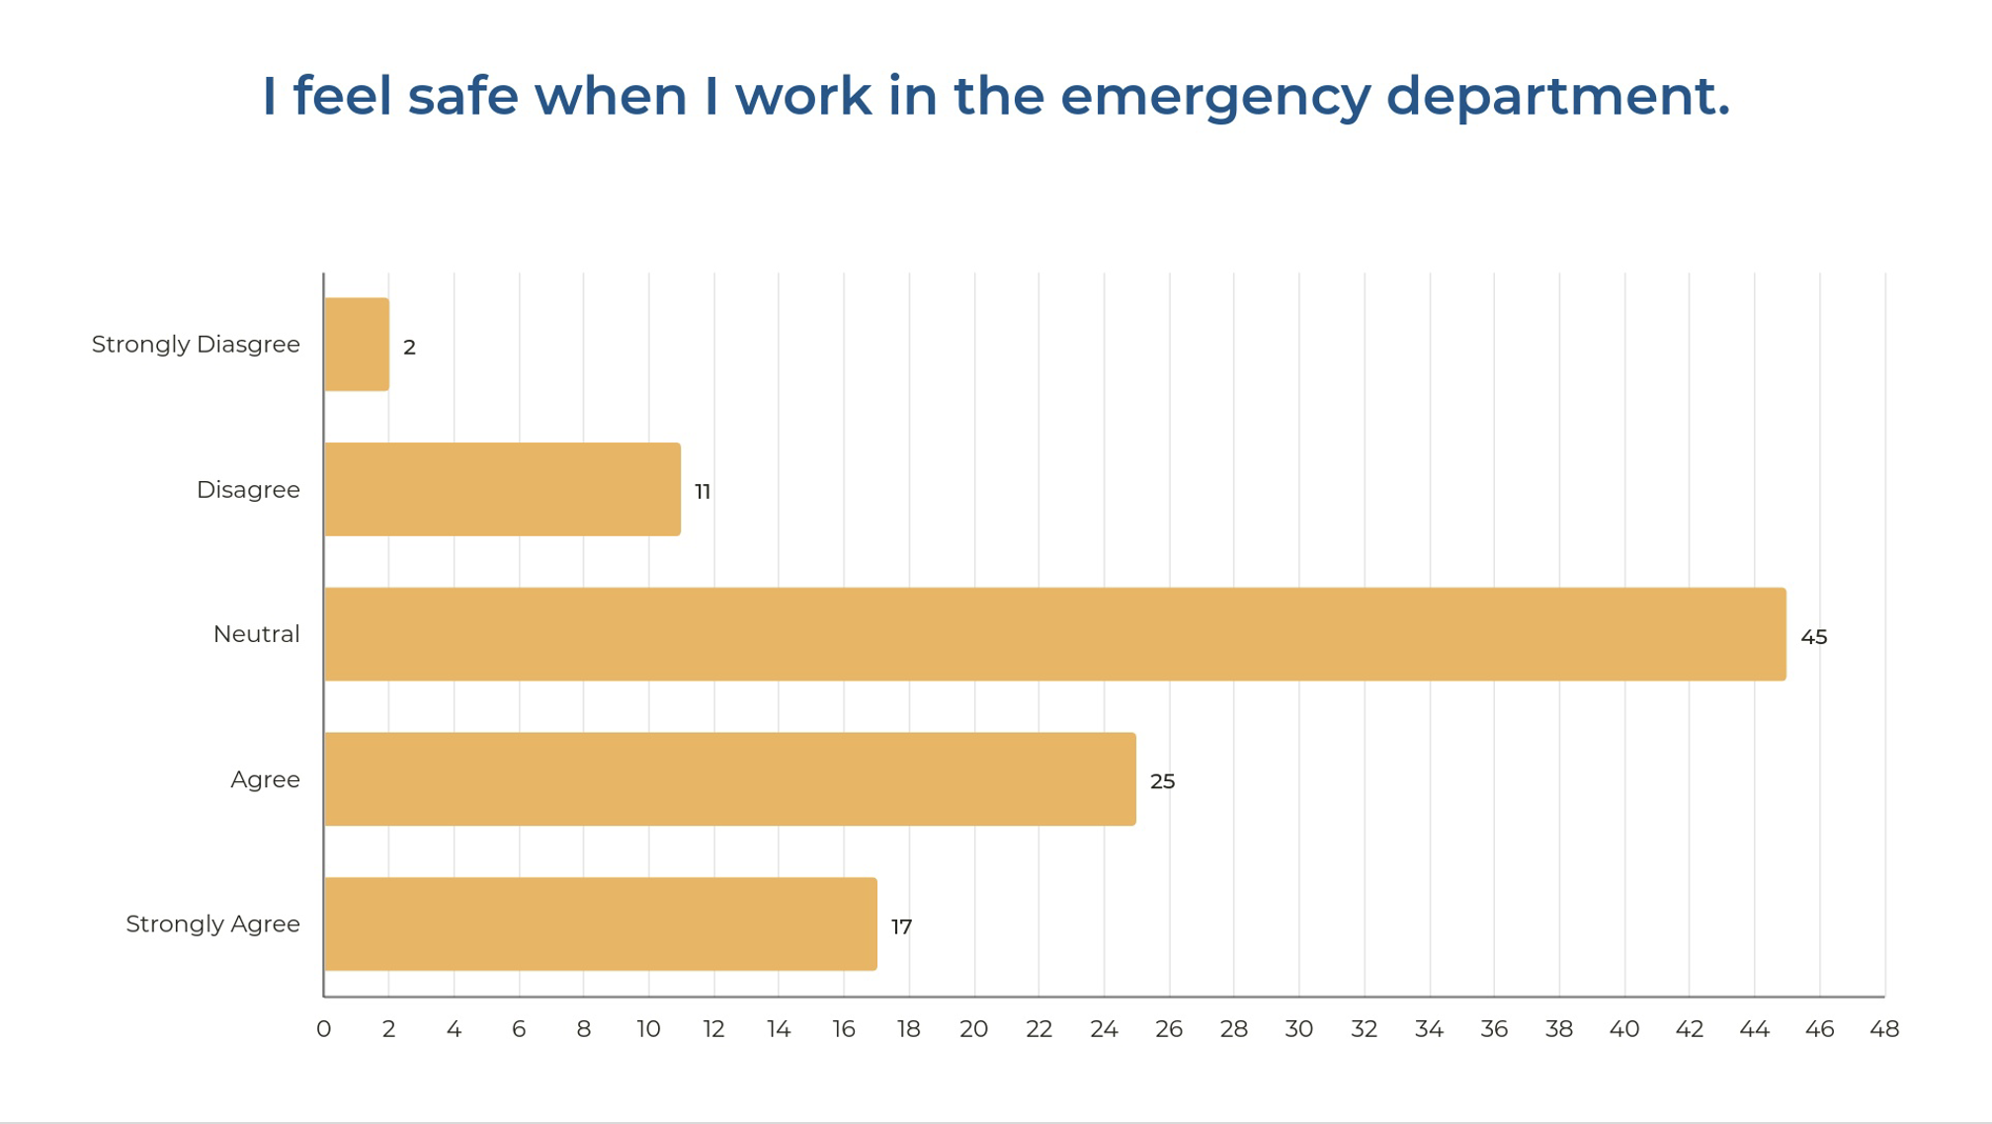
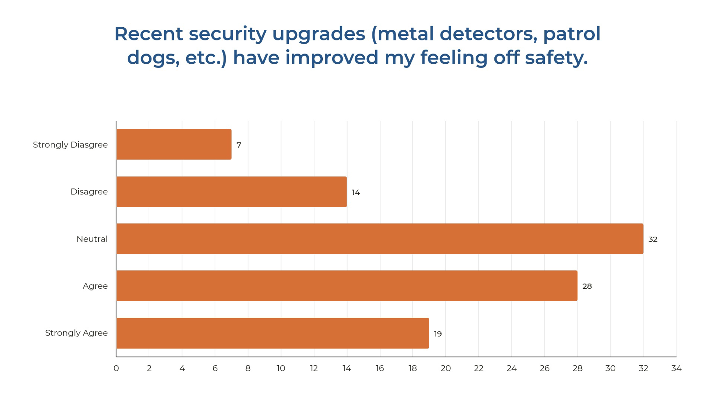
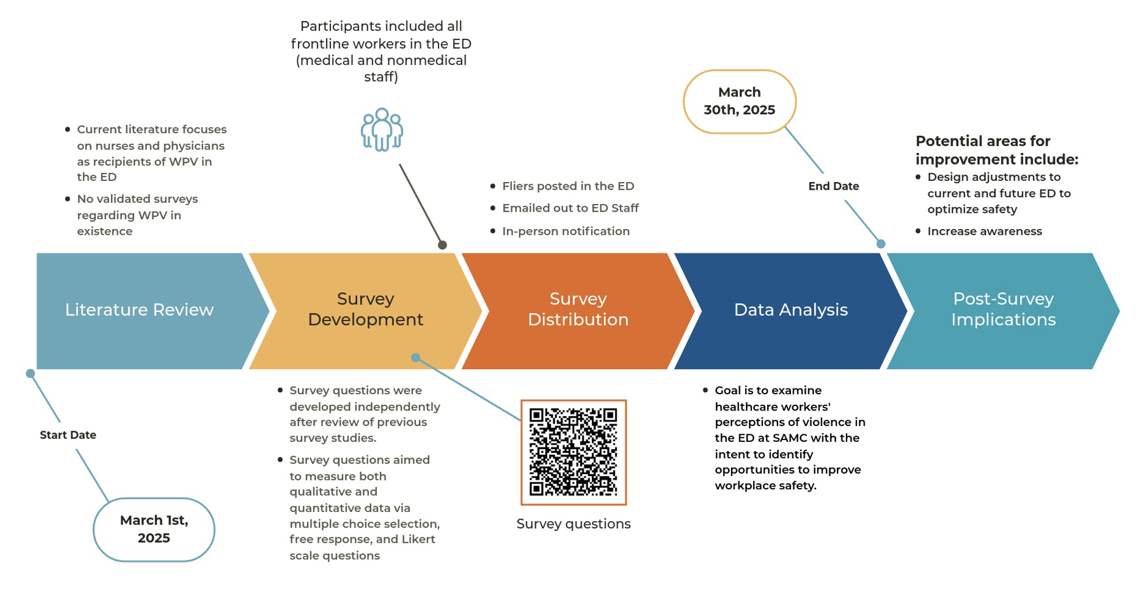
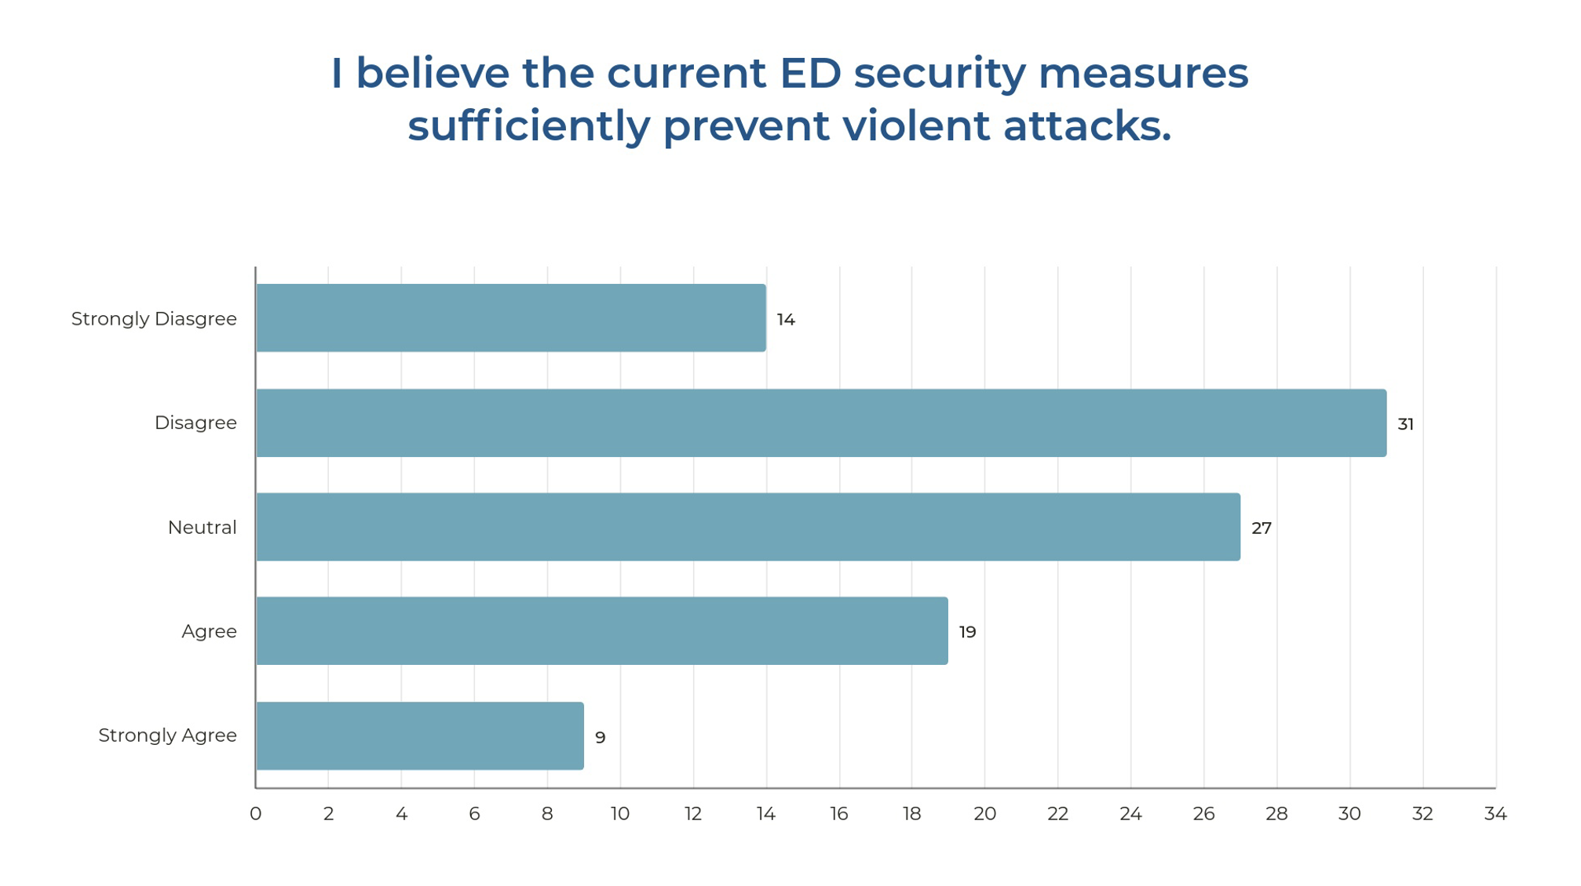
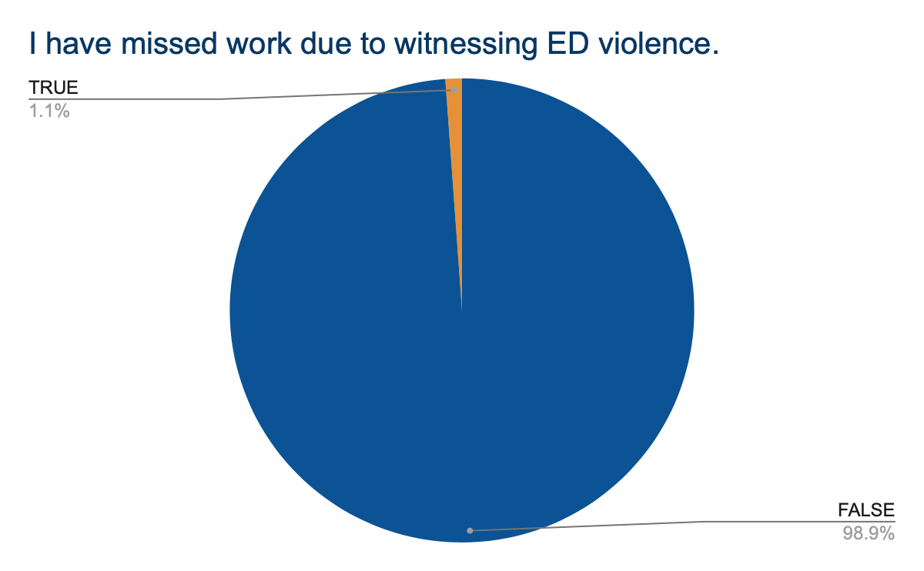
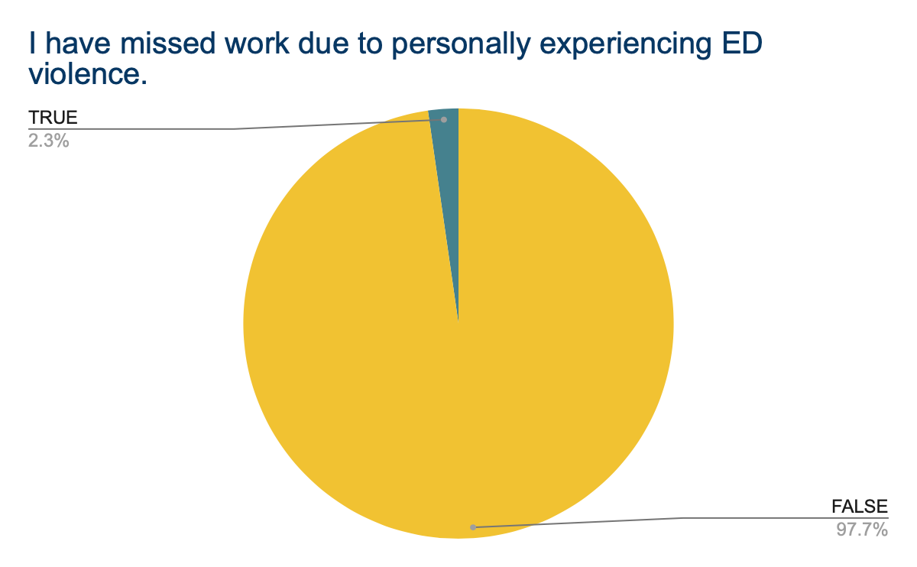
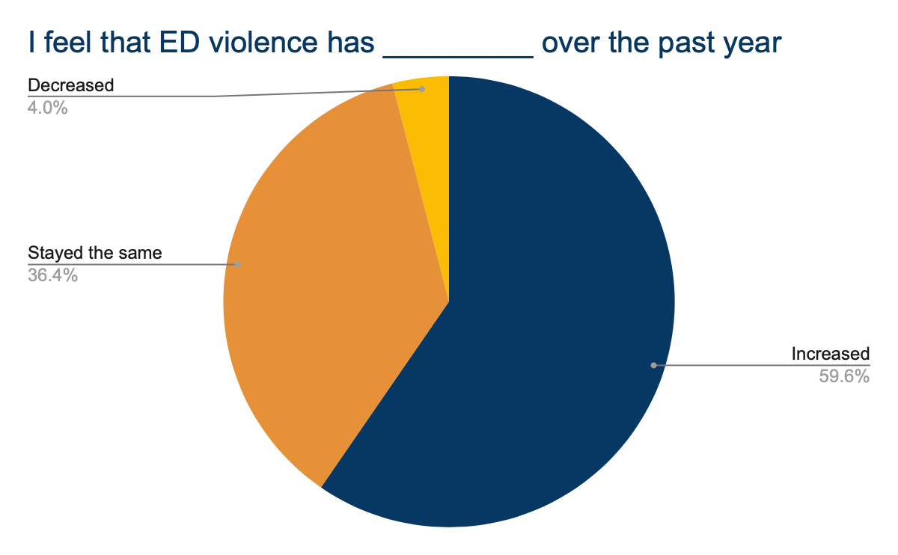

Rising Violence: An Emergency Department Survey Study
Mason Pitcher, Ashley Garispe
Saint Agnes Medical Center; Fresno, CA
Research Question:
What perceptions do frontline healthcare workers in the emergency department at Saint Agnes Medical Center have about safety?
Introduction
Results
Violence toward healthcare workers is a growing concern, particularly in emergency department (ED) settings which are known to be high-stress environments. The literature indicates that healthcare workers are often subjected to verbal abuse, threats of violence and even physical assault.¹ One study found that approximately 40% of emergency healthcare workers had experienced some form of physical or verbal abuse in their careers, underscoring the need for improved safety protocols and training on de-escalation techniques.² The current literature largely focuses on nurses and physicians as recipients of workplace violence (WPV) in the ED; there are no studies examining this concern in the Central Valley of California.
To address the gaps in the available literature, our study includes a broader pool of survey participants who are considered frontline workers in the ED at Saint Agnes Medical Center (SAMC). Our study aims to examine frontline healthcare workers’ perceptions of WPV in the ED; we hypothesize that the majority of healthcare workers will have personally experienced WPV while working the in the ED.
100 frontline workers completed the survey (97% completed the survey in its entirety; 3% omitted a single question). Survey responses are represented in Figures A-L. Figures A-B demonstrate survey participant demographics; Figures C-E examine the frequency of WPV; Figure F illustrate participants’ reflections regarding which individuals are most likely to respond aggressively while in the ED. Figures G-I show feelings of safety of the participants in general, in response to additional safety measures, and their perception of current security measures’ ability to prevent attacks; Figures J-K demonstrate the impact that experiencing violence has on healthcare workers; Figure L represents how the healthcare workers feel WPV has changed over the past year.
Figure A:
Figure B:
Figure C:
Figure D:
To see full responses
Figure E:
Figure F:
Figure G:
Figure H:
Methodology
This is a single center cross-sectional survey study that aims to examine frontline healthcare workers’ perceptions of WPV in the ED. Both qualitative and quantitative survey questions were developed independently with inspiration from previous studies.³
The survey was conducted anonymously using a Microsoft Forms platform via a QR code. All frontline workers (both clinical and nonclinical staff) were included in the study (Figure A). Participation in the study was voluntary. Figure 1 outlines the methodology.
Figure 1: Methodology Flow Chart
Figure I:
Figure J:
Figure K:
Figure L:
Discussion
Our study demonstrated that the majority of healthcare workers (from 15 different frontline roles) have experienced WPV in the ED (96%) with 58% of participants noting an experience of feeling unsafe while at work. On a more positive note, 55% of staff feel that current ED public safety measures are sufficient to prevent WPV. Overall, the survey participants recognized ongoing improvements with safety in their workplace, however the results still indicate that improvements may be necessary to ensure a safer work environment.
Some limitations of our study include uncertain response rate of participants (given the voluntary nature) and potentially leading survey questions. However, it still significantly contributes to the general body of knowledge regarding safety in the ED in the Central Valley. Further, many participants suggested mechanisms for improvement including: increased security and/or police presence, security personnel carrying weapons, additional K-9 units, additional metal detector screening protocols, and heightened awareness with patients who are at high risk to instigate violent behavior. These suggestions are in alignment with what has been previously suggested in the literature.^{4, 5, 6}
In conclusion, addressing healthcare workers’ perception of ED violence and ensuring a safe workplace is not only crucial to make certain the safety of healthcare workers, but for also maintaining the quality of care provided to patients in high-pressure settings.
References

