Slide 1

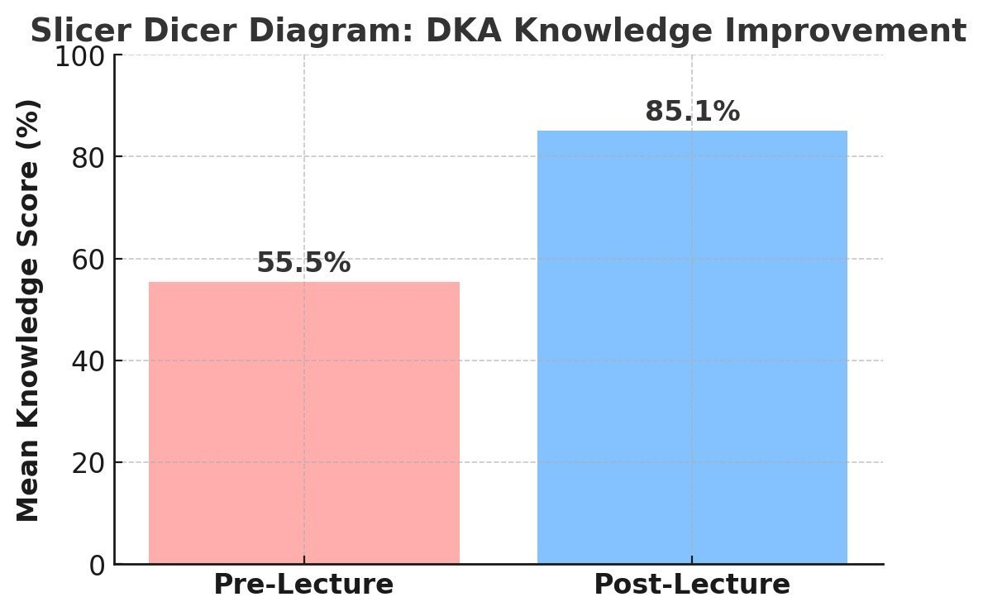
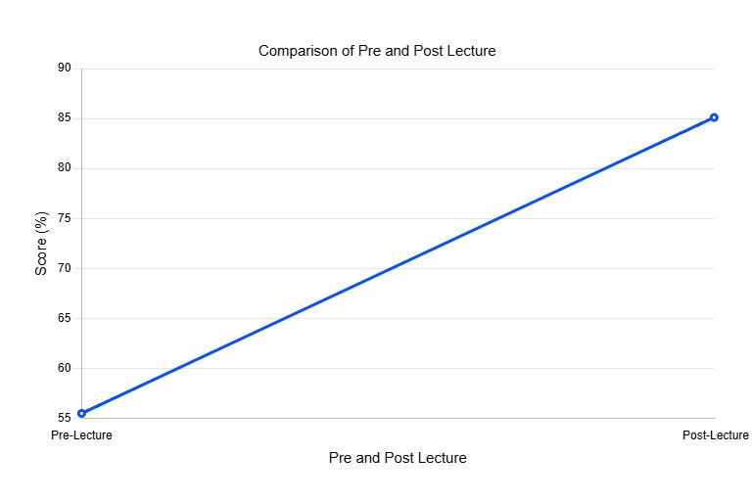
Enhancing Internal Medicine Residents’ Knowledge of DKA Management​
Nicholas Reyes, Shiva Hadadianpour, Spencer Johnson, Sukhampal Sidhu​
Internal Medicine Residency Program​
Saint Agnes Medical Center, Fresno, CA
Introduction
Results
Diabetic ketoacidosis (DKA) is a life-threatening emergency requiring rapid identification and management. Despite established guidelines, variability in physician knowledge and approach may impact patient outcomes. Our Quality Improvement (QI) project aimed to enhance internal medicine (IM) residents' understanding of DKA pathophysiology, diagnosis, and management through a structured educational lecture.
Assessment Phase​ | Mean Score (%)​
Pre-Lecture​ | 55.45%​
Post-Lecture​ | 85.1%​
Improvement​ | +29.65%​
​ | ​
Significant knowledge improvement observed.​​
P-value < 0.001, indicating statistical significance.​​
100% (22/22 residents) demonstrated improvement in post-lecture scores.​
Methods
Participants: 22 internal medicine residents at Saint Agnes Hospital.​​
Intervention: A short, structured lecture by the hospital endocrinologist covering:​​
DKA pathophysiology​​
Diagnostic criteria​​
Management principles (fluids, insulin, electrolytes)​​
Transitioning to subcutaneous insulin​​
Assessment:​​
Pre-Lecture Questionnaire (10 questions) → Baseline knowledge assessment​​
Post-Lecture Questionnaire (same 10 questions) → Knowledge improvement assessment​​
Primary Outcome: Change in mean test scores before and after the intervention.​
Discussion
The educational intervention was highly effective, demonstrating a significant increase in knowledge among IM residents.​​
Key learning points from post-intervention feedback:​​
Improved understanding of fluid resuscitation strategies.​​
Better grasp of electrolyte correction (especially potassium management).​​
Increased confidence in determining transition to subcutaneous insulin.​​
Future Directions:​​
Repeat sessions every 6 months to reinforce knowledge.​​
Expand the intervention to include case-based learning and simulations.​​
Implement DKA management protocols for standardization.​
References
American Diabetes Association. Diabetic Ketoacidosis (DKA) and Hyperosmolar Hyperglycemic State (HHS): Standards of Care in Diabetes – 2024. Diabetes Care. 2024;47(Suppl 1):S151-S159. doi:10.2337/dc24-S011.​​
Lane AS, Koh GC, Raj R, Hooi SC. Impact of Educational Interventions on Knowledge and Confidence in Managing Diabetic Ketoacidosis: A Systematic Review. Postgrad Med J. 2021;97(1147):545-551. doi:10.1136/postgradmedj-2021-140071.​​
Saint Agnes Hospital Internal Medicine Residency Program. Educational Materials for Diabetic Ketoacidosis Management. Presented at Resident Didactics, 2025

