Slide 1


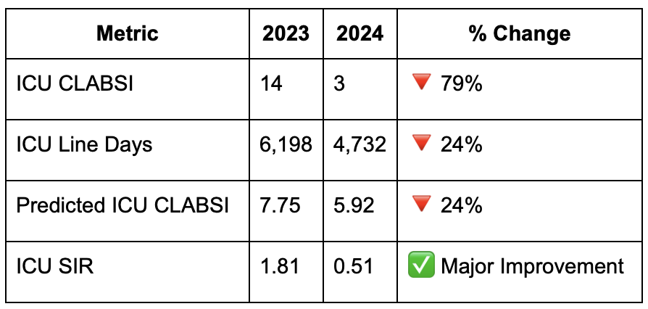
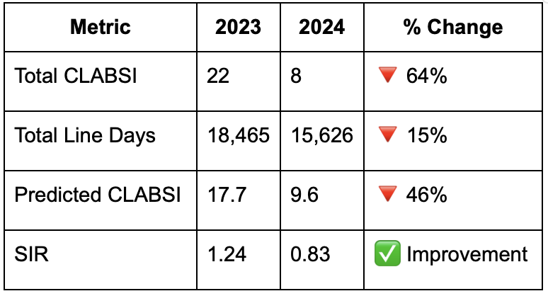
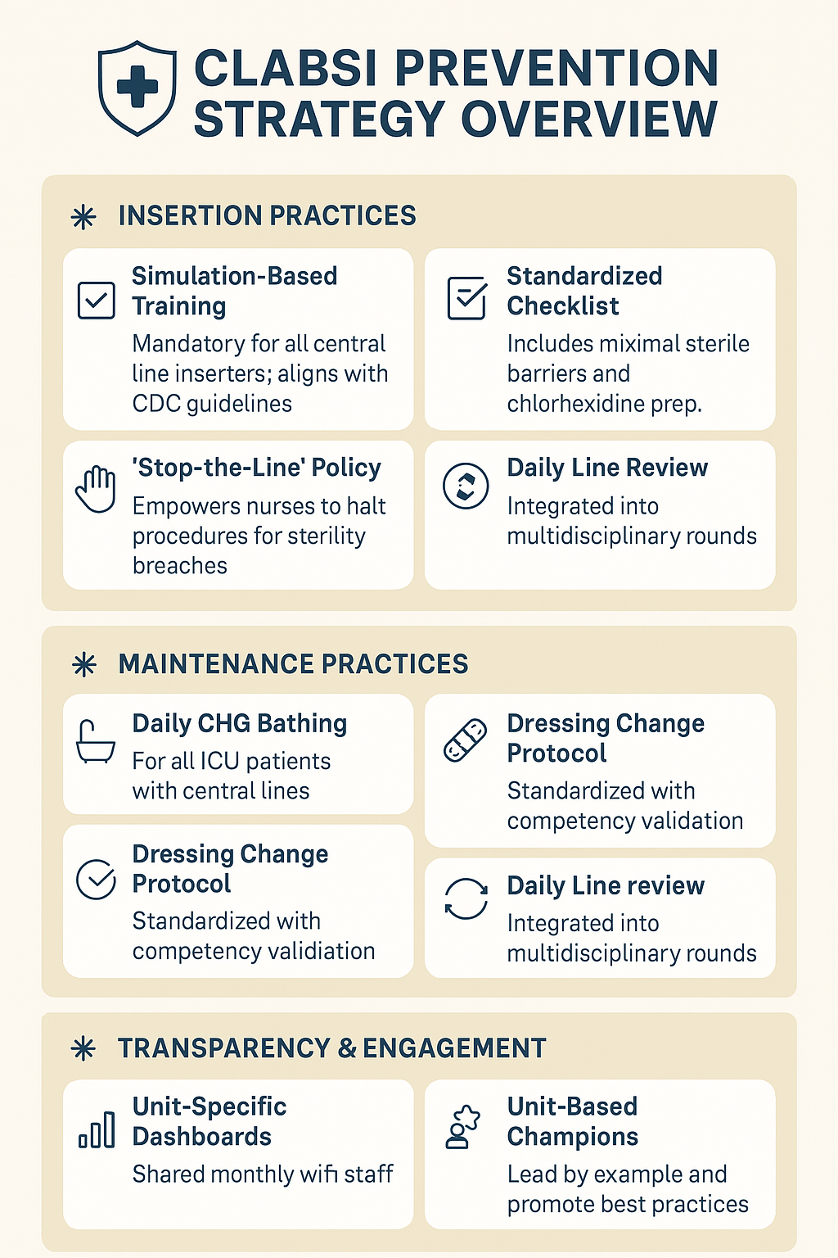

Line-by-Line: Cutting down CLABSI With Care
Andrew Clark MD, Hamna Javed MD, Aftab Arif MD, Amritpal Nat MD, Talal Arab MD
Saint Agnes Medical Center, Fresno, CA
Introduction
Results
Central Line-Associated Bloodstream Infections (CLABSIs) are among the most preventable healthcare-associated infections (HAIs) but remain a major cause of patient morbidity, mortality, and healthcare expenditures. According to the Centers for Disease Control and Prevention (CDC), each CLABSI can add up to $45,000 in direct hospital costs and increases the average length of stay by up to 10 days [1]. While significant progress has been made in large academic centers through evidence-based bundles and performance monitoring, community hospitals often lack the infrastructure to consistently apply these best practices [2].
In 2024, Saint Agnes Medical Center reported 8 CLABSIs over approximately 10,000 central line days. Using NHSN national benchmark rates for similar-sized hospitals, the predicted number of CLABSIs was 10, yielding a Standardized Infection Ratio (SIR) of 0.8. This indicates a 20% reduction in CLABSI occurrence compared to the national expected rate, reflecting favorable outcomes from targeted prevention strategies. The ICU at Saint Agnes Medical Center reported 3 CLABSIs over 4,732 central line days. Using the national ICU benchmark of 1.25 infections per 1,000 central line days, the predicted number of infections was 5.92, yielding a Standardized Infection Ratio (SIR) of 0.51. This suggests the ICU performed significantly better than the national average in preventing CLABSIs (Table 1 & 2).
Table 1: ICU CLABSI Data with comparison to National ICU CLABSI Predicted rates
Methods
Discussion
A multidisciplinary QI team—comprising physicians, nursing leadership, infection preventionists, and quality improvement specialists—was assembled. The project followed the Plan-Do-Study-Act (PDSA) framework over a 12-month period (January–December 2024) with comparison to the last 12-month period (January-December 2023).
The intervention focused on improving central line insertion and maintenance practices to reduce CLABSI rates. Insertion improvements included mandatory simulation-based training, a standardized checklist with maximal sterile barriers, and empowering nurses to halt procedures if sterility was compromised. Maintenance efforts emphasized daily chlorhexidine bathing, standardized dressing change protocols, and daily line necessity reviews during multidisciplinary rounds. Transparency was enhanced through monthly unit-specific CLABSI dashboards and a recognition program for high bundle compliance. A cultural shift was promoted through patient and staff storytelling sessions and the appointment of unit-based champions to model best practices.
The primary outcome was the CLABSI rate (infections per 1,000 central line days), with process measures including bundle compliance and daily necessity review documentation, and the balancing measure being the central line utilization ratio, all monitored monthly using infection prevention surveillance tools.
Table 2: Total Hospital CLABSI rates in comparison to National CLABSI Rates
This project demonstrated that CLABSI rates in a community hospital can be significantly reduced through a targeted, multidisciplinary intervention focused on standardized procedures, transparency, and cultural engagement. The study's limitations include being conducted at a single institution, relying on short-term analysis without assessing sustainability, potential measurement bias from self-reported compliance, and the absence of a control group to account for external factors. By leveraging low-cost strategies and frontline empowerment, the project highlights a scalable model for other community-based institutions.
References
Centers for Disease Control and Prevention. Healthcare-associated Infections – Central Line-associated Bloodstream Infections (CLABSI). CDC; 2020. Available at: https://www.cdc.gov/hai/bsi/clabsi-resources.html
Saint S, Greene MT, Krein SL, et al. A Program to Prevent Catheter-Associated Urinary Tract Infection in Acute Care. N Engl J Med. 2016;374(22):2111–2119. doi:10.1056/NEJMoa1504906
Pronovost P, Needham D, Berenholtz S, et al. An Intervention to Decrease Catheter-Related Bloodstream Infections in the ICU. N Engl J Med. 2006;355(26):2725–2732. doi:10.1056/NEJMoa061115

