Slide 1

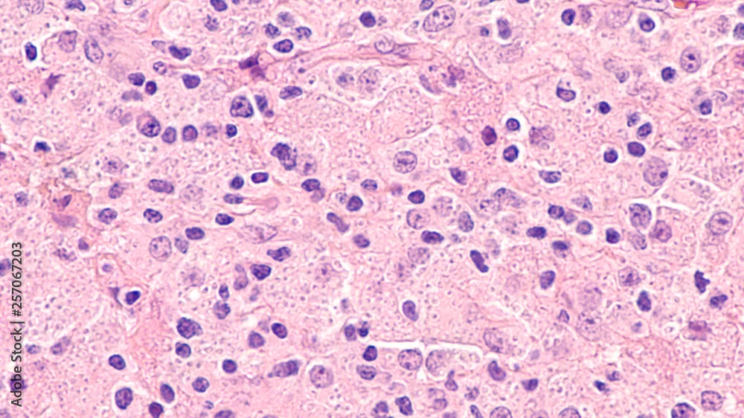
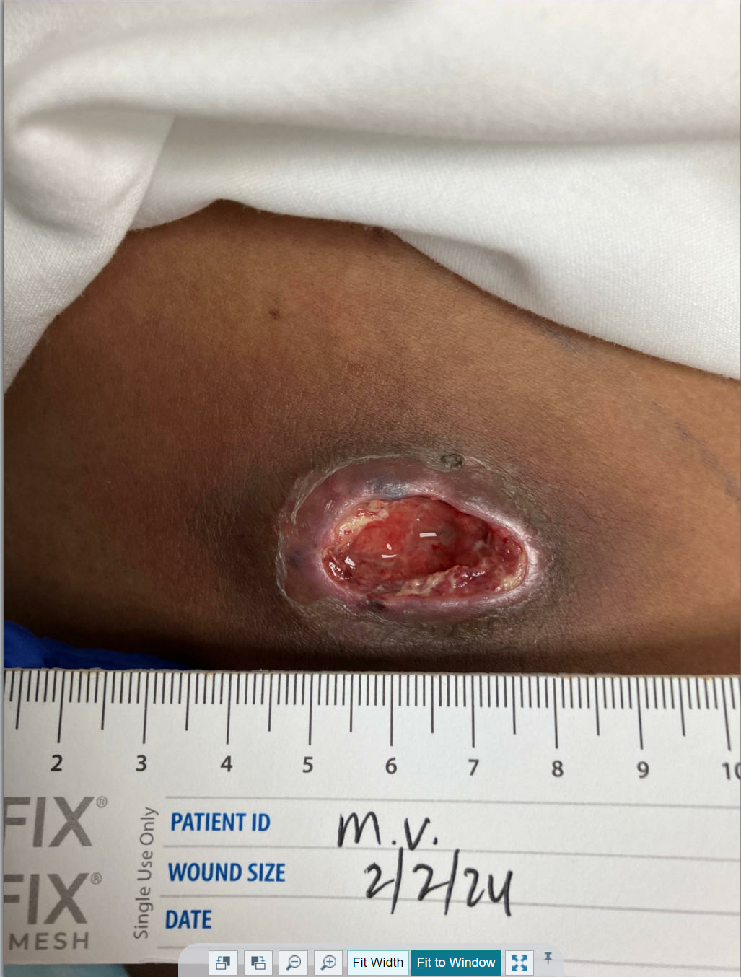
Abscess Manifesting as IRIS in an AIDS Patient with
Recent Disseminated Histoplasmosis: A Case Report
Karanvir Gill, Nicholas Gill, Louis Rosales, Kuwar Anand, Robert Tevendale
St. Agnes Medical Center, Fresno, CA
Abstract
Methodology
Case Presentation
Conclusion
Background: Histoplasmosis is a dimorphic fungal infection that can cause disseminated disease, particularly in immunocompromised individuals such as those with advanced HIV/AIDS. Immune reconstitution inflammatory syndrome (IRIS) can occur following the initiation of antiretroviral therapy, leading to paradoxical worsening or unmasking of infections.
Case Presentation: We report the case of a 51-year-old woman with AIDS and a recent history of disseminated histoplasmosis who presented with a progressively painful boil on her right thigh, present for one year. The patient had recently become compliant with her antiretroviral therapy (Biktarvy) and antifungal treatment (Itraconazole) following hospitalization for disseminated histoplasmosis, confirmed via bone marrow biopsy. On admission, she was afebrile with stable vital signs. Examination revealed a large, fluctuant mass on the right thigh. Imaging confirmed a 4–5 cm subcutaneous abscess. Surgical drainage was performed, and bacterial cultures were negative. Given the absence of bacterial growth and the patient’s known history of disseminated histoplasmosis, the abscess was suspected to be related to IRIS. The patient showed clinical improvement post-drainage and was discharged on continued antiretroviral and antifungal therapy, along with prophylaxis for opportunistic infections.
Conclusion: This case underscores the importance of recognizing IRIS as a potential cause of new or worsening symptoms in HIV-positive patients initiating treatment. In patients with a history of disseminated histoplasmosis, localized manifestations may emerge as part of immune recovery. Prompt identification and continued therapy are critical for successful outcomes.
We present the case of a 51-year-old woman with AIDS and past history of disseminated histoplasmosis, who arrived at the emergency department with a boil on her right leg that had progressively become more painful over one year. A general surgeon had previously evaluated the lesion and scheduled to remove it, but she came to the emergency room because of worsening symptoms, including fever and chills the day before her admission.
Patient was previously noncompliant with her HIV medications for a decade but became compliant after getting diagnosed with disseminated histoplasmosis four months ago. During that hospital visit, she had come in for severe pancytopenia and GI bleeding and was diagnosed with disseminated histoplasmosis via bone marrow biopsy. She was treated with Amphotericin B and was started on Biktarvy, which she has been compliant with since.
On day of admission, patient had a temperature of 37.2°C (99°F), HR 74, Resp 16, BP 136/97, and SpO2 100%. Physical examination revealed a large fluctuant tender mass to the right proximal thigh, overlying skin was thin and white centrally without active drainage or surrounding erythema. CT of the right lower extremity showed 4 to 5 cm subcutaneous abscess.
Labs were significant for a CD4 of 48 one month prior and 52 during second day of current admission. Follow up of HIV viral load was requested but not taken during admission.
Surgery was called and abscess was drained on the second day of admission, revealing purulent fluid. She was started on piperacillin/tazobactam and vancomycin to treat a presumed bacterial process but after blood cultures were unrevealing, the antibiotics were stopped. Fungal cultures were also sent but presumed negative. Resident physician suspected that right thigh abscess was part of a gradual immune reconstitution from disseminated histoplasmosis in the setting of AIDs due to previous diagnosis, gradual evolvement of the abscess over months, and confirmed negative bacterial cultures. Resident physician recommended continued management of both HIV and histoplasmosis with current medication, which included Itraconazole for active histoplasmosis infection, Biktarvy for HIV, and Bactrim for pneumocystis jirovecii pneumonia and toxoplasmosis prophylaxis.
On third day of admission, patient developed moderate swelling and redness around the debrided abscess, but gradually noted improvement in symptoms. She was eventually discharged after one week, and instructed to continue medication as described above.
This case highlights the complexity of managing opportunistic infections such as disseminated histoplasmosis in patients with advanced HIV/AIDS. The patient's persistent subcutaneous abscess, which evolved over the course of a year, likely represented a localized manifestation of immune reconstitution inflammatory syndrome (IRIS) following the recent initiation of antiretroviral therapy and antifungal treatment. The absence of bacterial pathogens and her known history of disseminated histoplasmosis support this hypothesis. Clinical improvement after abscess drainage and continuation of appropriate antifungal and antiretroviral therapy underscores the importance of maintaining compliance with treatment regimens. This case also emphasizes the need for clinicians to consider IRIS in patients with low CD4 counts who present with new or worsening lesions after beginning antiretroviral therapy. Ongoing monitoring, adherence to prescribed medications, and a multidisciplinary approach remain key components in the successful management of such cases.
.
Introduction
Microscopic image of disseminated histoplasmosis, a type of fungal infection caused by
the fungus Histoplasma capsulatum, The yeast forms appear as small dots within
the cytoplasm of macrophages.
References
Histoplasmosis is a dimorphic fungus that can lead to systemic infection. Those who are immunocompromised are especially vulnerable and it is categorized as an HIV opportunistic infection.^{1,5} Histoplasmosis is also most common in specific geographical areas, including river valleys, such as the Ohio and Mississippi regions in the U.S..¹ One of the defining features of the fungus Histoplasma capsulatum is that at body temperature histoplasmosis exists as a yeast and at colder temperatures it is a mold.¹ Most patients are infected as a result of contact with bird or bat droppings and the mode of entry is the lungs.^{1,2,6} Typical symptoms of pulmonary disease include flu-like illness (cough, shortness of breath, fever) and chest pain.^{1,2} Cutaneous lesions are seen in histoplasmosis and present as “papules, pustules, ulcers, and molluscoid centrally umbilicated papular lesions”.⁴ Extrapulmonary symptoms are more frequently seen in immunocompromised patients.² Treatment may include itraconazole for less severe cases, and amphotericin B for most disseminated cases of histoplasmosis.^{3,7}
Akram SM, Koirala J. Histoplasmosis. [Updated 2023 Aug 8]. In: StatPearls [Internet]. Treasure Island (FL): StatPearls Publishing; 2024 Jan-. Available from: https://www.ncbi.nlm.nih.gov/books/NBK448185/
Armstrong PA, Jackson BR, Haselow D, et al. Multistate Epidemiology of Histoplasmosis, United States, 2011-2014. Emerg Infect Dis. 2018;24(3):425-431. doi:10.3201/eid2403.171258
Azar MM, Loyd JL, Relich RF, Wheat LJ, Hage CA. Current Concepts in the Epidemiology, Diagnosis, and Management of Histoplasmosis Syndromes. Semin Respir Crit Care Med. 2020;41(1):13-30. doi:10.1055/s-0039-1698429
Bubna, Aditya Kumar. Umbilicated Lesions in Dermatology. Clinical Dermatology Review 3(1):p 99-103, Jan–Jun 2019. | DOI: 10.4103/CDR.CDR_52_18
Cano MV, Hajjeh RA. The epidemiology of histoplasmosis: a review. Semin Respir Infect. 2001;16(2):109-118. doi:10.1053/srin.2001.24241
Vidyanath S, Shameena P, Sudha S, Nair RG. Disseminated histoplasmosis with oral and cutaneous manifestations. J Oral Maxillofac Pathol. 2013 Jan;17(1):139-42. doi: 10.4103/0973-029X.110722. PMID: 23798850; PMCID: PMC3687172.
Wheat J. Histoplasmosis: recognition and treatment. Clin Infect Dis. 1994;19 Suppl 1:S19-S27. doi:10.1093/clinids/19.supplement_1.s19
S/p I&D with general surgery

