Slide 1

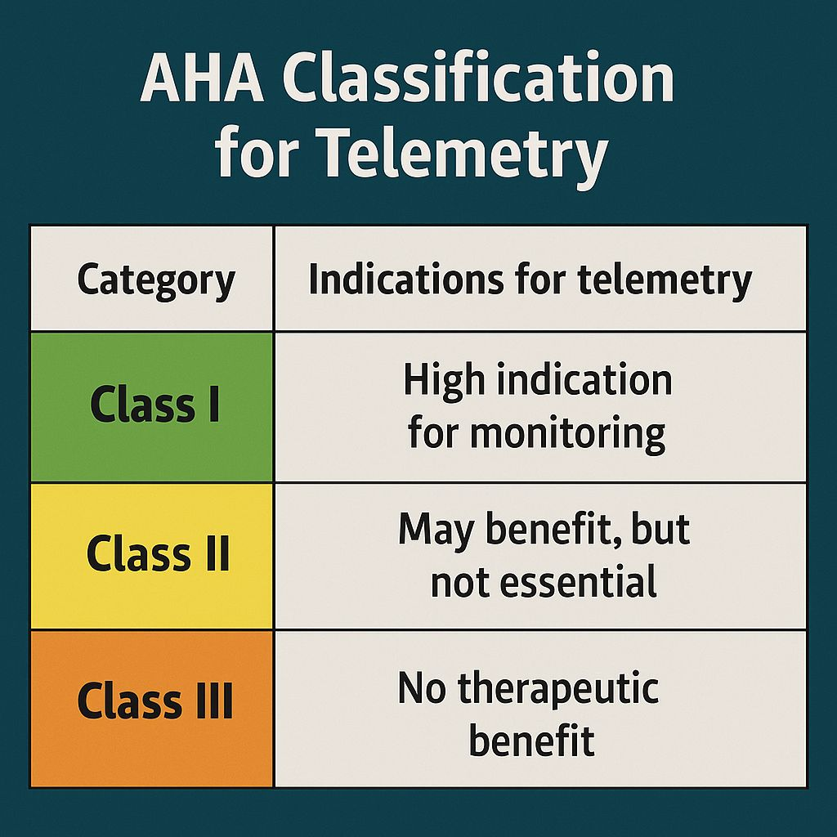

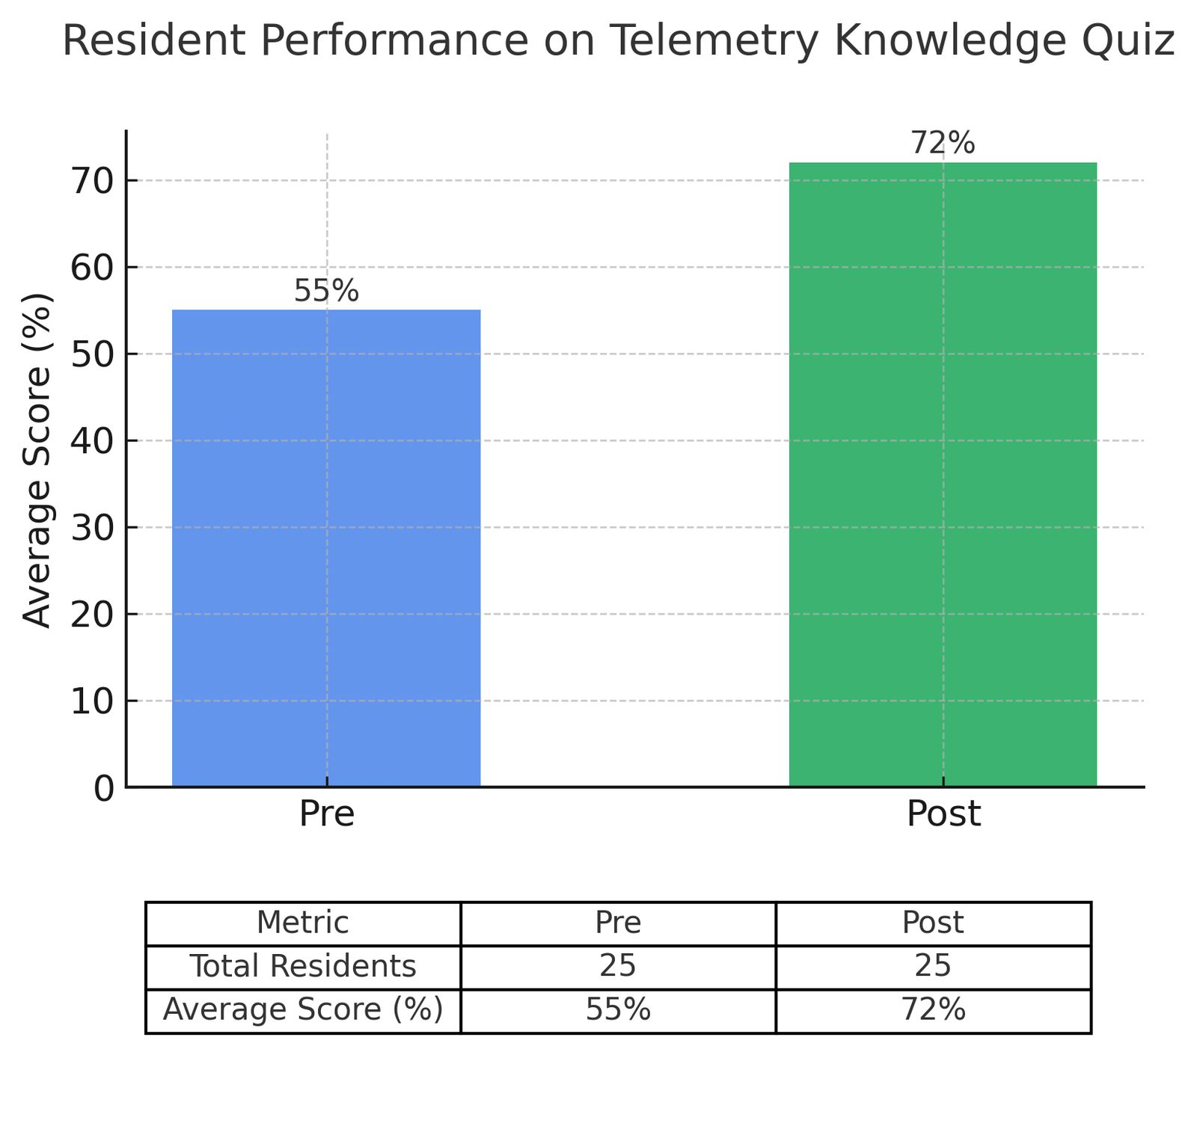
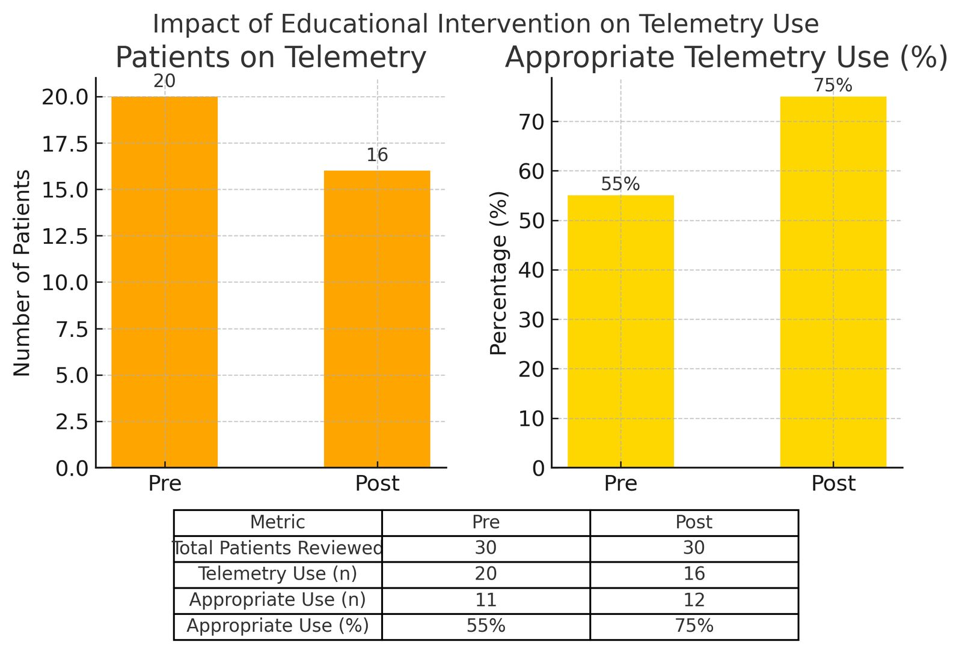

Rethinking Routine Telemetry: A Push for Smarter Care
Sukhman Boparai, M.D, Sukhmeet Dhillon, M.D, Muhammad Zahid, M.D,Anupama Poliyedath, M.D
Saint Agnes Medical Center, Fresno, CA
Introduction
Telemetry monitoring plays a vital role in cardiac care, but its overuse can lead to alarm fatigue, unnecessary healthcare costs and inefficient resource utilization in United States, more than $1 billion is spent annually on telemetry and studies estimates that up to 35-50% of this may be inappropriate or not guideline-supported.
Despite clear American Heart Association (AHA) recommendations for appropriate telemetry use, adherence remains variable. Educating residents about evidence-based indications offers an opportunity to reduce low-value care, promote high-value practices and enhance patient safety. This project aimed to improve the appropriate use of telemetry through a targeted educational intervention.
Methods
Results
Discussion
Figure 1:
Our project involved three phares designed to evaluate resident knowledge and practice patterns regarding telemetry use before and after an educational intervention.
Phase 1:Pre-Education Assessment
Baseline knowledge and telemetry utilisation were evaluated. A 10 question multiple-choice survey based on American Heart Association (AHA) telemetry guidelines was designed,25 medicine residents participated in this anonymous survey to assess baseline knowledge of appropriate telemetry use.Concurrently, telemetry orders for 30 inpatients were reviewed and each was classified as appropriate or inappropriate according to AHA guidelines criteria, establishing a baseline measure of telemetry ordering practices.
Phase 2:Educational intervention
An Educational module in appropriate telemetry use was implemented. a concise summary of AHA telemetry monitoring guidelines was created as a Powerpoint Presentation highlighting indication and proper use of telemetry. PowerPoint presentation was shared electronically with all residents, reinforcing guidelines recommendations and raising awareness about reducing inappropriate telemetry orders.
Phase 3: Post-Education Assessment
After the intervention the same 10-Question multiple choice survey was Re-administered to the Residents to measure changes in knowledge. additionally, a follow-up chart review of telemetry orders for 30 inpatients was conducted, with each order again classified for appropriateness using the same AHA criteria. Pre and post-intervention survey results and telemetry utilisation data were compared to assess improvements in resident knowledge and the appropriateness of telemetry use.
This quality improvement initiative showed that a focused, low-resource educational can meaningfully improve both residents knowledge and clinical practice related to telemetry use. After implementing AHA-guidelines-based teaching, residents demonstrated more confidence in identifying appropriate indication and telemetry utilisation aligned more closely with evidence based practices.
Reducing unnecessary telemetry not only improves patient safety by decreasing alarm fatigue but also helps free up critical resources and reduce excess healthcare costs. sustained reinforcements through education and decision -support tools can help ensure long-term improvements and promote a culture of high-value care.
References
Update to practice standards for electrocardiographic monitoring in hospitals settings: a scientific statement from the American heart Association. https://doi.org/10.1161/cir.0000000000000527 . AHA Telemetry guidelines improve Telemetry utilisation in the inpatient setting. http://doi.org/10.37765/ajmc.2020.88525.
https://www.ajmc.com/view/aha-telemetry-guidelines-improve-telemetry-utilization-in-the-inpatient-setting%0a

